Slide 1
CAB-LA for cis and trans women and men who have sex with men
Beatriz Grinsztejn, MD, PhD
Instituto Nacional de Infectologia Evandro Chagas - Fiocruz
Notes:
Good morning, afternoon or evening depending on where you are.
Thanks for the opportunity to participate in this great webinar,
Despite major advances in treatment and prevention, the HIV pandemic continues to pose a major global public health challenge.
By the end of 2021, about 38 million people were living with HIV worldwide, with estimated 650 thousand deaths and 1.5 million new infections in that year.
By the second quarter of 2022, 2.2 million people had initiated oral PrEP worldwide.
Despite evidence of impact on incidence in some settings and populations, we are still far from the global goal.
Even in countries with widespread PrEP availability, such as the United States, inequalities are apparent in the divergent rates of PrEP uptake along racial, ethnic, socioeconomic, geographic, age and self-identity lines.
As such, many people who could benefit from PrEP are still left behind.
Although PrEP is not meant to be a lifelong requirement, high adherence is needed during periods of use when an individual is at risk of HIV, what may be quite challenging to achieve, especially among most vulnerable populations.
To realize PrEP’s benefits, individuals need to both initiate PrEP and remain on PrEP during periods at-risk. In multiple studies, reasons for stopping or never initiating PrEP include, in addition to challenges accessing the medication, low self-perceived risk, concerns about medication side effects or a desire not to take a daily pill, stigma, or competing life events.
As such, daily oral prep is not feasible for everyone, and there is no single solution to address the HIV epidemic. Long-acting PrEP agents have the potential to address some of these concerns by providing consistent protection through infrequent, discrete administration, avoiding the need to take a daily or on demand oral medication. In this presentation, we will focus on injectable CAB LA, a potent strand-transfer integrase inhibitor that was evaluated for HIV prevention among different populations.

Slide 2
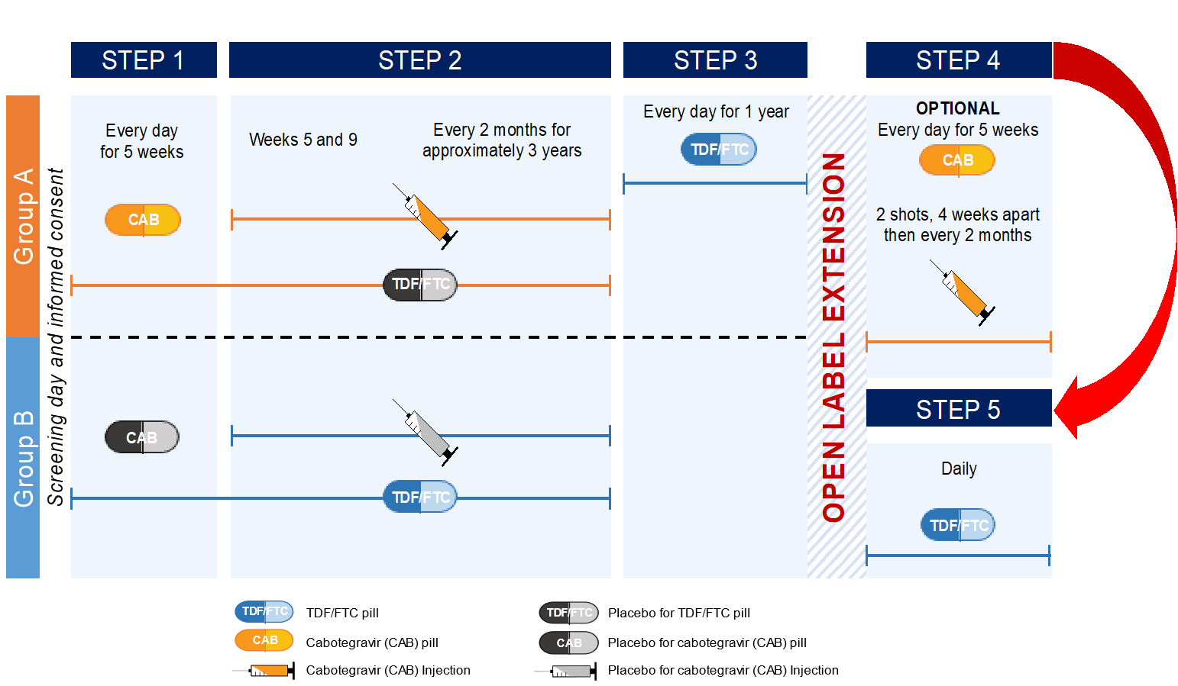


HPTN 083/084 Study Design
EFFICAY
(20% Intralipid solution)
Landovitz RJ et al. AIDS 2020, #OAXLB0101
Notes:
Two large randomized controlled trials (RCTs) have demonstrated the effectiveness of injectable cabotegravir when compared to oral tenofovir-disoproxil-fumarate/emtricitabine (TDF/FTC) PrEP: HIV Prevention Trials Network (HPTN) Study 083 and HPTN Study 084.
HPTN 083 was a double-blind double-dummy randomized controlled trial which assessed the effectiveness of LA cabotegravir for PrEP compared to oral TDF/FTC among over 45 hundred participants in the US, Brazil, Peru, Argentina, South Africa, Vietnam, and Thailand and showed a 66% reduction in new infections in the cabotegravir arm when compared to active TDF/FTC.
With a similar design, HPTN 084 observed an impressive 89% reduction in new infections in the in the CAB LA arm compared to the TDF/FTC arm among cisgender women in Botswana, Kenya, Malawi, South Africa, Swaziland, Uganda, and Zimbabwe. Both studies are ongoing in an open label extension phase

Slide 3
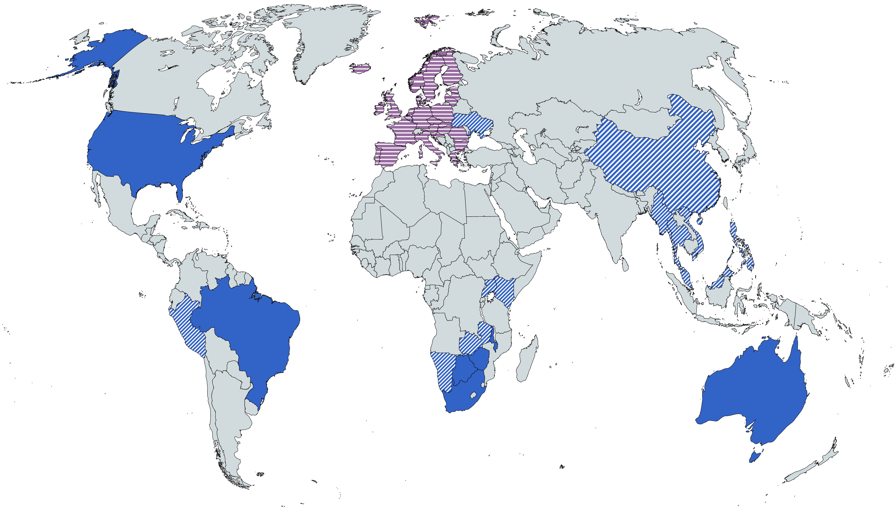
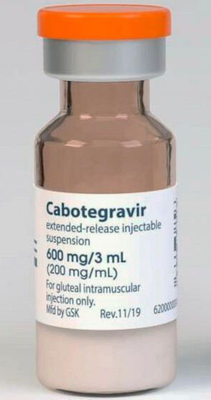

Approved for PrEP
Submitted for approval for PrEP, received positive opinion by EMA Committee for Medicinal Products for Human Use
Approved by the US FDA for
PrEP: December 20, 2021
Submitted for approval for PrEP

Slide 4
EFFICACY

Slide 5
HPTN 083 HIV Incidence: CAB vs. TDF/FTC
Combined blinded and unblinded period, through May 2021
Open to
Enrollment
Open to
Enrollment
Year 1 Unblinded
Analysis
Primary
Analysis
Year 1 Unblinded
Analysis
Primary
Analysis
1 Year
4.4 Years
1 Year
12-16-2016
4.4 Years
05-14-2021
05-14-2020
05-14-2021
05-14-2020
DEC-2016
DEC-2016
JUN-2017
JUN-2017
DEC-2017
DEC-2017
JUN-2018
JUN-2018
DEC-2018
DEC-2018
JUN-2019
JUN-2019
DEC-2019
DEC-2019
JUN-2020
JUN-2020
DEC-2020
DEC-2020
JUN-2021
JUN-2021
DEC-2021
DEC-2021
Landovitz, R. HIV Glasgow 2022.
Notes:
Just to remind people of the efficacy analysis that we have thus far. This is the aggregate of the blinded and the one-year unblinded data from 083. Overall, we have had 25 incident infections in the cabotegravir arm – again, this is a combination of the blinded and unblinded period – and 72 in the TDF/FTC arm. You can see the incidence rates listed right below those numbers. On the right, you can see the hazard ratio, with a 66% reduction in incident HIV in the CAB participants compared to TDF/FTC.

Slide 6

HPTN 084 HIV Incidence: CAB vs. TDF/FTC
Combined blinded and unblinded period, through Dec 2021
*Excludes 1 baseline infection from the blinded period
Delany-Moretlwe, S et al. AIDS 2022. #OALBX0108
Notes:
Here are the data from 084 through to the Year One unblinded period. Similarly, HPTN 084 observed very impressive reductions of HIV infections in the CAB LA arm compared to the TDF/FTC group. What you can see is that there were 89% fewer infections in the cabotegravir group, showing the superiority of cabotegravir over TDF-FTC in preventing HIV among cisgender women.
.

Slide 7
EFFICACY
Long-acting cabotegravir is very effective at preventing HIV in MSM, TGW, and cisgender women
  66% reduction in HIV infection when compared to MSM and TGW who were offered TDF/FTC
  89% reduction in HIV infection when compared to cisgender women who were offered TDF/FTC
Long-acting cabotegravir is also very effective at preventing HIV in:
  Young individuals
  Black individuals
  Transgender women
  Individuals from various regions of the world
  Individuals using various contraceptive methods
  Individuals with higher BMIs
Notes:
When examining specific sub-groups, the magnitude and direction of the effectiveness of cabotegravir in HPTN 083 was preserved among populations who have historically experienced greater adherence challenges with TDF/FTC PrEP,including among youth, transgender women, and U.S. Black participants.
This has been particularly important in individuals assigned female at birth because with other modalities we have seen lower efficacy because of adherence challenges in younger age groups and we haven’t seen that with cabotegravir. Differences by contraceptive method were also looked at and no difference by subgroup was seen. Also,no differences in efficacy were seen by body mass index.

Slide 8
SAFETY
Notes:
Moving into the safety aspects,

Slide 9
HPTN 083: Injection Site Reactions
80.9%
80%
60%
57.7%
48.4%
Cabotegravir
Percentage of Participants Reporting an ISR
Mild (Grade 1)
40%
38.6%
Moderate (Grade 2)
35.7%
34.9%
33.8%
Severe (Grade 3)
31.2%
33%
30.4%
28.3%
28.1%
29.6%
27.7%
TDF/FTC
26.6%
24.5%
26.9%
Mild (Grade 1)
22.8%
22.5%
Moderate (Grade 2)
20%
18.4%
19.6%
Severe (Grade 3)
15.5%
57.7%
9.3%
57.7%
7.1%
6%
4%
4.9%
4.5%
3.8%
3.8%
3.9%
4.3%
4.5%
3.3%
3%
1.7%
3.2%
1.4%
0
OVERALL
1
2
3
4
5
6
7
8
9
10
11
12
13
14
15
16
17
18
19
20
Injection Number
Cabotegravir, n
2117
2117
2037
1938
1872
1761
1620
1464
1360
1200
1034
877
744
604
465
372
298
234
168
111
8
TDF/FTC, n
2081
2081
2014
1940
1869
1760
1606
1463
1355
1193
1037
903
760
596
482
370
288
220
146
89
6
Landovitz RJ et al. NEJM 2021
Notes:
Injection site reactions were the most frequent adverse events in HPTN 083. You can see in this slide that about 80% of the 083 trial participants in the CAB arm referred an injection site reaction, mostly mild to moderate. But also 30% of people reporting injection-site reactions in the TDF/FTC arm were receiving a placebo injection. Over time you can observe that the reporting of those injection-site reactions went down, and only 2% of people actually discontinued injections for reactions to the injection as the reason for product discontinuation.

Slide 10
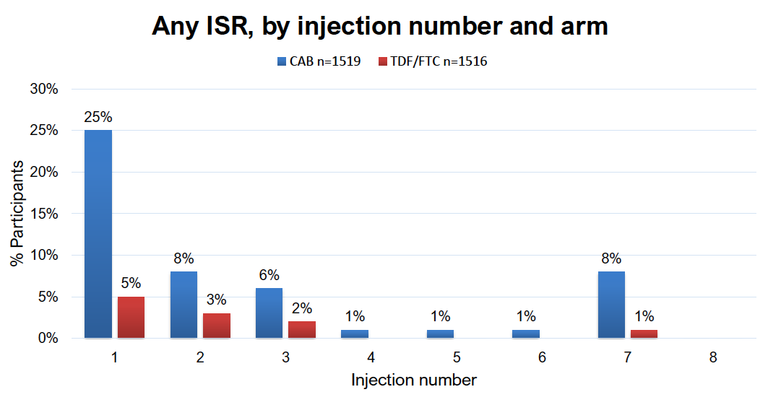
HPTN 084: Injection Site Reactions
21% participants any ISR
  32% CAB vs 9% TDF/FTC
4% participants Grade 2+ ISR
  7% CAB vs. 1% TDF/FTC
Zero discontinuations d/t ISR
Delany-Moretlwe, S. Lancet, 2022.
Notes:
In HPTN 084, 21% participants had any injection site reaction, with no discontinuations due to ISRs.

Slide 11
HPTN 083: Median Change in Weight (kg)
Estimated mean weight change (kg/y)
CAB: +1.23 (95%CI 1.05, 1.42) kg/y
TDF/FTC: 0.37 (95%CI 0.18, 0.55) kg/y
p<0.001
Week 0-40
CAB: +1.26 (95%CI 0.98, 1.54) kg/y
TDF/FTC: -0.50 (95%CI -0.78, -0.22) kg/y
p<0.001
Week 40-105
CAB: +1.11 (95%CI 0.82, 1.41) kg/y
TDF/FTC: +1.19 (95%CI 0.90, 1.49) kg/y
p=0.70
5.0
2.5
Study arm
Median weight change from enrollment (kg)
CAB
TDF/FTC
0.0
-2.5
W0
W2
W4
W5
W9
W17
W25
W33
W41
W49
W57
W65
W73
W81
W89
W97
W105
Visit week
Landovitz RJ et al. NEJM 2021
Notes:
In 083, people on CAB-LA and TDF/FTC gained weight at about the same rate EXCEPT for the first year, where TDF/FTC people LOST weight (but then gained thereafter)

Slide 12
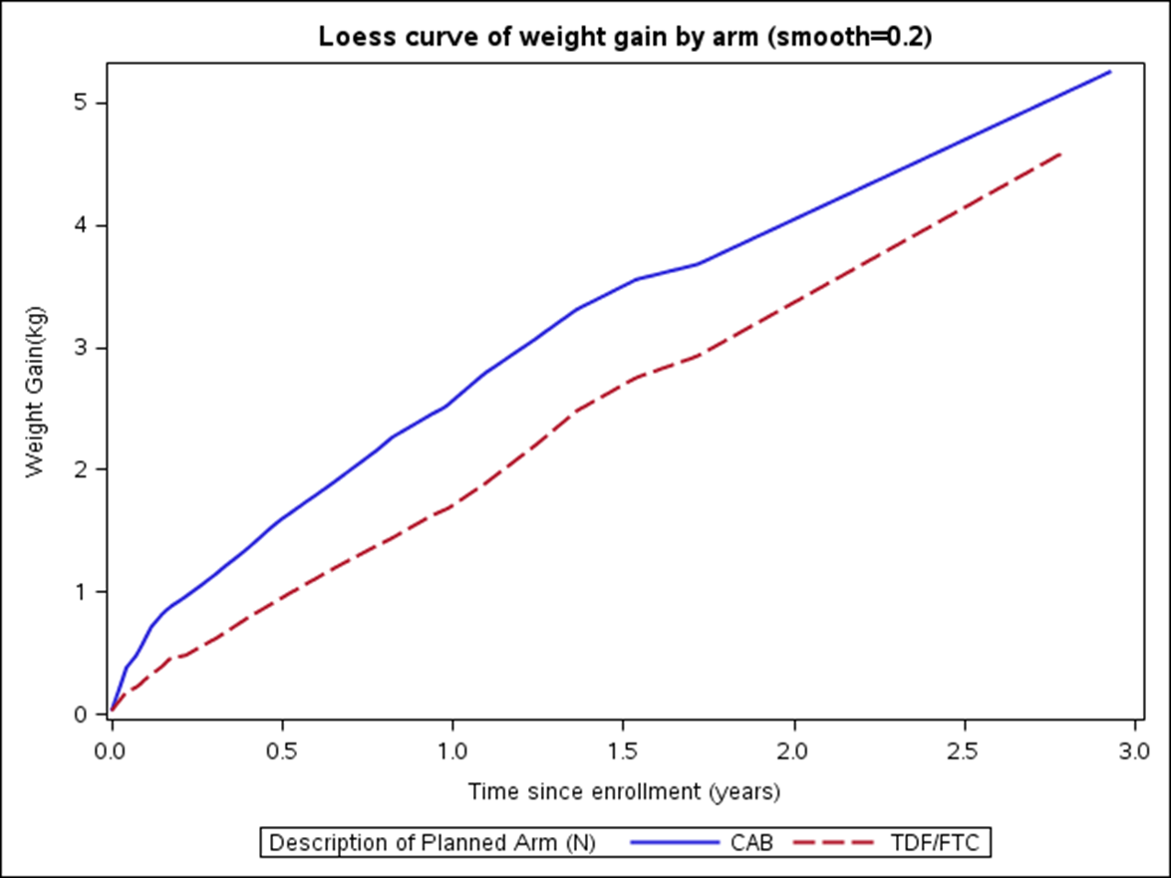
Safety: weight gain
Blinded period
28% participants BMI≥30 kg/m2
Weight gain in both groups
Initial weight gain in CAB group mean 0.4 kg
CAB 2.4 kg/year vs TDF/FTC 2.14 kg/year
Coming soon: Planned analyses to assess prevalence and incidence of risk factors for cardio-vascular disease, by study arm
Notes:
In 084, 28% participants had a BMI≥30 kg/m2; Weight gain in both groups was observed.
Overall during the blinded period weight gain of 2.4 kg/year in the CAB arm vs 2.14 kg/year
In the TDF/FTC arm

Slide 13
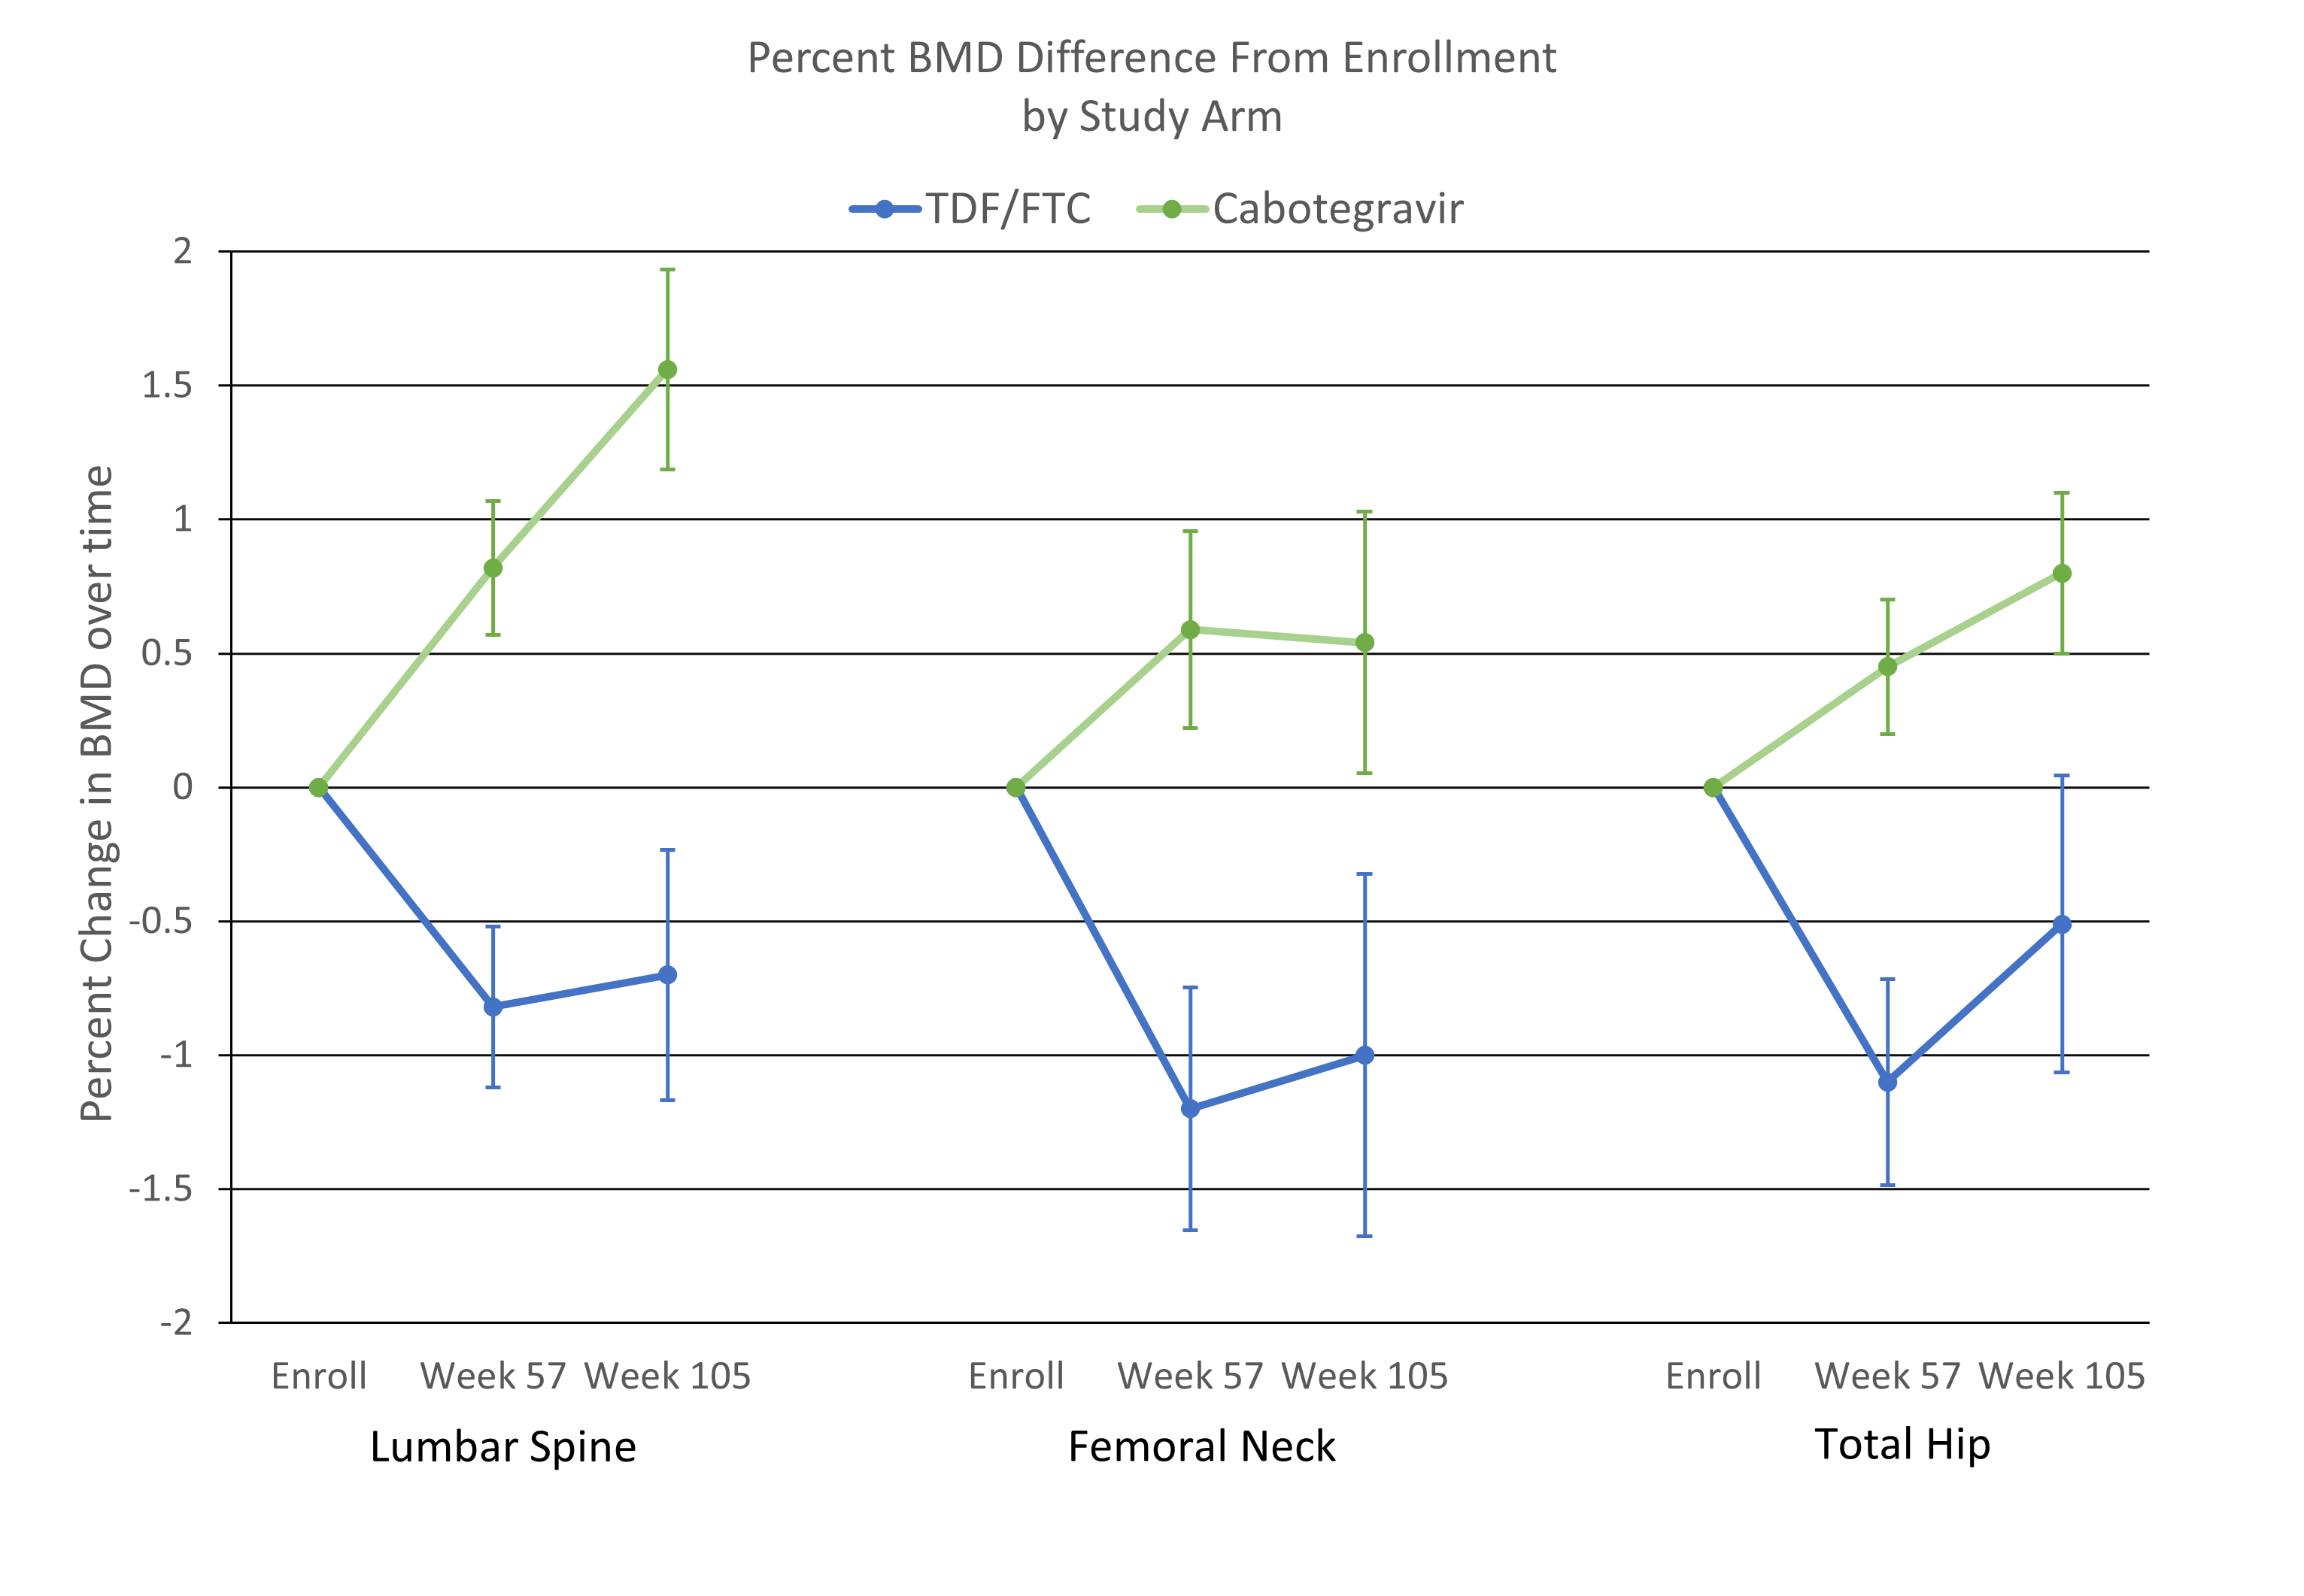
HPTN 083: DXA BMD change over time
BMD decreased in the TDF-FTC arm by 0.5-1.0%
BMD increased in CAB-LA arm 0.5-1.5%
Brown T et al. CROI 2023. Poster #987.
Notes:
By DXA measurement in 083, CAB-LA had better outcomes than TDF/FTC over two years, with no clinical differences

Slide 14
HPTN 084 Cumulative Pregnancy Outcomes - CAB vs. TDF/FTC
 | Total n=132 | CAB n=63 | TDF/FTC n=69
Ongoing | 57 | 23 | 34
Known pregnancy outcomes*
Live births | 61 | 31 | 30
Pregnancy loss
>=37 weeks | 0 | 0 | 0
20-36 weeks | 3 | 1 | 2
<20 weeks** | 13 | 9 | 4
Congenital anomalies | 0 | 0 | 0
*includes multiple births
**includes ectopic pregnancy, elective and spontaneous abortion
Delany-Moretlwe, IAS 2022
Notes:
Data are still being collected on the safety of cabotegravir during pregnancy and breastfeeding. To date, data does not suggest there are any safety concerns

Slide 15
HPTN 084, progress to date
Pregnancies during OLE
  N=268
  161/207 eligible for sub-study consented (79%)
    Both prevalent and incident pregnancies
    Acceptance of CAB in incident pregnancies similar to overall trial population
  Follow up ongoing
  44 participants have at least one post-partum visit
Cumulatively since start of HPTN 084
  465 pregnancies
  232 live births

Slide 16
Safety
Long-acting cabotegravir was safe and well tolerated
The most common side effect was injection site reaction (ISR)
  The majority were mild to moderate in severity
  Reports of ISRs decreased over time
  Very few ISRs led to the discontinuation of cabotegravir
We’re all gaining weight, people on CAB-LA and TDF/FTC at about the same rate EXCEPT for the first year, where TDF/FTC people LOST weight (but then gained thereafter)
By DXA measurement, CAB-LA had better outcomes than TDF/FTC over two years; no clinical differences
Data are still being collected on the safety of cabotegravir during pregnancy and breastfeeding
To date, data does not suggest there are any safety concerns

Slide 17
FAILURES
Notes:
We will now talk about potential failures and the HIV testing challenges.
As a long acting drug, CAB LA can make HIV diagnosis challenging if HIV infection is not diagnosed before CAB initiation, as it suppresses viral replication, delaying Ab production. Failure to diagnose HIV infection can lead to continued CAB administration, and even continued CAB injections.

Slide 18

Summary of HPTN 083 Major INSTI RAMs
CAB INITIATED OR RE-INITIATED WITH OCCULT HIV INFECTION | AHI | LEVI
 | N (%) | RAMs
A1-4 | 1 (25) | E138E/K, Q148K/R
BR1-2 | 1 (50) | Q148R
HIV ACQUISITION DURING OLI | Fever, chills, rash, night sweats, muscle aches, sore throat, fatigue, swollen glands | Protean, often no symptoms reported
C1-3 | 2 (66) | E138E/A/K, G140G/S, Q148R
HIV BREAKTHROUGH INFECTION WITH ON-TIME INJECTIONS | 1-2 weeks (until Ab detection) | Months (until viral breakthrough, cessation of anti-viral exposure or ART start)
D1-6 | 6 (100) | E138K, G140A, Q148R, N155H, R263K
HIV BREAKTHROUGH INFECTION WITH AT LEAST ONE 10+ WEEK DELAY | Very likely | Unlikely (except possibly through blood transfusion)
DX1-3 | 0 (0)
HIV INFECTION 6+ MONTHS FROM LAST INJECTION
B1-16* | 0 (0)
*No result for B4
GenoSure PRIme (Monogram Biosciences) | Low VL INSTI Genotyping
Notes:
In this slide you can see the different timepoints of HIV infections during HPTN 083. Ler o slide.
Groups A and BR1
If we do not diagnose HIV before PrEP agents start (acute or eclipse phase infection = very early infection), CAB can make it challenging to diagnose later
Failure to diagnose HIV infection can lead to continued CAB administration, and even continued CAB injections
Group C
If you don’t take CAB, it doesn’t prevent HIV infection
We don’t know how “forgiving” it is to missed doses
There is likely a “time to onset” of protection with oral CAB
We don’t know how long
If CAB delays new (incident) HIV detection by delaying testing, CAB injections can inadvertently be given
As with the “A” Cases, viral “escape” at HIGH CAB levels can lead to CAB (and other integrase) resistance
Groups D and DX
Delays in HIV tests detecting “new” HIV infections
CAB levels in the blood were as expected
It wasn’t “unexpectedly” low concentrations of CAB that explain the PrEP failure
If HIV “smolders” after a PrEP failure, it can lead to CAB (and other integrase) resistance
That resistance can be often avoided by earlier detection
When delays occur, CAB levels can drop, losing protection – but not leading to INSTI resistance to-date
Group B
If you don’t take CAB, it doesn’t prevent HIV infection
In 16 participants, exposure and HIV acquisition during the “tail” did not result in CAB resistance
This is reassuring, but DOES NOT RULE OUT THAT IT CAN HAPPEN WE NEED MORE DATA
When CAB is restarted after prolonged hiatus, failure to diagnose interim newly acquired HIV can lead to INSTI resistance, much as “A” cases can
When people were provided open-label TDF/FTC to “cover they tail” they did not take it – this likely contributed to HIV acquisition
Cases C1-3: Change E138A/E/K to E138E/A/K. DONE
There was no genotyping results from B4 (failed genotyping). – footnote added - DONE
Changed assay names - DONE

Slide 19
Diagnosing Acute HIV
Conventional Acute/Primary HIV Infection
1,000,000
100,000
CAB concentration
10,000
HIV-1 RNA
HIV 1 RNA (copies/mL)
Antibody titer
1,000
Threshold for detectable antibody
100
0
10
20
30
40
50
Days

Slide 20
Diagnosing Acute HIV with LA PrEP
Long-acting Early Viral Inhibition (LEVI)
1,000,000
20
100,000
CAB concentration
10,000
HIV-1 RNA
HIV 1 RNA (copies/mL)
CAB (mcg/mL)
1.35
Antibody titer
Threshold for detectable antibody
1,000
0.664
0.166
100
BLQ
Time

Slide 21
AHI vs. LEVI: What you need to know
 | AHI | LEVI
Cause | Phase of natural HIV infection | Long-acting anti-viral PrEP agent (prototype: CAB-LA)
Onset | New infection | Infection during PrEP Initiation of PrEP agent during acute/early infection
Viral replication | Explosive | Smoldering
Symptoms | Fever, chills, rash, night sweats, muscle aches, sore throat, fatigue, swollen glands | Protean, often no symptoms reported
Detection | Ag/Ab assay, RNA assays (including less sensitive POC and pooled tests), DNA assays, total nucleic acid assays | Ultrasensitive RNA assay (often low or undetectable RNA, low/undetectable DNA, diminished/delayed Ab production)
Duration | 1-2 weeks (until Ab detection) | Months (until viral breakthrough, cessation of anti-viral exposure or ART start)
Persistence | Rare* | Weeks-months after anti-viral agent is discontinued
Transmission | Very likely | Unlikely (except possibly through blood transfusion)
Drug resistance | No (unless transmitted) | Yes (can emerge early when viral load is low)

Slide 22
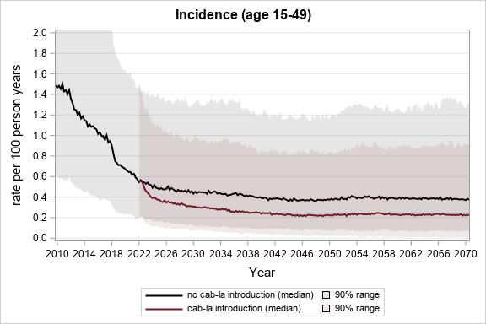
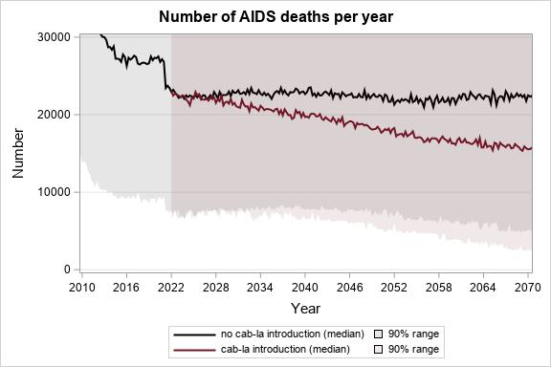
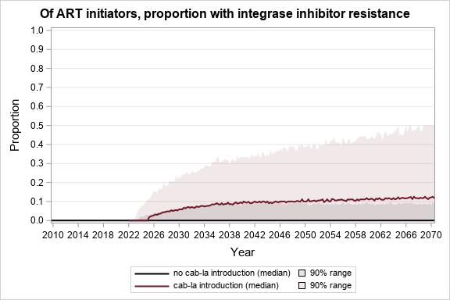
Predicted effects of introduction of LA CAB PrEP in sub-Saharan Africa
Philipps et al. Lancet 2022. Submitted.
Notes:
Of note, results from an elegant mathematical model of rapid scale-up of PrEP and nearly complete switch to CAB-LA in sub-Saharan Africa developed by Andrew Philip and his group, suggested that CAB-LA would result in a 27% reduction in HIV incidence and reductions in the number of people living with HIV but will result in an increase in the absolute number of people living with INSTI-resistant HIV. However, despite this, CAB-LA was predicted to lead to a decrease in HIV-related mortality.
Surveillance for INSTI-resistance and subsequent response to INSTI-based ART should be performed during CAB LA PrEP roll-out to further inform policy.

Slide 23
CLINICAL USE and
IMPLEMENTATION

Slide 24
Making Good Decisions without good data
What to start?
  Whatever the patient will adhere/persist with best
Onset of protection?
  PK suggests time from first injection (irrespective of OLI) to 8x PA-IC90 is median 2 days, 95% by 7 days
  Durability – incredibly interpatient variability (077 data), likely varies by sex (maybe BMI), wouldn’t assume more than 9-10 weeks for males, 12+ for females
Failures
  Poorly understood to date

Slide 25

Translating evidence into action
Implementation Science
Scientific Evidence
Public Health implementation
Notes:
Historically, the introduction of evidence-based technologies into public health programs has been fraught with delays that result in missed opportunities for impact.
Expanding HIV prevention options needs to be done while expanding PrEP coverage, ensuring that the introduction of new PrEP modalities increases access and reduces disparities in PrEP uptake, rather than simply providing alternatives for individuals already engaged in PrEP.
The rapid development of implementation science to guide the largescale adoption of long-acting injectable PrEP will be vitally important to understand the outstanding issues and implementation approaches for populations who urgently need effective prevention choices.

Slide 26
Funded PrEP introduction studies that include CAB-LA for PrEP
Project Name (Funder) | Focus | Country/ies | Population(s) | Sample Size | Status | Date
PILLAR (ViiV) | CAB specific | US | MSM, Transgender men | 220 | Recruiting | 06/2023
EBONI (ViiV) | CAB specific | US | Black Cisgender and Transgender women | 250 | Recruiting | 01/2023
MOSAIC- CATALYST (USAID) | PrEP general | Kenya, Lesotho, South Africa, Uganda, Zimbabwe | Cisgender women, AGYW, FSW and women engaged in transactional sex, PBFP, transgender women and gender diverse individuals assigned female sex at birth | 4,225 CAB | Recruiting | 07/2023
Project PrEP (Unitaid) | PrEP general | South Africa | AGYW | 2,609 CAB | Planned | 04/2022
ImPrEP/CAB-Brasil (Unitaid and Brazilian MOH) | PrEP general | Brazil | MSM, Transgender women, non binary individuals | 1.200 | Did not start recruitment | 08/2023
PrEP1519 (Unitaid) | PrEP general | Brazil | Adolescent MSM, Transgender women 15-19 years old | 340 | Closed to accrual | 08/2023
FASTPREP (Gates) | PrEP general | South Africa | AGYW, young MSM, PBFP | 19,800 AGYW, including 3,960 pregnant AGYW; 2,000 young MSM; 3,500 male partners | Planned | 06/2022
Axis (Gates) | PrEP general | South Africa | Women aged 18-35 and men over 18 | 250-300 | Planned | 06/2022
Thetha Nami ngithethe nawe (“Let’s talk”) (Gates) | PrEP general | South Africa | all young eligible people (men and women) aged 15-30 living in a rural community | 26.000 | Recruiting | 08/2022
Key Population Led Delivery of CAB-LA for PrEP in Thailand (TBD) | CAB specific | Thailand | MSM, transgender women | TBD | Planned | 2022
STEPS (USAID) | CAB specific | Vietnam | All KP | TBD | Planned | 03/2022
Australian CAB-LA implementation trial (TBD) | CAB specific | Australia | MSM, other pops TBD | TBD | Planned | 04/2022
CohMSM (ANRS) | CAB specific | Burkina Faso, Cote d'Ivoire, Mali, Togo | MSM | 400 | Planned | A definir
Prevenir ANRS (ANRS) | CAB specific | France | MSM | 400 | Planned | A definir
Pharmacy-delivered LA HIV PrEP in Kenya (AIDS Foundation) | PrEP general | Kenya | All | 2.000 | Recruiting | 06/2023
AMETHIST- Pharmacy-based PrEP (Wellcome Trust EJAF) | PrEP general | Zimbabwe | FSW | 4.400 | Completed | 03/2022
For more details see AVAC CAB for PrEP implementation study tracker www.prepwatch.org

Slide 27
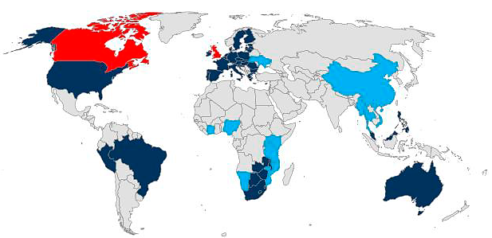
VIIV Registration footprint for CAB LA for PrEP
Geographically diverse global footprint
Includes prioritisation for registration based on HIV burden and evaluation of PrEP readiness
Planned submission to NRAs in 2H, 2023 (Wave 4)
UK | Canada
Registration submitted
Kenya | Myanmar
Uganda | China
Thailand | Nigeria
Vietnam | Rwanda
Ukraine | Tanzania
Namibia | Mozambique
Cote D’Ivoire
Approved
US | Zimbabwe
Australia | South Africa*
Malawi | Botswana
Brazil | Philippines
Malaysia | Zambia
Peru | EU
Points to note:
Access in other countries is not dependent on registration status
ViiV will support the use of alternative access pathways, such as import permits
Will consider registering the product on a case-by-case basis
External Regulatory Affairs tracker: We improve our access to medicines (viivhealthcare.com)
*Eswatini and Lesotho recognises a South African registration, separate process will not occur.
2H, second half; CAB LA, cabotegravir long-acting; EU, European Union; HIV, human immunodeficiency virus; PrEP, pre-exposure prophylaxis; NRA, national regulatory agency.

Slide 28

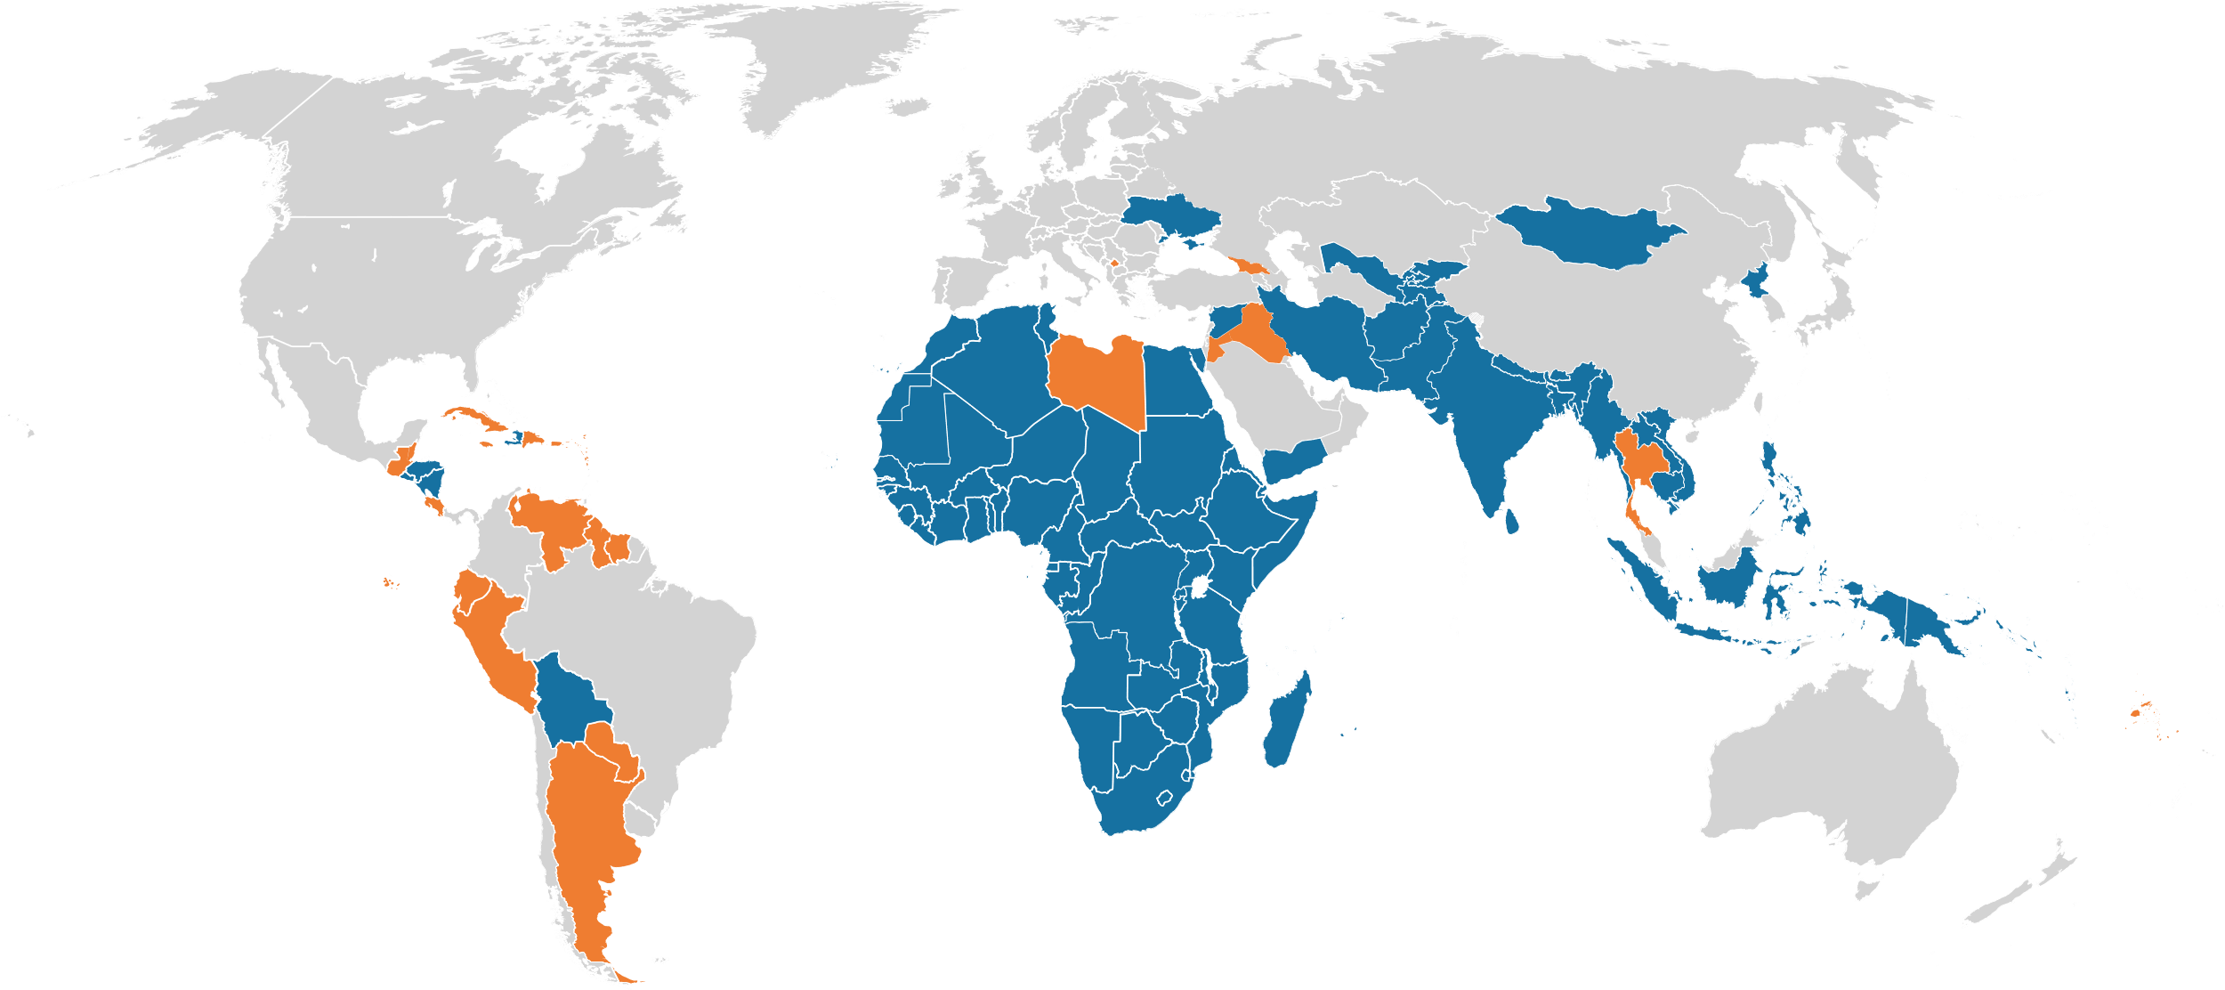

Patents and licenses for CAB-LA
Licensed territory
Countries outside the license territory with no patentes on CAB-LA
Source: www.medspal.org

Slide 29
Conclusions
Long-acting cabotegravir is highly effective for prevention of HIV in MSM, TGW, cisgender women and various subgroups
  Tenofovir-based PrEP is as well when properly used
CAB is safe, generally well-tolerated, and data does not suggest there are safety concerns for use during pregnancy or breastfeeding
The washout period after last CAB injection is longer in individuals born female compared to individuals born male
RNA testing finds CAB breakthrough infections earlier, and often before resistance, but high cost and may not be feasible in many settings
We need strong community advocacy to demand programmatic implementation and rapid generic production to bring costs down

Slide 30
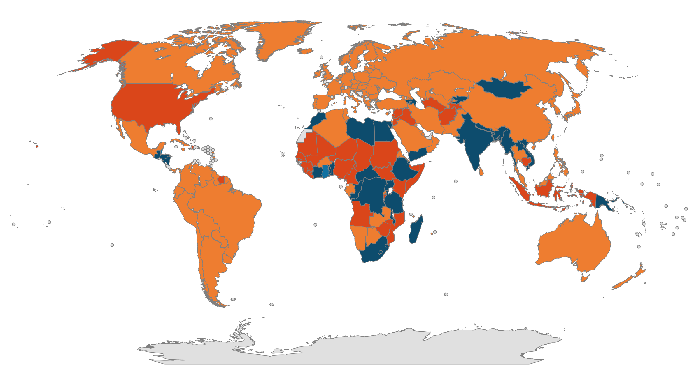

Health as a right!
Countries and access to health care
Countries with free and universal health care
Countries with universal but not free health care
Countries with free but not universal healthcare
Countries with neither free nor universal healthcare
Unknown
https://en.wikipedia.org/wiki/List_of_countries_with_universal_health_care
Notes:
And just to finalize, it is never enough to reiterate that inequalities are a major driver of the HIV epidemic, which continues to disproportionately burden vulnerable populations despite the availability of effective preventive and therapeutic interventions. Our current models of HIV prevention delivery are not responding to the needs of these populations.
Stigma and discrimination remain as significant roadblocks. The interplay of different forms of discrimination go beyond homophobia and transphobia to include race/ethnicity and social class. All these forms of discrimination, coupled with HIV-related stigma, significantly hinder access to health services. The most vulnerable populations struggling with poverty and social inequalities are the ones that suffer the most from HIV.
May long-acting PrEP not deepen the already profound inequalities. On the contrary, may it be a step forward in our effort against inequalities.
Thanks very much

Slide 31

Obrigada!
Beatriz Grinsztejn gbeatriz@ini.fiocruz.br
www.fiocruz.br
Notes:
Thank you very much for your attention.

