Slide 1


Requirements for bNAbs
in HIV prevention
Florian Klein
Professor & Head of the Institute of Virology
University of Cologne
Germany
16th of October 2023

Slide 2
Disclosures (Florian Klein)
Ad-hoc advisor for AstraZeneca, Gilead, MSD, Pfizer, Octapharma
Ongoing or past research collaborations with BioNTech, Boehringer Ingelheim
Filed patent applications for HIV-1 bNAbs
Payments (University of Cologne) for licensed monoclonal antibodies

Slide 3
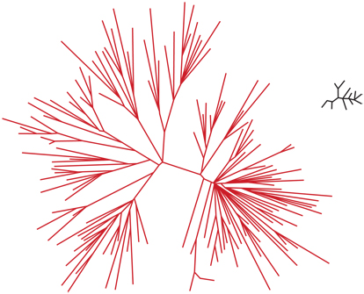
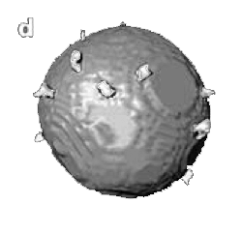
HIV-1 infection – Broadly neutralizing antibodies (bNAbs)
HIV-1
✓
Anti-retroviral therapy (ART) highly effective
Almost normal life expectancy / not infectious
Genetic diversity
HIV-1
Influenza A
ART access (75%)
Daily medication / lifelong treatment
No HIV-1 vaccine
No functional cure for HIV-1
Low spike
density
UNAIDS, Global update 2022; IHME, Global Burden of Disease

Slide 4
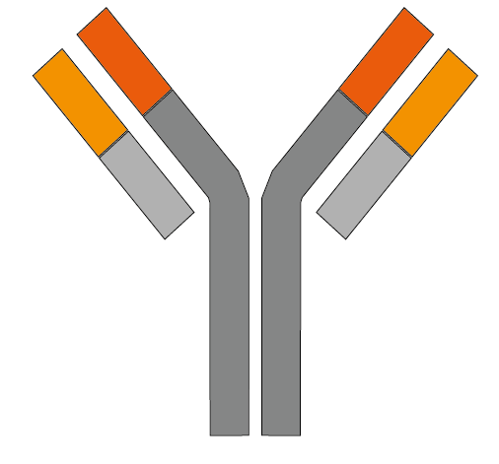
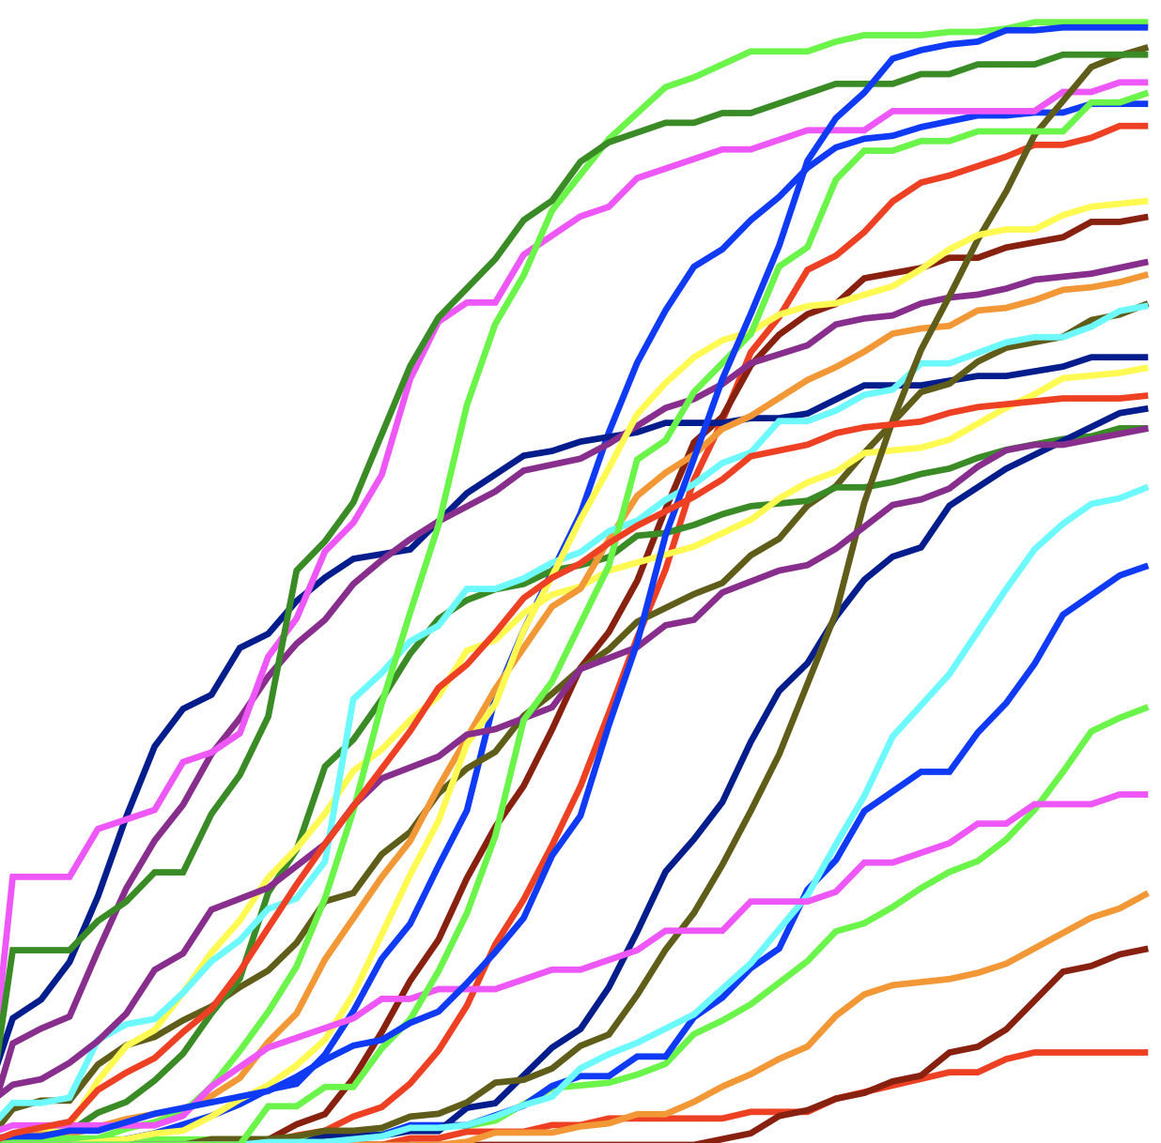
HIV-1 infection – Broadly neutralizing antibodies (bNAbs)
1994 - 2008
Neutralization (breadth)
1st Generation
2009 - 2018
Neutralization (potency)
Neutralization (breadth)
2nd Generation
Neutralization (µg/ml; potency)
Scheid et al., Science 2011; Klein et al., Cell 2013; Walker et al., Science 2009; Wu et al., Science 2010; Corti et al., Plos One 2010; Diskin et al., Science 2011; Walker et al., Nature 2011; Mouquet et al., PNAS 2012; Klein et al., J Exp Med 2012, Huang et al., Nature 2012; Bonsignori et al., J. Virol 2012; Huang et al., Immunity 2016; Kwon et al., J Virol 2016; Doria-Rose et al., J Virol 2016; Xu et al., Science 2017. Klein et al., Science 2013

Slide 5
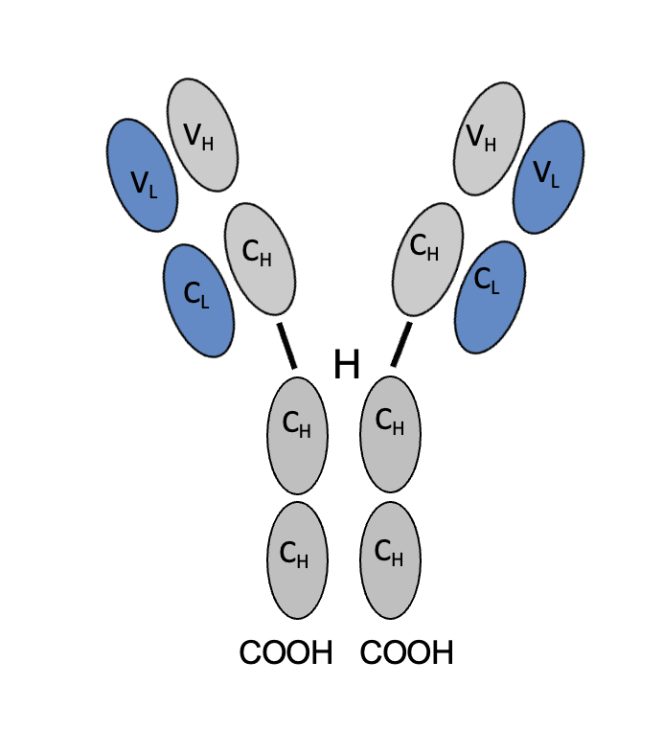
HIV-1 infection – Broadly neutralizing antibodies (bNAbs)
HIV-1
✓
Anti-retroviral therapy (ART) highly effective
Almost normal life expectancy / not infectious
ART access (75%)
Daily medication / lifelong treatment
No HIV-1 vaccine
No functional cure for HIV-1
Role of antibodies?
UNAIDS, Global update 2022; IHME, Global Burden of Disease

Slide 6
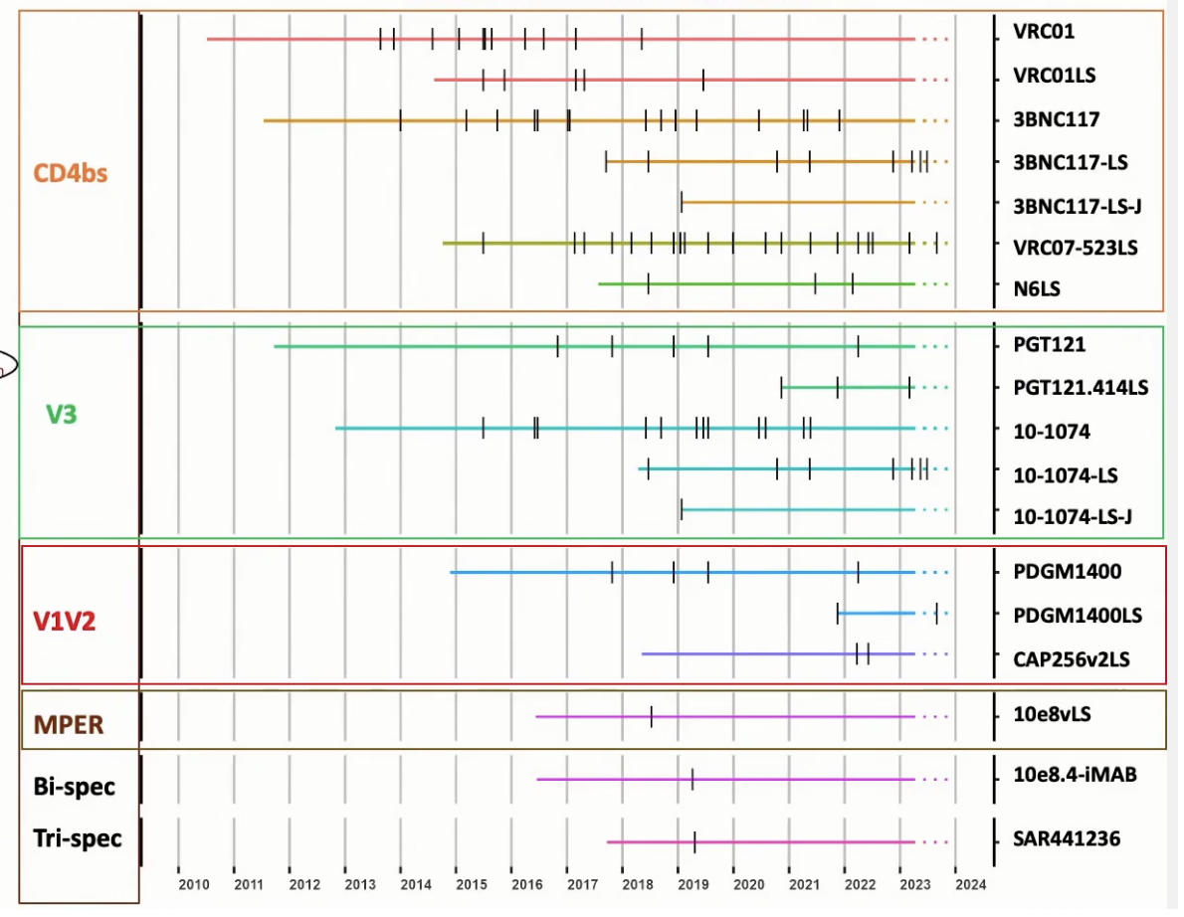
HIV-1 infection – Broadly neutralizing antibodies (bNAbs)
1994 - 2008
Neutralization (breadth)
1st Generation
2009 - 2018
Neutralization (potency)
Neutralization (breadth)
2nd Generation
Neutralization (µg/ml; potency)
Schommers and Gruell., Curr Opin Virol 2022; Frattari et al., Curr Opin HIV AIDS 2023

Slide 7
HIV-1 infection – Broadly neutralizing antibodies (bNAbs)
Can we advance HIV-1 prevention & treatment?
Schommers and Gruell., Curr Opin Virol 2022; Frattari et al., Curr Opin HIV AIDS 2023

Slide 8
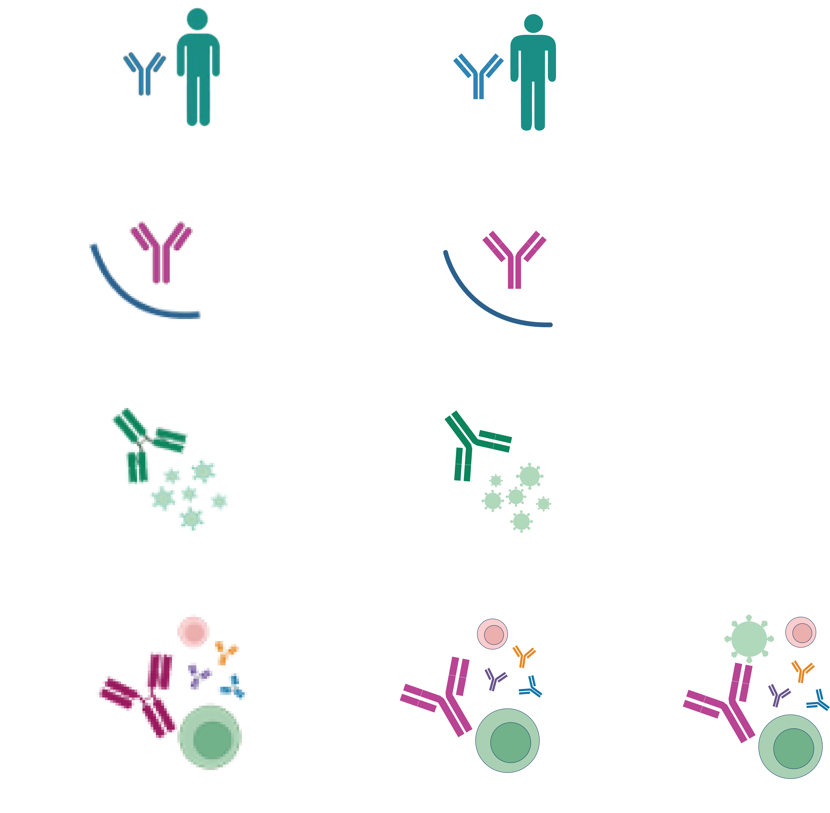
HIV-1 broadly neutralizing antibodies - Safety
> 20 different bNAbs
> 6,000 paticipants, > 60,000 infusions
  Single and bNAb/drug combinations, single and multiple infusions
  Safety data in on/off ART, in adults, but also in children & newborns
Notes:
SAE: Serious adverse events

Slide 9
HIV-1 broadly neutralizing antibodies - Safety
> 20 different bNAbs
> 6,000 paticipants, > 60,000 infusions
  Single and bNAb/drug combinations, single and multiple infusions
  Safety data in on/off ART, in adults, but also in children & newborns
bNAb administration is safe and well tolerated
Notes:
SAE: Serious adverse events

Slide 10
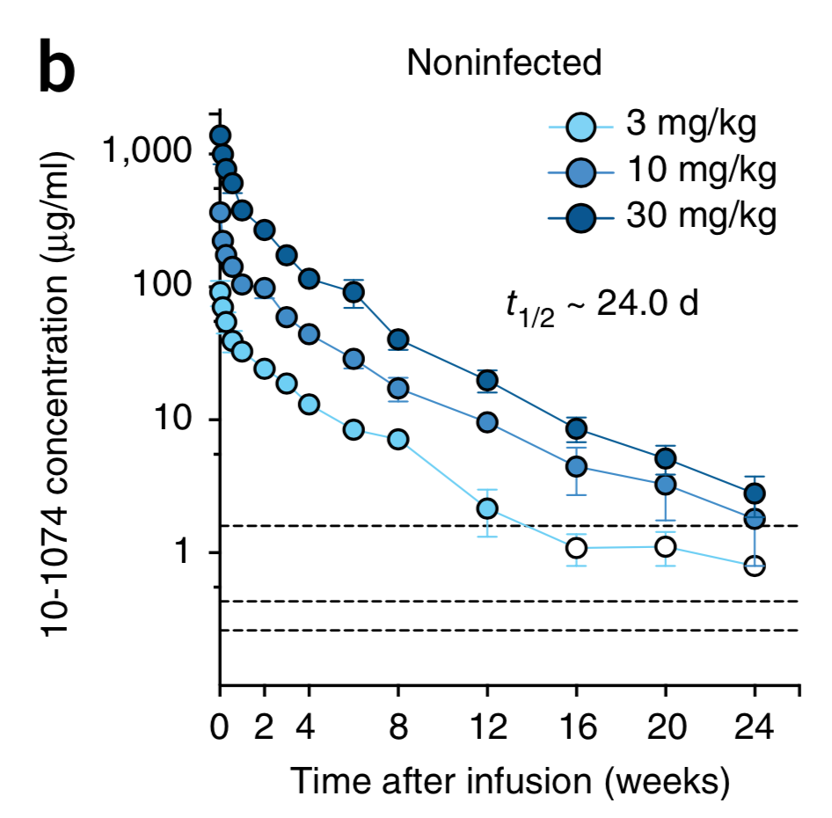
HIV-1 broadly neutralizing antibodies - PK
10-1074
(uninfected)
Gaudinsky et al., PLoS Med 2018; Caskey et al., Nat Med 2017, Caskey & Klein, Nature 2015; Mahomed et al., J Infect Dis 2022

Slide 11
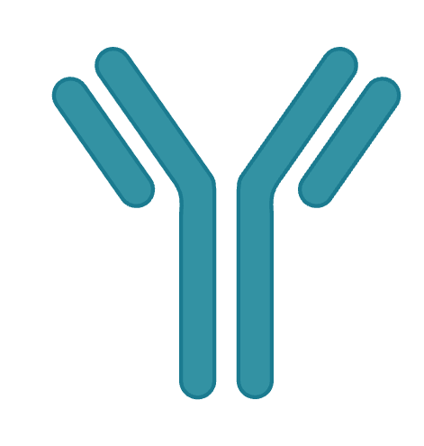
HIV-1 broadly neutralizing antibodies - PK
M428L
10-1074
(uninfected)
N434S
VRC01
15 d
71 d
10-1074
24 d
80 d
3BNC117
16 d
62 d
VRC07-523
ND
40 d
Gaudinsky et al., PLoS Med 2018; Caskey et al., Nat Med 2017, Caskey & Klein, Nature 2015; Mahomed et al., J Infect Dis 2022

Slide 12
HIV-1 broadly neutralizing antibodies - PK
M428L
10-1074
(uninfected)
N434S
VRC01
15 d
71 d
10-1074
24 d
80 d
3BNC117
16 d
62 d
VRC07-523
ND
40 d
bNAb can function as (very) long-acting drugs

Slide 13
HIV-1 broadly neutralizing antibodies – Antiviral activity
10-1074 (V3stem)
Δlog₁₀ (copies/ml)
Days after infusion
Drop viral load
1,52 log (1.0 – 2.1)
Caskey* and Klein* et al., Nature 2015; Caskey*, Schoofs*, Gruell*, et al., Nat Med 2017

Slide 14
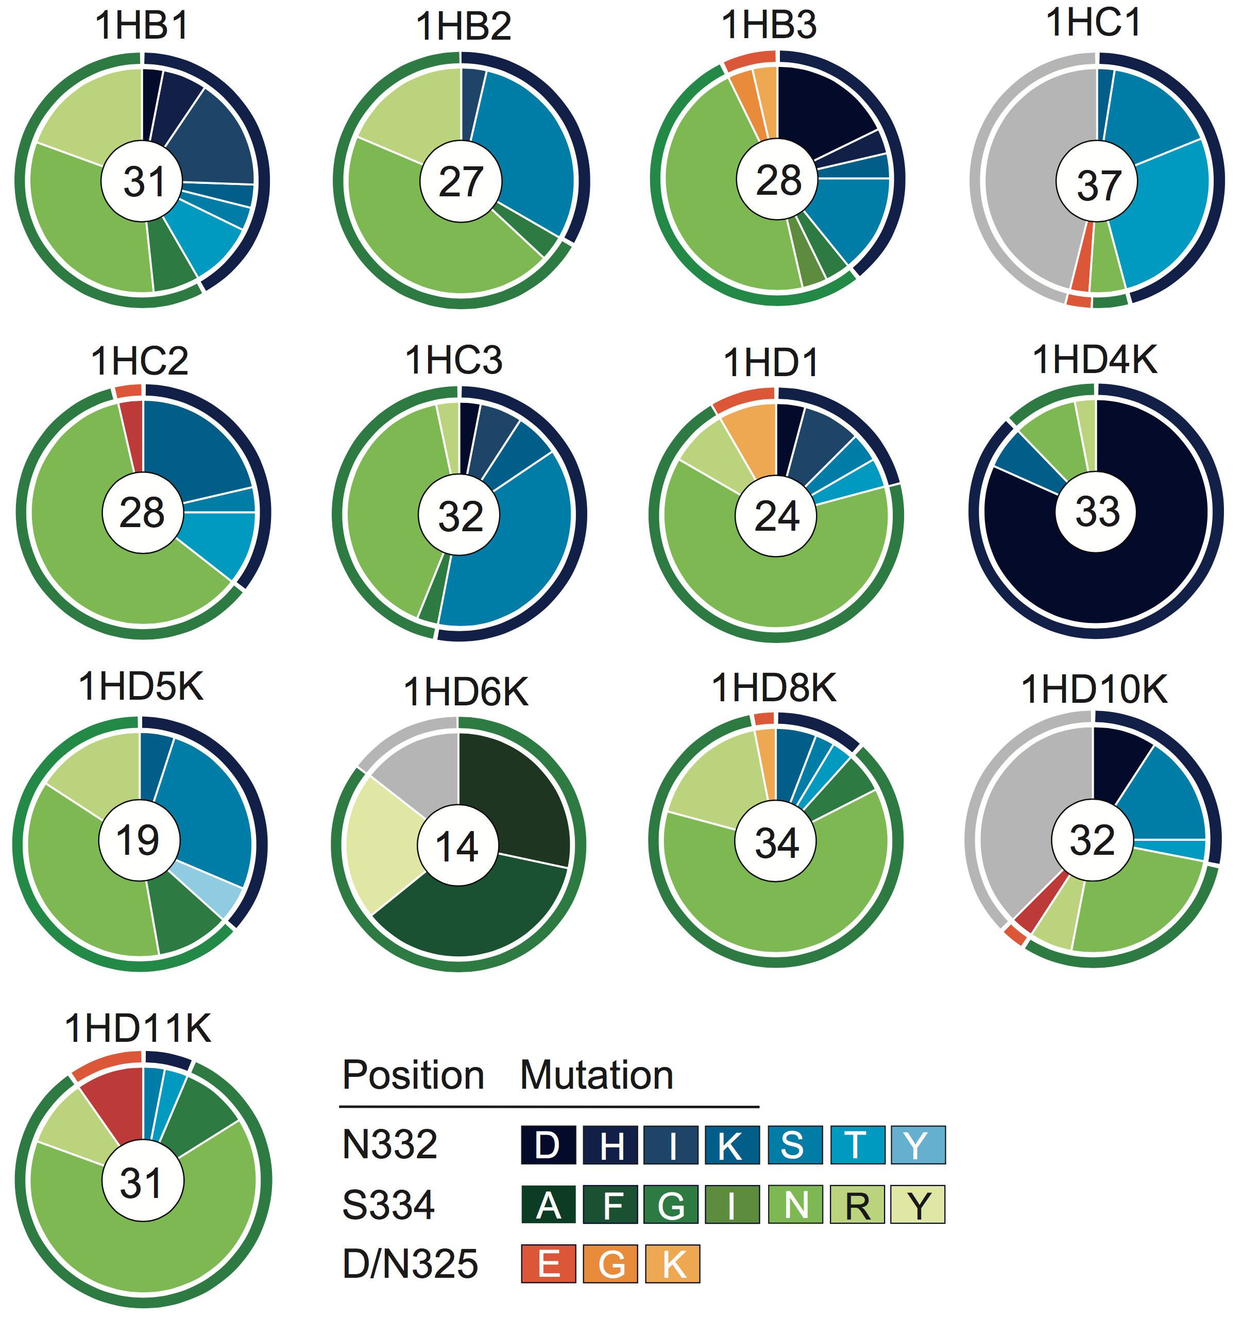
HIV-1 broadly neutralizing antibodies – Antiviral activity
10-1074 (V3stem)
HIV-1 escape mutations
Δlog₁₀ (copies/ml)
Days after infusion
Drop viral load
1,52 log (1.0 – 2.1)
Caskey* and Klein* et al., Nature 2015; Caskey*, Schoofs*, Gruell*, et al., Nat Med 2017

Slide 15
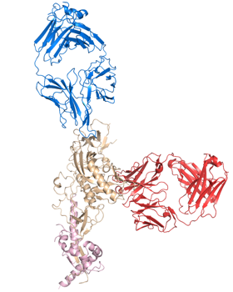
HIV-1 broadly neutralizing antibodies – Antiviral activity
10-1074
V3 glycan
3BNC117
CD4bs
gp120
gp41
Gristick et al., NSMB 2016; Sneller, et al., Nature 2022; Gaebler, et al., Nature 2022

Slide 16
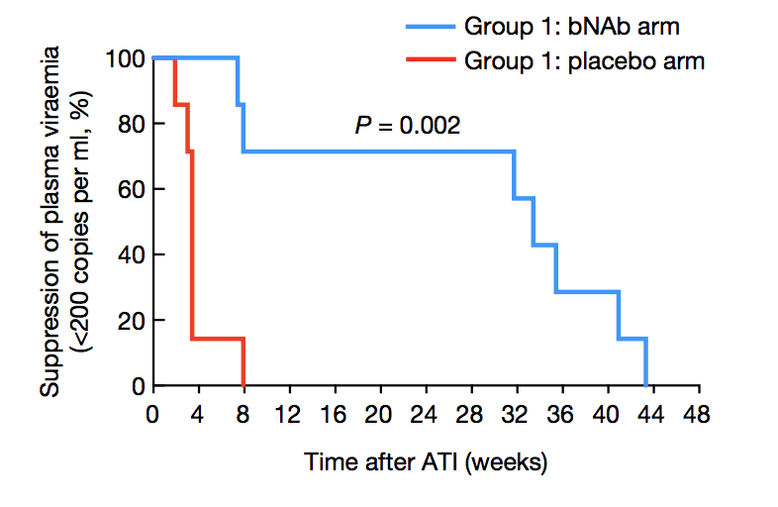
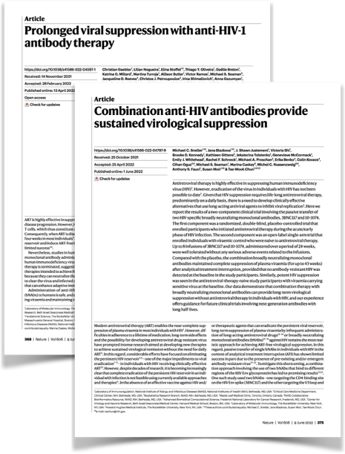
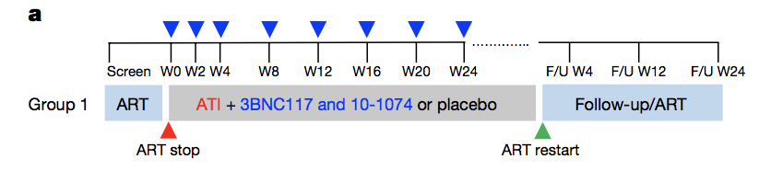
HIV-1 broadly neutralizing antibodies – Antiviral activity
10-1074
V3 glycan
3BNC117
CD4bs
gp120
gp41
Gristick et al., NSMB 2016; Sneller, et al., Nature 2022; Gaebler, et al., Nature 2022

Slide 17
HIV-1 broadly neutralizing antibodies – Antiviral activity
10-1074
V3 glycan
3BNC117
CD4bs
gp120
gp41
bNAb combination help to overcome HIV-1 escape

Slide 18
HIV-1 bNAbs – Immunological effects

Slide 19
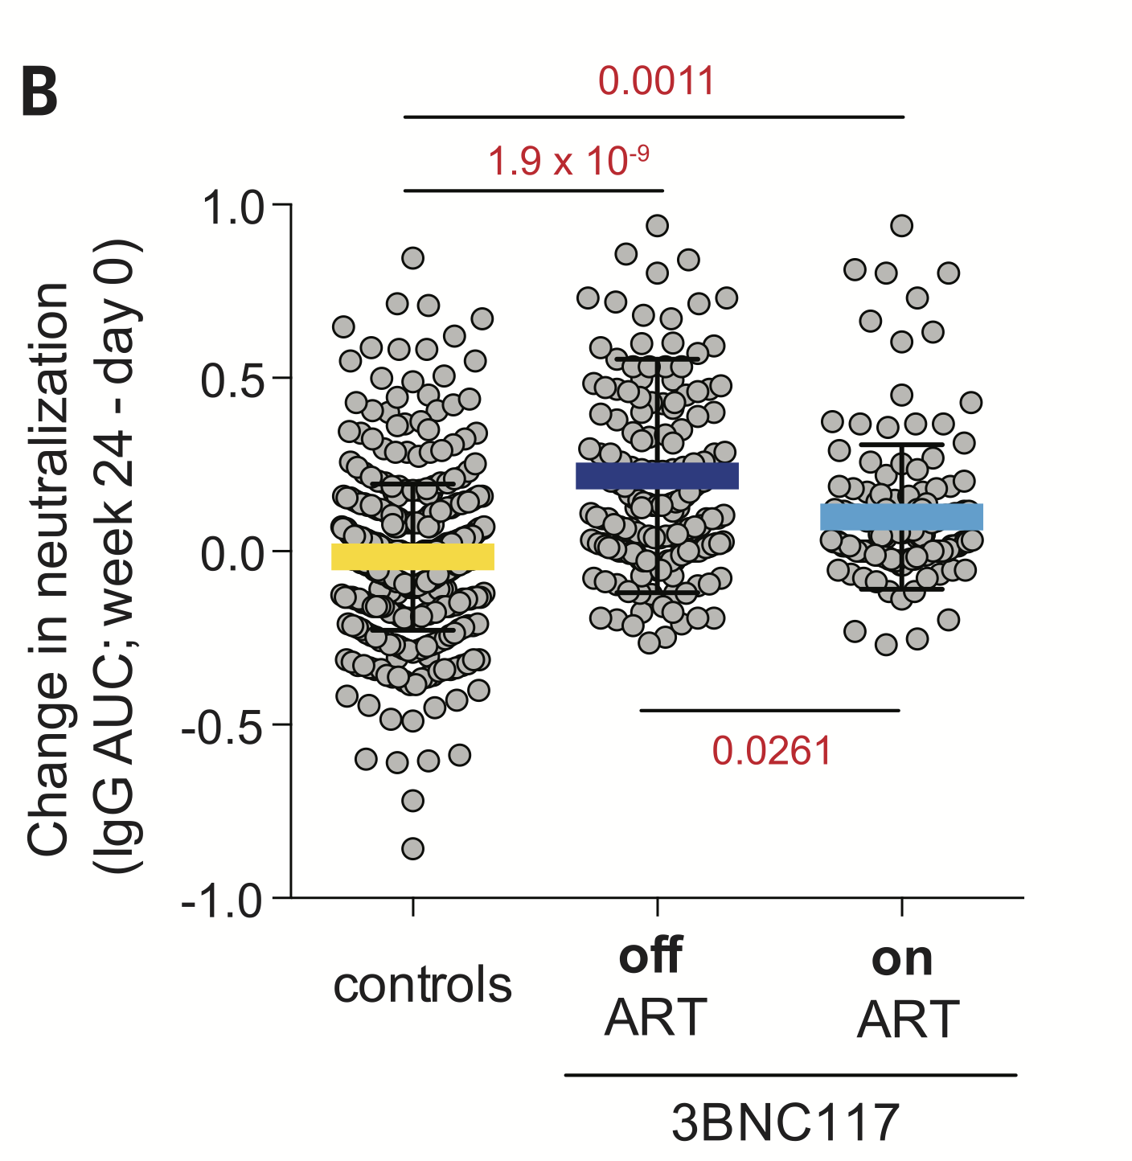
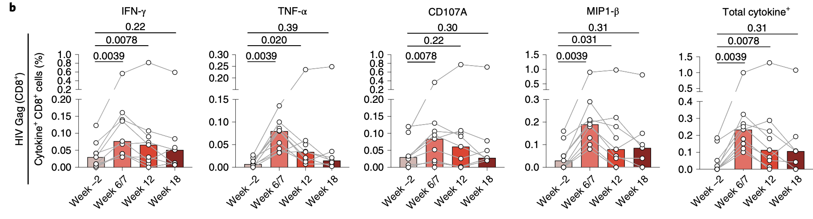
HIV-1 bNAbs – Immunological effects
Enhanced neutralization
Enhanced T cell activity
Nishimura et al., Nature 2017; Schoofs et al., Science 2016, Niessl et al., Nat Med 2020

Slide 20
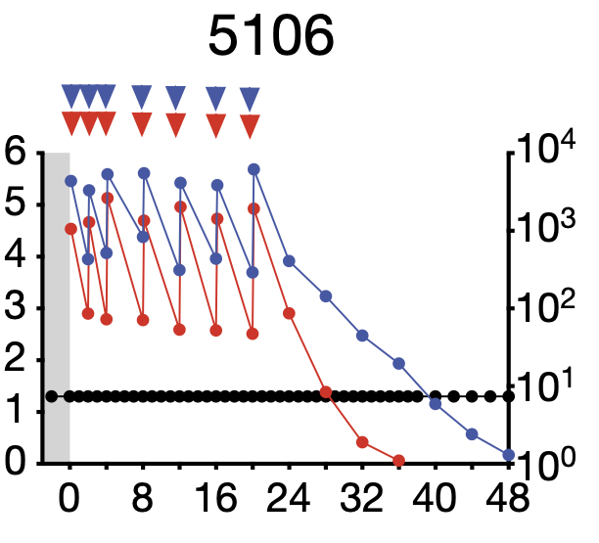
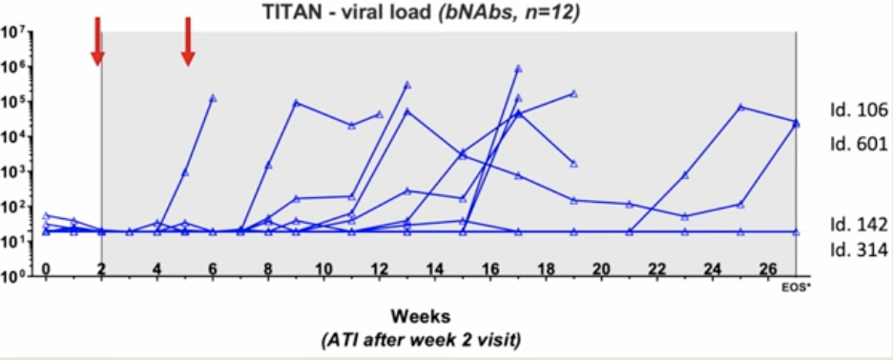
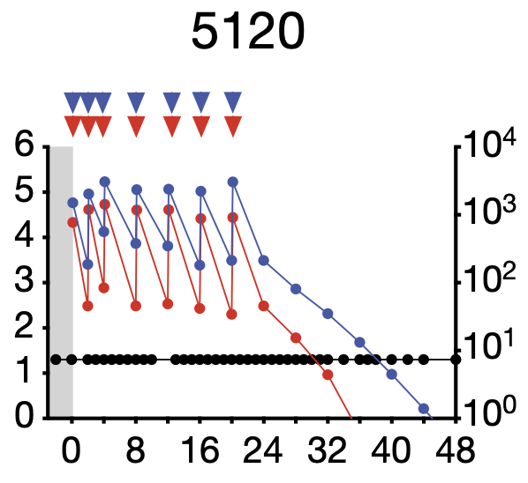
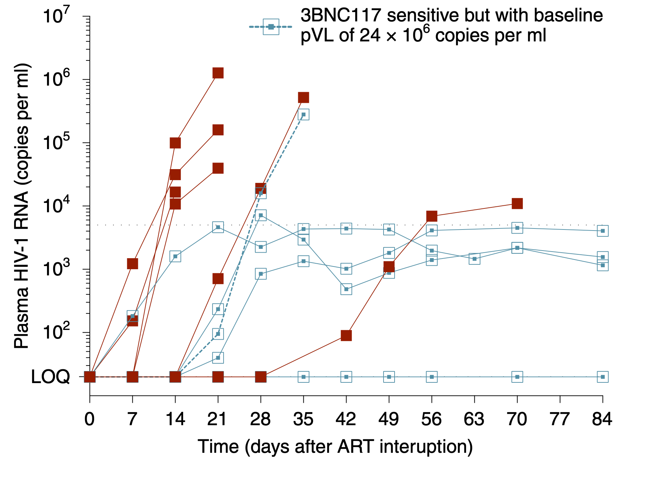
HIV-1 bNAbs – Immunological effects
Suppressed viremia
2/12
3BNC117
10-1074
(TITAN)
Romidepsin
3BNC117
>3.7 years
off ART

Slide 21
HIV-1 bNAbs – Immunological effects
Suppressed viremia
2/12
3BNC117
10-1074
(TITAN)
Romidepsin
3BNC117
>3.7 years
off ART
Mendoza et al., Nature 2018; Gunst et al., Nat Med 2022, Niessl et al., Nat Med 2020, Søgaard, CROI 2023; Lee, IAS 2023

Slide 22
HIV-1 bNAbs – Immunological effects
Suppressed viremia
2/12
3BNC117
10-1074
(TITAN)
Romidepsin
3BNC117
>3.7 years
off ART
Repeated observations of maintained control after bNAbs

Slide 23
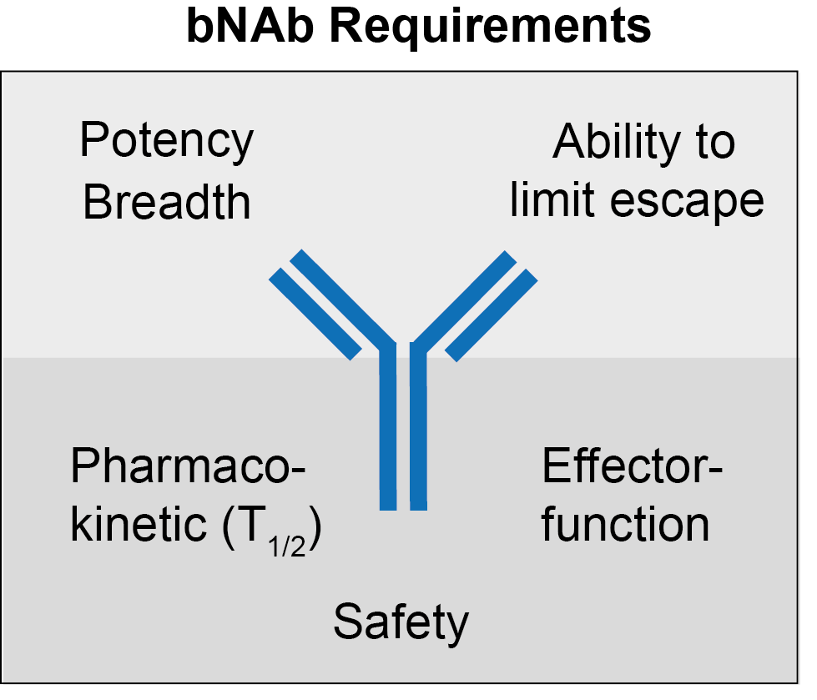
bNAb requirements for clinical practice

Slide 24
bNAb requirements for clinical practice

Slide 25
bNAb requirements for clinical practice

Slide 26
bNAb requirements for clinical practice
bNAb infrastructure (i.v./s.c. administration)
Host/Resistance screening (e.g., PhenoSense)
Clinical trial structure (e.g., ATI, prevention)
Community engagement (all countries)
Community representatives (industry, regulators)

Slide 27
bNAbs for HIV prevention

Slide 28

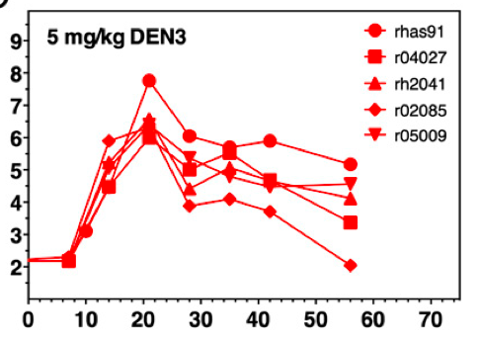
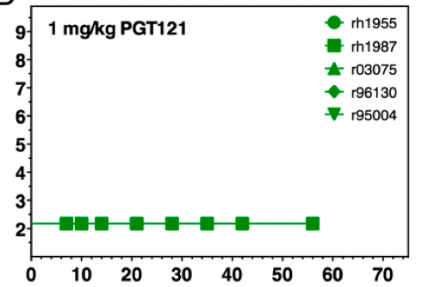
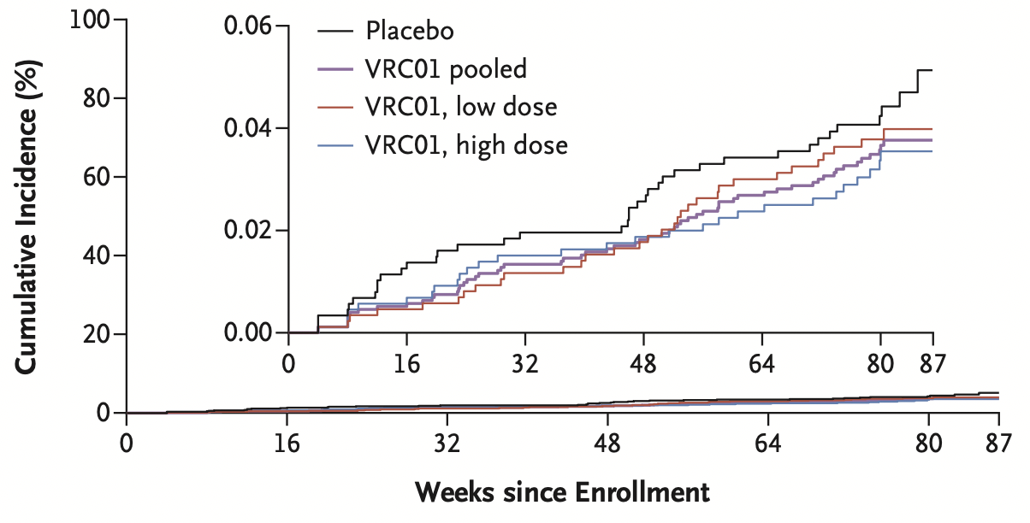
bNAbs for HIV prevention
HVTN 703/704
Total participants: 4,625
Infections
Placebo: 67
Low-dose: 60
High-dose: 47
Antibody-mediated prevention (NHPs)
control
bNAbs
Viral load SHIV
(copies in log₁₀/ml)
Days post SHIV challenge
Days post SHIV challenge
Moldt et al., PNAS 2012; Gautam et al., Nature 2016
Corey et al., NEJM 2021
Notes:
AMP: 46 sites, 99% adherence; 97,458 visits; 41T infusions. IV 10 or 30 mg; 2016 – 2018, 20 months (10 infusions every 8 weeks)

Slide 29
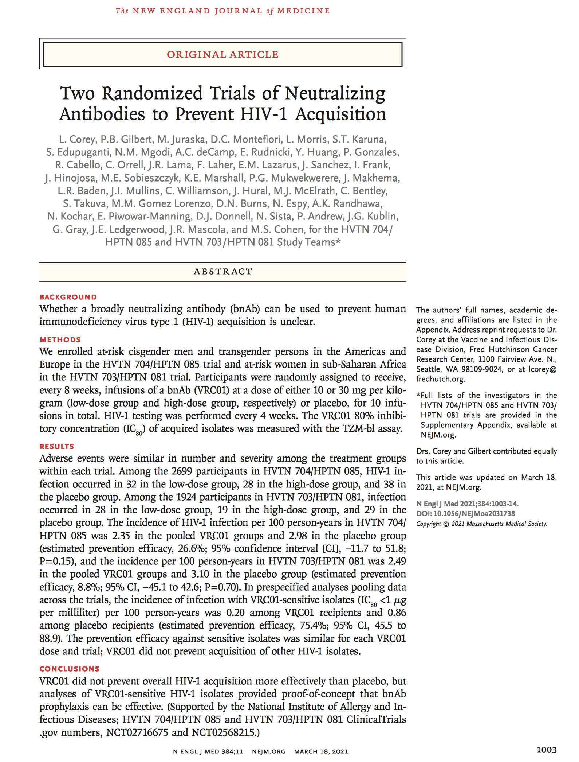
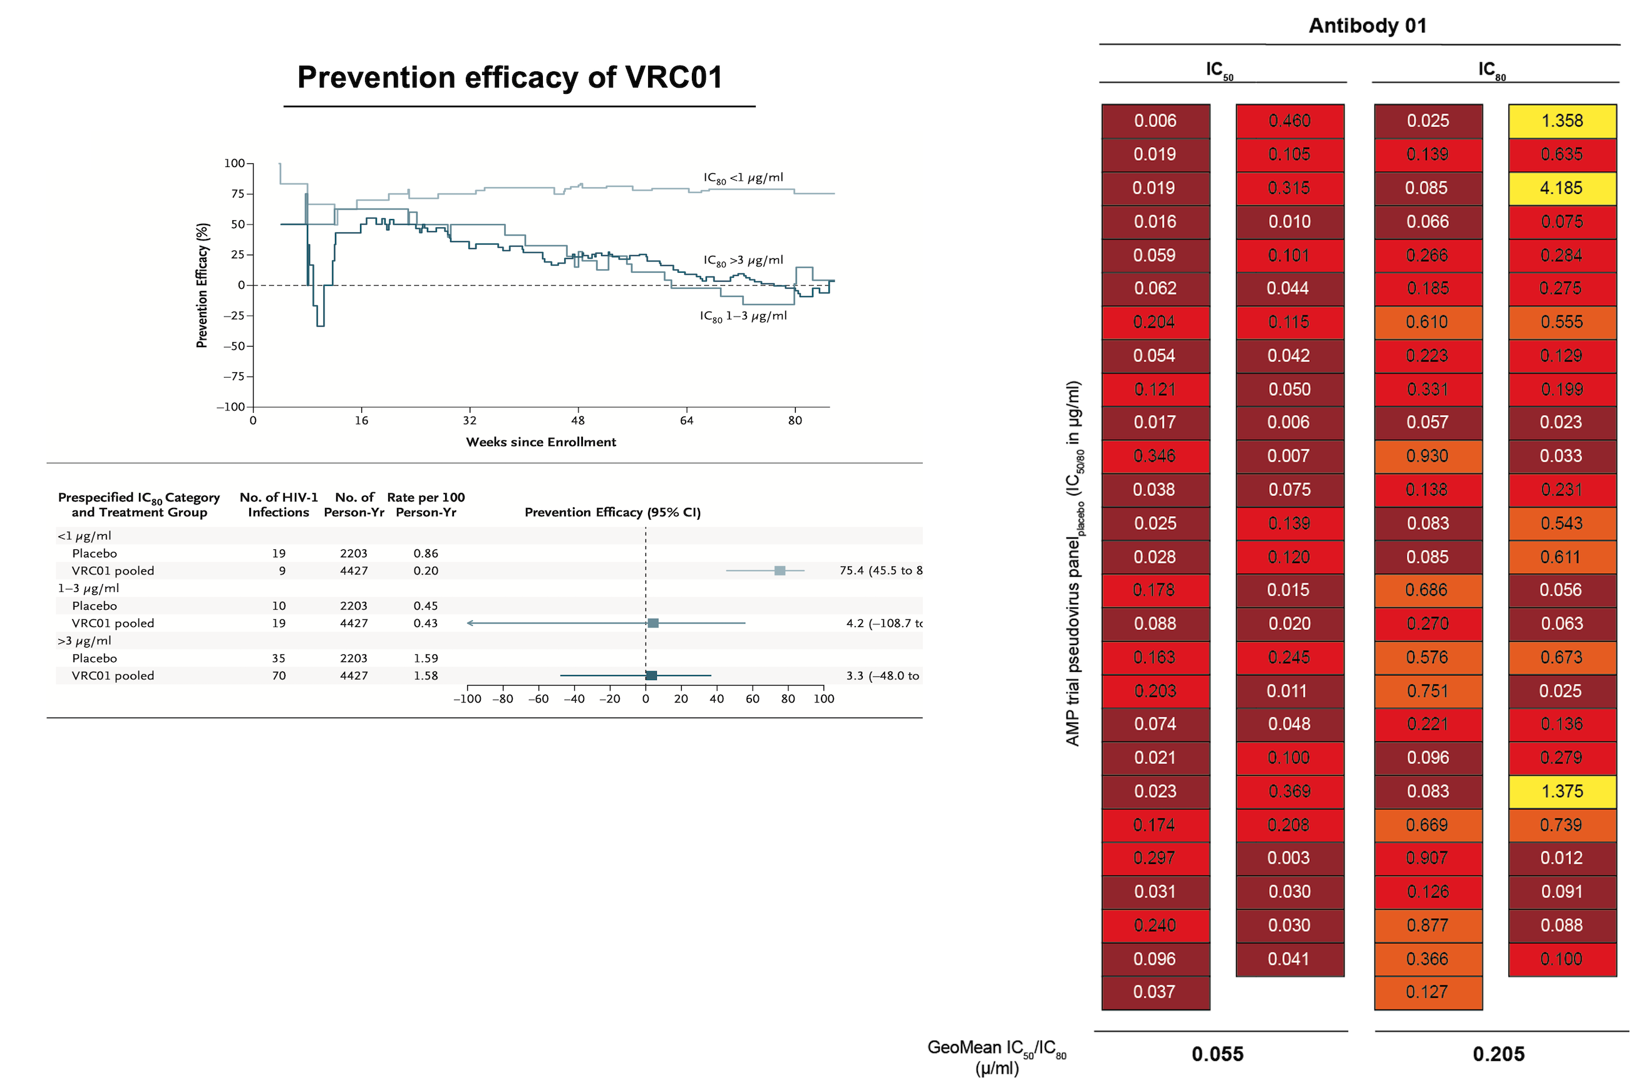
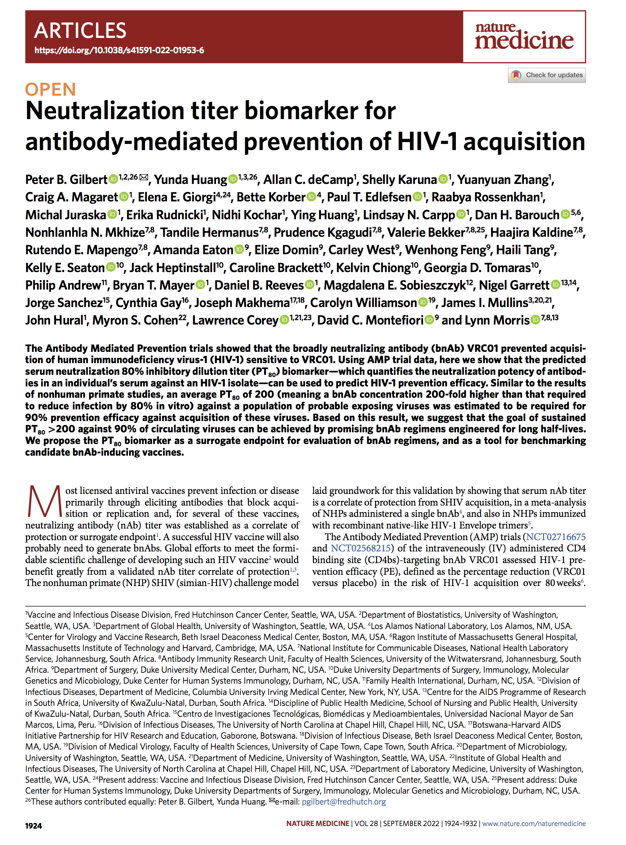
bNAbs for HIV prevention
(HVTN 703/704; VRC01)
VRC01 efficacy in
sensitive strains
IC₈₀ < 1 µg/ml
75% prevention efficacy (PE) against strains susceptible to VRC01
Corey et al., NEJM 2021; Gilbert et al., Nat Med 2022

Slide 30
bNAbs for HIV prevention
(HVTN 703/704; VRC01)
VRC01 efficacy in
sensitive strains
IC₈₀ < 1 µg/ml
75% prevention efficacy (PE) against strains susceptible to VRC01
bNAb-mediated prevention works against sensitive strains

Slide 31
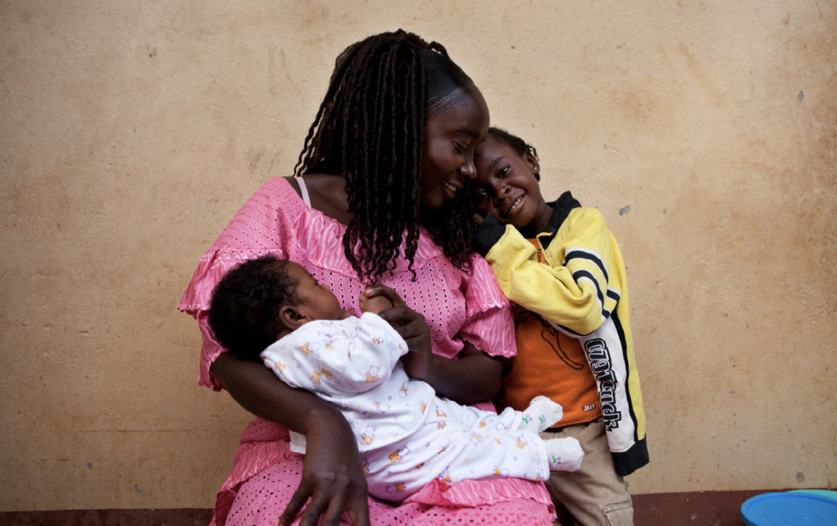

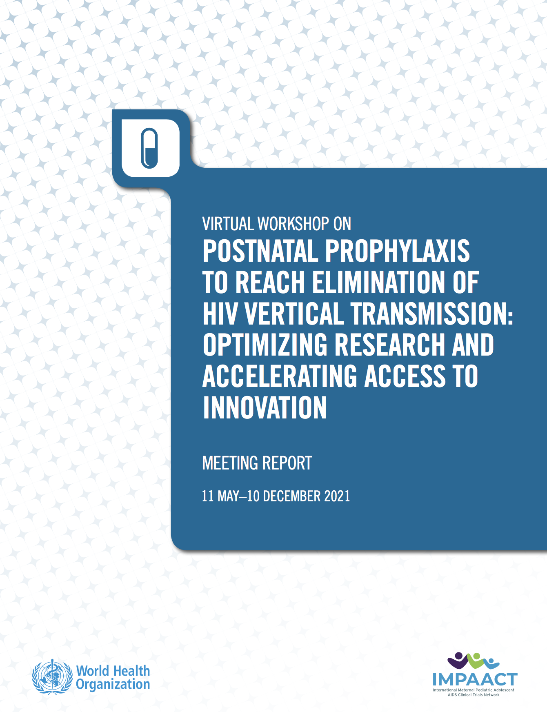
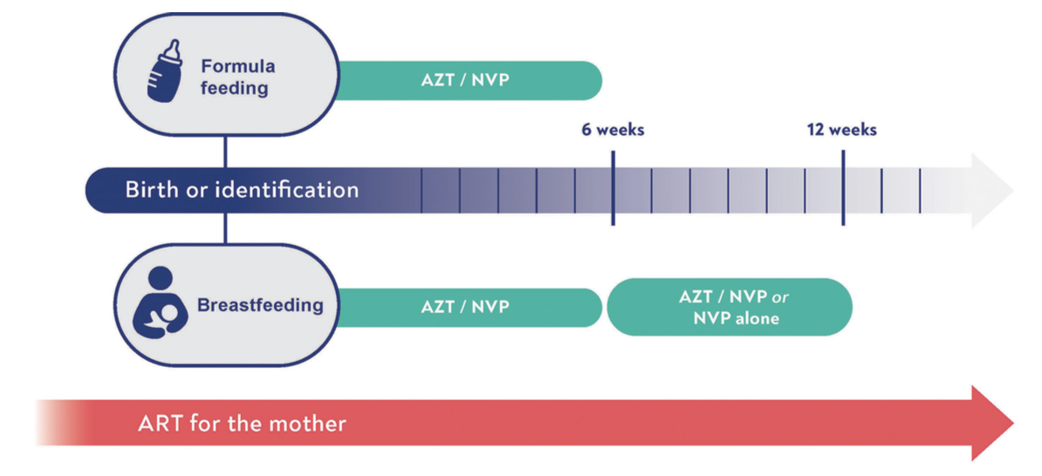
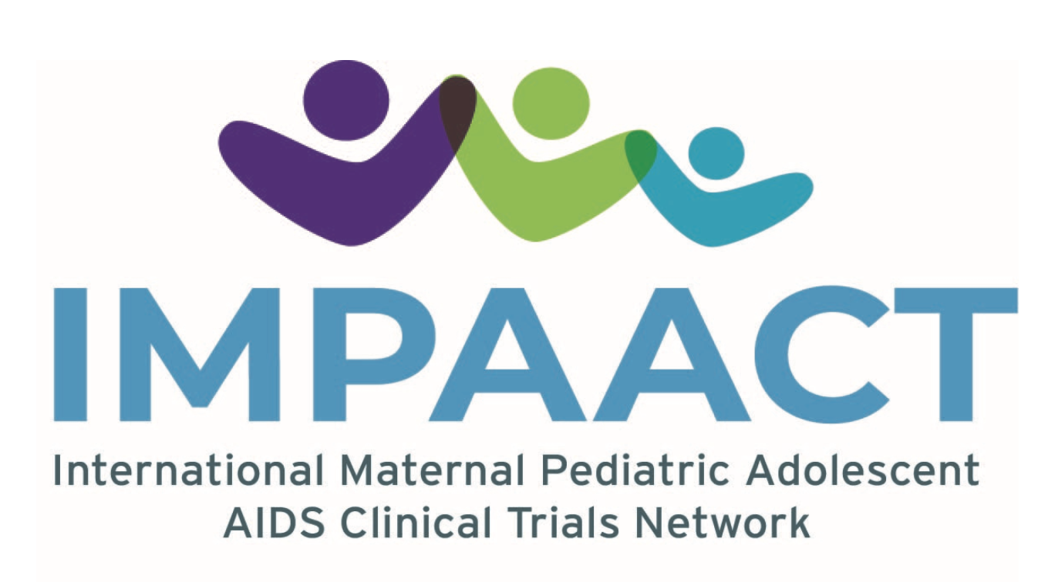

POSTNATAL PROPHYLAXIS
TO REACH ELIMINATION OF HIV VERTICAL TRANSMISSION; future in which no child is born with HIV
bNAbs for HIV prevention (mother to child transmission)
> 150,000 children < 5y aquired HIV in 2021 (UNAIDS)
2/3 of children from mothers living with undetected HIV-1
~ 50% pre/perinatal ~ 50% breastfeeding
Postnatal prophylaxis (e.g., AZT, NVP) reduces MTCT
Drug development & dose finding are challenging
Ruel et al., Global Health: Science and Practice 2023; WHO postnatal prophylaxis workshop 2021; Connor et al., NEJM 1994; WHO PADO-HIV group (2021); CDC 2023; Elizabeth Glaser Pediatric AIDS Foundation 2023
Notes:
XX pregnant women, 81% on ART; Abbreviations: AZT: zidovudine; NVP: nevirapine; ART: antiretroviral treatment.
82% of pregnant women globally received antiretroviral therapy (ART) in 2021(UNAIDS 2022)
Nevirapine (NVP), lamivudine (3TC), and zidovudine (AZT) will likely remain the best current options for premature neonates until pharmacokinetics and safety of newer drugs are defined for that population
WHO Paediatric Drug Optimization for HIV (PADO-HIV) group (2021)
The first evidence that antiretroviral drugs re- duced the risk of vertical transmission—and one of the earliest success stories in the HIV epidemic response—came from the Pediatric AIDS Clinical Trials Group 076 study. (Connor et al NEJM 1994)
In 2010, the HIV Prevention Trials Network 040/Pediatric AIDS Clinical Trials Group 1043 study demonstrated that for infants of mothers who deliv- ered before starting treatment, 2-drug or 3-drug short-course regimens to the infant provided equiv- alent protection against infection, with peripartum transmission rates of !2%–3%. (Dorenbaum JAMA 2002)
The first evidence that antiretroviral drugs re- duced the risk of vertical transmission—and one of the earliest success stories in the HIV epidemic response—came from the Pediatric AIDS Clinical Trials Group 076 study. (Connor et al NEJM 1994)
In 2010, the HIV Prevention Trials Network 040/Pediatric AIDS Clinical Trials Group 1043 study demonstrated that for infants of mothers who deliv- ered before starting treatment, 2-drug or 3-drug short-course regimens to the infant provided equiv- alent protection against infection, with peripartum transmission rates of !2%–3%. (Dorenbaum JAMA 2002)
Drug developmentand dose-finding for neonates is particularly challenging because of difficulties in performing clinical research in this population and highly variable pharma- cokinetics during the first months of life. Ruel et al., Global Health: Science and Practice 2023
postnatal prophylaxis for at least 12 weeks of prophylaxis, usually AZT + NVP for the first six weeks followed by NVP alone
However, the use of optimal ARV drug formulations for preventing and treating HIV infection among newborns and young infants remains a significant challenge. Limited availability of appropriate formulations and dosing schedules that account for prematurity and low birth weight continue to result in unavoidable complexity with which healthcare workers and families struggle.
The WHO Paediatric Drug Optimization for HIV (PADO-HIV) group brings together stakeholders and experts every 2–3 years to identify priority products and define research gaps in the development of new HIV drugs and formulations for children in low-income and middle-income countries
substantial number of vertical transmissions continue to occur perinatally and during breastfeeding, driven by shortfalls in testing, treatment coverage, adherence, and retention in care among mothers.
Among an estimated 160,000 children with new HIV infections globally in 2021, 48% had mothers who had not started ART, 22% had mothers who discontinued their treatment, and 8% had mothers on treatment but were not able to main- tain virologic suppression. (UNADS 2022)
Those cur- rently in use, nevirapine and zidovudine, require daily or twice daily oral administration and are delivered as syrups dispensed in bulky bottles with the potential for unintentional disclosure of the maternal HIV status.
This leaves breastfeeding infants vulnerable to transmission if their mothers experi- ence viremia secondary to lapses in adherence or treatment failure or if there are drug e.

Slide 32
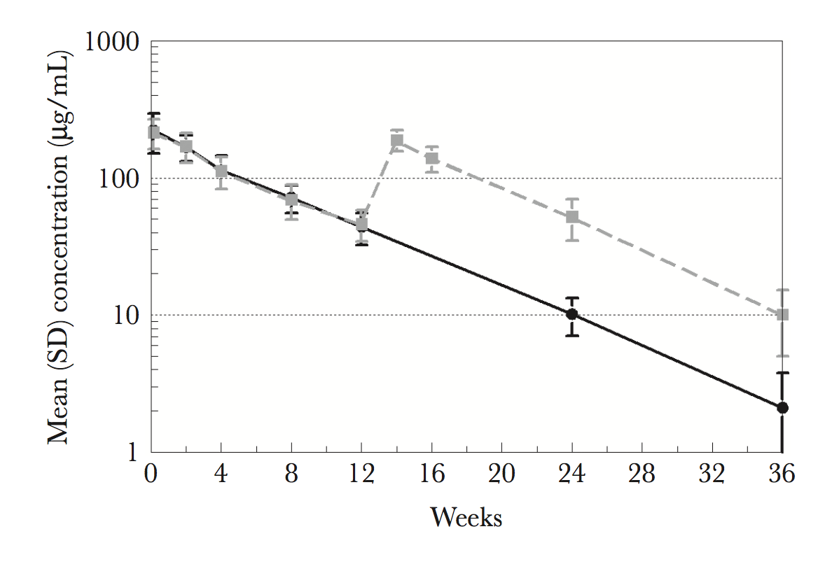
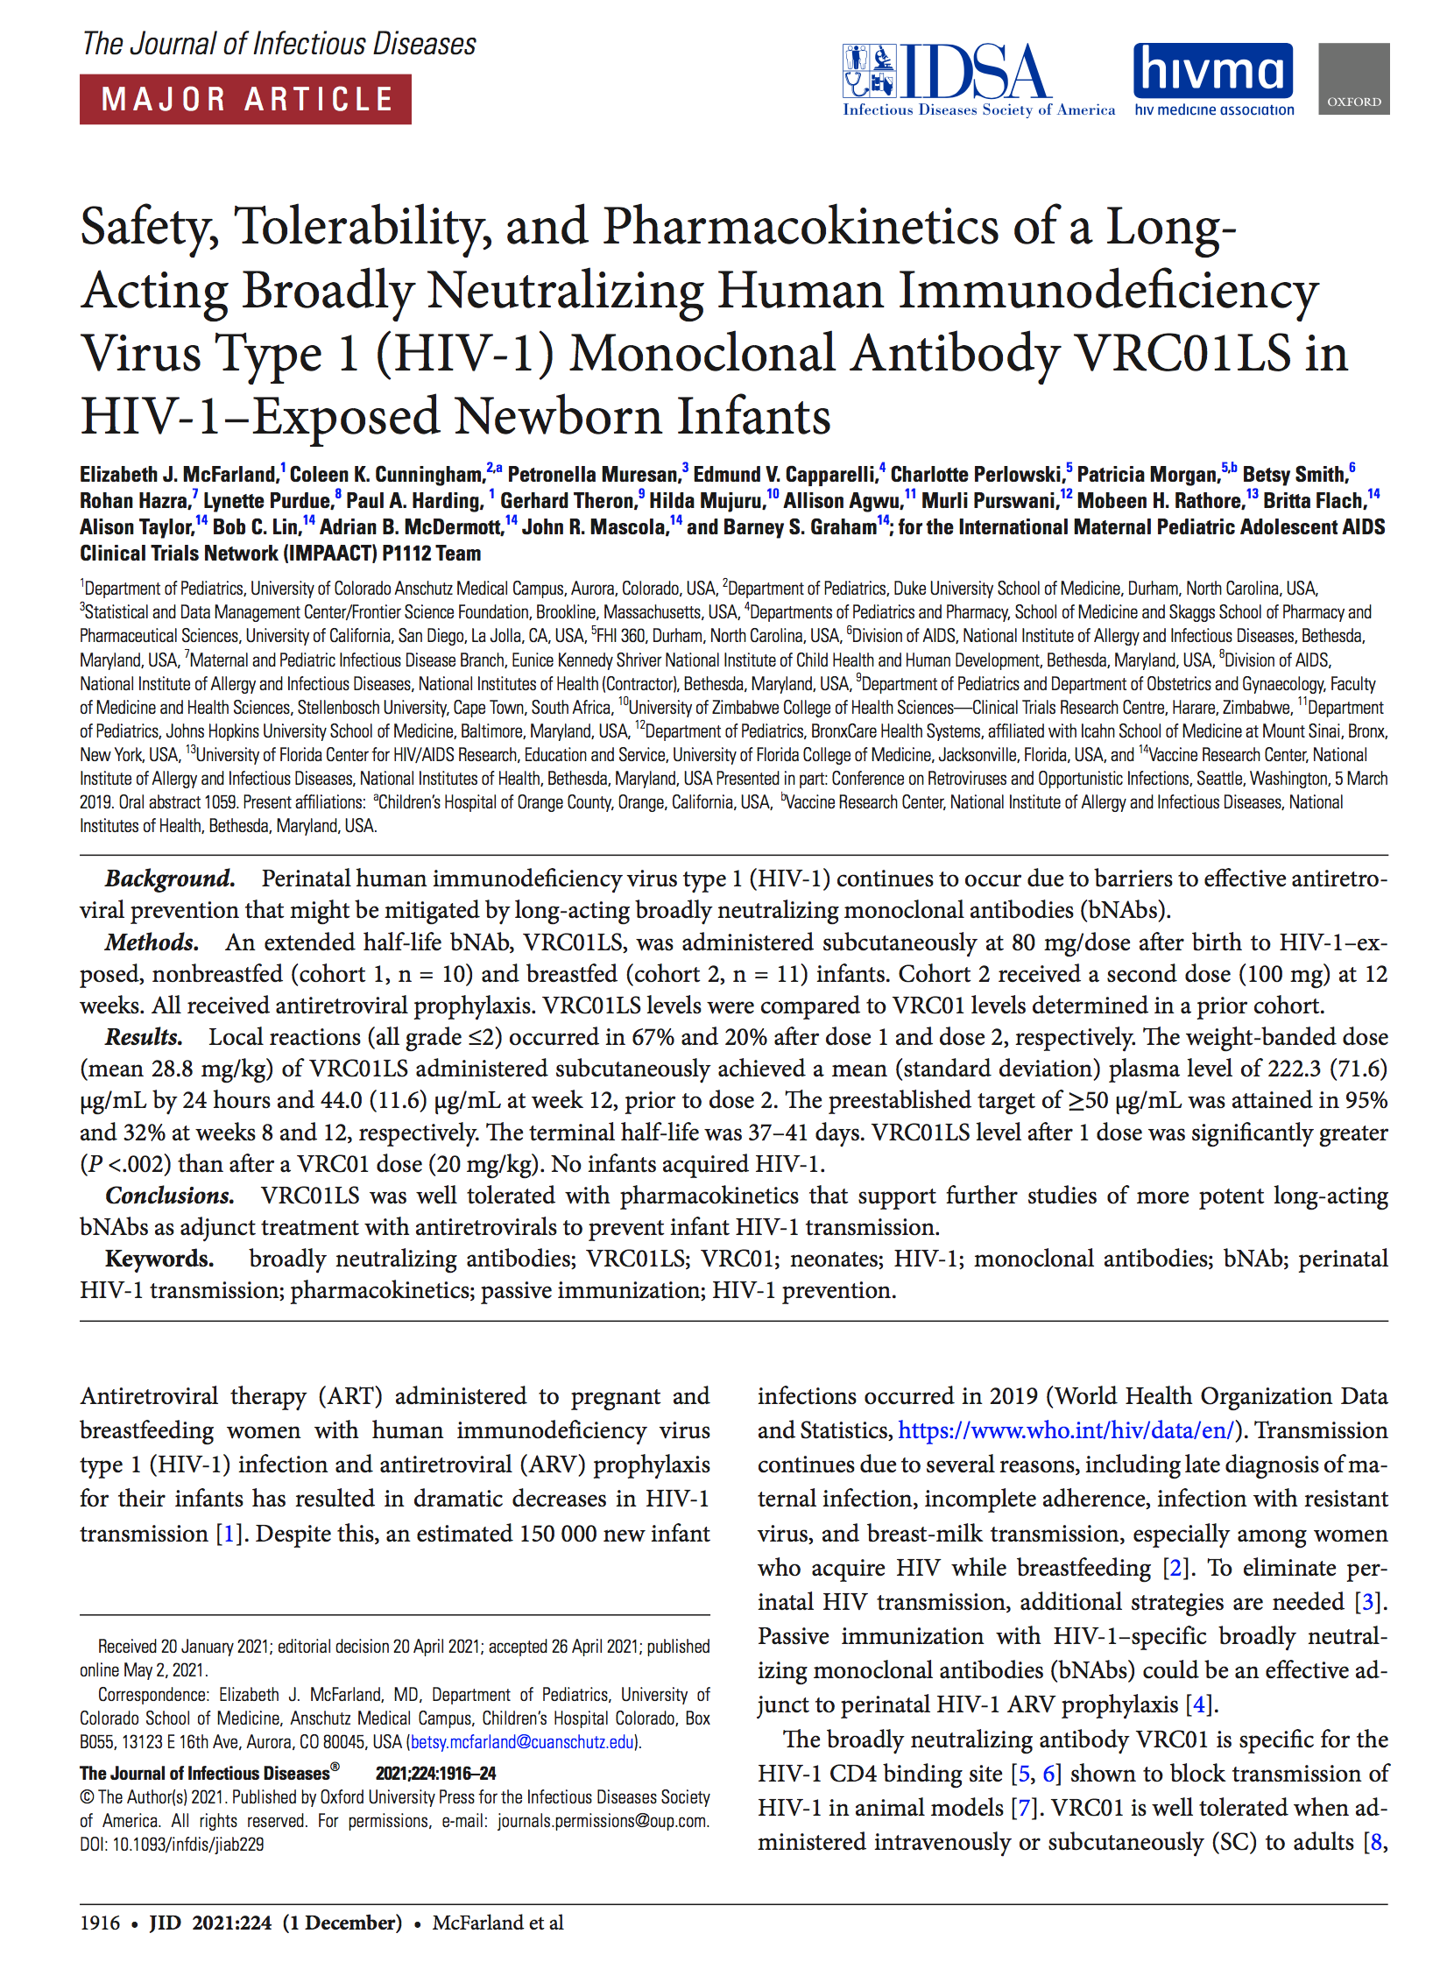
POSTNATAL PROPHYLAXIS
TO REACH ELIMINATION OF HIV VERTICAL TRANSMISSION; future in which no child is born with HIV
bNAbs for HIV prevention (mother to child transmission)
> 150,000 children < 5y aquired HIV in 2021 (UNAIDS)
2/3 of children from mothers living with undetected HIV-1
~ 50% pre/perinatal ~ 50% breastfeeding
Postnatal prophylaxis (e.g., AZT, NVP) reduces MTCT
Drug development & dose finding are challenging
VRC01-LS in newborns after birth (IMPAACT)
Pharmacokinetics of VRC01LS after 1 subcutaneous (SC) dose of 80 mg (solid black line) or 2 SC doses (80 mg followed by 100 mg at 12 weeks) (dashed gray line). The plasma pharmacokinetic sampling for VRC01LS (μg/mL) is described in the Methods. Error bars indicate the standard deviation (SD).
McFarland et al., JID 2021
Notes:
XX pregnant women, 81% on ART; Abbreviations: AZT: zidovudine; NVP: nevirapine; ART: antiretroviral treatment.
82% of pregnant women globally received antiretroviral therapy (ART) in 2021(UNAIDS 2022)
Nevirapine (NVP), lamivudine (3TC), and zidovudine (AZT) will likely remain the best current options for premature neonates until pharmacokinetics and safety of newer drugs are defined for that population
WHO Paediatric Drug Optimization for HIV (PADO-HIV) group (2021)
The first evidence that antiretroviral drugs re- duced the risk of vertical transmission—and one of the earliest success stories in the HIV epidemic response—came from the Pediatric AIDS Clinical Trials Group 076 study. (Connor et al NEJM 1994)
In 2010, the HIV Prevention Trials Network 040/Pediatric AIDS Clinical Trials Group 1043 study demonstrated that for infants of mothers who deliv- ered before starting treatment, 2-drug or 3-drug short-course regimens to the infant provided equiv- alent protection against infection, with peripartum transmission rates of !2%–3%. (Dorenbaum JAMA 2002)
The first evidence that antiretroviral drugs re- duced the risk of vertical transmission—and one of the earliest success stories in the HIV epidemic response—came from the Pediatric AIDS Clinical Trials Group 076 study. (Connor et al NEJM 1994)
In 2010, the HIV Prevention Trials Network 040/Pediatric AIDS Clinical Trials Group 1043 study demonstrated that for infants of mothers who deliv- ered before starting treatment, 2-drug or 3-drug short-course regimens to the infant provided equiv- alent protection against infection, with peripartum transmission rates of !2%–3%. (Dorenbaum JAMA 2002)
Drug developmentand dose-finding for neonates is particularly challenging because of difficulties in performing clinical research in this population and highly variable pharma- cokinetics during the first months of life. Ruel et al., Global Health: Science and Practice 2023
postnatal prophylaxis for at least 12 weeks of prophylaxis, usually AZT + NVP for the first six weeks followed by NVP alone
However, the use of optimal ARV drug formulations for preventing and treating HIV infection among newborns and young infants remains a significant challenge. Limited availability of appropriate formulations and dosing schedules that account for prematurity and low birth weight continue to result in unavoidable complexity with which healthcare workers and families struggle.
The WHO Paediatric Drug Optimization for HIV (PADO-HIV) group brings together stakeholders and experts every 2–3 years to identify priority products and define research gaps in the development of new HIV drugs and formulations for children in low-income and middle-income countries
substantial number of vertical transmissions continue to occur perinatally and during breastfeeding, driven by shortfalls in testing, treatment coverage, adherence, and retention in care among mothers.
Among an estimated 160,000 children with new HIV infections globally in 2021, 48% had mothers who had not started ART, 22% had mothers who discontinued their treatment, and 8% had mothers on treatment but were not able to main- tain virologic suppression. (UNADS 2022)
Those cur- rently in use, nevirapine and zidovudine, require daily or twice daily oral administration and are delivered as syrups dispensed in bulky bottles with the potential for unintentional disclosure of the maternal HIV status.
This leaves breastfeeding infants vulnerable to transmission if their mothers experi- ence viremia secondary to lapses in adherence or treatment failure or if there are drug e.

Slide 33
POSTNATAL PROPHYLAXIS
TO REACH ELIMINATION OF HIV VERTICAL TRANSMISSION; future in which no child is born with HIV
bNAbs for HIV prevention (mother to child transmission)
> 150,000 children < 5y aquired HIV in 2021 (UNAIDS)
2/3 of children from mothers living with undetected HIV-1
~ 50% pre/perinatal ~ 50% breastfeeding
Postnatal prophylaxis (e.g., AZT, NVP) reduces MTCT
Drug development & dose finding are challenging
VRC01 (n=40; single dose (s.c.) of 20 or 40 mg/kg after birth
Cunningham et al., JIC 2020
VRC01-LS (n=21; 80 mg/dose after birth)
McFarland et al., JID 2021
VRC07-523-LS (n=22; 80mg sc, repeat wk 12 )
Cunningham et al., CROI 2022
VRC01-LS/10-1074-LS (n=25; start in ART treated)
44% of children controlled for >6 months
Tatelo study; Shapiro et al., STM 2023
Notes:
XX pregnant women, 81% on ART; Abbreviations: AZT: zidovudine; NVP: nevirapine; ART: antiretroviral treatment.
82% of pregnant women globally received antiretroviral therapy (ART) in 2021(UNAIDS 2022)
Nevirapine (NVP), lamivudine (3TC), and zidovudine (AZT) will likely remain the best current options for premature neonates until pharmacokinetics and safety of newer drugs are defined for that population
WHO Paediatric Drug Optimization for HIV (PADO-HIV) group (2021)
The first evidence that antiretroviral drugs re- duced the risk of vertical transmission—and one of the earliest success stories in the HIV epidemic response—came from the Pediatric AIDS Clinical Trials Group 076 study. (Connor et al NEJM 1994)
In 2010, the HIV Prevention Trials Network 040/Pediatric AIDS Clinical Trials Group 1043 study demonstrated that for infants of mothers who deliv- ered before starting treatment, 2-drug or 3-drug short-course regimens to the infant provided equiv- alent protection against infection, with peripartum transmission rates of !2%–3%. (Dorenbaum JAMA 2002)
The first evidence that antiretroviral drugs re- duced the risk of vertical transmission—and one of the earliest success stories in the HIV epidemic response—came from the Pediatric AIDS Clinical Trials Group 076 study. (Connor et al NEJM 1994)
In 2010, the HIV Prevention Trials Network 040/Pediatric AIDS Clinical Trials Group 1043 study demonstrated that for infants of mothers who deliv- ered before starting treatment, 2-drug or 3-drug short-course regimens to the infant provided equiv- alent protection against infection, with peripartum transmission rates of !2%–3%. (Dorenbaum JAMA 2002)
Drug developmentand dose-finding for neonates is particularly challenging because of difficulties in performing clinical research in this population and highly variable pharma- cokinetics during the first months of life. Ruel et al., Global Health: Science and Practice 2023
postnatal prophylaxis for at least 12 weeks of prophylaxis, usually AZT + NVP for the first six weeks followed by NVP alone
However, the use of optimal ARV drug formulations for preventing and treating HIV infection among newborns and young infants remains a significant challenge. Limited availability of appropriate formulations and dosing schedules that account for prematurity and low birth weight continue to result in unavoidable complexity with which healthcare workers and families struggle.
The WHO Paediatric Drug Optimization for HIV (PADO-HIV) group brings together stakeholders and experts every 2–3 years to identify priority products and define research gaps in the development of new HIV drugs and formulations for children in low-income and middle-income countries
substantial number of vertical transmissions continue to occur perinatally and during breastfeeding, driven by shortfalls in testing, treatment coverage, adherence, and retention in care among mothers.
Among an estimated 160,000 children with new HIV infections globally in 2021, 48% had mothers who had not started ART, 22% had mothers who discontinued their treatment, and 8% had mothers on treatment but were not able to main- tain virologic suppression. (UNADS 2022)
Those cur- rently in use, nevirapine and zidovudine, require daily or twice daily oral administration and are delivered as syrups dispensed in bulky bottles with the potential for unintentional disclosure of the maternal HIV status.
This leaves breastfeeding infants vulnerable to transmission if their mothers experi- ence viremia secondary to lapses in adherence or treatment failure or if there are drug e.

Slide 34
POSTNATAL PROPHYLAXIS
TO REACH ELIMINATION OF HIV VERTICAL TRANSMISSION; future in which no child is born with HIV
bNAbs for HIV prevention (mother to child transmission)
History of passive immunization in newborns (e.g., HBV, RSV)
bNAbs safe/well tolerated
bNAbs have wide therapeutic window (easy to dose across growth)
Adherence
bNAb infusions were highly acceptable to caregivers (Mosetlhi et al., CROI 2023)
VRC01 (n=40; single dose (s.c.) of 20 or 40 mg/kg after birth
Cunningham et al., JIC 2020
VRC01-LS (n=21; 80 mg/dose after birth)
McFarland et al., JID 2021
VRC07-523-LS (n=22; 80mg sc, repeat wk 12 )
Cunningham et al., CROI 2022
VRC01-LS/10-1074-LS (n=25; start in ART treated)
44% of children controlled for >6 months
Tatelo study; Shapiro et al., STM 2023
Notes:
XX pregnant women, 81% on ART; Abbreviations: AZT: zidovudine; NVP: nevirapine; ART: antiretroviral treatment.
82% of pregnant women globally received antiretroviral therapy (ART) in 2021(UNAIDS 2022)
Nevirapine (NVP), lamivudine (3TC), and zidovudine (AZT) will likely remain the best current options for premature neonates until pharmacokinetics and safety of newer drugs are defined for that population
WHO Paediatric Drug Optimization for HIV (PADO-HIV) group (2021)
The first evidence that antiretroviral drugs re- duced the risk of vertical transmission—and one of the earliest success stories in the HIV epidemic response—came from the Pediatric AIDS Clinical Trials Group 076 study. (Connor et al NEJM 1994)
In 2010, the HIV Prevention Trials Network 040/Pediatric AIDS Clinical Trials Group 1043 study demonstrated that for infants of mothers who deliv- ered before starting treatment, 2-drug or 3-drug short-course regimens to the infant provided equiv- alent protection against infection, with peripartum transmission rates of !2%–3%. (Dorenbaum JAMA 2002)
The first evidence that antiretroviral drugs re- duced the risk of vertical transmission—and one of the earliest success stories in the HIV epidemic response—came from the Pediatric AIDS Clinical Trials Group 076 study. (Connor et al NEJM 1994)
In 2010, the HIV Prevention Trials Network 040/Pediatric AIDS Clinical Trials Group 1043 study demonstrated that for infants of mothers who deliv- ered before starting treatment, 2-drug or 3-drug short-course regimens to the infant provided equiv- alent protection against infection, with peripartum transmission rates of !2%–3%. (Dorenbaum JAMA 2002)
Drug developmentand dose-finding for neonates is particularly challenging because of difficulties in performing clinical research in this population and highly variable pharma- cokinetics during the first months of life. Ruel et al., Global Health: Science and Practice 2023
postnatal prophylaxis for at least 12 weeks of prophylaxis, usually AZT + NVP for the first six weeks followed by NVP alone
However, the use of optimal ARV drug formulations for preventing and treating HIV infection among newborns and young infants remains a significant challenge. Limited availability of appropriate formulations and dosing schedules that account for prematurity and low birth weight continue to result in unavoidable complexity with which healthcare workers and families struggle.
The WHO Paediatric Drug Optimization for HIV (PADO-HIV) group brings together stakeholders and experts every 2–3 years to identify priority products and define research gaps in the development of new HIV drugs and formulations for children in low-income and middle-income countries
substantial number of vertical transmissions continue to occur perinatally and during breastfeeding, driven by shortfalls in testing, treatment coverage, adherence, and retention in care among mothers.
Among an estimated 160,000 children with new HIV infections globally in 2021, 48% had mothers who had not started ART, 22% had mothers who discontinued their treatment, and 8% had mothers on treatment but were not able to main- tain virologic suppression. (UNADS 2022)
Those cur- rently in use, nevirapine and zidovudine, require daily or twice daily oral administration and are delivered as syrups dispensed in bulky bottles with the potential for unintentional disclosure of the maternal HIV status.
This leaves breastfeeding infants vulnerable to transmission if their mothers experi- ence viremia secondary to lapses in adherence or treatment failure or if there are drug e.
CAREGIVERS OF CHILDREN WITH HIV IN BOTSWANA PREFER MONTHLY IV bNAbs TO DAILY ORAL ART
Abstract CROI 2023
Maureen Mosetlhi, Gbolahan Ajibola, Roxanna Haghighat, Oganne Batlang, Kenneth Maswabi, Molly Pretorius Holme, Kathleen M. Powis, Shahin Lockman, Joseph Makhema, Mathias Lichterfeld, Daniel Kuritzkes, Roger L. Shapiro
Monthly intravenous infusion of broadly neutralizing monoclonal antibodies (bNAbs) may be an attractive alternative to daily oral antiretroviral treatment (ART) for children. Acceptability by caregivers remains unknown.
Methods:
We evaluated monthly infusion of dual bNAbs (VRC01LS and 10-1074) as a treatment alternative to ART among children participating in the Tatelo Study in Botswana. Eligible children aged 2-5 years received 8-32 weeks of bNAbs overlapping with ART, and up to 24 weeks of bNAbs alone, at monthly intravenous infusion visits. Using closed-ended questionnaires, we evaluated the acceptability of each treatment strategy among caregivers prior to first bNAb administration visit (pre-intervention) and after completion of final bNAb administration visit (post-intervention).
Results:
Twenty-five children completed all study phases, and acceptability data were available from 24 caregivers at both time points (1 primary caregiver was unavailable at pre-intervention visit). Responses were provided by the child’s mother at both visits (60%), an extended family member at both visits (28%), or a combination of mother and extended family member (12%). Caregiver acceptance of bNAbs was extremely high both pre-and post-intervention, with 21/24 (87.5%) preferring bNAbs to ART pre-intervention, and 21/25 (84%) preferring bNAbs post-intervention (9/21 cared for a child who remained virally suppressed, 12/21 for a child with a viral rebound on bNAbs) (Fig 1). No caregivers preferred ART pre-intervention; however, 2/25 preferred it post-intervention (1 cared for a child who remained virally suppressed, 1 for a child with viral rebound on bNAbs). Pre-intervention, 3 (13%) caregivers had no preference between bNAbs or ART, and 2 (8%) had no preference post-intervention. Pre-intervention, the most common reasons for preferring bNAbs over ART were “if infusions were better at sueppressing the virus than ART” (n=10) and “if infusions continued to be once monthly compared to daily ART” (n=9). Post-intervention, no dominant reason for preferring bNAbs over ART emerged from caregivers.
Conclusions:
Monthly intravenous bNAb infusions were highly acceptable to caregivers of children with HIV in Botswana and preferred over standard ART by most. Our findings suggest that caregiver acceptability is an unlikely barrier to bNAb uptake and eventual programmatic use for children living with HIV.

Slide 35
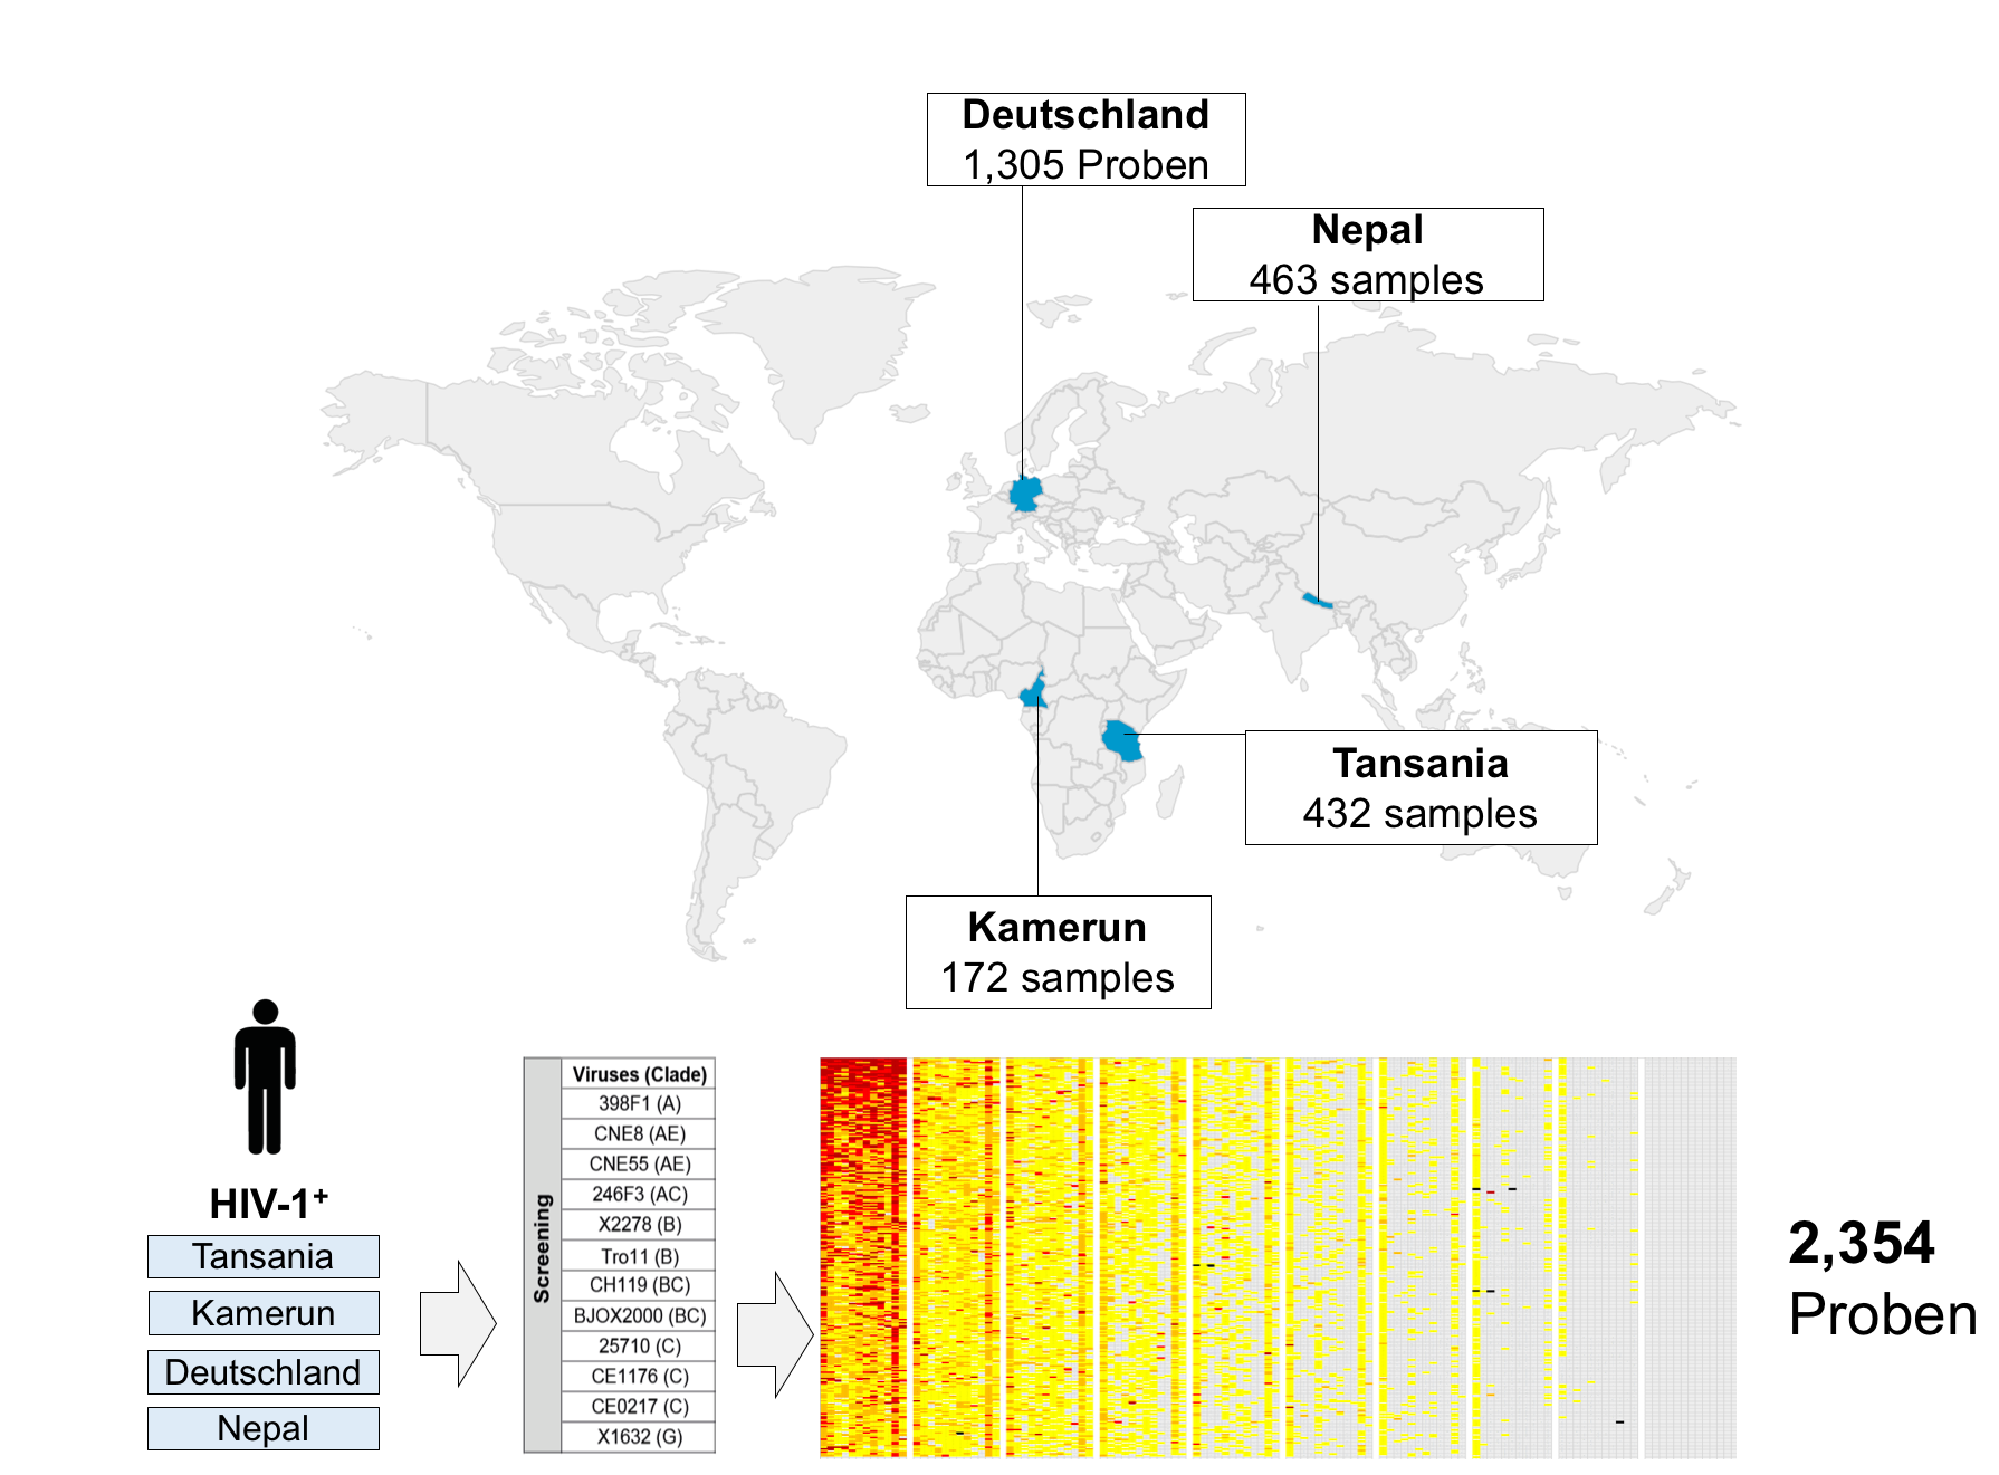


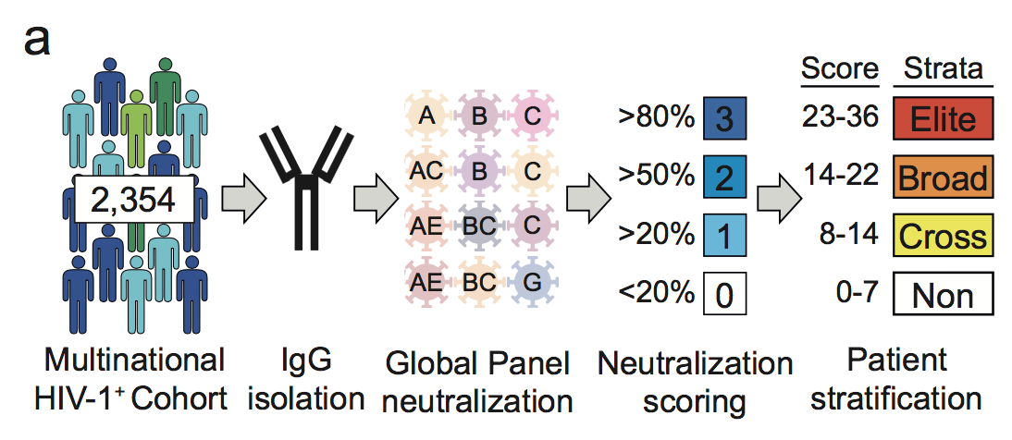
Dynamics of of the HIV-1 antibody response
Germany
Nepal
Philipp
Schommers
Maike
Schlotz
Tanzania
Cameroon
Schommers et al., Cell 2020; Schommers et al., Nat Med (in press); Gieselmann et al., Nat Prot 2021

Slide 36
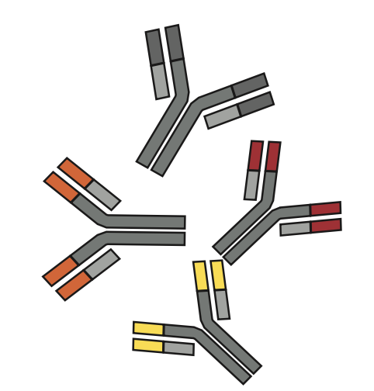

Dynamics of of the HIV-1 antibody response
HIV Elite
Neutralizer
Germany
Nepal
open
PrimerR
32
HIV-1 elite neutralizers
Large
scale
n=884
Tanzania
1%
Cameroon
>2,300 PLWH
Novel bNAb
04_A06
Lutz Gieselmann
Schommers et al., Cell 2020; Schommers et al., Nat Med (in press); Gieselmann et al., Nat Prot 2021

Slide 37
Novel CD4bs HIV-1 neutralizing antibody 04_A06
04_A06

Slide 38
Novel CD4bs HIV-1 neutralizing antibody 04_A06
04_A06
Reference bNAbs (Globl panel)

Slide 39
Novel CD4bs HIV-1 neutralizing antibody 04_A06
04_A06
Reference bNAbs (Globl panel)
119 HIV-1 pseudovirus panel (M. Seaman)
Breadth
98,4%
04_A06
N6
1-18
VRC07_{523LS}
N49P7
VRC07
IC₅₀ 0.04 µg/ml
3BNC117
IC₈₀ 0.13 µg/ml
Exceptional antiviral activity
Gieselmann et al., in preparation

Slide 40
Novel CD4bs HIV-1 neutralizing antibody 04_A06

Slide 41
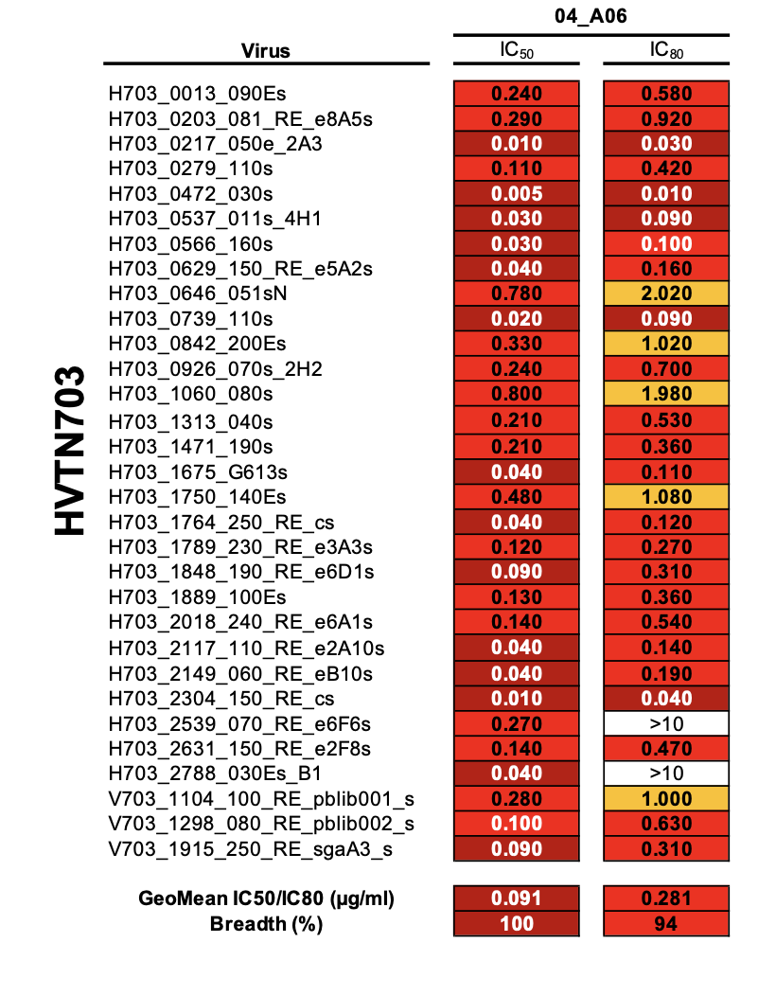
Novel CD4bs HIV-1 neutralizing antibody 04_A06
04_A06 against AMP strains
Virus IC₅₀ IC₈₀
M. Seaman; P. Moore; N. Mkhize

Slide 42
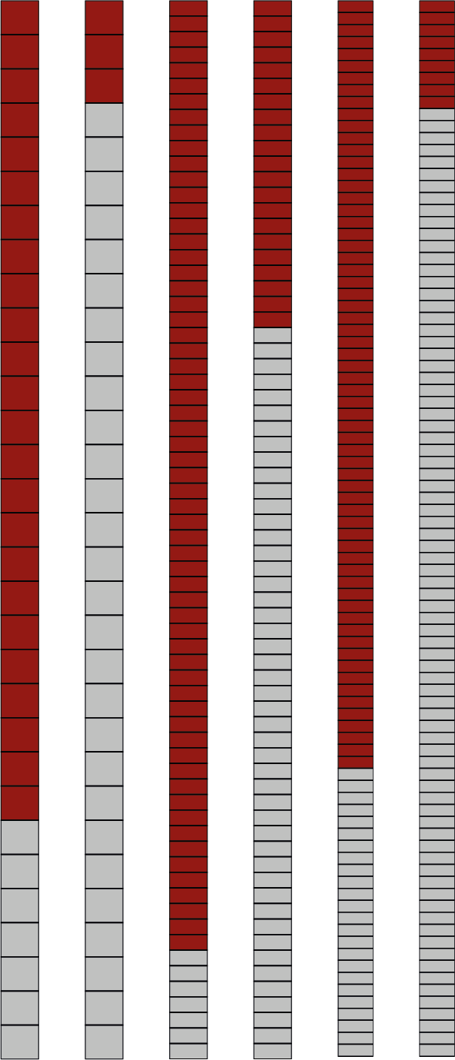
Novel CD4bs HIV-1 neutralizing antibody 04_A06
04_A06 against AMP strains
Placebo group
Virus IC₅₀ IC₈₀
04_A06
VRC01
04_A06
VRC01
HVTN703
HVTN704
<1 µg/ml
>1 µg/ml
GeoMean IC₈₀ (µg/ml)
2.2
0.3
1.7
0.3
Breadth < 1µg/ml (%)
79
10
90
31
M. Seaman; P. Moore; N. Mkhize
M. Seaman; P. Moore; N. Mkhize

Slide 43
Novel CD4bs HIV-1 neutralizing antibody 04_A06
04_A06 against AMP strains
Placebo group
Placebo group
Virus IC₅₀ IC₈₀
04_A06
VRC01
04_A06
VRC01
HVTN703
HVTN704
<1 µg/ml
>1 µg/ml
GeoMean IC₈₀ (µg/ml)
2.2
0.3
1.7
0.3
Breadth < 1µg/ml (%)
79
10
90
31
M. Seaman; P. Moore; N. Mkhize
M. Seaman; P. Moore; N. Mkhize

Slide 44
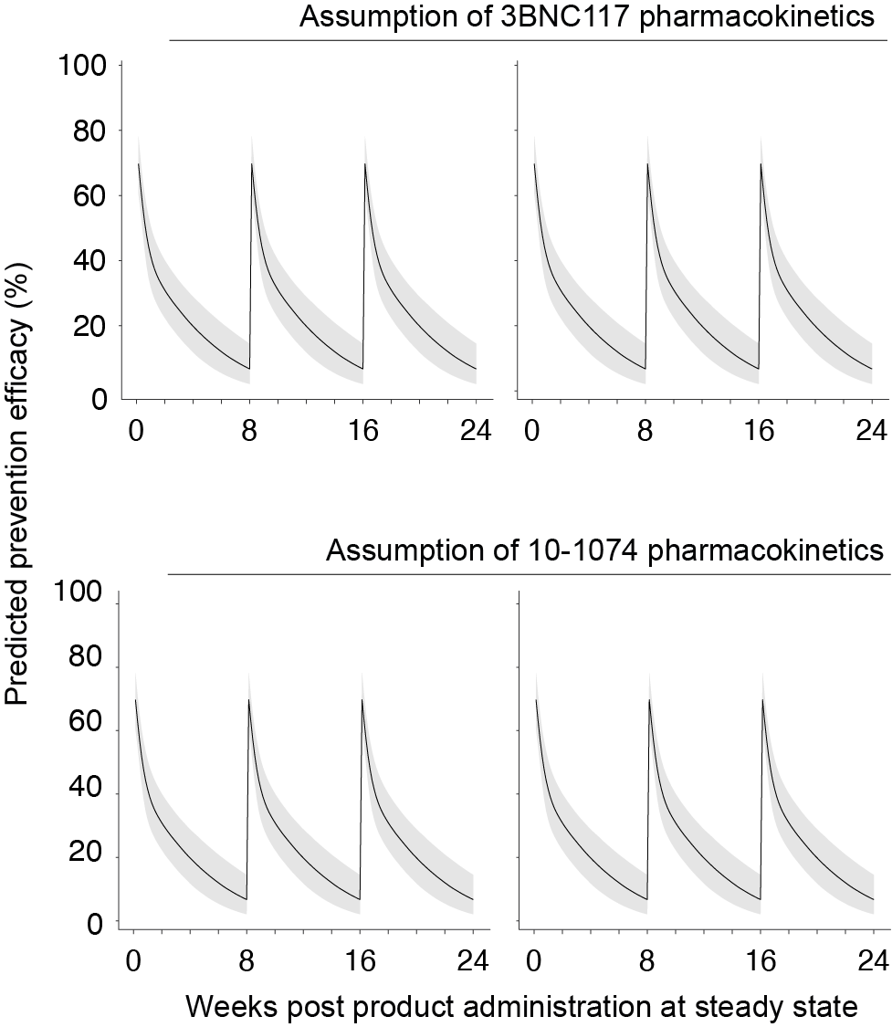
Novel CD4bs HIV-1 neutralizing antibody 04_A06
Placebo group
A06
In silico (!) PE (%)
Placebo group
04_A06
VRC01
04_A06
VRC01
VRC01 (30 mg/kg) - 23.3%
HVTN703
HVTN704
A06
VRC01 (30 mg/kg) - 23.3%
<1 µg/ml
>1 µg/ml
0.3
2.2
0.3
1.7
79
10
90
31
Y. Huang; L. Zhang; P. Gilbert
M. Seaman; P. Moore; N. Mkhize

Slide 45
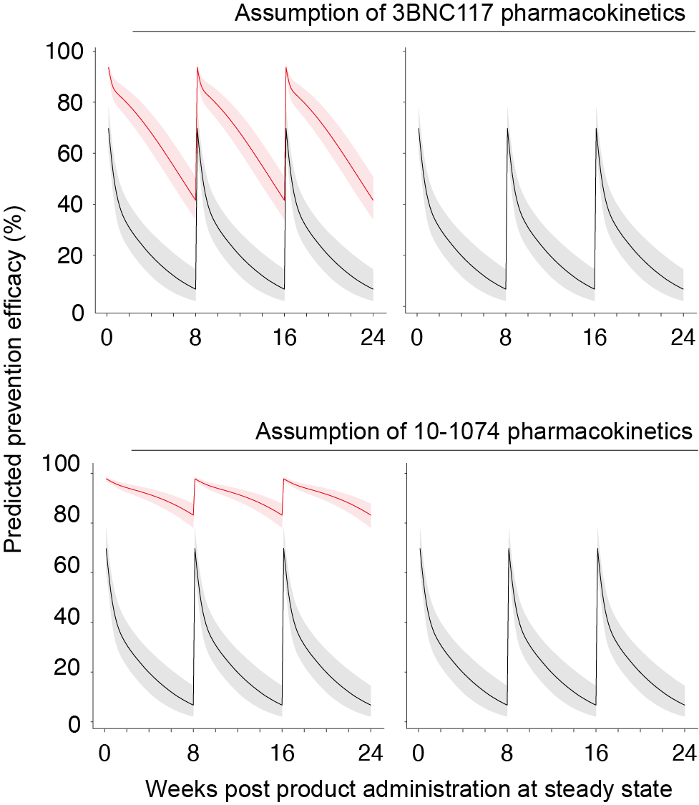
Novel CD4bs HIV-1 neutralizing antibody 04_A06
Placebo group
A06
In silico (!) PE (%)
Placebo group
04_A06
VRC01
04_A06
VRC01
VRC01 (30 mg/kg) - 23.3%
04_A06 (30 mg/kg) - 66.5%
HVTN703
HVTN704
A06
VRC01 (30 mg/kg) - 23.3%
04_A06 (30 mg/kg) - 90.9%
<1 µg/ml
>1 µg/ml
0.3
2.2
0.3
1.7
79
10
90
31
Y. Huang; L. Zhang; P. Gilbert
M. Seaman; P. Moore; N. Mkhize

Slide 46
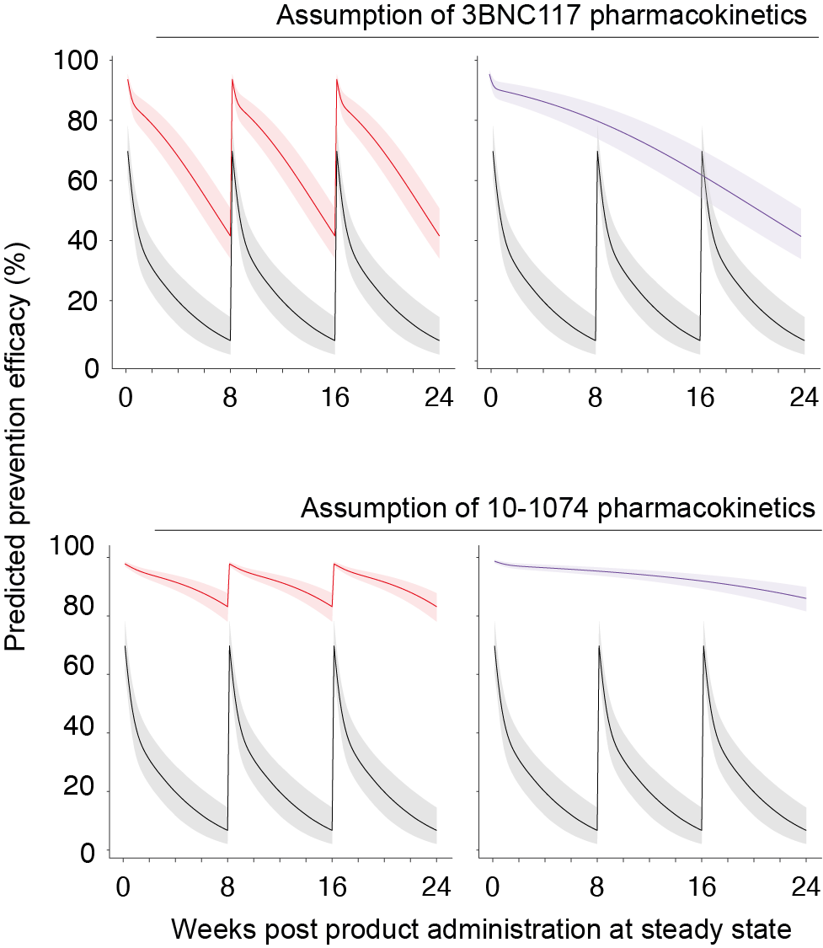
Novel CD4bs HIV-1 neutralizing antibody 04_A06
Placebo group
A06
In silico (!) PE (%)
Placebo group
04_A06
VRC01
04_A06
VRC01
VRC01 (30 mg/kg) - 23.3%
04_A06 (30 mg/kg) - 66.5%
04_A06_LS (30 mg/kg) - 70.1%
HVTN703
HVTN704
A06
VRC01 (30 mg/kg) - 23.3%
04_A06 (30 mg/kg) - 90.9%
04_A06_LS (30 mg/kg) - 93.1%
<1 µg/ml
>1 µg/ml
0.3
2.2
0.3
1.7
79
10
90
31
Y. Huang; L. Zhang; P. Gilbert
M. Seaman; P. Moore; N. Mkhize

Slide 47
Novel CD4bs HIV-1 neutralizing antibody 04_A06
Placebo group
A06
In silico (!) PE (%)
Placebo group
04_A06
VRC01
04_A06
VRC01
VRC01 (30 mg/kg) - 23.3%
04_A06 (30 mg/kg) - 66.5%
04_A06_LS (30 mg/kg) - 70.1%
HVTN703
HVTN704
A06
VRC01 (30 mg/kg) - 23.3%
04_A06 (30 mg/kg) - 90.9%
04_A06_LS (30 mg/kg) - 93.1%
<1 µg/ml
>1 µg/ml
0.3
2.2
0.3
1.7
79
10
90
31
Y. Huang; L. Zhang; P. Gilbert
M. Seaman; P. Moore; N. Mkhize

Slide 48
Broadly neutralizing antibodies targeting HIV-1 (summary)

Slide 49
Broadly neutralizing antibodies targeting HIV-1 (summary)
bNAb-mediated prevention/treatment is a real opportunity (e.g. MTCT)

Slide 50
Broadly neutralizing antibodies targeting HIV-1 (summary)
bNAb-mediated prevention/treatment is a real opportunity (e.g. MTCT)
Viral resistance is greatest challenge, but can be overcome by a combination of using superior bNAbs and bNAb mixes

Slide 51
Broadly neutralizing antibodies targeting HIV-1 (summary)
bNAb-mediated prevention/treatment is a real opportunity (e.g. MTCT)
Viral resistance is greatest challenge, but can be overcome by a combination of using superior bNAbs and bNAb mixes
Fostering bNAb-inducing HIV immunity

Slide 52
Broadly neutralizing antibodies targeting HIV-1 (summary)
bNAb-mediated prevention/treatment is a real opportunity (e.g. MTCT)
Viral resistance is greatest challenge, but can be overcome by a combination of using superior bNAbs and bNAb mixes
Fostering bNAb-inducing HIV immunity
i.v. or s.c. combined with new technologies (mRNA; vectors; AAV; etc.)

Slide 53
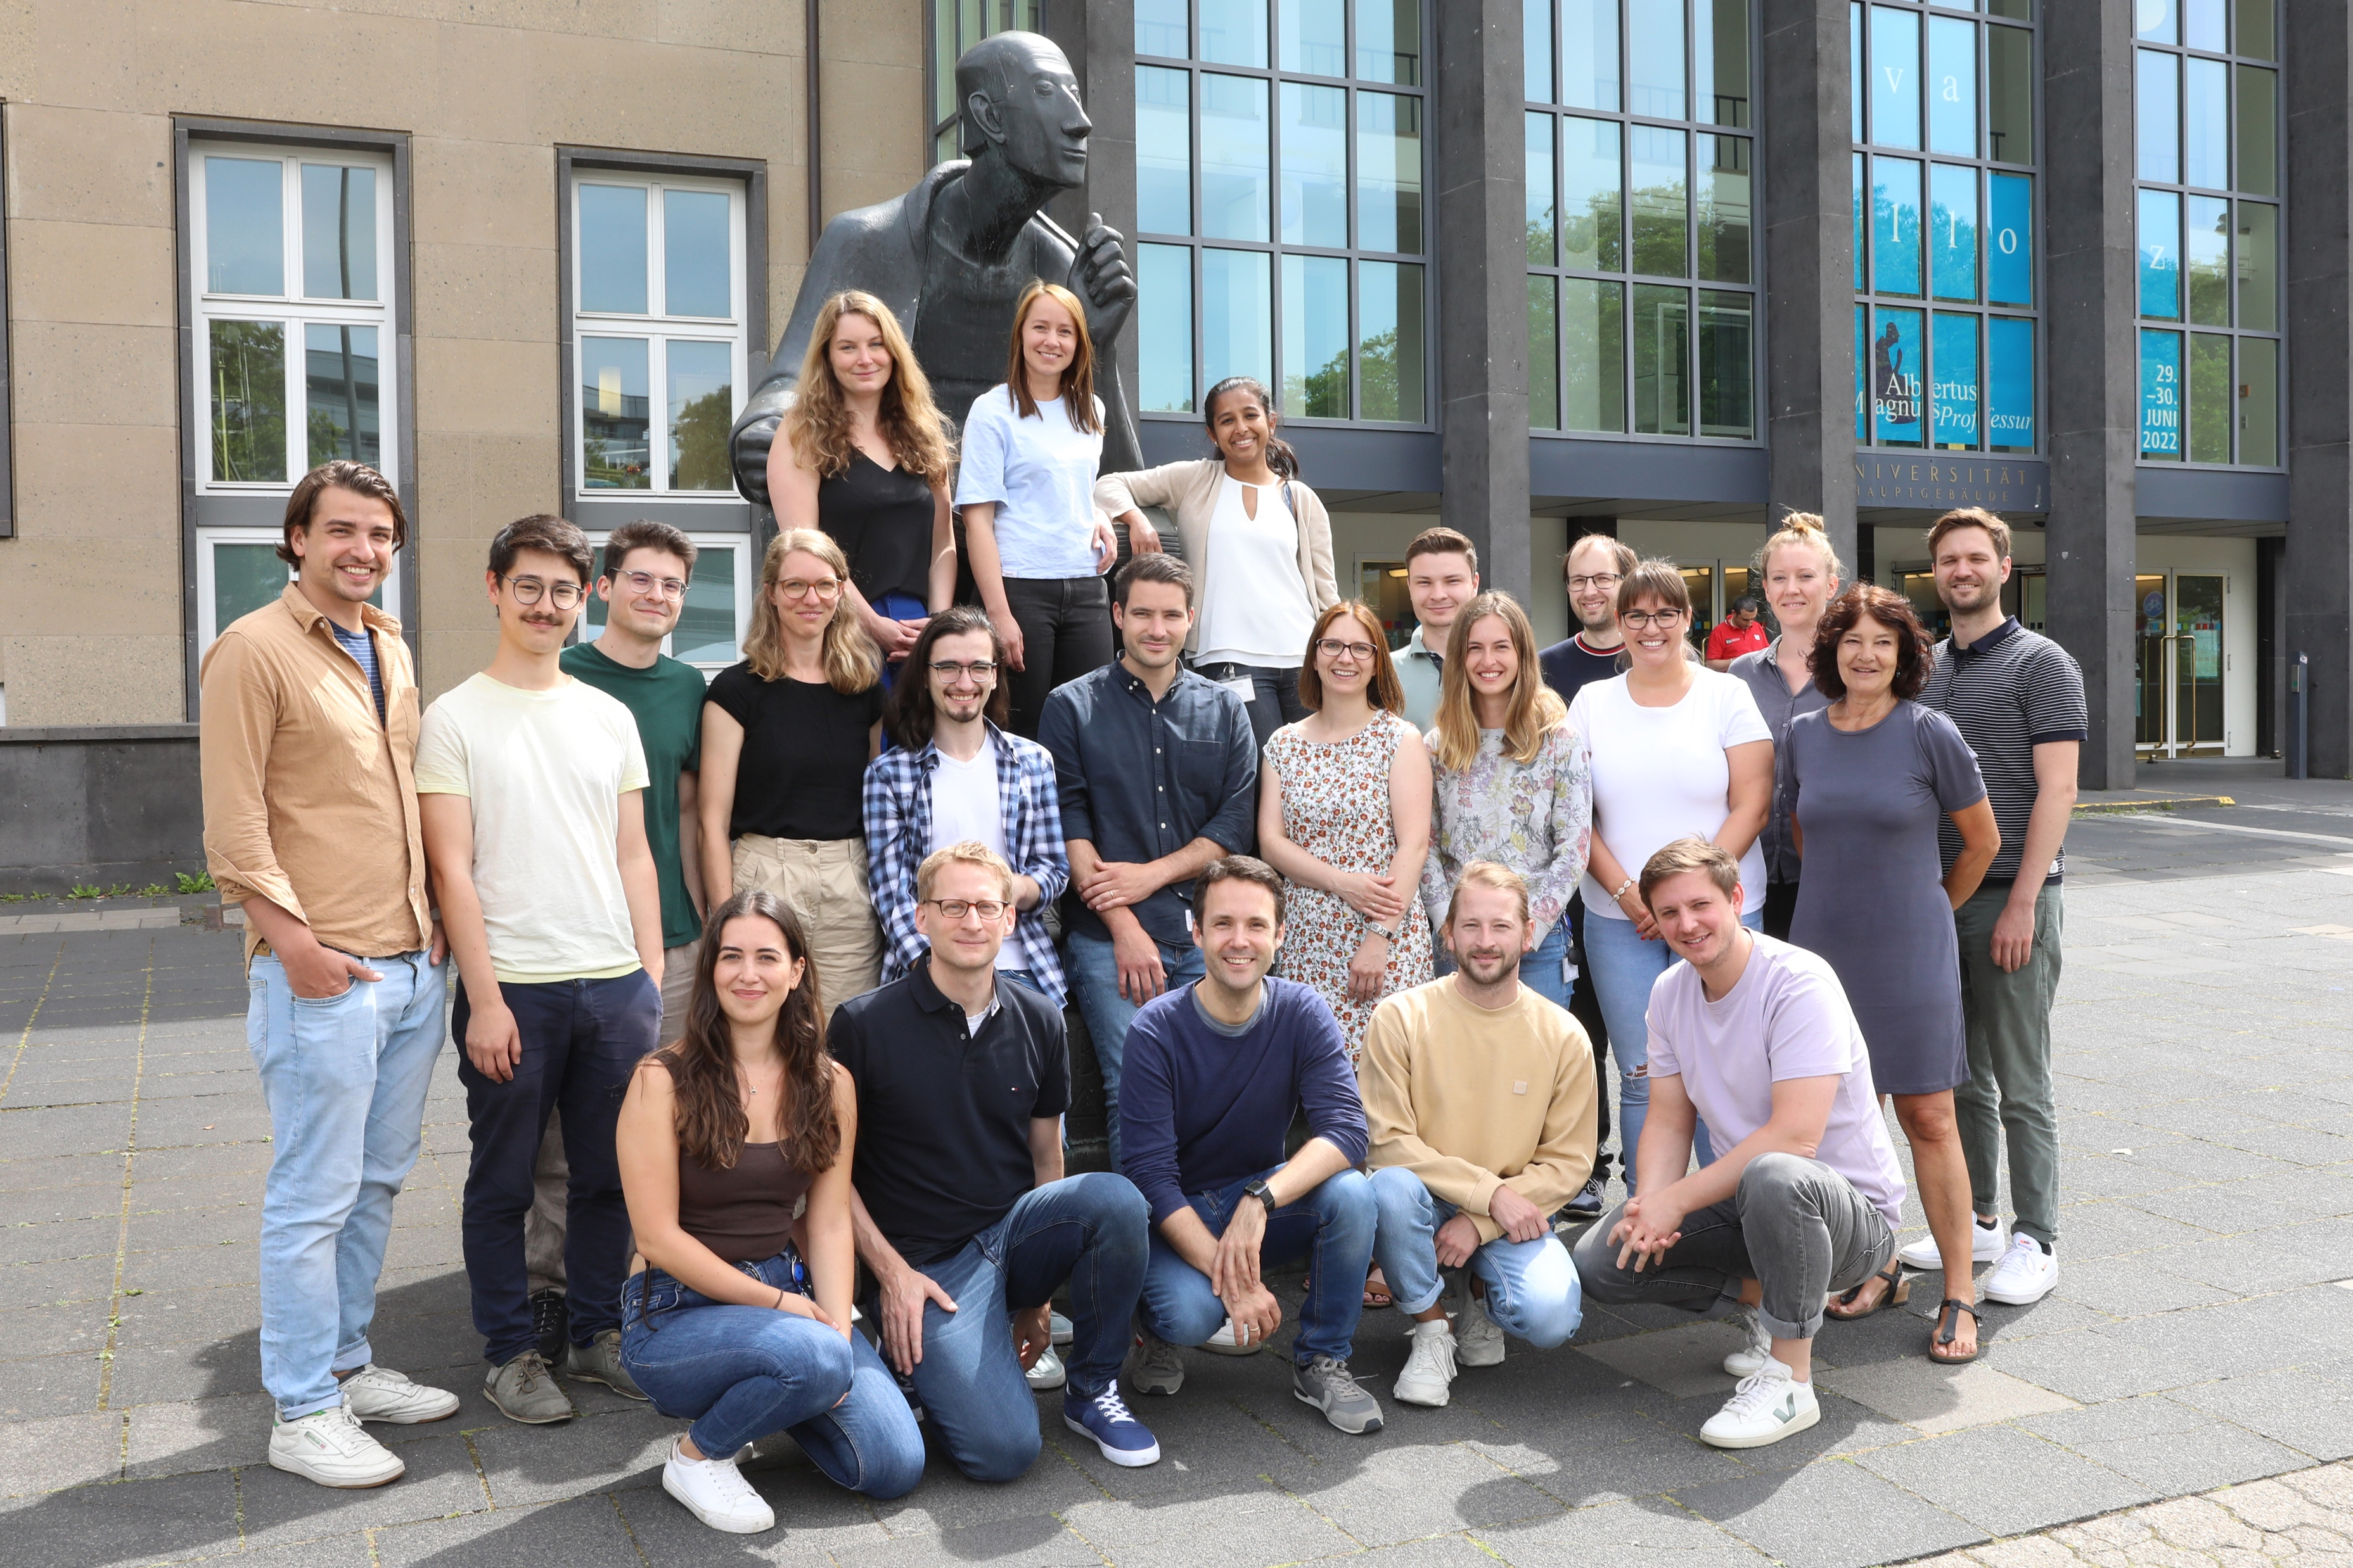
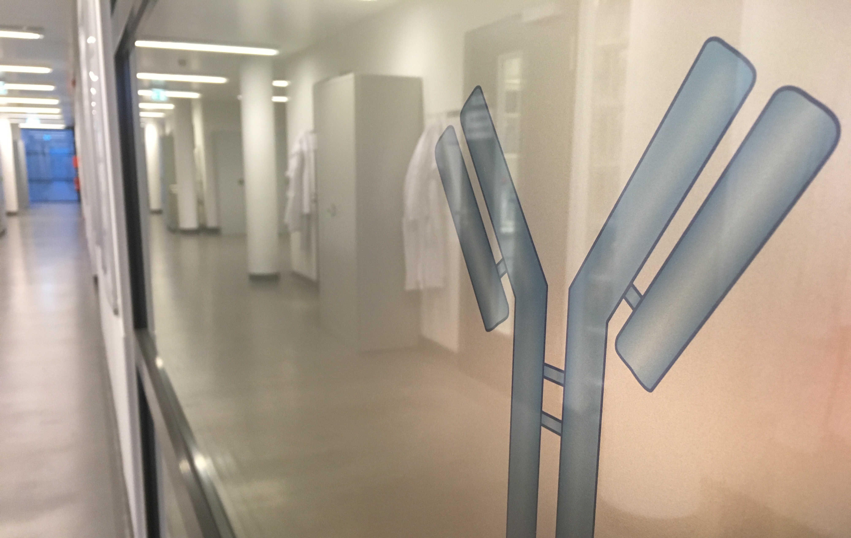







Acknowledgement
https://klein-lab.de
Philipp Schommers, Lutz Gieselmann, Henning Grüll, Kanika Vansyhlla, Patrick Affeldt, Elvin Ahmadov, Artem Ashurov, Sabrina Dähling, Felix Dewald, Michael Korenkov, Christoph Kreer, Svea Rose, Leon Ullrich, Timm Weber, Marie Wunsch, Matthias Zehner, Anna Schmitt, Tine Bresser, Franziska Kleipass, Susanne Salomon, Hanna Janicki, Johanna Worczinski, Jacqueline Knüfer, Lisa Buchholz, Maike Schlotz, Silvia Gulisano-Laudani & Institut für Virologie and partners University of Cologne

Slide 54
Acknowledgement
University of Cologne
G. Fätkenheuer, C. Lehmann,
I. Suarez; J. Malin
Harvard Med. School
M. Seaman
Mbeya Research Centre
N. Ntinginya,
L. Maganga
LMU Munich
M. Hölscher; A. Kroidl
Caltech
P. Bjorkman, A. DeLaitsch
Fred Hutch Cencer Center
P. Gilbert, Y. Huang
A. Dingens, J. Bloom
Weizmann Institute
R. Diskin; H. Cohen-Dvashi
Kathmandu Research Institute
A. Adhikari
& Team
https://klein-lab.de
AMC; Amsterdam
R. Sanders
M. van Gils
University of Witwatersrand
P. Moore, N MkHize, L. Morris
University of Texas
J. McLellan, G. Georgiou
Mount Sinai
S. Zolla-Pazner,
R. Duerr
NIH
N. Doria-Rose
University of Tübingen
N. Pfeiffer; R. Eggeling
All
study participants

Slide 55
Thank you very much for your attention!

