Slide 1
CAB-LA Implementation and Vaginal ring scale up: A civil society perspective
Imelda Mahaka, Pangaea Zimbabwe AIDS Trust
Session title

Slide 2
Introduction
Civil society has been part of the HIV/AIDS response from the very beginning of the epidemic
Traditional roles of civil society--advocacy, activism, serving as government watchdog, and acting as community caretaker--have been critical to the response
Providing world-class HIV prevention and treatment services and helping to ensure continuity of care
Our role is more important than ever, as we focus on epidemic control and ending AIDS by 2030
Notes:
Thank you, Mitchell , I thought I should start by highlighting the role of civil society in the Response.
Civil society has been part of the HIV/AIDS response from the very beginning of the epidemic using some of the traditional roles like advocacy, activism, government watchdog, and community caretaker which have been critical to the response. WE have also played a huge role in the provision of HIV prevention and treatment services and helping to ensure continuity of care. Now, Our role is more important than ever, as we focus on epidemic control and ending AIDS by 2030

Slide 3
Introduction
The burden of HIV in sub‐Saharan Africa remains unacceptably high, and disproportionately affects girls and women.
The introduction of oral HIV pre‐exposure prophylaxis (PrEP) a decade ago revolutionized HIV prevention, however, its effectiveness is dependent on user adherence.
Long‐acting (LA) formulations for PrEP, such as dapivirine vaginal ring (DPV‐VR) and injectable long‐acting cabotegravir (CAB‐LA) are critical additions to the HIV prevention toolkit.
Important for populations such as adolescent girls and young women (AGYW) and other key populations who remain at significant risk of HIV acquisition while facing substantial barriers to preventive services
Notes:
-Focusing on HIV prevention, where are we now/The burden of HIV in sub‐Saharan Africa remains unacceptably high, and disproportionately affects girls and women.
-The introduction of oral HIV pre‐exposure prophylaxis (PrEP) a decade ago revolutionized HIV prevention, however, its effectiveness is dependent on user adherence.
-Long‐acting (LA) formulations for PrEP, such as dapivirine vaginal ring (DPV‐VR) and injectable long‐acting cabotegravir (CAB‐LA) are critical additions to the HIV prevention toolkit and important Important for populations such as adolescent girls and young women (AGYW) and other key populations who remain at significant risk of HIV acquisition

Slide 4
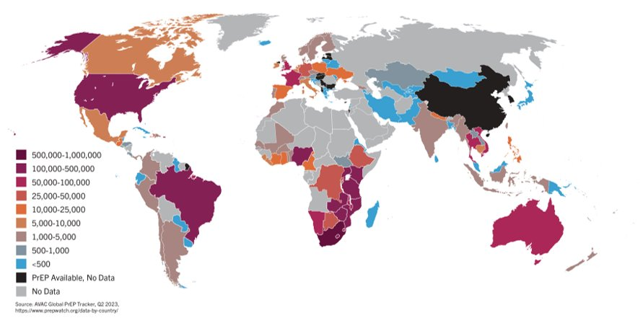
Global PrEP uptake 11+ years in
Approximate total PrEP initiations: 4.9 million
Strong increases in 2022 – BUT significantly missed UN target of 3 million users by 2020
Notes:
To date, nearly 4.9 million people have initiated PrEP globally with strong increases in 2022 as you will see in the next slide. However, we missed the UN targets of reaching 3 million users by 2020 and this figure of 4.9million is thought to represent only 10% of those who are at risk and could benefit from PrEP

Slide 5
Country trends in oral PrEP uptake
Eight countries in SSA have surpassed 100,000 PrEP initiations, accounting for 91% initiations in the region
South Africa and Kenya were two of the earliest adopters with national programs scaling up over time
Zambia, Uganda and Nigeria have seen steep growth since 2021 – nearly 100% of initiations in these countries were PEPFAR-driven
Notes:
Looking at country trends in oral Prep uptake, again, More than a decade after its approval , oral (PrEP) access is still concentrated in a relatively small number of countries, and PrEP distribution within countries is not equal, resulting in a significant unmet need for PrEP. Granted, we have seen a steady increase in uptake more recently but what does this really mean?

Slide 6
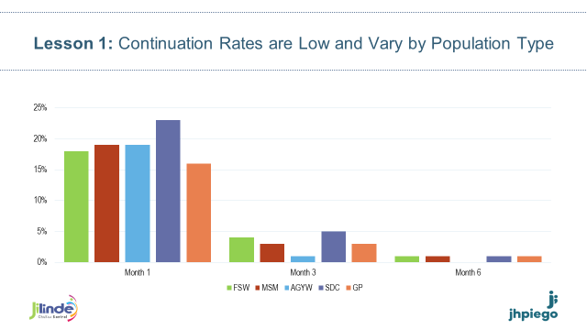
But initiation doesn’t always translate to continued use
PrEP continuation rates tend to decline significantly by 3 months after initiation across all populations¹
Study | Country | Continuation Rates (M=month)
POWER² | Kenya, South Africa | 43% (M1); 20% (M3)
PrIYA³ | Kenya | MCH Clinic: 39% (M1); 12% (M6) FP Clinic: 41% (M1); 24% (M3); 15% (M6)
EMPOWER⁴ | South Africa, Tanzania | 73% (M1); 61% (M3); 34% (M6)
⁵
Source: ¹ Rodrigues et al., Starting and staying on PrEP: a scoping review of strategies for supporting and improving effective use of PrEP, HIV R4P (2021); ² Rousseau-Jemwa et al., Early Persistence of HIV Pre-exposure Prophylaxis (PrEP) in African Adolescent Girls and Young Women (AGYW) from Kenya and South Africa, HIV R4P (2018); ³ Kinuthia et al., Pre-exposure prophylaxis uptake and early continuation among pregnant and post-partum women within maternal and child health clinics in Kenya: results from an implementation programme (2019); Mugwanya et al., Integrating preexposure prophylaxis delivery in routine family planning clinics: A feasibility programmatic evaluation in Kenya (2019); ⁴ Delany-Moretlwe et al., Empowerment clubs did not increase PrEP continuation among adolescent girls and young women in South Africa and Tanzania - Results from the EMPOWER randomised trial, AIDS 2018 (2018); ⁵ Jilinde (2019).
Notes:
I think we are all familiar with this narrative, while we have seen increased uptake, PrEP continuation rates tend to decline significantly by 3 months after initiation, this was seen in studies and similarly in programming.

Slide 7
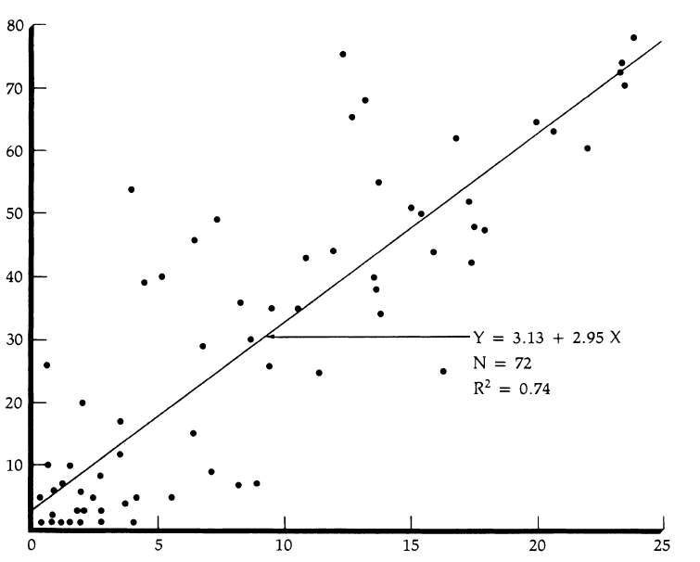
Choice Matters
WHO systematic review (231 articles) showed increased choice associated with:
  Increased persistence on chosen method
  Better health outcomes
  12% increase in contraceptive prevalence for each additional method
Similar to contraceptive needs: different people have different HIV prevention needs at different times
Contraceptive prevalence rate
Index of Contraceptive Availability
Notes:
Which is why Choice Matters! Communities together with CS have been advocating for choice for some time now.
choice is critical for meeting the diverse needs and preferences of those who may be at risk of acquiring HIV. Learning from contraception, data from the WHO systematic review shows that Increased choice is associated with increased persistence, better health outcomes and an increase in contraceptive prevalence for each additional method.
We need more HIV prevention options for people to choose from and we will likely see an increase in access, uptake and persistence learning from contraception.
Recently, civil society, through the African Women's accountability Board along with Winnie Byanyima from UNAIDS, launched the HIV prevention Choice Manifesto for women and girls, a landmark moment for civil society.
I take this moment to also call out a few groups that have been pushing for choice in the CS community like the Global Key Pop Advisory Group that is similarly elevating advocacy for accelerating intro of new options, the Civil Society Caucus in the long-acting PrEP coalition which includes members from the Women’s Accountability Board, AfroCAB and many other grassroots groups .
However, For choice to become a reality, it Requires a multi sectoral approach (pulling in policy makers, researchers, developers, donors, governments, CS/communities & implementers) to make the “mix” available, accessible & affordable

Slide 8
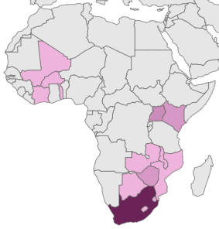
PrEParing for New Products- Geographically
Out of 36 planned and ongoing CAB for PrEP and Dapivirine Vaginal Ring implementation studies, 23 are taking place in Africa
*some studies are taking place in more than one country
Mali- 1
Burkina Faso- 1
Uganda- 4
Cote d’Ivoire- 1
Togo- 1
Kenya- 3
Malawi- 1
Zambia- 1
Mozambique- 1
Botswana- 1
Zimbabwe- 3
Eswatini- 2
South Africa- 12
Lesotho- 1
Notes:
Speaking of choice, there has been excitement with the introduction of two new PrEP products, Injectable CAB and Dapivirine Ring.
As we prepare for these new products, We have quite a number of planned CAB and Ring implementation studies with the majority of these being conducted in Africa. We see this as a plus as Sub Saharan Africa accounted for more than 50% of the 1.3 million new infections in 2022 and 63% of these new infections were among women and girls.

Slide 9
PrEParing for New Products –
Study Populations
Cis men, cis women,
and gay and bisexual
men who have sex with men well represented
Sex workers, trans
men, and gender non-conforming people less well represented
No studies planned for people who use drugs
or prisoners
Inclusion of diverse populations is key to gather evidence around safety, adherence, etc.
BioPIC Implementation Study Tracker
Notes:
Within the studies I just highlighted in the previous slide, Its good to note that most populations are represented within these studies.
I am especially excited that the current studies have included PLP, AGYW, Trans women, populations that were often excluded earlier in clinical trials.
Of course, there is a gap in people who use drugs and prisoners. As Civil society, inclusivity is critical if we are to leave no one behind so we implore researchers to include these populations.

Slide 10

Landscape of CAB PrEP Introduction – as of 09 Sep 2023
2023
8 studies introducing CAB in 6 countries: Brazil, Kenya, Lesotho, South Africa, Uganda, Zimbabwe
5 countries receiving CAB through PEPFAR COP allocations*: Malawi, Zambia, Zimbabwe, Ukraine, Vietnam
2024/2025
2023
*PEPFAR COP allocations may change
Likely to start via COP in first half of 2024*: Eswatini
Other potential countries on PEPFAR COP waiting list*: Kenya, Lesotho, Nigeria, Philippines, South Africa, Thailand, and Uganda (currently paused)
20+ studies in the pipeline: see PrEPWatch
Notes:
Just looking at Injectable CAB introduction, currently, we have 8 studies in 6 countries(majority of those are in Africa under the CATALYST study within the MOSAIC project funded by USAID), and we have 20+ studies in the pipeline.
Over and above studies that are introducing CAB, we also have 5 countries that are receiving CAB through PEPFAR COP allocations with other countries on the waiting list.
Zimbabwe is unique in that it has both the implementation study under CATALYST and PEPFAR support. It will be interesting to see the synergies and how they can learn from each other.

Slide 11
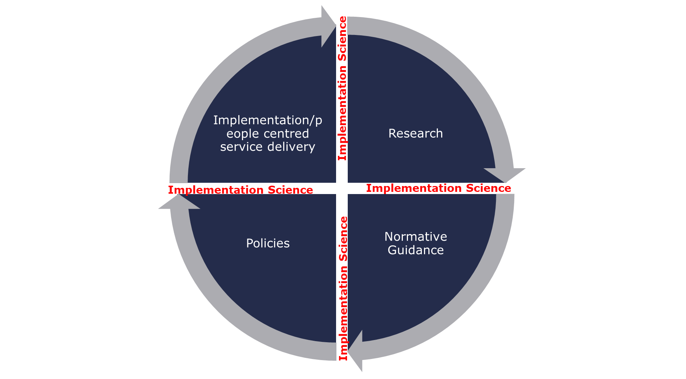
Research/Policy/Implementation Cycle
Productive client/ health system interaction
Design of products and clinical trials
Inclusivity eg of PBF, AGYW, KPs
Process
Health system considerations
Process
Duration
Notes:
With all the excitement of CAB LA and Dapivirine Ring, there are significant opportunities/challenges, considerations and emerging lessons.
So, We have 3 products Oral PrEP, DVR and Injectable CAB, and each product has different issues which I am sure most of you are familiar with. And there are issues irrespective of product which include health systems, structural issues etc . I have the privilege of working both in advocacy, prgramming and implementation research…..and I realize it's not just what the advocates or end users want, it's not just what the researchers or PEPFAR/donors want.
The question is How do you bring all these together to ensure sustained access to those that need these products the most?
So, this graphic shows the whole cycle from when Clinical research is conducted to gather evidence on products, to normative guidance where countries largely rely on WHO to adopt and adapt normative guidance. A huge piece that countries also push for is implementation science or demo projects to guide country level policies which then leads to roll out and scale up of products.
As civil society, we are involved in the continuous cycle, but we have concerns in terms of how some of the processes have been happening. So, we have research through clinical trials, along with evidence that demonstrates that these products work, but there are challenges in the long delays between generation of evidence to finalization of normative guidance.
We also have delays between the normative guidance and country adoption to roll out and scale. Our desire as civil society is that these processes be quicker. We appreciate that CAB took the least time to approval, but we hope the same happens for upcoming products if not sooner. From a civil society lens, there are so many key implementation issues for consideration as we think of implementation and scale up and I will highlight these in the next two slides

Slide 12
Key Considerations for scale up
Leadership and commitment
Financing
Supply chain management
Human resources
Political will and commitment
Global financing
Domestic resources
Public private partnerships
Manufacturing
Patents
Commodity security at service delivery points (right product, right place, right quantities, right time, right cost, right quality)
Competencies
Knowledge
Skills mix
Attitudes
Sustainability
Notes:
For successful implementation and scale up of Injectable CAB and Dapivirine ring, I have identified a few pillars for consideration. Firstly, there is leadership and Commitment. we need our governments to be committed, accountable and more efficient in how they approach implementation. Commitment includes expediting registrations and regularisation of products that have been demonstrated to work. So, we know for example in our region, we have governments that are not even considering the ring and yet we know women want choice. We have governments that have not even started the registration process for CAB LA and the ring .
-For Financing, we need to continue to engage with PEPFAR , Global fund and other global donors, but, more importantly, we need our governments to commit to domestic resourcing towards procurement of these products. We also see an opportunity in the private sector where Government could engage and advocate for public private partnerships.
Tied to financing is the Cost of CAB, which currently is a critical piece that can be a barrier to access based on indicated costs for CAB-LA. We know there are several ongoing discussions around pricing of CAB and we keep pushing ViiV to make the product affordable for low-income countries while we await the Generic manufacturing. While the cost for ring is lower, there is still a push for it to match current oral Prep cost.
-On supply chain, we need the manufacturers to meet potential demand, but we currently don’t have adequate injectable CAB which will hinder scale up. For current implementation studies, we are not sure if participants will have access to CAB post studies which is worrisome. We are happy that PePFAR is committing to support CAB-LA but to what extent?
While we may have adequate ring supply, the demand seems low for now given the challenges I raised earlier. We are excited that South Africa under Global fund has committed to procuring ring for 2024., again kudos to civil society groups that pushed for this… We need more countries to follow suit.
Overally, we advocate for cheaper generic formulations that can be produced regionally but it seems far off into the future especially for CAB .
At country level, we need commodities to be available looking at the 6Rs (the right product, at the right place, in the right quantities, at the right time, at the right cost, with the right quality).However, We continue to hear of oral prep stock outs in health care facilities, yet product is often available at the central level. Bottlenecks to supply need to be identified to allow for access now more than ever as we layer on new prep products.
For human resources, this is a huge issue as well especially in our low-income countries where there is an acute shortage of HCPs. I think its safe to say our HCPs are already overburdened and this can compromise quality of care and service provision. We need to tackle this from several angles…train and retain HCPs, again this brings us back to commitments from our governments to appropriately incentivize HCPs.
If scale up is to work as we layer more prevention products, training is critical to build on HCPs knowledge and competence in administering these new products while allowing for choice counselling so that end users can comfortably choose what suits them best. How do we tackle provider attitudes that can potentially keep those at highest risk from accessing services or derail one product vs the other?
As civil society, we strongly encourage our governments to seriously consider task shifting and identify cadres within the health system as well as communities like expert patients who can take on some of the responsibilities. Adherence is key if we want to see success on these products . Therefore, ensuring HCPs and communities have the right tools to encourage adherence becomes critical.

Slide 13
Key Considerations for scale up
Service delivery system design
Monitoring, evaluation, research and learning
Demand creation
Differentiated service delivery
Data systems that generate quality data in real time
Data analysis and use for decision making
Data driven quality improvement
Informed and activated consumers
Effective PrEP use
PrEP Stigma
Integrated service delivery
Notes:
For service delivery and design, this should be people centred and this is where Differentiated Service Delivery models can come in. For scale up of these new products, Let’s learn from ART, oral Prep and COVID and identify what works. While Injectable CAB may not work so well outside of the facility, ring has potential to be demedicalised borrowing from DSD and possibly the Community Adherence Refill Group model or the vending machine system that south Africa demonstrated.
We need to strengthen our health systems to accommodate new products while investing in community systems as well to also adopt new products. Are there opportunities for integration because we are often dealing with the same young woman who is on CAB and still needs contraception and 9 months later will need ante natal care but she must go to many different units for these services?
Drug resistance is a growing concern especially for Injectable CAB and more importantly, INSTI resistance especially in SSA, where most first‐line regimens include dolutegravir. Without robust follow‐up of patients who are missing their visits, which is typical of our health systems, drug resistance may increase, driving HIV care costs up. How can we Strengthen laboratory capabilities for monitoring patients on LA formulations . We need to Invest in robust HIV testing algorithms that can detect incident HIV infections early. We need to consider the role of self testing in the long run in the era of LA formulations.
-As we think about M&E , Research and Learning, we need systems to be able to monitor not just initiations but also effective use and data systems that generate quality data in real time. Often times, our systems are paper based resulting in data variances and errors and where EHR systems are in place, its not widely implemented. If decisions are to be made, you want to make them on reliable data. Our call as civil society is for government buy in and partner support so countries can have robust M&E systems.
- last but certainly not least, I think what we currently grapple with is how do you get healthy people to the clinic ? How do we address end user concerns, PrEP stigma? What outward facing resources do we need to engage potential end users with? What about adherence? How do we equip our HCPs for clinic-based adherence and strengthen our community interventions for adherence support. With Drug resistance becoming a growing concern, we need robust adherence interventions for end users to stay on PrEP when at risk.
In all of this, How do we ensure CS including communities are front and centre of all this. We insist that CS/communities should be engaged in formulating and driving HIV programmes. This hopefully will make end users feel they are part of the programmes and hopefully improve implementation success and help with reducing stigma and discrimination.

Slide 14
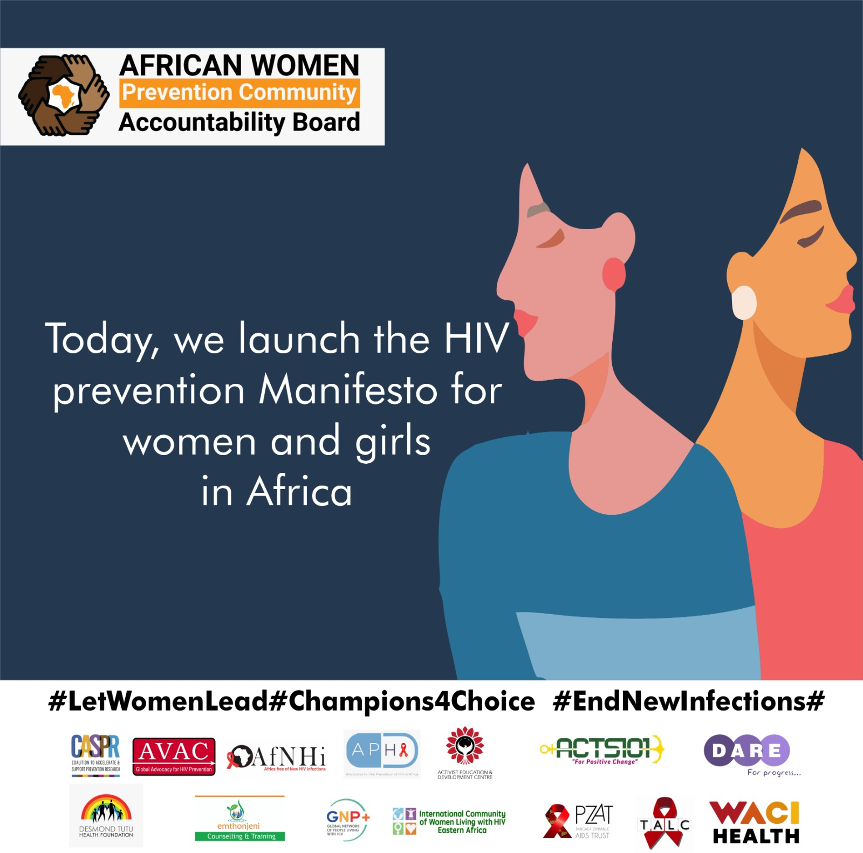
Key Takeaways
Choice matters
  Let’s make it work with current products
  Let’s continue to explore more options (different routes of administration/ formulations, mode of action and frequency)
Scale up is feasible if we address critical issues raised and ensure people centred and quality services
Civil society to continue data driven advocacy and activism to ensure our systems are designed to deliver PrEP choices effectively and efficiently
Notes:
So as I end this talk, key issues that we can take away!
Choice matters
Let’s make it work with current products while continuing to explore more options to widen our pool. We are looking forward to Lenacapivir and the dual Pill hopefully in the near future and vaccines and antibodies later. Let's explore different routes of administration/ formulations, mode of action and frequency.
I truly believe that Scale up is feasible if we address critical issues raised and our services are people centred and of high quality
As Civil society , we need to continue data driven advocacy and activism to ensure our systems are designed to deliver PrEP choices effectively and efficiently

Slide 15
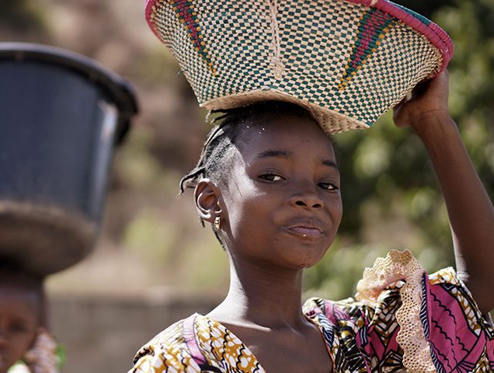
Thank you!

