Slide 1
Affordability and economic implications for bNAbs
Jayasree Iyer – CEO, Access to Medicine Foundation
The future of bNAbs

Slide 2




How we drive change
Building multi-stakeholder consensus
Tracking opportunities & progress
Sharing best practices
Strategic changemaking

Slide 3

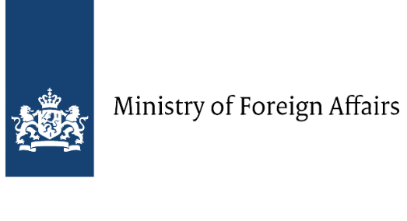
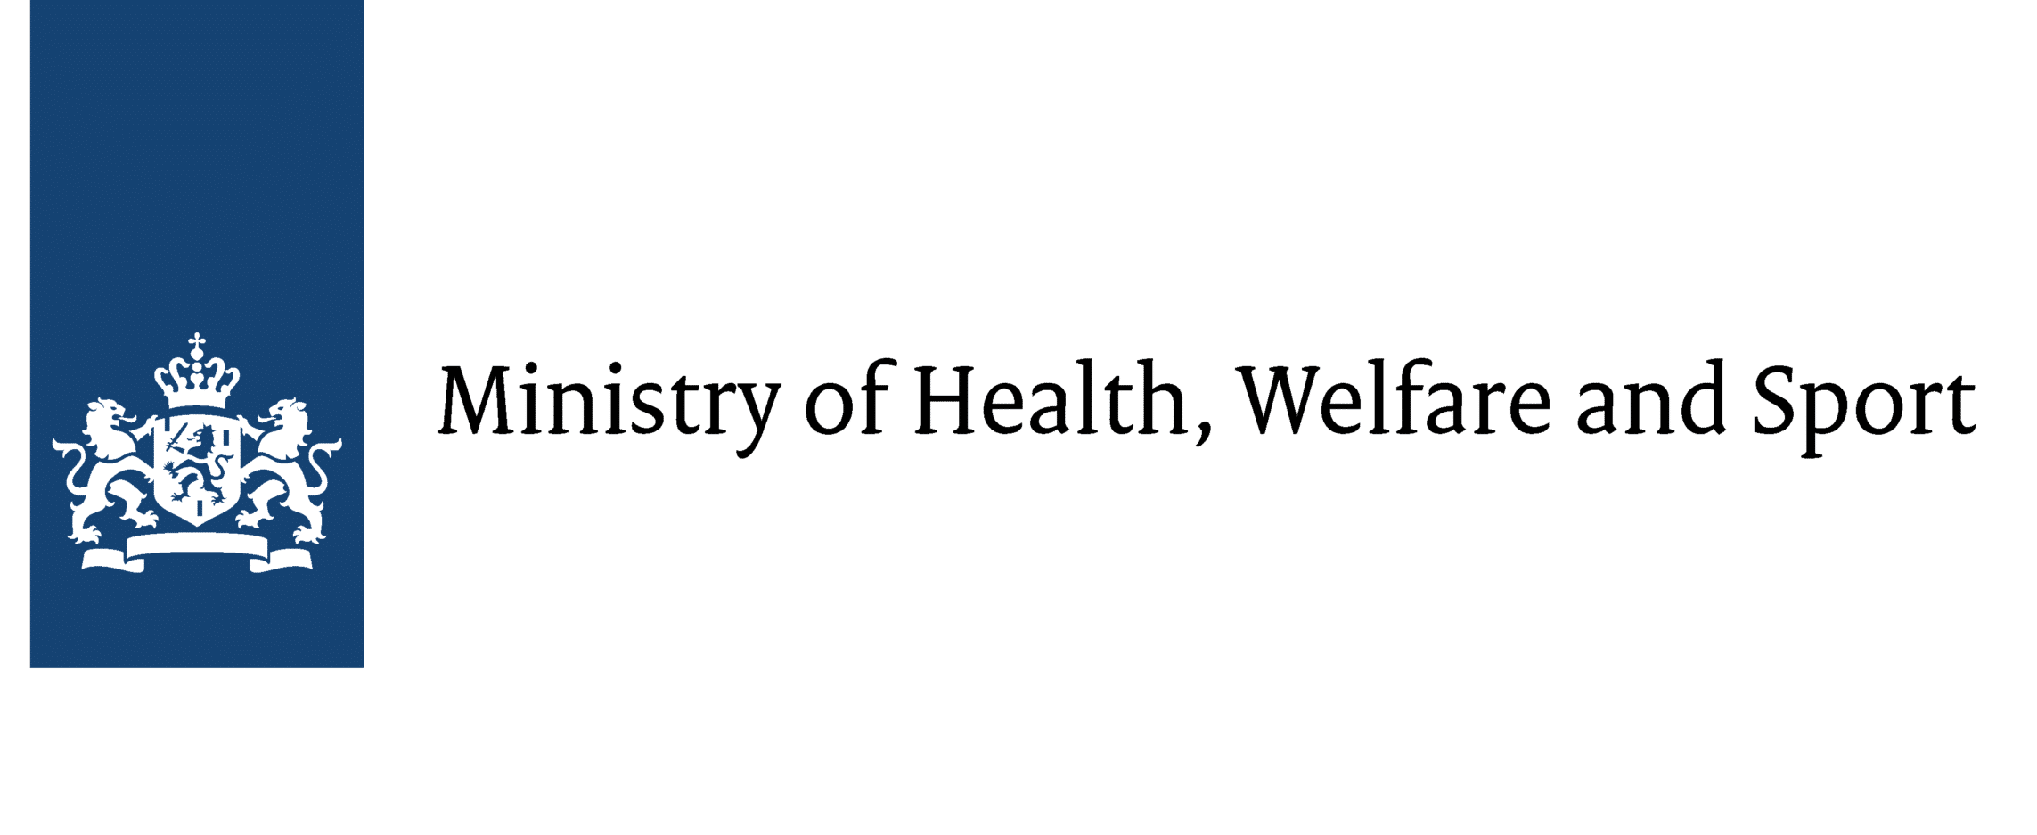




About the Access to Medicine Foundation
The Foundation mobilises essential healthcare companies to improve access to medicine in low- and middle-income countries.
The Foundation is an independent non-profit organisation. It does not receive any funding from the pharmaceutical industry or any other healthcare companies.

Slide 4
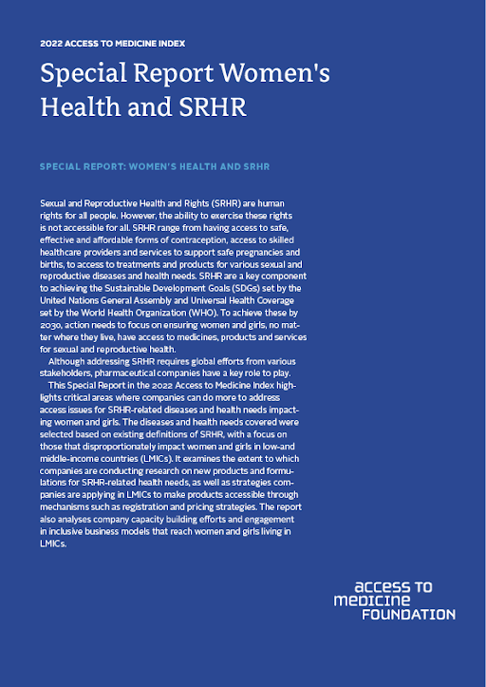
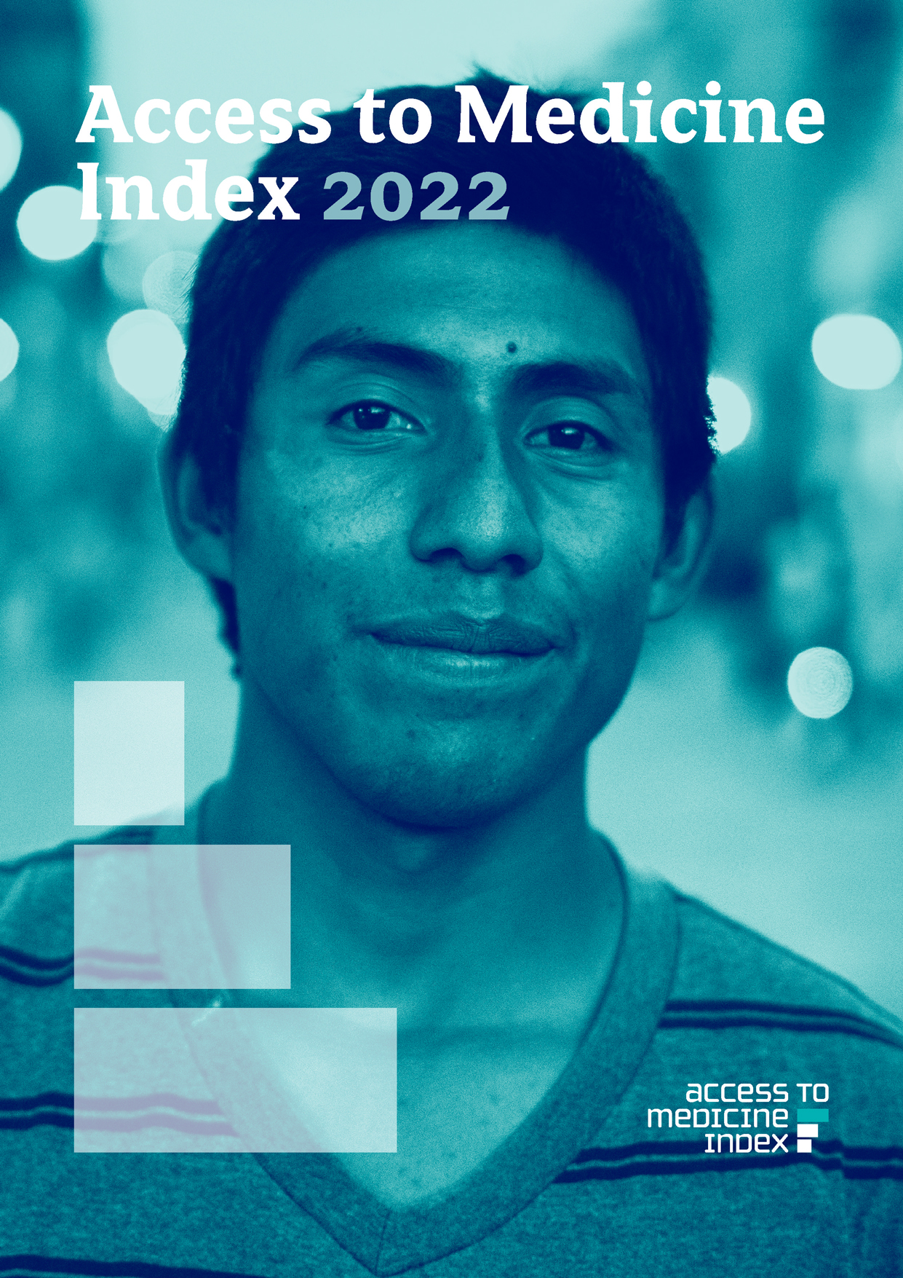
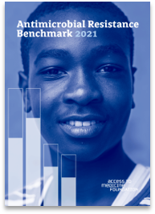

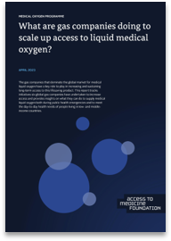
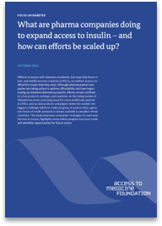
Our research
SRHR Special Report 2022
Amongst SRHR products, HIV products…
dominate the pipeline & portfolio;
get increased R&D attention;
are more likely to be covered in LMICs.

Slide 5
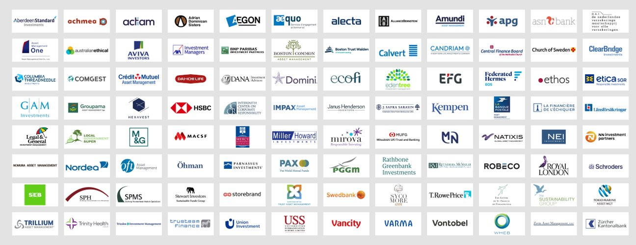
138 investors managing assets over USD 22 trillion

Slide 6
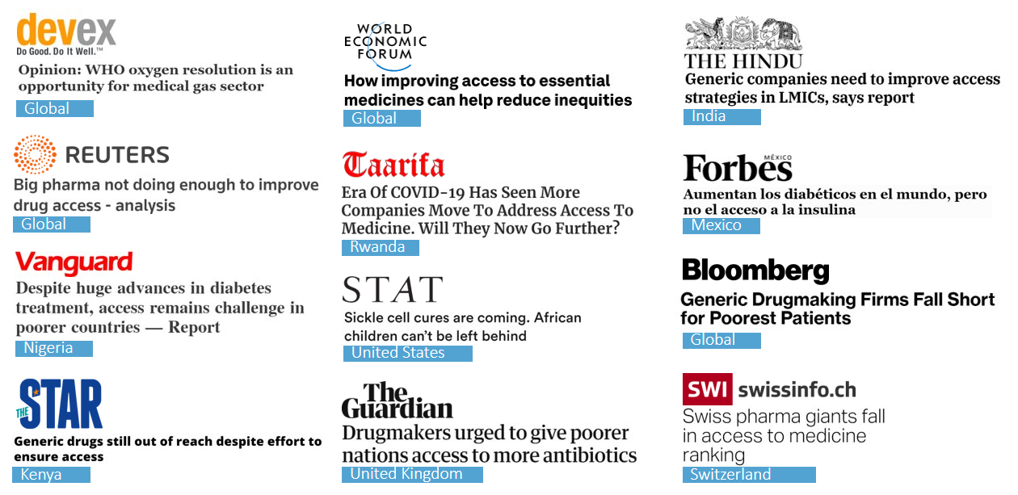
In the media

Slide 7
The burden of HIV in LMICs
39 million
…people are living with HIV globally
60%
…of new HIV infections occur in Sub-Saharan Africa
80%
…of all people with HIV are living in LMICs
Number
1
…cause of death for women in girls (15-49) in sub-Saharan Africa
IAVI. Broadly Neutralizing Antibodies for HIV prevention. (2023) Available from: https://www.iavi.org/our-science/bnabs-for-hiv-prevention; Access to Medicine Foundation. Access to Medicine Index 2022. (2022) Available from: https://accesstomedicinefoundation.org/resource/2022-access-to-medicine-index ; Bekker et al. Advancing global health and strengthening the HIV response in the era of the Sustainable Development Goals: the International AIDS Society-Lancet Commission. (2018) Available from: https://doi.org/10.1016/S0140-6736(18)31070-5

Slide 8



bNabs
Breakthrough
for HIV/AIDS research
Administration via IV route or injection
Prevention
Treatment
Cure
IAVI. Broadly Neutralizing Antibodies for HIV prevention. (2023) Available from: https://www.iavi.org/our-science/bnabs-for-hiv-prevention

Slide 9
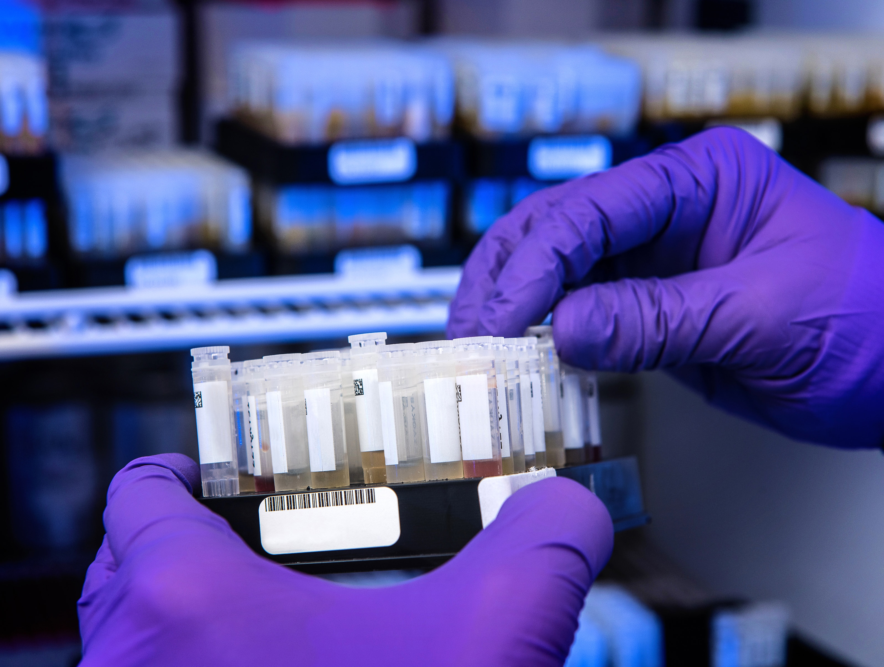
"80% of licensed mAbs are sold in the United States, Europe, and Canada. Only 20% of mAbs are sold in countries that make up 85% of the world's population"
Wellcome & IAVI (2020)
© CDC

Slide 10
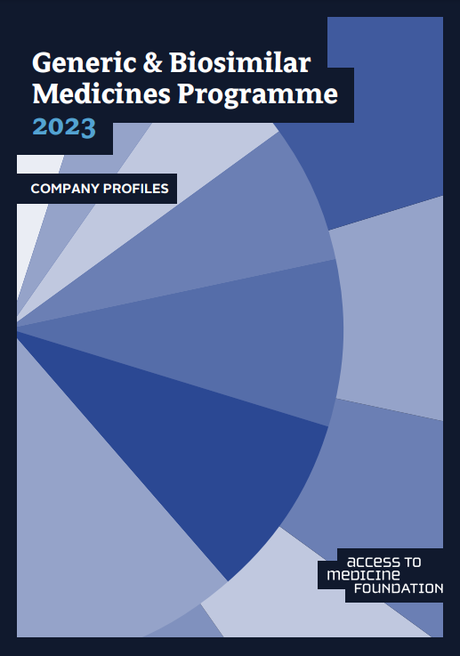
Affordability of bNabs
mAbs are unaffordable for most of the world's population
Product Characteristics
Complex development process
Expensive production and manufacturing
Potential impact of biosimilar industry
Industry Characteristics
Focus on markets in HICs provides little incentive for access in LMICs
IAVI & Wellcome. Expanding access to monoclonal antibody-based products. (2020). Available from https://www.iavi.org/news-resources/expanding-access-to-monoclonal-antibody-based-products-a-global-call-to-action; Access to Medicine Foundation. Generic & Biosilimar Programme 2023 – Company Profiles. Available from: https://accesstomedicinefoundation.org/news/is-the-generics-industry-stepping-up-on-access-to-medicine-new-analysis-spotlights-actions-of-5-major-companies

Slide 11
Accessibility of bNabs
Route of Administration
Healthcare Infrastructure
Self-administering vs. travel to facility
Treatment uptake/adherence
Opportunity to target delivery
Healthcare facilities (resources, equipment)
Cold-chain maintenance
Manufacturing process
Distribution pathways
IAVI & Wellcome. Expanding access to monoclonal antibody-based products. (2020). Available from https://www.iavi.org/news-resources/expanding-access-to-monoclonal-antibody-based-products-a-global-call-to-action

Slide 12
How to ensure access
Consideration of
access in R&D
Product
registration
1
2
Public-private
partnerships
Generic & biosimilar industry
3
4
IAVI & Wellcome. Expanding access to monoclonal antibody-based products. (2020). Available from https://www.iavi.org/news-resources/expanding-access-to-monoclonal-antibody-based-products-a-global-call-to-action ; Access to Medicine Foundation. Generic & Biosilimar Programme 2023 – Company Profiles. Available from: https://accesstomedicinefoundation.org/news/is-the-generics-industry-stepping-up-on-access-to-medicine-new-analysis-spotlights-actions-of-5-major-companies

Slide 13



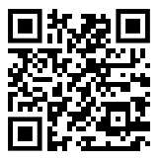

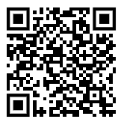

Contact
Jayasree Iyer
@JayasreeKIyer
Access to Medicine Foundation
@ATMIndex
www.accesstomedicinefoundation.org

