Slide 1
Viral hepatitis elimination – reaching the people
HIV updates:
Strategies for long-term success
Prof. Jeffrey V. Lazarus [Jeffrey.Lazarus@ISGlobal.org]
Professor, CUNY Graduate School of Public Health and Health Policy
Associate Research Professor, ISGlobal, Hospital Clínic, Barcelona, Spain
Associate Professor, Faculty of Medicine, University of Barcelona
Member, Policy and Public Health Committee, EASL
@JVLazarus
Notes:
30 min presentation

Slide 2
a new global health era
WHO Global health sector strategy on HIV for the period 2022–2030
The WHO strategy calls for a more precise focus to reach the most affected and at-risk of HIV and AIDS to address inequities, as they prevent the world from ending the HIV and AIDS epidemic
An opportunity to go beyond ART and viral suppression: a more holistic, people-centred HIV care approach focused on long-term well-being addressing HRQoL, multimorbidity in people living with HIV (NCDs, mental health, etc.) and stigma and discrimination
ART, antiretroviral therapy; HRQoL, health-related quality of life; NCD, non-communicable disease.
Source: WHO. The 2022–2030 global health sector strategies on, respectively, HIV, viral hepatitis and sexually transmitted infections. Published 18 July 2022. Available at: https://apps.who.int/iris/rest/bitstreams/1451670/retrieve [Accessed July 2022].
Notes:
Mention Consensus statement on the role of health systems in advancing the long-term well-being of people living with HIV
https://www.nature.com/articles/s41467-021-24673-w
Work on these issues in AUS have been catalytic to changing the field.

Slide 3
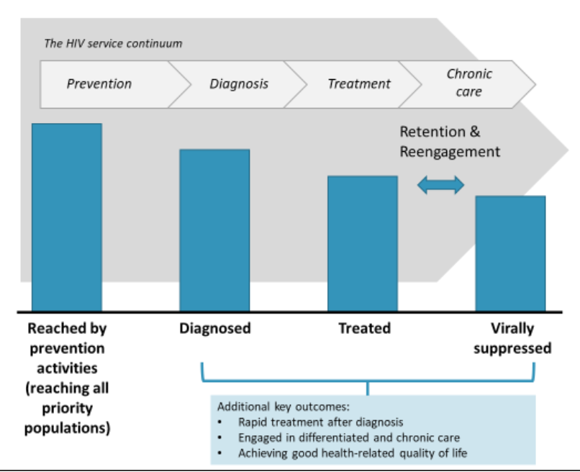
HRQoL in the WHO GHSS 2022-2030
Source: WHO Global health sector strategy on HIV for the period 2022–2030

Slide 4
ROOM FOR IMPROVEMENT
HRQoL is not addressed as a quantitative target on the WHO’s 2022–2030 global health sector strategies on HIV
The strategy falls short of making a commitment to monitoring global progress toward improving HRQoL outcomes in people living with HIV and assessing impact and service coverage
Addressing HRQoL related to people living with HIV can be relatively new for health systems
Without institutionalised targets, health systems may not recognise the importance of reporting on the HRQoL of people living with HIV
HRQoL, health related quality of life; WHO, World Health Organization.
Source:. Lazarus JV et al. JIAS Viewpoint 2022 (submitted).
Notes:
This omission may reflect the relative newness of addressing HRQoL outcomes in the monitoring of health system responses to HIV. When European countries were asked to report to the European Centre for Disease Prevention and Control in 2018 on whether or not their health systems monitored HRQoL outcomes in PLHIV, only five of 48 responding countries answered affirmatively. In the United States, the 2022–2025 national HIV/AIDS strategy expresses a commitment to monitor quality of life (QoL) for PLHIV following work to assess potential data sources and develop a suitable indicator, with this process being required because no such indicator currently exists.
The absence of a WHO-defined HRQoL target or a more general QoL target for the HIV field raises the risk that many countries may not recognize the importance of reporting on the HRQoL of PLHIV.

Slide 5
PARADIGM SHIFT: A NEW ERA FOR HIV CARE
The transition from disease-centred health systems and HIV care to holistic, people-centred HIV care within integrated health systems
Notes:
Really going back to the WHO def of health, in their 1948 constitution.
A state of complete… phys, mental, social

Slide 6
Paradigm shift: beyond viral suppression
People-centred HIV care
Disease-centred HIV care
Focus on ART and viral suppression
Focus on long-term well-being and HRQoL
ART, antiretroviral therapy; HRQoL, health-related quality of life.
Source: Lazarus JV et al. Consensus statement on the role of health systems in advancing the long-term well-being of people living with HIV. Nat Commun 2021;12(1):4450.
Notes:
With widespread availability anti-retroviral therapy, life expectancy among people living with HIV (PLHIV) is approaching that of the general population. Yet this does not always mean years spent in good health. PLHIV are at higher risk of developing a range of other physical and mental health conditions (comorbidities) – including cancers, cardiovascular disease, chronic kidney disease, diabetes, frailty and other physical disabilities, as well as depression and anxiety. Health-related quality of life (HRQoL), and mental health in particular, is lower among PLHIV than in the general population.

Slide 7
A global consensus for the new era of HIV
A global consensus on advancing the long-term well-being of PLHIV
Steering committee
Jane Anderson
Homerton University Hospital NHS Foundation Trust
United Kingdom
Ricardo Baptista Leite
UNITE Global Parliamentarians Network to End Infectious Diseases (President)
Portugal
Georg Behrens
European AIDS Clinical Society (Governing Board); Hannover Medical School
Germany
Georgina Caswell
Global Network of People Living with HIV (Head of Programmes)
Netherlands
Nikos Dedes
European AIDS Treatment Group
Greece
María José Fuster-Ruiz de Apodaca
Spanish Interdisciplinary AIDS Society (Manager and Scientific Coordinator); Universidad Nacional de Educación a Distancia
Spain
Richard Harding
King’s College London
United Kingdom
Adeeba Kamarulzaman
International AIDS Society (President); University of Malaya
Malaysia
Jeffrey Lazarus (Chair)
Barcelona Institute for Global Health (ISGlobal)
Spain
Caroline Sabin
University College London
United Kingdom
Kelly Safreed-Harmon
ISGlobal
Spain
A multidisciplinary panel of 44 global HIV experts, including PLHIV, clinicians and researchers,was convened to identify key issues that health systems must address to move beyond their focus on viral suppression and advance the long-term wellbeing of PLHIV from a patient-centred perspective.
Source: Lazarus JV et al. Consensus statement on the role of health systems in advancing the long-term well-being of people living with HIV. Nat Commun 2021;12(1):4450.
Notes:
>100 organisations endorsed the consensus statement
A multidisciplinary panel of 44 global HIV experts, including PLHIV, clinicians and researchers,was convened to identify key issues that health systems must address to move beyond their focus on viral suppression and advance the long-term wellbeing of PLHIV from a patient-centred perspective*

Slide 8
Key next steps from the consensus on advancing the long-term well-being of PLHIV
HRQoL, health-related quality of life; PLHIV, people living with HIV. Source: Lazarus JV et al. Nat Commun 2021;12(1):4450.

Slide 9
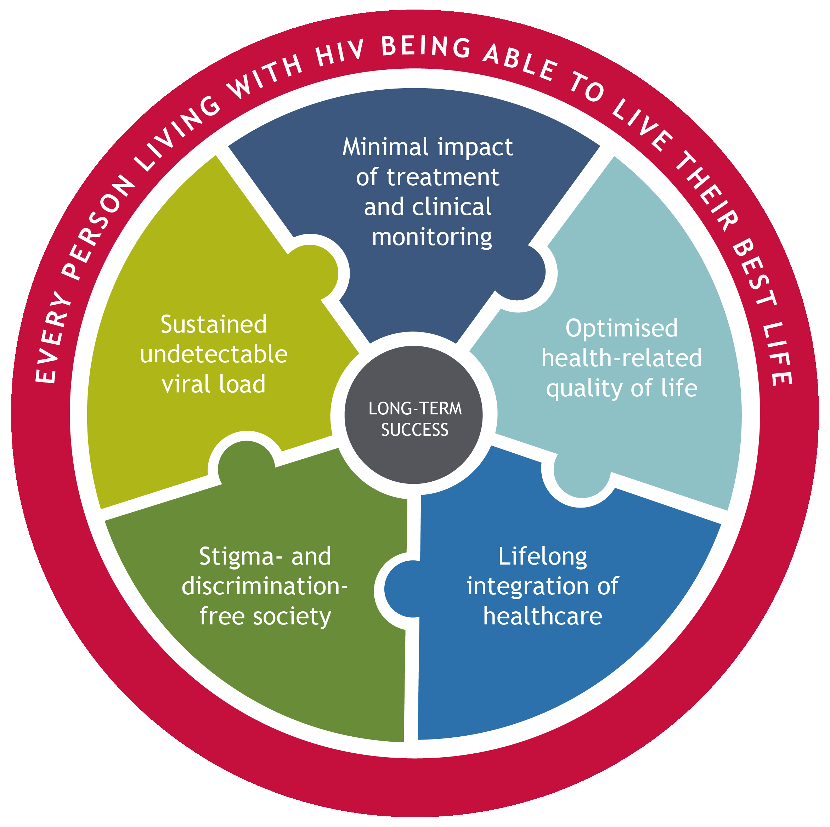
The Long-Term Success (LTS) Framework
HIV management goals have shifted to meet the evolving needs of people living with HIV.
Re-defining long-term success (LTS), in light of the new WHO strategy, is necessary to help address these needs.
An expert panel co-created a framework to help guide clinical practice and establish LTS as a new goal in the HIV management landscape.
The framework includes five key outcome pillars that, if achieved, would support the LTS vision of every person living with HIV being able to live their best life.
Sources: 1. Lazarus JV, et al. Long-term success for people living with HIV: a framework to guide practice. HIV Medicine, in press 2023.
DOI: 10.1111/hiv.13460
2.Fuster-RuizdeApodaca M, et al. Why we need to re-define long-term success for people living with HIV. HIV Medicine, in press 2023.
DOI 10.1111/hiv.13460

Slide 10
ENHANCING LONG-TERM HEALTH AND WELL-BEING AMONG PEOPLE LIVING WITH HIV:
Key area 1: Comorbidity prevention, treatment and management
Notes:
Really going back to the WHO def of health, in their 1948 constitution.
A state of complete… phys, mental, social

Slide 11
Policy recommendations: Comorbidity prevention, treatment and management
THE EUROPEAN UNION Expand the mandate of the Steering Group on Health Promotion, Disease Prevention, and Non- Communicable Diseases(NCDs) management to initiate work programmes on communicable diseases, such as HIV, including prevention, diagnosis and coordinated management of comorbidities.
NATIONAL AND REGIONAL HEALTH AUTHORITIES Develop/update a monitoring and evaluation framework for HIV care, incorporating indicators on comorbidities, leading causes of mortality and hospitalisation, and person-reported outcomes (PROs) including health-related quality of life (HRQoL).
HIV CLINICS / CARE PROVIDERS Implement routine screening for all relevant comorbidities based on individual characteristics and needs, in line with national and international guidelines, using short, easy to administer, validated screening instruments.

Slide 12
ENHANCING LONG-TERM HEALTH AND WELL-BEING AMONG PEOPLE LIVING WITH HIV:
Key area 2: AGEING WITH HIV
Notes:
Really going back to the WHO def of health, in their 1948 constitution.
A state of complete… phys, mental, social

Slide 13
Policy recommendations: Ageing with HIV
THE EUROPEAN UNION Provide funding for pilot studies on models of HIV care that employ or develop frameworks for healthy ageing, frailty, functional ability, and other dimensions of health that are relevant to people with HIV, using HRQoL as a key outcome measure. People with HIV should be meaningfully involved in these efforts.
NATIONAL AND REGIONAL HEALTH AUTHORITIES Develop and implement training programmes for carers, in particular those working in retirement homes, focused on the specific health and well-being needs of older people with HIV – including mental health.
HIV CLINICS / CARE PROVIDERS Provide specialised, integrated healthcare services focused on the needs of older adults with HIV, including frailty and other geriatric syndromes, disability, age-related comorbidities, and mental health (e.g. depression).

Slide 14
ENHANCING LONG-TERM HEALTH AND WELL-BEING AMONG PEOPLE LIVING WITH HIV:
Key area 3: measurement of pros and monitoring of hrqol
Notes:
Really going back to the WHO def of health, in their 1948 constitution.
A state of complete… phys, mental, social

Slide 15
Policy recommendations: Measurement of PROs and monitoring of HRQoL
THE EUROPEAN UNION Allocate funding for the inclusion of HIV within the OECD Paris Initiative to provide standardised, comparable data on PROs and experiences across countries.
NATIONAL AND REGIONAL HEALTH AUTHORITIES Establish annual surveys of people with HIV to collect and document data on HRQoL and on experiences of stigma and discrimination in healthcare settings.
HIV CLINICS / CARE PROVIDERS Integrate person-reported outcomes measurement (PROMs) into clinical practice, which can then be used for shared decision-making with those living with HIV, to tailor interventions to individual needs and preferences, and for monitoring of health outcomes.

Slide 16
ENHANCING LONG-TERM HEALTH AND WELL-BEING AMONG PEOPLE LIVING WITH HIV:
Key area 4: combatting stigma and discrimination
Notes:
Really going back to the WHO def of health, in their 1948 constitution.
A state of complete… phys, mental, social

Slide 17
Policy recommendations: Combatting stigma and discrimination
THE EUROPEAN UNION Given the negative impact of stigma and discrimination on mental health, ensure that any future EU mental health strategy includes a focus on reducing stigma and discrimination among groups at risk, including people with HIV.
NATIONAL AND REGIONAL HEALTH AUTHORITIES Design and implement interventions that can strengthen empathy towards people with HIV among healthcare staff and decrease stigma and discrimination in healthcare settings. Monitor and regularly review the effectiveness of these interventions.
HIV CLINICS / CARE PROVIDERS Offer peer-to-peer and community-based interventions to address stigma and discrimination experienced by people with HIV, including a focus on the fact that an undetectable viral load means untransmissible virus.

Slide 18
Priority areas moving forward
Integrate patient-reported outcome measures (PROMs) and patient-reported experience measures (PREMs) into clinical practice
People-centred, integrated health service delivery models
Availability of digital health technologies and tools
Recognising the importance of social determinants of health and inequity, stigma and discrimination, mental health, disability and life rehabilitation
PREM, patient-reported experience measure; PROM, patient-reported outcome measure.
SourceL Lazarus JV et al. JIAS Viewpoint 2022 (submitted). 2. WHO. The 2022–2030 global health sector strategies on, respectively, HIV, viral hepatitis and sexually transmitted infections. Published 18 July 2022. Available at: https://apps.who.int/iris/rest/bitstreams/1451670/retrieve [Accessed July 2022].
Notes:
Patient-reported outcome measures (PROMs) and patient-reported experience measures (PREMs)
PROMs and PREMs can be institutionalized in diverse ways:
The Swedish government has established the goal of having 95% of PLHIV in Sweden complete a nine-item questionnaire annually, with findings about issues such as physical, psychological and sexual health, medication adherence, and satisfaction with care intended to guide interventions to improve individual patient outcomes. There is also growing interest in using existing validated PROMs such as EuroQoL, PROQOL-HIV and WHOQOL-HIV-BREF to measure the self-reported health-related quality of life (HRQoL) of PLHIV in clinical settings (3).
People-centred health services
Digital health technology available
Recognizing the importance of social determinants of health and inequity, stigma and discrimination, mental health, disability and life rehabilitation as determinant factors involved in the HIV/AIDS epidemic and PLHIV’s health outcomes.

Slide 19
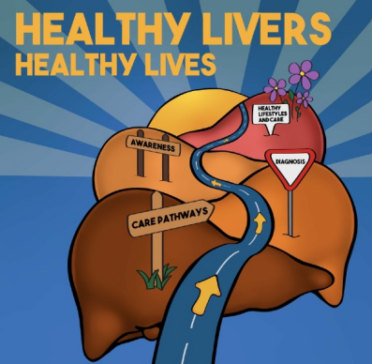
Acknowledgements
Acknowledgements
Everyone who has contributed to the cited slides, the WHO Global Health Sector Strategy on HIV team.
And everyone who continues to fight to for people living with HIV and communities at risk.– we can end this persistent public health threat.
The ISGlobal Health Systems Research team
Contact: Jeffrey.Lazarus@ISGlobal.org
Partner in the following 4 multi-country EU-funded projects: BOOST, CATALYSE, META-Trial and SEMID
@JVLazarus

