Slide 1






Leveraging person-centred public health for HIV treatment in Zambia (PCPH)
Njekwa Mukamba
Centre for Infectious Disease Research in Zambia (CIDRZ)
Satellite session: Person-centred approaches to address the health needs of people living with HIV and co-infections and co-morbidities
Notes:
Hello. My name is Njekwa Mukamba from the Centre for Infectious Disease Research in Zambia (CIDRZ). I’d like to begin by acknowledging the Traditional Owners of the land on which we meet today. I would also like to pay my respects to Elders past and present.
I would also like to express thanks to the organizers of this Satellite session on Person-centred approaches - for the opportunity to share our work from the ‘Leveraging person-centred public health for HIV treatment in Zambia study. I would like to also thank the recipients of care and the health care workers who participated in our study and often work under difficult and stressful conditions to deliver health care. We recognize the support from our partners who include among others, the Zambian Ministry of Health and our funder, the Bill & Melinda Gates Foundation.

Slide 2
Conflict of interest disclosure
I have no conflicts of interest to declare.
I have no relevant financial relationships with ineligible companies to disclose.
Notes:
I do not have any conflicts of interest to declare.

Slide 3
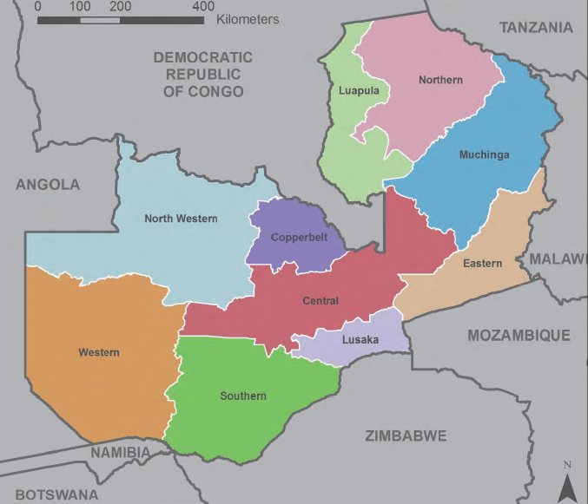

Study Setting: Lusaka, Zambia
Presentation Outline
Provider perspectives on person-centredness
Patterns of person-centred communications in public HIV clinics
Notes:
I have the pleasure of presenting results from two different workstreams within our study on behalf of myself and our team. Firstly, I will share our formative work that examined health provider perspectives on person-centeredness of HIV care and which informed our study intervention development. Then, I will share results from our examination of patterns of Person-centred communications in public HIV clinics in Zambia using the Roter Interaction Analysis System. *click* This work took place in Zambia, which has a generalized HIV epidemic, with an estimated prevalence of 11.3% and free antiretroviral therapy in the public healthcare system. The study was conducted in Lusaka, Province, the province containing the capital city.

Slide 4

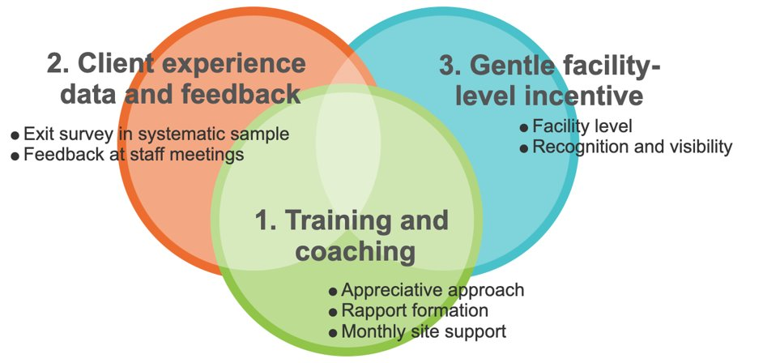
PCPH Trial
Outcomes
Service delivery
Client experience
Client retention
Client clinical outcomes
Provider experience
Formative Phase
Trialed Intervention
Theory of change
Qualitative work
Human-centred design
Summary Trial Results:
70% reduction in HIV care visits with a bad experience and 56,000 visits with bad experience averted during the intervention period
Qualitatively improved inter-personal dynamics between clients and providers
Notes:
From 2019-2021 we conducted a stepped wedge, cluster randomized trial of an intervention intended to improve person-centredness of HIV care across 24 government-run health facilities in Lusaka, Zambia. *Click*We began with a formative phase to design our approach. *click* The resulting trialed intervention included three main components: 1. provider training and coaching, 2. collecting client experience data and sharing it with facility staff members, and 3. supporting facilities to create improvement plans and providing gentle incentives for improved performance. We measured multiple outcome types. *click* . This intervention had measurable positive effects on client experience and retention, but not viral suppression (As presented in detail at CROI 2023 and in a forthcoming publication).
From 2022 to date, CIDRZ continues to lead PCC agenda in Zambia in collaboration with the Performance Improvement (PI) and Quality Assurance Quality Improvement (QAQI) Departments under the Zambian Ministry of Health. I will talk more in terms of what we are doing to advance PCC in Zambia.

Slide 5
“Person-centred care (PCC) is about treating people who use health and social services as equal partners in planning, developing and monitoring care to make sure care services meet their needs.”
Royal College of Nursing, UK
Notes:
In our study, we defined person-centred care as treating clients as equal partners in planning, developing and monitoring care.

Slide 6
Provider perspectives on person-centredness:
Participatory formative research and rapid analysis to inform a HIV Care improvement intervention in Zambia
Chanda Mwamba*, Laura K. Beres*, Njekwa Mukamba, Lazarus Jere, Marksman Foloko, Kasapo Lumbo, Kombatende Sikombe, Sandra Simbeza, Aaloke Mody, Charles Holmes, Izukanji Sikazwe, Carolyn Bolton, Katerina Christopoulos, Anjali Sharma, Elvin Geng
*equal contributors
Notes:
I’ll begin with our participatory formative research and rapid analysis to inform an HIV Care improvement intervention in Zambia

Slide 7
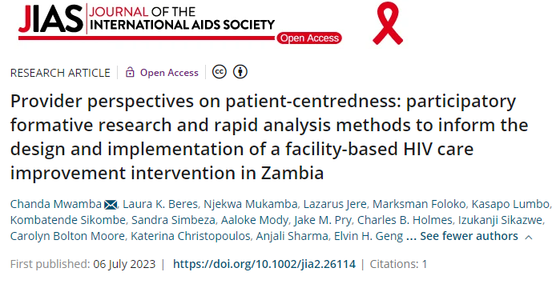
Notes:
included in the recent JIAS supplement

Slide 8
Background
Healthcare workers’ perception of the acceptability, appropriateness, and feasibility of PCC practices – key to successful implementation.
Evidence on effective implementation of PCC practices in the real world, and provider views in low-middle-income countries is limited.
We sought to understand healthcare workers’:
  beliefs and attitudes about PCC principles, enablers, and activities,
  perceptions of ongoing HIV service delivery and the client experience,
  motivation for improved practice
  to tailor intervention content and implementation pre-trial.
Notes:
Successful implementation of person-centred care (PCC) practices in HIV depends on how healthcare workers perceive the acceptability, appropriateness, and feasibility of the practices.
While person-centred practices are widely desired, evidence on effective implementation of the practices in the real world, and provider views on person-centred care practices in low-middle-income countries is limited.
We sought to understand healthcare workers’:
beliefs and attitudes about PCC principles, enablers, and activities,
perceptions of ongoing HIV service delivery and the patient experience,
motivation for improved practice
to tailor intervention content and implementation pre-trial.

Slide 9
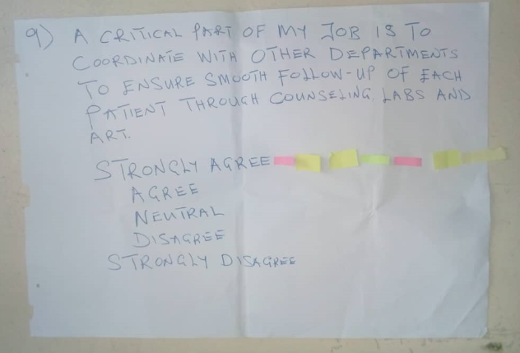

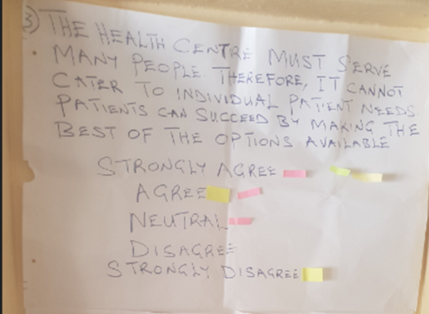

Methods
8 participatory focus group discussions
Purposeful sampling of n=46 healthcare workers (HCW) across three cadres: health facility management teams, professional HCWs and lay HCWs
Rapid data analysis: Analytic memos, study team debriefs, summarized implications for PCC intervention, member checking with HCWs
FGD Topics covered:
Critique of proposed study client experience measures
Interactive prioritisation of 10 PCC statements derived from Scholl et al¹.
Open-ended discussion of:
facility context for HIV services
HCW motivation
DSD models
suggestions to improve client retention
Reflection on reasons for HIV care disengagement given by clients
1- Scholl I et al. An integrative model of patient-centeredness - a systematic review and concept analysis. PloS one. 2014;9(9):e107828.
Notes:
Between September and October 2018 (prior to the PCPH trial), we conducted 8 audio-recorded focus group discussions at 2 pilot health facilities (one urban and one rural facility). We applied rapid analysis approaches to rigorously synthesize results in a timely manner to inform the trial. The Focus Group Discussions were participatory and included open-ended discussion of, among other areas, the facility context for service delivery; participatory likert scale voting and discussion on agreement with 10 PCC-related statements derived from a PCC framework by Scholl & others (Scholl et al) and critique of patient experience measures proposed for the study.

Slide 10
Results: PCC Principles, Enablers, Activities
Facilitators of PCC practices
Person-centered care acceptable: HCWs valued and endorsed PCC concepts e.g., respectful communication, shared decision making, provision of emotional & social support.
Perceive appropriateness and feasibility limited by practice environment: Workflows focused on physical health. Limited organizational and infrastructure (human resource, space, etc.) Clash of value of PCC with inability to implement led to HCW moral injury and defensiveness.
Mentors can build on the endorsement of PCC principles. On-site mentorship by PCC study could support a flexible PCC implementation approach amidst resource constraints. Mentors to acknowledge that HCWs work under difficult conditions
Barriers to PCC practices
Intervention
implementation opportunities
Notes:
Health care workers largely endorsed the concepts of person-centred care but felt challenged in the practice of person-centeredness by workflows and limited resources. This frustrated healthcare workers and led to some defensiveness in discussions around PCC. This led our intervention to embrace mentorship that recognized the HCWs, themselves, and built on the existing PCC successes that were there in each facility, despite the challenges.

Slide 11
Results: HCW perspectives and motivation
Facilitators of PCC practices
Health care workers motivated by: Positive client outcomes. Supportive colleagues or supervisors.
Motivation undermined by: Restrictive power dynamics from leadership limited HCW autonomy for innovation and improvement. Feeling ‘‘unappreciated’’ by management. Encounters with difficult clients.
Mentoring and training on work culture, team-based approach and power dynamics Support HCWs to feel “heard’. Visible celebration of positive client outcomes. Frustration management strategies (e.g., mindfulness).
Barriers to PCC practices
Intervention
implementation opportunities
Notes:
Healthcare workers felt motivated by positive interpersonal interactions but undermined by power dynamics that limited their agency and success in these practices. Our intervention targeted improved coordination of care and frustration management strategies for difficult circumstances.

Slide 12
Results: Data and feedback supporting PCC
Facilitators of PCC practices
Health care workers interest in monitoring: Valued client satisfaction survey question: leadership preferred summaries, other HCWs preferred specifics (e.g. lost lab results)
Limited application opportunities undercut coherence: Lack of data analysis skills and opportunities to participate in data review meetings.
Facility leadership teams key to provide objective information from client experience measurements. Feedback of data should include mentor support for data interpretation and use.
Barriers to PCC practices
Intervention
implementation opportunities
Notes:
Healthcare workers were interested in client experience data but desired a clear path to interpret and apply findings.

Slide 13
Calls to Action - Provider Perspectives
Interventions should target organisational and structural barriers that inhibit PCC practices.
Improved PCC must include both clients and providers.
Notes:
1) As PCC is widely perceived as acceptable by HCWs. Interventions should target organisational and structural barriers that inhibit PCC practices such as organizational policies, facility culture, and power dynamics. This is important when promoting implementation of PCC.
2) Facilitating improved person-centred care must include both clients and providers at the centre to be successful.

Slide 14
Patterns of Person-centred communications in public HIV clinics: A Latent Class Analysis using Roter Interaction Analysis System (RIAS)
Njekwa Mukamba, Chanda Mwamba, Salil Redkar, Marksman Foloko, Kasapo Lumbo, Herbert Nyirenda, Debra L. Roter, Musunge Mulabe, Anjali Sharma, Sandra Simbeza, Kombatende Sikombe, Laura K. Beres, Jake M. Pry, Katerina Christopoulos, Charles B. Holmes, Elvin H. Geng, Izukanji Sikazwe, Carolyn Bolton-Moore, Aaloke Mody
Notes:
Now I turn to our work that measured changes in service delivery outcomes for the intervention we developed and implemented. We used RIAS to assess Patterns of Person-centred communications in public HIV clinics

Slide 15
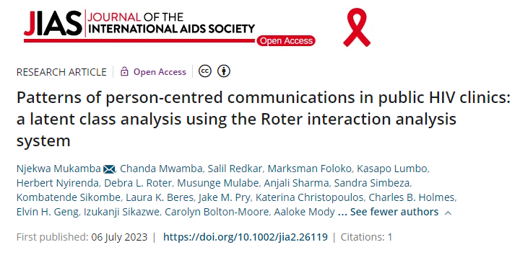
Notes:
Also included in the recent JIAS supplement

Slide 16
Background
Poor client-provider communication is a critical barrier to long-term retention in care among people living with HIV.
However, standardized assessments of this key metric are limited in Africa.
Roter Interaction Analysis System (RIAS) is a well-validated method to parse out and quantify patient and provider communication that has been used across diverse settings
We used RIAS to quantitatively parse and characterize patterns of person-centered communication (PCC) behaviors in Zambia.
Notes:
Long term adherence and retention in HIV care remain a challenge and can be negatively affected by many factors, among which include a bad client experience and poor client-provider communication.
However, standardised assessment of client provider communication as a measure of client experience in sub-Saharan Africa is limited.
We used the Roter Interaction Analysis System (RIAS) to characterize HIV provider patterns of person-centered communication (PCC).

Slide 17
Methodology
We enrolled pairs of people living with HIV (≥18 yrs) making a routine HIV follow-up visit and their providers and audio-recorded client-provider encounters at the 24 parent study clinics.
Trained staff coded encounters using RIAS schema (high levels of intercoder reliability - Pearson correlation 0.8).
RIAS coding schema classifies each client and provider utterance into one of 37 mutually exclusive categories. Examples include:
-- question types (open vs. close ended, question topics)
-- types of information giving (medical, psychosocial)
-- statement types (encouragement, empathy, criticism,)
After coding, we performed latent class analysis (LCA) to identify interactions with distinctive patterns of provider PCC behaviors.
Notes:
1) We enrolled pairs of people living with HIV (≥18 yrs) making a routine HIV follow-up visit and their providers.
2) Trained staff coded encounters using RIAS schema.
3) RIAS coding schema classifies each patient and provider utterance into one of 37 mutually exclusive categories.
Examples include open vs. closed ended questions, or statements about medical vs. psychosocial topics.
4) After coding, we performed latent class analysis (LCA)

Slide 18
Results
Table 1. Client, Provider, Interaction, and Facility Characteristics (n = 478)
Client | Overall | Nurse | Clinical Officer | Medical Officer | p-value
 | (n = 478) | (n = 67) | (n = 352) | (n = 59)
Sex, n (%)
Female | 299 (62.6%) | 41 (61.2%) | 220 (62.5%) | 38 (64.4%) | 0.93
Male | 179 (37.4%) | 26 (38.8%) | 132 (37.5%) | 21 (35.6%)
Age, n (%)
18 - 30 years | 89 (18.6%) | 10 (14.9%) | 71 (20.2%) | 8 (13.6%) | 0.76
31 - 40 years | 160 (33.5%) | 23 (34.3%) | 116 (33.0%) | 21 (35.6%)
41 - 50 years | 137 (28.7%) | 20 (29.9%) | 98 (27.8%) | 19 (32.2%)
>50 years | 59 (12.3%) | 11 (16.4%) | 40 (11.4%) | 8 (13.6%)
Missing | 33 (6.9%) | 3 (4.5%) | 27 (7.7%) | 3 (5.1%)
Provider
Sex, n (%)
Female | 236 (49.4%) | 51 (76.1%) | 159 (45.2%) | 26 (44.1%) | <0.001
Male | 242 (50.6%) | 16 (23.9%) | 193 (54.8%) | 33 (55.9%)
Provider Type, n (%)
Nurse | 67 (14.0%) | - | - | - | -
Clinical Officer | 352 (73.6%) | - | - | -
Medical Officer | 59 (12.3%) | - | - | -
Facility
Facility Typeª, n (%)
Small Clinic | 98 (20.5%) | 19 (28.4%) | 79 (22.4%) | 0 (0.0%) | <0.001
Medium Clinic | 180 (37.7%) | 16 (23.9%) | 136 (38.6%) | 28 (47.5%)
Large Clinic | 81 (16.9%) | 8 (11.9%) | 55 (15.6%) | 18 (30.5%)
Hospital-Based Clinic | 119 (24.9%) | 24 (35.8%) | 82 (23.3%) | 13 (22.0%)
Notes:
Between 2019 and 2021, we enrolled a total of 478 clients & 139 providers. This included more female than male clients, more providers from the clinical officer cadre and more encounters from medium-size facilities.
(The median encounter time was 7.8 minutes).

Slide 19
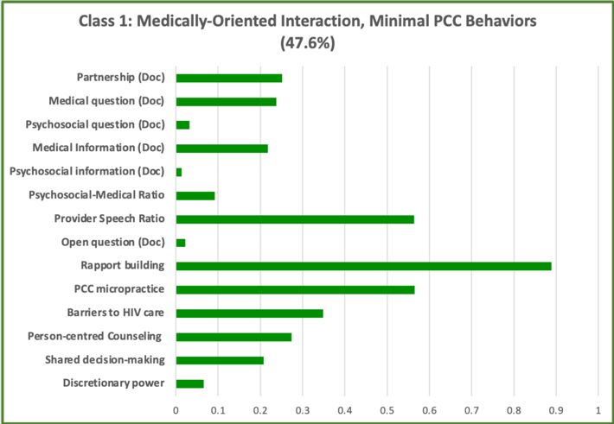
Results
47.6% of interactions were characterized by discussion predominately around medical topics only.
Notes:
We identified 4 distinct classes/profiles of client-provider communication. Class 1: The first class “Medically-Oriented Interaction, Minimal PCC Behaviors” group, with 47.6% of interactions was characterized by discussion predominately around medical topics, minimal discussion of psychosocial topics, and relatively low use of PCC behaviors such as shared decision-making and leveraging discretionary power.
(For the RIAS codes, it is the percent of RIAS codes that were categorized as X over all RIAS codes…but for the PCC specific codes it is percent of interactions that had at least one PCC code).

Slide 20
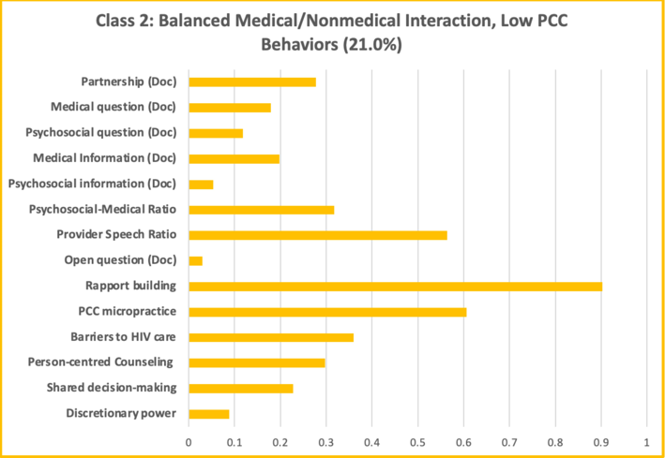
Results
21.0% of interactions was characterized by more balance between medical and psychosocial topics, but still low use of PCC behaviors.
Notes:
Class 2: The second class (“Balanced Medical/Nonmedical Interaction, Low PCC Behaviors” group, shows 21.0% of interactions were characterized by more balance between medical and psychosocial topics, but still low use of PCC behaviors.

Slide 21
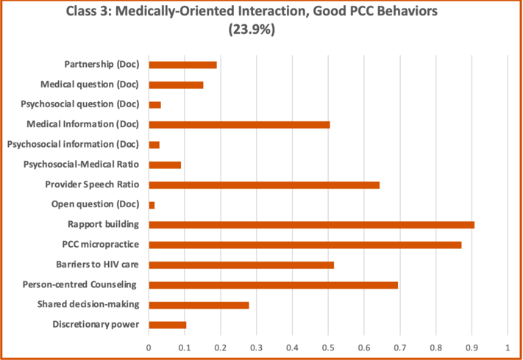
Results
23.9% of interactions was characterized again by predominately medically-oriented discussion, but greater use of PCC behaviors.
Notes:
Class 3: The third class (“Medically-Oriented Interaction, Good PCC Behaviors” group, with 23.9% of interactions was characterized again by predominately medically-oriented discussion, but greater use of PCC behaviors, including integrating PCC principles into counselling, using more PCC micropractices, assessing barriers to HIV care, and using shared decision-making.

Slide 22
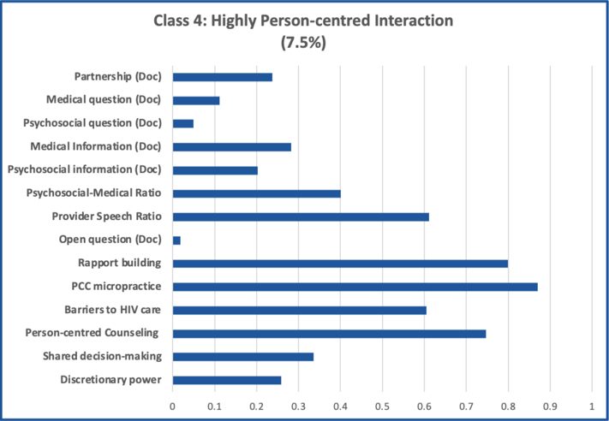
Results
7.5% of interactions was characterized by discussion of both medical and psychosocial topics and the highest of use of PCC behaviors.
Notes:
Class 4: The fourth class (“Highly Person-Centered Interaction” group) represented only 7.5% of interactions was characterized by discussion of both medical and psychosocial topics and the highest of use of PCC behaviors.

Slide 23
Results
Table 2: Interaction by Health Provider Type
Position of Health Provider | Latent Classes
 | Medically-Oriented Interaction, Minimal PCC behaviour | Balanced Medical/Non Medical Interaction, Low PCC Behaviour | Medically-Oriented Interaction, Good PCC Behaviour | Highly Person-Centred Interaction
Medical Officer | 37.3% | 28.8% | 23.7% | 10.5%
Clinical Officer | 53.7% | 19.0% | 21.0% | 6.3%
Nurse | 38.8% | 16.4% | 34.3% | 10.5%
Notes:
An analysis of interaction type by health provider type revealed that *click* nurses were more likely to have interactions classified as more client-centred in their communication with clients.

Slide 24
Conclusions
Majority of client-provider communication focused only on medical aspects of clients living with HIV.
Person-centred communication still possible within the public health HIV setting. Improvements still needed.
Integration of PCC behaviours varied across the profiles & health care worker cadre.
PCC behaviours - key in improving client experience and long-term engagement in HIV care.
Notes:
1) Majority of client-provider communication focused only more on medical aspects of clients living with HIV with more limited discussion on psychosocial issues that may affect engagement in care.
2) Person-centred communication is possible within the public health HIV setting. And it is evident from this research that client-provider communication still needs improvement given that the communication was highly focused on medical aspects of clients living with HIV.
3) Integration of PCC behaviours varied across the profiles/classes and health care worker cadre, with nurses and medical officers being more client-centred.
4) Improving the client-centredness of communication behaviors may be an important target for optimizing the overall client experience and improving retention in HIV treatment programs.

Slide 25
Calls to Action - RIAS
Systems for positive reinforcement of non-medical communication.
Deliberately train and mentor HCWs in good communication skills.
Research is needed to understand changes in client-provider communications over time.
Notes:
The implications therefore include the following:
Firstly, we need to find systems for positive reinforcement of non-medical communication.
Secondly, a pragmatic way of strengthening communication between clients and health care workers can be by deliberately training and mentoring health care workers in good communication skills to improve the experience of HIV patients.
Finally, research is needed to understand changes in client-provider communications over time and how that relates to retention in HIV care.

Slide 26
Continued operationalization of PCC
MoH & CIDRZ Letter of Agreement – signed: training, curriculum & policy intergration.
Client Satisfaction Tool launched.
PCC theme for National Quality Improvement Conference.
Light touch PCC Mentorship in 24 public clinics.
PCC Trainer of Trainers for HCWs.
Develop a sustainable PCC activity package – Human-Centred Design workshop.
Roadmap for PCC Integration.
Notes:
How is CIDRZ operationalizing PCC action? CIDRZ continues to lead PCC agenda in Zambia in collaboration with the Performance Improvement (PI) and Quality Assurance Quality Improvement (QAQI) Departments under Zambian Ministry of Health. Over the last 1 year, our efforts have focused on engaging Ministry of Health and other key implementation partners on how best to integrate PCC in quality improvement initiatives in Zambia. In order to achieve this, the following key activities have been done:
Letter of Agreement was signed between CIDRZ and MoH, with CIDRZ committing to support the training of HCWs, development of PCC curriculum and integration of PCC into the National Health Policy.
CIDRZ worked with MoH to develop the Client Satisfaction Tool and related Guidelines for use across health facilities – the CST Tool was launched this year.
Supporting the National QI Conference – the theme for this years’ conference is on PCC – ‘’PCC: An Approach to improving the delivery of quality health care and people’s wellbeing’’
Provision of light touch PCC Mentorship across 24 Public Health Facilities in Lusaka Province.
PCC Trainer of Trainers Workshop for Health Care Workers conducted in expansion Districts with refresher trainings at original health facilities.
Planned Human-Centred Design Workshop – to develop sustainable PCC activity package.
We are in the process of developing a ROADMAP for integrating and sustaining PCC activities (strengthening Quality Improvement and Performance Improvement) with Policy entrepreneurs identified to promote PCC integration.

Slide 27






Acknowledgement of contributors
Notes:
I wish to especially thank the recipients of care, Zambian Ministry of Health and the following partners for their continued support.

