Slide 1
Facilitating person-centered care Integrating an electronic client feedback tool into continuous quality improvement processes to deliver client-responsive HIV services in the Democratic Republic of Congo
Davina Canagasabey | Senior Technical Advisor | PATH
Person-centred approaches to address the health needs of people living with HIV and co-infections and co-morbidities

Slide 2
Disclosures
Conflict of interest: I have no relevant financial relationships with ineligible companies to disclose.
Funder acknowledgement and disclaimer: This work was financed by the US President’s Emergency Plan for AIDS Relief (PEPFAR) through the United States Agency for International Development (USAID) under the PATH-led Integrated HIV/AIDS Project in Haut-Katanga (IHAP-HK).
The views expressed in this presentation and the contents of our manuscript do not necessarily reflect the views of USAID or the United States government.

Slide 3
Purpose and objectives
Purpose
To create a digital system for gathering and using client feedback to ensure services are responsive to client needs and to improve perceived client satisfaction with HIV services received.
Where and when
System was designed and tested at eight high-volume facilities in six health zones supported by the USAID/PATH IHAP-HK project from May 2021 through September 2022.
Objective of our analysis
Understand the feasibility and effectiveness of our service quality monitoring system in identifying and addressing quality-of-care gaps not aligned with client needs and preferences.

Slide 4
“We consider person-centered HIV care to be HIV services that are informed by and respect the expressed preferences of people living with HIV.”
IHAP-HK study team
Notes:
World Health Organization → Integrated, people-centered approach “Responsiveness and participation: Care is coordinated around people’s needs, respects their preferences, and allows for people’s participation in health affairs.”
https://www.who.int/health-topics/integrated-people-centered-care#tab=tab_1

Slide 5
Background and context
“The experience of patients should serve as the fundamental source of the definition of quality.”
-- D. Berwick
Comprehensive community engagement across the implementation life cycle (design → implementation → monitoring) is needed to deliver high-quality and responsive services that keep clients engaged in care.
Communities and clients need to be at the core of person-centered care.
Understanding client satisfaction with services provided is critical to ensuring continuity in HIV services.
IHAP-HK embedded passive tools to collect client feedback as part of continuous quality improvement (CQI) processes.
Seeking an active service quality feedback collection mechanism that was feasible to implement and effective at addressing service quality gaps.
Source: Berwick DM. A user’s manual for the IOM’s “Quality Chasm” report. Health Affairs, 2002.
Notes:
Use of paper-based survey tools are expensive, logistically more difficult to administer, and results in more time-consuming data compilation processes → leads to delayed or missed opportunities to address core issues in a timely manner.

Slide 6
Human-centered design to co-create client service quality feedback tool
Methods
Stakeholder mapping to identify 20 individuals involved in co-creation process:
9 service providers (5 community and 4 facility); 8 people living with HIV; 2 Ministry of Health representatives; 1 religious leader.
Discover
Design
Used empathy maps to identify pain points encountered by clients when seeking health care services.
IHAP-HK designed prototype for client feedback mechanism using an open-source data collection digital tool and worked with stakeholders to develop the questionnaire.
Define
Dream
Through focus group discussions and leveraging inputs from empathy mapping exercise, prioritized service delivery aspects exit interview should focus on.
Additional discussions defined group preferences for a client feedback mechanism, such as:
Exit interviews
Administered by peers
Anonymous survey
Digital format using tablets/smart phones
Questions about PATH’s Living Labs methodology? Learn more here > https://www.path.org/programs/mdht/living-labs-initiative/
Notes:
Ensuring clients and providers were integrally involved in the design process was critical to ensure that the final tool was both feasible and acceptable and focused on the most critical care issues, from the perspective of clients.
IHAP using human centered design approach co-created with key stakeholders a patient feedback system, starting by a stakeholder mapping then convene focus groups with key stakeholders that allowed to draw an empathy mapping, identify pain point/ issues on the process of seeking care/ services
Participants opted for exit interviews, conducted by peer educators, on tablets , using Kobo, collect as the preferred method to gather clients feedback that will be incorporated on

Slide 7
Service quality monitoring feedback loop
Methods
Issues identification & tool
development
IHAP-HK, facility quality improvement teams, and peer educators jointly identify solutions to quality-of-care gaps.
Findings and identified solutions integrated into monthly remediation plans for implementation and monitoring.
Trained 30 peer educators to administer exit interview with consenting clients and record answers via the KoboToolbox mobile application.
Client feedback compilation & analysis
IHAP-HK, people living with HIV, and facility providers co-identify exit interview focus areas and questions.
IHAP-HK integrates selected questions into electronic client feedback tool (English and Swahili).
Exit
interview administration
IHAP-HK staff exports client responses and shares with facility quality improvement team and peer educators for analysis to identify quality-of-care gaps (by topic; frequency of occurrence; and severity of issue).
Integration into quality improvement plans

Slide 8
Service quality questionnaire
Methods
Feedback gathered and analyzed from 4,917 exit interviews conducted with clients
receiving HIV treatment and care services at the 8 pilot facilities.
Wait time: How long did you wait before being received by a healthcare provider?
Medication dispensing: Did you receive all prescribed medications?
Provider attitude:
What was the provider’s attitude towards you?
Did you feel stigmatized by facility staff?
Were services offered to you in complete confidentiality?
Viral load (VL) services:
Have you had a viral load sample taken in the past six months?
Did you received your results, and if so, how long did it take to receive your results?
Recommendations: Do you have suggestions to improve the quality of services received?

Slide 9
Results
Service quality gaps, solutions, and impact over time: Long wait time
Solutions
Using peer educators to conduct appointment prep tasks.
Coaching providers to use appointment agendas to better triage needed services.
Escorting clients to consultation rooms, pharmacies, and/or laboratories.
Improving waiting room conditions.
Figure 1: Maximum and average wait time, by month, May 2021–September 2022.
Impact
Decrease in wait time range (min-max):
May 2021: 0–60 minutes
September 2022: 1–17 minutes.
Decrease in mean wait time from 11.2 minutes to 8.2 minutes. (Figure 1)
Increase in reported client satisfaction with wait time → 76% wait times to be excellent or acceptable (May 2021) compared to 100% (September 2022).
Notes:
Long wait time, reported stigma, perceived confidentiality, and viral load services highlighted as key service quality issues.

Slide 10
Service quality gaps, solutions, and impact over time: Stigma and confidentiality
Results
Solutions
Removing HIV status from access cards used by clients to enter facilities.
In-service coaching for providers on delivering services in a non-stigmatizing manner.
Limiting individuals permitted in consultation rooms during client appointments.
Figure 2: Client grading of provider attitude, by quarter, May 2021–September 2022.
Impact
Increase in the proportion of clients reporting providers’ attitudes to be excellent or very good (Figure 2).
Decrease in percentage of clients reporting cases of stigma → 5% (May 2021) to 0% (September 2022).
Improved perceptions of confidentiality → 71% (May 2021) to 99% (September 2022).

Slide 11
Results
Service quality gaps, solutions, and impact over time: Viral load services
Solutions
Figure 3: Comparison of turnaround time for VL results between May-July 2022 and July-September 2022.
Conducting daily follow-up with referral laboratories to ensure timely analysis of client samples.
Providing results to clients on multi-month dispensing through text, telephone call, or home visit, based on client preference.
May-July 2021
n=264 VL results
Impact
July-September 2022
n=318 VL results
Increase in the number of clients who were informed of their VL results, from 264 to 318 (Figure 3).
Increase in the number of VL results returned within one month of sample collection, from 196 to 224 (Figure 3).
Note: Reagent stock out in June and July 2022 that created backlogs of VL samples to be processed.

Slide 12
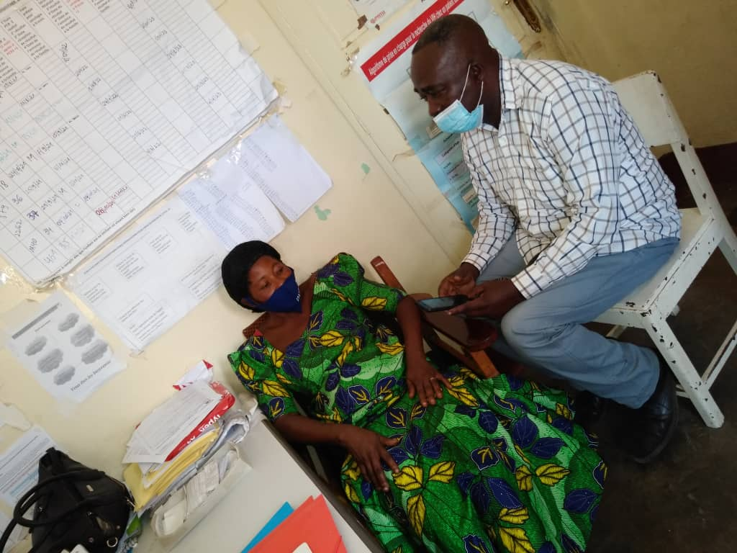
Conclusions & next steps
Use of an electronic client service quality feedback tool as part of a client-driven service quality monitoring system proved to be feasible and effective at rapidly identifying and deploying solutions leading to improved client perception of service quality.
This client feedback collection tool and larger service quality monitoring system is a promising mechanism for advancing client-responsive → recommended next steps are to expand and test use of this system in other provinces.
Peer educator administering an exit interview and recording responses on the KoboToolbox mobile application at an IHAP-HK health facility.
Photo: IntraHealth International.
Notes:
Promising mechanism for advancing client-responsive thus person-centered HIV services.

Slide 13
“The feedback system allowed us to gather clients’ complaints…for example, about waiting time, viral load results delay…the [quality improvement] team worked to address [these] issues by preparing drug packages prior to each appointment to reduce time duration of each client refill. Then these complaints have drastically decreased.”
Lylian Masengo
Peer educator | Clinique Universitaire Lubumbashi

Slide 14
Acknowledgements
Programme National de Lutte contre le Sida
Programme Multisectoral Nationale de Lutte contre le SIDA
Health care providers and quality improvement teams at 8 pilot facilities
6 local HIV community-based partners
30 peer educators who led exit interview
PEPFAR and USAID
IHAP-HK project staff and fellow co-authors
Short Report: Facilitating person-centred care: integrating an electronic client feedback tool into continuous quality improvement processes to delivery client-responsive HIV services in the Democratic Republic of the Congo.
Find it here> https://www.path.org/programs/mdht/living-labs-initiative/
Check out the full Journal of the International AIDS Society special issue on person-centered approaches in HIV here> https://onlinelibrary.wiley.com/toc/17582652/2023/26/S1

