Slide 1
HIV testing approaches: Current and new approaches and considerations for long-acting PrEP
Lucia Hans, National Health Laboratory Service and University of the Witwatersrand
SY11 HIV testing in the context of long-acting extended delivery of HIV PrEP

Slide 2

PrEP Guidelines
WHO
It is important for programs to promote access to CAB-LA
Select current national HIV testing strategy and algorithm for HIV screening
South Africa
PrEP must be integrated into existing services
Should not be offered as a vertical program
Use national HTS algorithm

Slide 3
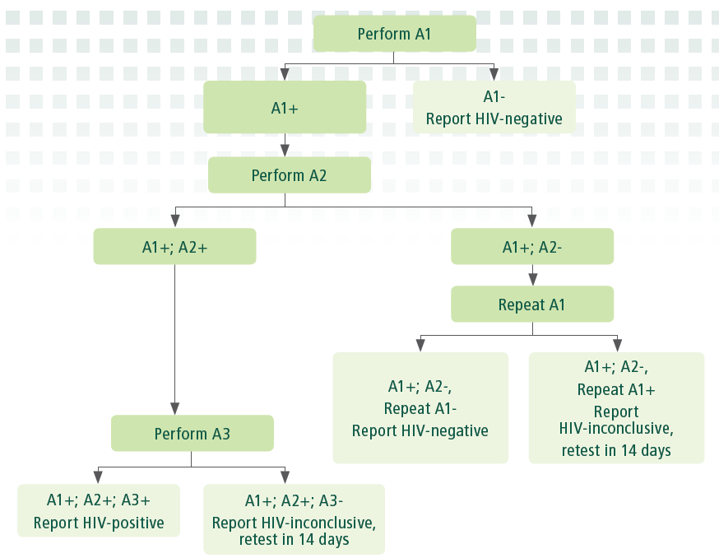
HIV Testing in PrEP
WHO Recommendations
WHO HIV testing strategy
combination of rapid diagnostic tests (RDTs) and/or enzyme immunoassays (EIAs)
does not currently recommend the use of NAT for HIV diagnosis of adults
Most NATs do not have regulatory approval for HIV diagnosis in adults
Source WHO ENCOURAGES COUNTRIES TO ADAPT HIV TESTING
STRATEGIES IN RESPONSE TOCHANGING EPIDEMIC
POLICY BRIEF NOVEMBER 2019
Source: WHO ENCOURAGES COUNTRIES TO ADAPT HIV TESTING STRATEGIES IN RESPONSE TO CHANGING EPIDEMIC, Nov 2019

Slide 4
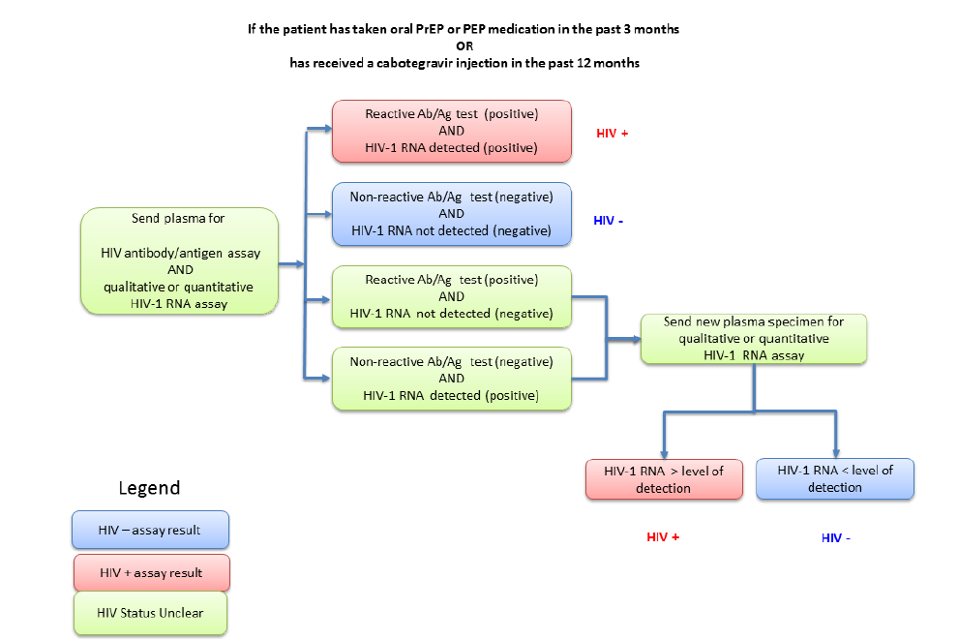
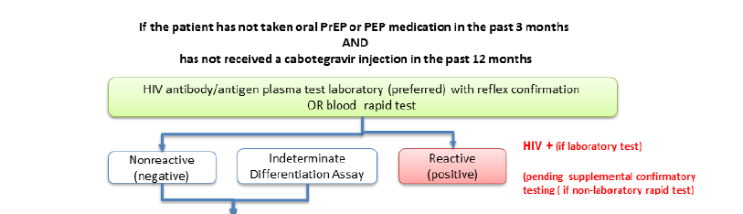
HIV Testing PrEP
CDC
US Public Health Service
Two testing algorithms recommended
Based on PrEP Exposure status
HIV RNA testing is recommended
Source: Preexposure Prophylaxis for the Prevention of HIV Infection in the United States – 2021 Update Clinical Practice Guideline

Slide 5
Natural History of HIV infection
Source WHO CONSOLIDATED GUIDELINES ON HIV TESTING SERVICES 2019

Slide 6
Assay Specifications
Evolution of Serology Assays
Serology
SPECIFICATIONS | 3rd Gen | 4th Gen | 5th Gen
Detects | IgG, IgM HIV-1, HIV-2 and Group O | IgG, IgM HIV-1, HIV-2 and Group O, hiv-1 p24 | IgG, IgM HIV-1, HIV-2 and Group O, hiv-1 p24
Sensitivity | >99.5 | 99.5 | 99.5
Specificity | >99.5 | >99.8 | 100%
Window period | 2-3 weeks | 2 weeks | 2 weeks
Result produced | single result | single result, no differentiation between antigen and antibody | differentiation between HIV 1, HIV-2, and p 24 antigen
Considerations
delayed immune response due to
low levels nucleic acid
later generation of antibodies
Window period affected
Adapted from Alexander, T. S. (2016). Human immunodeficiency virus diagnostic testing: 30 years of evolution. Clinical and Vaccine Immunology, 23(4), 249-253.

Slide 7
CAB arm HPTN 083 CAB received within 6 months of the first HIV-positive visit
CAB LA Breakthrough Infections
Case ID | VL (copies/mL) at first pos visit | Days to detection | Ag/Ab at first positive visit | Confirmatory test Ab first visit | DX Delay
A1 | 4,010 | 28 | NR | NA | Yes
A2 | 50,080 | 60 | NR | NA | Yes
A3 | 1,360 | 72 | NR | NA | Yes
A4 | 44,180 | 63 | R | NEG | Yes
C1 | 120 | 47 | NR | NA | Yes
C2 | 494 | 185 | NR | NA | Yes
C3 | SCA, 15.3 | 35 | NR | NR | Yes
D1 | 130 | 112 | NR | NR | Yes
D2 | SCA, 6.1 | 98 | NR | Yes | Yes
D3 | 86 | 117 | NR | NA | Yes
D4 | <40 | 45 | NR | NA | Yes
D5 | 59 | 42 | NR | NA | Yes
D6 | 2,020 | 59 | NR | NA | Yes
DX1 | 1,212,660 |  | R | IND | No
DX2 | 73,380 |  | R | IND | No
DX3 | 48,030 |  | R | POS | No
BR1 | 450 | 81 | NR | NA | Yes
BR2 | 1,620 |  | NR | NA | No
Most cases could have been infected earlier with HIV RNA detected
However, HIV RNA levels low in some cases
Below LOD of commercial assays in two cases
Adapted from Marzinke Antimicrob Agents Chemoth 2023;67(4):e0005323)

Slide 8
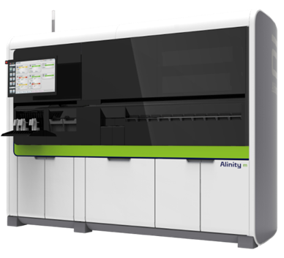
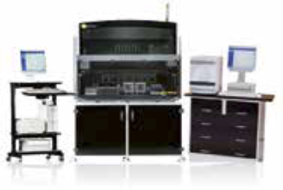
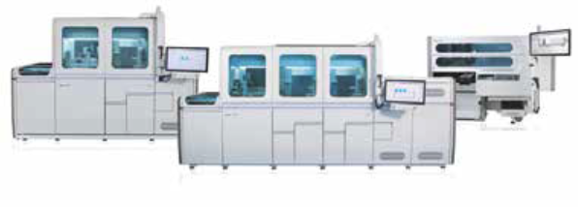
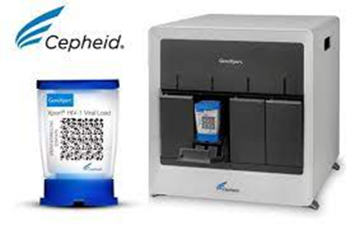
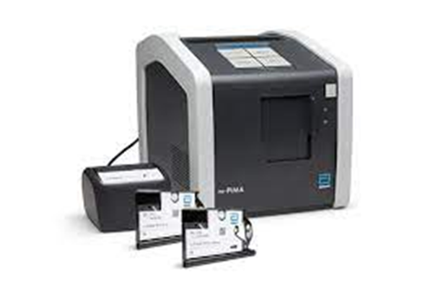
Molecular Assays
Commercial Assays
RNA – quantitative, qualitative
DNA – qualitative
Automated medium- to -high throughput
Point-of-care

Slide 9
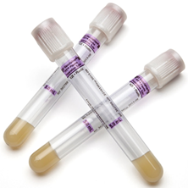
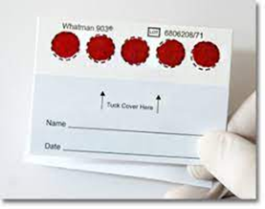
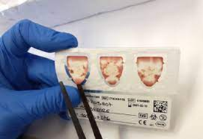
Sample Types
Types
Limitations
Plasma – gold standard
DBS
PSC
Sample stability – refrigeration required
Sample input volumes
Centrifugation
Sensitivity, over-quantification
Sensitivity

Slide 10
Molecular Assays
Qualitative Assays
Not validated in ART–exposed PLWIH
Some verification in adult ART-unexposed PLWHIV
Qualitative
SAMPLE TYPE LOD (cp/mL)
Assay | DBS | WB | Plasma | Serum
m-PIMA HIV-1/2 Detect | N/A | 2491
Xpert® HIV-1 Qual XC | 531 | 278
cobas® HIV-1/HIV-2 Qualitative | 255 |  | 12.6 | 12.1
ABBOTT REALTIME HIV-1 QUALITATIVE | 2500 |  | 110

Slide 11
Quantitative
 | SAMPLE TYPE LOQ (copies/mL)
Assay | DBS | PLASMA | PSC | Qualitative result
Aptima HIV-1 Quant (Panther) | 883 (LOD 873) | 30 |  | aid in the diagnosis of HIV-1 infection, confirmation of HIV-1 infection, User to use diagnostic qualitative Interpretation according to IFU
cobas ® HIV-1 Quantitative | N/A | 20 0R 50 | 790
ROCHE CAPCTM HIV -1 Quant | 400 | 20
Xpert HIV-1 Viral Load |  | 40 (LOD 13.6)
Alinity m HIV-1 | 400 | 20 or 50, dilution 1000 |  | for diagnostic confirmatory evaluation. User to use diagnostic qualitative Interpretation according to IFU
m2000 Realtime HIV-1 | 839 (one-spot, 70uL) | 40 - 150 sample vol dependent
m-PIMA™ HIV-1/2 VIRAL LOAD |  | 800
Quantitative Assays
DBS and PSC less sensitive
PSC not validated in non- Roche assays yet
Some qualitative claims –aid in diagnosis and confirmatory
Input volumes of plasma range from 350uL to 1mL

Slide 12
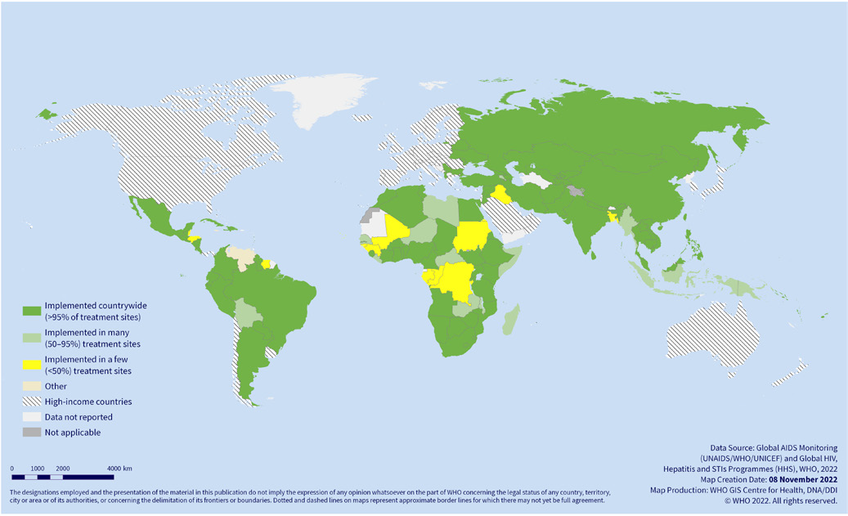
HIV VL COVERAGE
National policy on routine viral load testing for monitoring ART and implementation status among adults and adolescents living with HIV in low- and middle-income countries, July 2022
VL testing still suboptimal in high burden countries
88% (22 of 25) had VL testing coverage <90%
32% of the countries reported <50% viral load testing coverage
Source REPORT ON THE GLOBAL ACTION PLAN ON HIV DRUG RESISTANCe 2017–2021

Slide 13
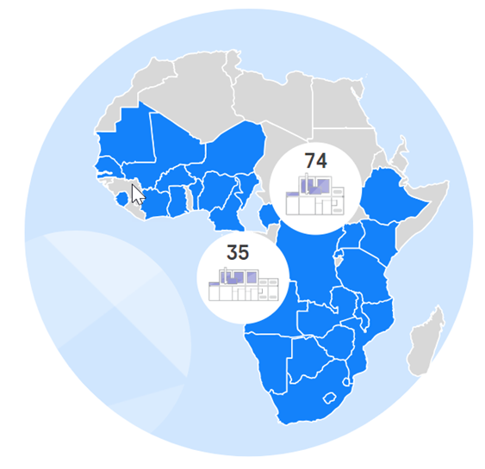

Footprint in Africa some commercial assays
Roche cobas
Abbott
90 active systems, almost 1/3 in South Africa
m2000sp – approx. 120 systems
m2000rt – approx. 90 systems
Plus 3 c8800 systems and 13 c6800 systems.
Provided by Abbott SA (AMD) Molecular Diagnostics
Provided by Roche Diagnostics

Slide 14
Other Assays
Newer POC quantitative tests
? sensitivity
? sample type
testing procedure – sample separation
Self-collection devices for plasma
plasma volume
Sensitivity
Western Blot
not widely used anymore
In SA public sector, only available at reference centre
Single copy NAT assays
Not used in routine labs
Procedure more complex and larger volumes
of plasma required

Slide 15
Limitations/Concerns
Programmatic
Assays
HIVVL coverage in Africa not optimal
Integration into routine VL testing without a vertical stream requires careful planning
High volumes of tests performed in routine monitoring – PrEP cases may get lost
VL not routinely performed at 3 months
Turnaround time may be prolonged – especially in diagnostic dilemma cases
SCA not available in routine labs
True result and validation of HIV diagnosis in ART exposure
False negatives
False positives
DBS and PSC – not sensitive enough
POC
Good possible use case
Xpert LOQ <40 cp/mL requires higher volume plasma – 1 mL
mPIMA requires 50 սL plasma but RNA LOQ is <800 cp/mL
Other considerations – user, QA, location

Slide 16




ACKNOWLEDGEMENTS
Dr Kim Steegen
Prof Lesley Scott
Dr Vidya Keshav
Laboratory staff involved in testing and verifications

