Slide 1
Long-acting PrEP and the potential for resistance
Urvi M Parikh, PhD, University of Pittsburgh USA
SY11 HIV testing in the context of long-acting extended delivery of HIV PrEP

Slide 2

Long-acting PrEP Saves Lives
PrEP is highly successful at preventing HIV infection
Resistance cannot occur in individuals who do not acquire HIV

Slide 3

HIV drug resistance is a risk for individuals who acquire HIV while on long-acting PrEP
Image credit:www.hivplusmag.com “New treatment against Advanced Drug Resistant HIV”

Slide 4
Outline
Overview of resistance risk with long-acting PrEP​
  Dapivirine Ring
  Long-Acting Cabotegravir (CAB-LA)​
Research Gaps and Solutions

Slide 5
A decade of lessons learned from oral PrEP
Type of Study | % with PrEP-Associated Resistance (K65R, M184IV or K70E)
 | Follow-Up Visit | Retrospectively determined to be living with HIV at Enrollment
Clinical Trials | 5% | 65%
On-Demand PrEP | 7% | 40%
Demonstration Project | 4% | 50%
Implementation Cohort | 22% | -
The risk of HIV-1 resistance from oral TDF/FTC PrEP is highest when started during undiagnosed acute infection.
Rates of resistance from TDF/FTC PrEP in rollout settings may be higher than what was observed in clinical trials
Ref: Parikh and Mellors. Curr Opin HIV/AIDS 17(4): 2022

Slide 6
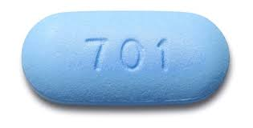

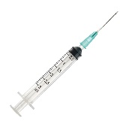
Same drug classes for treatment and prevention
HIVDR could lead to virologic failure on ART
HIV PREVENTION
HIV TREATMENT
TDF/XTC
F/TAF
NRTI
TDF/XTC
F/TAF
Dapivirine Ring
(DVR)
NNRTI
Efavirenz
Cabotegravir (CAB)
INSTI
Dolutegravir
Bictegravir, CAB/RPV
Transmitted resistance from failing ART could lead to breakthrough infection on PrEP modalities
Ref: Figure adapted from Parikh and Mellors. Curr Opin HIV/AIDS 17(4): 2022

Slide 7
Resistance risk with HIV acquisition on long-acting PrEP
Starting PrEP during undetected acute infection
Continuing PrEP after breakthrough infection
PrEP not protective against transmitted resistant strains from partner
Ref: Parikh & Mellors Curr Opin HIV AIDS 11(1): 2016

Slide 8

Dapivirine Ring

Slide 9
Starting dapivirine ring during undetected acute infection
Low plasma dapivirine concentrations – no systemic pressure
Low risk of resistance
Study | Acutely Infection at Enrollment in DPV Arm | Resistance
ASPIRE | 0 | -
HOPE | 3 | None
RING | 5 | 1 (E138A)
DREAM | 3 | None
Nel et al AIDS 2014 28:1479
Parikh et al JIAS 2021 23:e25833
Nel et al Lancet HIV 2023; 9:e77-86

Slide 10
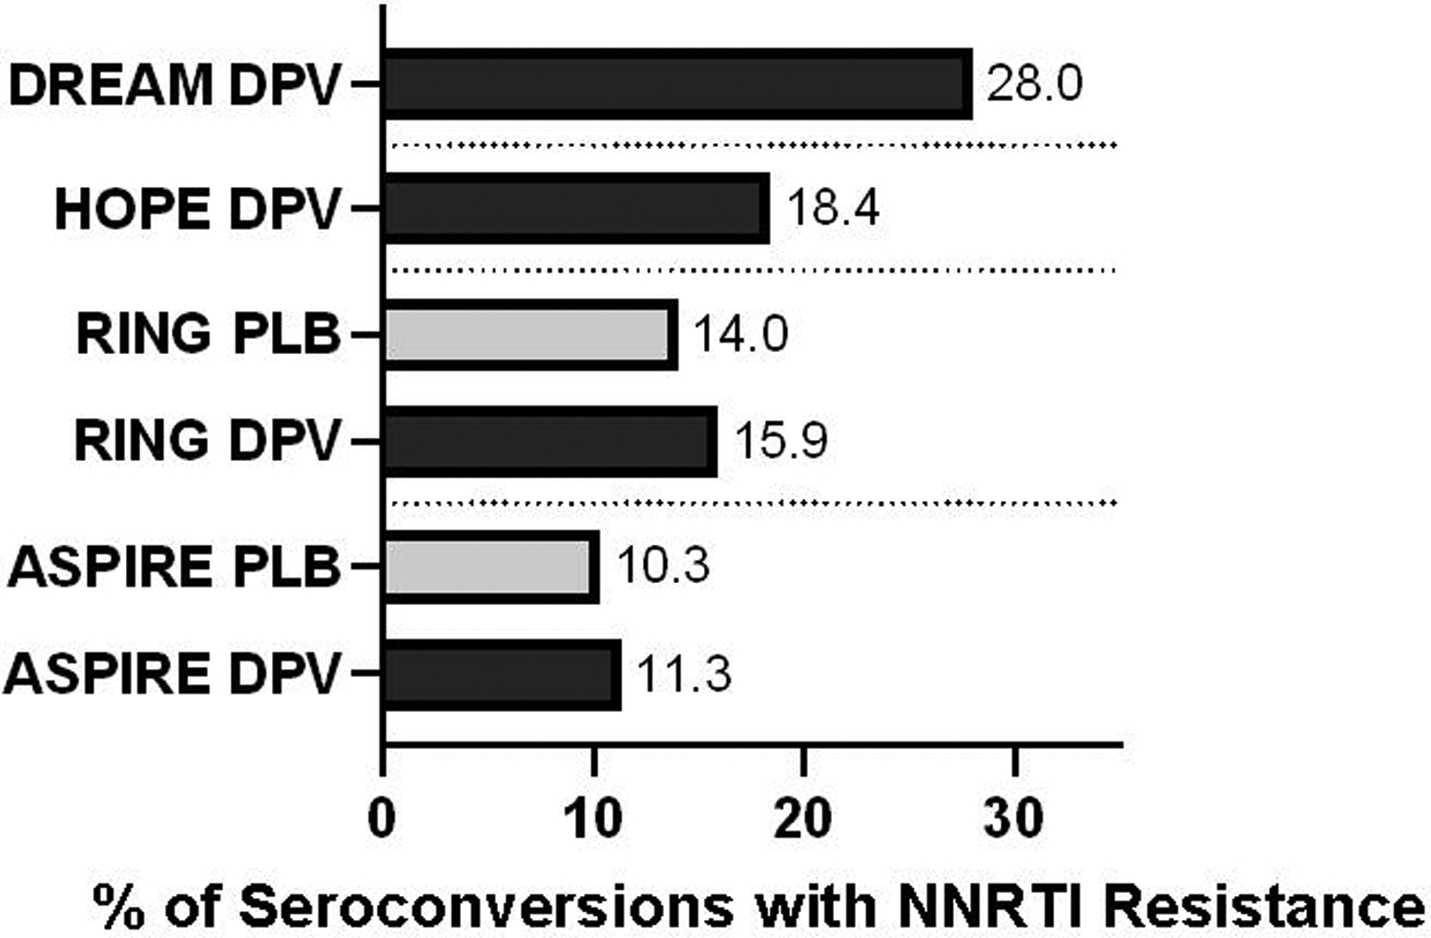
Continuing dapivirine ring after breakthrough infection
Rates of resistance independent of study arm
Resistance likely transmitted and not selected by dapivirine ring
DPV = dapivirine ring arm;
PLB = placebo ring arm
Ref: Figure adapted from Parikh and Mellors. Curr Opin HIV/AIDS 17(4): 2022

Slide 11
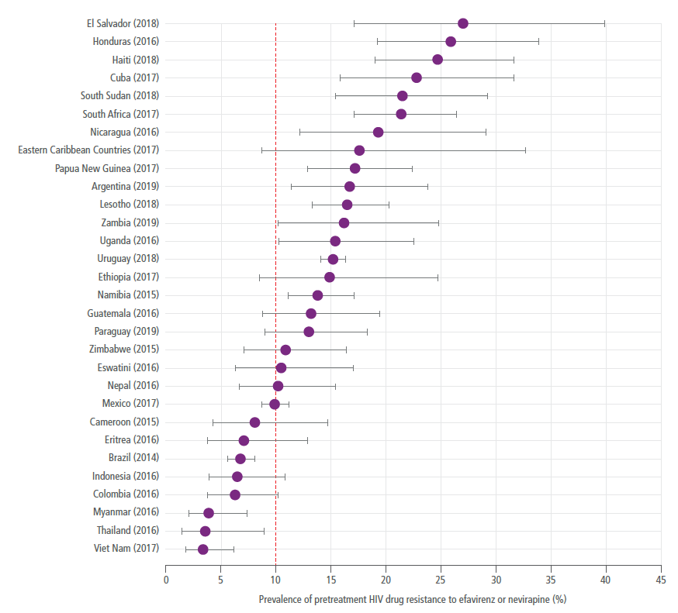
High rates of pre-treatment NNRTI resistance
2021 WHO HIV Drug Resistance Report

Slide 12
Transmitted NNRTI resistance
High rates of background NNRTI resistance
MOSAIC is monitoring for drug resistance in countries in Africa rolling out Ring
DPV = dapivirine ring arm;
PLB = placebo ring arm
Ref: Figure adapted from Parikh and Mellors. Curr Opin HIV/AIDS 17(4): 2022
Notes:
.

Slide 13

Long-Acting Cabotegravir

Slide 14
Starting CAB-LA during undetected acute infection
4 cases in HPTN-083
 | Genotype at Enrollment | Detection of Infection | Genotype at Detection of Infection
Case A1 | K65R+M184V (NRTI) L100I+K103N+P225H (NNRTI) | Week 4 | Viral load too low
Case A2 | WT | Week 6 | E138K+Q148K (INSTI)
Case A3 | WT | Week 10 | WT (Week 24)
Case A4 | WT | Week 9 | Viral load too low
Time to diagnosis extended
INSTI resistance with 2 mutations selected in one case
. Ref: Marzinke Antimicrob Agents Chemoth 2023;67(4):e0005323

Slide 15
Continuing CAB-LA after breakthrough infection
Updated HPTN-083 Analysis
Group 1 Group 2
Participants who acquired HIV with Recent CAB PrEP Administration (<6 months) N = 18 | Participants who acquired HIV with No recent CAB PrEP administration (>6 months) N = 14
Includes:
HIV pos at enrollment (n = 4)
Oral-phase infection (n = 3)
Infected despite on-time injection (n = 6)
Delayed injection (n = 3)
CAB restarted after infection (n = 2)
Ref: Marzinke et al.. Antimicrob Agents Chemother 67(4): 2023

Slide 16
Continuing CA-LA after breakthrough infection
Updated HPTN 083 analysis in participants who acquired HIV
 | Recent CAB PrEP (<6 months) N = 18 | No recent CAB PrEP (>6 months) N = 14
Major INSTI mutations | 10 (56%) | 0 (0%)
Delayed Seroconversion | 14 (78%) | 1 (7%)
Ref: Marzinke et al.. Antimicrob Agents Chemother 67(4): 2023

Slide 17
Resistance in Group 1
Category | Number with INSTI Resistance at Any Visit | INSTI Resistance-Associated Mutations (Major in Bold)
(A) HIV Pos at Enrollment | 1 of 4 (25%) | M50I, E138K, Q148K
(C) Oral Phase Infection | 2 of 3 (67%) | L74I, Q146Q/R, E138E/K, G140G/S, Q148R, E157Q
 |  | E138A, Q148R
(D) Infected despite on-time injection | 6 of 6 (100%) | Q146L, Q148R, N155H, R263K
 |  | N155H, S230R
 |  | R263K
 |  | M50I, E138K, G140A, Q148R
 |  | M50I, R263K
 |  | L74I, Q148R
(DX2) Delayed injection | 0 of 3* (2 not tested)
(BR1) CAB restarted after infection | 1 of 2 (50%) | Q148R
Overall 10 of 16 (56%)
Ref: Marzinke et al.. Antimicrob Agents Chemother 67(4): 2023

Slide 18
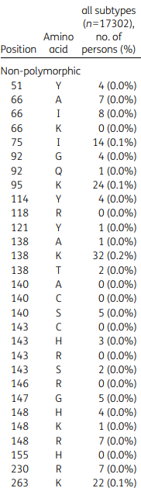
Transmitted INSTI Resistance
Rates of pre-treatment INSTI resistance are low
Resistance rates may increase with increased use of DTG as first line treatment
Could pose future risk
Will be important to have updated pre-treatment INSTI resistance data
Prevalence of INSTI-resistance-associated mutations in INSTI-naïve persons
<0.2%
Ref: Tsou J Antimicob Chemother 2020; 75:170

Slide 19


Summary
Resistance risk with acquiring HIV on dapivirine is low
  Low systemic drug levels
  Equivalent rates of resistance in active and placebo arm of trials
  Efficacy of ring against NNRTI-resistant strains unknown
Resistance risk with acquiring HIV on CAB-LA is high when HIV diagnosis is delayed
  Drug concentrations at the sites of transmission may be insufficient to block transmission but concentrations elsewhere (e.g. blood, lymph nodes) are sufficient to select resistance
  Secondary transmissions have not been reported but will be important to monitor

Slide 20
MOSAIC will monitor for HIV drug resistance with PrEP use
To understand local rates of resistance in PrEP clients who seroconvert during Ring or CAB LA use
To ensure effectiveness of PrEP programs and to understand if additional support is needed for PrEP adherence and/ or routine HIV testing
ACTION (Kenya) and SeroPrEP (US) will evaluate seroconversions on PrEP to understand causes of infection and follow for 12 months to assess treatment outcomes with PrEP seroconversion

Slide 21






Acknowledgements
ACTION and SeroPrEP Study Team
Catherine Koss, Monica Gandhi, David Glidden, Amy Conroy, Matthew Spinelli, Bob Grant, John Mellors, Amy Heaps, UCSF Hair Analytical Laboratory
Kristine Torjesen
Jason Reed
Lisa Levy
Jill Peterson
Edward Livant
Bhavna Chohan
HIVDR Team
Country Teams
CATALYST
Parikh Lab
Lauren Kudrick
Amy Heaps
Kerri Penrose
Kelley Gordon
Jay Goetz
Cory Shetler
Lauren Siffert
Mellors Lab
John Mellors
Lou Halvas
Josh Cyktor
Jana Jacobs
Dianna Hoeth
And all lab members
All members of the study teams
Funding: NIAID R01 AI167753 (Koss, Parikh); UCSF CFAR/ARI, USAID/PEPFAR (GEMS & MOSAIC)
NIH Rustbelt CFAR
Individuals and their providers who have generously participated in the GEMS, HPTN, MOSAIC, CATALYST, ACTION and SeroPrEP studies

