Slide 1
Lessons Learned from Community Engagement in HIV Phylogenetic Research
Brian Minalga, MSW | Fred Hutchinson Cancer Center
Satellite session: Person-centred approaches to address the health needs of people living with HIV and co-infections and co-morbidities

Slide 2
Conflict of interest disclosure
I have no relevant financial relationships with ineligible companies to disclose.

Slide 3
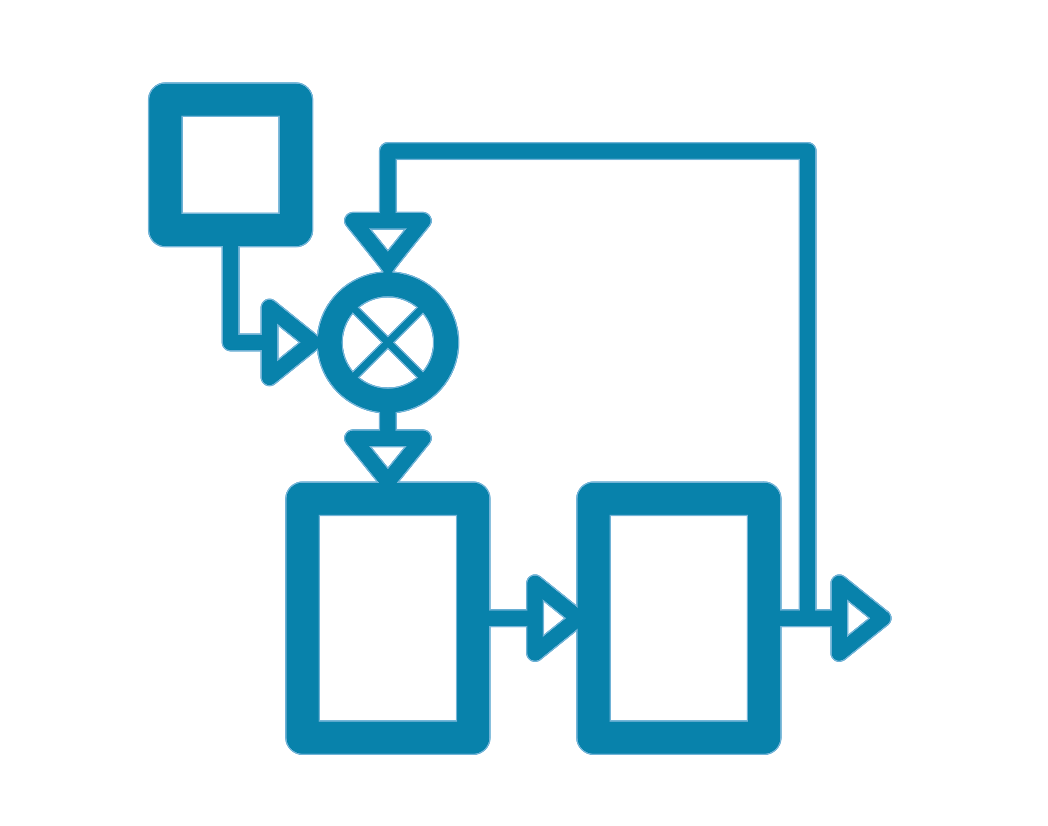
Background
Phylodynamic Model of HIV Transmission
“Black men have an X% probability of acquiring/transmitting HIV from/to another Black man.”
“Young men have an X% probability of acquiring/transmitting HIV from/to older men.”
Notes:
In 2020, I became aware of a research project that was underway at the University of Washington in Seattle, USA. This research project involved a phylodynamic model of HIV transmission to generate conclusions such as these…
I was alarmed by the conclusions that were being generated by this model—especially given the inputs of the model.

Slide 4
Original Study: Phylodynamic Modeling of HIV Transmission
Research Question: Is there phylogenetic evidence of assortative HIV transmission by age, race, or ethnicity among men who have sex with men in King County, Washington, USA?
Notes:
It turns out that this research project was using HIV genetic sequences stored in the local health department’s database to ”predict” HIV transmission patterns in Seattle/King County by race, age, and ethnicity.

Slide 5
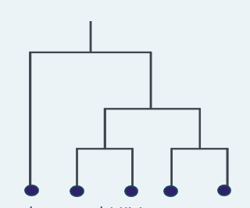
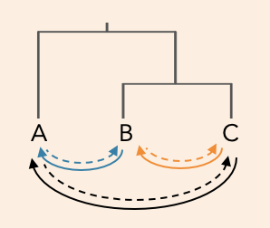
Original Study: Phylodynamic Modeling of HIV Transmission
Research Question: Is there phylogenetic evidence of assortative HIV transmission by age, race, or ethnicity among men who have sex with men in King County, Washington, USA?
Inputs
Outputs
2. Linked
Data
Demographic information (age, race, ethnicity)
CD4+ counts
date of HIV sequence sampling
1. Estimate a transmission probability weight for all pairs of HIV sequences
2. Predict population-level patterns
1. Phylogenetic Tree of HIV Sequences collected via MHS
Notes:
It turns out that this research project was using HIV genetic sequences stored in the local health department’s database to ”predict” HIV transmission patterns in Seattle/King County by race, age, and ethnicity.

Slide 6
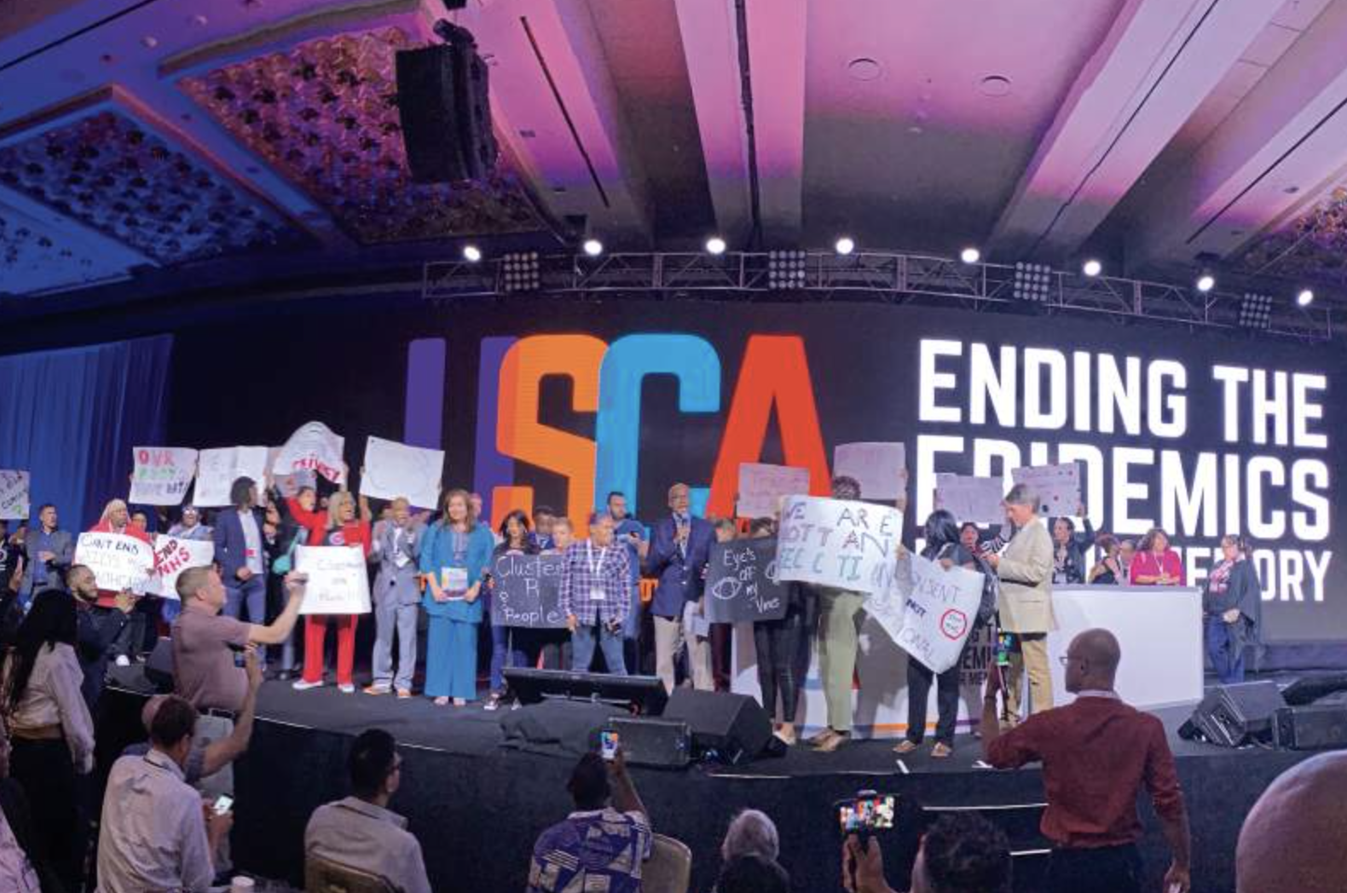
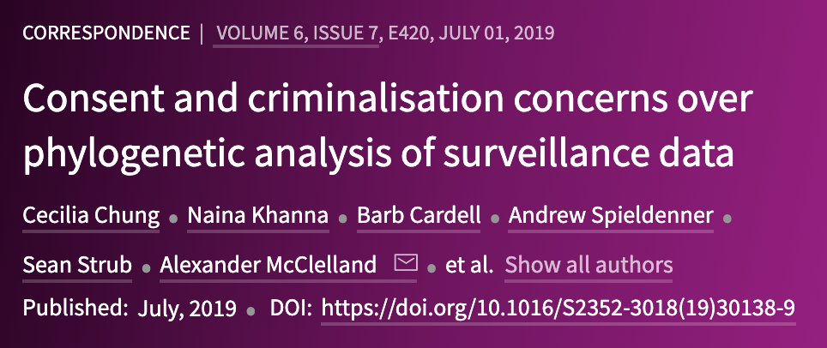
Notes:
At the time, I was heavily involved with community-based advocacy that arose out of ethical concerns with molecular HIV surveillance. I have an activism and advocacy background in the global HIV decriminalization movement, I was involved with the US implementation of a global community-based participatory research project called the HIV Stigma Index, and I also work in HIV clinical trials where I apply ethical frameworks and community engagement methodologies, including to the suite of groundbreaking treatment as prevention studies that informed the highly successful and community-led U=U campaign—studies that used HIV phylogenetic analyses to determine that undetectable equals untransmittable. It was at this nexus of my experiences in HIV activism and academic research that I became involved in this relatively niche field of HIV molecular epidemiology, phylodynamic research, and related ethical and community-focused issues.

Slide 7
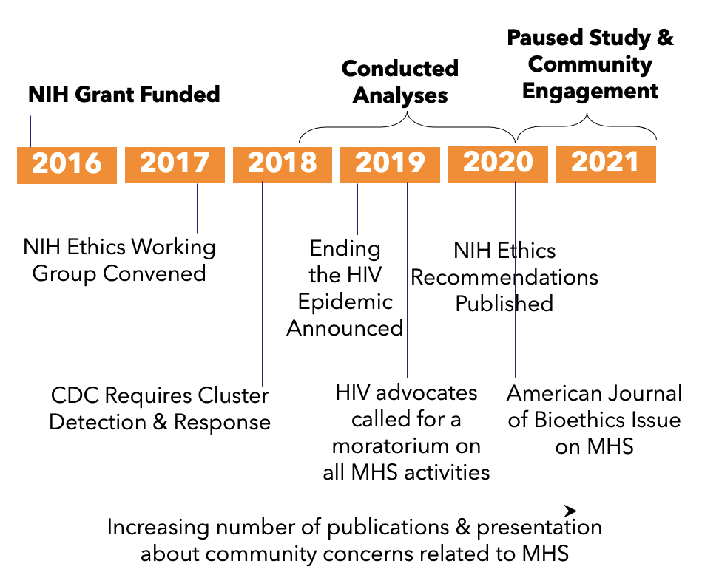
Timeline
Notes:
I had been working in this space for several years already, but it wasn’t until 2020 that the researchers working on this phylodynamic model became aware of these growing concerns and the rapidly expanding body of literature on HIV molecular epidemiology. The parent grant for this modeling project was funded in 2016, so unfortunately, these researchers were nearing the end of their project when they became aware of the breadth and depth of the concerns. In fact, they had already prepared a draft manuscript of their model and its predictions related to population-specific transmission patterns.

Slide 8
Methodology: Community Consultation Process
Meetings and presentations:
Center for AIDS Research Community Engagement Office
Dialogue with researchers and clinicians (~50)
Dialogue with community-based organizations and advocates (~15)
*Consultation with a National Coalition on molecular HIV surveillance:
What are the perceived benefits of this project?
What are the potential harms?
Reflexive writing/journaling
Notes:
Although their project was near completion, the researchers working on this phylodynamic model made a surprising decision: they chose to embark upon a community consultation process. They did so in partnership with me and others working in this advocacy and academic arena.

Slide 9
Issues
Informed Consent
Interlocking Systems of Oppression
Racism
Homophobia
Syndemics
Stigma
Ageism
Discrimination
Criminalization
Notes:
Through this community consultation process, the researchers identified many issues and concerns held by the community. Two important issues are listed here:
There is no informed consent for research uses of HIV phylogenetic samples and associated metadata collected through molecular HIV surveillance, calling the ethics of this research project into question, and
This particular research project was interacting with longstanding systems of oppression such as racism, homophobia, and HIV criminalization, and its outputs only served to reproduce harmful and stigmatizing norms about communities disproportionately affected by HIV with no directly intervenable public health outcomes.

Slide 10
Decision Not to Publish
Does this research translate into public health action and efforts to end the HIV epidemic? (Public Health Utility)
Does this research benefit—or at minimum not harm—communities of people living with HIV who are included in this research without their consent? (Beneficence and nonmaleficence)
Does this research equitably distribute benefits and risks to people living with HIV as well as people susceptible to acquiring HIV? (Justice)
Notes:
Considering these questions in the context of the issues raised by the community, the researchers decided not to publish their original project.
These are three considerations for researchers to take into account when designing and conducting their studies.
Table 1 in our final publication outlines about a dozen additional recommendations for HIV researchers in any field—not limited to phylodynamic modeling. These recommendations are focused on advocating for structural interventions, promoting autonomy, promoting transparency, and bridging understanding.

Slide 11
Alternate Publication
“Lessons Learned from Community Engagement Regarding
Phylodynamic Research Using Molecular HIV Surveillance Data”
Our community engagement process
What we learned from the community
Decision not to publish
Recommendations for other researchers
Originally published in 2022 as a pre-print—until now!

Slide 12
Conclusions
HIV: The H stands for Human!
HIV research must never serve to exploit human suffering or disease
for academic profit or intrigue.
HIV research must always center people.
Notes:
All HIV research: this includes modeling studies.

Slide 13
Thank you!
Coauthors: Diana Tordoff, Alfredo Trejo, Alic Shook, Roxanne P. Kerani, and Joshua T. Herbeck.
The Community Coalition on Molecular HIV Surveillance, including Alexander McClelland, Andrew Spieldenner, Ronald Johnson, Marco Castro-Bojorquez, and Edwin Bernard.
Positive Women’s Network-USA, including Naina Khanna, Victoria Siciliano, and Kelly Flannery.
Everyone who contributed to our community engagement process including Stephaun Wallace and the Community Engagement Office with the University of Washington/Fred Hutch Center for AIDS Research; the attendees of the Public Health-Seattle & King County Lunchbox Talk and Salon Presentation as well as its organizers, Susan Buskin and Jsani Henry.
This work was funded by the US National Institute of Allergy and Infectious Diseases (R01AI127232).
bminalga@fredhutch.org

