Slide 1
Person-centred care: Shifting the power dynamic in the delivery of adolescent- and youth-friendly health services JIAS Viewpoint by PATA and Y+ Global
Tung Doan, The Global Network of Young people living with HIV (Y+ Global)
Satellite session: Person-centred approaches to address the health needs of people living with HIV and co-infections and co-morbidities

Slide 2
Conflict of interest disclosure
I have no relevant financial relationships with ineligible companies to disclose.

Slide 3
Purpose and objectives of the article/study
The specific goal is to investigate the idea of person-centred care (PCC) in the context of health services geared towards adolescents and young people.

Slide 4
Person-centred care (PCC) refers to an approach in healthcare that shifts the power dynamic from the healthcare provider to the patient or service user. It involves engaging the patient in decision making, promoting effective communication, offering multiple choices and fostering patient empowerment, autonomy, and trust in their healthcare journey.
Y+ Global and PATA

Slide 5
PCC fundamental principles Client is a unique person Client should be fully involved in care Client must be given the power to make their own decisions
Y+ Global and PATA

Slide 6
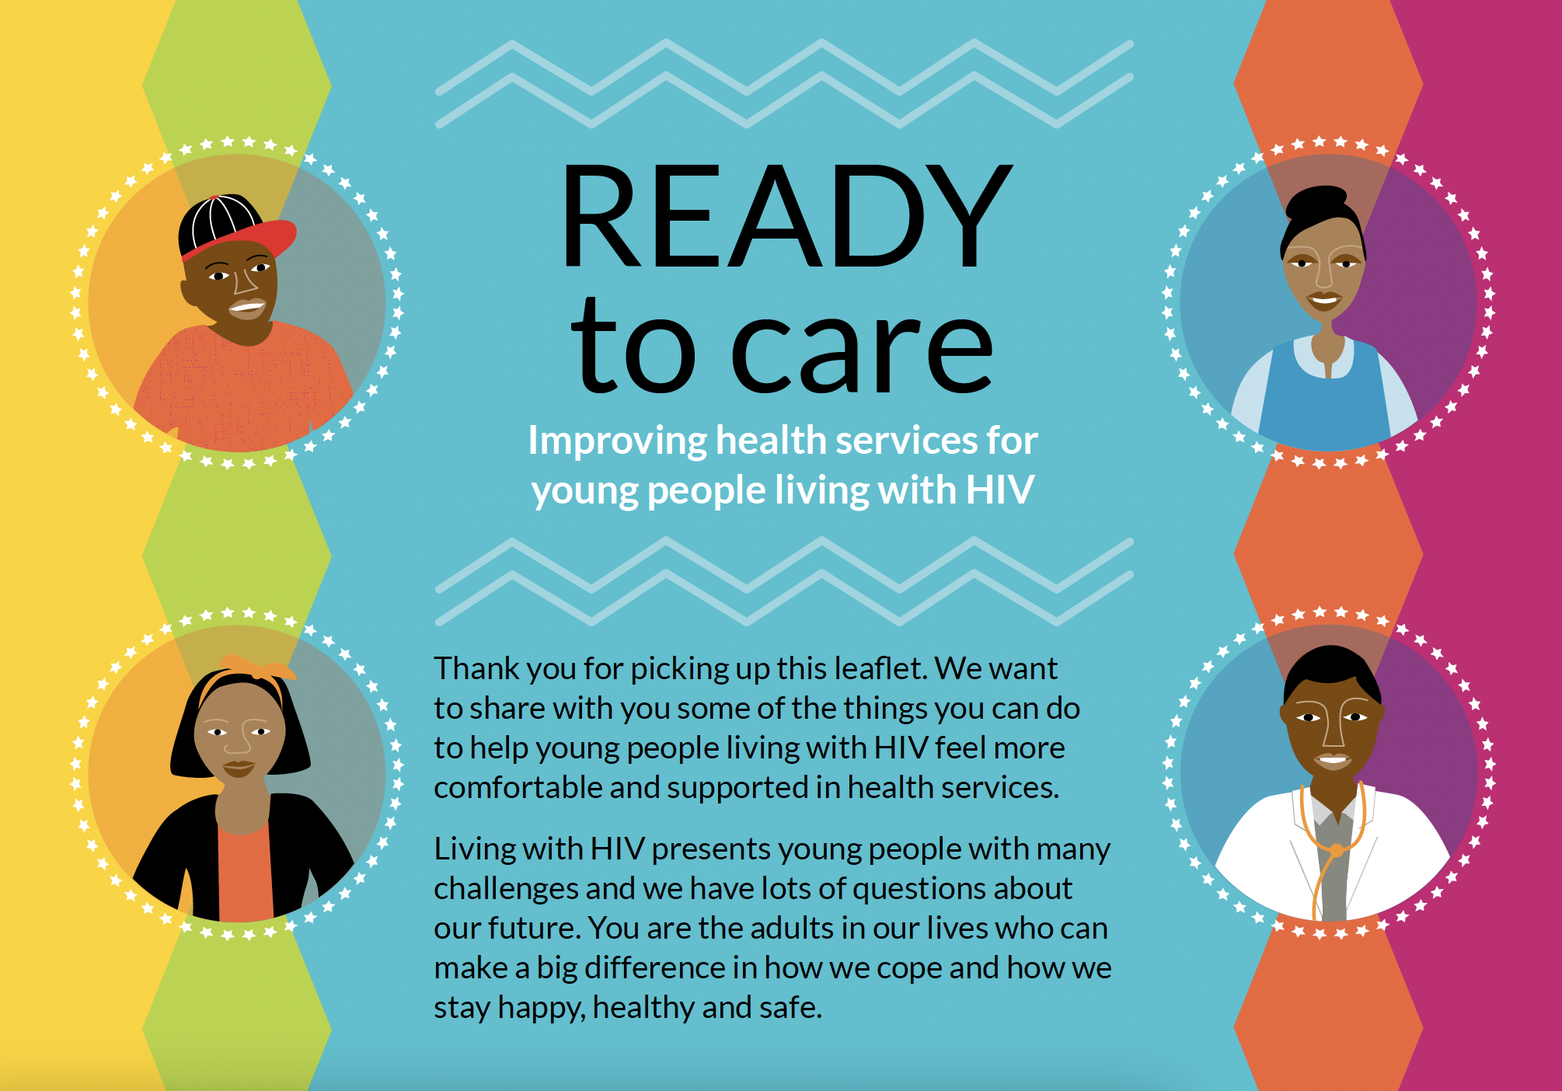
Methodology
PATA collaborated with Y+ Global to bring together health providers and AYPLHIV, creating a unique platform for promoting and enhancing a more equal and empowering relationship between service providers and users.
Practical strategies and recommendations are informed by joint program implementation and a systematic review of person-centred care within the context of HIV treatment settings in sub-Saharan Africa.

Slide 7
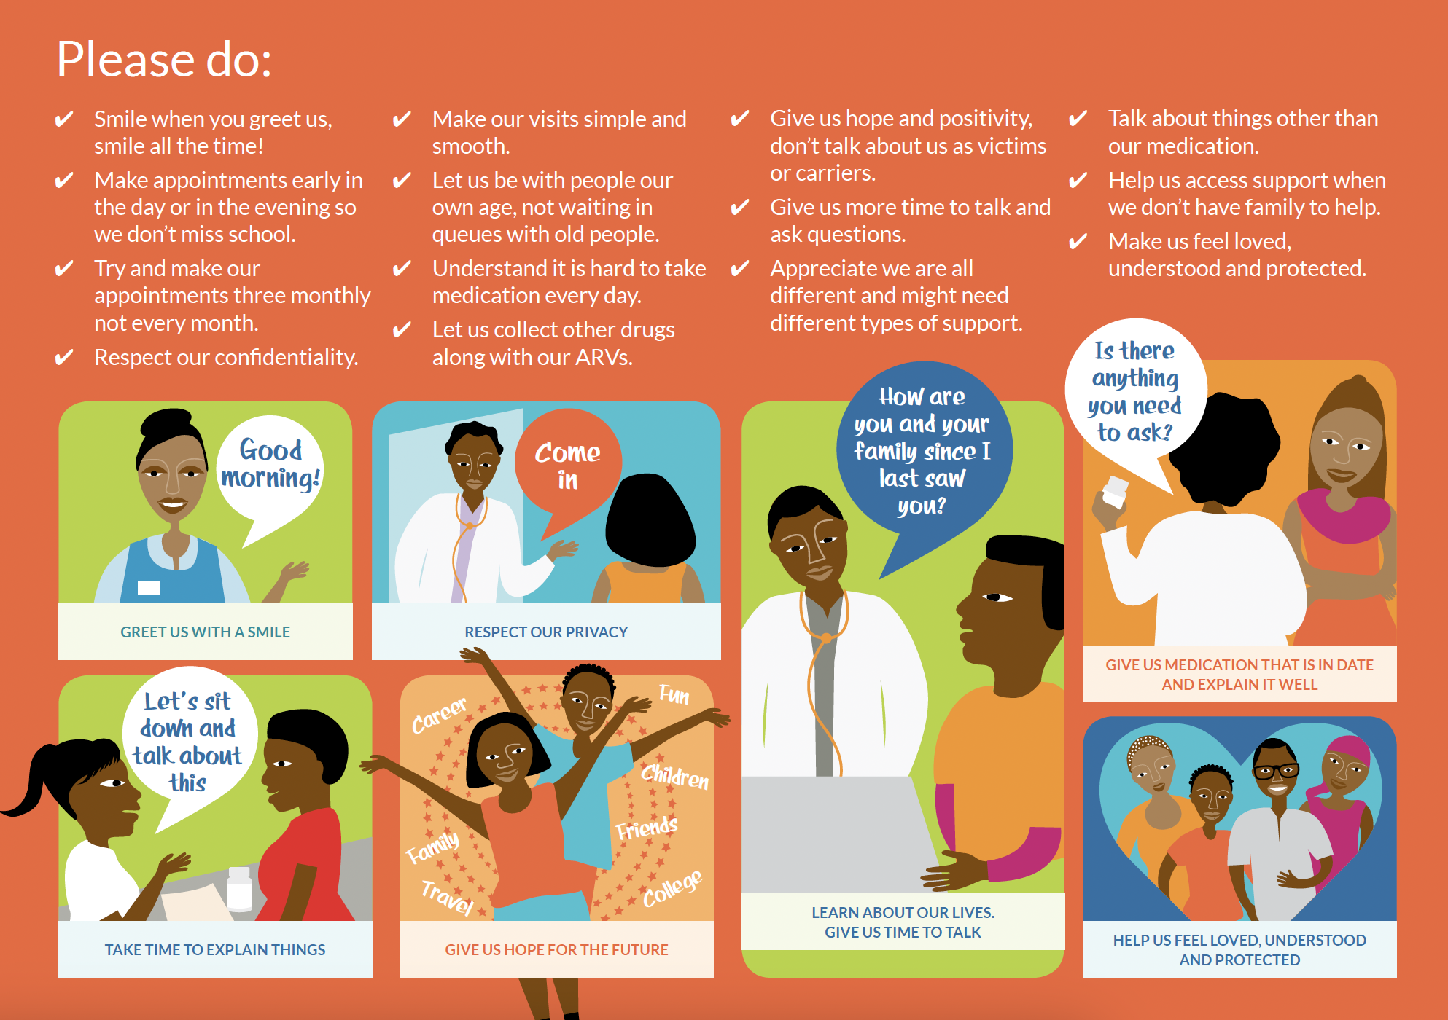
Lessons Learned
Health provider attitude
Multiple, ongoing and layered sensitization strategies are required to deliver PPC that is adolescent-friendly, including:
Values clarification training supporting health providers to reflect on and redefine their values
Relationship-building sessions to support health providers to engage more meaningfully
PCC champions to lead the process of shifting power and changing entrenched mindsets within the health facility

Slide 8
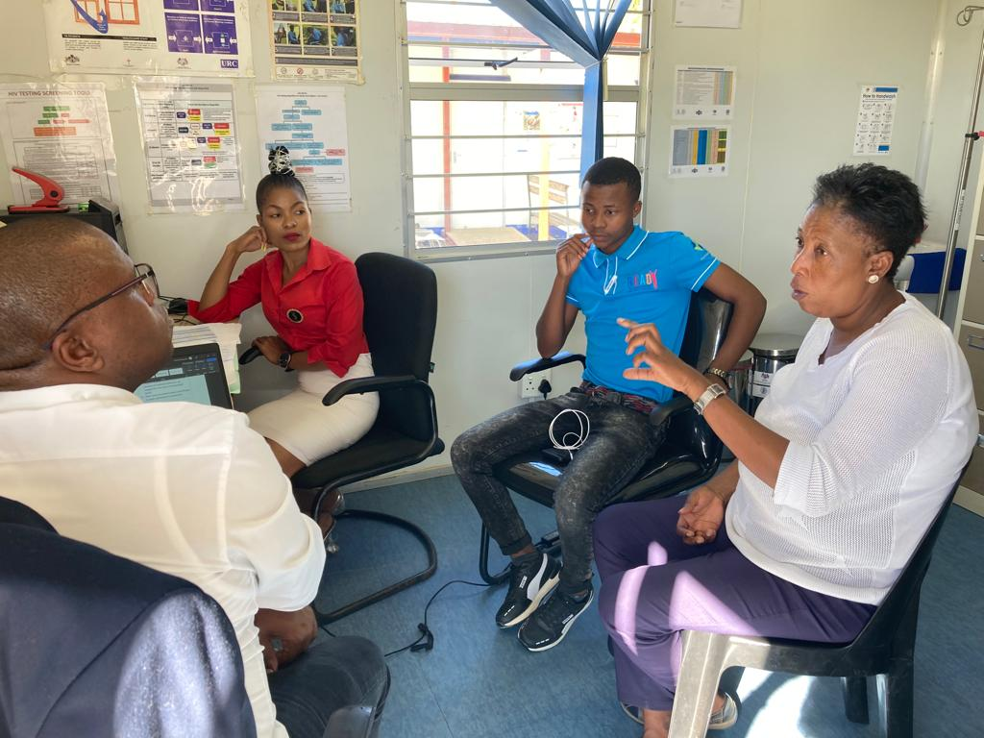
Lessons Learned
Peer support
AYPLHIV peer supporters working in partnership with health care teams can facilitate a fundamental shift in health facility power structures
Engaging AYPLHIV can break down inequalities and challenge often ingrained practices and beliefs
Teen clubs and adolescent-friendly safe spaces – for psychosocial support, counselling and health promotion – improve retention in care and viral suppression
Effective peer support requires successful health facility integration with mutually agreed upon roles and responsibilities

Slide 9
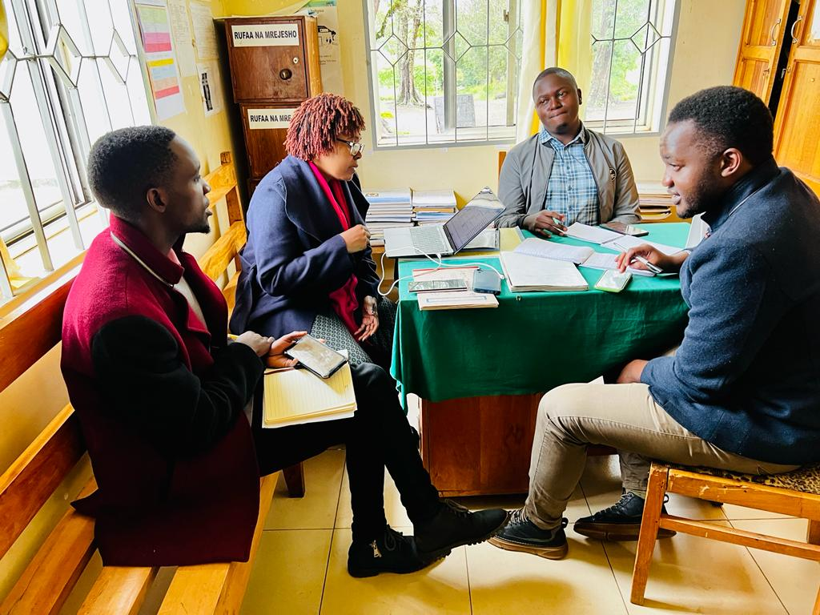
Lessons Learned
Community-led monitoring and service quality improvement
Community-led monitoring assists health care teams and service users to identify service delivery challenges, develop quality improvement plans and hence promote PCC.
AYPLHIV should be involved in the design and implementation of community-monitoring tools.
Health facilities and clients (AYPLHIV) should collectively review feedback and collaboratively determine interventions for action

Slide 10
Conclusions
Strengthening health systems to provide PCC requires institutional commitment and considered implementation across designated roles
An enabling environment with available resources that respond to the clients' needs will go a long way to increase health providers intrinsic motivation and attitude to providing person-centred care.

Slide 11
Calls to action / Next steps in your work
Invest in healthcare staff capacity building, sensitization and composition
Engage the community in the service supply chain.
Facilitate community-led monitoring and continuous quality improvement

Slide 12
Acknowledgement of contributors
Y+ Global and PATA team members who co-authored the Viewpoint:
Lynn Phillips, PATA
Heleen Soeters, PATA
Maximina Jokonya, Y+ Global
Allen Kyendikuwa, Y+ Global
Luann Hatane, PATA

