Slide 1
Introduction
Nelli Barrière – International AIDS Society
Advancing HIV care for mothers and newborns:
Exploring long-acting solutions

Slide 2
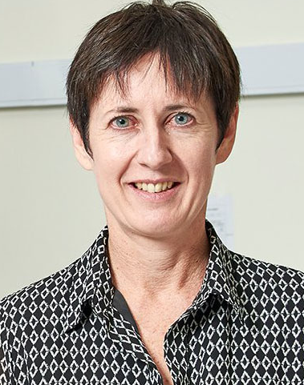
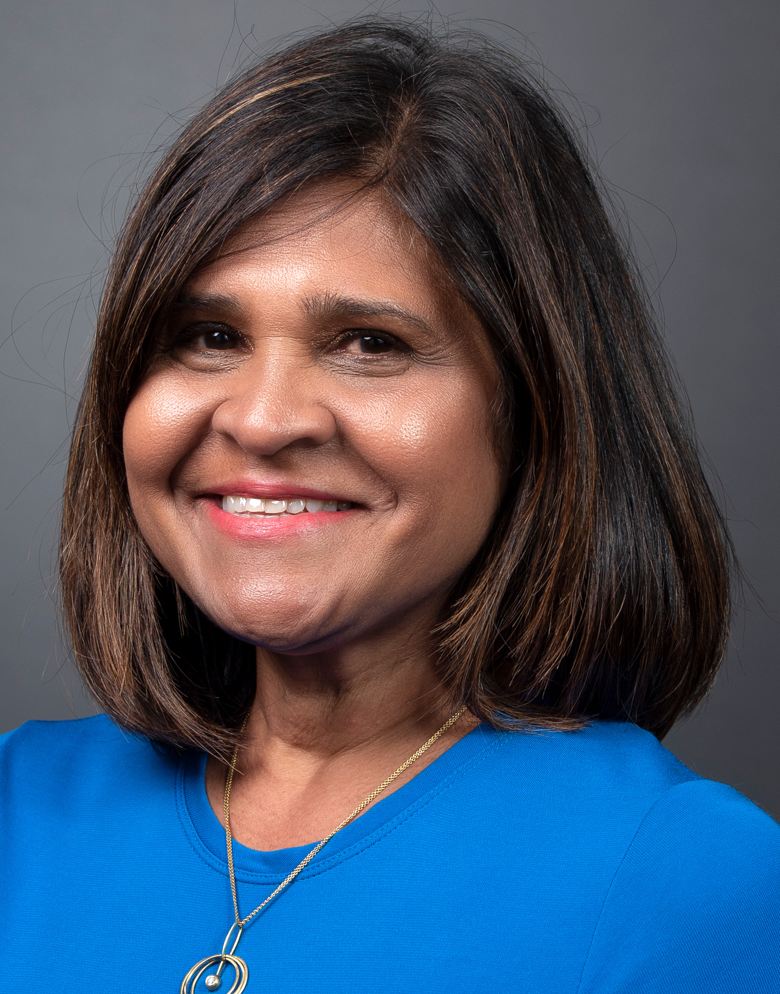
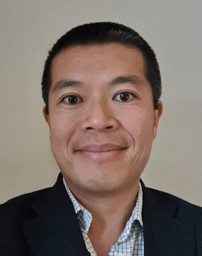
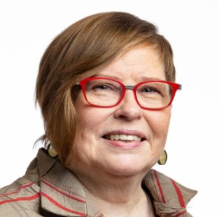
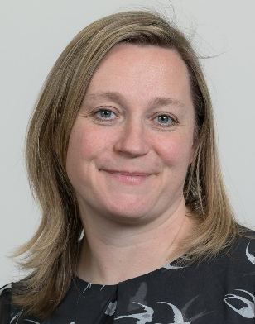
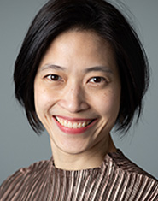
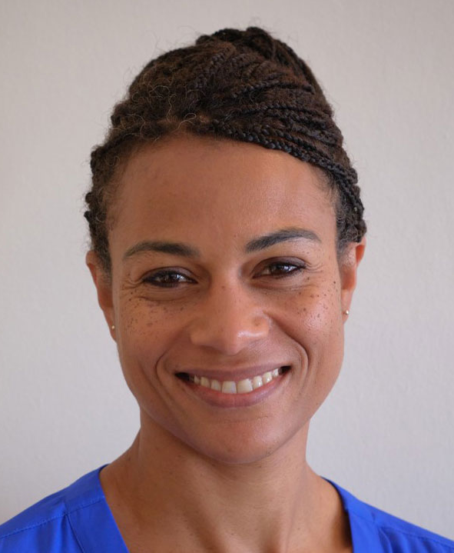
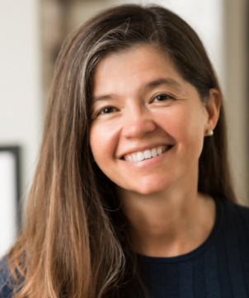

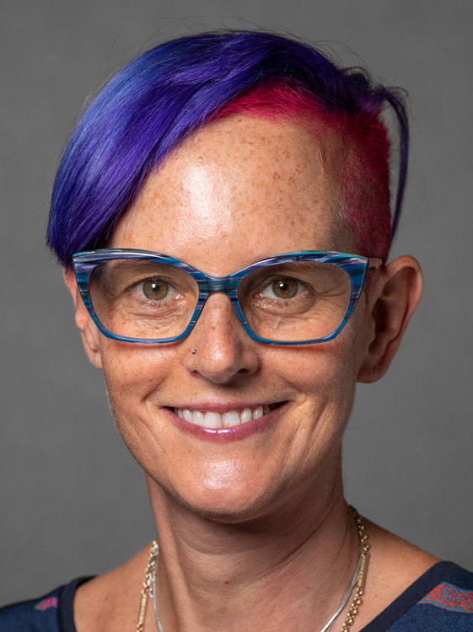

Meet the session co-chairs and presenters
Presenters
Co-chairs
Sínead Delany-
Moretlwe,
Wits RHI
Deborah Persaud, Johns Hopkins University School of Medicine
Lionel Tan,
ViiV Healthcare
Kathryn Kersey,
Gilead
Helen McDowell, ViiV Healthcare
Nittaya Phanuphak,
Institute of HIV
Research and
Innovation
Ingrid Eshun-
Wilsonova,
Janssen
Rebeca Plank
Merck
Moti Ramgopal,
Midway Immunology and Research Center
Chloe Orkin,
Barts Health NHS Trust, Royal London Hospital, Grahame Hayton Unit
Notes:
Charting the Course: Overview of the long-acting HIV prevention and treatment options available and in development for pregnant, breastfeeding women and newborns
Deborah PERSAUD
Johns Hopkins University School of Medicine, United States
Kathryn Kearsey from Gilead will speak about inclusion of pregnant people in clinical trials, and what they are doing in PURPOSE
Ingrid Eshun-Wilsonova from Janssen will speak on how they collect data on pregnancy and lactation on CAB-RPV LAI in sub-Saharan Africa trials and company-wide initiatives to address the inclusion of pregnant and post-partum women in Janssen clinical trials
Lionel Tan from ViiV Healthcare is planning to focus on opportunities and challenges in developing LA solution for post-natal prophylaxis for babies
Rebeca Plank would speak about the provisions in the protocol and design of MSD’s recent HIV PrEP trials in women regarding options for retention of these participants in the trials.

Slide 3
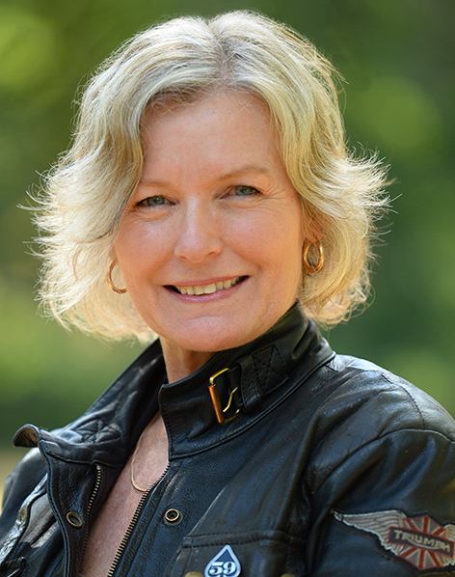
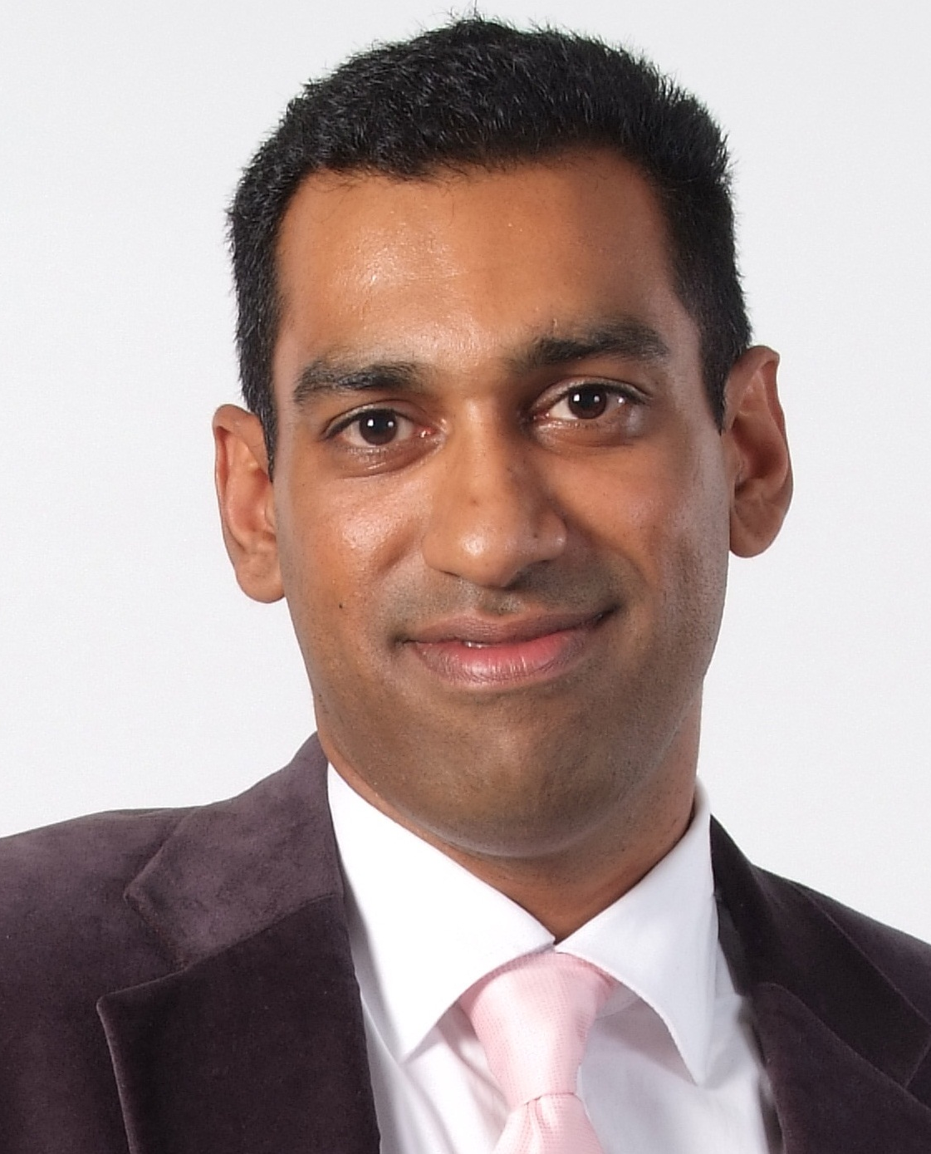
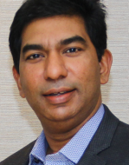
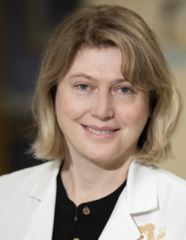
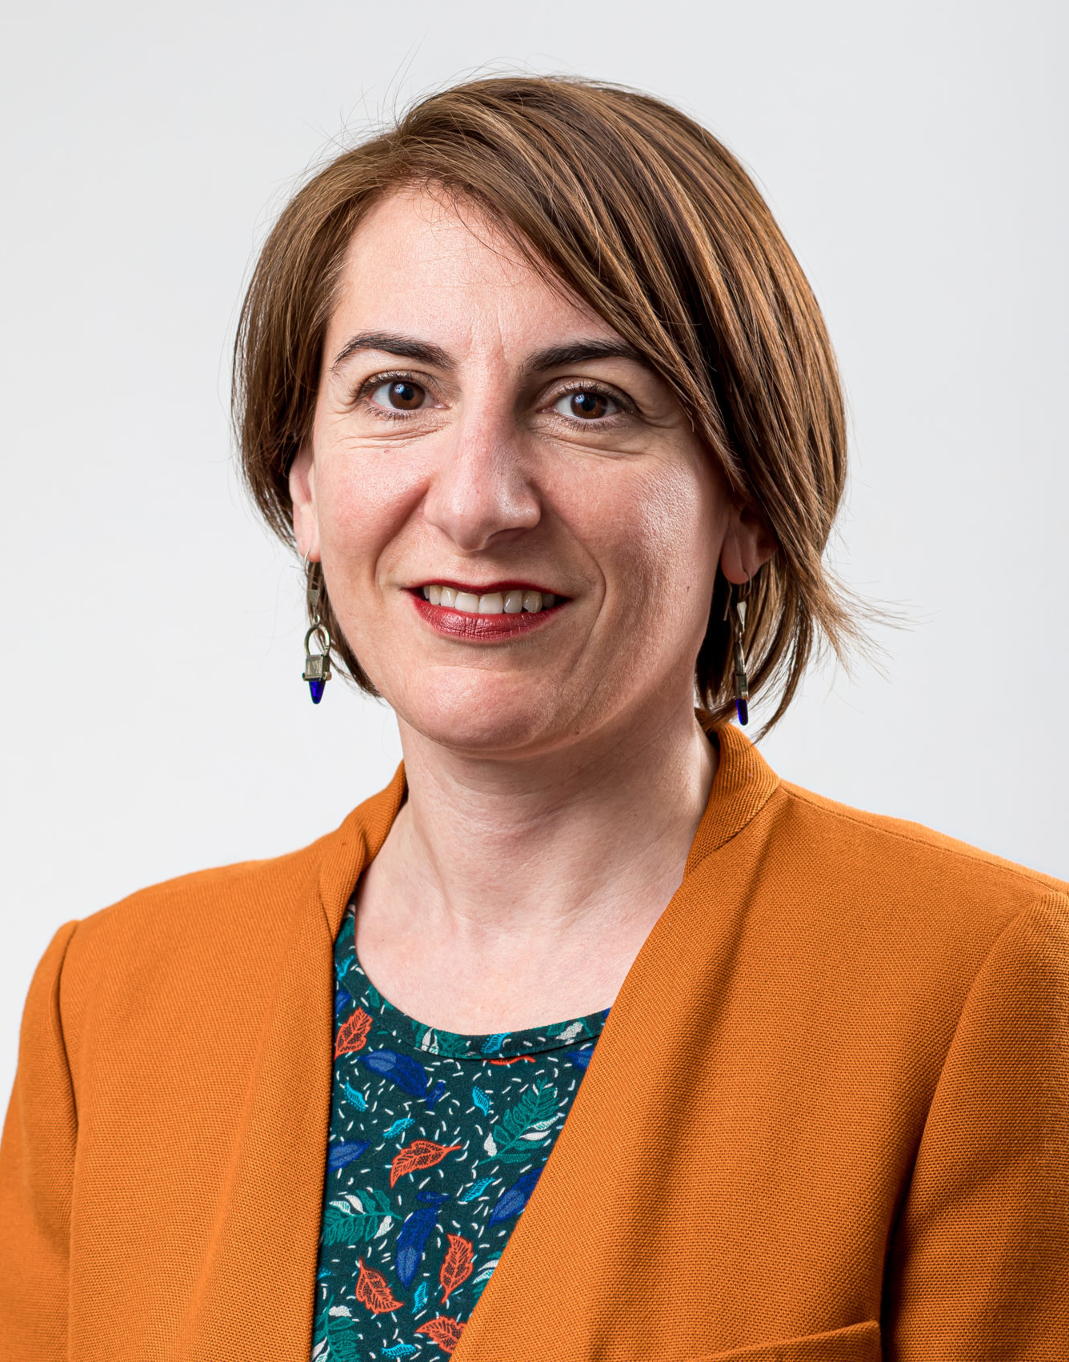
Meet the session panelists
Panelists
Co-chairs
Heather Ellis
Positive Women Victoria
Moherndran Archary
University of KwaZulu-Natal
Nagalingeswaran Kumarasamy
VHS Infecrious Diseases Medical Centre, Voluntary Health Services
Helen McDowell, ViiV Healthcare
Nittaya Phanuphak,
Institute of HIV
Research and
Innovation
Natella Rakhmanina
EGPAF and Children’s National Hospital
Lobna Gaayeb
Medicines Patent Pool

Slide 4









Thank you to our Corporate Partnership Programme sponsors
Learn more on: www.bit.ly/CPPIAS
Learn more on: www.bit.ly/CPPIAS
Notes:
To make all of this possible, we would like to thank our sponsors listed on your screens now for their contribution! As you can see, we have enlarged our sponsorship base this year thanks to the newly created structure. We want to welcome Vir Biotechnology as a Silver member, Worcester HIV Vaccine, Malaika Vx, Sanofi, ImmunityBio as new Bronze partners and welcome back Omega Diagnostics as a Bronze partners as well.
I will now pass over to Nelli to walk us through some of the achievements of the Programme to date.
4

