Slide 1
Protection through research: including pregnant and lactating people in trials of novel LAED
Sinead Delany-Moretlwe, MBBCh PhD DTM&H
University of the Witwatersrand
IAS, July 2023

Slide 2
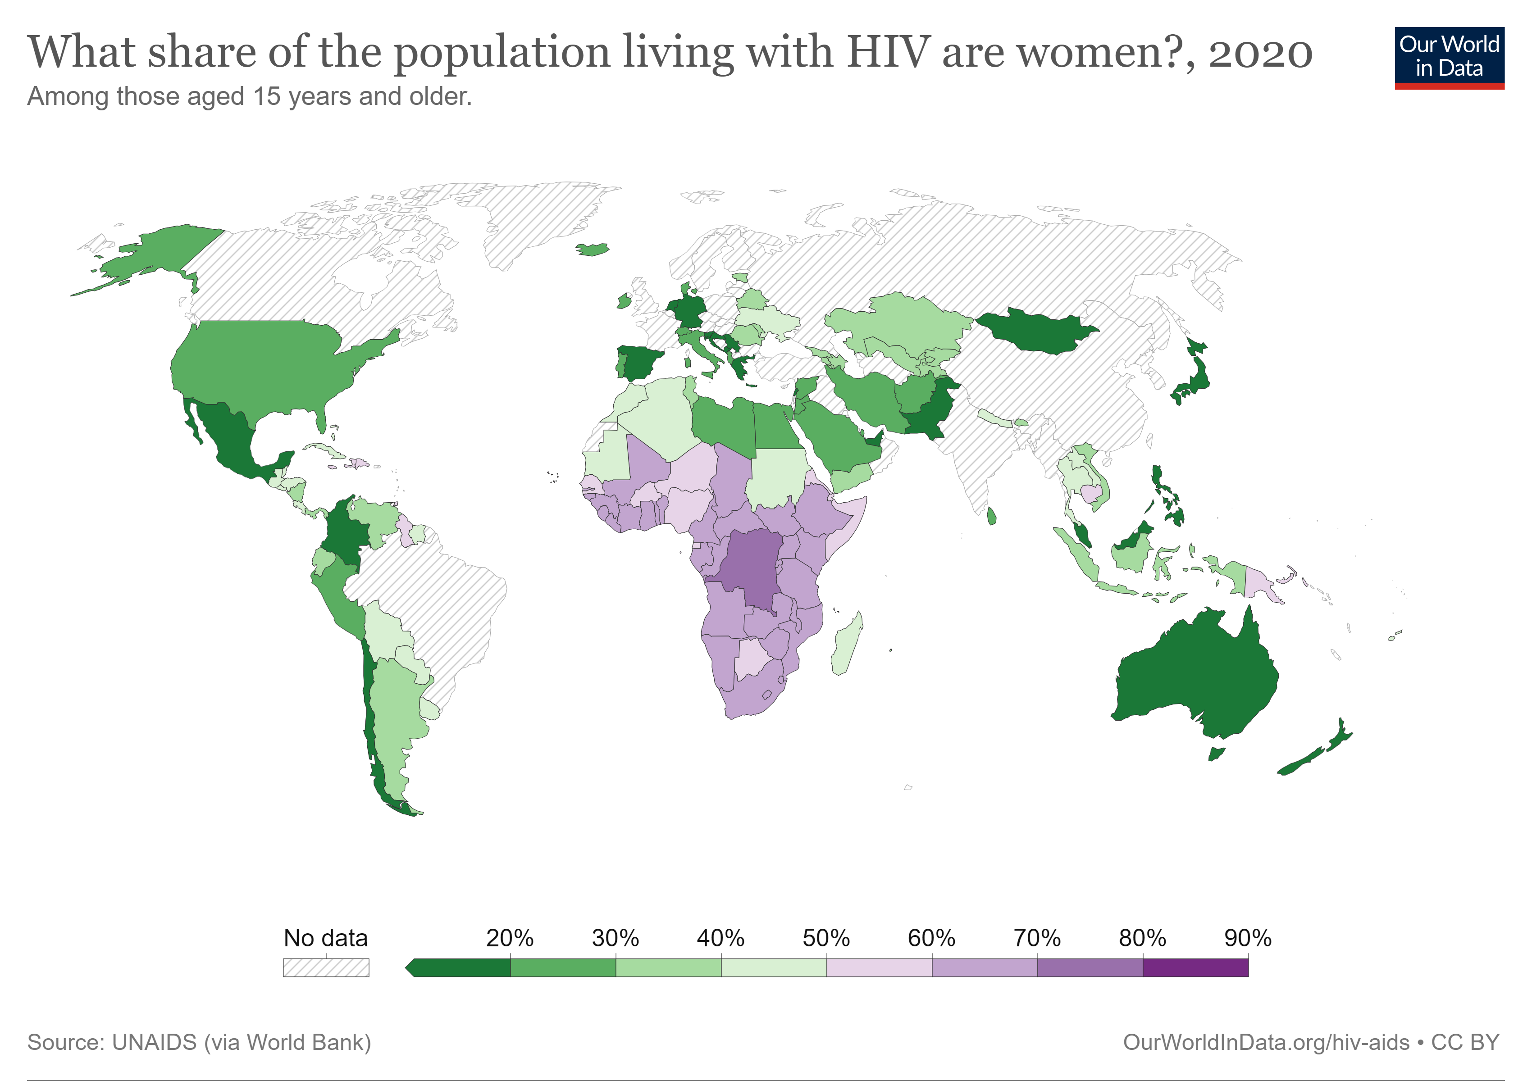
Women in sub-Saharan Africa have an unmet need for HIV prevention

Slide 3
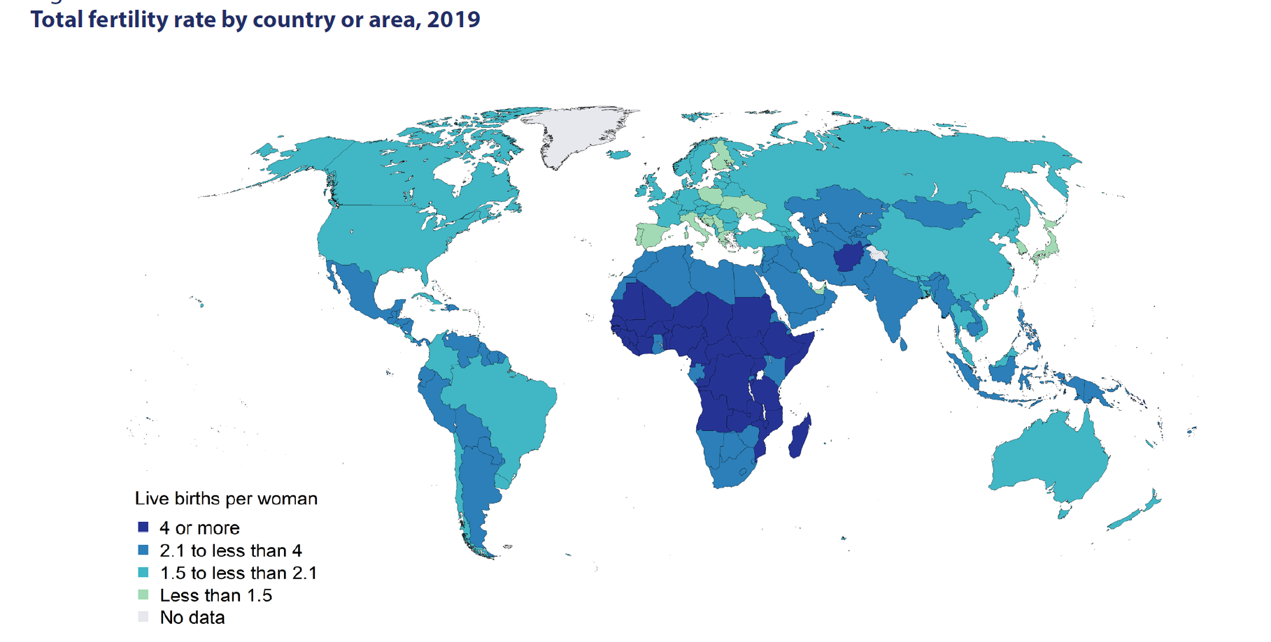
Fertility rates are highest in high HIV burden settings
Source: United Nations Population Division, 2020
Notes:
In sub-Saharan Africa, the region with the highest fertility levels, total fertility fell from 6.3 births per woman in 1990 to 4.6 in 2019.

Slide 4
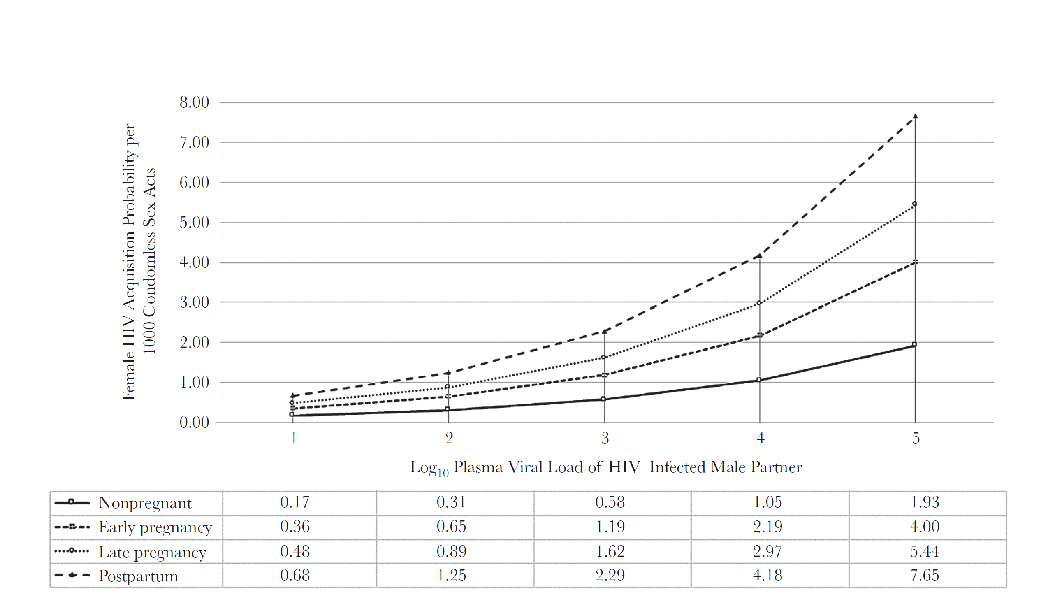
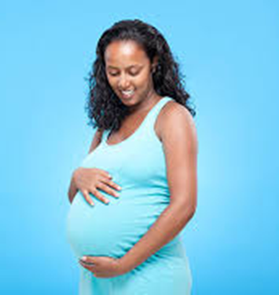
Pregnancy and post-partum period associated with increased risk for HIV
Suggests that biological changes during pregnancy and the postpartum period increase HIV susceptibility
among women.
Source: Thomson, JID 2018
Notes:
Preterm birth = the leading cause of neonatal and under-5 mortality globally
Poor long-term outcomes including cognitive disability, impaired hearing/vision, neurological complications, infections, and chronic pulmonary, cardiovascular, metabolic, and renal disorders (especially in very preterm babies)
Low birthweight (or small for gestational age) babies are at significantly higher risk of poor health outcomes (including mortality), particularly in low-income settings

Slide 5
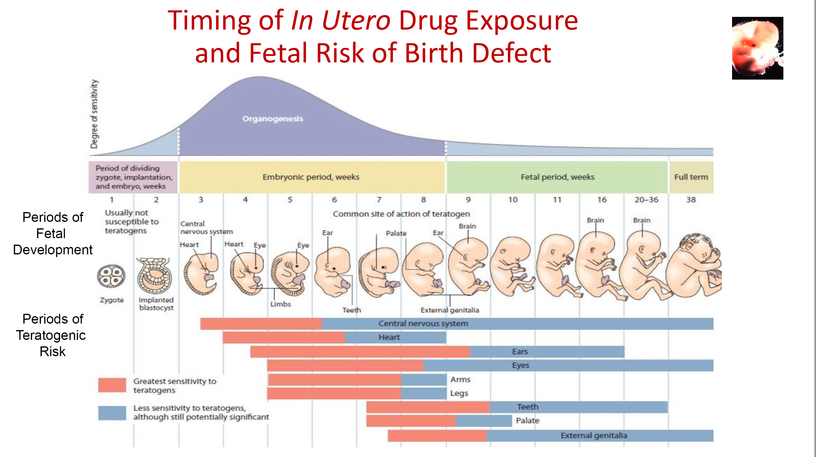
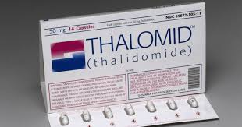
Concerns about fetal exposure to medications during pregnancy
Historically women of childbearing potential are under-represented in trials, are required to use contraception, and required to stop study product if they become pregnant.
Slide courtesy of L. Mofenson
Notes:
Pregnant and lactating women are typically
excluded from clinical trials in order to protect the mother
and foetus from potential harm. Advocacy for the women’s health research agenda
Essential elements of pregnancy-related clinical pharmacology
are the direct and indirect drug effects on the fetus. Indirect
drug effects, such as increased risk of preterm labor or impaired
glucose homeostasis, may have profound effects on fetal
well-being. Also, many drugs cross the placenta, resulting in
exposure of the fetus, with potential toxicity. Exposure during
the first trimester may impact fetal organogenesis and result in
teratogenicity. Exposure later in pregnancy may put the fetus
at risk for impairments of growth and development or harm to
specific organ systems. Fetal exposure to antiretroviral drugs

Slide 6
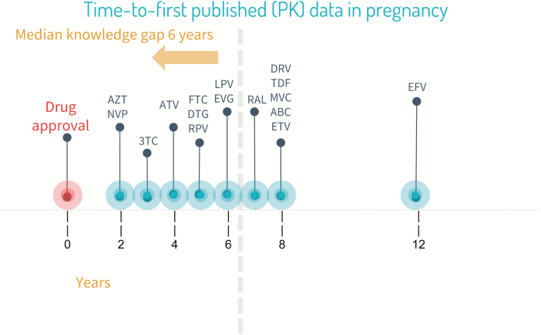
Excluding pregnant women from trials shifts risk of harm
Without research, pregnant people
May be given drugs in the wrong dose
May be given drugs that carry unacceptable risk
May be denied access to critically needed drugs
Source: Colbers, 2019; PHASES working group, 2020
Notes:
Therefore, pregnancy safety and pharmacokinetic (PK) data for new drugs are routinely delayed by as much as a decade after initial drug approval if studies are performed at all. This results in substantial delays in women accessing new and better drugs. Additionally, despite the lack of data, these new drugs are prescribed for women of childbearing potential who become pregnant, as well as for pregnant women. This means that women have to make decisions about using new agents without adequate information about dosing or safety in pregnancy.
However, excluding these
women from trials instead shifts the risk of harm from occurring
under trial settings in which informed consent and intensive
monitoring are practiced, to occurring in routine care
settings in which medications may be used despite a lack of
data for evidence-based management decisions. Therefore, the
strategy of excluding pregnant and lactating women from clinical
trials to avoid harm in fact only serves to increase risk for
larger numbers of women who are exposed to medications
with uncertain dosing, safety and efficacy data.
an approximate
six-year lag between antiretroviral licensure and any data in
pregnancy

Slide 7
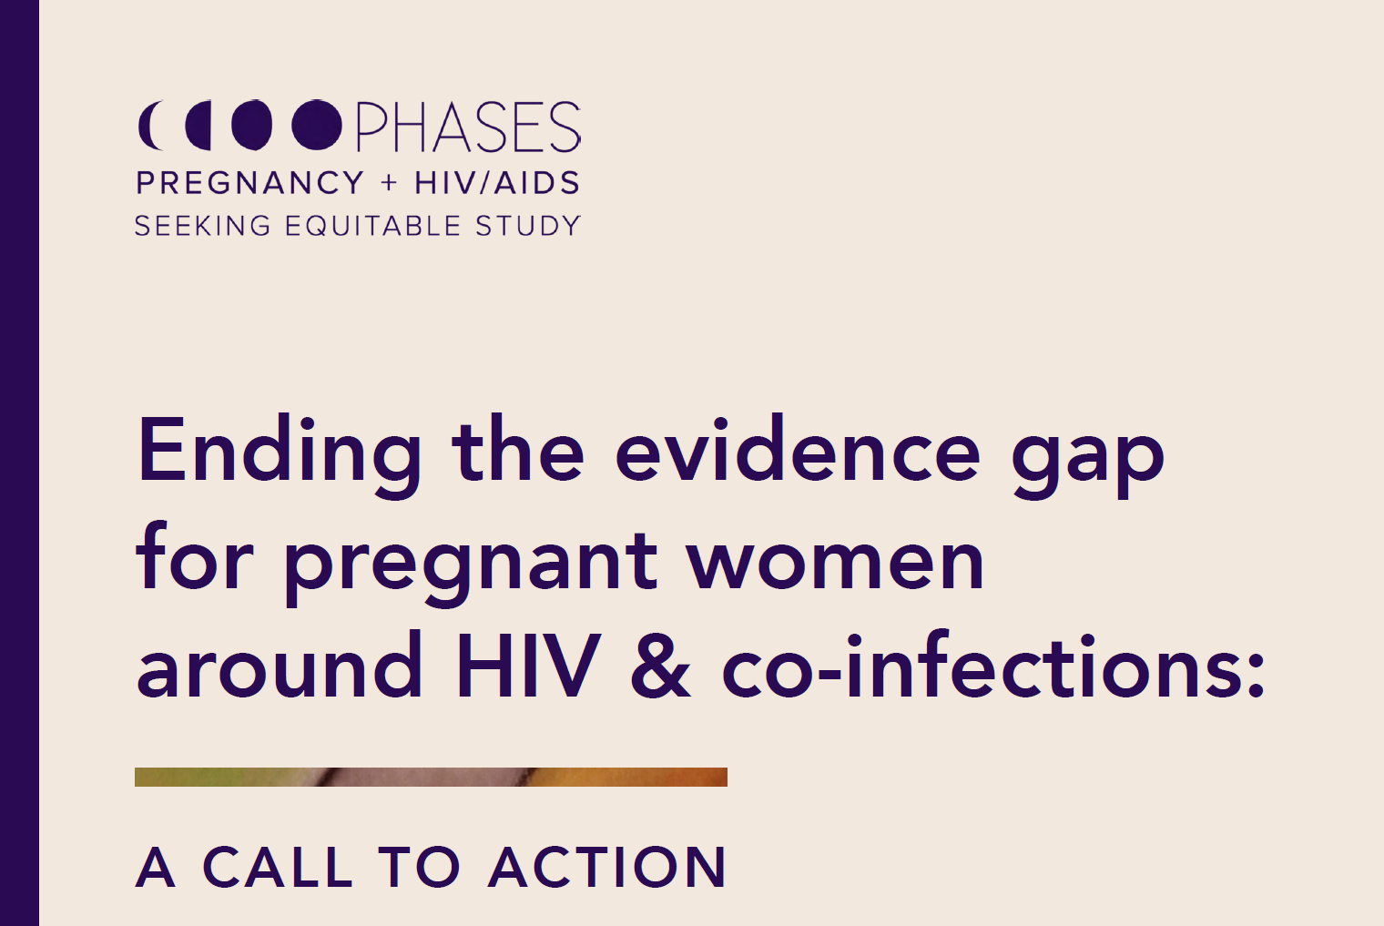
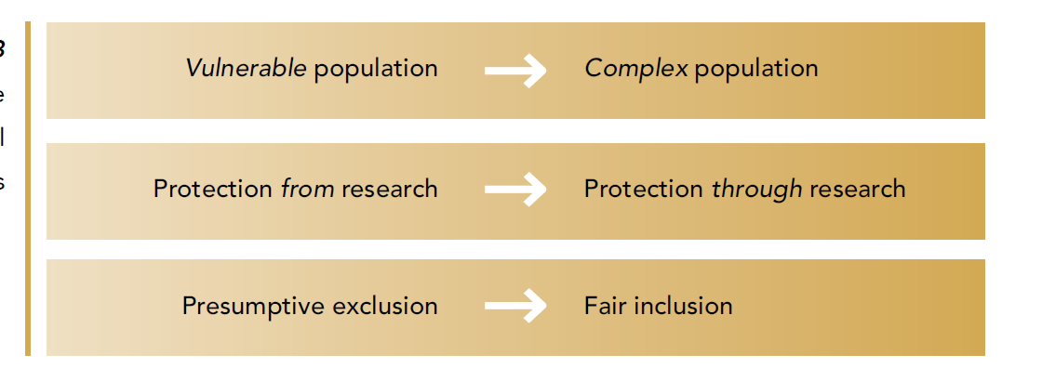
A paradigm shift is underway
Multiple stakeholders have voiced their concerns around the exclusion of pregnant women from pre- and post-registration drug trials and the associated harms and risks of these policies.
Three major conceptual shifts that will facilitate the inclusion of pregnant women in research:
Notes:
includes leadership from the Task Force on Research Specific
to Pregnant and Lactating Women (PRGLAC), sponsored by
the National Institute of Child Health and Human Development
(NICHD), and the Pregnancy and HIV/AIDS Seeking
Equitable Study (PHASES) Working Group, sponsored by the
National Institute of Allergy and Infectious Diseases (NIAID).
These groups have outlined and are working to overcome barriers
to research in pregnant and lactating women,

Slide 8

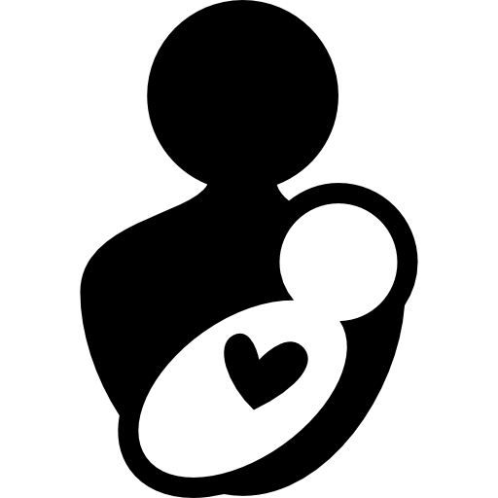





Key principles for studying new antiretrovirals in pregnancy
If the agent is efficacious in non-pregnant adults (viral load suppression) and adequate drug exposures are achieved in pregnancy, then efficacy can be assumed in pregnancy without additional trials.
If the agent is efficacious in non-pregnant adults (viral load suppression) and adequate drug exposures are achieved in pregnancy, efficacy for prevention of vertical transmission can be inferred.
All new agents must be studied in pregnant woman for pharmacokinetics/optimal dosing and short-term safety.
Dedicated pregnancy safety studies assessing pregnancy, birth and infant outcomes should be conducted for all new ARVs with expected broad use in pregnant women and women who may become pregnant.
There is no expectation to have meaningful clinical information about teratogenicity risk before registration; Large numbers of observations with exposure at conception/early pregnancy are needed to identify increased risk of rare events and will only come through active surveillance/Phase 4 studies.
Once pharmacokinetic/dosing and short-term safety in pregnancy are determined to be adequate, there should be no restrictions to access during pregnancy once the ARV is licensed.
Abrams, JIAS 2022

Slide 9
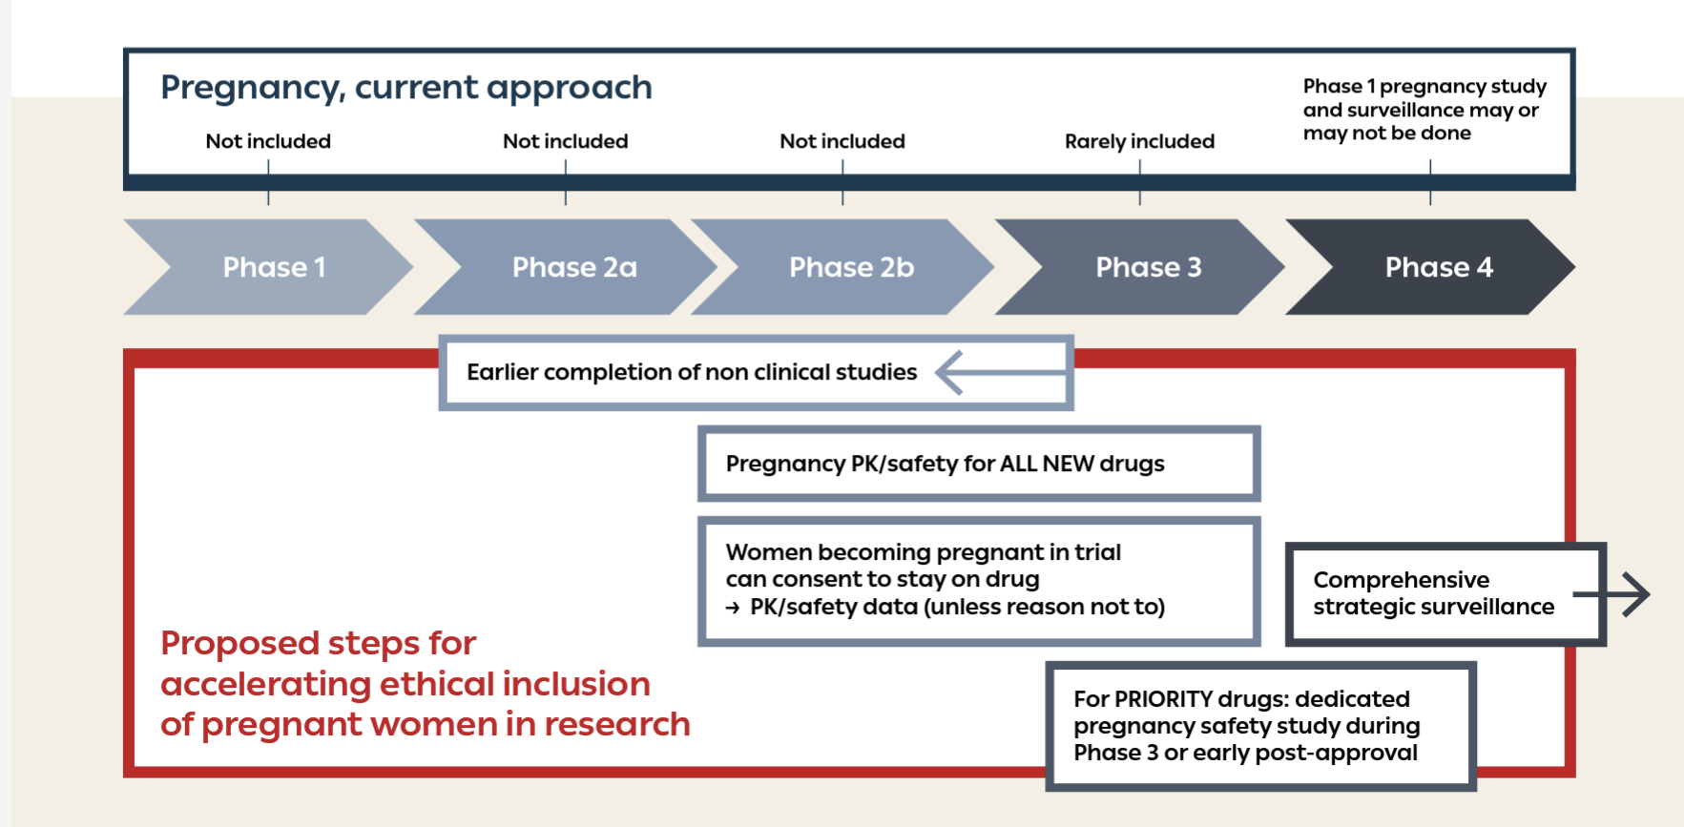
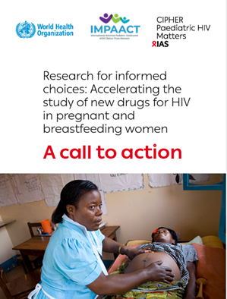
A framework for accelerating inclusion in pre-licensure clinical trials
Trials of DVR, CAB, LEN, ISL all include pregnant and lactating people
WHO/IMPAACT, 2022
Notes:
This slide presents the new framework and timelines to accelerate the study of new drugs for HIV in pregnancy – compared to the current practice (in blue at the top) where studies usually starts once the drug is registered (most often several years after) , the new approaches consist in performing the required studies earlier during drug development from phase 2 to early phase 4
And of interest of our meeting today, you can see that the new framework highlights the need for a comprehensive strategic surveillance as the drug is introduced
Perform non-clinical developmental and reproductive toxicology (DART) studies earlier during drug development for all new HIV agents
Fertility, early embryonic, and embryo-fetal development (FEED /EFD) studies completed during or no later than the end of Phase 2
Prenatal and postnatal development (PPND) studies completed during early or no later than the end of Phase 3
Enroll pregnant women in specific studies to determine pregnancy PK and preliminary safety
As soon as non-clinical PPND studies are completed with no negative signals
For all new HIV agents.
Women who become pregnant in pre-licensure trials can consent to stay on study drug
Once non-clinical FEED and EFD studies are completed with no negative signals and dosing is established in non-pregnant adults
To contribute pregnancy PK and safety data
Conduct dedicated pregnancy safety studies for all new HIV agents prioritized through WHO drug optimization work
as soon as dosing in pregnancy is confirmed
Expand active surveillance of drug safety in pregnancy
to enable systematic and rapid detection of adverse maternal, pregnancy and birth outcomes, especially rare events, such as birth defects.
Involve women of childbearing age affected by HIV during all the steps of research study
Number of studies have included PBFW now

Slide 10

Congenital anomalies are not the only (nor even the most important) safety endpoint related to medications taken in pregnancy
Congenital anomalies
Pregnancy outcomes, including
  Preterm delivery (PTD, birth <37 weeks)
  Low birthweight (LBW, <2500g)
  Small for gestational age (SGA, <10th %ile)
  Fetal loss (miscarriage, stillbirth)
Maternal health outcomes
Child outcomes
Pregnancy, maternal health, child outcomes
Slide courtesy S. Lockman
Notes:
Vertical transmission and congenital anomalies are highly visible outcomes that have been the focus of much HIV pregnancy research, but the effect of HIV treatment in pregnancy on other important outcomes has been less visible yet has a substantial impact on the health of mothers and children

Slide 11
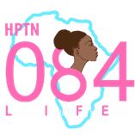
HPTN 084 design, OLE period
No LARC requirement
CAB
TDF/FTC
Eligible sub-study
TDF/FTC
CAB
CAB
TDF/FTC
Eligible sub-study
Eligible substudy
CAB
Follow through to 1 year post-partum
TDF/FTC
No consent, follow as below
Key questions about safety, need for dose adjustment in pregnancy, and safety during lactation
Continue follow up and assess outcomes

Slide 12
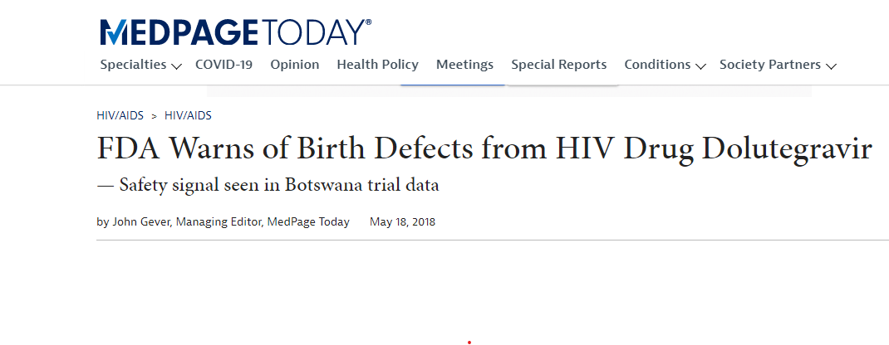
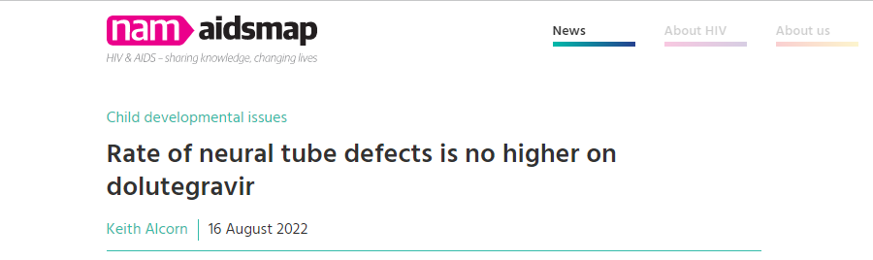
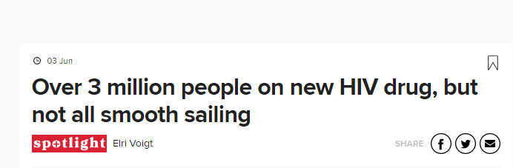
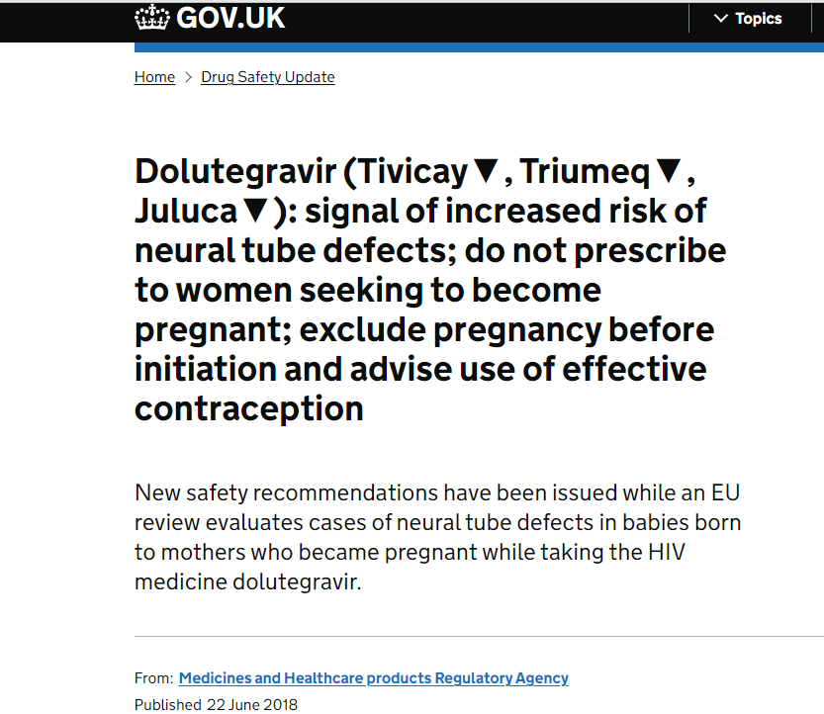
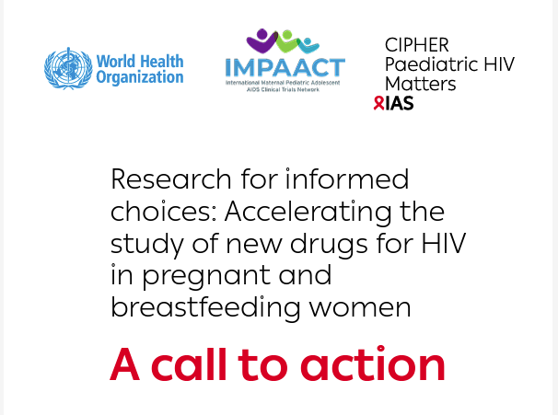
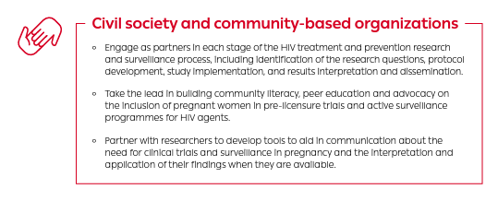

Slide 13
Community consultation, May 2021
N=101 participants, mainly community stakeholders
Emphasized safety concerns and need for information +++
Pregnant women part of social network with many stakeholders in a safe pregnancy outcome
White, JIAS 2023

Slide 14




Video to support risk benefit discussion

Slide 15
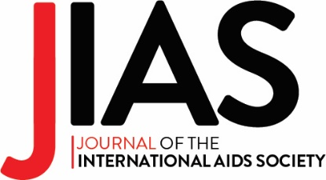
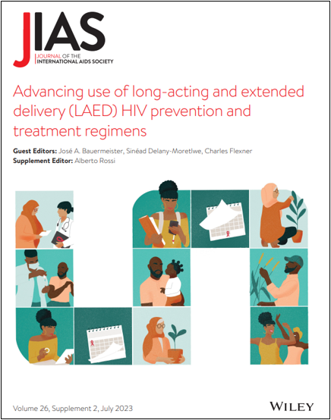

Just launched! New JIAS special issue freely available now.
Access the special issue:
bit.ly/3CgfXe0
www.jiasociety.org

Slide 16
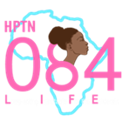
HPTN 084, progress to date
Pregnancies during OLE
  N=268
  161/207 eligible for substudy consented (79%)
    Both prevalent and incident pregnancies
    Acceptance of CAB in incident pregnancies similar to overall trial population
    See poster AS-IAS-2023-05743 and oral abstract AS-IAS-2023-05998 Wed 26/07
  Follow up ongoing
  44 participants have at least one post-partum visit
Cumulatively since start of HPTN 084
  465 pregnancies
  232 live births

Slide 17
Conclusions
Women experience overlapping risks for HIV and pregnancy and have need of effective HIV prevention options, but historically have been excluded from pre-licensure trials because of safety concerns
A paradigm shift is underway, with a call to action to include pregnant and lactating people in pre-licensure trials using a new set of decision criteria
This change is an opportunity for to address the evidence gaps in pregnancy safety data, to engage and educate communities and support participants, and to build the evidence base for current and future HIV prevention products to ensure timeous access pregnant and lactating people
Notes:
What is the main issue or question the presentation addresses?
What is the key finding or ‘takeaway message’?
How does the research advance HIV prevention efforts?

Slide 18

Acknowledgments
HIV Prevention Trials Network
Leadership and Operations Centre, FHI360
Laboratory Centre (Johns Hopkins)
Statistical Center for HIV/AIDS Research and Prevention, Fred Hutchison Cancer Research Center
HPTN Leadership
HPTN 084 Study team
20 sites in 7 countries in sub-Saharan Africa
Community advisory boards and partners
Pregnancy advisors: Friday Saidi, Lynda Stranix-Chibanda
… and our study participants!
Sponsor
U.S. National Institute of Allergy and Infectious Diseases (NIAID), all components of the U.S. National Institutes of Health (NIH)
Additional funding support
ViiV Healthcare
Bill & Melinda Gates Foundation
National Institutes of Mental Health
Pharmaceutical support
Gilead Sciences
ViiV Healthcare
WHO Pregnancy and Breastfeeding Therapeutics Working Group
/HIVptn
UM1AI068619-15 (HPTN Leadership and Operations Center), UM1AI068617-15 (HPTN Statistical and Data Management Center), and UM1AI068613-15 (HPTN Laboratory Center).
hptn.org

