Slide 1
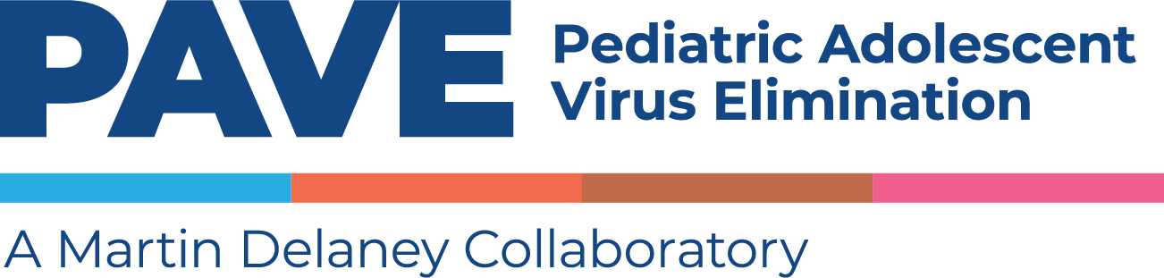
Charting the Course:
Overview of the long-acting HIV prevention and treatment options available and in development for pregnant, breastfeeding women and newborns
Deborah Persaud, MD
July 23rd, ,2023

Slide 2
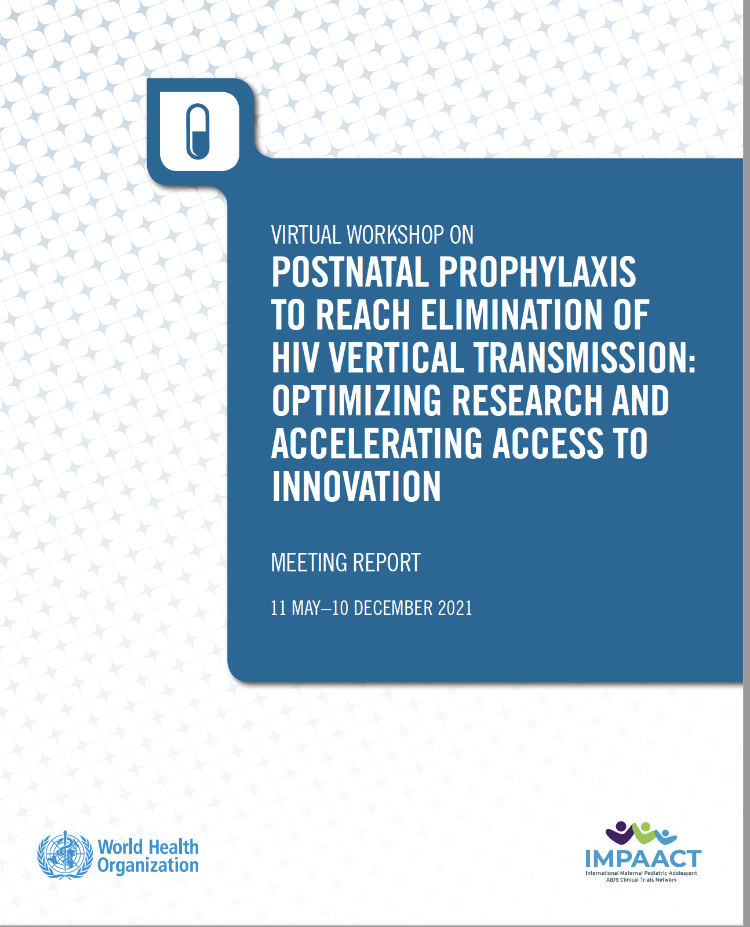
Acknowledgements and Key Reference
Ted Ruel
Shelly Malhotra
Elaine Abrams
Lynne Mofenson
Sharon Nachman
Betsy MacFarland
Sue Eshleman
Lynda Stranix-Chibanda
Virtual workshop on postnatal prophylaxis to reach elimination of HIV vertical transmission: optimizing research and accelerating access to innovation, meeting report, 11 May-10 December 2021. Geneva: World Health Organization; 2022. Licence: CC BY-NC-SA 3.0 IGO.

Slide 3
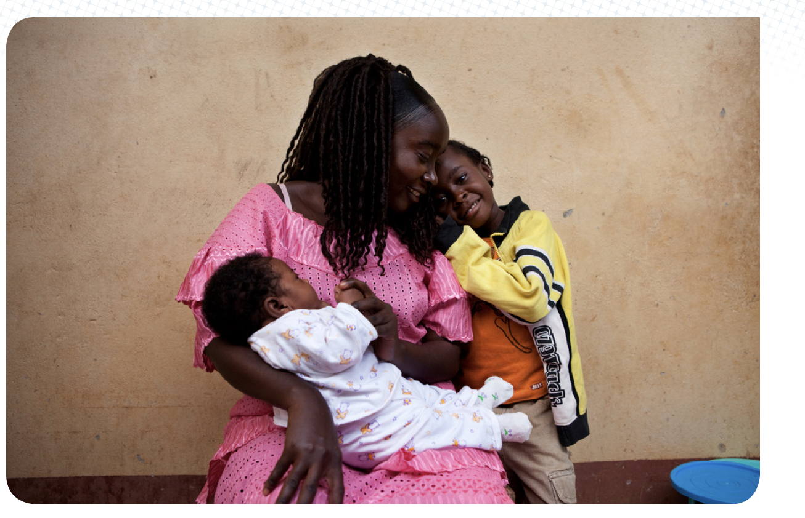
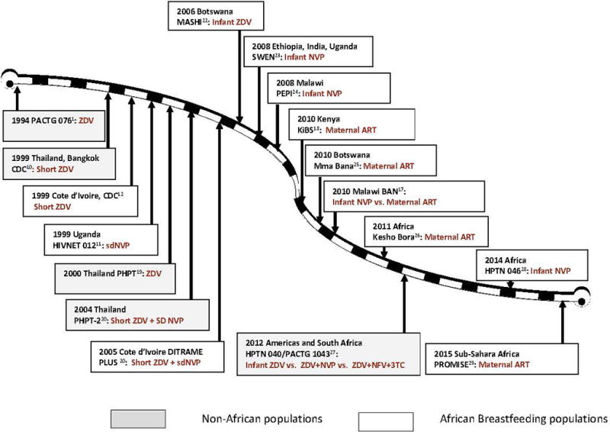
Pipeline of Clinical Trials
in Pregnant Women and Infants to Prevent Vertical Transmission
(1994-2015)
Fowler MG et al. 2018
Notes:
17 trials in African and Non-African populations and in breastfeeding and non-breastfeeding populations, starting with monotherapy with ZDV to maternal ART with efavirenz and LPV/R.

Slide 4
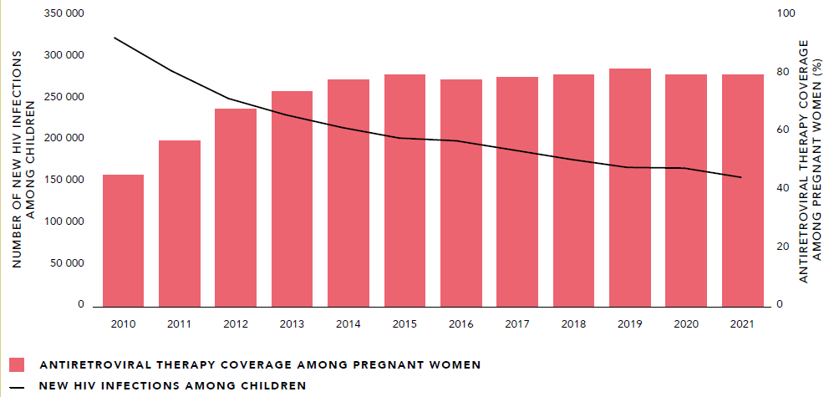
New HIV Infections in Children (aged 0-14 years) and Antiretroviral Coverage among Pregnant Women Globally (2010-2021)
Source: UNAIDS epidemiological estimates 2022: aidsinfo.unaids.org
Notes:
59% drop from 2010, 22% decline from 2016-2021
160,000 new infections in 2021
130,000 in 2022
Halving the number of children infected with HIV
HIV, perinatal transmission continues to occur among
infants born to women with HIV diagnosed in pregnancy
or at delivery. Infants are also at risk of acquiring HIV
during breastfeeding to viraemic women with HIV;
innovative strategies to prevent HIV vertical transmission
perinatally and in the postnatal period and establish the
next steps for implementing such studies.

Slide 5
Nearly 50% of Vertical Transmissions Occurred During Breastfeeding
% Vertical Transmission rate
Mary Mahy (UNAIDS) and George Siberry (USAID) at PNP meeting 1, May 11, 2021
Source: UNAIDS 2020 estimates
Notes:
Check last column

Slide 6

Postnatal Prophylaxis:
Mainstay is ZDV and NVP
Low-risk
High-risk
High-risk
Women with <4 weeks of ART
VL>1000 C/mL in the 4 weeks prior to delivery
Incident HIV infection during pregnancy or BF
Diagnosis postpartum
Formula
Nevirapine (daily for 4-6 weeks)
or
Zidovudine twice daily
(4-6 weeks)
Breast milk
6 weeks daily NVP
Formula
ZDV+NVP
(6 weeks)
Breast milk
12 weeks ARVs
(6 weeks daily ZDV +NVP + additional 6 weeks daily NVP+ZDV or NVP only
Notes:
Add ref

Slide 7
Challenges with Current Infant Postnatal Prophylaxis
Daily administration
  6-12 weeks
  adherence challenge
Can lead to disclosure of maternal diagnosis and associated stigma
Relies on first-generation ARVs
  Zidovudine and nevirapine
    no longer used for adult treatment
    vulnerability to sustainability in supply
Highlights the need for continued investment in novel therapeutics for postnatal prophylaxis
Slide courtesy of Ted Ruel and Shelly Malhotra

Slide 8
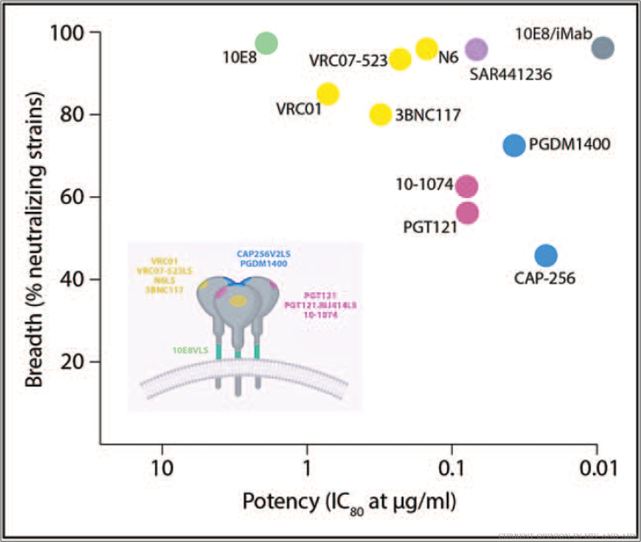
Emerging Field: Immune-based Interventions for HIV Prevention and Treatment (Broadly Neutralizing Antibodies-bNAbs)
HIV bNAbs in clinical development and trials
given intravenously or subcutaneously
serum half-life of 12-73.5 days
Fc region modification can lengthen half-life
HVTN704/HPTN 085 and HVTN 703/HPTN085
(April 6, 2016, and October 5, 2018; Corey L et al. NEJM 2021)
Proof-of-concept that VRCO1 can prevent HIV acquisition in adults
Estimated prevention efficacy,:75.4%; 95% CI, 45.5 to 88.9)
VRC01-sensitive isolates (IC₈₀ <1 μg per milliliter)
Diverse populations cisgender men and transgender persons (N=2699) and at-risk African women (N=1924)
Generally safe
CD4 binding site
MPER
Tri-specific
V1/V2 loop
V3 glycan
Bispecific
Awan SF et al. 2022
Notes:
NCT02716675 and NCT02568215.

Slide 9
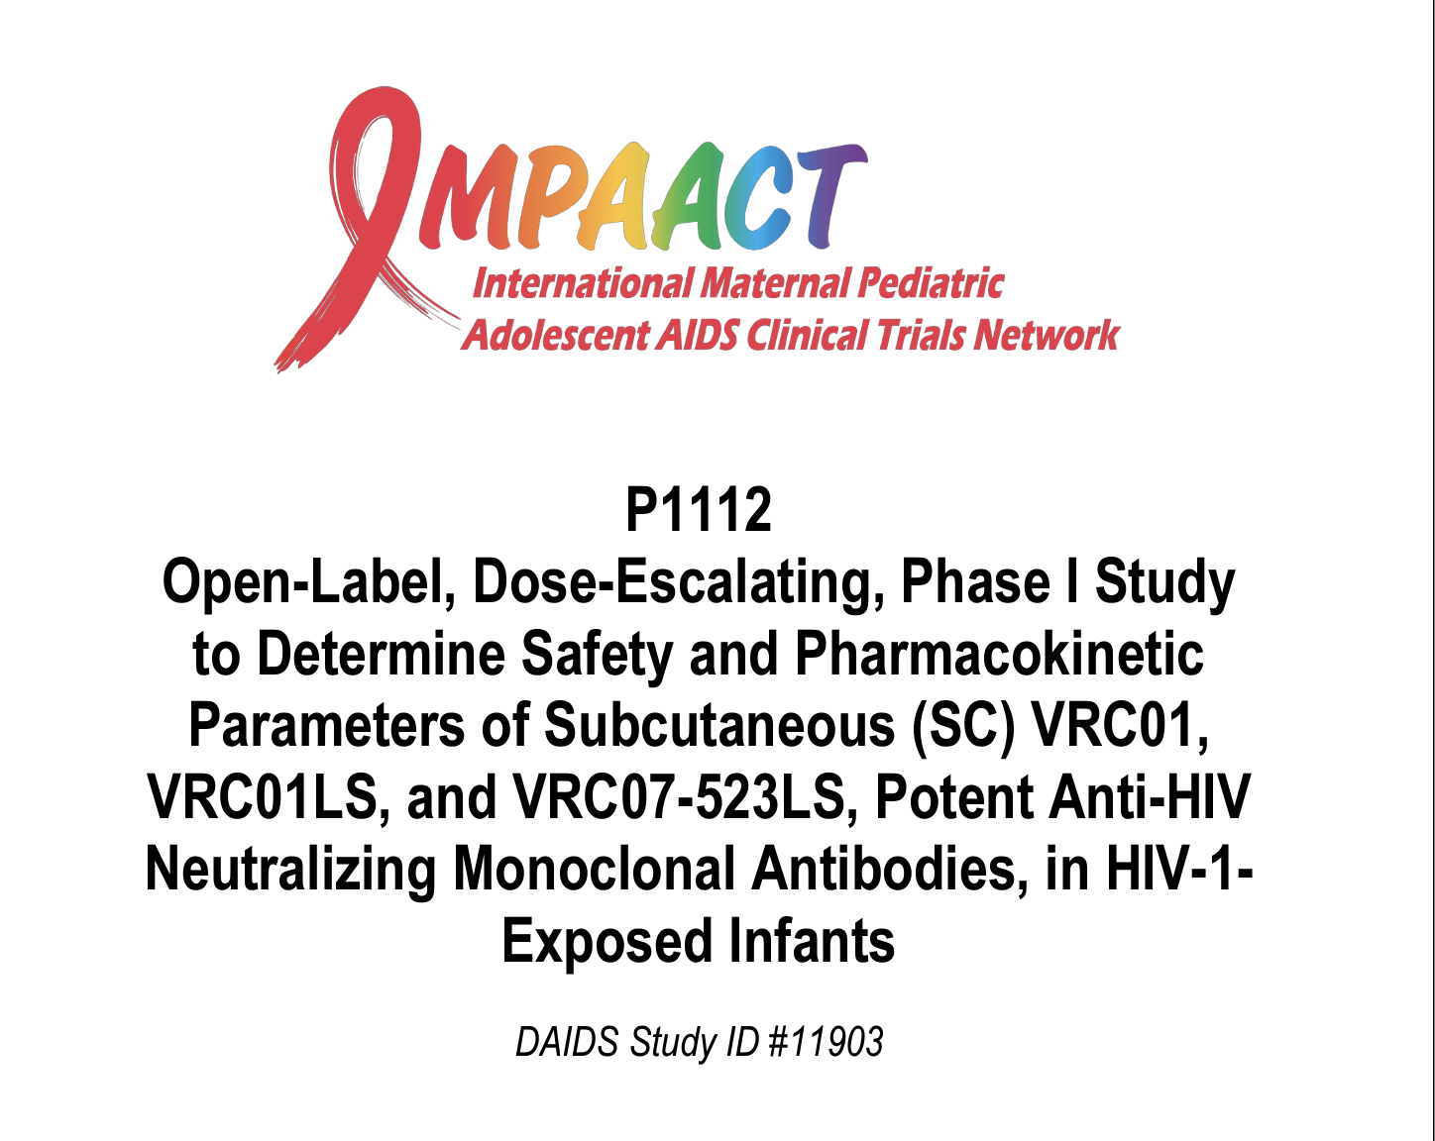
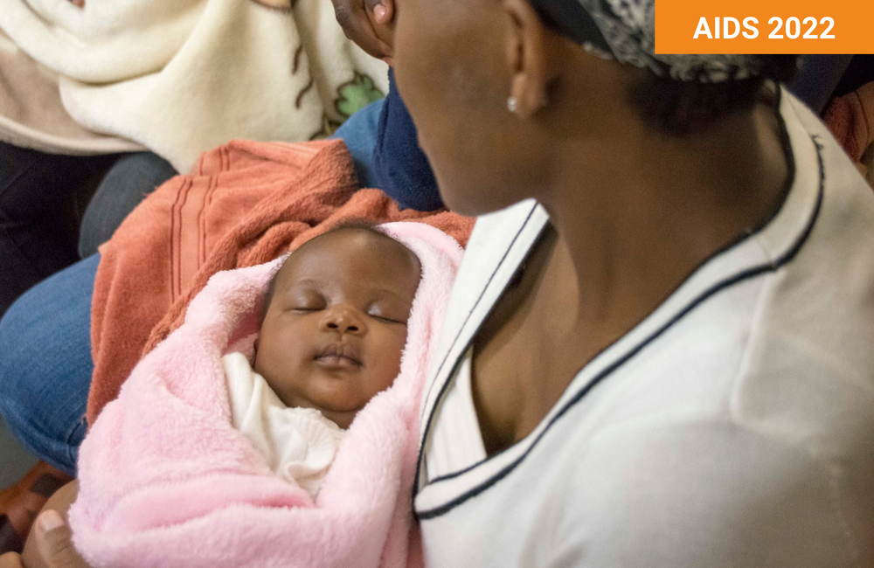
Clinical Trials of bNAbs for Infant Postnatal Prophylaxis
VRCO1
June 2015 – Jan 2017
N=40
VRCO1LS
July 2017 – Jan 2018
N=21
VRCO7-523-LS
N=22
Publications:
2020, 2021
  Design: Open-label, dose escalating, Phase 1, multicenter trial of:
  VRCO1(20 mg/kg or 40mg/kg)
  VRCO1LS (80 mg/dose)
    repeated (100 mg) at 12 weeks in breast-fed group)
  VRCO7-523LS ((80 mg/dose)
    repeated (100 mg) at 12 weeks in breast-fed group)
  Sample size: N = 79 mother-infant pairs
  Groups:
  Dose groups 1, 2, and 3 (13 per group)
  Groups 4 and 5 (10 per cohort; 20 per group)
  Monthly dosing to breastfeeding infants through 6 to 72 months of life
  Countries: U.S., Puerto Rico and Africa
  Safety, Tolerability and
  PK of VRCO1 for infant prophylaxis
    (Cunningham CK et al., 2020)
  Safety, Tolerability and
  PK of VRCO1LS for infant prophylaxis
    McFarland B et al. 2021)
  Potential for long-acting protection
    Subcutaneous injection of VRC07-523LS to neonates (Cunningham CK, CROI 2022)
    Levels maintained for 12 weeks
    Potential for quarterly dosing
Image by USAID | Southern Africa. Creative Commons license.
Notes:
P1112 was an open-label, dose-escalating, Phase 1, multicenter study of VRC01 (VRC-HIVMAB-060-00-AB) conducted in the United States, Zimbabwe, and South Africa (ClinicalTrials.gov NCT02256631). The target sample size was 39; 13 per dose group. Eligible infants were born to women with HIV, ≥36 weeks gestation, and ≥2 kg. Nonbreastfeeding infants enrolled into the single
Dose Group 3 received a single SC 40 mg/kg dose within 5 days of birth, followed by monthly 20 mg/kg SC doses for at least 6 months, and continued for the duration of breastfeeding to a maximum of 72 weeks.

Slide 10
Phase 1/2 Clinical Trials in Development for bNAbs for Prevention of Vertical Transmission
 | IMPAACT 2037 | South African Medical Research Council, PACTR202205715278722 | IAVI/VRC/HVTN
bNAbs | PGT121.414LS VRC07-523LS | CAP256V2LS VRC07-523LS | ePGT121v1; ePGDM1400v9-LS VRC01.23.LS
Population | Infants Exposed to HIV | Infants Exposed to HIV | Phase 1 in adults (2023) Phase 2 HIV-1 exposed uninfected neonates & infants (2026)
Country | Brazil, Kenya, South Africa, US | South Africa | TBD: South Africa, Uganda, US
Outcome | Protection when administered subcutaneously soon after birth in infants at high risk for peripartum or breastfeeding HIV transmission | Safety and PK of subcutaneous administration | Safety and PK of subcutaneous administration
(Slide courtesy of Ted Ruel and Shelly Malhotra)
Notes:
Status
In Development,
Planned at sites in 8/2023
Date of first enrolment: 27/06/2022
Date of first enrolment: Q3 2023

Slide 11
No studies to date of bNAbs for Pregnant People to Prevent Vertical Transmission

Slide 12
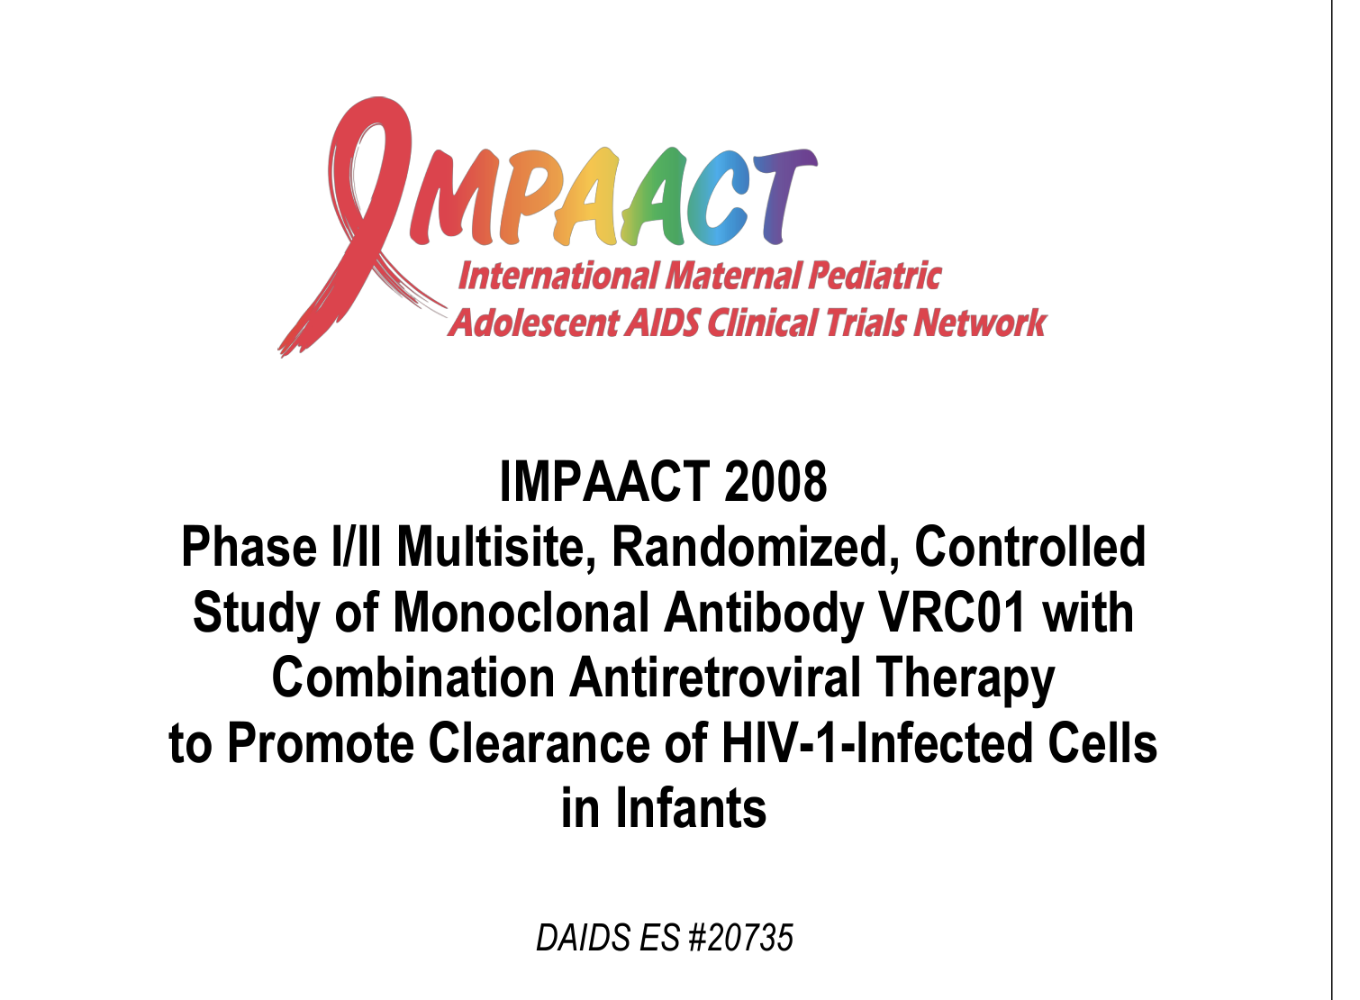
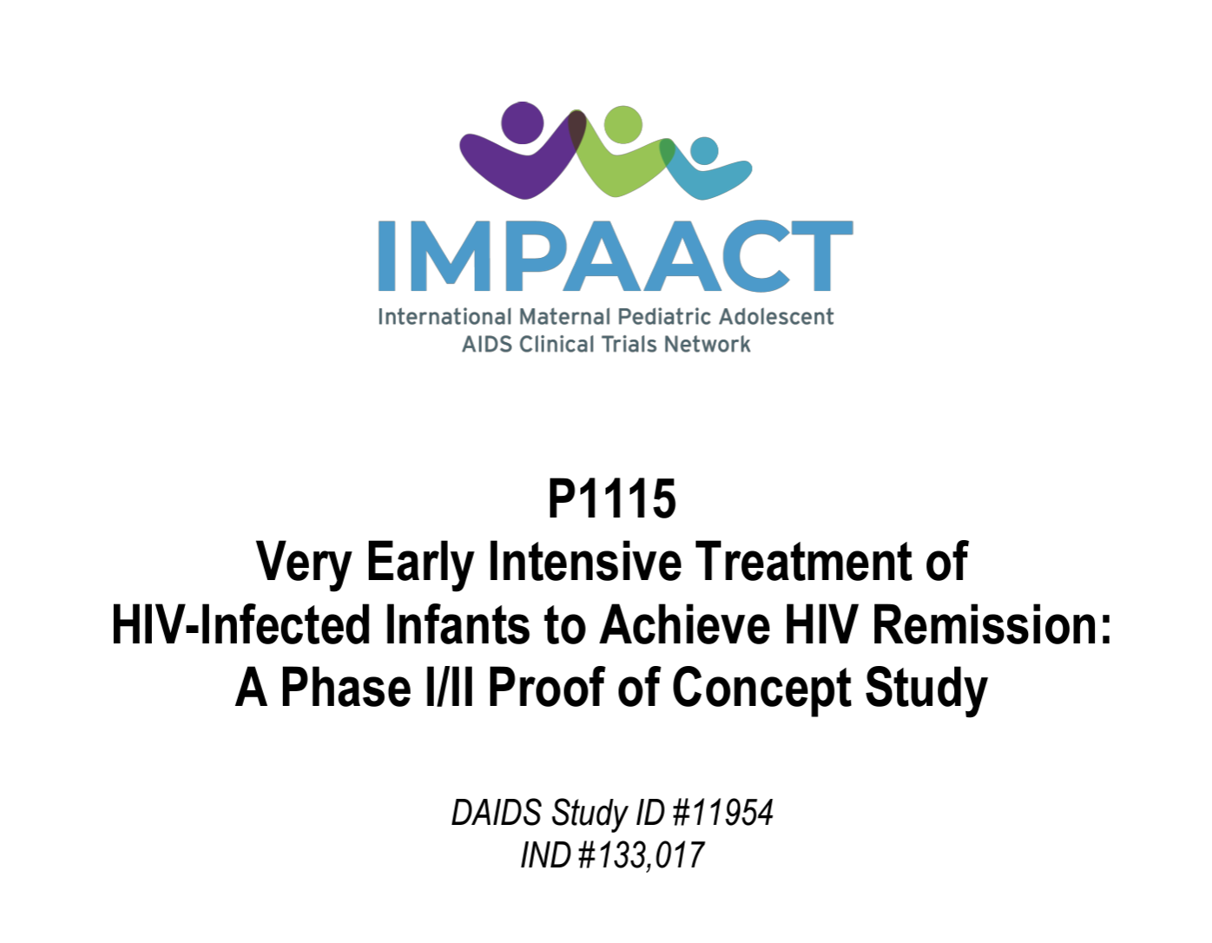
bNAbs for Very Early and Early treatment of infants for ART-Free Remission
  Safety, PK and Efficacy of VRCO1 for early treatment of infants
  (Khaitan A et al. IAS 2022)
  Very Early ART +/- VRCO1 (v2.0 enrolling)
  VRCO7-523LS planned for V 3.0

Slide 13
LA-ARV for Pregnant People
(Slides courtesy of Ted Ruel, MD; Chair of the IMPAACT HIV Treatment Committee)

Slide 14
Long-Acting Injectable ARV Cabotegravir for Pregnant People
IMPAACT 2040 (CREATE): Pregnant women with HIV and their infants (PK/Safety) in virally suppressed women during pregnancy and postpartum
ACT 2022: Youth aged 12 to < 2
HPTN 084
Neonatal safety data from cisgender women who become pregnant during open label extension of CAB for PrEP trial
Cord blood at delivery, maternal and infant blood and breastmilk collected. Analysis of infant outcomes at 12 months
ACT 2022: Youth aged 12 to < 2
(Courtesy of Ted Ruel, MD)
(Courtesy of Sue Eshleman, MD, PhD)

Slide 15
Long-Acting Injectable ARV: Cabotegravir and Rilpivirine
IMPAACT 2040 (CREATE) : Pregnant women with HIV and their infants (PK/safety)
Anticipate protocol to ​sites by
August 2023
IMPAACT 2036 (CRAYON): Children aged 2 to < 12 years with virologic suppression (PK/safety)
Anticipate open to accrual by
April 2023
IMPAACT 2017 (MOCHA): Youth aged 12 to > 18 with virologic suppression (PK/safety)
Completing follow-up and analyses
IMPAACT 2022: Youth aged 12 to < 25 with adherence challenges (PK/safety/acceptability)
In development, scientific collaboration with PENTA
(Slides courtesy of Ted Ruel, MD)
Notes:
This slide summarizes our portfolio of studies advancing dosing of CAB and RIL for our populations

Slide 16
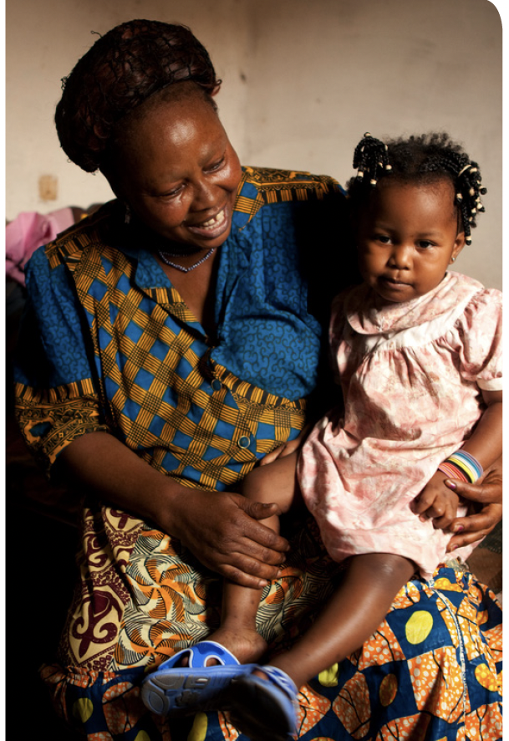
Challenges in enhanced and extended postnatal prophylaxis implementation:
ARV drug stock-outs
Lack of appropriate formulations
Lack of guidance on alternative
ARV drug options for prophylaxis
Poor adherence
Poor documentation
Inconsistent infant feeding practices
Inadequate retention throughout the duration of breastfeeding
Virtual workshop on postnatal prophylaxis to reach elimination of HIV vertical transmission: optimizing research and accelerating access to innovation, meeting report, 11 May-10 December 2021. Geneva: World Health Organization; 2022.
License: CC BY-NC-SA 3.0 IGO.
“Newer ARV drug options and technologies that enable simplified regimens, non-toxic potent agents and convenient administration, including longer-acting formulations, should be given priority to optimize the effect of postnatal prophylaxis – especially throughout the breastfeeding period – in preventing vertical HIV transmission”

Slide 17
Acknowledgements and Key Reference
Ted Ruel
Shelly Malhotra
Elaine Abrams
Lynne Mofenson
Sharon Nachman
Betsy MacFarland
Sue Eshelman
Lynda Stranix-Chibanda
Virtual workshop on postnatal prophylaxis to reach elimination of HIV vertical transmission: optimizing research and accelerating access to innovation, meeting report, 11 May-10 December 2021. Geneva: World Health Organization; 2022. Licence: CC BY-NC-SA 3.0 IGO.

