Slide 1

Supporting the Development of Innovations for Pregnant and Breastfeeding Women and Infants
IAS-ILF Satellite: Advancing HIV care for mothers and newborns: Exploring long-acting solutions
Ingrid Eshun-Wilsonova MBChB, MSc, J&J Global Public Health, 23 July 2023

Slide 2






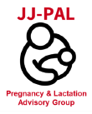







Several J&J efforts underway to generate evidence in pregnant and breast-feeding women
EM-136226
J&J innovations
Support for and utilization of antiretroviral pregnancy registry data as part of broad post-marketing surveillance efforts
Post Marketing Surveillance
Protocol revisions and dedicated studies to facilitate clinical trial inclusion
Company wide initiatives
Efforts to support pregnant and breastfeeding women
Inclusion in CAB-RPV LAI clinical trials
Company wide initiatives to include pregnant and breast-feeding women in trials through J&J Pregnancy and Lactation Advisory Group (JJ-PAL)
New commitments to include pregnant and breastfeeding women in trials outlined in Rome Action Plan - December 2022
Commitments:
Rome Action Plan
https://www.paediatrichivactionplan.org/
https://www.impaactnetwork.org/studies/impaact2040
https://www.apregistry.com/HCP.aspx
Notes:
For oral Rilpivirine, there are now a sufficient numbers of first trimester exposures that have been monitored through the APR to
detect at least a two-fold increase in risk of overall birth defects. No such increases have been detected to
date. There is however limited reporting from LMICs in the registry, making strengthening passive surveillance systems in LMICs
For CAB-RPV LAI we revised protocols in 2021 to ensure that women who become pregnant in trials can stay on the regimen and collaborate with ViiV on additional pregnancy specific studies.
We have outlined our commitments to making these changes in the Rome action plan in 2022, which is a high level dialogue led by WHO to improve
J&J also has numerous initiative within the company to facilitate inclusion of pregnant and breastfeeding women in clinical trials through the Pregnancy and Lactation Advisory group.

Slide 3
EM-136226
Company-wide efforts
Johnson & Johnson Pregnancy and Lactation Advisory Group (JJPAL)
  Developed in 2021 and includes 14 functions across J&J to co-ordinate efforts across the company to efficiently address regulatory and stakeholder requirements for robust, timely evidence in the pregnancy and lactating population by:
Identifying and assessing fit-for-purpose real world data sources/partners for evidence generation to meet health authority requirements
  Exploring barriers and facilitators for pregnant and lactating populations on clinical trial inclusion*
  Developing and delivering methods for studying real world use of medications in pregnancy
  Advancing equity for pregnant and lactating individuals
  Organizing consultations for internal and/or external experts
*Jacobson MH, Yost E, Sylvester S, Renz C, Wyszynski DF, Davis KJ. Determinants of Participation in Clinical Trials During Pregnancy and Lactation. International Society for Pharmacoepidemiology, August 23-27, 2023, Halifax, NS.

Slide 4
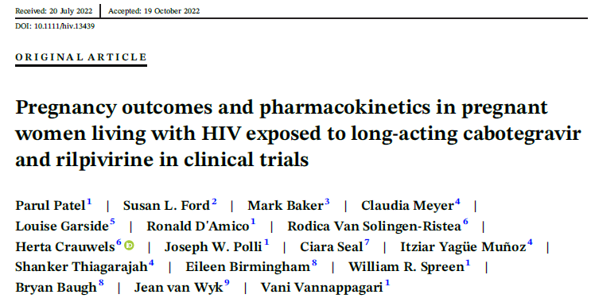
Evidence generation for CAB-RPV LAI through Janssen-ViiV collaboration
EM-136226
2022
2023
2024
2025
2026
CARES: Adults (South Africa, Kenya, Uganda)
LATA: Adolescents 12-19 yr (South Africa, Kenya, Uganda, Zimbabwe)
IMPALA: Adults with history/at risk of vir. failure (South Africa, Kenya, Uganda)
AFINAty: Adolescents and young adults 12-24 yr (South Africa)
ACROSS TRIALS:
Limited safety data for CAB + RPV LA in pregnancy, participants must use effective forms of birth control.
In the case of incident pregnancy:
  Informed consent procedures
  PK sampling across trimesters
  Adverse pregnancy outcomes evaluation
  Breast milk sampling & infant outcomes (in select trials)
CREATE STUDY (IMPAACT 2040):
Pregnant and Post-partum women
Protocol development underway
CARES. Available at https://pactr.samrc.ac.za/PACTR202104874490818; IMPALA. Available at: https://ichgcp.net/clinical-trials-registry/NCT05546242;. LATA. Available at: https://clinicaltrials.gov/ct2/show/NCT05154747; IMPAACT 2040 available at: www.impaactnetwork.org;

Slide 5
Future initiatives under consideration for LAI ART regimens
EM-136226
Ongoing evaluation of next steps for generating evidence in pregnant and post-partum women
Removing contraception criteria in early phase studies
Generating PK and early safety data in pregnancy by end of Phase 3
Ensuring timely label updates as more evidence emerges
Supporting implementation efforts in pregnant and post-partum women
Support passive reporting surveillance systems in LMICs

Slide 6

Acknowledgements
Janssen - Compound Development Team
J&J – Global Public Health Evidence Generation Team
ViiV Collaborators
Antiretroviral Pregnancy Registry team (apregistry.com)
Study participants

Slide 7
Thank you.
Ingrid Eshun-Wilsonova, Global Medical Affairs Lead, HIV
Global Public Health, Johnson & Johnson

