Slide 1
Opportunities and challenges in developing long-acting solutions for post-natal prophylaxis
Dr. Lionel Tan, Medicine Development Lead, Paediatric HIV, ViiV Healthcare
Advancing HIV care for mothers and newborns: Exploring long-acting solutions

Slide 2
Conflict of interest
I am an employee of ViiV Healthcare and hold shares in GSK

Slide 3
Infants still acquire HIV infection in spite of high maternal antiretroviral therapy coverage
New HIV infections among children (0–14 years) and antiretroviral coverage among pregnant and breastfeeding women, global, 2010–2022
> 80% antiretroviral therapy coverage among pregnant women
50% of children acquired HIV during pregnancy
130,000 new infections in children
50% of children acquired HIV
during breastfeeding
Reasons for children acquiring HIV
New mother:
Did not receive treatment
Dropped off treatment
Acquired HIV during pregnancy or breastfeeding
The path that ends AIDS: UNAIDS Global AIDS Update 2023. Geneva. Joint United Nations Programme on HIV/AIDS; 2023

Slide 4
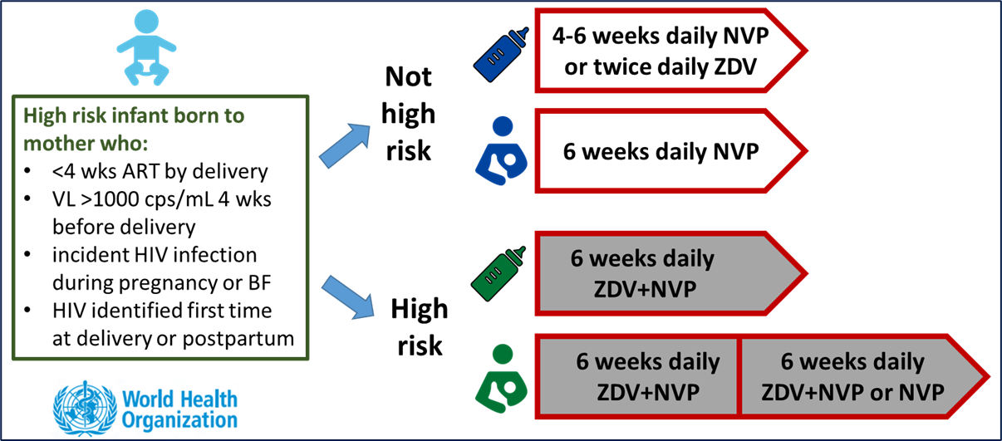
Current recommendations for post-natal prophylaxis are complex and may not be suited to drug administration in the neonatal period
Current post-natal prophylaxis is Efficacious
Complicated
Dependent on care-giver
Old drugs - safety, tolerability and market access concerns
  Doesn’t address social/lifestyle issues
WHO PADO5 (2022): focus on prevention
Long-acting drugs for postnatal prophylaxis
PADO-HIV 5 priority list: medium term, 3–5 years
Cabotegravir for postnatal prophylaxis
PADO-HIV 5 watch list: longer term, 5-10 years
Islatravir
Broadly neutralising antibodies
Lenacapavir
ZDV – zidovudine, first approved by FDA in 1987
NVP – nevirapine, first approved by FDA in 1996
PADO – Paediatric Antiviral Drug Optimisation group
Penazzato M, et al.. Lancet HIV 2022; 9(9): e658-e66.

Slide 5



Potential advantages of long-acting drugs for post-natal prophylaxis
Single dose - potentially covers post-natal period or multiple doses to cover breastfeeding. Removes need for daily oral administration
Efficacy and safety known in adults and adolescents; target exposure for prevention established
Safety profile in paediatrics being studied (children aged >2 years)
Improved compliance - administration in health care setting instead of dosing by care-giver
No age-specific (neonatal) formulation development likely to be required
Service delivery – potential to co-ordinate injection delivery in parallel with childhood vaccination schedules

Slide 6


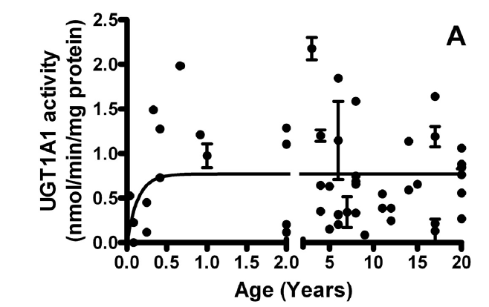
Growth and maturation result in challenges for developing ARVs for neonates
Rapid Weight Gain and Neonatal ARV Dosing
Neonates typically triple their weight from birth to 1 year of life, necessitating frequent dose changes
2X
At birth: 3 kg
At 6 months: 6 kg
At 1 year : 9 kg
Maturation processes and Neonatal ARV Dosing
Neonates have immature metabolic pathways…
so lower dosing (mg/kg) vs adults is required to achieve the same drug exposures
infants and young children have higher clearance and require higher dosing than adults
Most pediatric ARVs are metabolized via the UGT or CYP450s enzyme pathways, all maturing at different rates towards adult values
Miyagi et al. Drug Metabolism and Disposition 2011; 39(5): 912-9.
Slide adapted from Adrie Bekker

Slide 7


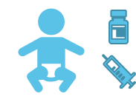
Potential challenges of long-acting drugs for post-natal prophylaxis
Clinical study requirements - PK and Safety study provide quicker access to data, but would not demonstrate efficacy and safety in comparison to established standard of care
PK exposure target – is target for prophylaxis of sexually acquired infection the same as for peri-natal acquisition?
Rapid change in muscle mass and drug absorption & distribution in neonates & infants. Needle size will need to vary depending on dosing volume
Neonatal presentation - vial and needle size may need to vary to prevent overdosing risk
Drug resistance – both maternal INI-R from use of CAB and potential for treatment-emergent resistance in neonates
Uncertainty in demand and service delivery - small volumes of new presentation introduces manufacturing and supply complexity and potentially higher cost/vial which could be a barrier to uptake.

Slide 8

Conclusion
Global partnerships are essential to eliminate new HIV infections in children
Vatican City, Rome, Italy

