Slide 1


Building bridges: Pregnant and lactating people in the lenacapavir HIV PrEP PURPOSE program
Kathryn Kersey
Executive Director, Virology Clinical Development, Gilead Sciences, Inc.
Advancing HIV care for mothers and newborns: Exploring long-acting solutions
12th IAS Conference on HIV Science, Brisbane
Sunday July 23, 2023

Slide 2
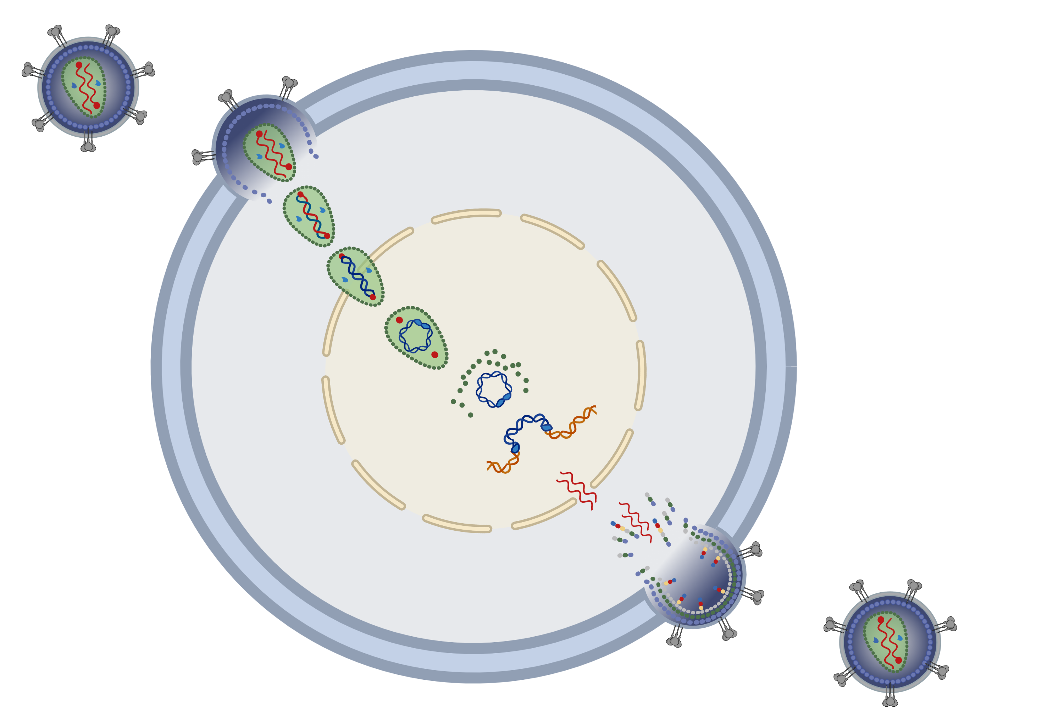

Lenacapavir: A first-in-class multistage HIV capsid inhibitor
LEN is a small molecule capsid inhibitor:
High potency (EC₅₀ = 100 pM)
Well-characterized PK including a long half-life
Potential for a flexible dosing profile
(oral or injectable)
Approved in combination with an optimized background regimen for HIV treatment in persons with multidrug-resistant HIV-1 infection in Australia, Canada, Europe, Israel, Switzerland, The United
Arab Emirates, United Kingdom and United States
1
Virus Entry
HIV
Reverse
Transcription
2
CYTOPLASM
Nuclear Entry & Capsid Disassembly
3
4
Integration
NUCLEUS
6
Virus Assembly & Budding
Maturation
LEN (twice yearly, subcutaneous, single agent) is being studied for HIV prevention (PrEP)
5
Capsid Functions
LENACAPAVIR
2
EC₅₀, half maximal effective concentration; HIV, human immunodeficiency virus;
LEN, lenacapavir; PK, pharmacokinetics; pM, picomolar; PrEP, pre-exposure prophylaxis.
Scan QR code for MOA video
Dvory-Sobol H, et al. Curr Opin HIV AIDS. 2022;17:15–21.

Slide 3


Lenacapavir for PrEP: Prevention with PURPOSE
Cisgender Adolescent Girls and Young Women
South Africa, Uganda
CGMSM, TGW, TGM, GNB
US, SA, Peru, Brazil, Thailand Mexico, Argentina
AGYW, Uganda, South Africa
N=5010
N=3000
QUALITATIVE
N=230
QUALITATIVE
N=220
PURPOSE 3
US Women
N=250
PURPOSE 4
US PWID
N=250
Community & stakeholder collaboration
Person-Centered Design
Investigator engagement
Proof of Concept that Capsid Inhibitors Prevent SHIV in Non-Human Primates
Robust Pharmacokinetic and Safety Database in persons with and without HIV
3
www.purposestudies.com

Slide 4




PURPOSE : First to include pregnant and lactating people in Phase 3 HIV PrEP trials
The PURPOSE program is evaluating LEN for HIV prevention in diverse global populations and intentionally includes PLP
Pre-clinical studies do not indicate harmful effects of LEN on fertility, pregnancy, fetal development, or postnatal development
On track to provide LEN PK data in pregnant people by 2026 per our Rome Action
Plan commitments
Aisha Fayyaz
“Rather than justifying inclusion of pregnant people, exclusion of pregnant persons from research should be justified”
“Protect pregnant people through research instead of from research”
4
HIV, human immunodeficiency virus; LEN, lenacapavir; PLP, pregnant and lactating people; PK, pharmacokinetic.

Slide 5
pharmacokinetic substudy
Pregnancy, breast milk, and infant PK substudies:
Week
0
4
8
13
26
39
52
65
78
1st trimester
2nd trimester
3rd trimester
1st trimester
2nd trimester
3rd trimester
1st trimester
2nd trimester
3rd trimester
1st trimester
2nd trimester
3rd trimester
PK samples
Maternal plasma
Infant plasma
Breast milk
Objectives | Describe maternal systemic drug concentrations during pregnancy and postpartum period Qualitatively assess drug concentrations in maternal breast milk and paired infants
Limit burden | No additional samples for maternal PK Breast milk and infant samples collected at 2 scheduled visits post-delivery Participants can opt out of breast milk and infant PK sampling
Compared with studies of prior HIV drugs, the pregnancy, lactation, and breast milk substudy in PURPOSE 1 will provide data on LEN in PLP and infants at the time of approval instead of years later
5
G-CAG, Global Community Advisory Groups; HIV, human immunodeficiency virus; LEN, lenacapavir; PLP, pregnant and lactating people; PK, pharmacokinetics.

Slide 6
: Best practices for inclusion of PLP
Partnerships
  Sites experienced with research in adolescence and pregnancy
  Expert investigators to lead responses to Ethics Committee/Institutional Review Board questions
Voice of the people (PWBP and G-CAGs)
  Advocacy from community groups, including young women
Person-centric study design, including:
  Provision of contraceptives, if desired, supporting people’s reproductive choices
  Continuation on study with reconsent for those who become pregnant
  Provision of child care to facilitate visits
  Minimization of PK maternal and infant sampling burden
Diversity, equity, inclusion:
  Support for reproductive choices for all persons assigned female at birth with
  reproductive potential
6
G-CAG, Global Community Advisory Groups; PK, pharmacokinetic; PLP, pregnant and lactating people; PrEP, pre-exposure prophylaxis; PWBP, people who would benefit from PrEP.

Slide 7
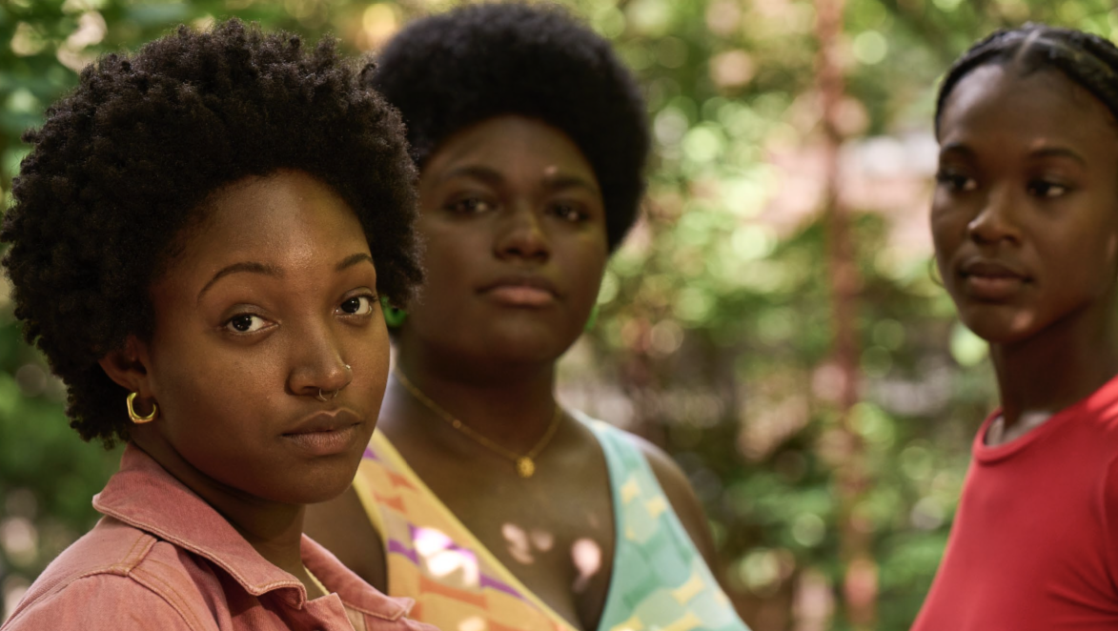
We would like to extend our thanks to all the participants, their partners and families, global community advisors, our investigators and site staff, and all of our
partners for their support
of the PURPOSE program
www.purposestudies.com

