Slide 1
Introduction
Nelli Barrière – International AIDS Society
bnAbs: From prevention to cure

Slide 2









Thank you to our Corporate Partnership Programme sponsors
Learn more on: www.bit.ly/CPPIAS
Learn more on: www.bit.ly/CPPIAS
Notes:
To make all of this possible, we would like to thank our sponsors listed on your screens now for their contribution! As you can see, we have enlarged our sponsorship base this year thanks to the newly created structure. We want to welcome Vir Biotechnology as a Silver member, Worcester HIV Vaccine, Malaika Vx, Sanofi, ImmunityBio as new Bronze partners and welcome back Omega Diagnostics as a Bronze partners as well.
I will now pass over to Nelli to walk us through some of the achievements of the Programme to date.
2

Slide 3

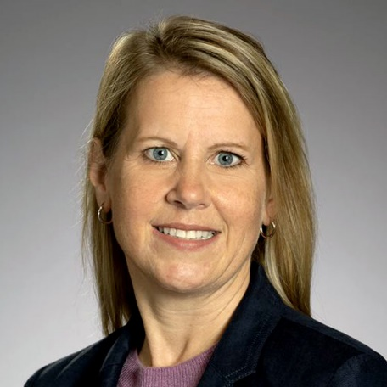
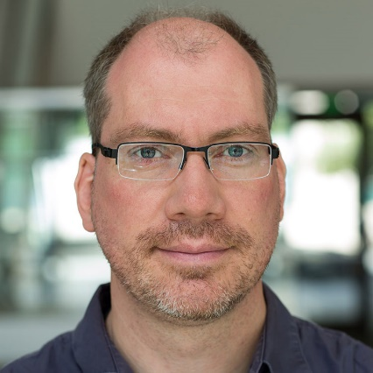
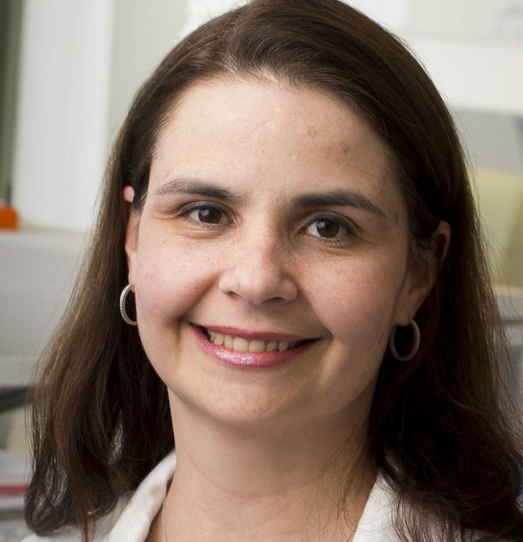
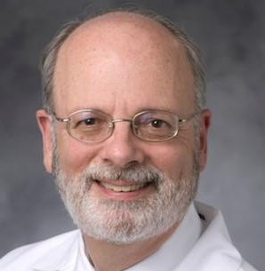
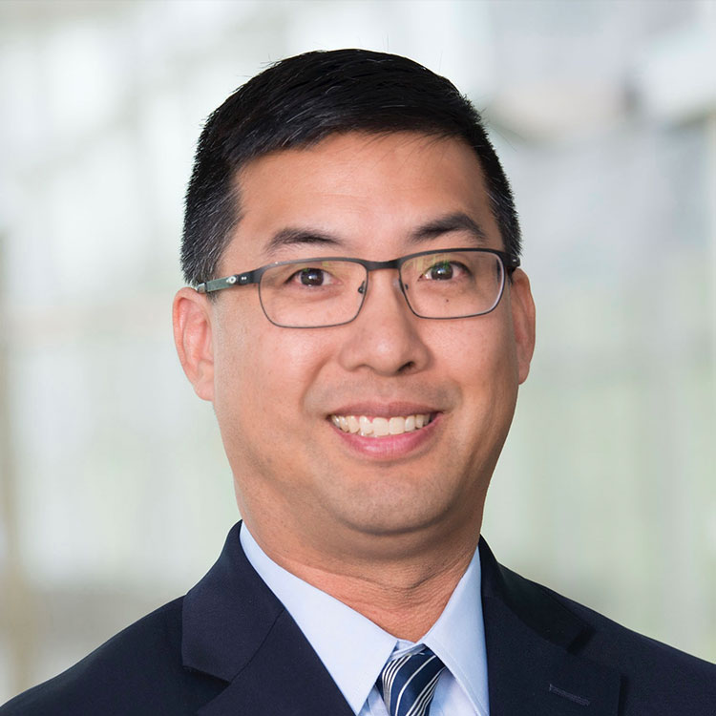
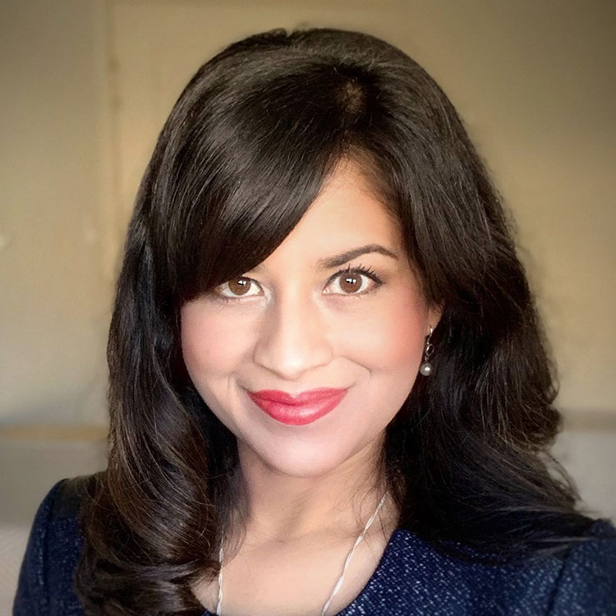
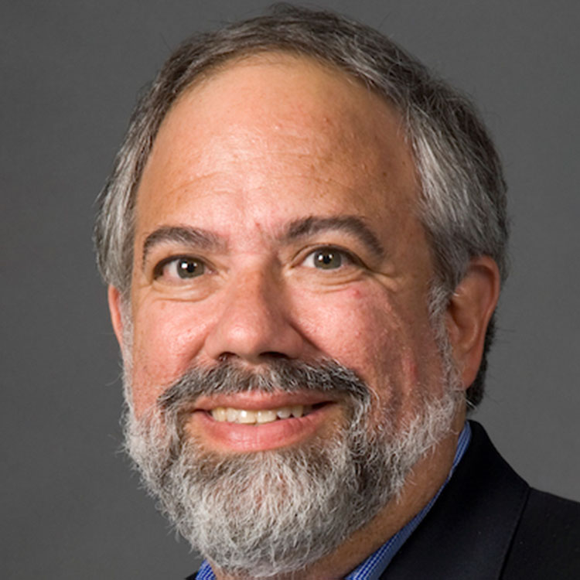
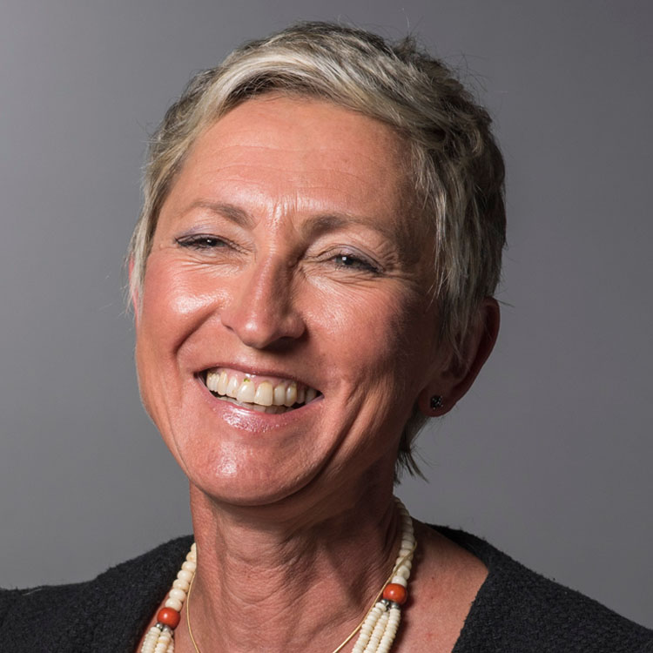
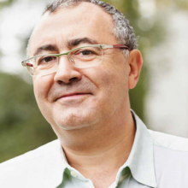
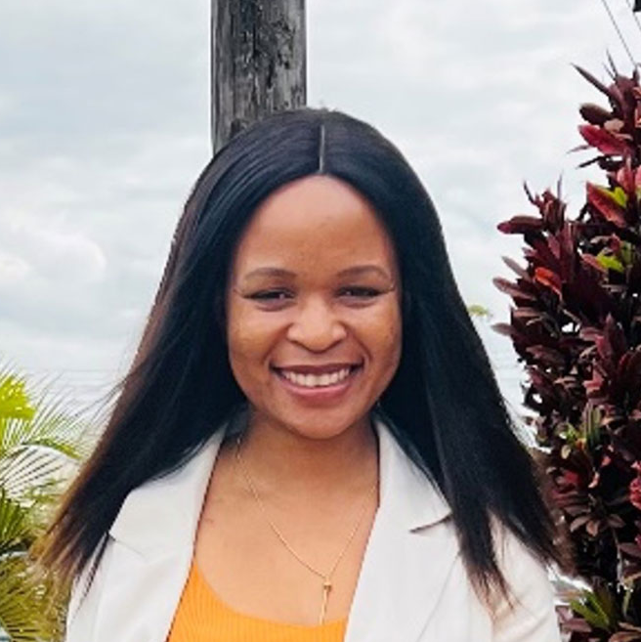
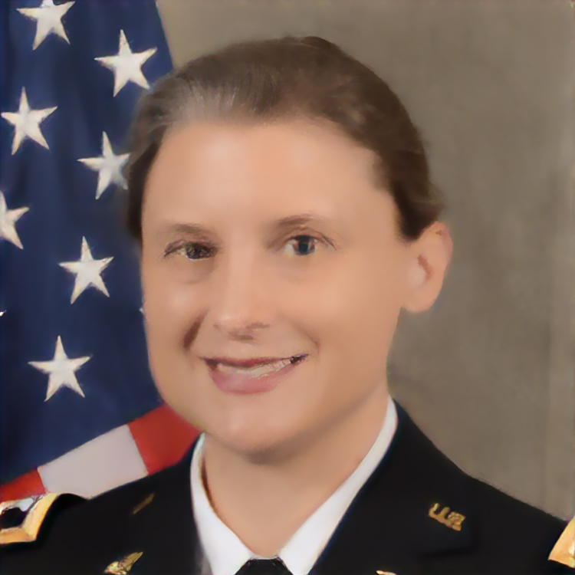
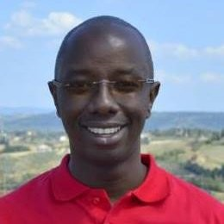
Meet the session co-chairs, presenters & panelists
Co-chairs
Bonnie Howell Merck Sharp & Dohme
Timothy Henrich University of California, San Francisco
Marina Caskey
Rockefeller University
Barton Haynes
Duke University
Carey Hwang
Vir Biotechnology
Devi SenGupta
Gilead Sciences
Alan Landay
Rush University
Linda-Gail Bekker
Desmond Tutu HIV Centre Institute of Infectious Disease and Molecular Medicine
Jean-Pierre Routy
McGill University
Maureen Luba
Cooper Smith
Julie Ake
US Military HIV
Research Program
Vincent Muturi-Kioi
International AIDS Vaccine Initiative

