Slide 1
bNAb Strategies for
HIV Cure
Marina Caskey, MD
The Rockefeller University
Session: bNAbs – from Prevention to Cure

Slide 2
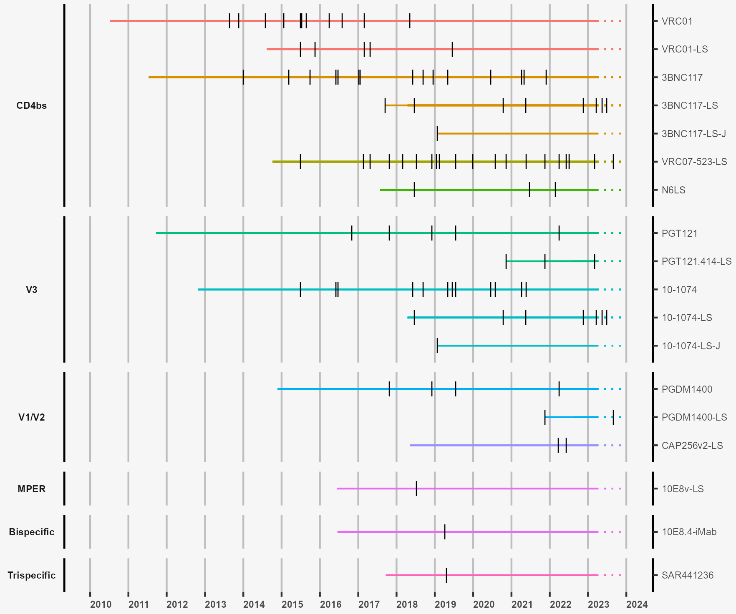
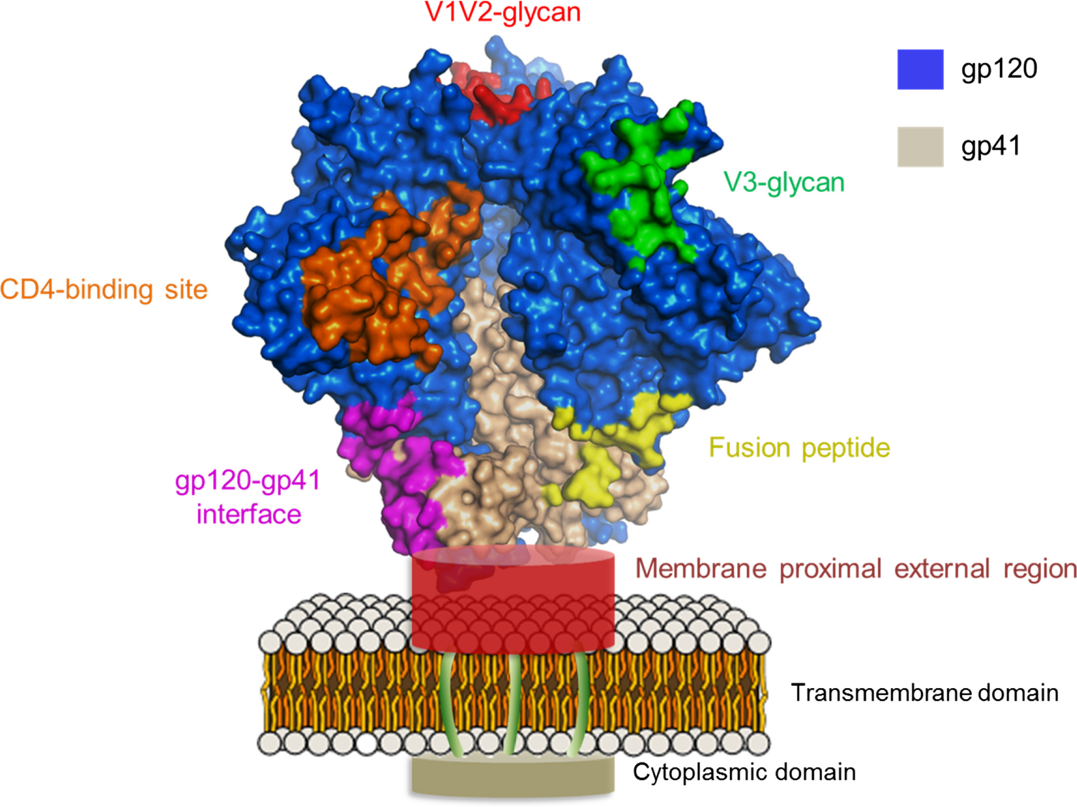
Passive Transfer of Anti-HIV-1 bNAbs in Clinical Trials
Neutralization Targets
Clinical Evaluation – Timeline
CD4bs
V3
V1V2
MPER
Bi-spec
Tri-spec
VRC01
VRC01LS
3BNC117
3BNC117-LS
3BNC117-LS-J
VRC07-523LS
N6LS
PGT121
PGT121.414LS
10-1074
10-1074-LS
10-1074-LS-J
PDGM1400
PDGM1400LS
CAP256v2LS
10e8vLS
10e8.4-iMAB
SAR441236
Bonsignori et al , Immunol Rev 2017
Frattari et al, Curr Opi HIV 2023
Notes:
Antibodies to 4 Env epitopes are in clinical trials, both naturally occurring and modified variants.
Since 2014 there have been many clinical trials with several of these antibodies ( as illustrated in this timeline where each “tick” represents a clinical trial) and these have ranged from studies focused prevention, therapy and remission …including adults, infants, and people with HIV – both viremic and on suppressive ART.

Slide 3
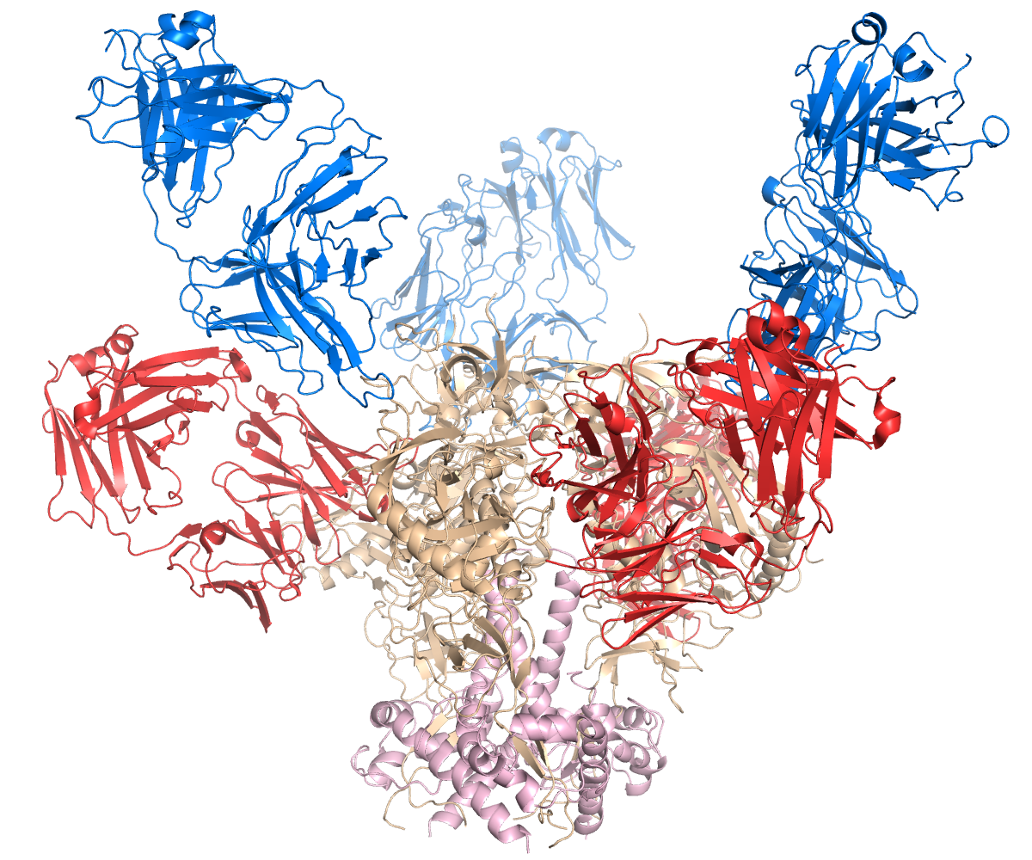
bNAbs: Antiviral Activity
10-1074
(V3 loop)
In vitro, the 3BNC117+10-1074 combination has in vitro activity against > 80 % of diverse strains
Well-tolerated following SC and IV administration, including repeated doses
Antiviral activity in individuals harboring sensitive viruses
3BNC117
(CD4 binding site)
Viremic individuals
ART-suppressed
Fc-mutations prolong half-life
bNAb infusions
Off ART
Log-decline
HIV-1 RNA levels
bNAb serum conc
. (mcg/ml)
HIV-1 RNA levels
weeks after ART interruption
weeks after infusion
Transient decline in viremia
Maintain viral suppression
after ART interruption
Single IV infusions maintain expected therapeutic levels for at least 6 months
Bar-On, et al., Nat Med. 2018 Mendoza, et al., Nature 2022
Gaebler, et al., Nature 2022
Caskey, et al., CROI 2022
Notes:
Over the last several years, we conducted a series of studies with 2 of these bNAbs. This antibody combination showed in vitro activity against diverse viral strains. Collectively, our studies showed that 1) the antibodies are well tolerated when given in combination, SC or IV routes, including with repeated doses, 2) when one or 2 antibodies are given, the level of circulating virus decreases significantly (demonstrating that the antibodies have direct antiviral effects in humans), 3) in individuals who were taking antiretroviral therapy, the antibodies could maintain viral suppression (or undetectable viral loads) after the participants discontinued their medications, 4) Engineering of the antibody’s Fc region prolonged half-lives by > 3-fold which allows for intravenous administration every 6 months to maintain therapeutic levels.

Slide 4
Repeated doses of two bNAbs can maintain suppression of sensitive viruses in the absence of ART
Sneller et al., 2022
Gaebler et al., 2022
Participants not screened for sensitivity
  13/17 (76%) ppts maintained VL < 200 cp/ml
  through the dosing period of 20 wks.
Median time to rebound was 28.5 wks (7- > 48 wks)
Participants initiated on ART in acute/early HIV
Participants not screened for sensitivity
  5/7 ppts maintained VL < 40 cp/ml for > 28wks
Median time to rebound was 33 wks (7-43 wks)
Notes:
These 2 recent studies tested repeated doses of 3BNC and 1074 over 20-24 weeks. In one study we enrolled individuals who started treatment during chronic infection, and the other enrolled individuals treated during acute infection. Participants enrolled without pre-screening for sensitivity. 13 out of 17 and 5 out of 7 participants maintained suppression during the dosing period. The 2 participants in this acute study had outgrown viruses with resistance to 1 or both antibodies at baseline.

Slide 5
In addition to suppressing viremia,
can bNAbs perturb HIV-1 reservoirs and enhance immune responses?
Notes:
But for this talk, the more relevant question is: In addition to looking at suppression of viremia, we have conducted studies to assess if the antibody combination can perturb HIV-1 reservoirs and enhance immune responses. I will share what we and others have found with studies using 3BNC117&10-1074.

Slide 6
The reservoir: Recent Insights and
Potential Opportunities for Intervention
Established early after infection
Rare, long-lived memory CD4⁺ T cells
Abundance of defective proviruses
Chun et al., 1997
Finzi et al, 1997
Chun et al., 1998
Siliciano et al., 2003
Ho et al., 2013
Cohn et al., 2015
Most of the reservoir that persists appears to be have formed just prior to ART initiation
Clonal expansion is a major driver of HIV persistence, likely driven by antigen
A subset of infected-cells are transcriptionally active and selected against during suppressive ART
However, some “resist” the negative selection pressures and persist
In elite controllers, intact proviruses are often
located in “silent” genomic regions.
Abrahams et al, 2019
Lorenzi et al, 2016
Simonetti et al, 2026
Mendoza et al., 2020
Simonetti et al, 2021
Wiegand et al, 2017
Einkauf et al, 2022
Jiang et al, 2020
Sun et al, 2023
Notes:
So here I will take a moment to discuss some recent insights and potential opportunities for intervention. We know that most individuals will experience viral rebound within a few weeks after ART is discontinued…mostly because of a reservoir of rare but long-lived CD4 T cells that decline very slowly overtime during suppressive ART
However recent studies provided new insights showing that the reservoir may not be as stable or invisible as previously thought… As clones of infected cells expand over time and a subset of these are transcriptionally active and could be targets to immune-mediated mechanisms (however a subset persists and “resists’ being eliminated.

Slide 7
Immunologic Interventions to Interfere with HIV Persistence:
Antibodies have the potential to directly eliminate HIV-infected cells
and enhance host immune responses
Neutralize
cell-free virions
Data from non-clinical experiments
bNAbs mediated ADCC in vitro - sustained cell surface binding of bNAbs to Env (Bruel et al., 2016)
bNAbs accelerate clearance of HIV-infected cells in hu-mice - FcgR engagement was required to facilitate clearance of HIV-1-infected cells (Lu et al., 2016)
Clearance of
Infected Cells
Early bNAb therapy led to CD8-mediated control of SHIV-AD8_{EO} infection in subset of non-human primates
(Nishimura et al, Nature 2017, Nishimura et al, JEM 2020)
Different combination strategies with bNAbs led to virologic control in a subset of animals.
  Mechanisms of control not fully elucidated, but data showing involvement of CD8 cells
  (Whitney, CROI 2020; Borducchi, Nature 2018;
  Walker-Sperling, Nat Comm 2022)
Enhance Adaptive
Antiviral Responses
Halper-Stromberg et al, 2016
Notes:
The passive administration of bNAbs is being evaluated as one immunologic intervention to interfere with HIV persistence. Because In addition to prevent new rounds of infection through neutralization of cell-free virions, they have the potential to directly eliminate HIV-infected cells and enhance host immune responses through Fc medicated functions. These are a few examples of studies that demonstrated that bNAbs can mediate ADCC and can accelerate the clearance of infected cells in a hu-mice model. Studies in NHP primates also suggest that bNAbs can modify immune responses – a vaccinal effect – leading to virologic suppression in a subset of animals when administered early during infection or in combination with other strategies such as vaccines of TLR agnonists….however the mechanisms mediating control are not fully elucidated.

Slide 8
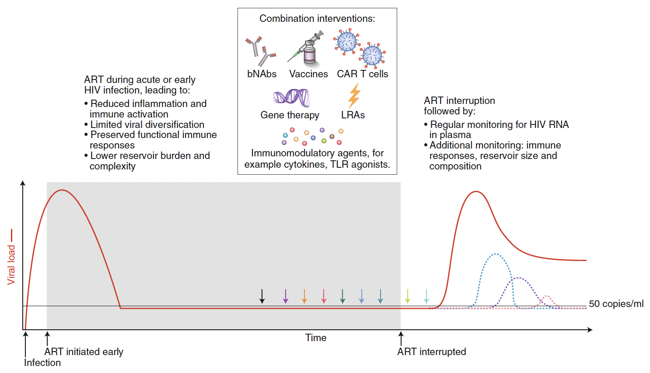
Combination Immunotherapy Strategies
During Early infection or at ART initiation: Approaches to Limit reservoir establishment and preserve immune responses
During ART suppression and/or ART interruption: Approaches to Reduce and/or Control the reservoirs
Deeks / IAS, Nat Med 2022
Notes:
Clinically, there are different approaches being studied to achieve long-term control – ranging from antibodies, vaccines, molecules to induce latency reversal to CAR-T cells. These approaches could be used at ART initiation to limit the establishment of the reservoir and preserve immune responses, or during suppressive ART or following ART discontinuation aiming to reduce or control the reservoir with the goal to maintain viral suppression following ART discontinuation.

Slide 9
Can bNAbs perturb HIV-1 reservoirs and
enhance immune responses in PLWH?
Notes:
What have we learned in studies in PWH?

Slide 10
Neutralizing antibody responses evolved over 6 months after 3BNC117 infusion
Increased neutralizing activity against autologous cultured viruses
Increased neutralization breadth against heterologous tier 2 pseudoviruses
Serum neutralization breadth evolves over several years during untreated HIV-1 infection.
The evolution of humoral responses during suppressive ART has been less studied.
But recent studies showed that:
  Autologous NAb restrict outgrowth of replication-competent viruses in vitro (Bertagnolli PNAS 2020)
  Autologous neutralizing activity evolves during ART – increased activity of “on-ART plasma” against “pre-ART” HIV-1 strains (Esmaeilzadeh et al, Sci Trans Med 2023)
Autologous neutralization (AUC)
Schoofs T et al, Science 2016
Notes:
We know that neutralization breath evolvers over several yrs during untreated HIV infection. But the evolution of humoral responses during suppressive ART has been less studied…Recent studies showed that autologous antibodies restrict outgrowth of replication competent viruses in vitro and that autologous neutralizing activity evolves overtime during ART (in individuals who initiated ART early).
Analysis of autologous responses and viral dynamics following 3BNC117 administered during viremia showed that NAb responses evolved over 6 months:
(1) Increasing against day 0 and wk 4 autologous cultured viruses
(2) And broadened against a panel of heterologous tier 2 viruses representing multiple clades (in comparison to controls) – this also happened to a lesser extent among participants on ART.
(3) Development of cross-clade ADCC after viral suppression with early ART initiation (Trauttmann JCI 2022)

Slide 11
Gag-specific T cell responses were enhanced during bNAb-mediated viral suppression therapy
During ART-mediated viral suppression
During bNAb-mediated viral suppression
Wk 0
Wk 12
Wk -2 Wk 6 Wk 12 Wk 18
Wk 0
Wk 12
Wk -2 Wk 6 Wk 12 Wk 18
Niessl et al, Nat Med 2020
Notes:
Daniel Kaufmann at the Univ of Montreal also evaluated HIV-specific responses during bNAb-mediated suppression and found that Gag-specific responses are enhanced during bNAb therapy. These graphs show the frequency of gag-specific CD4 and CD8 T cells (by measuring secretion of cytokines) in a cohort of ART treated individuals and in a group of 9 participants from one of our clinical trials. As you can see the frequency of responses does not change over time…..whereas in the group of bNAb treated individuals responses increase over the first 6 weeks after ART is discontinued and remain elevated over a period of 18 weeks.
While these suggest that bNAb therapy may impact immune responses, in both cases these changes in immune responses were not sufficient to control viremia.

Slide 12
Decrease in intact proviruses over 6 months during combination bNAb therapy
bNAb therapy (≥7 yrs ART)
bNAb therapy (≥7 yrs ART)
Q4PCR time points
Recovered sequences
Intacts
(n=841)
ART alone
ART alone
Moderate but significant changes (baseline vs 26 wks) in both the absolute number and relative representation of intact proviruses in the combined study groups (n=12).
Intacts
Defectives
Gaebler et al., Nature 2022
Notes:
Lastly, Christian Gaelber in Michel’s lab measured the intact proviral reservoir by (a PCR-based method that allows confirmation of sequences) before and 26 wks after bNAb therapy during ATI or suppressive ART. He found changes in intact proviruses but not in defectives…these were statistically significant although not large in magnitude, Data from this small cohort suggests bNAbs may be able to interfere with established/ peripheral blood HIV reservoir

Slide 13
bNAbs in HIV Cure Strategies:
Clinical trial design– open questions
  What is the best timing for Cure interventions?
  Will interventions be as effective during ART or in the absence of ART?
  Will interventions be more likely to succeed in early treated individuals?
  How long do interventions need to be?
  Will ART-free control of HIV require additional immune modulation and antigen expression: vaccines, latency reversing agents, TLR agonists or cytokines?
Notes:
So far, these results suggest that bNAbs may have additional effects, in addition to suppressing viremia. But many questions remain in how to best design (and evaluate) Cure interventions that include bNAbs
1) what’s the best timing for Cure intervention, 2) will interventions be as effective during suppressive ART or at ART initiation or during ART interruption? 3) Will interventions be more successful among individuals treated early (but not too early)? 4) Will ART-free control require additional immune modulation and antigen expression?

Slide 14
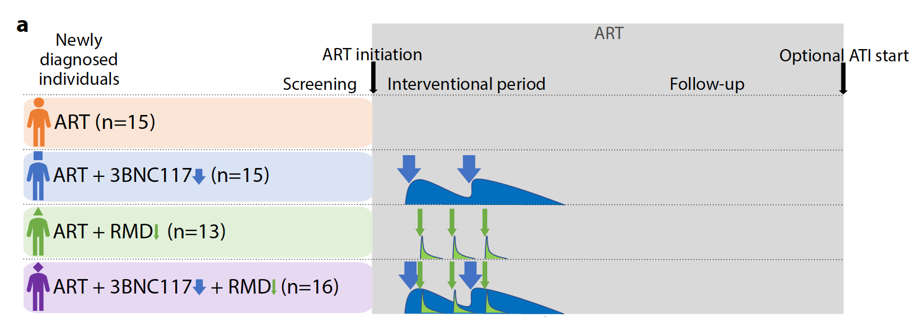
eCLEAR Study: 3BNC117 +/- Romidepsin at ART Initiation
8/15 sensitive**
10/16 sensitive
* 51% of participants in the trial harbored non-subtype B viruses
** Sensitivity by PhenoSense on pre-ART plasma viruses – IC₉₀ < 1 mcg/ml
Enhanced HIV gag-specific CD8 T cell responses
Delayed time to viral rebound
These effects were observed among participants harboring 3BNC117-sensitive pre-ART viruses
Cohort included participants who initiated ART early (within 6 mo of infection)
Gunst et al, Nat Med 2022
Rosás-Umbert et al, Nat Comm 2022
Notes:
A few studies have explored combination strategies with 3BNC117 and/or 10-1074.
Another recently completed study was eCLEAR conducted by Ole Sogaard in Denmark. In the study, ART naïve participants were randomized to initiate ART only, or receive 3BNC, romidepsin or the combination during 2 cycles…..which was then followed by ATI 1 year later. About half of the cohort harboured non-subtype viruses. While there were no significant differences across groups in terms of reservoir decay,
They observed enhanced HIV gag-specific CD8 T cell responses among participants harboring 3BNC117 sensitive pre-ART viruses pre-ART viruses, and these changes were associated with delayed to time to viral rebound (and apparent different kinetic of rebound). A caveat is that number of participants undergoing ATI was small.

Slide 15
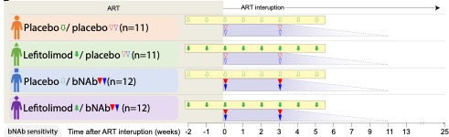
TITAN study: 3BNC117+10-1074 +/- TLR9 agonist during ATI
Trends towards increased Gag-specific CD8 T cells
in bNAb recipients during viral suppression
bNAb groups had longer period of viral suppression
placebo
TLR9
Median time to loss of control during ATI was 14 (bNAb/TLR9) and 17 weeks (bNAb)
4/11 participants in bNAb only group did not meet ART restart criteria in 25wks
bNAb
bNAb/TLR9
No clear additional beneficial effect of combining lefitolimod with bNAbs
Gunst et al, CROI 2023
Notes:
In prior studies, leftolimod, a TLR9 agonist in PWH on ART-induced activation of pDCs and potent upregulation of antiviral immune responses. In this study, participants were again randomized in 1 of 4 groups to receive 3BNC+1074 with our without the TLR9 agonist, or placebo. Two doses of bNAbs were given 3 weeks apart during ATI and the dosing period ended at wk 5 of ATI. The ATI period was defined to be of 25 weeks.
They found that the bNAb groups had longer period of viral suppression, and 4 out 11 bNAb only participants did not meet ART restart criteria. Again, they observed a trend towards increase gag CD8 responses among bNAb recipients who maintained viral suppression for 13 wks.
Of note, they did not observe clear additional beneficial effect of combining TLR9 with bNAbs.
The study’s primary endpoint was time from stopping ART to the date of meeting the criteria for loss of virologic control (defined as 4 weeks with plasma HIV-RNA >1,000 copies/mL or 2 consecutive measurements >100,000 copies/mL).
One partial controller in the placebo/bNAb group had a known protective HLA class I allele (ID601: HLA*B27) (Extended Table 1) and one started ART less than 6 months from presumed date of HIV-1 infection (ID142)

Slide 16
Summary
Effects on viremia
  Viral suppression was maintained with repeated bNAb dosing during ATI in participants harboring sensitive proviruses (Mendoza et al, Nat Med 2018, Gaebler et al, Nature 2022, Sneller et al, Nature 2022).
Effects on immune responses
  3BNC117 enhanced humoral immune responses in PWH (Schoofs et al, Science 2015).
  HIV-1 specific T cell responses were enhanced during bNAb therapy after ART discontinuation (Niessl et al, Nat Med 2020) and following bNAb administration at ART initiation (Gunst et al, Nat Med 2022, Rosás-Umbert et al, Nat Comm 2022).
Effects on the reservoir
  Immunotherapy with 3BNC117 and 10-1074 (over 6 months) was associated with changes in the size of the intact proviral reservoir without measurable effects on the defective reservoir (Gaebler et al, Nature in 2022).
Interventions at ART initiation (or ART resumption after viral rebound) may impact the course of HIV infection
Viral diversity remains a key challenge to bNAb-based strategies
Notes:
So to summarize what we know so far……

Slide 17
Combination Immunotherapy Strategies: Vaccines
During ART suppression and/or ART interruption: Approaches to Reduce and/or Control the reservoir
During Early infection or at ART initiation: Approaches to Limit reservoir establishment and preserve immune responses
Most planned/ongoing studies focus on T cell vaccines
Can immunogens designed to prime-expand bNAb-precursors accelerate the generation of
bNAb responses in PLWH?
Deeks / IAS, Nat Med 2022
Notes:
In addition to the passive administration of bNAbs, there is a more recent interest in exploring potential effects of B-cell vaccines. Most (if not all Cure studies) so far have focused on T-cell immunogens as the importance of T cells in virologic control has been apparent.

Slide 18
Multiple Immunogens and Strategies in
Clinical Development
Germline-targeting
Vaccine Design
Lineage-based
Vaccine Design
Polishing (Trimers)
eOD-GT8 multimer (CD4bs)
BG505.v4.1-GT1.1 SOSIP trimer (CD4bs-V2 )
CH505TF SOSIP trimer (CD4bs-V2) 426c Core gp120 and boost (CD4bs)
CH505 M5 G458Y SOSIP (CD4bs) NP
CH848 10.17DT SOSIP trimer (V3) (NP and mRNA)
N332-GT5 SOSIP trimer (V3)
MT145KdV5 SOSIP trimer (V2)
EnvSeq1: CH505 gp120s (CD4bs CH103 lineage (VH4-59) HVTN 115 and HVTN 135
EnvSeq2: M5 gp120s (CD4bs CH235 lineage (VH1-46) HVTN 115
BG505.664 SOSIP trimer
BG505 DS SOSIP.4mut (Trimer 4571)
Con M SOSIP.v7
ConS UFO 664
Mos1, Mos2, Mos3 SOSIPs
Acute 763, 936, AMC011 SOSIPs HIV Trimer-FPv2 (Trimer 6931)
16055 NFL trimer
BG505 MD39.3 gp151 HIV trimers mRNA/LNPs
Epitope-based
Vaccine Design
MPER liposome – HVTN 133 on hold
FP8-rTTHC (fusion peptide on carrier)
Proof of concept for germline-targeting: immunizations with eOD-GT8 multimer+AS01b induced VRC01-class IgG B cells (Leggat et al, Science 2022)
Adapted from Steve Smiley (DAIDS)
Notes:
As all of you know (as developers of these immunogens) many different B-cell immunogens are in development and several of them entered clinical testing. With Bill Shief’s study with eOD GT8 showing that the germline-targeting approach initiated the first step towards bNAbs by inducing VRC01-class IgG B cells.

Slide 19
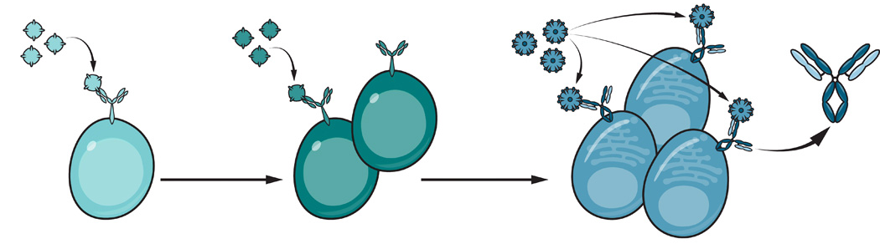
Can immunogens designed to prime-expand bNAb-precursors accelerate the generation of bNAb responses in PLWH?
PWH on ART were already exposed to HIV Env
  bNAb precursor responses are already primed in some PWH
Will ‘polishing’ immunogens suffice to boost or expand bNAb precursors in PWH?
  Will existing immune memory interfere with the ability to broaden responses?
PWH on ART have ongoing exposure to HIV Env
  Virions persist on follicular dendritic cells
  Low-level viremia occurs despite ART
  Recent data suggest humoral responses evolve during ART suppression.
Might germline- or epitope-targeting immunogens suffice in PWH?
  Autologous Envs might auto-polish and auto-boost
If successful in inducing/accelerating bNAb development in PWH during suppressive ART, vaccine-induced antibodies might: limit viral rebound and modulate HIV-1-specific responses through Fc-mediated mechanisms for long-term control.
Notes:
Now that we have safety and immunogenicity data with these types of immunogens…should we consider evaluating their potential to expand and mature bNAb precursor responses in people with HIV?
We know that PWH have ongoing exposure to HIV even during suppressive ART and that humoral neutralizing responses can evolve during ART. bNAb precursor responses are likely present in some PWH? So can germline- or epitope targeting immunogens suffice to initiate new lineages of bNAb precursor responses where autologous Env might auto-polish and auto-boost? (would this happen during suppressive ART?).
Alternatively, since PWH already have pre-existing responses…would these interfere (or perhaps improve) the ability to broaden existing precursor responses? Would polishing immunogens be able to boost such precursor responses during ART suppression.
How is this relevant for Cure strategies – if we were successful in inducing or accelerating bNAb development, these vaccine-induced antibodies might limit viral rebound after ART discontinuation and modulate HIV specific responses (in a similar – but possibly polyclonal/long-lasting way as passively administered bNAbs.

Slide 20
Summary
Studies of passively administered bNAbs showed effects on intact proviruses and HIV-specific immune responses
  Are the observed responses due to a “vaccinal effect”?
  So far, not sufficient to mediate long-term virologic control (consistently)
  Small studies to date
How to improve upon these results?
  Evaluate different clinical scenarios such as timing/length of intervention and study populations
  Evaluate combination approaches
Can B-cell immunogens have a role in Cure strategies?
  Can we learn lessons from studies in PLWH that may be relevant to the prevention field?

Slide 21






Acknowledgements
Study participants
Rockefeller University
Michel Nussenzweig
Christian Gaebler
Thiago Oliveira
Victor Ramos
Cintia Bittar
Anna
Jill Horowitz
Katrina Millard
Martina Turroja
Deanna Dong
Melissa LaMar
Leah Todd
Irina Shimeliovich
Aarhus University
Ole Soogard
Jesper Gunst
Miriam Rosás-Umbert
Amsterdam UMC
Rogier Sanders
Tom Caniels
Godelieve de Bree
Emma Reiss
Karlijn van der Straten
Cologne University
Florian Klein
Gerd Fatkenheuer
Henning Gruell
George Washington (GW)
David J. Diemert
Jeffrey Bethony
University of Montreal
Daniel Kaufmann
Imperial College
Sarah Fidler
IAVI
Dagna Laufer
Pat Fast
Vince Philiponis
Angela Lombardo
Harriet Park
Oxford
John Frater
Weill Cornell Medicine
Brad Jones Trip Gulick
Tim Wilkin
Duke University
Georgia Tomaras
Kelly Seaton
Nicole Yates
David Montefiori
BIDMC Harvard
Michael Seaman
VRC / CCVIMC
Richard Koup
Madhu Prabhakaran
Dartmouth
Margie Ackerman

