Slide 1
bnAbs Vaccinal Effect – Preclinical Models
Carey Hwang, MD, PhD
Vir Biotechnology, Inc., United States
Session: bnAbs: From prevention to cure

Slide 2
Introduction
Antibodies work in multiple ways to control or prevent viral infection as well as anti-tumor effects
Vaccinal effect can induce long-term antiviral effects and have been demonstrated in different animal models
Anti-tumor effects in murine models
Anti-viral effects in animal models
Influenza
HIV
Understanding and harnessing these mechanisms may be critical to understanding applications in HIV functional cure and prevention

Slide 3
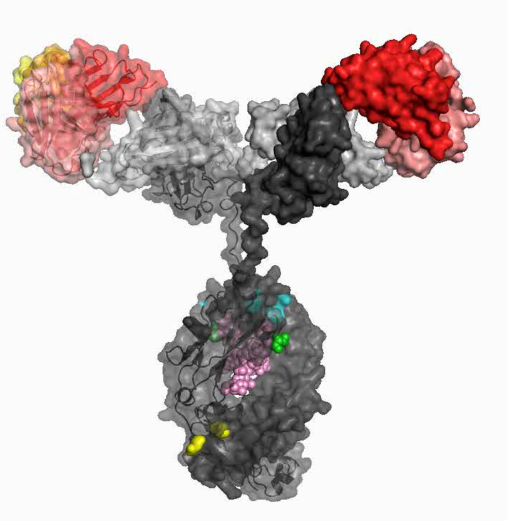
Fc domain plays an instrumental role in effector functions
Fab domain binds to specific epitope on pathogens or cells
Affinity maturation to improve potency, escapability, breadth
Fc domain binds to FcRs on immune cells, activates complement (C1q), and triggers effector functions
Antibody-dependent cytotoxicity and phagocytosis
DC maturation and antigen presentation
Boosting of T and B cell responses (vaccinal effect)
Half-life extension (improved PK)
Complement activation against bacterial targets
Fc modified mAbs (incl. Vir’s) are in the clinic

Slide 4
Vaccinal Effect: immune complexes of mAbs with engineered Fc boosts the activation of dendritic cells, antigen presentation and long-term T cell-immunity
mAb:antigen
generation
of immune complexes
Immune complex binding to FcRs on dendritic cells (DCs)
Phagocytosis,
DC maturation and antigen presentation
Generation of effector T cells
activating
FcγRIIa
T_{eff}
Vaccinal mAb
inhibitory
FcγRIIb
activated DC
Fc engineering
to increase binding to FcgRs
IIA & IIIA (activating) and
to decrease binding
to FcgRIIB (inhibitory)
Durable
pathogen-specific immunity,
potential functional cure

Slide 5
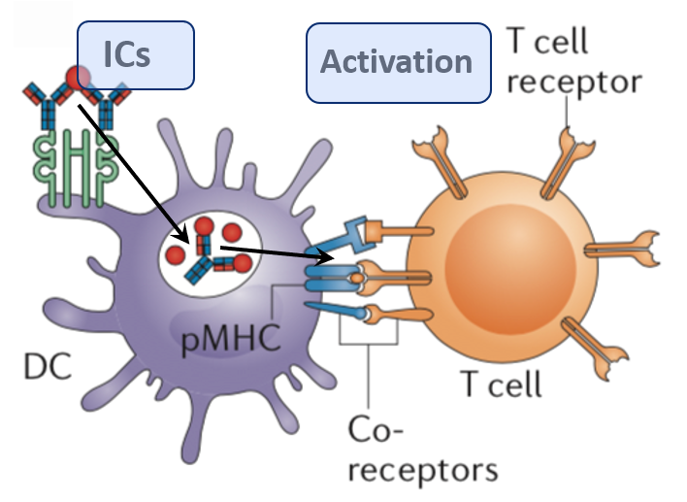

Background | GAALIE (XX2) Fc modification
The antibody Fc domain plays an instrumental role in effector functions
Fc domain binds to FcRs on immune cells and triggers:
→ antibody-dependent cytotoxicity and phagocytosis
→ DC activation and antigen presentation: Induction of long-lasting immunity against viral infections
Fc modification can boost IC-mediated DCs activation
(Fc-engineered immunity) :
The first critical step for vaccinal effect
GAALIE → Increased FcγRIIA and IIIA binding (activating)
→ Decreased FcγRIIB binding (inactivating)
GA → Increased FcγRIIA
afuc → Increased FcγRIIIA
LS → Increased half-life

Slide 6
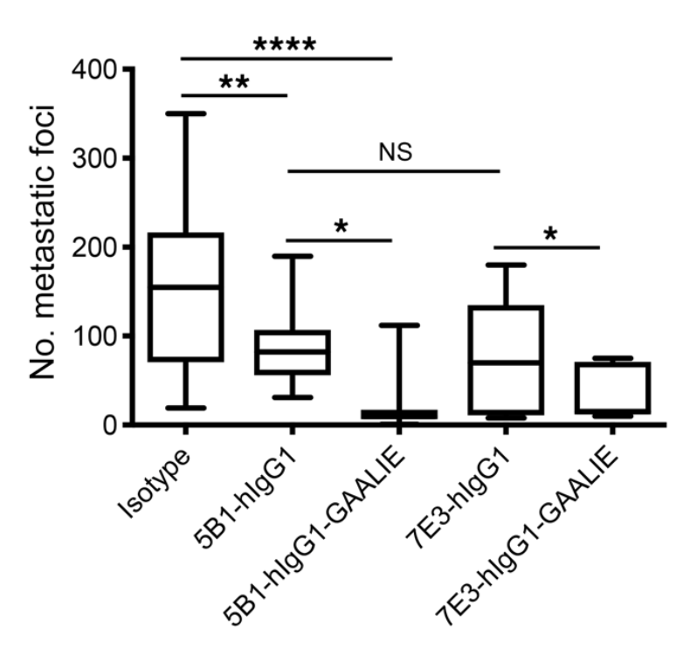
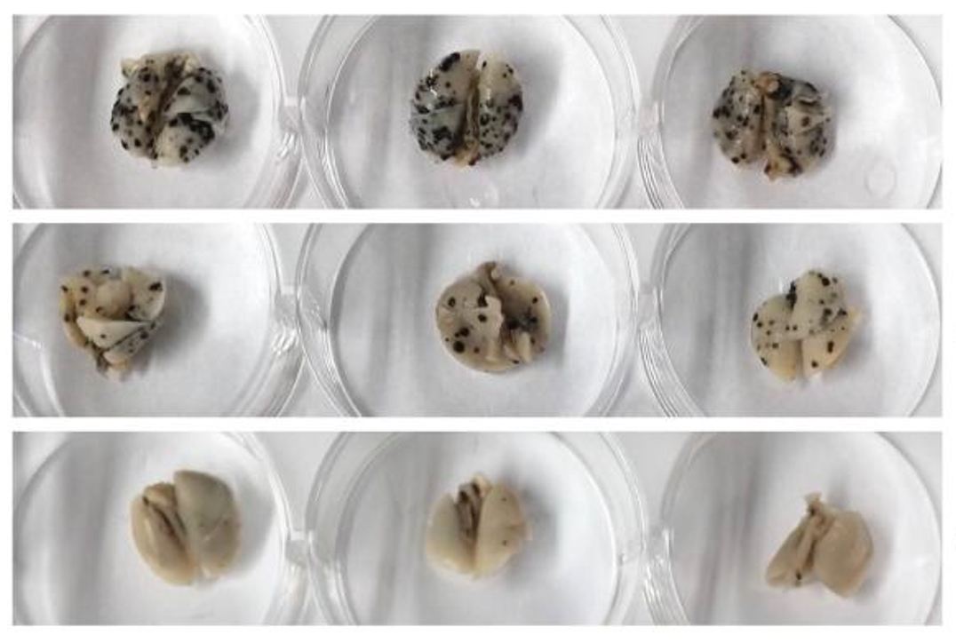
Engineering GAALIE Fc and a vaccinal effect protect against cancer lung metastasis
Anti-sLeA carbohydrate cancer antigen mAb 7E3-GAALIE reduced lung metastatic foci
of B16 tumor cells compared to WT-Fc
Isotype
wild type-Fc
GAALIE-Fc
Weizenfeld et al. JClinInvest. 2019; 129(9):3952–3962.

Slide 7
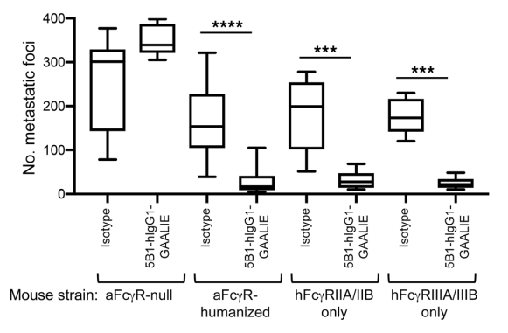
FcɣIIA or FcɣIIIA engagement is essential for tumor clearance
Weizenfeld et al. JClinInvest. 2019; 129(9):3952–3962.

Slide 8
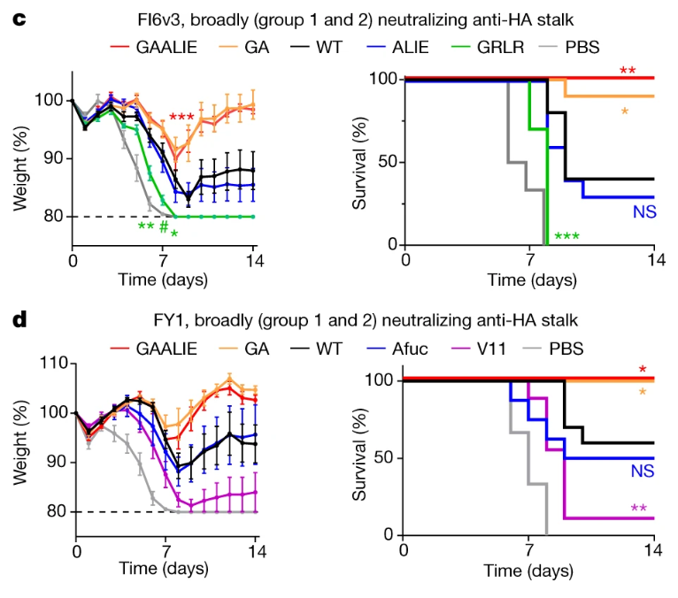
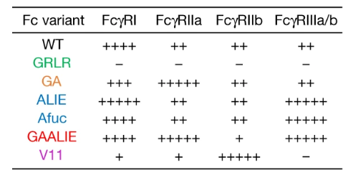
Influenza Model Evaluating Fc-engineered Abs
Different receptor affinities were evaluated
Those binding FcɣIIa had greatest protection
Bournazos et al. Nature 2020; 588,485–490

Slide 9
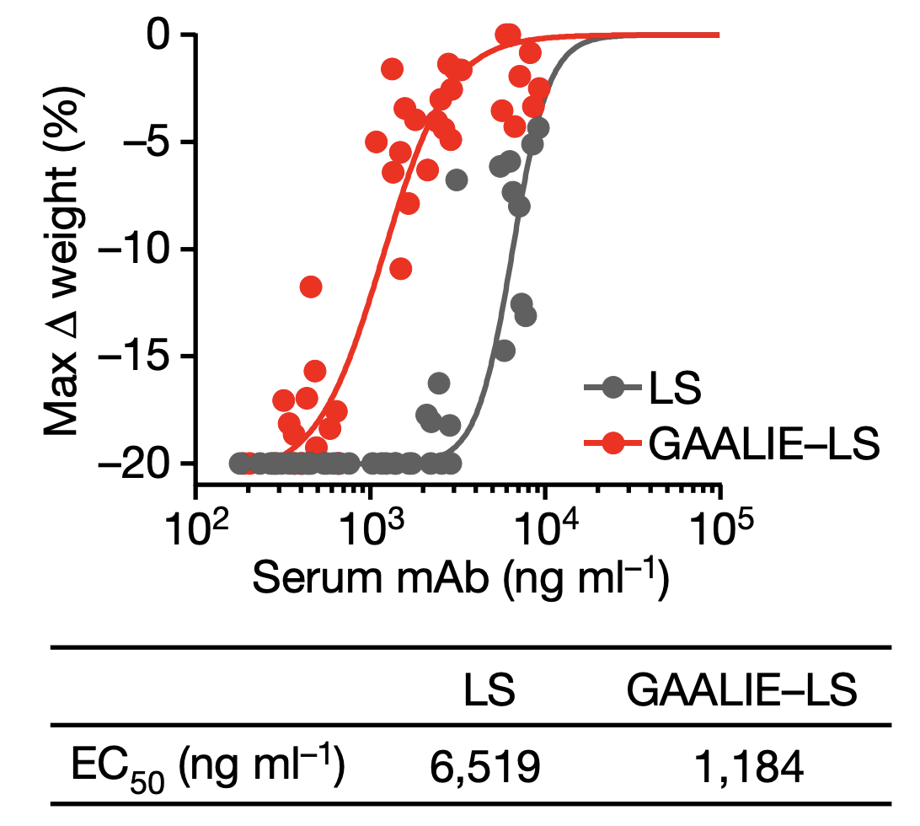
Engineering GAALIE Fc better protects against influenza virus infection via induction of CD8+ T cells
Anti-influenza HA stem mAb
GAALIE Fc is more potent in prophylaxis
→ 5x lower mAb dose protects
human FcɣR transgenic mice
Protection via rapid induction of CD8+ T cells, depletion eliminates protective effect
Bournazos et al. Nature 2020; 588,485–490

Slide 10
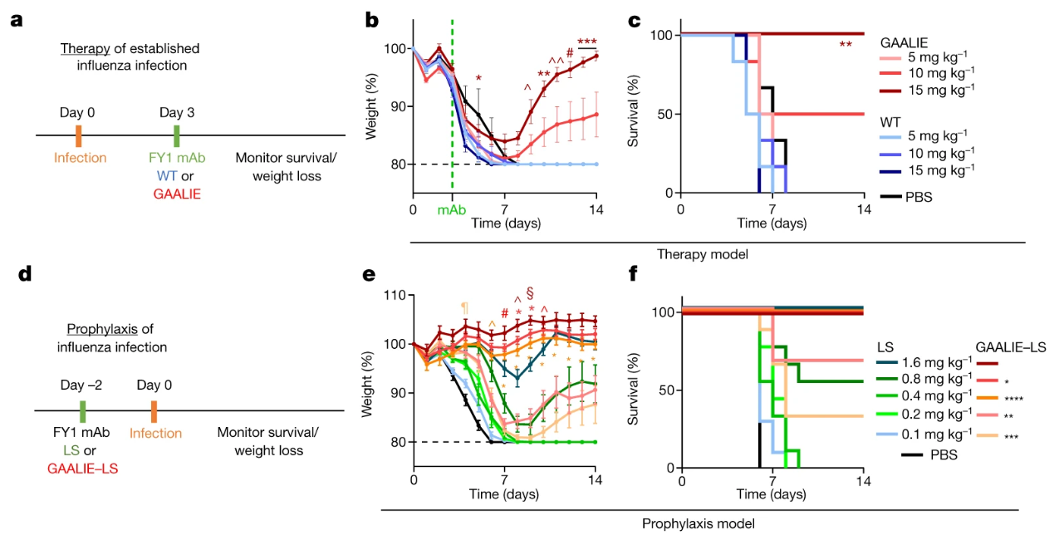
Evaluation of GAALIE variants in therapy and prevention
Bournazos et al. Nature 2020; 588,485–490

Slide 11
Vaccinal increase in prophylactic potency against influenza virus depends on CD8 T cells
Dendritic cell activation
T cell activation
Survival after H1N1 (PR8) inoculation
Bournazos et al. Nature 2020

Slide 12
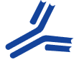
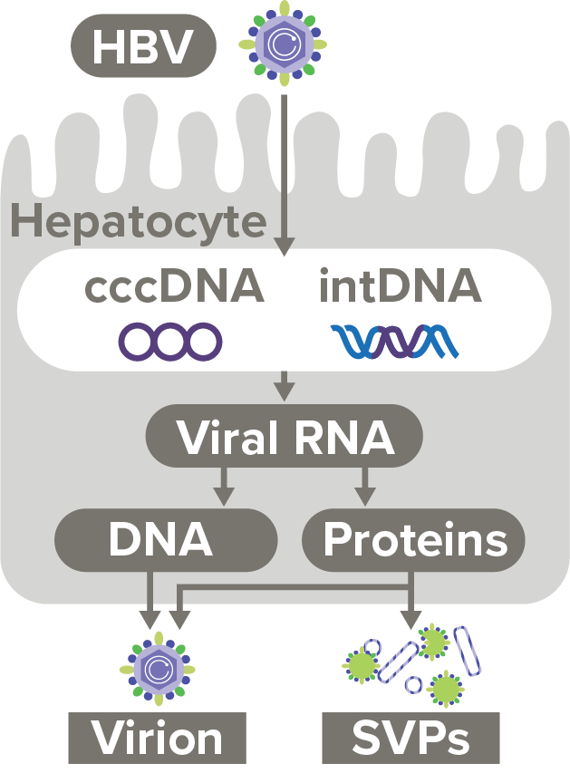

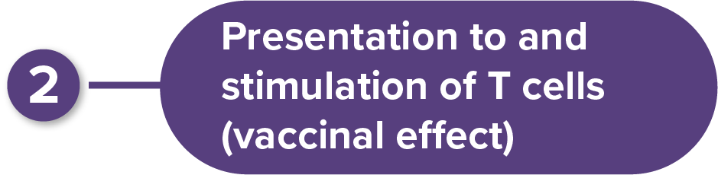
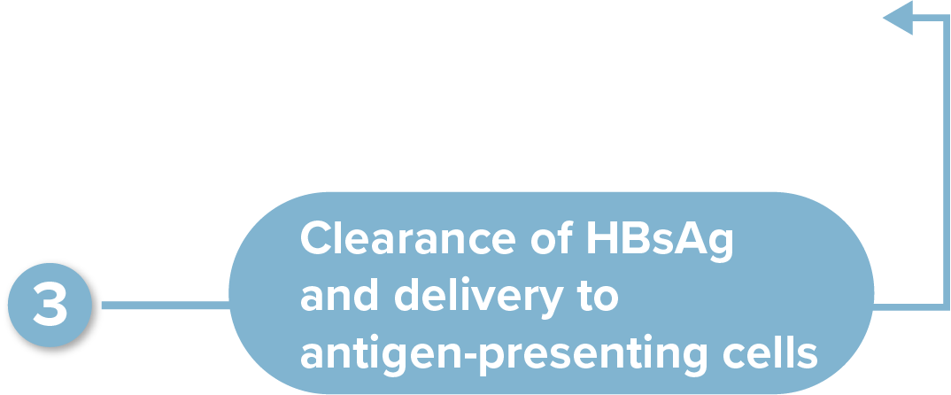
VIR-3434, mAb directed against HBsAg
VIR-3434

Slide 13
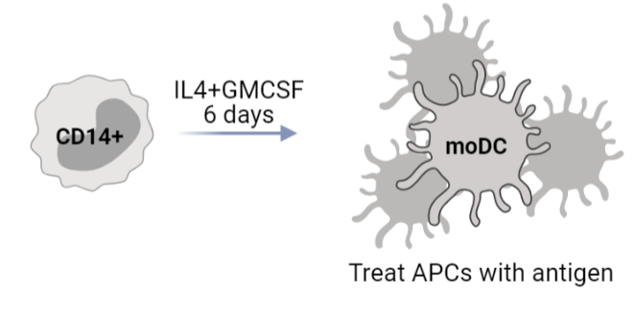
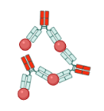
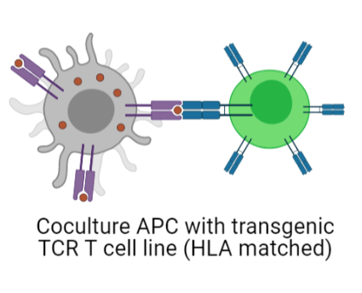
Vaccinal effect: VIR-3434 in complex with HBsAg activates moDCs and stimulates antigen-specific reporter CD4+ T cells
HBsAg:mAb
50 µg/ml VIR-3434
+
VIR-3434
VIR-3434
moDC activation marker CD83,
similar for CD86 and cytokines
TCR-transgenic Jurkat reporter cells as model for HBsAg-specific CD4+ T cells
Similar results for CD4+ memory T cells
from HBV vaccinees or huFcγR mice
Lempp, et al. Preclinical Characterization of VIR-3434, a Monoclonal Antibody Neutralizing Hepatitis B Virus That Facilitates FcyR-Mediated Elimination of HBsAg. Poster presented at AASLD 2021. Nov 12-15, 2021. Virtual.

Slide 14
Hypothesis for a Vaccinal Effect mediated by T cells in HIV
Is a functional cure or prevention possible for HIV?
Can the immune system play a role in a functional cure and long-term prevention?
Can vaccinal Abs enhance/kick-start immune control in people living with HIV?
Generation of Ab:Ag immune complexes that can enhance T cell immunity and mediate long-term viral control via Fc engineering

Slide 15
Evidence supportive of Fc modified Vaccinal Antibodies
Vaccinal Effect -- Can processing of immune complex be leveraged for therapeutic gain?
Study | Disease/ Model/Intervention | Clinical/viral response observed | Immunological response observed | Proposed Mechanism
Gaebler, Nussenzweig 2022 Nature | HIV (chronic), Human Unmodified bnAbs | - 2 of 23 subjects remained virally suppressed post bnAb treatment - Majority of subjects maintained VL suppression with mAbs present | Not reported | Not stated
Bournazos, Ravetch 2020 Nature | Flu (acute), Mouse Fc modified Ab | Increased survival in therapy and prophy | Increase DC and T cell activation in lung | CD8 T cells
Niessl, Kaufmann 2020, Nature Imm | HIV (chronic), Human Unmodified bnAbs | Immunological response of cohort reported in Mendoza et al 2018 | Increased HIV specific CD4 and CD8 T cell responses after HIV bnAb treatment | CD8 and CD4 T cells
Mendoza, Nussenzweig 2018 Nature | HIV (chronic), Human Unmodified bnAbs | 2 of 15 subjects remained virally suppressed post bnAb treatment | Not reported (later Kaufmann T cell work shows increase HIV specific T cell responses) | T cells
Schoofs, Nussenzweig 2016 Science | HIV (chronic), Human Unmodified bnAb | ~1 log suppression of VL while bnAb present | Increased HIV neutralizing Ab breadth | B cells
Hishimura, Martin 2017 Nature | SHIV (early), Macaque Unmodified bnAbs | Suppressed virus after many weeks to undetectable in some animals | HIV specific T cell responses T cell depletion showed impact. | CD8 T cells
DiLillo, Ravetch 2015, Cell | Lymphoma (early), Mouse 1st gen Fc modified mAbs | Protection from re-challenge | CD3⁺ transfer protects in mouse model | Ab/FcR initiated protection transferable with CD3⁺ T cells
Bournazos, Ravetch 2014, Cell | HIV, mouse model 1st gen Fc modified bnAbs | Enhanced therapeutic potency of Fc HIV bnAbs in | Fc enhanced > IgG > Fc effector function null | FcγR dependent

Slide 16
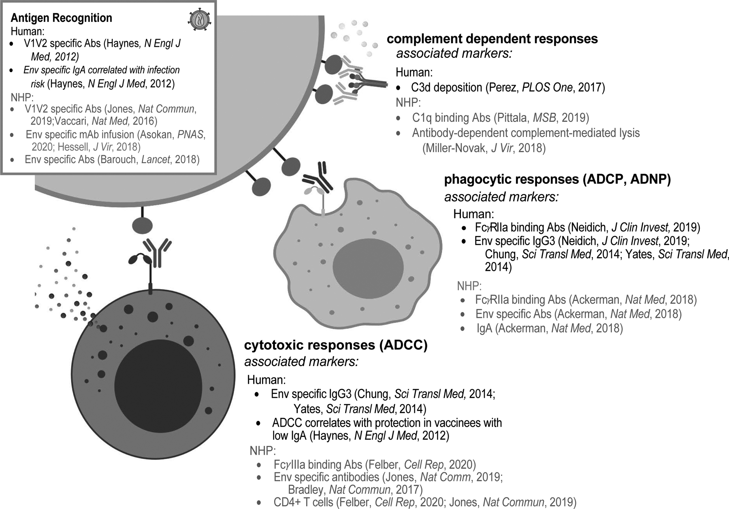
Role of Fc-effector function in prophylactic and therapeutic contexts of HIV infection
There is clinical and NHP evidence that ADCC, ADCP and complement deposition can correlate with better (clinical) outcomes
Combining ADCC, ADCP, and complement deposition with vaccinal effect could further improve outcomes

Slide 17
Summary
Multiple studies have shown the ability of the vaccinal effect of antibodies to have anti-tumor or anti-viral effects
Antibodies can generate long-lasting protective immunity and disease control in the clinic and animal models through improved humoral and cellular adaptive immune responses
The vaccinal effect of antibodies may play a key role in enhancing antiviral responses
Understanding and harnessing these mechanisms will be critical to improving bnAbs for HIV functional cure and prevention

