Slide 1
^{9th} Workshop on Children and Adolescents with Perinatal HIV exposure
Jessica Jexler; Project Manager CIPHER, International AIDS Society
Notes:
Welcome everyone to the 9th edition of the workshop on Children and adolescents with perinatal HIV exposure. I am Jessica Jexler, project manager for CIPHER at the international aids society, on behalf of the co-organizers, WHO, Mass General Brigham, PACHS, PATA, UNICEF and the coalition for children affected by aids welcome to everybody here in the room and to everybody online.

Slide 2
Housekeeping
This event is being recorded.
Participation in the event signals your consent to have the recording posted on the IAS 2023 and organizer’s websites
We welcome your questions, which will be shared during the panel discussion
If you are joining online, please use the Q&A function to submit questions at any time during the presentation
If you are in the room, we welcome you to use one of the microphones

Slide 3
Background
The workshop focuses on the health and wellbeing of the 16 million children and adolescents HIV-exposed uninfected.
The workshop is a catalyst for shaping research agendas, health policy, programming and promoting advocacy to ensure children and adolescents HIV-exposed uninfected are healthy and reach their fullest possible developmental potential.
Notes:
The workshop every year..
Jessica: Say this after the you say the first bullet > Past workshops have highlighted the health and development disparities in this population of children and adolescents affected by HIV
Jessica: Say this after you say the second bullet > This year the theme of the workshop will be Moving beyond a negative HIV test - Establishing a thrive agenda for children and adolescence with perinatal HIV exposure

Slide 4
Agenda
Predictors of Neurodevelopment among HIV-Exposed infants, Michelle Bulterys
A quasi-experimental trial of nurturing care among children HIV-exposed uninfected, Bareng Aletta Nonyane
Lower Academic Performance Among Children with Perinatal HIV Exposure in Botswana, Lesedi Labanna
Global Alliance, Morkor Newman Owiredu
Panel discussion
Closing remarks, Vani Vannappagari
Notes:
First we are going to hear
4

Slide 5
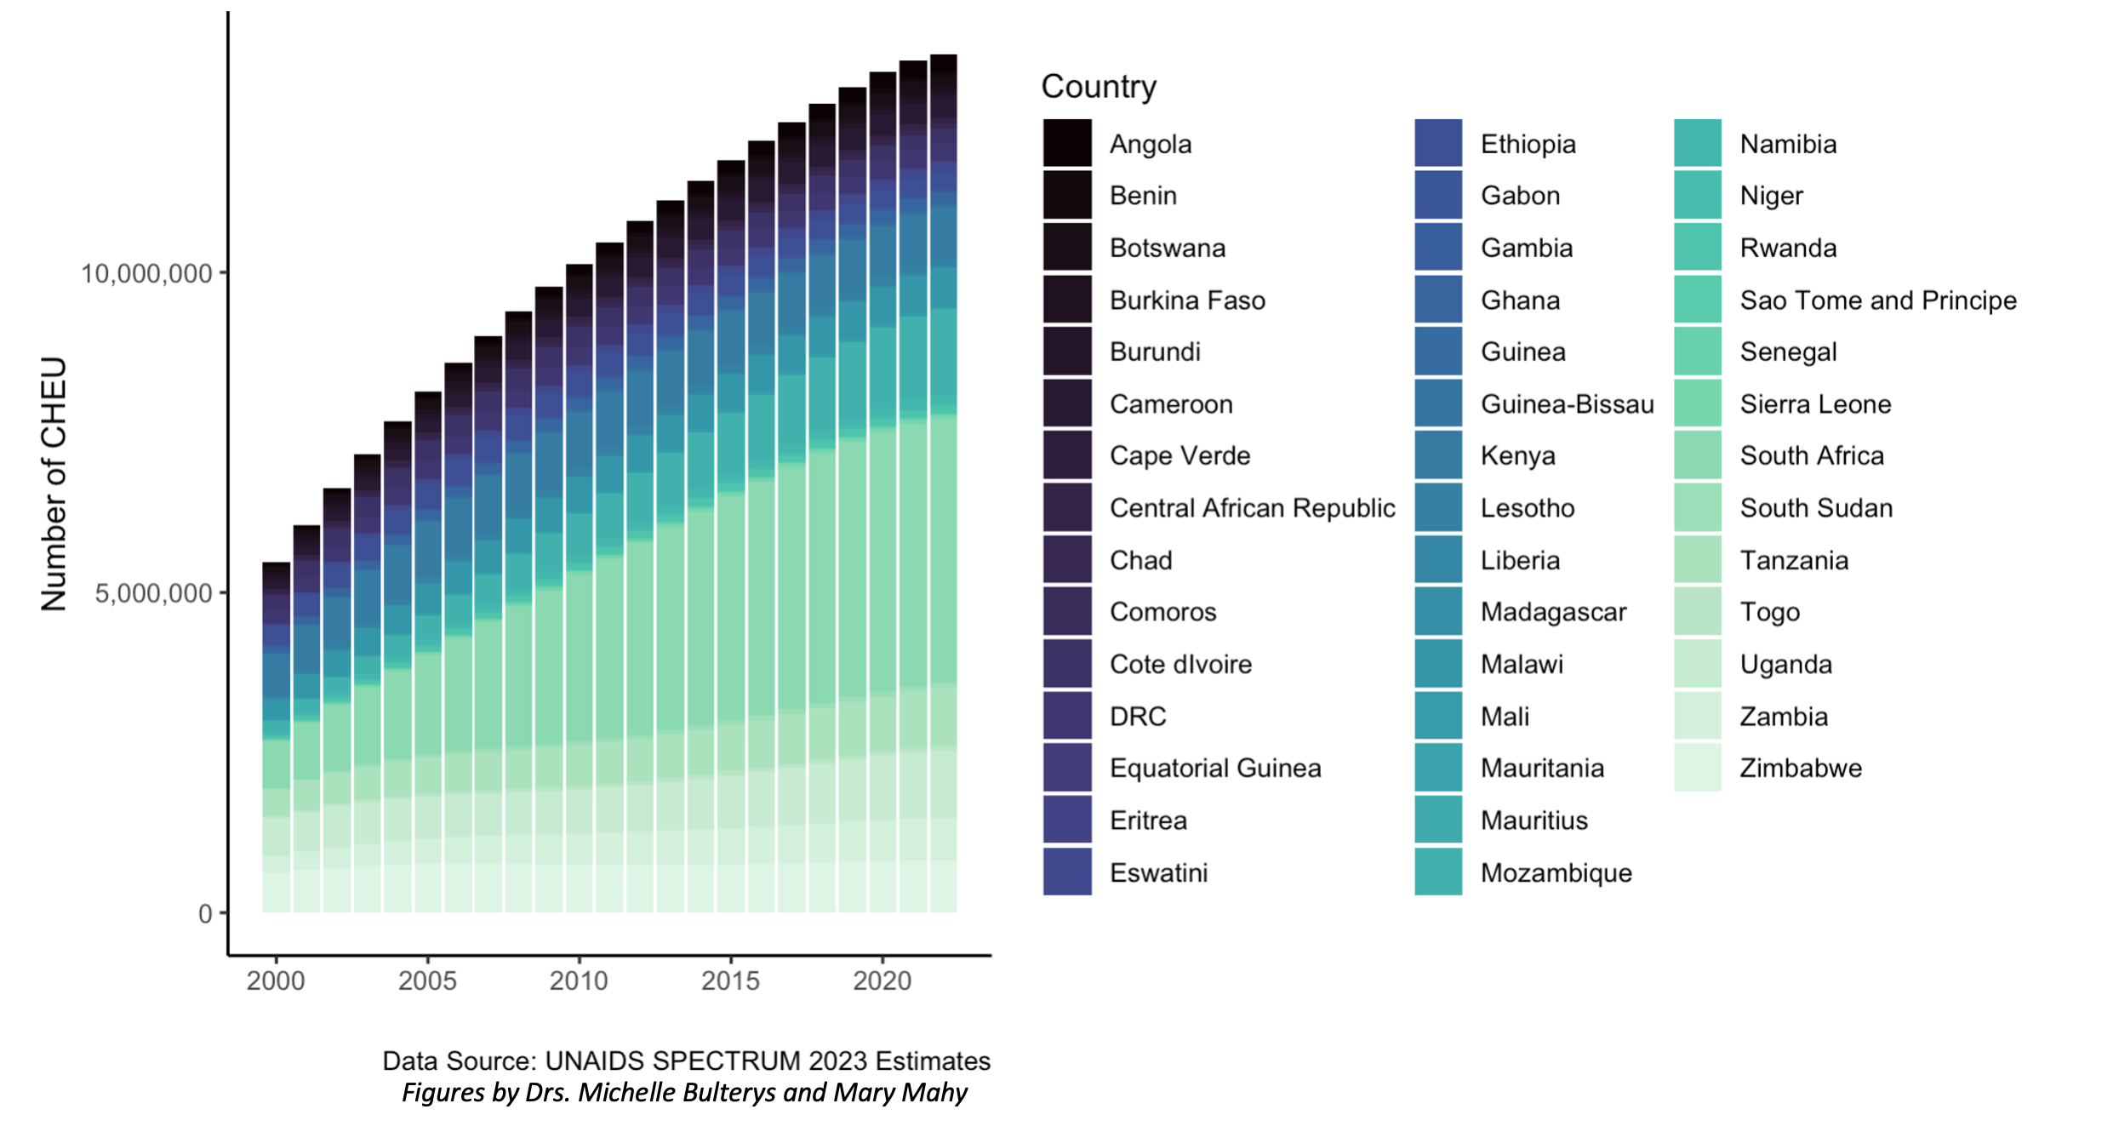
Children who are HIV-exposed uninfected (CHEU)
Figures by Michelle Bulterys and Mary Mahy
Notes:
Drs. Michelle Bulterys and Mary Mahy developed these figures using the UNAIDS latest 2023 Spectrum estimates on the global population of children who are HIV-exposed uninfected (CHEU). As we can see, successful prevention of vertical infant HIV acquisition has resulted in an expanding population of now 16 million CHEU <15 years of age, the majority of whom reside in central, South, East and Western Africa.

Slide 6
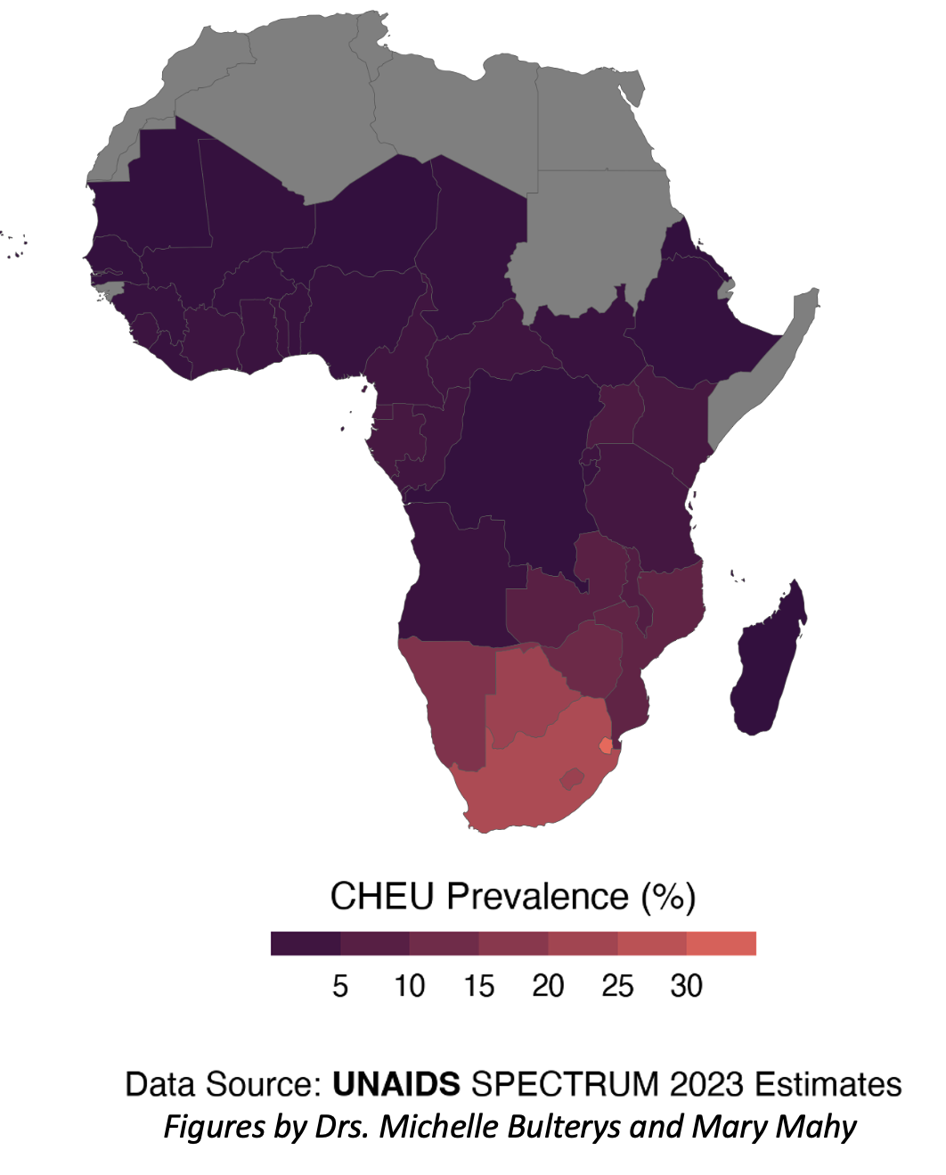
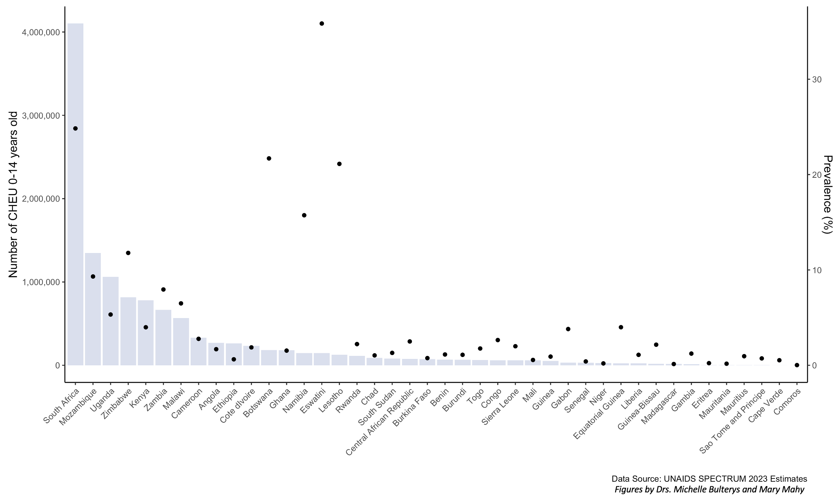
Children who are HIV-exposed uninfected (CHEU)
Prevalence of CHEU, 2023
Figures by Michelle Bulterys and Mary Mahy
Notes:
UNAIDS estimates the prevalence of CHEU among all children <15 years in the general population exceeds 20% in several countries in central, South, East and Western Africa, with over one million CHEU born every year. That means that in countries with high HIV burden, sometimes a quarter of all children <15 years are HIV-exposed, and therefore are a very important population to pay attention to.

Slide 7
Virtual scholarships
117 scholarship applications!
Number awarded: 23
16 different countries
4 continents
Notes:
Thanks to our sponsors we have again been able to provide virtual scholarship to this workshop and IAS conference. 23 awarded across 16 countries and 4 continents. We welcome you to this workshop.

Slide 8
Thank you!
Funded by:
Organizing Committee
Kate Powis
Agnes Ronan
Jessica Jexler
Giulia Moschen
Sonia Lee
Pim Brouwers
Ute Feucht
Catherine Wedderburn
Martina Penazzato
Renata Sanders
Jane Mutanga
Shaffiq Essajee
Corinna Csaky
Ivy Kasirye
Wole Ameyan
Laurie Gulaid
In partnership with:
Notes:
Finally a big thank you to the organizing committee, with special shoutout to Agnes Ronan, Kate Powis and Giulia Moschen for your leadership and organization as well to our funders and partners.
With that, please enjoy the workshop, ask questions, engage. Now I will hand over to Dr Michele Bultery, BIO
8

