Slide 1
Child neurodevelopment among children who are HIV—exposed uninfected in Kenya
9th Workshop on Children and Adolescents with Perinatal HIV Exposure
Michelle Ann Bulterys, PhD, MPH
Global WACh, University of Washington
Notes:
Thank you for the opportunity to present our latest research findings on child neurodevelopment among children who are HIV-exposed uninfected in Kenya.

Slide 2
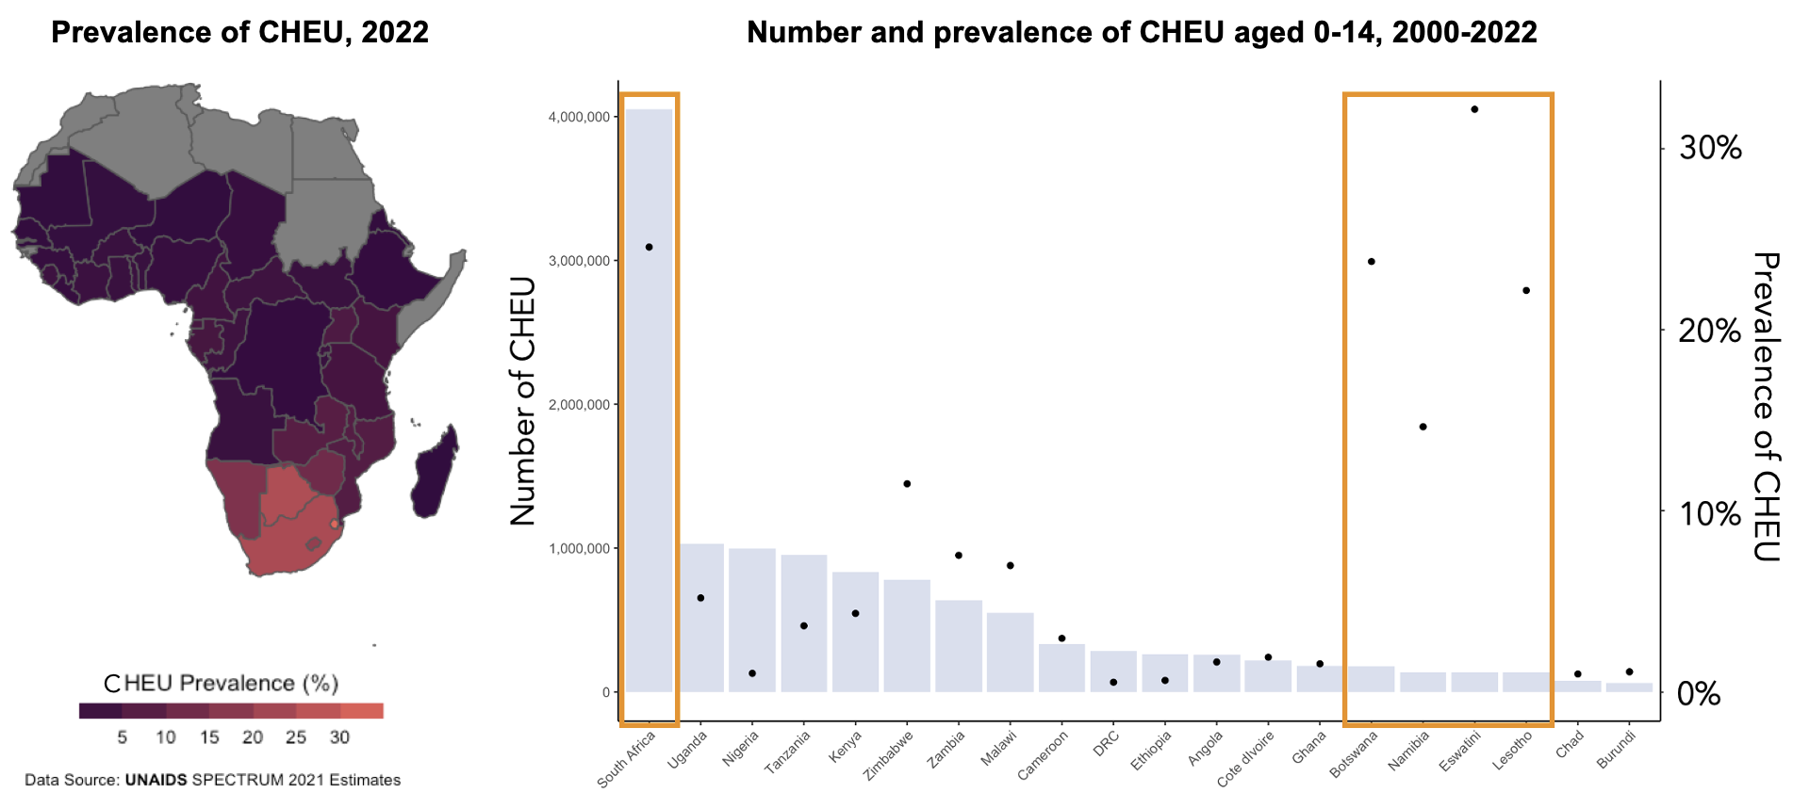
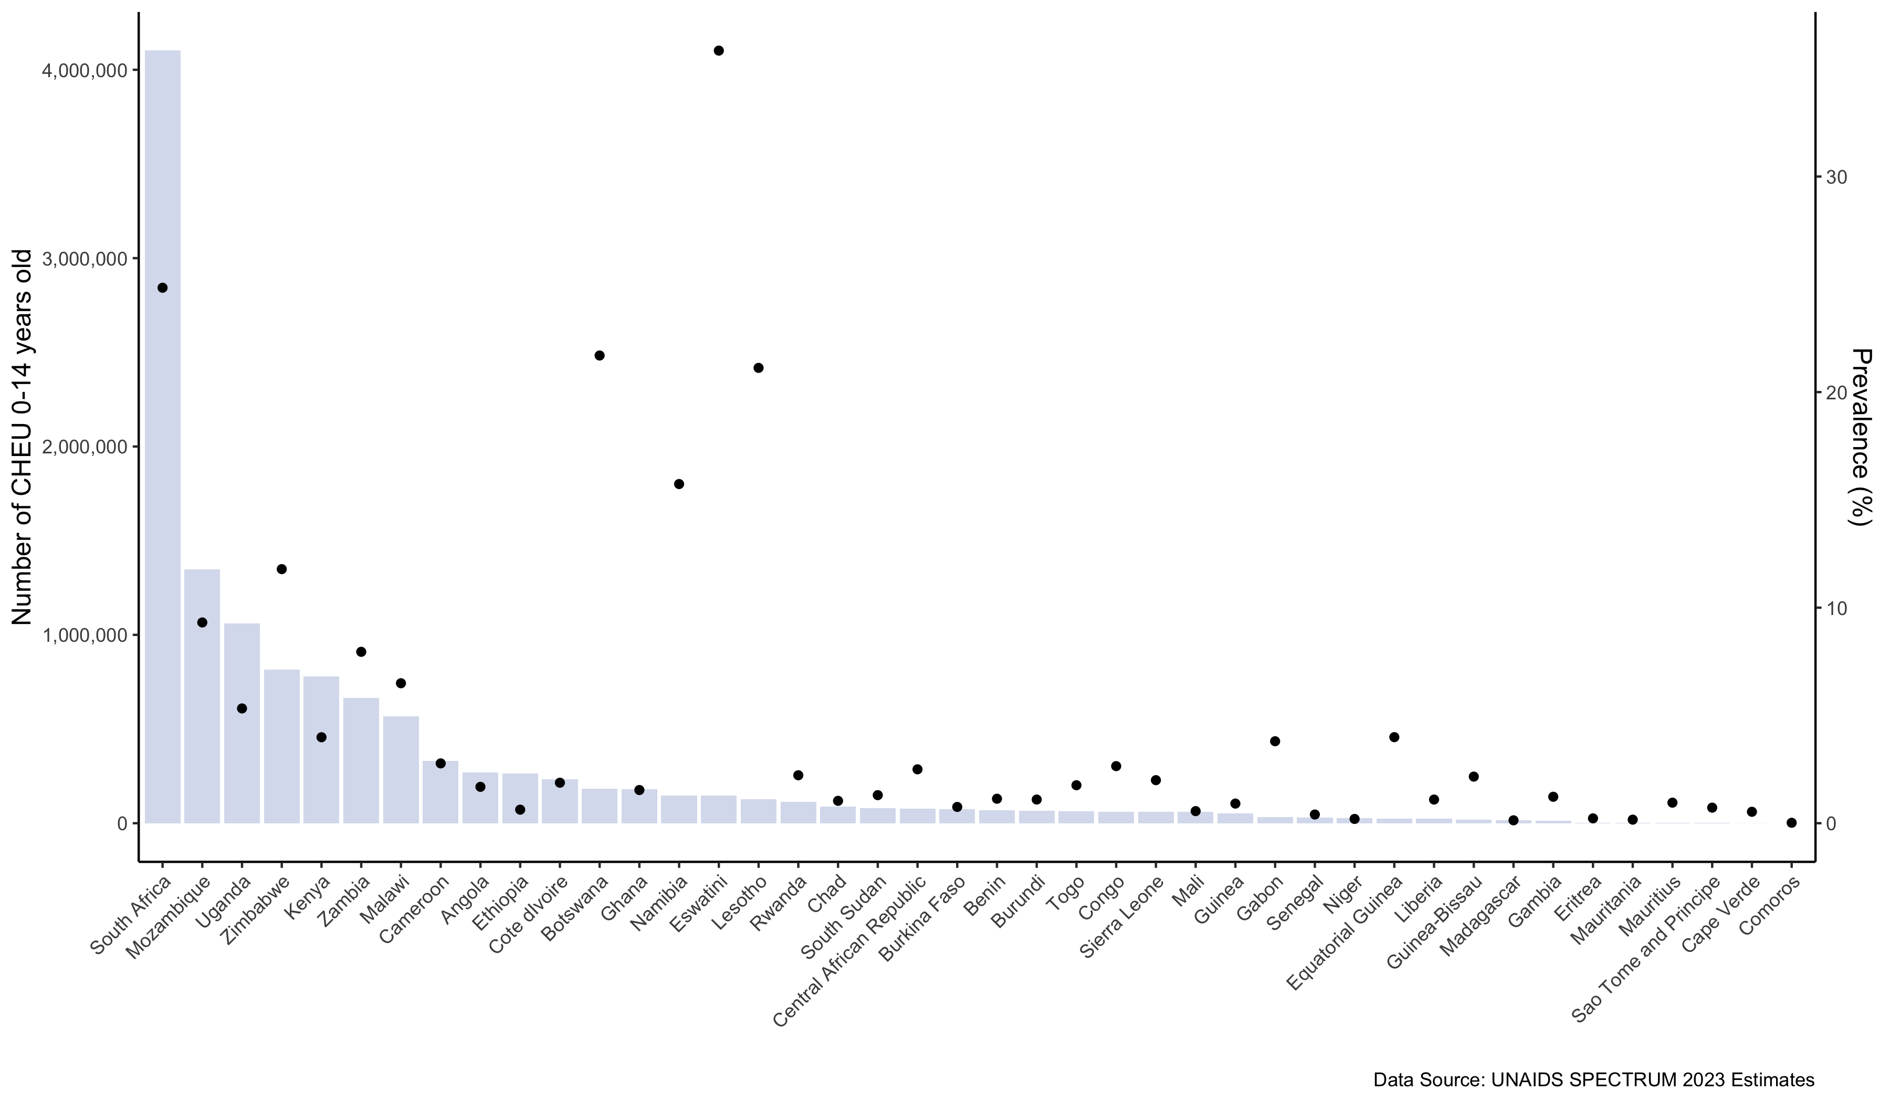
Children who are HIV-exposed uninfected (CHEU)
Prevalence of CHEU >20%
Number of CHEU
Figures by Michelle Bulterys and Mary Mahy
Figures by Michelle Bulterys and Mary Mahy
Notes:
Youve now already seen these figures in the introduction slides, but I wanted to show them here to reinforce here that CHEU make up a substantial proportion of the child population under age 15, in many parts of SSA

Slide 3
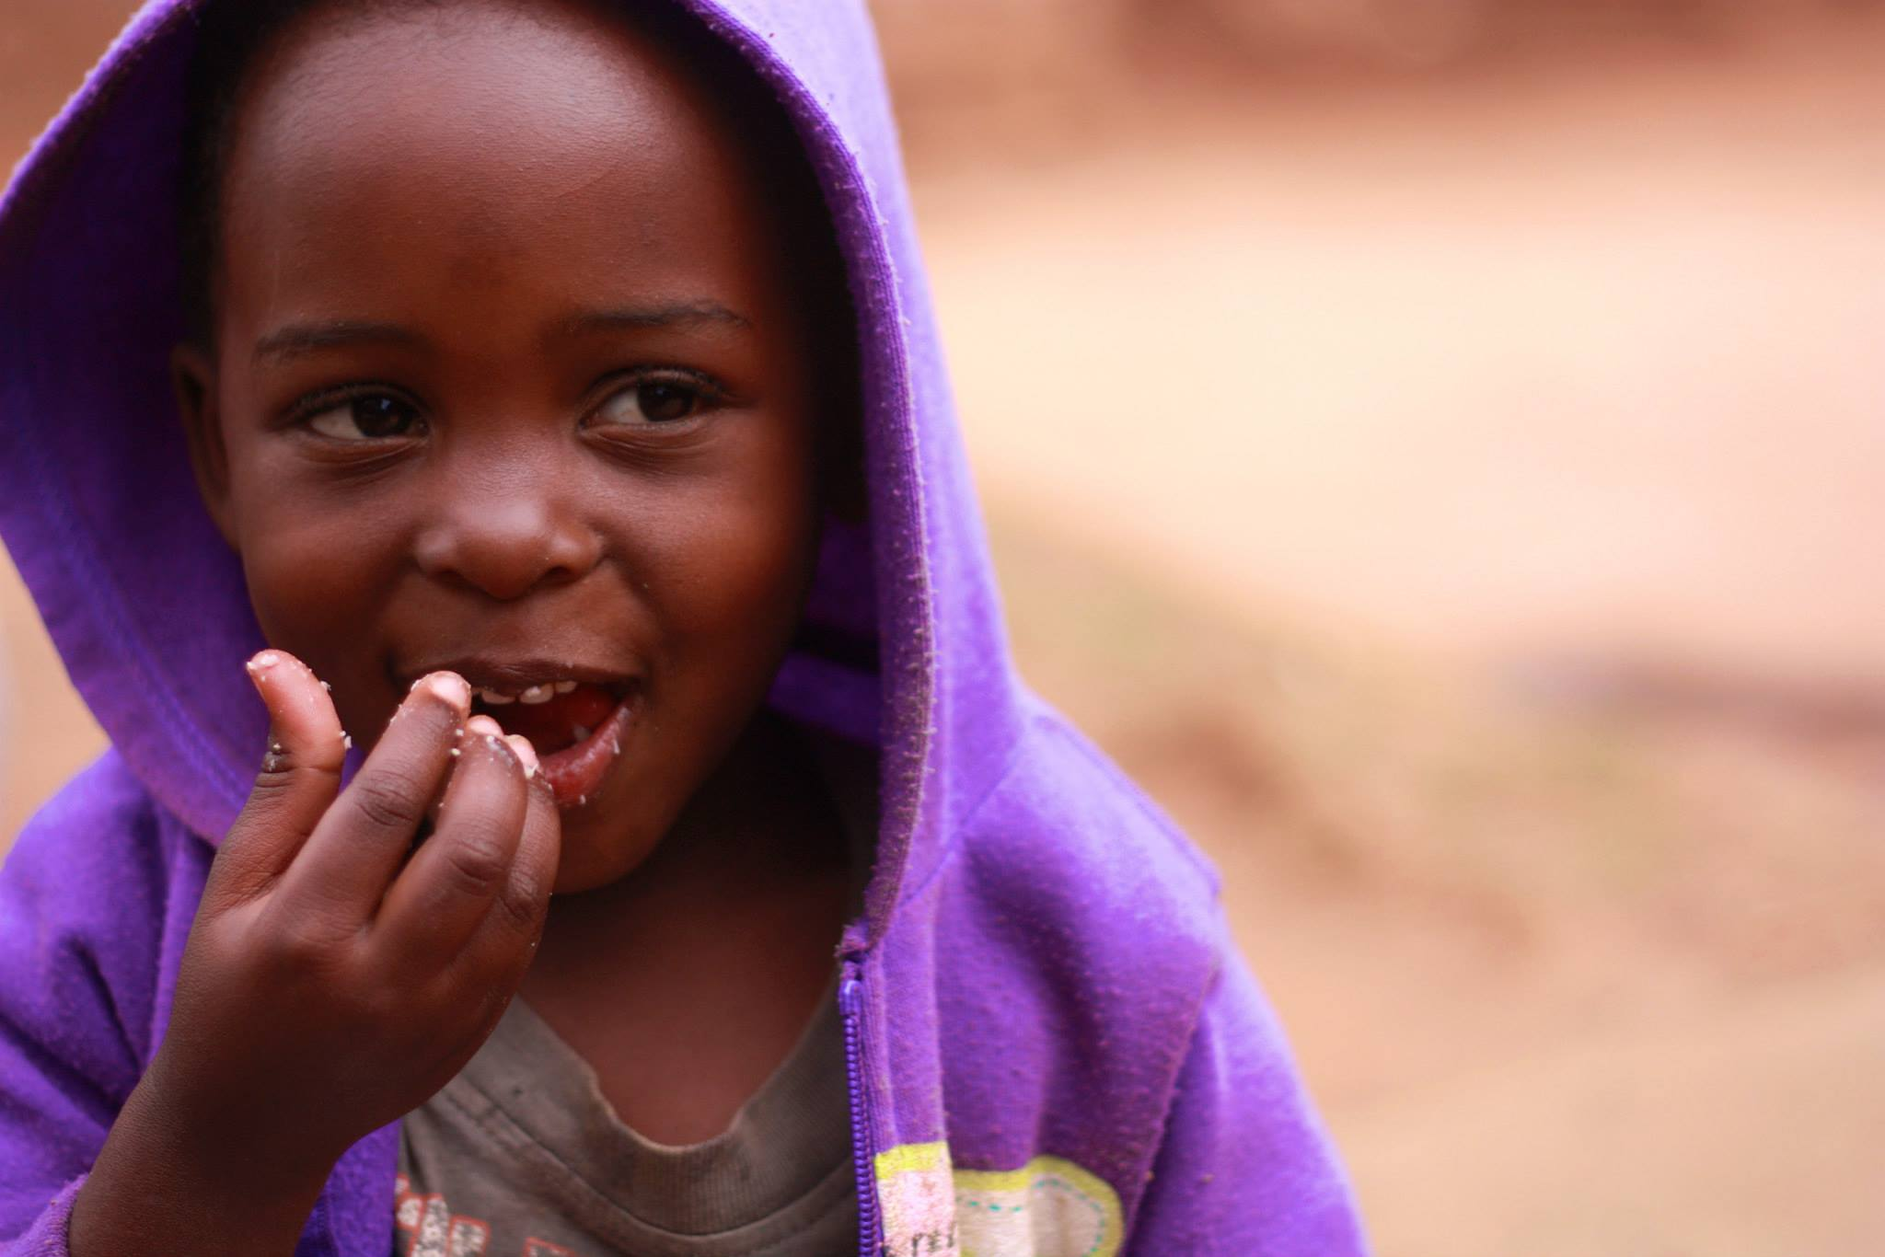
Neurodevelopment of CHEU
Most, not all, studies have found that CHEU have poorer neurodevelopment than children who are HIV-unexposed uninfected (CHUU)
Biologic and social factors play important roles¹⁻³
Maternal infections and in-utero environment
Preterm birth or growth faltering
Poverty or food insecurity
Household conflict/violence
Exposures to drugs in utero
Efavirenz (EFV) regimens may influence neurodevelopment⁴
Limited data on the impact of Dolutegravir (DTG) regimens
¹Wedderburn et al. Lancet Ch Ad Health, 2022
²Prendergast et al. AIDS, 2023
³McHenry et al. Pediatrics, 2018
⁴Cassidy et al. Ped Inf Dis J, 2019
Image by Michelle Bulterys with parental consent
Notes:
Most, but not all, studies have found that CHEU have poorer neurodevelopment compared to CHUU.
There are several biologic and socio-behavioral factors that could negatively impact a child’s neurodevelopment, for example:
Our study was enrolling during the period of expanded access to DTG and this gave us a unique opportunity to compare these regimens and their association with child neurodevelopment among CHEU.

Slide 4
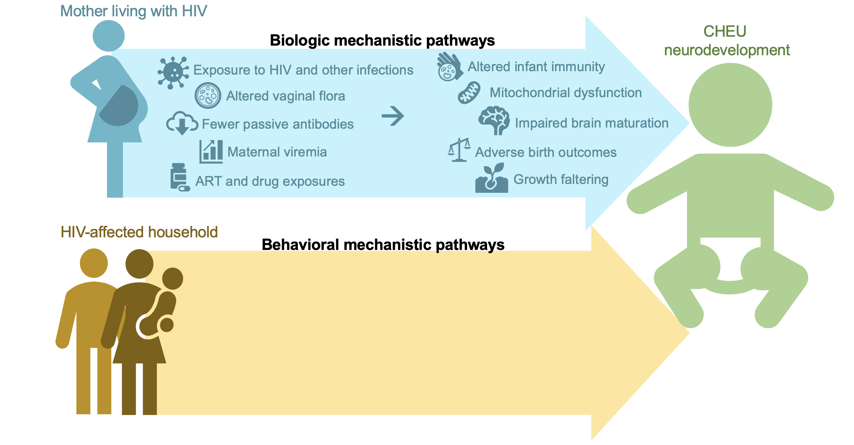
Pathways through which HIV exposure could impact CHEU neurodevelopment
Household affected by HIV
Prendergast & Evans. AIDS, 2023
Le Roux et al. Ped Inf Dis J, 2019
Juliana et al. Front Pub Health, 2020
Williams et al. Pediatrics, 2010
Patel et al. J Ped Inf Dis Soc, 2020
Schnoll et al. J Neuro Pharm, 2021
Sevenoaks et al. Brain Beh Imm, 2021
Anderson et al. AIDS, 2021
Caniglia et al. AIDS, 2016
Notes:
Based on the current state of the literature, the biologic mechanistic pathways are currently much better understood than the social behavioral pathways, on which very little data exist. There is an urgent need for rigorous, multidisciplinary research to identify the household factors that impact child neurodevelopment, which could be more approachable and modifiable through future interventions.
This pushed us to try and fill these knowledge gaps through our work within the HOPE Study:

Slide 5
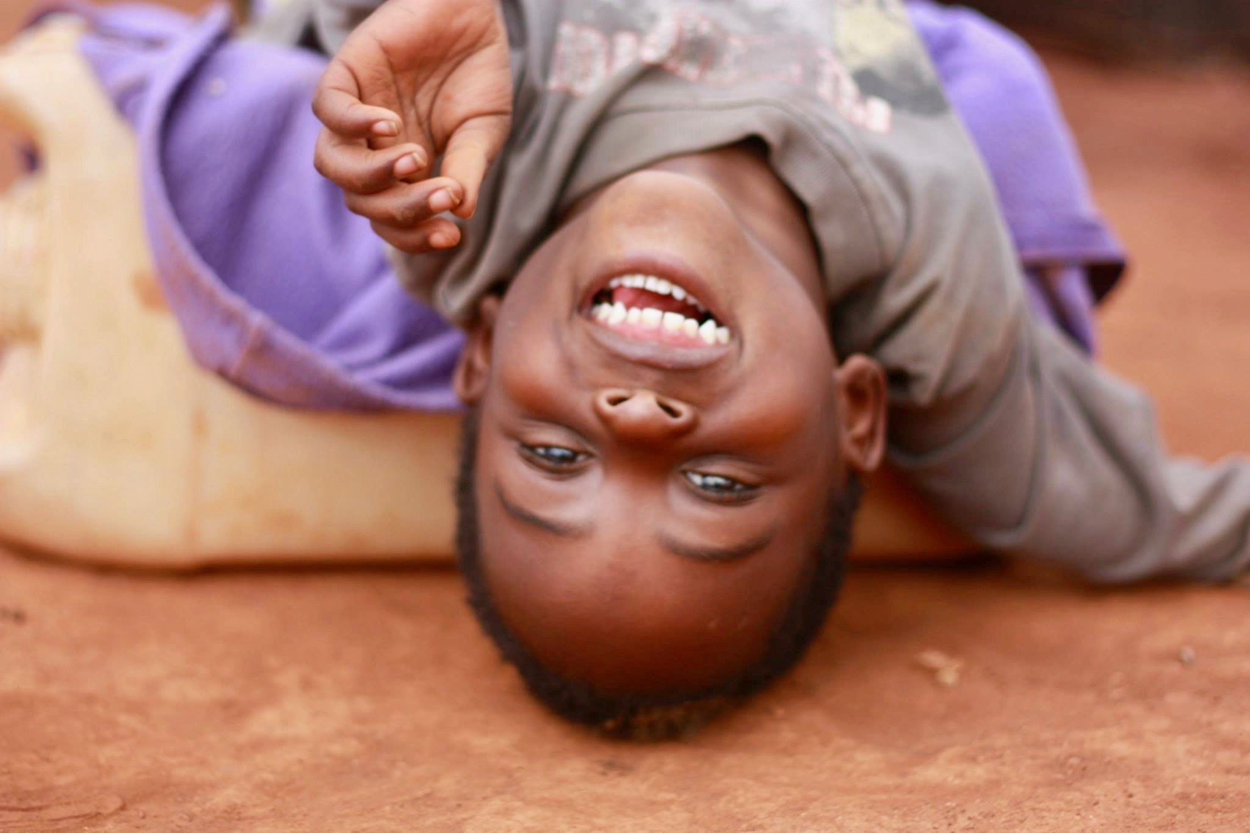
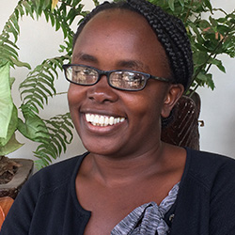
Kenya
Grace John-Stewart
University of Washington
Dalton Wamalwa
University of Nairobi
Irene Njuguna
Kenyatta National Hospital
Study Design: Multi-site prospective longitudinal cohort across Kenya
Population: 2,000 mothers living with and without HIV and their infants (1,000 CHEU and 1,000 CHUU)
Image by Michelle Bulterys with parental consent
Notes:
The HOPE Study is led by Drs. Grace John-Stewart, Dalton Wamalwa, and Irene Njuguna, and is an ongoing, multi-site prospective longitudinal cohort of 2,000 Kenyan mother infant pairs, 1000 HEU and 1000 HUU
We enrolled infants at 6 weeks old and are conducting neurodevelopmental assessments every 6 months for first years of life - our cohort has now surpassed 1 year of age

Slide 6
Methods
Exploratory analysis using mixed effects linear models
Adjusted for child and mother sociodemographic characteristics a priori
Clustered by site (Nairobi and W Kenya sites)
Image by Michelle Bulterys with parental consent
Notes:
We conducted an exploratory analysis using mixed effects linear models adjusting for confounders and site clustering

Slide 7
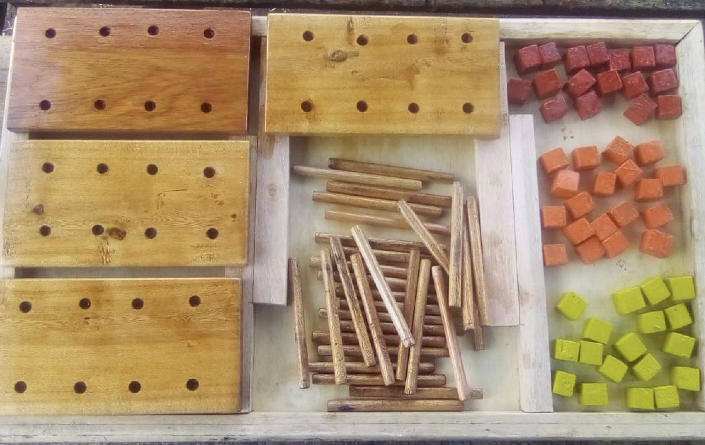
Outcome: 1-year neurodevelopment
Locally sourced items from the MDAT kit used to assess fine motor skills
Photo credit: Felix Otiento on study team
Notes:
To assess 1-yr neurodevelopment, we conducted a validated, culturally appropriate tool called the Malawi Developmental Assessment Tool – MDAT, which used locally sourced items to assess social, language, fine motor, and gross motor domains

Slide 8
Cofactors of neurodevelopment
Notes:
First, we compared neurodevelopment scores between CHEU and CHUU

Slide 9
Cofactors of neurodevelopment
Notes:
To identify factors associated with neurodevelopment among all children, adjusting for maternal HIV status

Slide 10
Cofactors of neurodevelopment
Notes:
And lastly, to test for HIV/ART-related cofactors among CHEU only.

Slide 11
Table 1: Baseline characteristics of entire cohort, by HIV exposure status
Characteristic | Overall, N = 1,427 | CHEU, N = 712 | CHUU, N = 715 | Unadjusted p-value
Child has deceased or absent biologic father | 109 (8%) | 71 (10%) | 38 (5%) | <0.01
Mother is single or widowed | 145 (10%) | 92 (13%) | 53 (7%) | <0.01
Mother age (years) | 29.0 (25.0, 33.0) | 31.0 (27.0, 35.0) | 27.0 (24.0, 31.0) | <0.01
Mother education, primary or less | 541 (38%) | 353 (50%) | 188 (26%) | <0.01
Moderate to severe hunger in the household | 247 (17%) | 182 (26%) | 65 (9%) | <0.01
Intimate partner violence | 33 (2.4%) | 14 (2%) | 19 (3%) | 0.4
Notes:
CHEU were more likely to have a deceased or absent father and an older mother who is single or widowed. Additionally, CHEU were more likely to experience moderate to severe hunger in the household. Maternal report of intimate partner violence was less than 3% in both groups

Slide 12
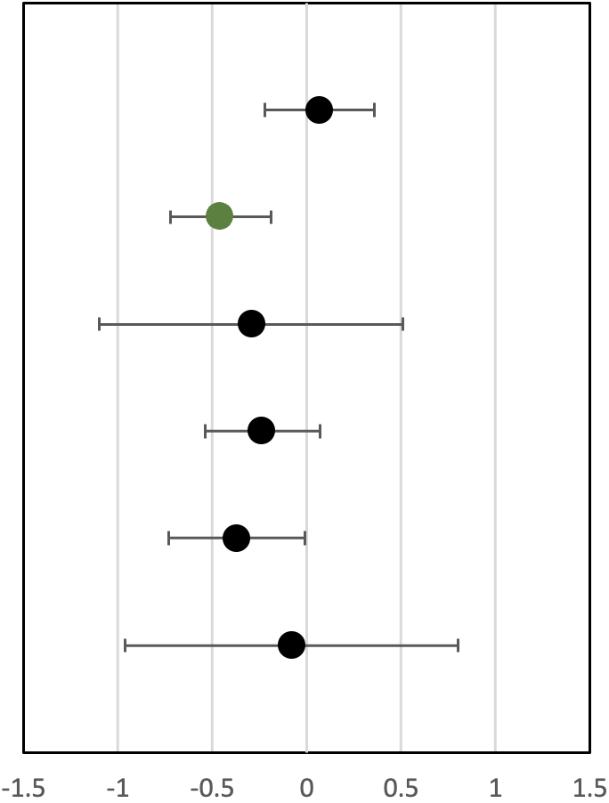
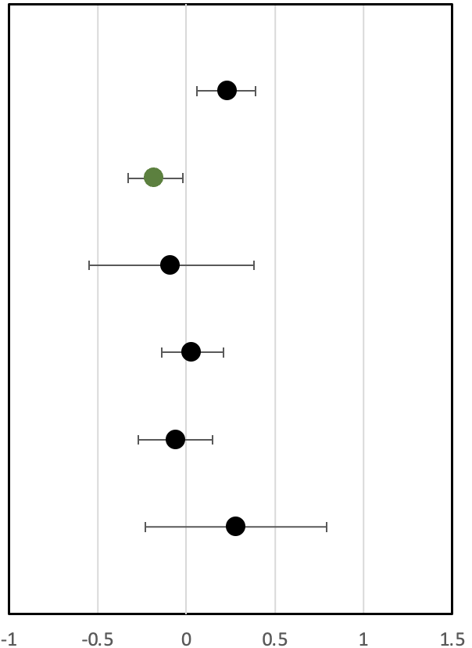
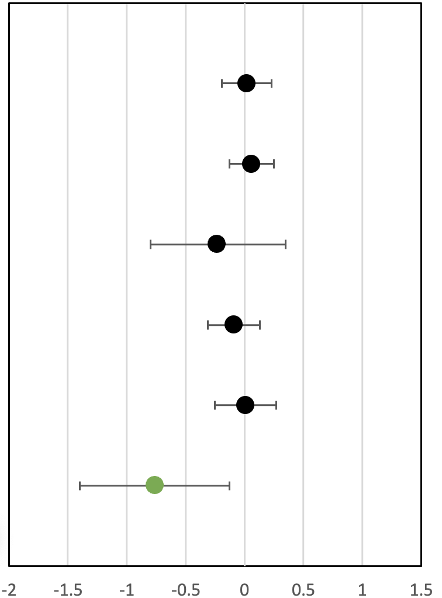
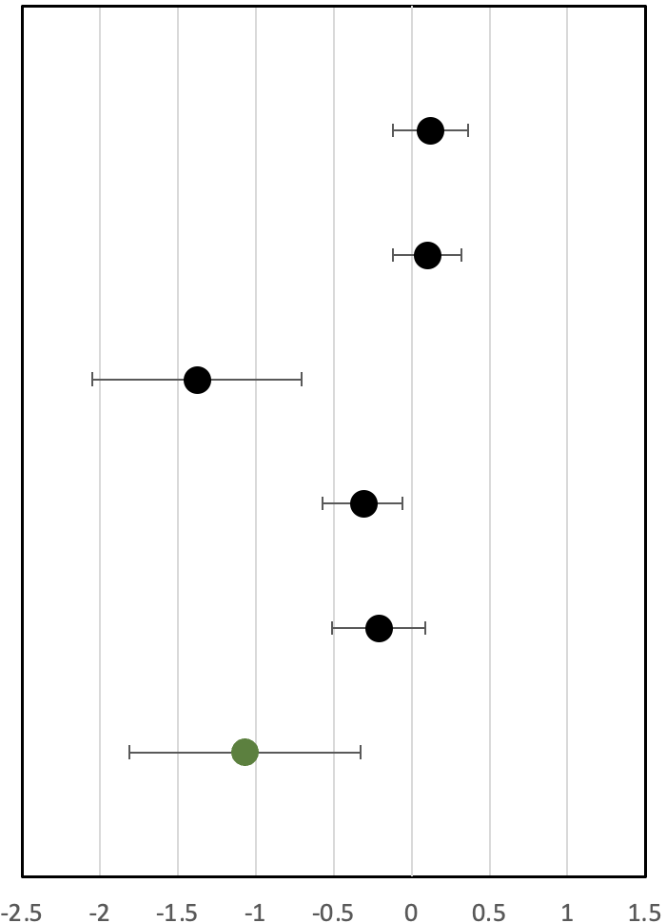
Neurodevelopment at 1-year: overall cohort
Colored dots represent statistically significant findings
Child is CHEU
Child is male
Preterm birth
Lower social
support
Food insecurity
Intimate partner violence
Adjusted coefficients [95% confidence intervals]
Notes:
The dots in this forest plot represent the differences in neuro scores in each domain. The colored dots represent statistically sig signals

Slide 13
Neurodevelopment at 1-year: overall cohort
Colored dots represent statistically significant findings
Child is CHEU
Child is male
Preterm birth
Lower social
support
Food insecurity
Intimate partner violence
Adjusted coefficients [95% confidence intervals]
Notes:
At 1-year assessment, CHEU and CHUU had comparable neurodevelopment, and if anything, CHEU had higher language scores than CHUU. One potential explanation is that our CHEU were significantly more likely to have older siblings than our CHUU, and the impact of birth order on language development should be further explored.

Slide 14
Neurodevelopment at 1-year: overall cohort
Colored dots represent statistically significant findings
Child is CHEU
Child is male
Preterm birth
Lower social
support
Food insecurity
Intimate partner violence
Adjusted coefficients [95% confidence intervals]
Notes:
Children assigned male at birth performed worse than females of the same age - in both the social and language domains – and this warrants further investigation to see if these differences persist longitudinally

Slide 15
Neurodevelopment at 1-year: overall cohort
Colored dots represent statistically significant findings
Child is CHEU
Child is male
Preterm birth
Lower social
support
Food insecurity
Intimate partner violence
Adjusted coefficients [95% confidence intervals]
Notes:
Regardless of maternal HIV status, preterm birth was associated with significantly lower gross motor scores.

Slide 16
Neurodevelopment at 1-year: overall cohort
Colored dots represent statistically significant findings
Child is CHEU
Child is male
Preterm birth
Lower social
support
Food insecurity
Intimate partner violence
Adjusted coefficients [95% confidence intervals]
Notes:
Children whose mothers reported having a lower level of perceived social support had significantly lower gross motor scores.

Slide 17
Neurodevelopment at 1-year: overall cohort
Colored dots represent statistically significant findings
Child is CHEU
Child is male
Preterm birth
Lower social
support
Food insecurity
Intimate partner violence
Adjusted coefficients [95% confidence intervals]
Notes:
Food insecurity in the household was associated with poorer social scores.

Slide 18
Neurodevelopment at 1-year: overall cohort
Colored dots represent statistically significant findings
Child is CHEU
Child is male
Preterm birth
Lower social
support
Food insecurity
Intimate partner violence
Adjusted coefficients [95% confidence intervals]
Notes:
Although the overall prevalence of IPV was less than 3%, we still saw a strong association between IPV and poorer fine motor and gross motor scores.

Slide 19
Among CHEU only: maternal ART characteristics
Notes:
Now to move onto the restricted analysis, assessing CHEU only. Among this group, 88% of mothers living with HIV disclosed their HIV status to their male partners. All mothers were on ART and 88% started ART before this pregnancy. Median duration of ART was 54 months, and 74% of mothers were on DTG-based regimens at the time of delivery.

Slide 20
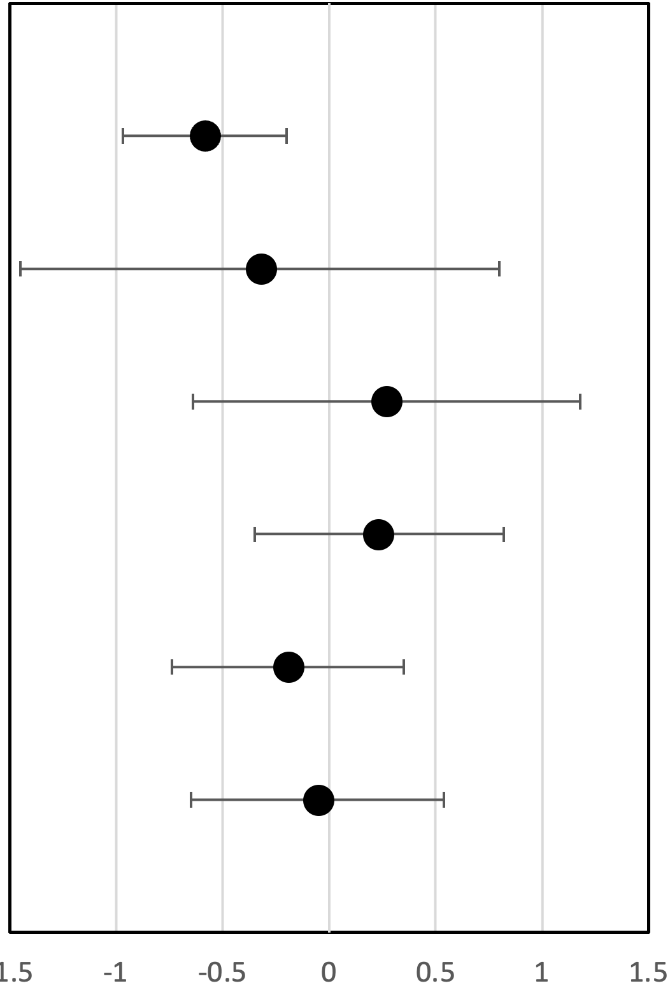
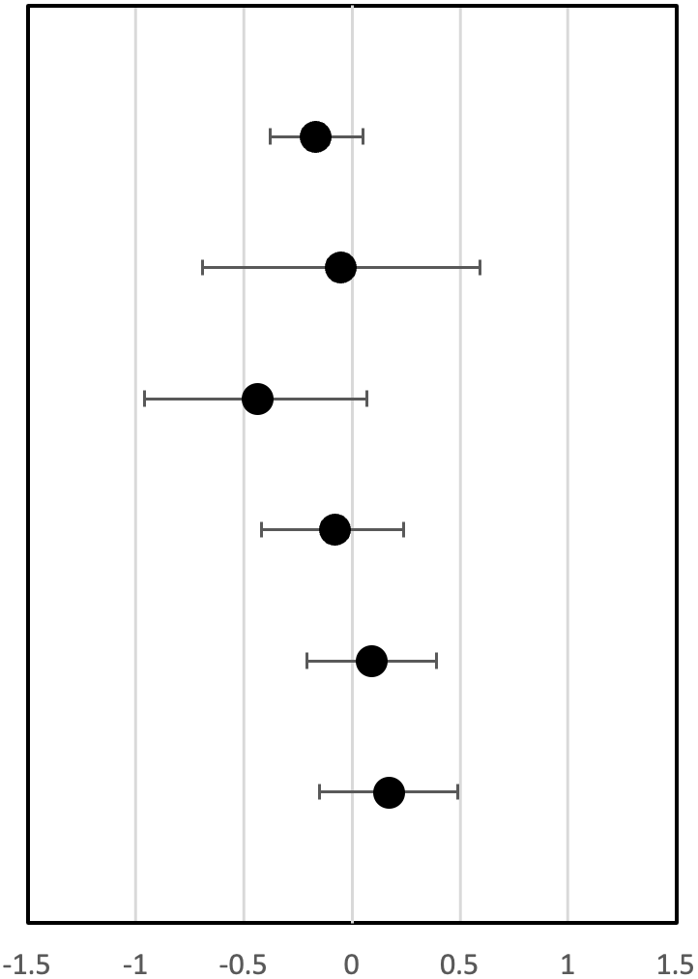
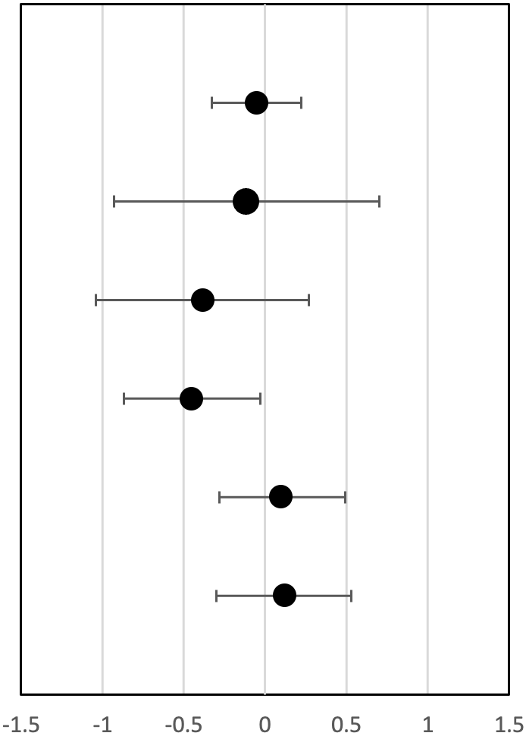
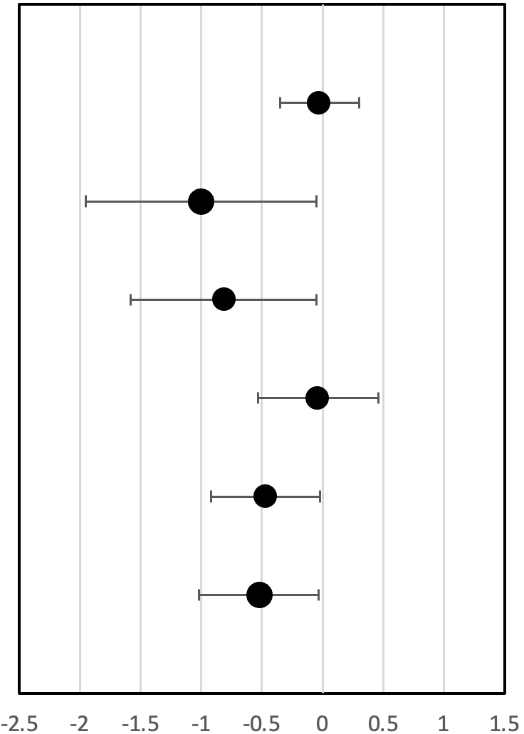
Neurodevelopment at 1-year: CHEU only
Child is male
Preterm birth
Deceased or absent father
Single or widow mother
Most recent ART was EFV
EFV only vs. DTG only
Adjusted coefficients [95% confidence intervals]
Notes:
Just as we saw in the overall cohort, we found that male CHEU performed worse than female children in the social domain.

Slide 21
Neurodevelopment at 1-year: CHEU only
Child is male
Preterm birth
Deceased or absent father
Single or widow mother
Most recent ART was EFV
EFV only vs. DTG only
Adjusted coefficients [95% confidence intervals]
Notes:
Again, preterm birth was associated with poorer gross motor scores.

Slide 22
Neurodevelopment at 1-year: CHEU only
Child is male
Preterm birth
Deceased or absent father
Single or widow mother
Most recent ART was EFV
EFV only vs. DTG only
Adjusted coefficients [95% confidence intervals]
Notes:
poorer gross motor scores were significantly associated with having a deceased or absent father --- and similarly,

Slide 23
Neurodevelopment at 1-year: CHEU only
Child is male
Preterm birth
Deceased or absent father
Single or widow mother
Most recent ART was EFV
EFV only vs. DTG only
Adjusted coefficients [95% confidence intervals]
Notes:
having a single or widowed mother was associated with poorer fine motor scores

Slide 24
Neurodevelopment at 1-year: CHEU only
Child is male
Preterm birth
Deceased or absent father
Single or widow mother
Most recent ART was EFV
EFV only vs. DTG only
Adjusted coefficients [95% confidence intervals]
Notes:
For our main research question comparing EFV to DTG… we found that children exposed in utero to EFV-based regimens had significantly poorer gross motor scores than children exposed to DTG. This is a MASSIVELY important finding and is in support of the global scale up to replace EFV with DTG.

Slide 25
Neurodevelopment at 1-year: CHEU only
Child is male
Preterm birth
Deceased or absent father
Single or widow mother
Most recent ART was EFV
EFV only vs. DTG only
Adjusted coefficients [95% confidence intervals]
Notes:
In recognizing that pregnant women often have heterogeneity in their ART regimens, we conducted a sensitivity analysis restricted to comparing mothers who ONLY received EFV-based regimens to mothers who ONLY received DTG-based regimens, by excluding mothers who had regimen switches. Still this gross motor finding persists.

Slide 26
Conclusions
Biologic and social factors influence neurodevelopment
CHEU/CHUU: comparable 1-yr neurodevelopment
Addressing IPV and supporting single mothers is essential, especially for mothers living with HIV
DTG exposure was associated with higher neurodevelopment scores compared to EFV exposure
Painting by Mwamba Mulangala (Zambia), purchased by speaker
Notes:
In this cohort of Kenyan CHEU and CHUU, biologic and social factors were associated with 1-year neurodevelopment. CHEU and CHUU had similar neurodevelopmental scores across all domains and may be due to the high frequency of DTG use during pregnancy but warrants further investigation. Among CHEU, in utero exposure to DTG-based regimens was associated with higher gross motor scores, compared to EFV-based regimens. Maternal marital status, father absence, food insecurity and IPV were associated with poorer neurodevelopmental scores. Rigorous longitudinal and mixed methods research are needed to identify modifiable factors among families impacted by HIV and caregiver relationship conflict. It is critical to introduce neurodevelopmental screening and monitoring programs with clear referral pathways that equip healthcare workers and caregivers to identify early signs of delays, and to design multi-factorial interventions that best support children at highest risk of suboptimal outcomes. We can no longer be satisfied with an HIV-free start to life for this rapidly growing population of children.

Slide 27
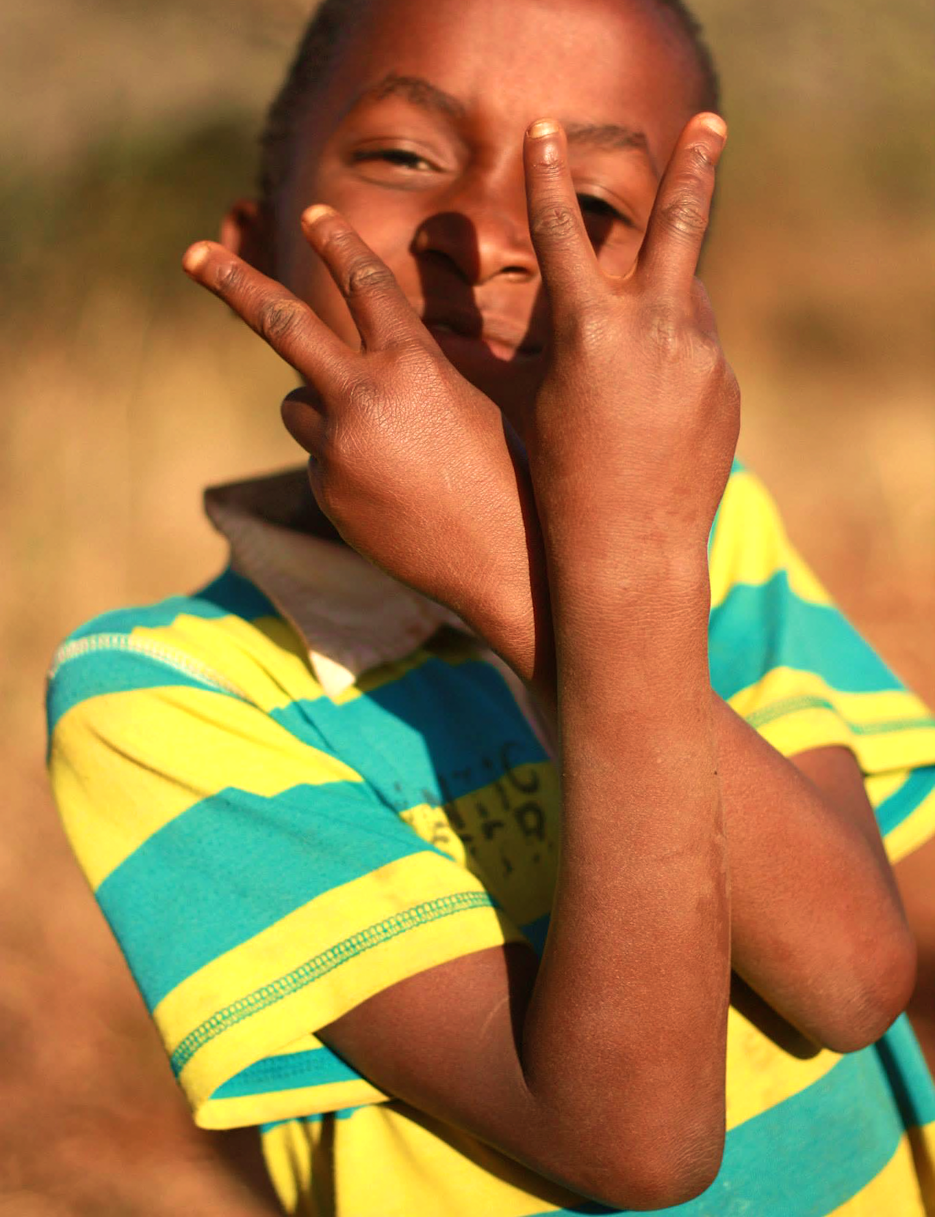
Thank you!
HOPE Study participants
HOPE Study research team:
Grace John-Stewart (University of Washington)
Dalton Wamalwa (University of Nairobi)
Irene Njuguna (Kenyatta National Hospital)
Sarah Benki-Nugent (University of Washington)
Maureen King’e (University of Nairobi)
Hellen Moraa (University of Nairobi)
Daisy Chebet (University of Nairobi)
Let’s get in touch!
Michelle Bulterys mbult@uw.edu
Notes:
I would like to thank our HOPE study participants and research team, the UW Global Center for Integrative Health of Women, Adolescents and Children, UW Center for AIDS Research, and the National Institute of Child Health and Human Development for making this research possible. I welcome you to keep in touch, my email address is here -
NOW I’d like to introduce the next speaker, Dr. ALETTA Nonyane….

