Slide 1
The Global Alliance to end AIDS in Children by 2030
Morkor NEWMAN OWIREDU On Behalf of UNAIDS, UNICEF and WHO
9th Workshop on children and adolescents with perinatal HIV exposure

Slide 2
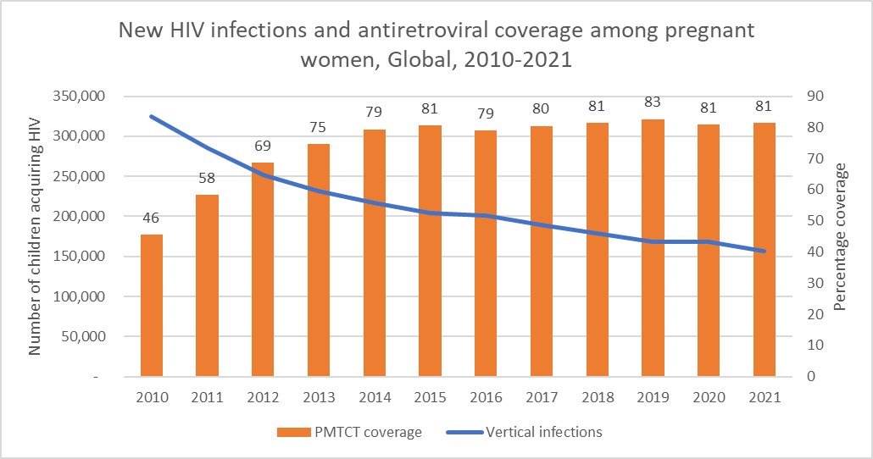
Progress for children has been stalling and there are stark inequities
We are off target to ending AIDS by 2030
Annually, 160,000 new child (0-14) HIV infections and 160,000 in adolescents (10-19)
1.68M children (0-14) living with HIV and 1.58M adolescents (10-19)
Decline in new infections in children is off track
New infections have reduced by 52%
Maternal ART coverage in 2021 was 81% and has been stagnant since 2015
New reality related to retention in care and newly acquired infections during pregnancy and breastfeeding
Treatment inequity among children and adolescents
Only 52% of children and 60% of adolescents are receiving ART compared with 76% of adults and 81% in pregnant women
An estimated 800,000 children 0-14 years and 400,000 adolescents 15-19 years are not on treatment

Slide 3
Major gaps remain in prevention for women and treatment for children and adolescents
To close the prevention gap:
Ensure pregnant and breastfeeding women are started, and remain, in care
Identify new approaches and technologies to prevent women from acquiring HIV during pregnancy and breastfeeding
To close the treatment gap:
Locate untreated children, recognizing that almost two thirds are in the 5-14 age group
Develop innovative testing initiatives beyond early infant diagnosis

Slide 4
The Global Alliance is the successor to the Global Plan and the 3-Frees Framework
A 9-year global strategic initiative in 3-year phases with the goal of ending AIDS in Children by 2030
PILLARS
Early testing and comprehensive, high-quality treatment & care for children and adolescents living with HIV and perinatally exposed children
Closing the treatment gap and optimizing continuity of treatment for pregnant and breastfeeding women living with HIV
Preventing new HIV infections among pregnant and breastfeeding women
Addressing rights, gender equality, and the social & structural barriers that hinder access
POPULATIONS
Children (0-14 years) and Adolescents (15-19 years) Living with HIV
Children perinatally exposed to HIV
Pregnant and Breastfeeding Girls and Women who are Living with HIV including marginalized and key populations
Pregnant and Breastfeeding Girls and Women who are HIV-negative but at risk of HIV

Slide 5
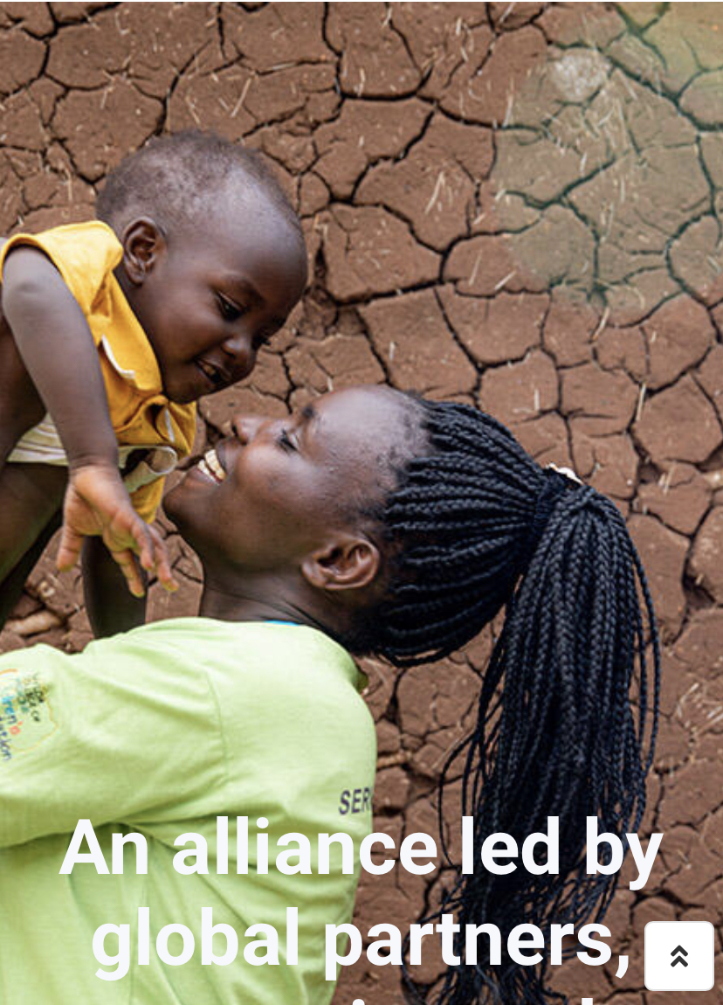
Stakeholder engagement in co-creation
Co-creation
Joint efforts from UN agencies
Involvement of key funders from inception
Community engagement and representation from inception
Country technical teams formed to design country specific action-plans addressing country-specific gaps
Political leadership engaged and made commitments
Multi-stakeholder consultations and input

Slide 6
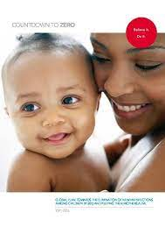
Learning from the past, the new Global Alliance will take some novel approaches
Build momentum over a longer period – 9 years from 2022 to 2030 in three phases, each will involve leadership of different regional and national partners.
Promote country leadership and community ownership with the participation of national programmes and affected communities of children, adolescents and mothers living with HIV, to lead, develop and execute plans
Boost existing initiatives to end AIDS in children, with the commitment to coordinate, collaborate and celebrate shared successes
Increase advocacy and ensure senior high-level engagement from partners including countries, UN agencies, global networks of PLHIV, implementers, PEPFAR and GF to drive support for the initiative;
Address programme gaps AND structural barriers that are hampering progress for children especially for marginalized communities including key populations
Use data to target and focus our attention
LESSONS LEARNED
Country buy-in
Senior political leadership
Donor alignment
Focused action
Community engagement

Slide 7
For each pillar we have identified several key interventions for prioritization
Treatment and Care for Children & Adolescents
Closing the PMTCT gap
Preventing HIV in ANC and PNC
Addressing structural barriers that hinder access to services
Case-Finding though multi-modality testing
Data-driven differentiated services
Optimal ART for children & adolescents per WHO
Improving quality of care, including VL monitoring, comprehensive care and mental health services
Promoting cross-sectoral collaboration
Triple elimination HIV, syphilis, HBV
Data-driven EMTCT approaches
Address needs of pregnant and BF adolescents
Better quality and better data collection
Partner testing
HIV retesting in
Innovative prevention in ANC and postnatal care
Increasing access to and uptake of HIV services among men
Gender and age disaggregated data collection and use
Tracking the 10:10:10 targets to address legal impediments and promote gender equality
Build capacity for community-led monitoring
Track stigma & discrimination
Strengthen meaningful involvement of women, children and adolescents living with HIV

Slide 8
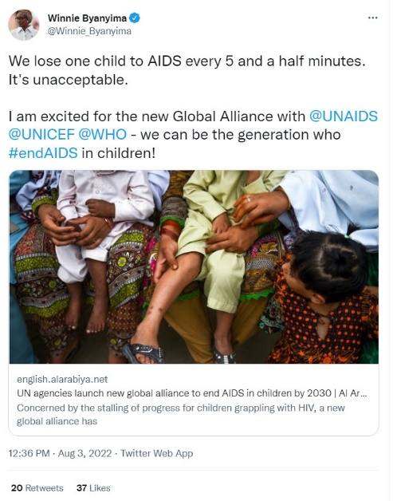
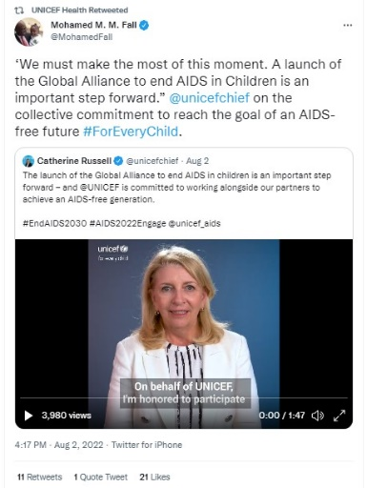
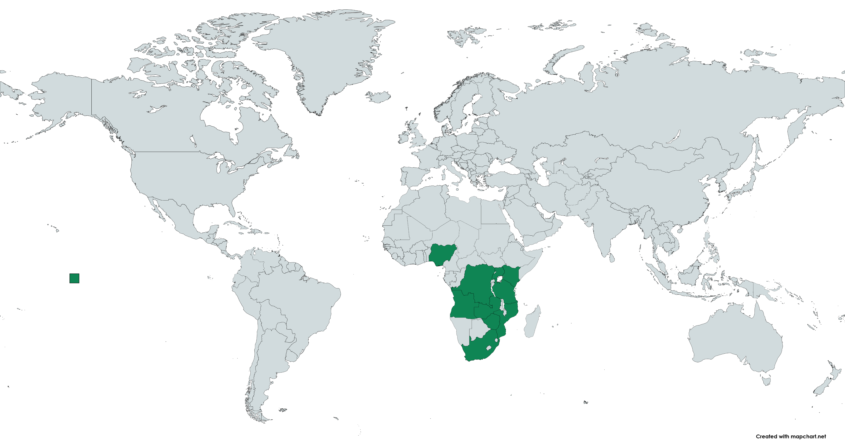
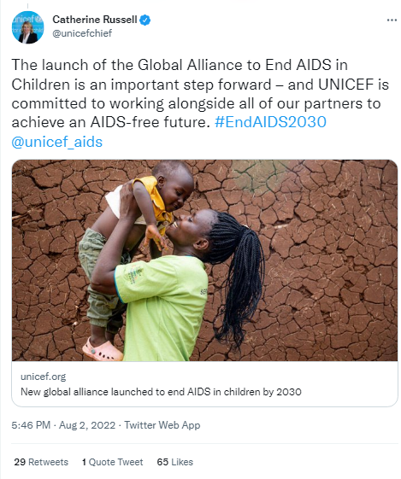
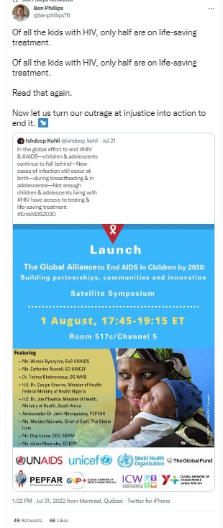
At launch at AIDS conference in Montreal, 12 African countries committed to join the Alliance. Kick-off meeting held in Dar es Salaam
Angola, Cameroon, Cote d’Ivoire, Democratic Republic of Congo, Kenya, Mozambique, Nigeria, South Africa, Tanzania, Uganda, Zambia, Zimbabwe
Partner countries will:
Have the opportunity to shape the Alliance through their leadership
Benefit from TA and expertise
Contribute to the South-south learning network
Partner Countries were asked to:
Provide high-level political commitment
Convene a country team to implement the work
Ensure representatives of communities of women living with HIV
Track the response and share data

Slide 9
Timelines of activities to date
1st August 2022
Aug 2022- Jan 2023
1st February 2023
February- ongoing
Ongoing
Global Alliance launched at IAS
Development of Country Action Plans
High-Level kick-off meeting in Dar es Salaam, Tanzania: Country commitments presented and Ministerial signing of the Dar-Declaration
Countries incorporating GA activities in Grant Applications (PEPFAR and Global Fund)
Activation of regional hubs
ToR development for TWGs
Implementation of GA activities

Slide 10
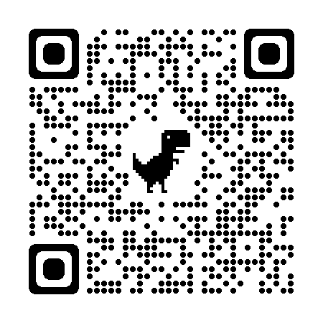
Each 3-year phase of the Alliance will be an opportunity to take stock and re-align our efforts
Phase 1: 2022 to 2024
Launch
Co-creation of strategy with partners
Focus on high burden countries
Phase 2: 2025 to 2027
Building on success
Expanded focus on additional countries including those with low prevalence or concentrated epidemics
Phase 3: 2028 to 2030
Countdown to 2030
Stocktaking & strategy adjustment
Focused on closing remaining country gaps
For more information including joining the alliance as a Member – go to:
https://www.childrenandaids.org/global-alliance

Slide 11
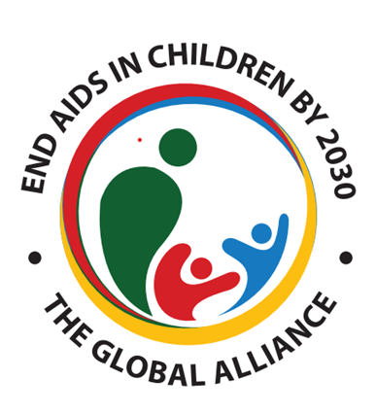
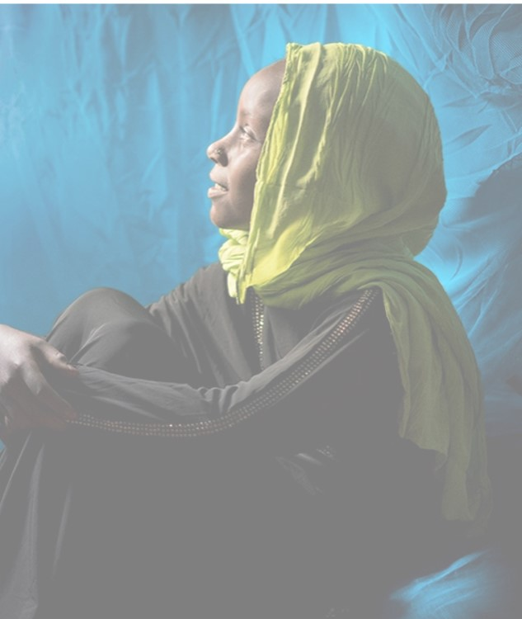
Acknowledgements

