Slide 1
^{9th} Workshop on Children and Adolescents with Perinatal HIV exposure
Vani Vannappagari, ViiV Healthcare Limited, United States

Slide 2
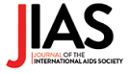
In November, the Journal of the International AIDS Society, in partnership with the Collaborative Initiative for Paediatric HIV Education and Research will publish a supplement entitled:
Understanding the Challenges and Optimizing Outcomes of Children with Perinatal HIV Exposure
The JIAS Supplement will be released in conjunction with the 2nd International Paediatric HIV Symposium in Africa (IPHASA 2023) to be held in Harare, Zimbabwe in December 2023

Slide 3
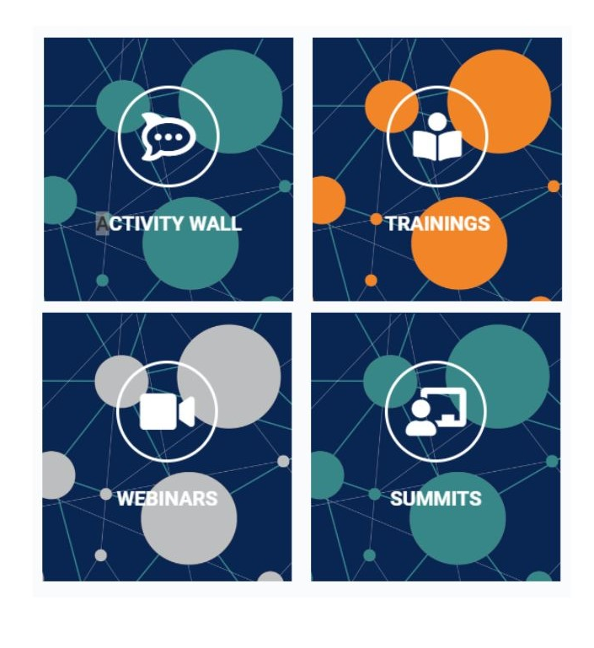
Launch of Community of practice - The PATA Linking and Learning Hub features
Benefits of the Linking and Learning Hub:
A platform for sharing news and resources
The ability to host closed or open Zoom events for the group
The option to brand the group with the community of practice branding
A news feed displaying the latest conversations and discussions from the group
A member's tab showing profiles for each member and enabling direct messaging
A documents, photos, and videos tab for sharing resources and media
Notifications via email for events and updates posted in the group
Notes:
We are thrilled to present to you today the new Community of practice: The PATA Linking and Learning Hub features!
3

Slide 4
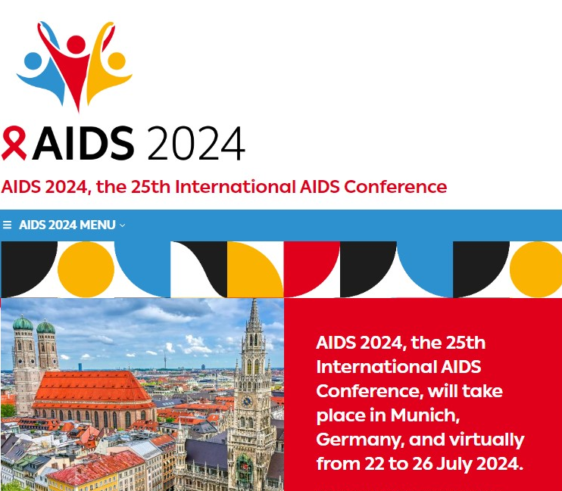
10th Workshop on Children and Adolescents with Perinatal HIV
Notes:
4

Slide 5
Thank you!
Funded by:
In partnership with:
Notes:
5

Slide 6
Thank you for your participation!

