Slide 1
Person-centred approaches to address the health needs of people living with HIV and co-infections and co-morbidities
Marlène Bras, International AIDS Society, Switzerland

Slide 2
Acknowledgement of country
Notes:
We acknowledge the Jagera people and the Turrbal people as the Traditional Custodians of Meanjin, the land on which we gather today. I would also like to pay my respects to the Elders both past and present and extend that respect to other Aboriginal and Torres Strait Islanders who are present here today.

Slide 3
Satellite with support from:
Notes:
Marlène This satellite was sponsored by ViiV Healthcare and we very much appreciate their support

Slide 4
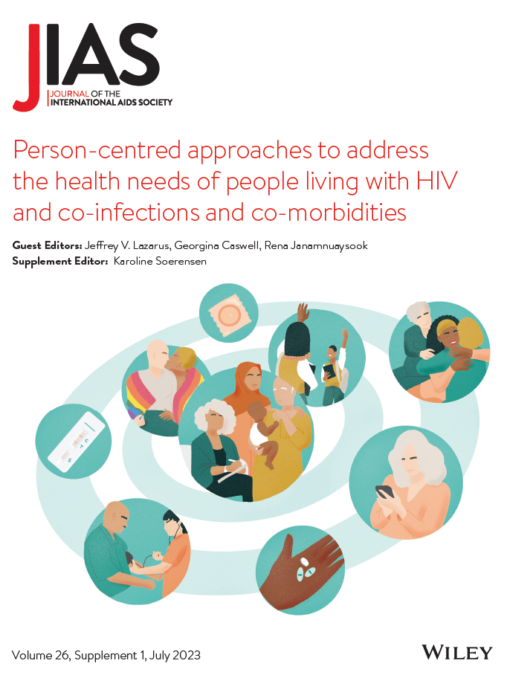
With support from:
Notes:
Marlène
The supplement was funded via our PCC partnership with Gilead but neither Gilead or the IAS PCC programme had any influence over the selection of abstracts, peer review of papers or the editorial process

Slide 5
Acknowledgement of contributors
This supplement was guest edited by:
Rena Janamnuaysook, Institute of HIV Research and Innovation, Thailand
Jeffrey V. Lazarus, Barcelona Institute for Global Health, Spain
Georgina Caswell, Global Network of People Living with HIV, South Africa
With thanks to the JIAS Editorial Team and the IAS person-centred care programme
Notes:
Marlène

Slide 6
Moderators
Jeffrey V. Lazarus, Barcelona Institute for Global Health, Spain
Rena Janamnuaysook, Institute of HIV Research and Innovation, Thailand
Notes:
Marlène Two of our three dedicated guest editors are here today to present and moderate the session. I would like to thank them for their hard work.
Jeffrey V. Lazarus is a Professor at the CUNY Graduate School of Public Health and Health Policy and the head of the Health Systems Research Group at the Barcelona Institute for Global Health. He currently serves as co-chair of the HIV Outcomes Beyond Viral Suppression coalition and he is the author of more than 300 publications, including the global consensus statement on HIV and health systems, which followed up a landmark proposal for a “fourth 90” in HIV monitoring, which focused on quality of life.
Rena Janamnuaysook is a Program Manager for Transgender Health at the Institute of HIV Research and Innovation in Bangkok, Thailand, where she established the Tangerine Community Health Clinic, the first transgender-led health clinic in the region. She manages and provides technical guidance for the development and implementation of HIV research and programmes for transgender populations.

Slide 7
A people-centred health system must be the foundation for person-centred care in the HIV response
Rena Janamnuaysook, Institute of HIV Research and Innovation, Thailand
Person-centred approaches to address the health needs of people living with HIV and co-infections and co-morbidities
Notes:
Rena

Slide 8
Conflict of interest disclosure
Gilead Sciences and ViiV Healthcare: Speaker’s bureau
The potential effects of relevant financial relationships with ineligible companies have been mitigated. Any clinical recommendations are based on evidence and are free of commercial bias.
Notes:
Rena to complete

Slide 9
Background
Despite advances made by health systems to improve the care of people living with HIV, “a higher burden of multi-morbidity and poorer health-related quality of life are reported by many people living with HIV in comparison to people without HIV” [1]
WHO’s Consolidated HIV Guidelines includes guidance on task-sharing, integration and decentralization of services “to promote the highest quality, person-centred delivery of care for people living with and affected by HIV” [2]
Gaps in implementation science evidence to support this guidance exist
1. Lazarus, J.V. et.al. Nat Commun 12, 4450 (2021). 2.WHO, Consolidated guidelines on HIV prevention, testing, treatment, service delivery and monitoring, July 2021
Notes:
Rena

Slide 10
Objective of the supplement
Spotlight the latest evidence, best practices and community perspectives from around the world related to person-centred care approaches
Enable research groups to share developments around implementing the components of person-centred care in their unique settings
Notes:
Rena

Slide 11
10 publications launched on 6 July 2023 including:
1 editorial
5 research articles
2 viewpoints
1 short report
1 commentary
Notes:
Rena - We are very pleased to have all of these publications represented in this satellite session

Slide 12
“People-centred health systems are programmes of care that provide individuals, families and communities with humanistic, holistic and trusted healthcare that must be acceptable and responsive to the needs, rights and preferences of people living with HIV and key populations .”
JIAS supplement editorial
Notes:
Rena

Slide 13
Key takeaways
Meaningful and sustained engagement
Proven to enhance outcomes
Implementation barriers exist
Now need to champion wellbeing
Notes:
Rena Four main themes
1. Person-centred care systems require meaningful and sustained engagement between stakeholders, co-designed approaches and feedback mechanisms.
2. Person-centred care systems result in higher retention in care and better HIV outcomes.
3. Healthcare providers encounter barriers to implementing person-centred care, and the transition to integrated and person-centred care systems requires a systemic shift that addresses inequity in all its forms and for all stakeholders involved.
4. As HIV has evolved into a manageable chronic disease, person-centred care systems should move beyond merely focusing on acuity and, instead, champion well-being.

Slide 14
“It is time for the HIV field to, once again, raise its banners as a champion towards equity in healthcare and strive for the accelerated and universal shift towards person-centred health systems globally.”
JIAS supplement editorial
Notes:
Rena

