Slide 1
Overview of Mental Health in Aging People with HIV, Interventions and Treatments:
Current and Future Treatments for Brain Health
Professor Karl Goodkin MD. PhD, DLFAPA, FACPsych, FRSM
Department of Psychiatry and Institute of Neuroscience
University of Texas Rio Grande Valley, Harlingen, Texas, USA
Fostering Cognitive and Mental Health in Aging People with HIV
While Prioritizing the Community
and Lived Experience Perspectives

Slide 2
I acknowledge the Traditional Owners of the land on which we meet today,
the Yuggera and Turrbul people, and pay my respects to Elders past and present.
Conflicts of Interest: Support from Dr. Reddy's Lab for pramipexole ER and from Cipla Pharmaceuticals for escitalopram in an AIDS Clinical Trials Group study. Support from American Psychiatric Association for lectures and book royalties. Support from MDPI as Editorial Board member of the International Journal of Environmental Research and Public Health.

Slide 3
Overview
The Problems:
  Psychosocial context
  Depression
  Anxiety
  Psychoactive substance use
  Serious mental illness
Proposals for Solutions
Goodkin, July 23, 2023

Slide 4
Psychosocial Context
Stressful Life Event burden (including stigmatizing events and micro-aggressions)
Major
Minor / hassles
Parameters: Number of events and impact of events
Predictability, controllability, and duration of events
Social Support (vs. Social Isolation)
Instrumental support
    Emotional support
    Parameters: Availability, satisfaction, and sufficiency of support
Coping Strategies:
Active versus Passive coping
Adaptive versus maladaptive coping
Coping self-efficacy
Hope / Optimism
Goodkin, July 23, 2023

Slide 5
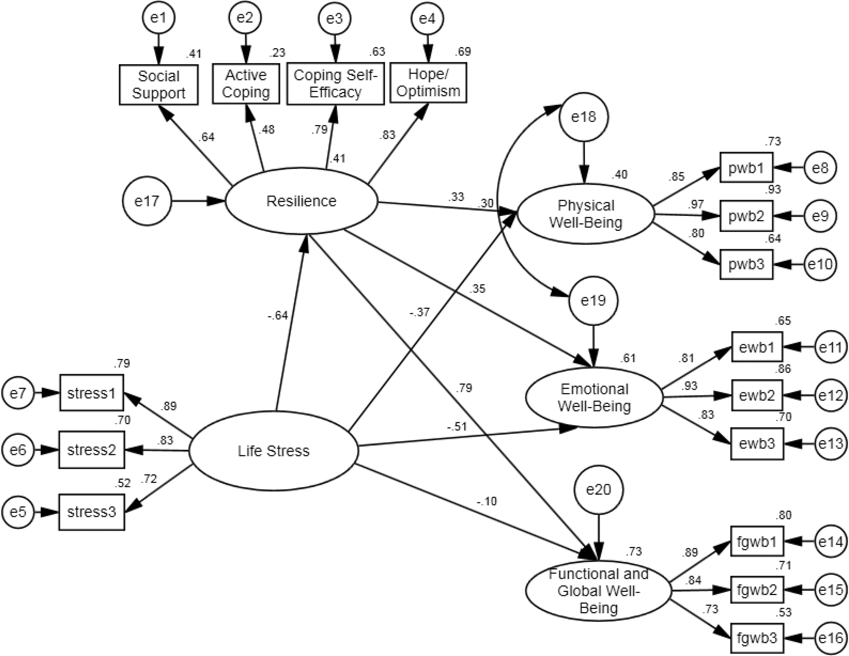
Resilience: Life Stressors, Social Support and Coping on Health-Related Quality of Life (Physical, Emotional, and Functional Wellbeing)
Goodkin, July 23, 2023
Fang et al., Aging & Mental Health, 2015

Slide 6
Social Support Vs. Isolation and CSF Neuroinflammation
Social Isolation is linked to CSF inflammation
in aging people with and without HIV
Neuroinflammation, as indexed by CSF biomarkers, was
more strongly related to social support than systemic
Inflammation, as indexed by plasma biomarkers
Social Isolation was significantly associated with higher
levels of a CSF factor comprised by MCP-1 and IL-6
Goodkin, July 23, 2023
Ellis et al, JAIDS, 2021

Slide 7
Role of depression chronicity and recurrence on neurocognitive dysfunctions in middle-aged adults with HIV
Lifetime and recent depressive history were more strongly associated with decreased independence in daily living and cognitive complaints than with baseline neuropsychological performance in a sample of average age = 56.
Yet, lack of full remission, instability on treatment in chronic MDD, and severity of symptoms in current episode were factors in whether MDD impacted baseline neuropsychological performance
Comorbidity of major depressive disorder with neurocognitive disorder in persons with HIV is of importance to study and may be related to neuroinflammation in both conditions

Slide 8
Depression in older people with HIV
Despite a substantially higher prevalence of depression among people living with HIV, limited data exist on the incidence and correlates of depression in older people with HIV
In a sample of persons without HIV; newly diagnosed with HIV; and previously diagnosed with HIV, the risk of depression increased with age [sHR 1.3 (1.1, 1.5), 80+ vs. 65–69] and over the time period observed (1.1, 1.5), 2011–2015 vs. 1995–2000].
This occurred especially among women newly diagnosed with HIV
The results highlight the need for the integration of mental health care with HIV primary care
Goodkin, July 23, 2023
Yu et al., Social Psychiatr and Psychiatr Epi, 2023

Slide 9
Lifetime depression in older persons with HIV on suppressive antiretroviral therapy and inflammation
In a sample of older persons with HIV on suppressive antiretroviral therapy vs. age-matched persons without HIV, HIV infection was related to elevated plasma neopterin level
Elevated neopterin level was related to higher odds of a clinically significant depression history -- but only among persons with HIV
Neopterin level was also elevated with comorbid medical illnesses (i.e., diabetes, HCV) and was notably lower in PWH with a history of cannabis use disorder
Goodkin, July 23, 2023
Saloner et al., JAIDS, 2022

Slide 10
Anxiety and older age in persons with HIV
Anxiety is much less well studied than depression in older persons with HIV
Participants in this study included 163 older (50+ years) persons with HIV, 113 younger (< 40) persons with HIV, 95 older persons without HIV, and 75 younger persons without HIV who completed the Profile of Mood States and a psychiatric Composite International Diagnostic Interview (CIDI)
Persons with HIV had significantly higher rates of anxiety symptoms as well as 12-month and lifetime diagnoses of Generalized Anxiety Disorder and Panic Disorder
There was no significant effect of age and no significant interaction between HIV serostatus and age
Yet, older persons with HIV were significantly older at onset of anxiety diagnoses
Goodkin, July 23, 2023
Brandt et al., J HIV/AIDS Soc Serv, 2016

Slide 11
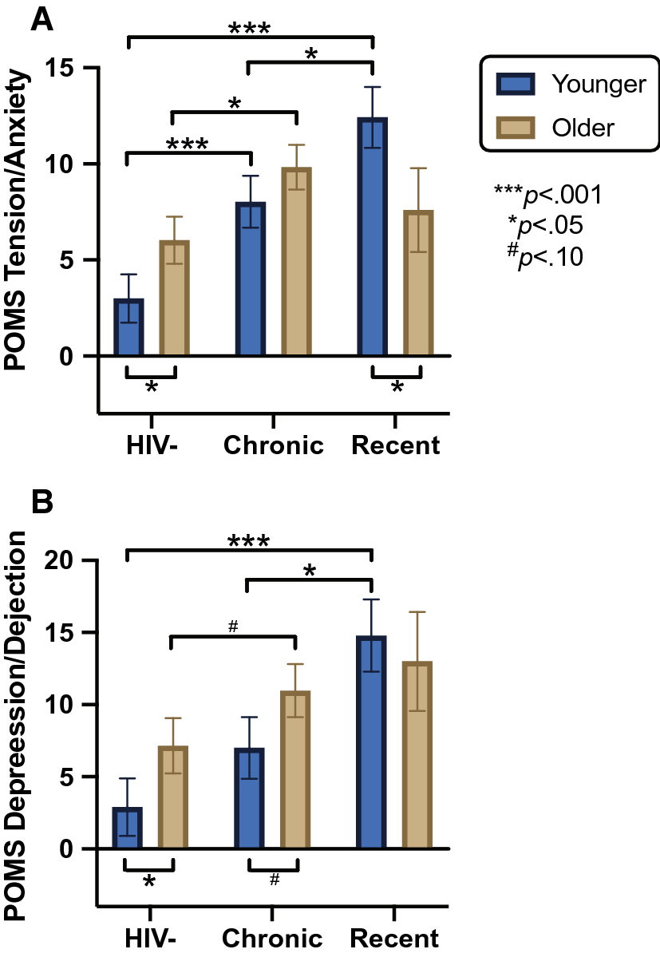
Effects of Age and Duration of HIV Infection on Anxiety in Cis-Gender Men
An observational cross-sectional study of 152 persons with HIV on age effects and estimated duration of HIV
All were cis-gender men and completed the Profile of Moods States, a self-report inventory of past week
Results showed higher levels of anxiety in persons with HIV compared to those without HIV
Age group (< 50 or ≥ 50) moderated the effect of duration of infection with younger persons with HIV and early diagnosed infection showing highest anxiety
Anxiety was attenuated in older persons with HIV in early infection – as their scores did not significantly differ from those without HIV and with chronic HIV
Older people may have greater adaptive ability to manage the acute life stressors of recent HIV infection
Goodkin, July 23, 2023
Gianella et al., AIDS and Beh, 2021

Slide 12
Anxiety among persons with HIV at Conakry University Hospital, Guinea
Cross-sectional study of socio-demographic, clinical and psychosocial data related to anxiety and depression in 160 persons with HIV at the University Teaching Hospital, Conakry, Guinea
Prevalence of anxiety symptoms among persons with HIV was high at 13.8% using the Hospital Anxiety and Depression Scale (HADS)
Having age < 40 years (AOR = 2.81, 95% CI 1.04–7.58) was significantly associated with higher anxiety
Similar anxiety findings epidemiologically with relatively deceased anxiety issues in older persons with HIV
Goodkin, July 23, 2023
Camara et al, Epi and Infection, 2020

Slide 13
Substance use disorders in older persons with HIV
Epidemiological data from population studies in the United States and internationally consistently show a substantial decline in the rate of substance use disorders with progressive age in the general population
Early on, data suggested this decline was NOT observed for older persons with HIV – unlike in older persons without HIV where rates of disorder did decline substantially compared with younger adults
Hence, from a relative perspective, substance use disorder is more likely to occur in older persons with HIV than in older persons without HIV
Goodkin, July 23, 2023
Rabkin et al., AIDS, 2004

Slide 14
Impact of substance use and comorbidities on quality of life in older persons with HIV
A study of 114 older persons with HIV using substances (aged 50 or older) examined associations with the number of current comorbid health conditions on quality of life
The number of comorbid conditions was associated with reduced quality of life.
Substance use specifically was also negatively associated with quality of life
The findings indicated clinical and supportive care for older persons with HIV, particularly when related to substance use, should include an integrated care focus on the comparatively high number of current comorbid conditions with substance use that often accompany, and potentially complicate, HIV treatment and decrease quality of life
Goodkin, July 23, 2023
Millar et al. AIDS & Beh, 2017

Slide 15
Addressing treatment of older persons with HIV using substances
Psychoactive substance use among older persons with HIV remains under-studied to date
In another study from the United States (US), 10.5% of older persons with HIV were found to have used cocaine, 10.5% also separately used crack cocaine, 6.3% used methamphetamines, 7.4% used heroin and 7.4% used prescription opioids without a prescription in the prior 12 months
Close to 25% of older persons with HIV have been found to meet the criteria for a substance use disorder
Substance use is a primary predictor of engagement in sex without condoms and non‐adherence to medications among older persons with HIV, as with younger persons with HIV
Ageism with respect to the index of suspicion for substance use in older persons with HIV must be actively addressed
Goodkin, July 23, 2023
Chayama et al. JIAS, 2020

Slide 16
Knowledge and risks of HIV transmission among veterans with severe mental illness
Severe mental illness represents a high risk for HIV infection
One study of behavioral risks for HIV transmission among veterans with severe mental illness examined associations between accuracy of HIV knowledge, risk behaviors, and clinical and demographic characteristics in a sample of male veteran psychiatric inpatients diagnosed with SMI (N = 353)
Results showed high rates of inaccurate HIV knowledge, with > 40% of psychiatric inpatients demonstrating some inaccuracies, particularly related to the progression and symptoms of HIV
Older age was associated with inaccurate HIV knowledge
Higher rates of inaccurate HIV knowledge among older participants differed from earlier reports, which did not find significant associations between age and HIV knowledge variables
Participants in the prior studies were, on average, 10 to 13 years younger than those in this study (average age = 49)
Thus, older age further increases the risk for contracting HIV amongst SMI
Goodkin, July 23, 2023
Strauss et al., Military Med, 2006

Slide 17
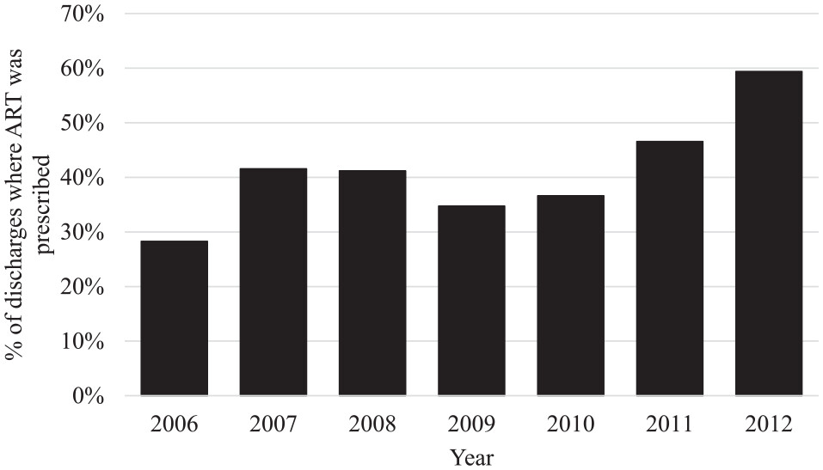
Prescribing Antiretroviral Therapy Upon Discharge to Psychiatric Inpatients with SMI
People with SMI may lack access to recommended antiretroviral therapy, and inpatient psychiatric admission is an opportunity for persons with SMI and HIV to receive recommended treatment
Antiretroviral therapy was prescribed at 39% of discharges - but increased over the course of the study
Prescription was more common in persons admitted with an AIDS diagnosis and age > than 29 and less common in persons admitted specifically with psychotic diagnoses
Future studies should explore interventions to increase antiretroviral therapy prescription both during hospitalization and at discharge for those with SMI in order to minimize increases in plasma viral load post-discharge for this neglected sub-group of patients who are at high risk for non-adherence and early mortality generally
Goodkin, July 23, 2023
Momenzadeh et al., Ann Pharmacother,,2020

Slide 18
Future prospects for care of older persons with serious mental illness and HIV
The greatest concern is for the “quadruply diagnosed"––persons with HIV and HCV co–infection, substance use disorder and serious mental illness
Pre-exposure prophylaxis needs to be made more accessible for persons with serious mental illness
Data to date show that older persons in general have lower discontinuation rates of PrEP
Persons with serious mental illness are highly likely to have primary medical comorbidities beyond HIV and HCV, including diabetes and hypertension -- as well as the psychiatric comorbidity of substance use disorder
Persons with SMI are at high risk for lack of follow-up for their primary medical comorbidities and have a high premature mortality rate
Specific interventions tailored for this population are required to optimize care
Investigation of combination treatment of long-acting antiretroviral medications with long-acting antipsychotic medications is merited
Goodkin et al., Addiction Med., 2020
McKinnon et al, Cournos, HIV Psychiatry, 2022
Goodkin, July 23, 2023

Slide 19
Proposals for Solutions
Psychosocial Context: Assessment-driven decision making for interventions -Use of life stressors surveys for stressful life event burden -Use of social support questionnaires for social support availability -Use of coping questionnaires for adaptive vs. maladaptive coping
Interventions predicted to enhance resilience: -Stress management interventions when life stressor burden is the predominant issue -Social support interventions when social support availability is the predominant issue -Coping skill enhancement interventions when coping strategy choice is the predominant issue
Depression: -Aim for full remission of depressive symptoms -Ensure stable, ongoing, effective treatment -Maintain antidepressant therapy after major depressive episodes -Consider dopaminergic agonists for comorbid neurocognitive disorder with major depressive disorder

Slide 20
Proposals for Solutions
Anxiety: - Data suggest anxiety is more common in persons with HIV overall but is - relatively - not as great of an issue for older persons with HIV - Nevertheless, active screening for anxiety in older persons with HIV is indicated
Substance use disorder: - Risk for substance use disorder in older persons with HIV is under-estimated - Active screening for substance use disorder in older persons with HIV is indicated together with assessing for other comorbid psychiatric disorders - Maintain focus on adherence optimization and transmission risk while providing treatment within an integrated medical care environment
Serious Mental Illness: - Risk for HIV is high among those with serious mental illness, and PrEP should be considered actively - HIV knowledge is low amongst older persons and warrants intervention - Treatment for those with serious mental illness and HIV is optimized in an integrated medical care setting with strong capacity to treat primary medical comorbidities - Future treatment of persons with serious mental illness and HIV with combination long-acting antiretroviral medication and long–acting antipsychotic medication warrants development

