Slide 1
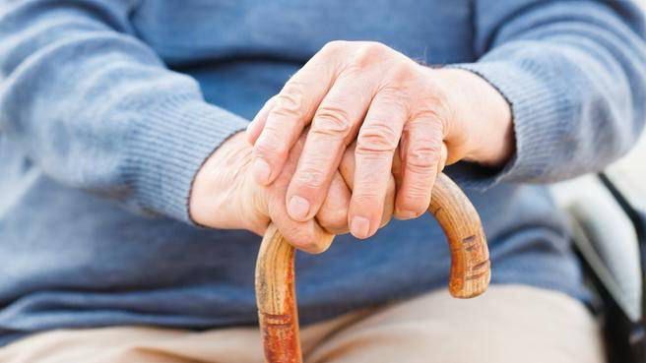
Cognitive Health Interventions for People Aging and Living with HIV
David J. Moore, PhD
Professor of Psychiatry
University of California, San Diego

Slide 2
Cognitive Improvement Approaches
Physical Activity
Diet
Cognitive Training
Pharmacologic / Treatment of Other Medical Comorbidities

Slide 3
Physical Activity

Slide 4
Slide Courtesy of Kristine Erlandson, MD
Notes:
Instead, perhaps we need to rethink our paradigm of physical activity and think of exercise AS a prescription… the ony prescription that we give with unlimited refills.

Slide 5
Montoya et al., AIDS 2019

Slide 6
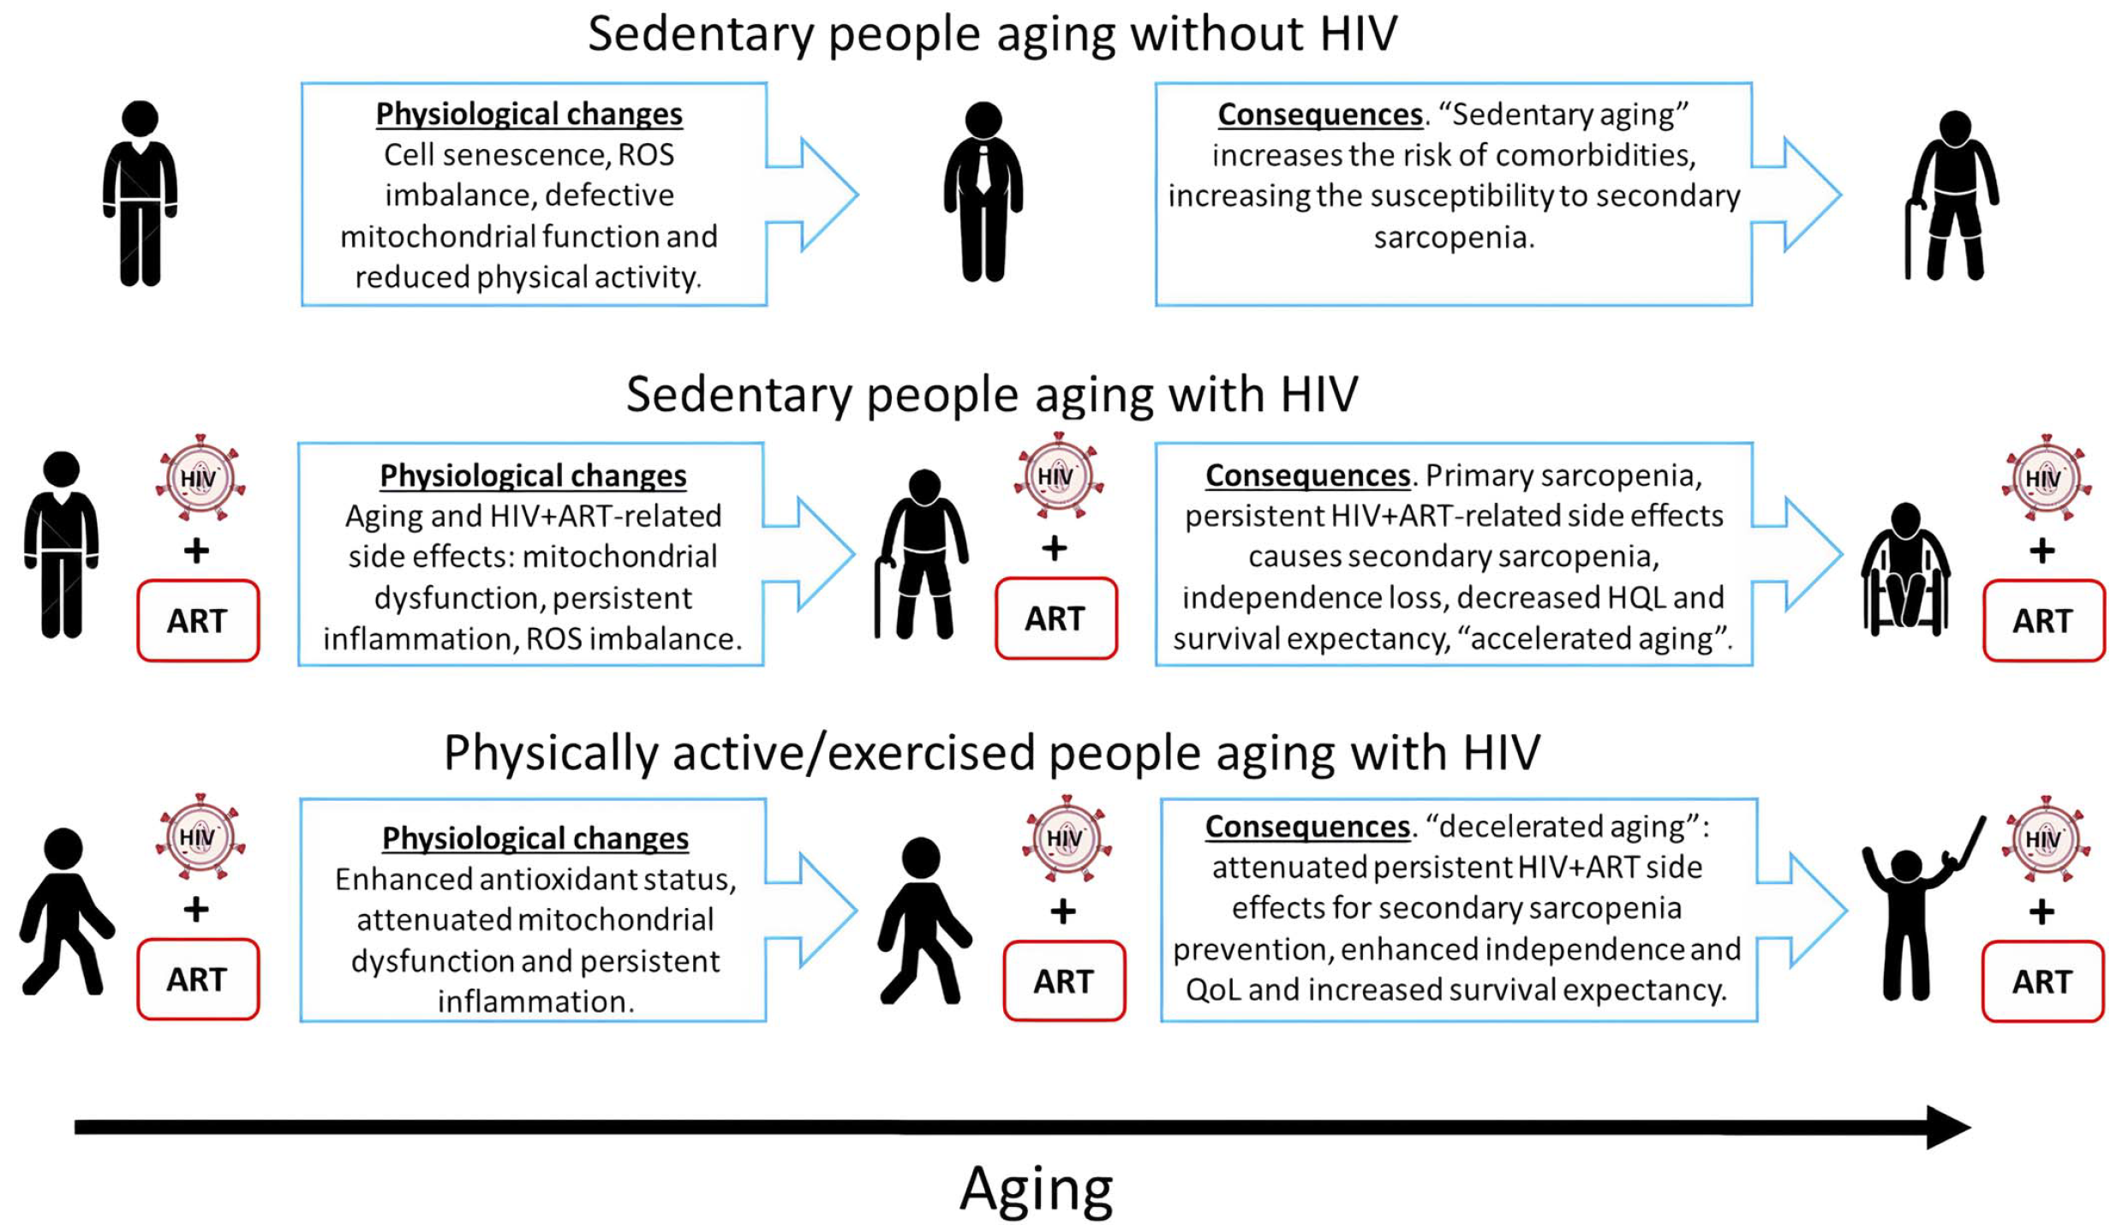
Benefits of Exercise in PWH
Deminice et al, Exerc. Sport Sci. Rev. 2022, PMID: 35029356
Slide Courtesy of Scott Letendre, MD

Slide 7
Fazeli et al., 2015, AIDS & Behavior

Slide 8
Objectively assessed physical activity and cognition among older PLWH (N=75)
4% met old DHHS criteria (150 min bouted – at least 10 min at a time -- PA per week), 39% met new non-bouted criteria
Greater light PA, less sedentary time, were associated with:
  Better functioning in select cognitive domains: speed of processing, executive function, and working memory/attention
  Adjusted for age and CD4 count
Summary: Even among PWH with very low levels of moderate to vigorous PA, even light PA may benefit cognition
Fazeli et al., 2022, AIDS & Behavior

Slide 9
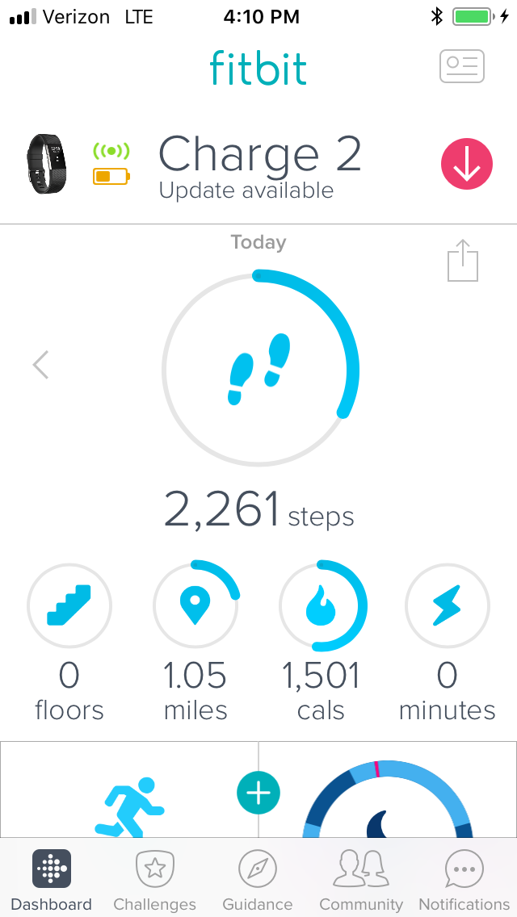
iSTEP: An mHealth Physical Activity and Diet
Intervention for Persons Living with HIV
6-month RCT of CTRL v. PA v. PA + Diet
Objective:
  Increase physical activity and improve diet
  Improve cardiovascular and neurocognitive function
Methods:
  Daily text and picture messages on cell phone
  Monitor physical activity with a Fitbit and set activity goals
  Promote a Mediterranean-style diet; provide free walnuts and olive oil
Slide courtesy of Brook Henry, PhD

Slide 10
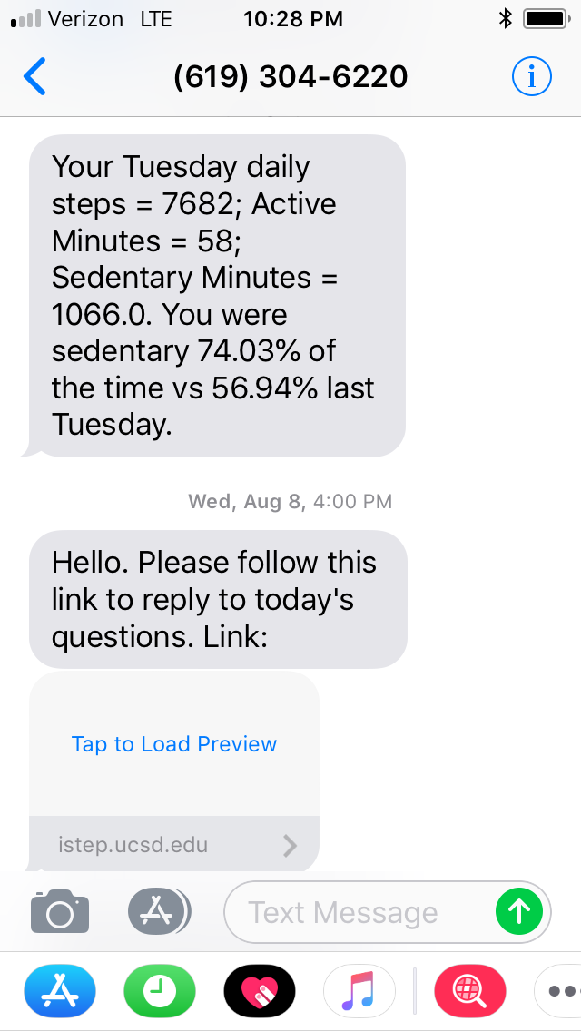

iSTEP Interactive Texting and Website Platform
9944
Slide courtesy of Brook Henry, PhD

Slide 11
iSTEP Maintains Higher Physical Activity at 24 Weeks

Slide 12
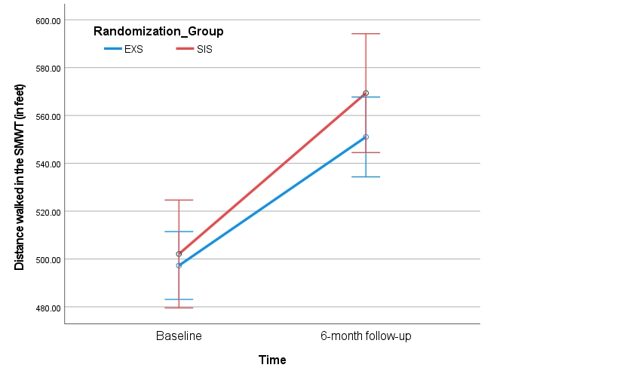
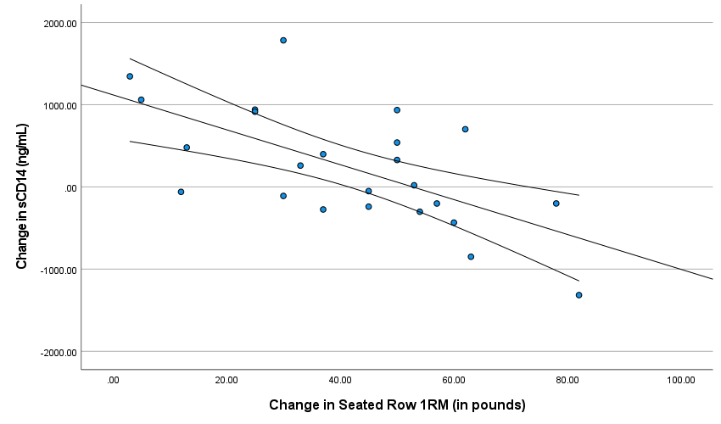
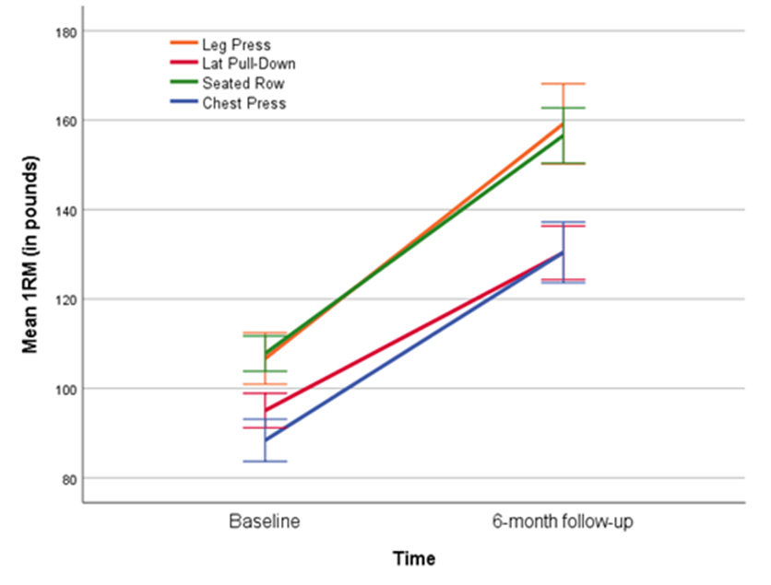
Exercise intervention results
Both the Exercise (EXS) and Stretching (SIS) groups improved physical fitness (time to complete six-minute walk test (SMWT))
Increases in strength correlated with improved cognitive performance and reduced inflammation (soluble CD14)
Physical strength (1 rep max) significantly improved in the EXS group
Cooley et al., 2023, JMIR Research Protocols

Slide 13
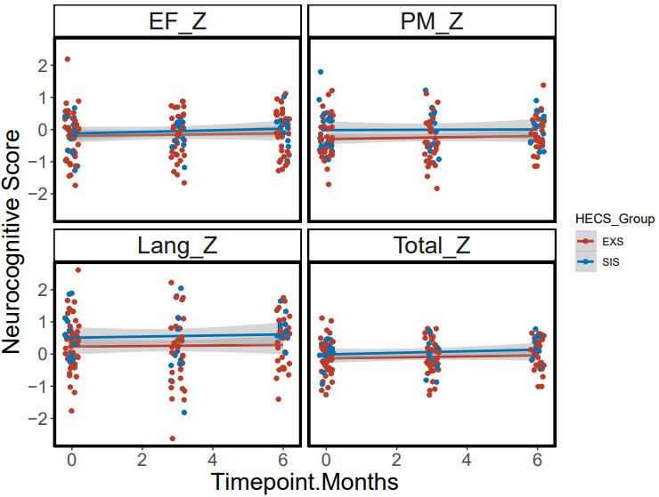
Cognition Outcomes
No overall significant change in cognition over time for either intervention group (EF= executive function; PM = psychomotor speed; Lang = language)
Takeaway: An exercise intervention significantly improved physical fitness and strength in older PWH, which in turn associated with changes in inflammation and cognitive performance. Changes in cognition were not significantly different over time. Longer interventions may be needed.
Cooley et al., 2023, JMIR Research Protocols

Slide 14
Diet

Slide 15

Diet and Cognition
Sample had low Healthy Eating Index scores 45.00 (38.95—51.65) out of 100
Just being nourished (higher calories) was associated with better cognitive function
Higher glycemic index associated with poorer cognitive function
Several amino acids, MUFAs/PUFAs/SFAs associated with better cognitive function
Fazeli et al., INS Conference 2023

Slide 16
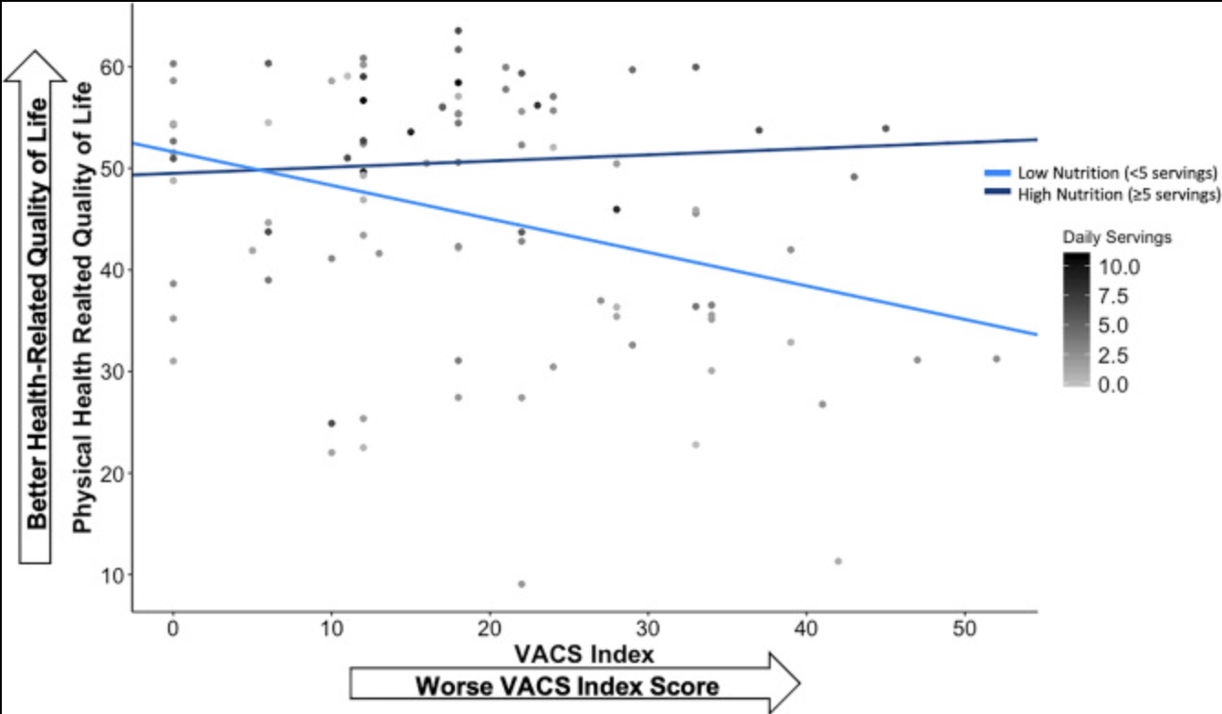
Nutrition, VACS and HRQoL
Nutrition moderates the negative relationship between VACS Index and physical health-related quality of life.
Campbell et al., 2023 International Journal of Behavioral Medicine
Notes:
Note. Model was run with nutrition as a continuous variable but was dichotomized into low (< 5 daily servings) and high (≥ 5 daily servings) nutrition for demonstrative purposes. Regression lines adjust for other variables in the model (i.e., physical activity, diabetes). VACS Index, The Veterans Aging Cohort Study Index; nutrition, daily fruit and vegetable servings

Slide 17
Cognitive Training

Slide 18
Computerized Cognitive Training (CCT)
Meta Analysis shows CCT improves cognition is 6 of 8 domains
Several studies examining computerized cognitive training in older PLWH and found improvements in
  Cognitive function
  Everyday Function
  Driving
  Quality of Life
Non-invasive brain stimulation + cognitive training has shown some promising, though inconsistent, effects on cognitive outcomes, as well as:
  Effects on indices of cautionary simulated driving behavior (speed, driving violations, collisions, variability in lane positioning, and lane deviations)
Fazeli, P. L., Woods, A. J., Vance, D. E., Pope, C. N.*, & Ball, K. K. (2019). Applied Neuropsychology
Pope, C. N.*, Stavrinos, D., Vance, D. E., Woods, A. J., Bell, T. R., Ball, K. K., & Fazeli, P. L. (2018). Psychology and Behaviour
Wei et al., (2022). JAMA Open Network.
Modified slide from Pariya Fazelli, PhD
Notes:
20 hours over 12 weeks

Slide 19
Pharmacologic / Treatment of Other Comorbidities

Slide 20
Clinical Trials of Therapy for Neurocognitive Impairment
Pharmacologic – Non-Antiretroviral Therapy
Pharmacologic – Antiretroviral Therapy
Intervention | Status | Result
Memantine | Completed | No NP benefit
Selegiline | Completed | No NP benefit
Deprenyl ± Thioctic Acid | Completed | Deprenyl improved verbal memory
CPI-1189 | Completed | No NP benefit
Minocycline | Completed | No NP benefit
Nimodipine | Completed | No NP benefit
Rivastigmine | Completed | No NP benefit
Paroxetine ± Fluconazole | Completed | Paroxetine improved global performance
Intranasal Insulin | Terminated | Not published
Methylphenidate | Unknown | Not published
Liraglutide | Terminated | Not published
Cenicriviroc | Completed | Not published
Atorvastatin | Completed | No effect on CD16+ MCs
Galantamine | Completed | Not published
Intervention | Status | Result
Switch from Efavirenz to Rilpivirine | Completed | Improved sleep and NP symptoms, not objective NP
Switch from Efavirenz to Raltegravir | Completed | Improved anxiety and stress symptoms
Adding Raltegravir | Terminated | No effects on neopterin
Adding Maraviroc | Completed | Possible NP benefit
Adding Dolutegravir ± Maraviroc | Completed | No NP benefit
Non-Pharmacologic
Intervention | Status | Result
Cognitive Training | Completed | Most indicate NP benefit
Exercise | Multiple | Most indicate NP benefit
Transcranial Direct Current Stimulation | Multiple | NP benefit in combination with cognitive training
Slide Courtesy of Scott Letendre, MD

Slide 21

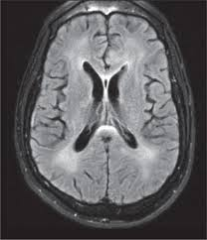
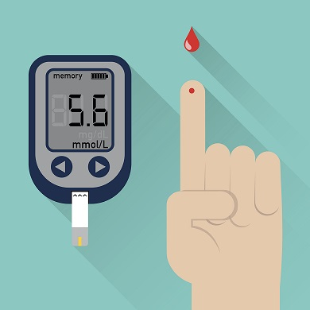
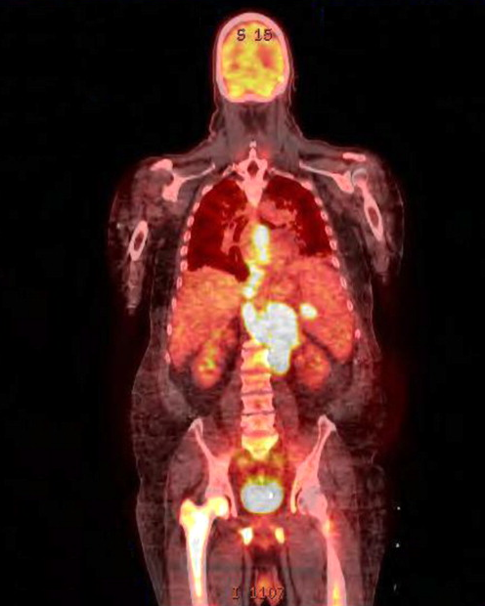
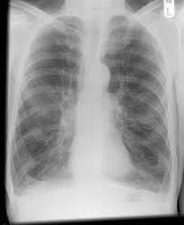
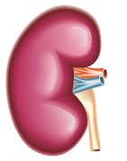
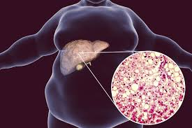
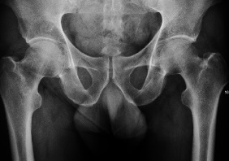

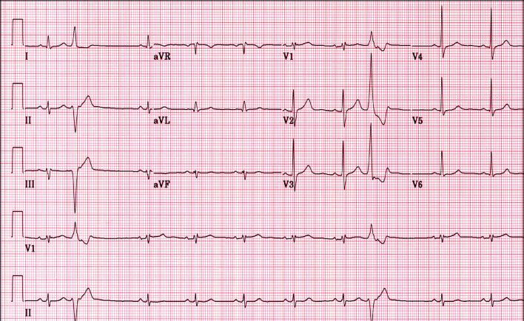
Increased aging-related comorbidities in HIV
Neurocognitive Impairment (NCI)
Diabetes
Non-AIDS Defining Malignancy
COPD
Kidney Disease
NAFLD
Bone disease
Frailty
Cardiovascular disease
Slide Courtesy of Mary Clare Masters, MD
Frailty
Notes:
With ART, life expectancy for PWH nears that of the general population
However, PWH experience earlier onset and higher rates of age-related non-infectious comorbidities and geriatric syndromes as well as higher rates of multimorbidity
Thus, despite improvements in lifespan, PWH experience reduced health span (period of life free from aging related chronic disease and disability)

Slide 22
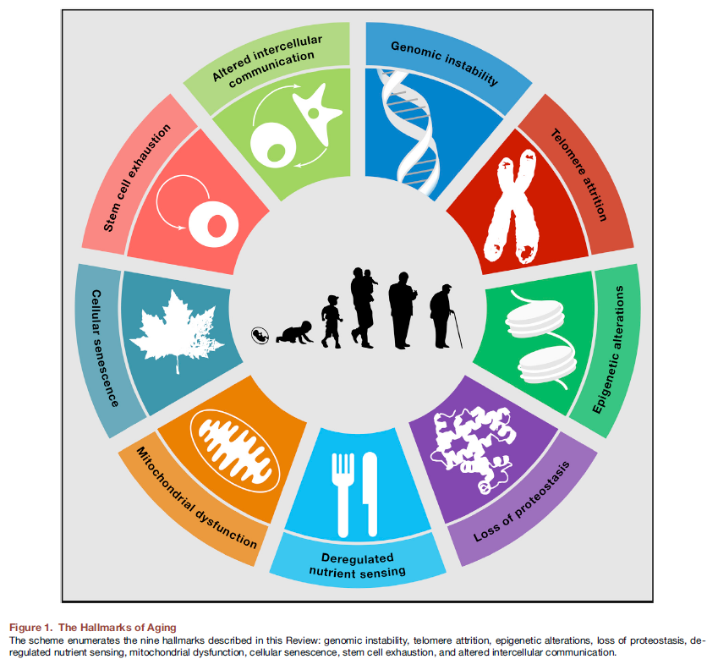

Geroscience approach target pillars of aging
Phenotypes
Geriatric Syndromes:
Sarcopenia
Frailty, Immobility
Cognitive impairment
Chronic Diseases:
Dementias
Cancers
Atherosclerosis
Diabetes
Osteoporosis
Osteoarthritis
Renal dysfunction
Blindness
Chronic lung disease
Decreased Resilience:
Infections
Delayed wound healing
Slow rehabilitation
Chemotherapy toxicity
ICU Care
Senescence
Inflammation
Macromolecular/
Organelle Damage
Stem Cell dysfunction
Aging
Slide credit Tamara Tchkonia.
Slide Courtesy of Mary Clare Masters, MD
Notes:
The field of geroscience is based on the fact that age is the greatest risk factor for many conditions
The geroscience hypothesis posits that therapeutically targeting fundamental aging biology will have a significantly greater impact on overall human disease than treating individual diseases
Research into the biology of aging has led to the identification of hallmarks or “pillars” of aging that represent the varied mechanistic drivers of aging physiology. As seen here, these include cellular senescence, impaired proteotasis, altered metabolism.
These aging pathways contribute to geriatric syndromes, chronic disease, and decreased resilience seen with aging
Although historically viewed as distinct types of biological processes, growing evidence demonstrates that these aging hallmarks are intricately linked to one another suggesting that improving one hallmark will improve the others as well

Slide 23
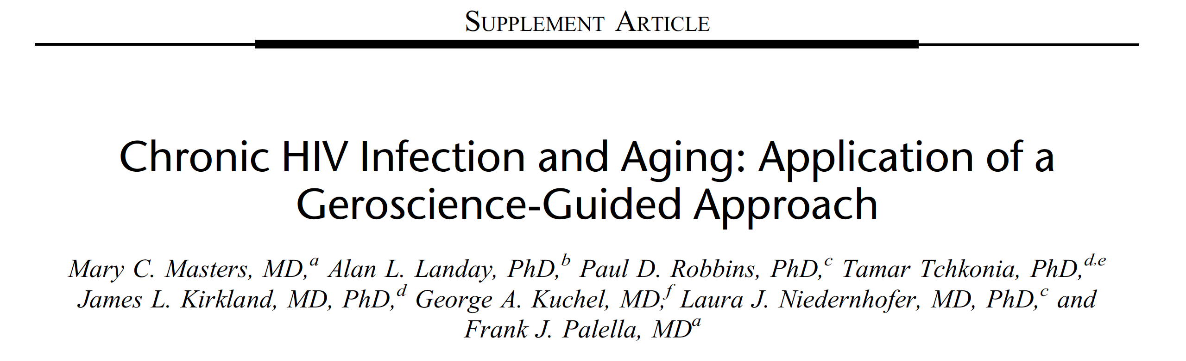
Class | Mechanism | Example Agents
Senolytics | Selectively kill senescent cells | BCL-2/BCL-xL inhibitors (e.g.,venetoclax, navitoclax) HSP-90 inhibitors Dasatinib + quercetin (D+Q) Fisetin
Senomorphics | Suppress senescence phenotypes, like SASP | JAK inhibitors (e.g., ruloxitinib, baricitinib) Rapamycin Metformin
Slide Courtesy of Mary Clare Masters, MD

Slide 24
Obesity and brain health
In HIV negative individuals, overweight and central obesity are associated with adverse effects on cognition and brain structure.
Debette et al (Neurology® 2011;77:461–468)
  obesity in midlife ➔increased risk of being in the top quartile of worsening in executive function (OR 1.4 [1.0-1.9], p = 0.035)
  increasing waist-to-hip ratio ➔marked decline in total brain volume (OR 10.8 [1.4-81.0], p = 0.021).
Slide Courtesy of Ron Ellis, MD, PhD
Notes:
VAT is particularly important in this regard

Slide 25
Increasing abdominal girth and inflammation (↑IL-6) related to worse Global Deficit Scores (GDS)
Entire Cohort
High IL-6 group
Worse
Rho = 0.26
P = 0.001
N= 152
Rho = 0.39
P = 0.005
N = 51
Better
Correlation of GDS and WC for the entire cohort of patients (left panel) and those with high tertile IL-6 (right panel)
Sattler R et al.. JAIDS. 2015
Slide Courtesy of Ron Ellis, MD, PhD

Slide 26
Tesamorelin might improve NC function by decreasing VAT
In non-HIV, abdominal obesity is associated with increased risk for and progression of NC impairment
Panza et al: J Alzheimers Dis. 2012; 30 (suppl 2):S31–S75
In HIV (a chronic inflammatory disorder), abdominal girth is associated with NCI
Waist Circumference (WC) was correlated with severity of NCI.
McCutchan et al: Neurology 2012; 78:485-92
WC was highly associated with NCI, especially in presence of systemic and CNS inflammation.
Sattler et al: JAIDS 2015; 68(3):281-288
Notes:
Take out references, or shroten, eg, to McCutchan et al: Neurology 2012

Slide 27
Additional good news…successful aging

Slide 28
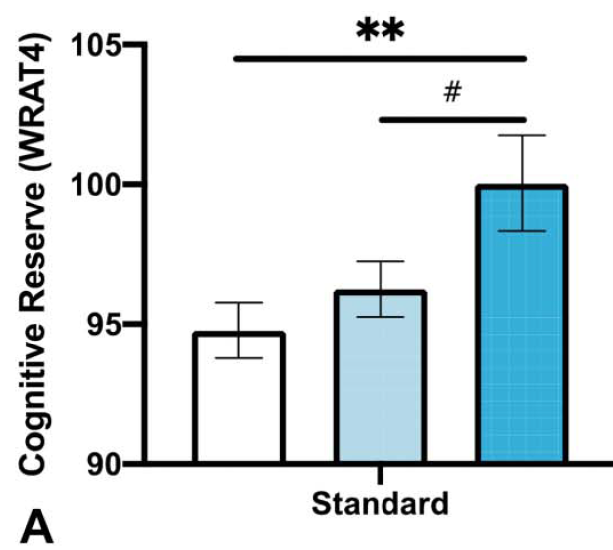
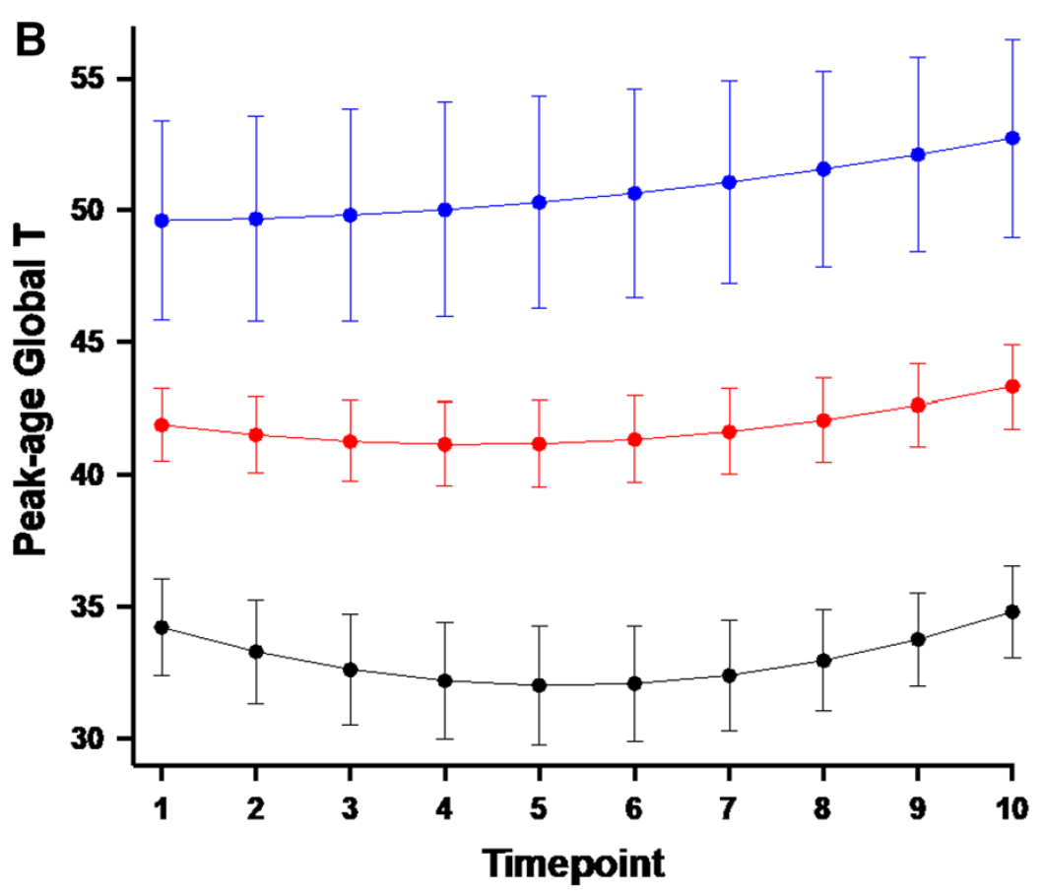
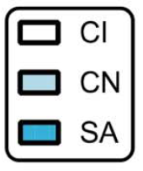
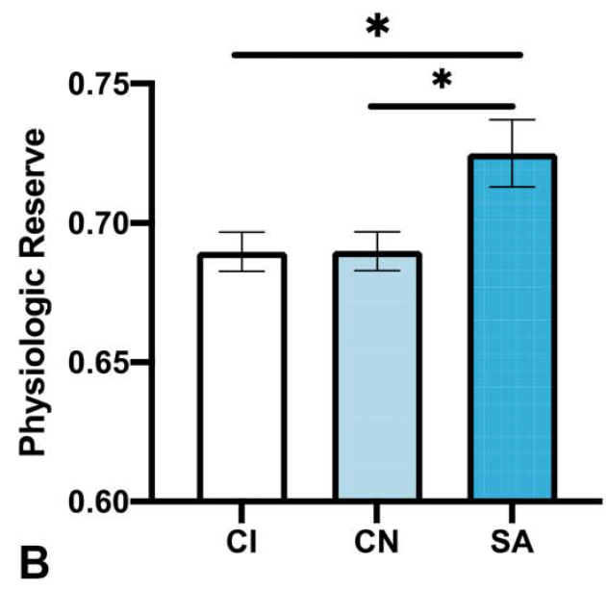
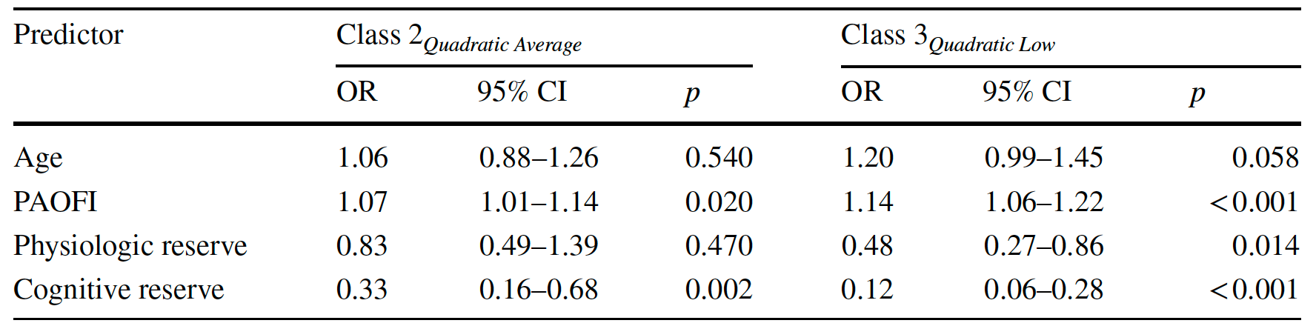
Cognitive SuperAging and Youthful Trajectory in PWH
Up to 5 Years
Follow-up
Saloner et al, JAIDS 2022, PMID: 35364601
Saloner et al, AIDS Behav, 2022. PMID: 34878634

Slide 29
Positive Psychological Factors Influence Successful Aging
 | PWH/SA+ Group 1 | PWH/SA- Group 2 | HIV-/SA+ Group 3 | HIV-/SA- Group 4
 | M (SD) | M (SD) | M (SD) | M (SD) | p-value | Pairwise
Grit | 3.64 (0.45) | 3.32 (0.47) | 3.69 (0.45) | 3.58 (0.45) | < 0.01 | 2 < 1,3,4
Social Support (DSSI) | 9.05 (1.79) | 8.17 (1.83) | 9.19 (1.49) | 9.24 (2.02) | 0.02 | 2 < 1,3,4
Resilience (CD-RISC10) | 30.38 (8.14) | 25.98 (7.31) | 32.59 (5.90) | 31.48 (6.24) | < 0.01 | 2 < 1,3,4
Attitude Toward Aging (PGCMS) | 3.66 (1.55) | 2.33 (1.60) | 4.04 (1.22) | 3.86 (1.39) | < 0.01 | 2 < 1,3,4
Optimism (LOT-R) | 21.64 (5.10) | 20.34 (4.55) | 24.56 (4.02) | 22.71 (4.72) | < 0.01 | 1,2 < 3
Satisfaction with Life (SWLS) | 20.10 (6.85) | 18.52 (7.18) | 23.19 (5.91) | 21.85 (7.25) | 0.02 | 1,2 < 3
Personal Mastery (PPMS) | 21.74 (3.94) | 20.08 (3.34) | 23.44 (3.38) | 22.67 (3.93) | < 0.01 | 1,2 < 3
Emotional Support (ESS) | 2.33 (0.82) | 2.08 (0.89) | 2.74 (0.54) | 2.43 (0.88) | < 0.01 | 1,2 < 3
Post-traumatic Growth (PTGI) | 56.92 (26.56) | 50.74 (28.07) | 59.08 (30.24) | 59.71 (33.37) | 0.46
Religiosity/Spirituality (BMMRS) | 4.77 (1.56) | 4.79 (1.76) | 4.70 (1.59) | 3.67 (1.68) | 0.05
Moore et al, AIDS Behav. 2018 ; 22(5): 1551–1561

Slide 30
Acknowledgements
Participants
Funding Support
  NIMH, NIDA, NIA, NINR, NINDS, CHRP
Collaborators/Contributors
  Sarah Cooley, PhD
  Ron Ellis, MD, PhD
  Kristine Erlandson, MD
  Pariya Fazeli, PhD
  Brook Henry, PhD
  Scott Letendre, PhD
  Mary Clare Masters, MD
  Jessica Montoya, PhD
  Rowan Saloner, PhD,
Staff
  Ben Gouaux
Programs
  HIV Neurobehavioral Research Center
  CHARTER
  California NeuroAIDS Tissue Network

Slide 31
Contact
David J. Moore, PhD
djmoore@health.ucsd.edu

