Slide 1
Perspectives from lower- to middle-income countries on cognitive aging in people aging and living with HIV
Wong Pui Li, Universiti Malaya, Malaysia
Fostering cognitive and mental health in aging people with HIV while prioritizing the community and lived experience perspectives
Notes:
Good morning, I am thankful for the opportunity to speak to you this morning on “Perspectives from lower to middle-income countries on cognitive aging in people aging and living with HIV”

Slide 2
Outline
Definitions:
Cognition, cognitive aging and cognitive impairment
Challenges faced with screening and management for cognitive impairment in lower- to middle-income countries (LMIC)
Perspectives from healthcare providers (HCP) and people aging and living with HIV (PWH) on screening and management for cognitive impairment
Notes:
My presentation will begin with some definitions,
then focus on challenges faced by lower- to middle-income countries (LMICs) when it comes to screening and managing cognitive impairment in people aging and living with HIV.
I’ll also be sharing some perspectives from healthcare providers and clients where I work in Malaysia.

Slide 3
Definitions
Cognition
Mental function
Cognitive aging
What happens to our mental function as we age
Cognitive impairment
Abnormal mental function
For eg. attention, thinking, understanding, learning, remembering, problem-solving, decision making
Notes:
During my talk, I’ll refer a lot to the term cognitive impairment, and it is important to know what it refers to.
Cognition refers to our mental functions, which include attention, thinking, understanding, learning, remembering, problem solving and decision making.
Cognitive aging refers to what happens to our mental functions as we age, and cognitive impairment just means any abnormal mental function.

Slide 4
Challenges in screening and managing cognitive impairment in people aging and living with HIV (PWH) in LMICs
Notes:
What might be the challenges in screening for cognitive impairment / assessing cognition in LMICs?

Slide 5
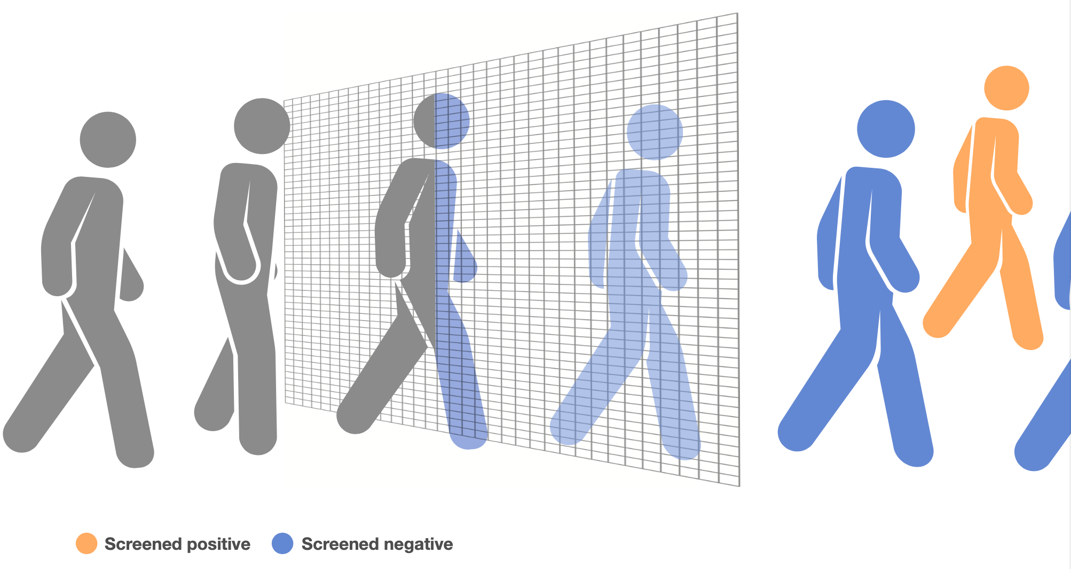
Challenges in LMICs
Should we screen?
Who do we screen?
What do we use to screen?
What do we do after screening?
Notes:
I’m going to highlight 4 main challenges.
Firstly, should we screen,
who do we screen,
what should we use to screen and
what do we do after screening?
Some of you may feel that the answers to these are straight-forward and obvious, but I would argue it isn’t in resource-limited settings.

Slide 6
Challenges in LMICs
Should we screen?
Notes:
Firstly, should we screen?

Slide 7
“So you can also argue is it worth doing it or not, in our setting, I don't think we have a good idea what is the prevalence of neurocognitive (impairment) in our population, … ours was just a small study but what is the prevalence and the true prevalence” - Infectious Disease Specialist, 14 years of experience, Malaysia.
Notes:
This is a quote from an Infectious Disease physician from Malaysia.
And what is the true prevalence in older PLWH?
Do they have a point?
When your resources are limited, the burden needs to be big enough to justify allocating resources to it. So what do we know about the prevalence of cognitive impairment in LMICs?

Slide 8
Low- to middle-income countries 2021
https://datatopics.worldbank.org/world-development-indicators/the-world-by-income-and-region.html
Notes:
This is a map showing where the low and lower-middle income countries are, and they are highlighted here in purple, mainly focused in North and sub-Saharan Africa, as well as regions within Asia. Before I show you the next slide, pay attention, to what happens to the areas in purple turns in the next map.

Slide 9
Prevalence of CI in PWH
12 assessments were used
Keng et al. 2023. AIDS.
Notes:
If you’ve noticed, a lot of the areas of purple in the previous map have turned white. That means there are no studies on the prevalence of cognitive impairment in people aging and living with HIV in those countries.
Furthermore, the prevalence was reported with 44 countries using 12 different assessments, so we can’t be sure if this is the true prevalence.

Slide 10
Challenges in LMICs
Should we screen?
Who do we screen?
Prevalence is not known
Notes:
So we don’t know the true prevalence of cognitive impairment in LMICs. Next, who do we screen?

Slide 11
Who do we screen?
39 million people living with HIV (PWH) in 2022¹
Average prevalence of CI – 39.6%², HAND 50.41%³
Who do we screen?
All people living with HIV (PWH)?
→ More than 80% of all PWH are in LMICs⁴
All PWH over the age of 50?
→ In 2022, 9.46 million PWH above the age of 50
→ 80% are in LMICs
→ Increased risk of cognitive impairment compared to those without HIV⁵
Do we risk stratify?
→ Low CD4 / Co-infections / Comorbidities/ Duration and type of therapy?⁶
Only symptomatic?⁷
1. https://aidsinfo.unaids.org/
2. Keng et al. 2023. AIDS
3. Zenebe et al 2022. Front Psychiatry
4. Allel et al. 2020. PLOS Glob Public Health
5. Deng et al. 2021. Ageing Res Rev 6. Alford et al. 2018. British Medical Bulletin
7. Nightingale et al. 2023. Nat Rev Neurol
Notes:
We have 38.4 million people living with HIV in 2021
Based on various publications, the prevalence of cognitive impairment or HIV-associated Neurocognitive Disorders (HAND) vary between 39.6% and 50.41%.
So who should we screen (again bearing in mind the limitation of resources)?
Should we screen everyone? 80% of people aging and living in HIV live in LMICs
Should we narrow it down to those over 50? In 2022, there were 9.38 million people, with 80% again living in LMICs
In a meta analysis looking at the association of HIV infection and cognitive impairment in older adults, they found an increased risk.
Should we risk stratify instead to those with risk factors for developing cognitive impairment?
Or should we only screen those who are symptomatic, which is something which was suggested by the International HIV-cognition working group with 8 out of 20 members coming from low-middle income countries?

Slide 12
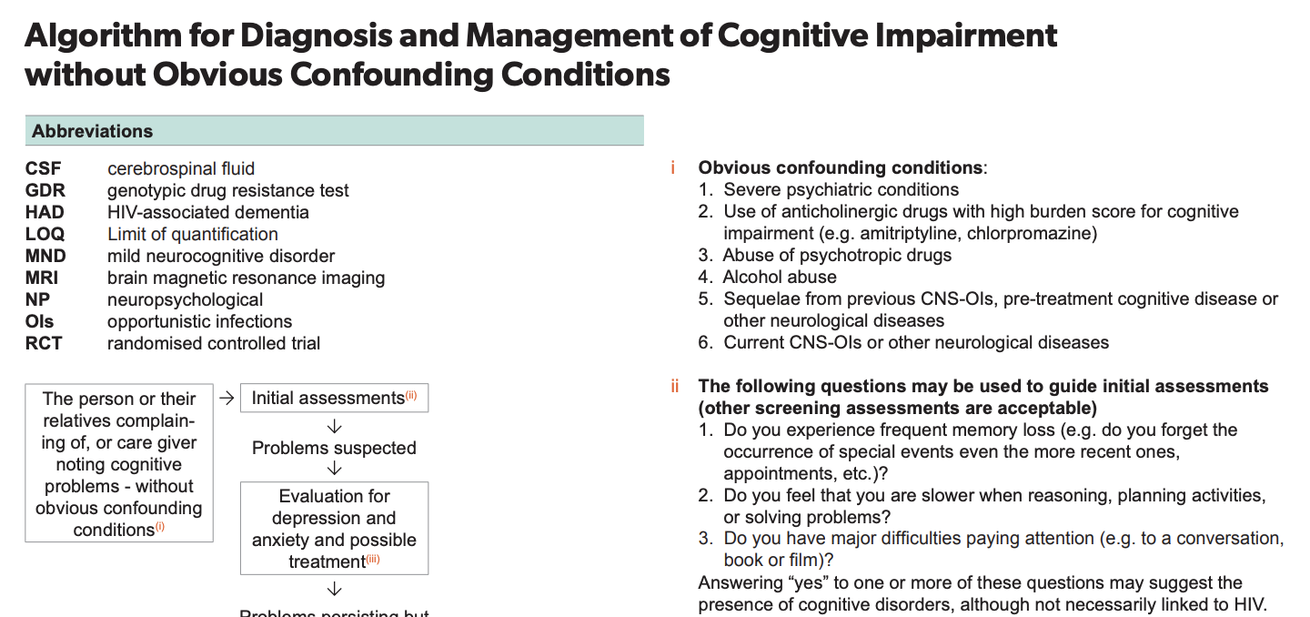
Who do we screen?
BHIVA 2016
Screening for cognitive impairment within the first three months of HIV diagnosis and on an annual basis afterward
The Italian Society for Infectious and Tropical Diseases recommends conducting tests like Montreal Cognitive Assessment (MoCA) and Cogstate for all patients with cognitive symptoms.
Mind Exchange Working Group 2013
All PWH regardless of symptoms or risk factors using sensitive screening tools and 6-24 months
EACS 2022
National Guidelines for HIV Prevention, Treatment and Care (Nigeria) 2020 Conduct assessment and management for HAND in ALL Refer for neuropsychiatric assessment
WHO 2021
Mostly mentioned for children and adolescents
Vastag et al. 2022. Int J Gen Med.
Notes:
What do various guidelines say?
The British HIV Guidelines, Mind Exchange Working Group and Nigerian National Guidelines recommended screening for all people living with HIV.
The World Health Organization does not say very much except for screening in children and adolescents.
The Italian Society and European Guidelines both recommend screening in symptomatic patients.

Slide 13
Challenges in LMICs
Should we screen?
Who do we screen?
What do we use to screen?
Prevalence is not known
Everyone/
Symptomatic?
Is it feasible?
Notes:
So we are no further forward with who to screen, and the question is it even feasible?
Even after deciding who to screen, what should we use to screen?

Slide 14
Screening tools
HIV Dementia Scale (HDS)
International HIV Dementia Scale (IHDS)
Mini-mental State Examination (MMSE)
Brief Neurocognitive Screen (NeuroScreen)
CogState Computerized Battery
Bender Gestalt Test
California Computerized Assessment Package (CalCAP)
Coin Rotation Test
Computer Assessment of Mild Cognitive Impairment (CAMCI)
Four-item scale from Health Survey
Grooved pegboard
Brief Cognitive Screen
HIV Dementia Diagnostic Test
Hopkins Verbal Learning Test / WAIS-III Digit Symbol
Medical Outcome Study (MOS-HIV) Health Survey
Mental Alternation Test
Motor Battery
Prospective and Retrospective Memory Questionnaire (PRMQ)
Screening Algorithm
Timed-Gait Test
Wechster Memory Scale
Hopkins Verbal test-revised + Grooved Pegboard Test Non-dominant hand
Montreal Cognitive Assessment (MoCA)
Simioni Symptom Questionnaire (SSQ)
Community Screening Interview for Dementia (CSID)
Cognitive assessment tool – rapid version (CAT-rapid)
Interventions for Dementia in Elderly Africans (IDEA)
Kamminga et al. 2013. Curr HIV/AIDS Rep.
Joska et al. 2016. AIDS Behav.
Kellett-Wright et al. 2021. AIDS Behav.
Keng et al. 2023. AIDS
Notes:
In the literature there are at least 27 different screening tools that have been used to screen for cognitive impairment / HAND throughout the world. This list goes on.

Slide 15
Screening tools
HIV Dementia Scale (HDS)
International HIV Dementia Scale (IHDS)
Mini-mental State Examination (MMSE)
Brief Neurocognitive Screen (NeuroScreen)
CogState Computerized Battery
Bender Gestalt Test
California Computerized Assessment Package (CalCAP)
Coin Rotation Test
Computer Assessment of Mild Cognitive Impairment (CAMCI)
Four-item scale from Health Survey
Grooved pegboard
Brief Cognitive Screen
HIV Dementia Diagnostic Test
Hopkins Verbal Learning Test / WAIS-III Digit Symbol
Medical Outcome Study (MOS-HIV) Health Survey
Mental Alternation Test
Motor Battery
Prospective and Retrospective Memory Questionnaire (PRMQ)
Screening Algorithm
Timed-Gait Test
Wechster Memory Scale
Hopkins Verbal test-revised + Grooved Pegboard Test Non-dominant hand
Montreal Cognitive Assessment (MoCA)
Simioni Symptom Questionnaire (SSQ)
Community Screening Interview for Dementia (CSID)
Cognitive assessment tool – rapid version (CAT-rapid)
Interventions for Dementia in Elderly Africans (IDEA)
Kamminga et al. 2013. Curr HIV/AIDS Rep.
Joska et al. 2016. AIDS Behav.
Kellett-Wright et al. 2021. AIDS Behav.
Keng et al. 2023. AIDS
Notes:
Of this list, only 8 were developed with HIV in mind.

Slide 16
What do we use to screen?
“Tests should be validated in the language and culture of the patients, and the interpretation of the results should be made under normative data that are specific to each population.”¹
Has it been validated?
How sensitive / specific is it?
Is there normative data?
What domains do they cover?
Neurological assessment
Language & Translations
Human Resources
Education & Literacy
Diagnostic / Screening
Testing environment
Who will be doing the screening?
Who will be managing them?
How many translations are there?
Have they been culturally adapted?
Busy clinics (Time)
Noise levels
Ability to concentrate
Is the tool suitable for low literacy and low education populations?
1. Antinori et al. 2013. Clin Inf Dis
2. Haddow et al. 2016. Neurobehav. HIV Medicine
Notes:
So how do we choose which tool to use in our individual settings? The Mind Exchange Working Group says that tests should be validated in the language and culture of the patients, and the interpretation of the results should be made under normative data that are specific to each populations.
We have to go through this exhaustive list to see:
1. ….

Slide 17
Challenges in LMICs
Should we screen?
Who do we screen?
What do we use to screen?
What do we do after screening?
Prevalence is not known
Everyone/
Symptomatic?
Is it feasible?
There are many tools,
BUT few have been
translated, culturally
adapted and
have normative data
Notes:
Which brings me to our last a final challenge, what do we do after screening?

Slide 18
“That's why I think before we want to implement something, you need to know the baseline… So we want to introduce screening, it will (need to) be cost effective and then some intervention can be offered” -Infectious Disease Specialist, 2 years of experience, Malaysia.
Notes:
An Infectious Disease Specialist at my centre mentioned… “…” What intervention can we offer?

Slide 19
What do we do after screening?
Orange Clinic, United Kingdom³
HIV physician
Old age psychiatrist (Dementia)
Neuropsychologist
Psychology assistant
Clinical psychologist
HIV clinical nurse consultant
Neurology (virtual)
Neuroimaging services
PWH: 2457
Country | Income country | PWH | Ratio of psychiatrists per 100 000 individuals
Global average¹ |  |  | 3.96
Malaysia² | Upper middle | 92,063 | 1.048
South Africa² | Upper middle | 7,500,000 | 1.521
Cambodia² | Lower middle | 74,000 | 0.387
India¹ | Lower middle | 2,400,000 | 0.301
Nigeria² | Lower middle | 1,900,000 | 0.06
Ethiopia¹ | Low | 610,000 | 0.04
Mozambique² | Low | 1,500,000 | 0.046
Uganda² | Low | 1,400,000 | 0.082
Zambia² | Low | 1,300,000 | 0.056
Cambodia
HCP: 2 HIV Doctors, 2 HIV Counsellors
Estimated PWH: 74,000
One clinic session: 60-80 patients
_{Personal communications.}
1. Rathod et al. 2017. Health Services Insights
2.https://apps.who.int/gho/data/node.main.MHHR?lang=en 3. Alford et al. 2019. Brain Sci.
Notes:
The Orange Clinic in the United Kingdom has a memory assessment service for people living with HIV. They had access to …
In Cambodia a lower-middle income country, they have 2 HIV doctors and 2 HIV counselors attending to 60-80 patients a day.
If we look at the availability of psychiatrists in LMICs with high numbers of people living with HIV, we can start to see the disparity.

Slide 20
Challenges in LMICs
Should we screen?
Who do we screen?
What do we use to screen?
What do we do after screening?
Prevalence is not known
Everyone/
Symptomatic?
Is it feasible?
There are many tools,
BUT few have been
translated, culturally
adapted and
have normative data
Lack of expertise to
manage CI in LMICs

Slide 21
What does the community think about screening?
“I never heard about this, I never heard. But since today, when you said that, the side effects… I personally feel.. I feel difficult(y) in remembering faces” – PWH age 53, 18 years living with HIV
“So I’m paying quite close attention to what I have experienced daily. I actually make it a point to note it down, when I see doctors, I expect to discuss with them. But some of the doctors , they just rush it through…. I don’t want to force it.” - PWH age 46, 13 years living with HIV
PWH may not know it is an issue
Our HCPs are not equipped to deal with cognitive impairment
Wong PL. Unpublished.
Notes:
When I conducted a focus group discussion at my centre with people living with HIV, these were some of their reactions.

Slide 22
Summary
We need more studies in LMIC to understand the true burden
Studies on different biotypes may be able to help
Published protocols to adapt screening tools for local practice
Capacity building and integrated care in LMIC to manage CI in PWH
Should we screen?
Who do we screen?
What do we use to screen?
What do we do after screening?
Prevalence is not known
Everyone/
Symptomatic?
Is it feasible?
There are many tools,
BUT few have been
translated, culturally
adapted and
have normative data
Lack of expertise to
manage
Notes:
So this is my summary, but really it is also a call to action:
People living with HIV are growing older and the time for action to improve their care is now.
We need more studies in LMICs to understand the true burden of cognitive impairment to show people/funders that this is a problem
Further research into biotypes of cognitive impairment may help to identify which individuals need to be screened and how they can be managed
We need to publish protocols so that LMICs are able to adapt screening tools for their local practice
And lastly, there needs to be a global effort to build capacity and integrate care in managing cognitive impairment in people aging and living with HIV in LMICs, as cognition is only one aspect of aging.

Slide 23
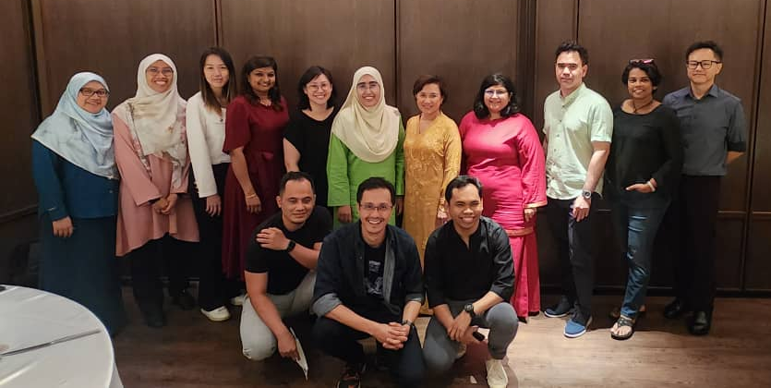
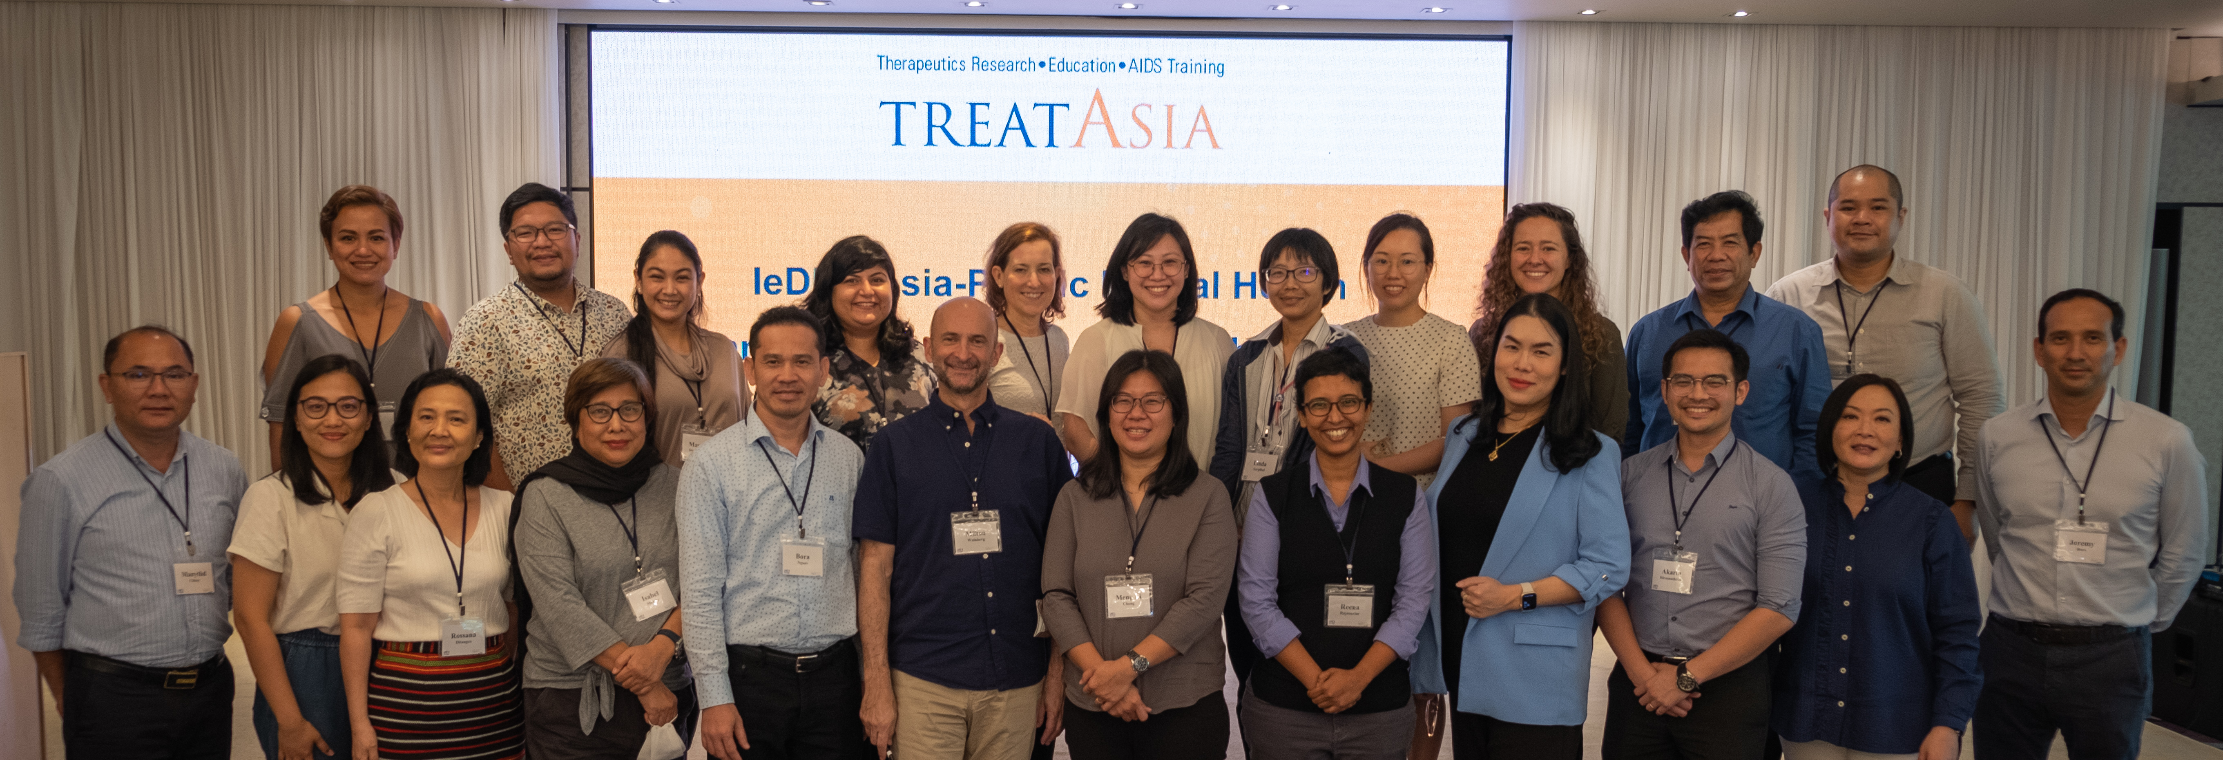
Acknowledgement
The participants of my study
NeuroHIV and AGING Working Group
Reena Rajasuriar
Hetta-Mari Gouse

Slide 24
THANK YOU
Questions?
wongpl@ummc.edu.my

