Slide 1
Improved clinical outcomes for clients on preferred differentiated ART in Uganda
Esther Nkolo
USAID Uganda

Slide 2
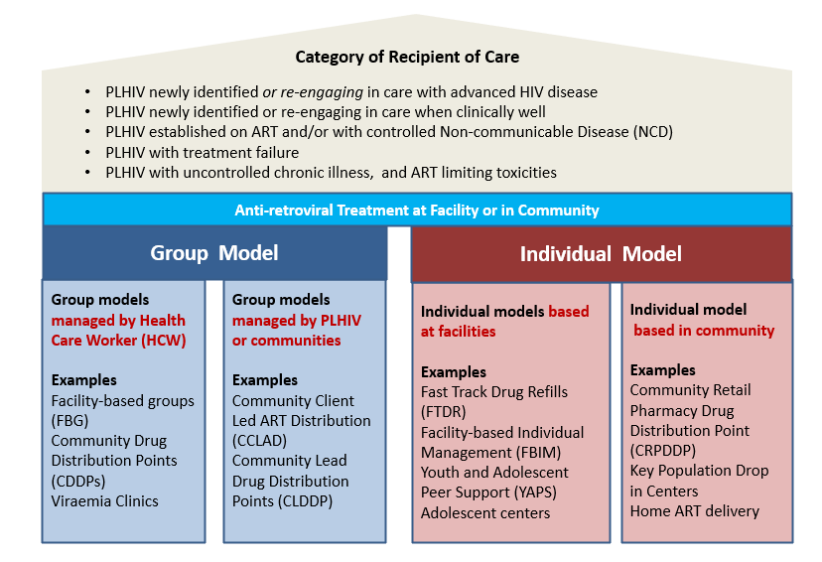
Uganda national HIV treatment guidelines provides for DSD models to advance person-centered care for improved HIV treatment outcomes
Revised 2022 national treatment guidelines has lifted restrictions for DSD eligibility from previous restrictions on age, WHO stage, and non-suppression.
Guidelines allow for ARV 3-6 months multi-month dispensing

Slide 3
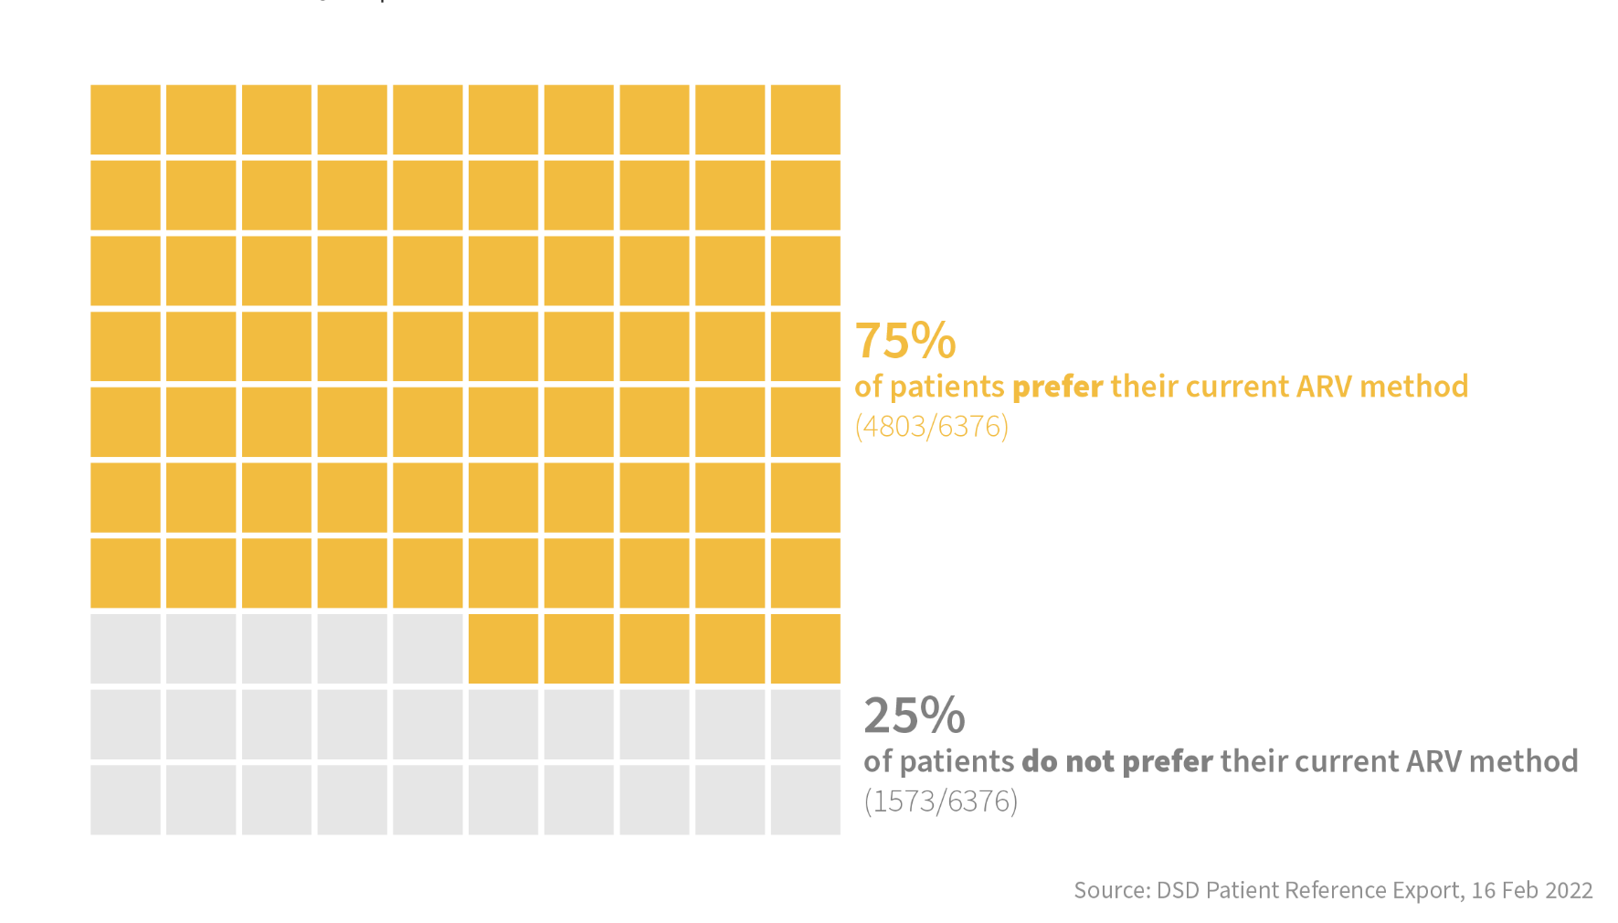
A client preference survey from 6,376 HIV positive individuals on treatment showed only 75% of participants were currently in their preferred model of ARV dispensing
Share of Participants Currently in Preferred DSD Model
Period of survey: January 2022
Sample size: 6,376
Age: from 1yr old to 50+
Sample sites: conducted in 113 sites in nine regions and included public and private not-for-profit health facilities (sites).

Slide 4
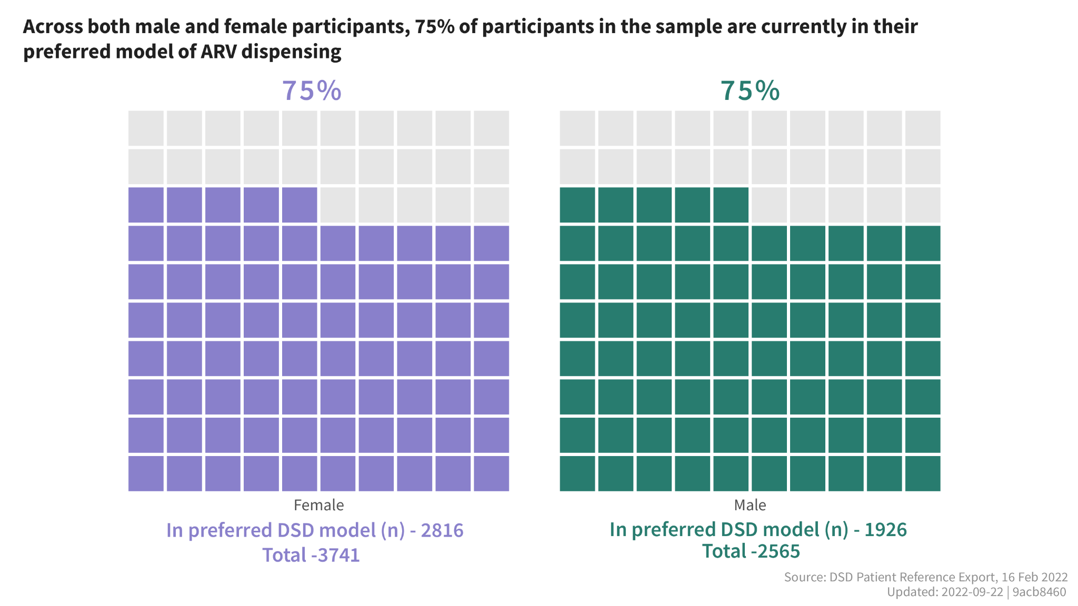

Slide 5
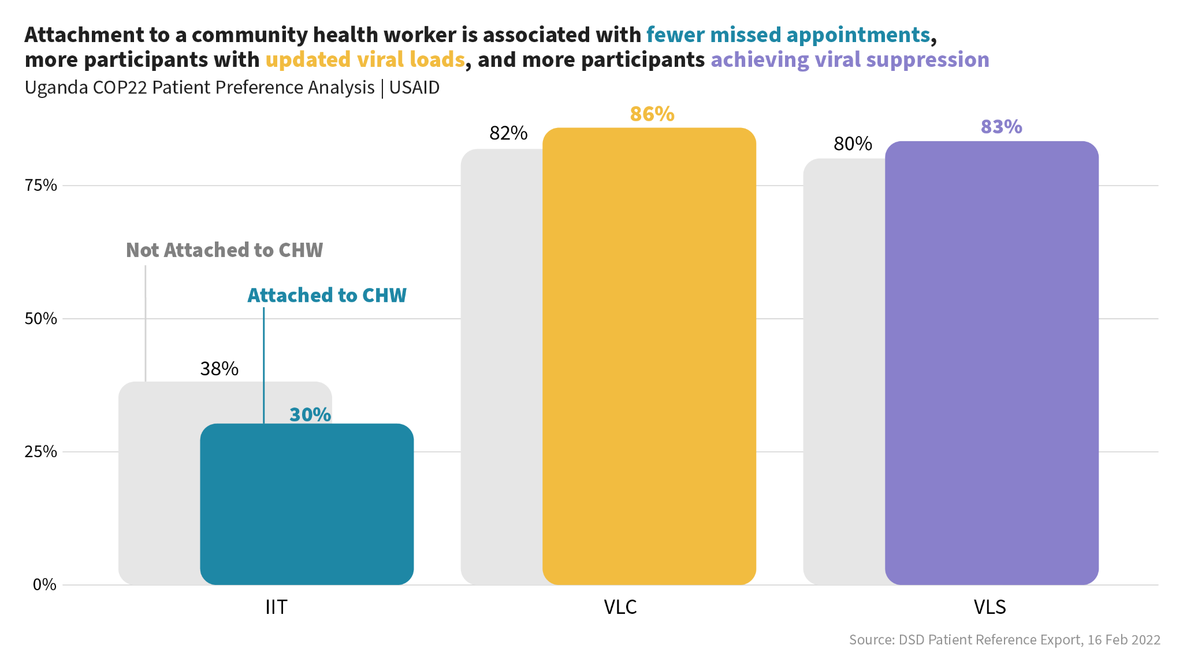
Attachment to a Community Health Worker or resource person is associated with improved treatment outcomes
Interruption in treatment (IIT)
Viral Load Coverage (VLC)
Viral Load Suppression (VLS)
Notes:
We also conducted a client preference feedback survey with 6,376 participants. Our findings showed that attachment to a community resource person or group is associated with fewer missed appointments, updated viral load and viral suppression.

Slide 6
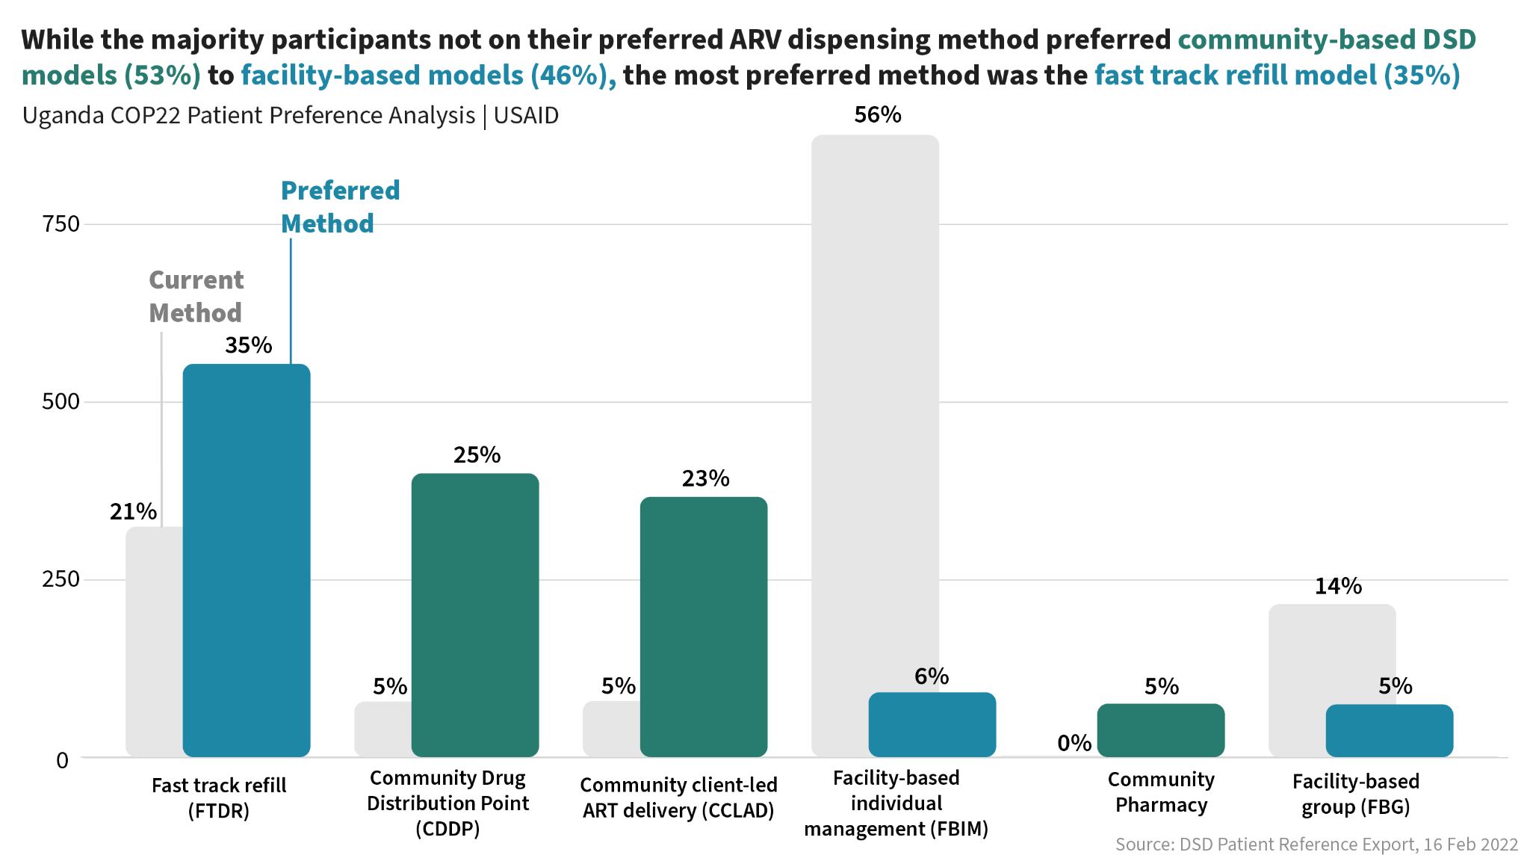
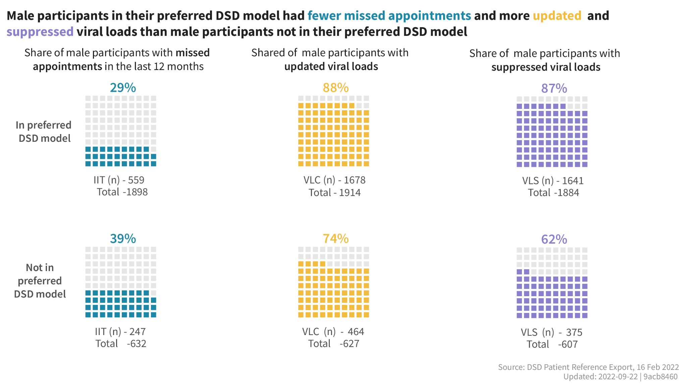
Notes:
75% of clients were on their preferred DSD/ARV distribution model. 53% of participants not on preferred DSD models preferred community-based DSD models to facility-based models (46%). Of the facility model, the fast track refill model and a health center pharmacy was the most preferred model.

Slide 7
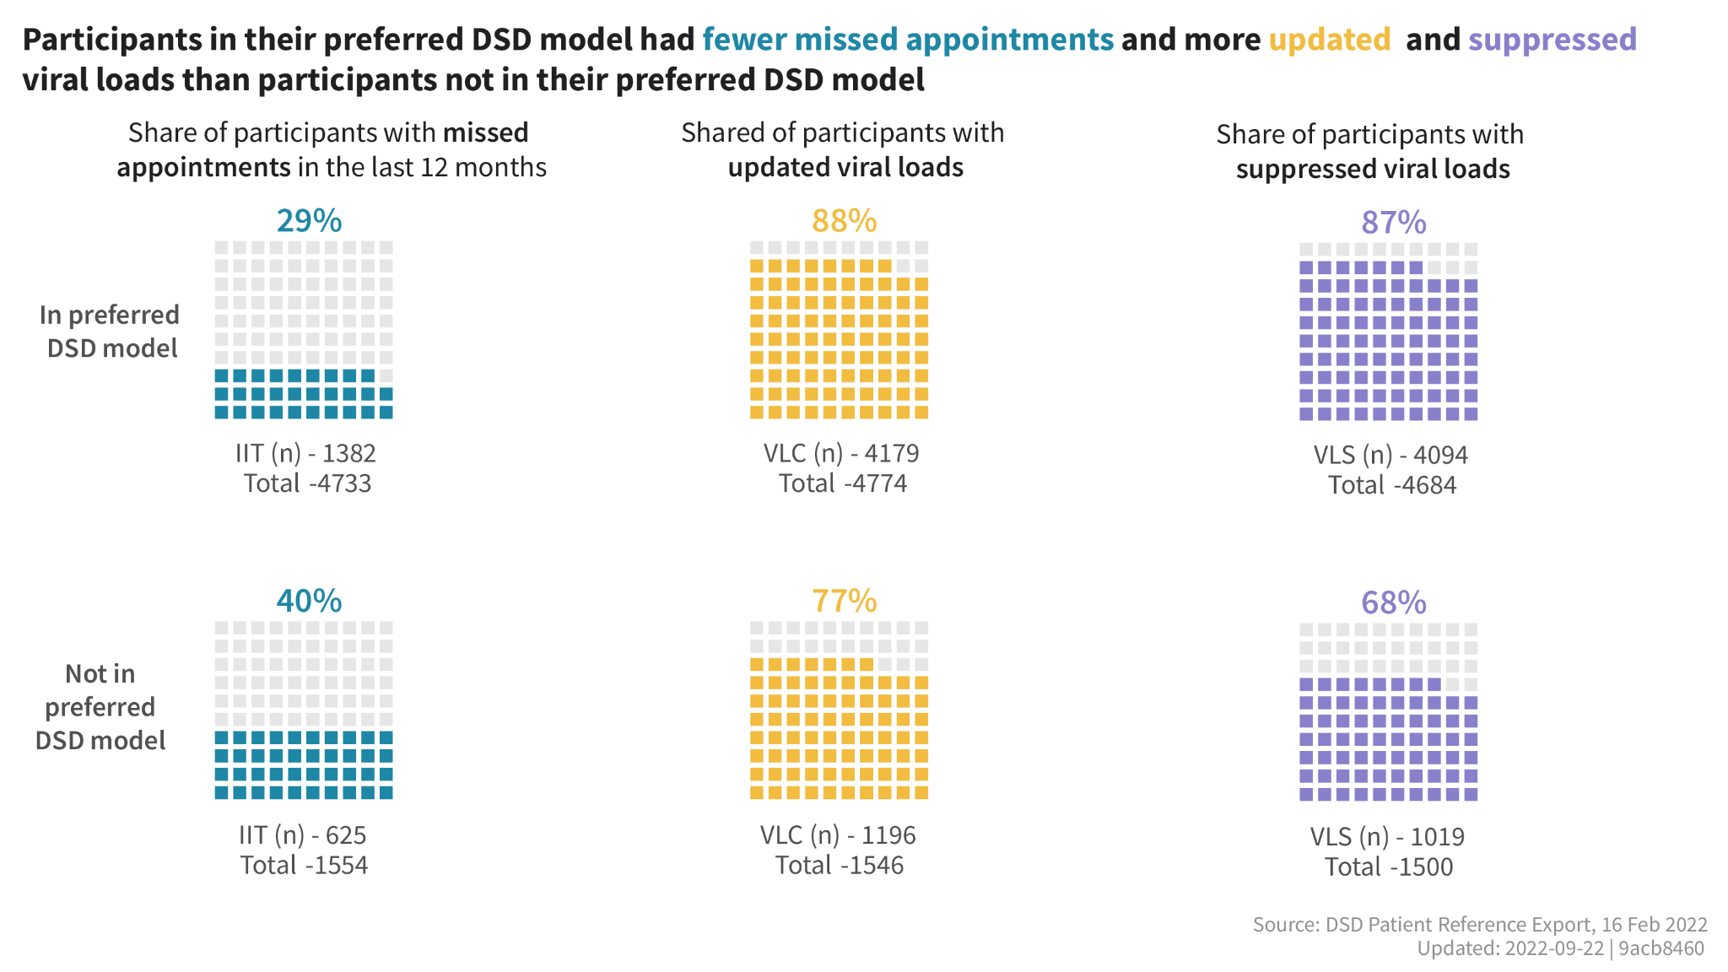

Slide 8
Notes:
Men in their preferred model had fewer missed appointments (29% missed appointments) and more updated viral loads (88%) and suppressed viral loads (87%). I am attaching this analysis for total across sex, as well as for male and female. Not too many systematic differences across the board here.

Slide 9
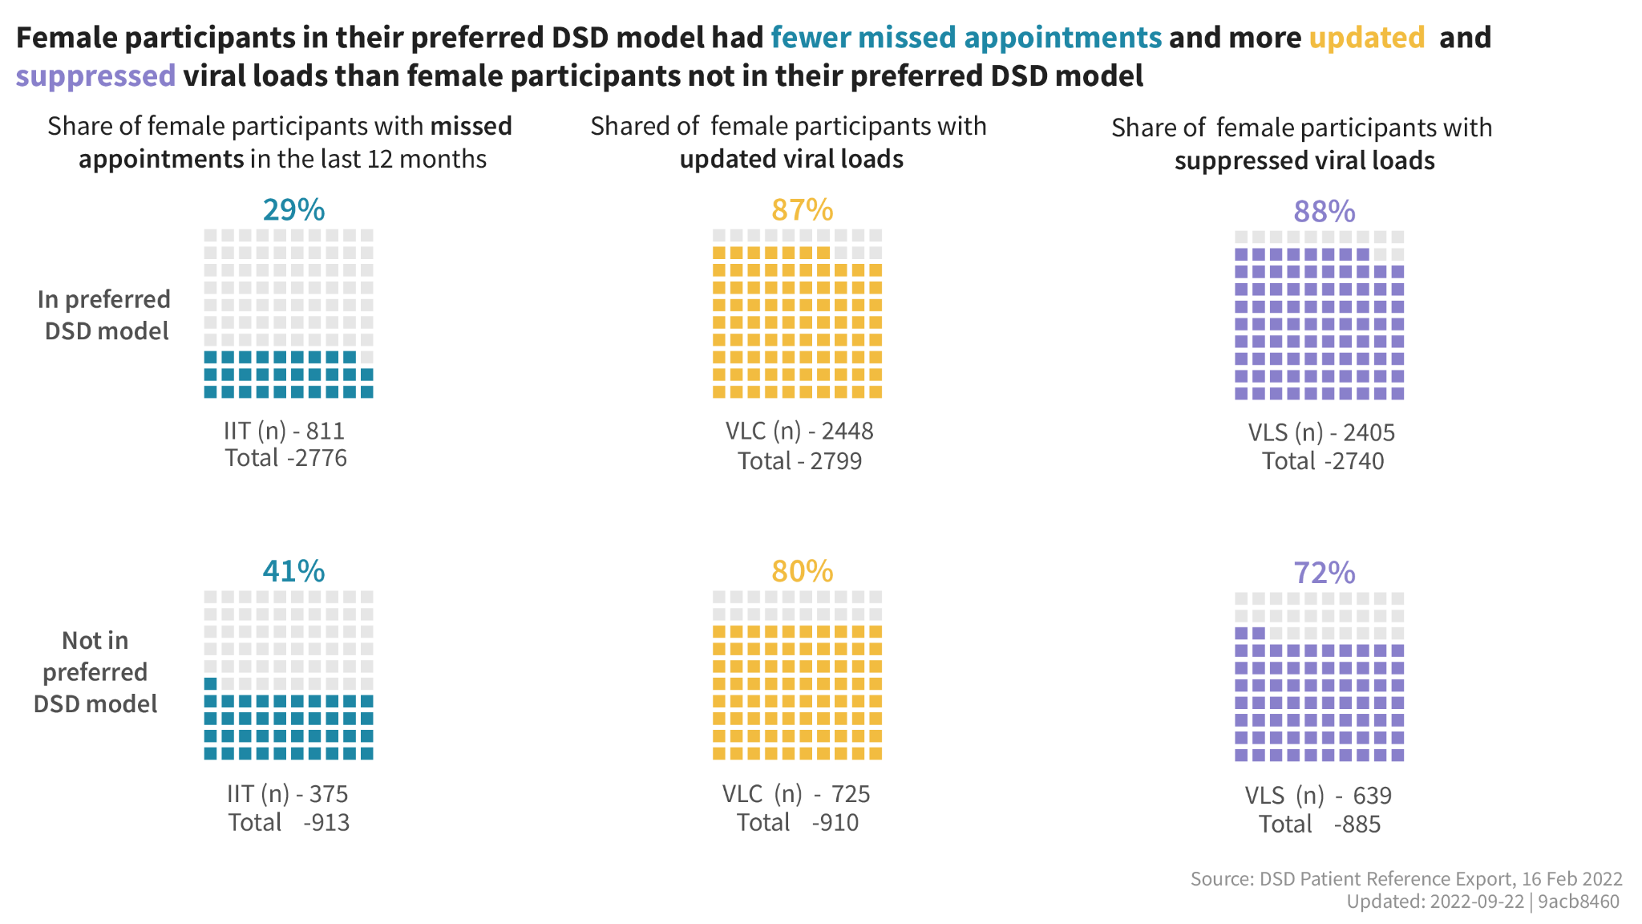
Notes:
Female participants in their preferred model had fewer missed appointments (29% missed appointments) and more updated viral loads (88%) and suppressed viral loads (88%).

Slide 10
Community models missed reported less appointments
Share of clients with missed appointments by current ARV dispensing model
Community models led by PLHIV or community engagement (drug distribution point identified by the community)

Slide 11
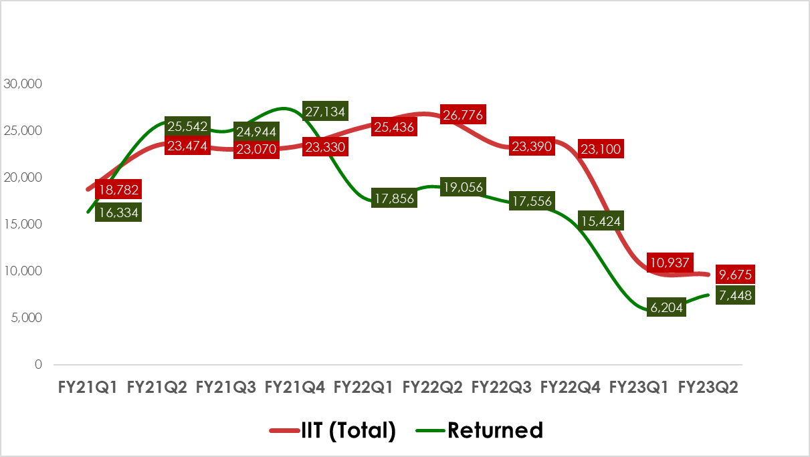
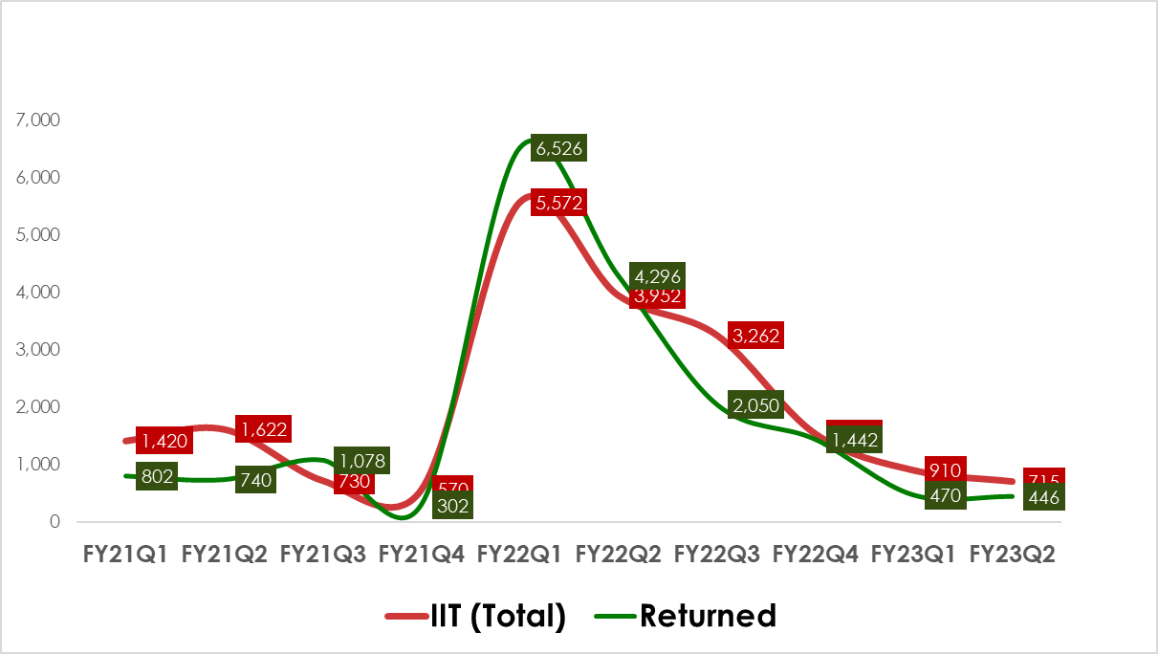
FY2023Q2: Interruption in Treatment (IIT) and Return to Treatment (RTT
Programs with high coverage of such priority strategies demonstrate positive performance trend
A substantial reduction in IIT and RTT. Starting to see an upward trend in RTT and reduction in IIT – need to sustain this trajectory
High coverage of priority strategies resulting in sustained improvements in IIT and RTT.

Slide 12
SERVICE COVERAGE GAPS ACROSS REGIONS FOR CALHIV FROM JANUARY PATIENT AUDIT TOOL
Comparing January (and November) audit tools, biggest gaps have improved: VL bleeding is 49% (from 27%), community contact is 69% (from 43%), Index testing of sexual partners is 25% (from 19%), IAC is 86% (from 72%)
 | All USAID | G2G Gulu | G2G Jinja | G2G Kabale | G2G Lira | G2G Mbale | G2G Mbarara | G2G Moroto | Mbale Region | Jinja Region | Moroto Region | Kabale Region | Lira Region | Gulu Region | Mbarara Region | UPMB LSDA
VLC | 75% | 61% | 91% | 75% | 73% | 40% | 84% | 79% | 64% | 78% | 75% | 79% | 85% | 86% | 62% | 73%
VL bleeding | 49% | 34% | 38% | 26% | 37% | 0% | 15% | 82% | 25% | 48% | 38% | 55% | 34% | 47% | 28% | 94%
TPT | 95% | 99% | 96% | 91% | 94% | 99% | 100% | 93% | 93% | 94% | 96% | 95% | 98% | 96% | 93% | 96%
TB screening | 100% | 100% | 98% | 100% | 100% | 100% | 100% | 100% | 100% | 100% | 100% | 100% | 100% | 100% | 80% | 100%
OVC screening | 97% | 100% | 97% | 99% | 99% | 100% | 100% | 100% | 96% | 99% | 100% | 99% | 99% | 98% | 84% | 100%
OVC enrolment | 94% | 100% | 100% | 100% | 100% | 100% | ND | ND | 100% | 100% | 100% | 100% | 100% | 100% | 72% | 100%
MMD ≥ 3months | 77% | 76% | 60% | 94% | 76% | 91% | 89% | 84% | 81% | 67% | 88% | 85% | 65% | 64% | 77% | 84%
ICT- Sexual Partners | 25% | 24% | 67% | 0% | 8% | 0% | 0% | 3% | 24% | 74% | 60% | 14% | 34% | 8% | 74% | 66%
ICT- Children | 95% | 100% | 84% | 56% | 87% | 100% | 100% | 76% | 88% | 96% | 88% | 95% | 99% | 97% | 89% | 96%
IAC | 86% | 85% | 100% | 0% | 80% | 98% | 100% | 100% | 82% | 93% | 80% | 87% | 88% | 82% | 74% | 95%
DTG | 98% | 99% | 98% | 98% | 97% | 96% | 95% | 100% | 98% | 98% | 99% | 98% | 98% | 97% | 99% | 99%
Community contact | 69% | 59% | 74% | 90% | 60% | 92% | 85% | 0% | 94% | 63% | 67% | 56% | 53% | 44% | 64% | 86%
CHW attachment | 98% | 100% | 100% | 7% | 98% | 100% | 100% | 100% | 100% | 99% | 100% | 94% | 99% | 100% | 100% | 98%
Appt keeping | 93% | 66% | 95% | 98% | 92% | 97% | 100% | 91% | 98% | 95% | 96% | 96% | 91% | 87% | 89% | 98%
Client Audit Analysis
Notes:
With the same data we are able to determine the service coverage gaps for children and adolescents across all our regions.
While the program data uses a proxy indicator for viral load coverage - measuring against TX_CURR two quarters prior, the audit tool gives us the actual gap in our VL coverage. We have determined that the contributing factors for low viral load coverage are either due to delays in getting samples from eligible children because of over representation by caregivers, limited community bleeding and other contextual issues.
We also see suboptimal testing of sexual partners of adolescents and low contact/follow-up of the children despite high community attachment - this is where every child is attached to either OVC support or community resource person or group. We are prioritizing and addressing these gaps as part of our AP3 implementation approach, and have started seeing improvements when we compare November and January audit tools.
In addition to the service gaps identified, we also found that in May 2022 CPHL transitioned to a new Abbott platform called Alinity which is more sensitive with low detection levels. We have seen a significant increase in the low level viremia since the introduction of Alinity. The contribution of this change on suppression levels is not clear/confirmed. However, as of December 2022, CPHL stopped using Alinity for DBS samples pending further guidance from Abbott. We will continue to monitor the audit tools to understand if this has an impact on VL suppression rates.

Slide 13
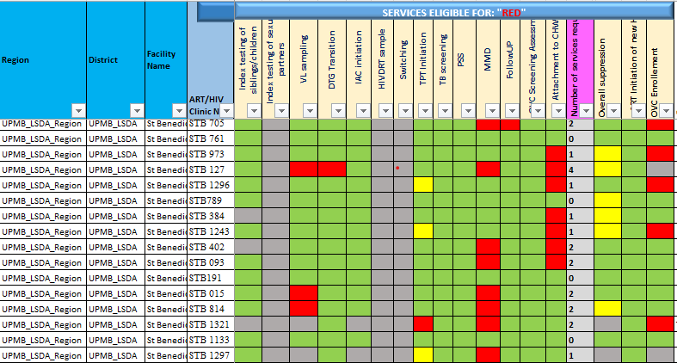
We are able to identify and respond to pediatric service gaps at district, site, and individual level
Screenshot of the audit tool at a facility level
Client Audit Tool
Notes:
This is a screenshot of what the tool looks like at a site level. It is used largely for micro planning at a facility level where health workers are able to differentiate risk, reaching higher risk individuals more frequently with the services they need. For instance, client STB 127 (on the fourth row) would be prioritized for intensive support and follow-up - the client is missing a VL test, not transition to DTG, not on MMD and not attached to a CHW or enrolled in OVC program - the result is suboptimal viral suppression.
In summary, the audit tool is used for micro planning at a facility level where multi-disciplinary teams respond to differentiated risk at individual level, assess service gaps at all levels down to individual level, guide on how to optimize resources at clinic level, and once consolidated at the district level, we are able to identify and rapidly respond to service gaps addressing structural barriers that may be outside the manageable capacity of a health facility. It is rolled up to program level to inform national responses and for partner management.

Slide 14
THANK YOU!

