Slide 1
Detailed modelling of viremia exposure does not independently predict cardiovascular diseases in people with HIV
Elvstam O (Lund University, Sweden), Ryom L, Neesgaard B, Tau L, Günthard H, Zangerle R, Vehreschild JJ, Wit F, Sönnerborg A, Abutidze A, Pethoumenos K, Jaschinski N, Hosein S, Bogner J, Grabmeister-Pfistershammer K, Garges H, Rooney J, Young L, Law M, Kirk O, for the RESPOND Study Group
Co-morbidities: The heart of the matter

Slide 2
Disclosures
Gilead Sciences: Honoraria as speaker
The potential effects have been mitigated.

Slide 3
Summary
What is your main question?
Does consideration of HIV viremia improve prediction of cardiovascular diseases (CVD) among people with HIV?
What did you find?
Neither current, pre-antiretroviral therapy (ART), peak during ART, nor cumulative viremia had statistically significant associations with CVD when adjusting for other risk factors.
None of the viremia measures improved predictive capacity.
Why is it important?
Viremia has been associated with incident CVD in previous observational studies. Our study, which could adjust for a wide range of relevant CVD factors, indicates that HIV viremia is not an independent CVD risk factor.
Notes:
Note to the author:
Oral abstract presenters are required to start their presentation with a summary slide answering the following questions:
What is your main question?
What did you find?
Why is it important?

Slide 4
Cardiovascular prevention is an important part of HIV care
People with HIV have around double the risk of CVD, compared with people without HIV.
Shah et al. Circulation 2018;138:1100-1112.
Age-standardized incidence of CVD has decreased rapidly the last 20 years.
The total burden of CVD among HIV is increasing (as the average age of people with HIV increases).
Guidelines recommend estimation of CVD risk to guide preventive interventions.
Observational studies indicate association between HIV viremia and CVD – but many studies could not adjust for relevant CVD risk factors.

Slide 5
Aim
Association between viremia variables and CVD when adjusting for established risk factors
Prediction of CVD with and without viremia variables

Slide 6
Methods
Viremia classification
1. Most recent viral load (VL)
2. Pre-ART VL
3. Peak viremia category during ART
 | Suppression ≤200 c/mL
 | Low-level viremia 201–999 c/mL
 | Non-supression ≥1000 c/mL
Cumulative viremia (viremia-copy-years)
 | 4. Including all available VLs
 | 5. During ART (>12 months after start of ART)
 | 6. Recent (sliding 3-year window)
Study design
RESPOND consortium – 19 cohorts across Europe and Australia
>18 years
Data from 2012–2021
Outcome: CVD (myocardial infarction, stroke, invasive cardiovascular procedures)
Variables in the D:A:D CVD risk score: age, gender, smoking, family history, diabetes, cumulative PI and NRTI, recent abacavir, CD4 count, blood pressure, cholesterol, high-density lipoprotein (HDL)

Slide 7
Study population
Characteristics of study participants (n=17,479)
Sex/gender
 | Male | 13,265 (76%)
 | Female | 4,232 (24%)
Age [median (IQR) years] |  | 45 (37,52)
Ethnicity
 | White | 13,297 (76%)
 | Black | 1,489 (9%)
 | Other | 894 (5%)
 | Unknown or missing | 1,817 (10%)

Slide 8
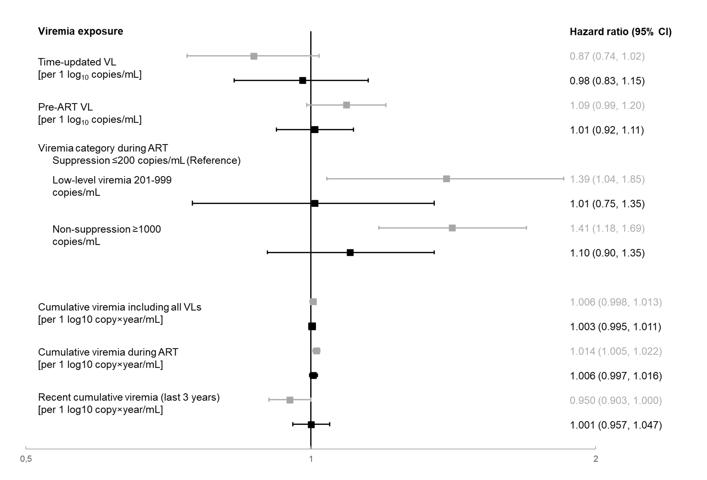
Associations between viremia variables and CVD
109,381 person-years; 547 events of CVD
Variables related to viremia exposure during ART had statistically significant associations in univariable analyses.
No viremia variable had statistically significant association when adjusting for established risk factors.

Slide 9
No statistically significant association when adjusting for CVD risk factors
 |  | Model 1 Unadjusted | Model 2 Adjusted for age, gender, CD4 count | Model 4 (Adjusted for all D:A:D variables) Further adjusted for smoking, blood pressure, cholesterol, HDL, family history, abacavir, PI, NRTI | Model 5 Extended model further adjusted for CKD, BMI, risk group, ethnicity, INSTI
Time-updated VLª |  | 0.87 (0.74, 1.02) | 0.98 (0.83, 1.16) | 0.98 (0.83, 1.15) | 0.98 (0.83, 1.16)
Pre-ART VLª |  | 1.09 (0.99, 1.20) | 1.01 (0.93, 1.11) | 1.01 (0.92, 1.11) | 1.01 (0.92, 1.10)
Viremia category during ART
 | Low-level viremia 201-999 copies/mL | 1.39 (1.04, 1.85) | 1.08 (0.81, 1.43) | 1.01 (0.75, 1.35) | 1.01 (0.75, 1.35)
 | Non-suppression ≥1000 copies/mL | 1.41 (1.18, 1.69) | 1.18 (0.98, 1.41) | 1.10 (0.90, 1.35) | 1.10 (0.90, 1.35)
Cumulative viremia including all VLs^{b} |  | 1.006 (0.998, 1.013) | 1.006 (0.998, 1.013) | 1.003 (0.995, 1.011) | 1.003 (0.995, 1.011)
Cumulative viremia during ART^{b} |  | 1.014 (1.005, 1.022) | 1.010 (1.001, 1.019) | 1.006 (0.997, 1.016) | 1.006 (0.997, 1.016)
Recent cumulative viremia^{b} |  | 0.950 (0.903, 1.000) | 1.005 (0.962, 1.051) | 1.001 (0.957, 1.047) | 1.000 (0.956, 1.047)
Data are hazard ratio (95% CI). ªper 1 log₁₀ copies/mL. ^{b}per 1 log₁₀ copy×year/mL.

Slide 10
Viremia does not improve CVD prediction
 | Calibration (mean predicted 5-year risk) | Discriminiation (Harrell’s C)
Kaplan-Meier estimate of 5-year CVD risk (95% CI) | 2.44% (2.20%, 2.71%)
D:A:D model | 2.34% | 0.75
D:A:D model + time-updated VL | 2.34% | 0.75
D:A:D model + pre-ART VL | 2.20% | 0.75
D:A:D model + peak viremia category | 2.35% | 0.75
D:A:D model + cumulative, all VLs | 2.34% | 0.75
D:A:D model + cumulative, during ART | 2.35% | 0.75
D:A:D model + cumulative, recent | 2.32% | 0.75

Slide 11
Sensitivity analyses
Our conclusions remained the same in the following sensitivity analyses:
Considering the three components of the composite CVD endpoint separately.
Also including people with a known prior CVD.
Excluding the variable “Family history”.
Using 50 c/mL as the threshold for suppression.
Modelling with restricted cubic splines to allow for non-linear relationships between viremia and CVD.

Slide 12
Limitations and strengths
Limitations
Strengths
Limited median follow-up (5-year risk)
HIV viremia before diagnosis is unknown
Generalizability (high CD4 counts, high degree of viral suppression, relatively few non-white people with HIV, Europe/Australia)
Excluded 51% of the cohort (and excluded individuals had higher CVD risk)
Main reason (35%), cohort with low reporting of CVD events or risk factors
Lack data on e.g. recreational drug use
Large cohort
Rigorously validated endpoints
Rich data on CVD risk factors

Slide 13
Conclusions
Exposure to HIV viremia was not associated with higher CVD risk.
Consideration of viremia history did not improve CVD prediction.
Viral suppression undoubtedly remains an important goal – though not associated with CVD.
Underscores complex pathogenesis of CVD among people with HIV.

