Slide 1
Dolutegravir-containing antiretroviral therapy and incident hypertension: Findings from a prospective cohort in Kenya, Nigeria, Tanzania, and Uganda
Matthew L. Romo,^{1,2} Seth Frndak, Nicole Dear, Hannah Kibuuka, John Owuoth, Valentine Sing’oei, Jonah Maswai, Emmanuel Bahemana, Victor Anyebe, Zahra Parker, J. Sean Cavanaugh, Neha Shah, Julie A. Ake, Trevor A. Crowell; on behalf of the African Cohort Study (AFRICOS) group ¹U.S. Military HIV Research Program, CIDR, Walter Reed Army Institute of Research, Silver Spring, MD ²Henry M. Jackson Foundation for the Advancement of Military Medicine, Inc., Bethesda, MD 26 July 2024
Material has been reviewed by the Walter Reed Army Institute of Research. There is no objection to its presentation and/or publication. The opinions or assertions contained herein are the private views of the author, and are not to be construed as official, or as reflecting true views of the Department of the Army or the Department of Defense. The investigators have adhered to the policies for protection of human participants as prescribed in AR 70–25.

Slide 2
Conflicts of Interest Disclosure
I have no relevant financial relationships with ineligible companies to disclose.

Slide 3
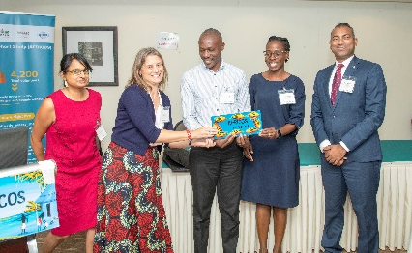
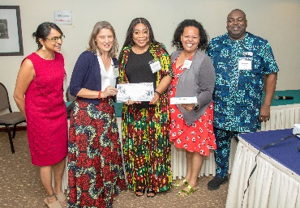
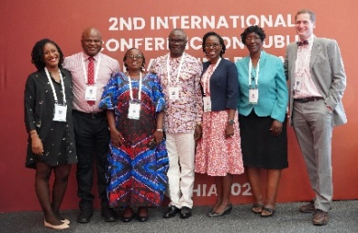
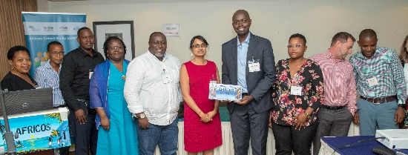
How do we make this all happen?
AFRICOS Uganda
Hannah Kibuuka
Betty Mwesigwa
Michael Semwogerere
AFRICOS Kenya
South Rift Valley:
Raphael Langat
Rither Langat
Jonah Maswai
Fred Sawe
Kisumu West:
Solomon Otieno
John Owuoth
Winnie Rehema
Valentine Singoei
AFRICOS Tanzania
Emmanuel Bahemana
Reginald Gervas
Lucas Maganga
John Ngejite
Mkunde Chachage
AFRICOS Nigeria
Yakubu Adamu
Victor Anyebe
Chiamaka Ibeanu
Tunde Adegbite
Uzoamaka Agbaim
Mfreke Asuquo
Nkechinyere Harrison
Abdulwasiu Tiamiyu
MHRP
MHRP Leadership:
Julie Ake
Sandhya Vasan
Clinical Research Directorate:
Paul Adjei
Brennan Cebula
Trevor Crowell
Emma Duff
Leigh Anne Eller
Jaclyn Hern
Michelle Imbach
Kara Lombardi
Jacob Patterson
Badryah Omar
Ajay Parikh
Zahra Parker
Matthew Romo
Linsey Scheibler
Michael Thigpen
DCAC:
Danielle Bartolanzo
Jillian Chambers
Nicole Dear
Seth Frndak
Natalie Burns
Alexus Reynolds
Department of International
HIV Prevention and Treatment:
Patricia Agaba
Kim Bohince
Sean Cavanaugh
Priyanka Desai
Rosemary Mrina
Mary Schmitz
Neha Shah
HDRL:
Joanna Freeman
Jennifer Malia
Sheila Peel
Study Participants

Slide 4
Summary slide
What is your main question?
Was DTG use associated with incident hypertension?
What did you find?
In a prospective observational cohort in 4 African countries, we did not find evidence to support that DTG use was positively associated with incident hypertension.
Why is it important?
There is a high burden of hypertension among PWH, most of whom are now on DTG-containing ART regimens.
ART, antiretroviral therapy; DTG, dolutegravir; PWH, people with HIV.

Slide 5
Introduction
Global HIV treatment has transitioned to DTG-containing ART
Context of increasing burden of non-communicable diseases among PWH, including hypertension¹
DTG associated with excess hypertension risk compared with EFV in randomized trials²
Objective: To examine the association between DTG and incident hypertension in a real-world setting in four African countries
ART, antiretroviral therapy; DTG, dolutegravir; EFV, efavirenz; PWH, people with HIV. 1. Romo ML, et al. Conference on Retroviruses and Opportunistic Infections (CROI), Denver, Colorado, abstract 791, 2024; 2. Venter WF, et al. 12th International AIDS Society Conference on HIV Science (IAS 2023), Brisbane, Australia, abstract OALBB0504, 2023.

Slide 6
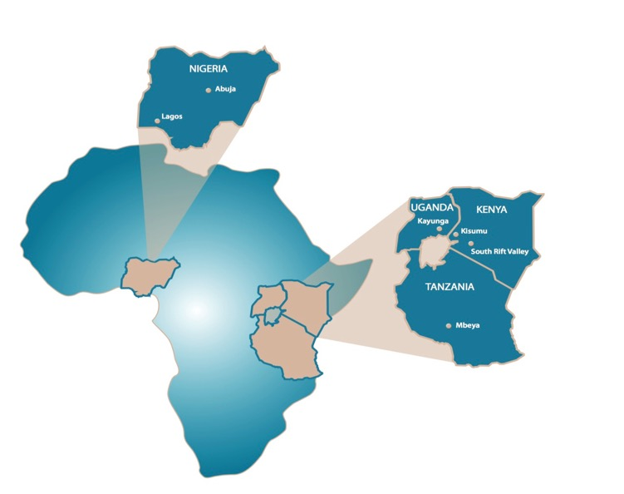
Methods: Sample
The African Cohort Study (AFRICOS) enrolls PWH and PWoH at 12 PEPFAR-supported facilities in Kenya, Nigeria, Tanzania, and Uganda with follow-up every 6 months after the enrollment visit
Sample: PWH on ART and PWoH with more than 2 study visits, with observation time starting after confirming no hypertension
Excluded participants with prevalent hypertension, PWoH who seroconverted; study visits with pregnancy
Enrollment visit
Follow-up visit 1
Follow-up visit 2
Follow-up visit n
Ascertain prevalent hypertension
Start follow-up if PWH on ART or PWoH
ART, antiretroviral therapy; PEPFAR, U.S. President's Emergency Plan for AIDS Relief; PWH, people with HIV; PWoH, people without HIV.

Slide 7
Methods: Definitions
Outcome definition: Incident hypertension defined as persistently elevated SBP ≥140 mmHg and/or DBP ≥90 mmHg at two or more consecutive 6-monthly visits, or receipt of any blood pressure lowering medication
Exposure definition: time-varying ART anchor drug (DTG, EFV, NVP, PI/r)* or PWoH
*Combined with two NRTIs, most commonly lamivudine (3TC) with tenofovir disoproxil fumarate (TDF) or zidovudine (ZDV). Tenofovir alafenamide (TAF) was not used.
ART, antiretroviral therapy; DBP, diastolic blood pressure; DTG, dolutegravir; EFV, efavirenz; NVP, nevirapine; PI/r, ritonavir-boosted protease inhibitor; PWH, people with HIV; PWoH, people without HIV; SBP, systolic blood pressure.

Slide 8
Methods: Analysis
Cox proportional hazards models to examine associations between ART anchor drug or PWoH and incident hypertension
Unadjusted model
Model adjusted for sociodemographic characteristics (age at enrollment, sex, study site, education level, and formal-sector employment status)
Model adjusted for sociodemographic characteristics and time-varying BMI
Model adjusted for sociodemographic characteristics, CD4 count nadir, and duration on ART (among PWH only)
ART, antiretroviral therapy; BMI, body mass index; PWH, people with HIV; PWoH, people without HIV.

Slide 9
Results: Sample Characteristics
Between 01/2013–03/2024, 4136 participants were enrolled in the cohort
3250 participants were included in these analyses
 | n (Column %) or mean (SD)
Total | 3250 (100%)
HIV status
People with HIV | 2705 (84.4%)
People without HIV | 545 (16.8%)
Sex
Male | 1370 (42.2%)
Female | 1880 (57.8%)
Age at enrollment in years | 36 (12)
Study site
Kayunga, Uganda | 575 (17.7%)
South Rift Valley, Kenya | 1142 (35.1%)
Kisumu, Kenya | 641 (19.7%)
Mbeya, Tanzania | 555 (17.1%)
Abuja & Lagos, Nigeria | 337 (10.4%)
SD, standard deviation.

Slide 10
Results: Incident Hypertension and ART Anchor Drug Use
427 (13.1%) participants had the outcome of incident hypertension during follow-up
 | n (Column %) | Median (IQR) years of follow-up
PWH: Ever ART anchor exposure*
DTG | 1907 (70.5%) | 3.4 (2.2-4.0)
EFV | 1737 (64.2%) | 4.2 (3.0-5.5)
NVP | 615 (22.7%) | 4.5 (3.5-5.4)
PI/r | 310 (11.5%) | 6.0 (3.7-7.9)
PWoH | 545 (100%) | 7.5 (5.2-8.7)
*PWH can contribute to multiple anchor drug categories. ART, antiretroviral therapy; DTG, dolutegravir; EFV, efavirenz; IQR, interquartile range; NVP, nevirapine; PI/r, ritonavir-boosted protease inhibitor; PWH, people with HIV; PWoH, people without HIV.

Slide 11
Results: Associations of Time-Varying ART Anchor or PWoH with Incident Hypertension
Model among PWH adjusted for sociodemographic characteristics + CD4 nadir + ART duration
Model adjusted for sociodemographic characteristics + time-varying BMI
Model adjusted for sociodemographic characteristics
Unadjusted model
DTG use was not significantly associated with increased hazards of hypertension compared with EFV, NVP, PI/r, and PWoH
ART, antiretroviral therapy; BMI, body mass index; CI, confidence interval; DTG, dolutegravir; EFV, efavirenz; HR, hazard ratio; PI/r, ritonavir-boosted protease inhibitor; PWH, people with HIV; PWoH, people without HIV.

Slide 12
Strengths and Limitations
Strength
Cohort follow-up included blood pressure measured every 6 months for all participants
Outcome not differentially assessed by exposure group
Limitations
Possible unmeasured confounding
Possible misclassification of hypertension, as some blood pressure-lowering medications have other indications

Slide 13
Conclusions
DTG was not positively associated with incident hypertension compared with EFV, NVP, PI/r, and with PWoH
Contrasts with other data comparing with EFV,¹⁻³ but may better reflect programmatic transition to DTG
DTG was associated with significantly lower hazards of hypertension compared with NVP
Many PWH in LMICs transitioned to DTG from NVP-containing regimens⁴
Recommendations:
Routine blood pressure monitoring for all PWH
Determine best models of care to provide long-term hypertension care to PWH
ART, antiretroviral therapy; DTG, dolutegravir; EFV, efavirenz; IQR, interquartile range; LMIC, low- and middle-income country; NVP, nevirapine; PI/r, ritonavir-boosted protease inhibitor; PWH, people with HIV; PWoH, people without HIV. 1. Venter WF, et al. 12th International AIDS Society Conference on HIV Science (IAS 2023), Brisbane, Australia, abstract OALBB0504, 2023; 2. Brennan AT, et al. EClinicalMedicine. 2023;57:101836.; 3. Shamu T, et al. J Int AIDS Soc. 2024;27(2):e26216.; 4. Romo ML, et al. Ann Intern Med. 2022 Jan;175(1):84-94.
Notes:
=

Slide 14
Thank you!
Presenter contact information: mromo@hivresearch.org
AFRICOS website: https://www.hivresearch.org/african-cohort-study-africos
Other presentations from the AFRICOS at AIDS 2024:
Title | Presenter | Session Details
High-risk human papillomavirus persistence and incidence among women living with HIV in the African Cohort Study (WEPEA035) | Mkunde Chachage | Date: Wednesday, 24 July Time: 12:00-13:00 Location: Poster exhibition area
Neurocognitive Trajectories Among a Young Adult Cohort from Four African Countries: Associations with HIV and Food Insecurity (OAB2103) | Seth Frndak | Session: Young people age too! Date: Thursday, 25 July Time: 10:30-11:30 Location: Room 14b/Channel 3

Slide 15
Back-up slide (not for presentation)

