Slide 1
Integrating Non-Communicable Disease Screening and Treatment in Antiretroviral Clinics: Insights from Malawi
Shalom Kawonga Dunga
Elizabeth Glaser Pediatric AIDS Foundation

Slide 2
Introduction: ART Cohort in Malawi
Increased access to ART has improved the life expectancy of people living with HIV (PLHIV)
As PLHIV age, they are at high risk of developing non-communicable diseases such as hypertension (HTN) and diabetes mellitus (DM)
Integrating NCD care within ART clinics is important for comprehensive healthcare of an aging PLHIV population
81% > 30 years
57% > 40 years
30% > 50 years
Data Source: Malawi Analytics Platform

Slide 3
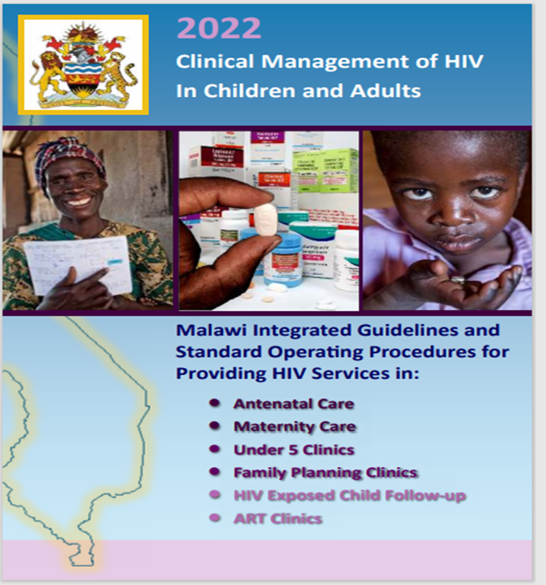
MoH Guidance on NCD integration in Malawi
Integration of NCD Management and ART
Integrate HIV and NCD education in ART clinic health talks
Integrate NCD screening and management in ART services whenever possible
Refer NCD patients for end organ damage investigation.
Align ART and NCD clinic appointments if a full integration is not feasible
Annual hypertension screening for all adults aged 30 years and above
Annual diabetes screening for all adults aged 40 years and above using blood glucose measurement.

Slide 4
Operational Considerations for NCD Integration in Malawi
Human Resources
Non-Clinical Cadres
HIV Diagnostic Assistants (HDAs)
glucose testing
Treatment supporters
education on NCDs
blood pressure measurements
basic lifestyle modification counseling
Clinical Cadres
Clinicians and nurses
prescriptions
lifestyle counselling
follow-up and referral
Capacity Building
Clinical cadres trained on MoH guidelines
Site-level orientation for lay cadres including videos and practice
Infrastructure
Revisions to clinic flow needed
Screening and health education done in waiting area
Clinical management done in consultation room
some small sites refer individuals with NCDs to the outpatient department for clinical management
Drug dispensation for treatment of NCDs is done at the main pharmacy

Slide 5
Additional Operational Considerations for NCD Integration
NCD Commodities
Procured:
glucometers and Glucostix
automated blood pressure monitors
batteries for the equipment
Verified HTN and DM drugs availability
M & E systems
Incorporated NCD screening results on ART mastercard
Attached NCD mastercard to ART card for PLHIV with NCDs
Developed NCD register
Planning transition to an integrated EMR

Slide 6
Data Collection and Analysis
Routinely collected aggregate data for all PLHIV on ART at 46 EGPAF-supported facilities between March and September 2023 were included in the analysis
Eligibility for screening was defined as > 30 years of age for HTN and > 40 years of age for DM per MoH guidelines
HTN was defined as at least two blood pressure readings of > 140 systolic or diastolic of > 90 mmHg
DM was defined as a random blood sugar of ≥ 200 mg/dl or fasting
blood sugar of ≥ 163 mg/dl
We estimated the prevalence of HTN and DM disaggregated by age and sex
We used descriptive analysis and logistic regression based on two outcome variable (HTN & DM)

Slide 7
HTN and DM Screening Cascade Among Eligible PLHIV (Mar-Sept 2023)
22% of all eligible PLHIV were screened for HTN and 16% for DM
The prevalence of HTN was 3,815 (16%) and DM was 197 (2%)
Among those with HTN and DM, 85% and 65% respectively were first time diagnoses
HTN
80%

Slide 8
There was a higher prevalence of HTN in males and those > 60 years of age
The occurrence of HTN was higher in males than females (p=0.013)
Individuals aged >60 years of age were more likely to have HTN than those aged 40 – 60 years (OR=2.84)

Slide 9
There was no difference in DM prevalence by sex, however, DM was more common in those aged over 60 years
Individuals aged >60 years were more likely to have DM (OR=2.04) than those aged 40 – 60 years.

Slide 10
Hypertension and Diabetes Management
60%
Notes:
A high percentage diagnosed with HTN (>90%), and DM (>70%) were treated within the HIV clinic

Slide 11
Lessons Learned
Integrating NCD screening and management within HIV clinics led to the identification of a high number of PLHIV with HTN and DM
There is a need to improve access to screening for hypertension (HTN) and diabetes mellitus (DM) among aging people living with HIV (PLHIV).
additional tasks in ART clinics may require additional human resources for quality care
there is need for careful consideration for the type of equipment and power sources that will be required for testing (incl. batteries)
there is need to consider the clinic space and flow for efficient service delivery
integrated monitoring and evaluation (M&E) systems should be available, preferably digital
Using non-clinical providers in NCD screening can increase access to integrated NCD services by supplementing the clinical staff
There is need to explore models of integration that may include medication dispensation within the ART clinics

Slide 12
Acknowledgements
The work described in this presentation was supported by the U.S. President’s Emergency Plan for AIDS Relief (PEPFAR) through the Centers for Disease Control and Prevention (CDC) under the Cooperative Agreement NU2GGH002425. Its contents are solely the responsibility of the authors and do not necessarily represent the official views of CDC.
We also acknowledge the Ministry of Health with the leadership of Department of HIV and AIDS for technical support and guidance.
We also appreciate the support from the Ministry of Health and EGPAF district and facility staff.

