Slide 1
Abacavir is associated with Elevated Risk of Cardiovascular Events in the REPRIEVE Trial
Abstract OAB3406LB
Carl J. Fichtenbaum, Carlos D. Malvestutto, Maya G. Watanabe, Emma Davies Smith, Heather J. Ribaudo,
Sara McCallum, Kathleen V. Fitch, Judith S. Currier, Marissa Diggs, Judith A. Aberg, Michael T. Lu,
Javier Valencia, Cristina Gómez-Ayerbe, Indira Brar, Jose Valdez Madruga, Gerald S. Bloomfield,
Pamela S. Douglas, Steven K. Grinspoon, Markella V. Zanni, for REPRIEVE Investigators.

Slide 2
Background of REPRIEVE ART analysis
Antiretroviral therapy (ART) has been linked to the risk of cardiovascular disease (CVD).
Recent and cumulative use of abacavir has been associated with a risk of CVD events in observational studies.
The REPRIEVE trial may provide unique opportunity to investigate the role of ART in CVD.
CVD events were independently adjudicated (TIMI group).
Study population was not known to have prior CVD.
Global population was of low-to-moderate risk for CVD.
Contemporary ART regimens
The aim of this project was to evaluate the prior and current exposure to select antiretroviral agents at study entry and evaluate the risk of subsequent CVD events.

Slide 3
REPRIEVE Methods
REPRIEVE was a randomized, double-blind study that demonstrated a 36% reduction in major adverse cardiovascular events (MACE) in persons with HIV (PWH) assigned to pitavastatin compared to placebo¹⁻².
We enrolled PWH age 40-75 years, on stable ART for at least 180 days, with a CD4 count >100 c/mm³, who were at low-moderate risk of CVD.
The study enrolled between 2015-2019 with follow-up ending in July 2023.
It was conducted in more than 100 sites in 12 Countries.
Antiretroviral agents and regimens reflected the contemporary patterns of use.
¹N Engl J Med. 2023 Aug 24;389(8):687-699. doi: 10.1056/NEJMoa2304146
²N Engl J Med 390;17 nejm.org May 2, 2024. DOI: 10.1056/NEJMc2400870

Slide 4
Study Methods
ART history was collected at baseline, including exposure to select agents.
Abacavir, Tenofovir DF, Protease Inhibitors, and Thymidine analogs (AZT/d4T)
Analyses in the REPRIEVE ITT¹ population were performed for first MACE (including MI, TIA/stroke, revascularization, peripheral artery disease, and CV death).
Median duration of follow-up in REPRIEVE was 5.6 years.
Effects of ART exposure were estimated using Cox proportional hazards
Models were stratified by treatment group to account for treatment group differences.
Effect estimates are presented unadjusted and adjusted for entry risk factors previously shown to be associated with MACE in REPRIEVE.
¹Intent to Treat

Slide 5
Notes:
Baseline characteristics in the pitavastatin and placebo arm are very similar, therefore focus can be directed to the total column. In the trial population, 31% of participants had female natal sex and only 35% of participants were white making the trial population highly diverse. Of note, the majority of participants had suppressed viral load.
The median ASCVD risk for the trial participants was 4.5% which is very low predicted risk and LDL-C was only minimally increased at 108 mg/dL. This is not a typical population that would be recommended for statin therapy.
Figure footnote: ABC exposure includes participants with former and/or current ABC exposure.
Race was reported by participants. "Other" race includes participants who identified as native or indigenous to the enrollment region, as having more than one race, or as having an unknown race.
The 10-Year Atherosclerotic Cardiovascular Disease risk score is calculated by assessing age, sex, race, systolic blood pressure, total and high-density lipoprotein cholesterol, treatment for hypertension, smoking history, and presence of diabetes. It is measured on a scale of low risk (<5%), borderline risk (5 to <7.5%), intermediate risk (7.5 to <20%), and high risk (≥20%)
Created by: /home/reprieve/POOLED/final/MACE_artexp/programs/manuscript/bslchar.sas on July 2, 2024

Slide 6
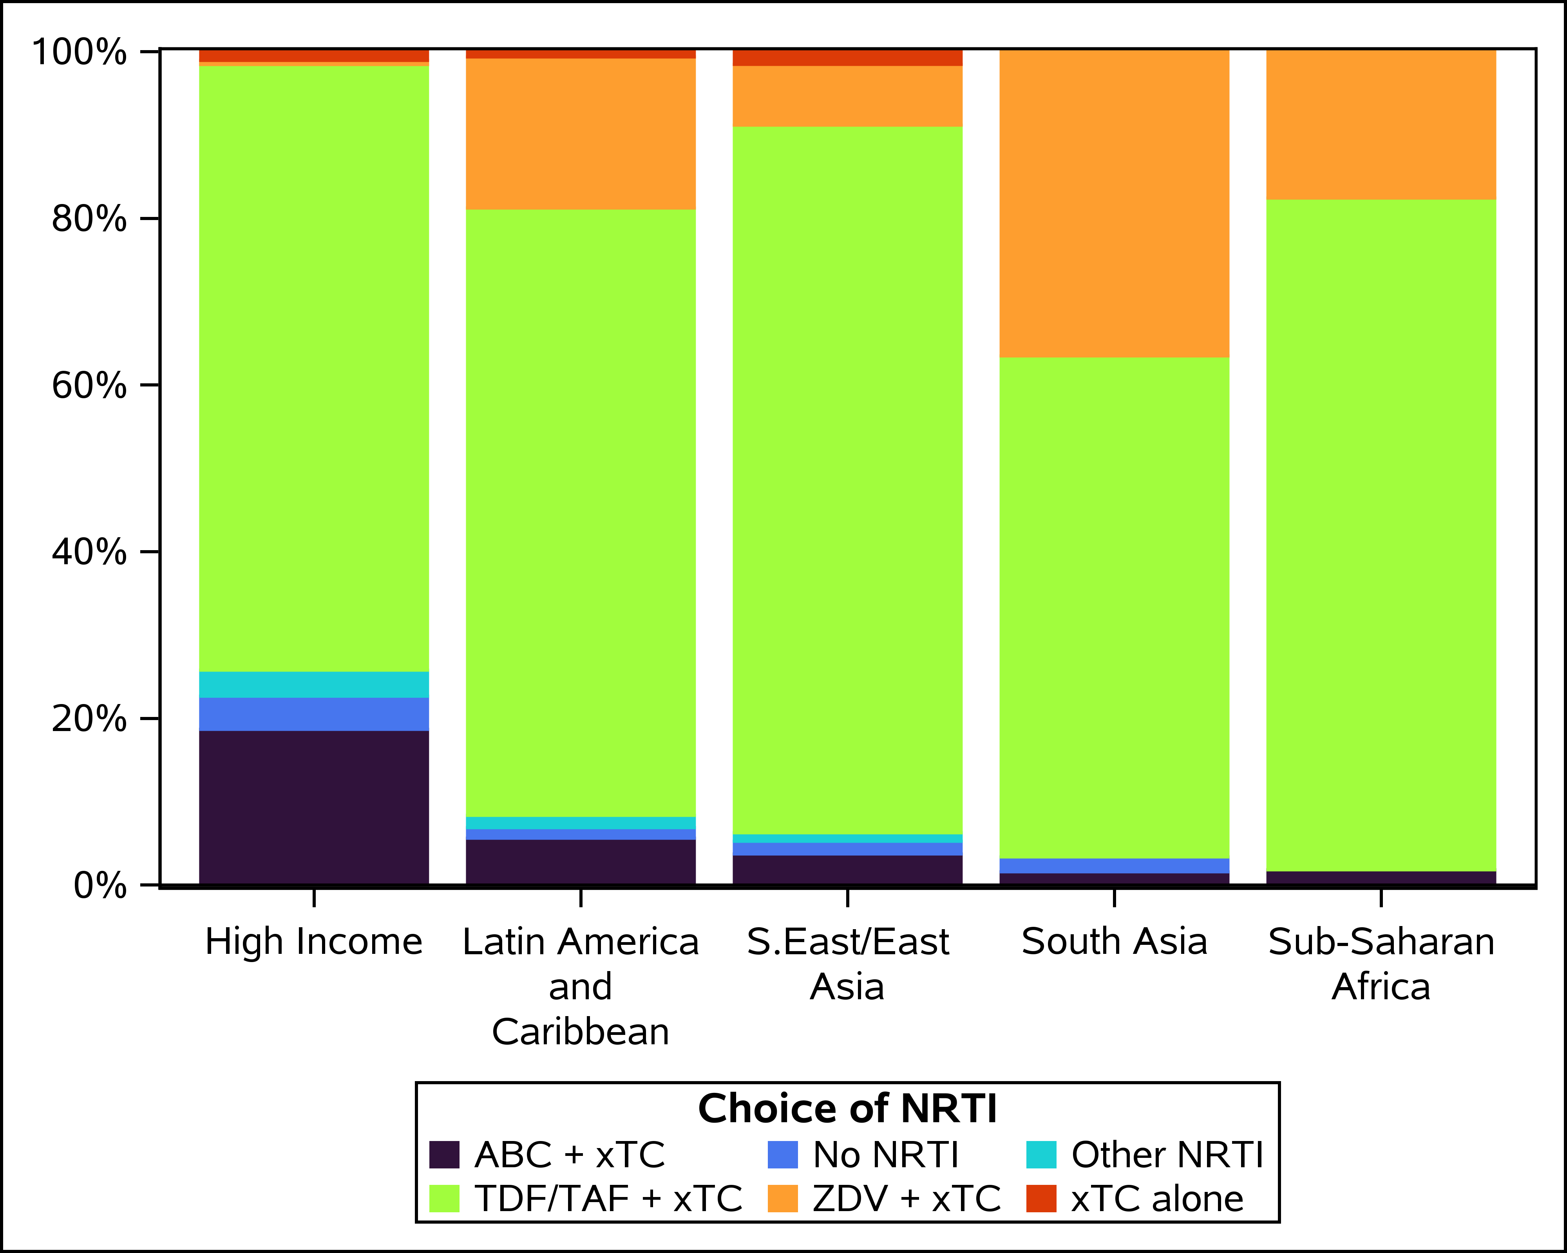
Abacavir use in REPRIEVE Trial
Global distribution of NRTI Use at Study Entry
22% of participants had a history of ABC exposure
9% had former exposure to ABC
Median duration of prior use = 3.0 years (1.10, 6.90)
13% of participants were on ABC at randomization
Median duration = 1.47 years (0.604, 3.17)
78% of participants never had any ABC exposure
xTC=3TC or FTC

Slide 7
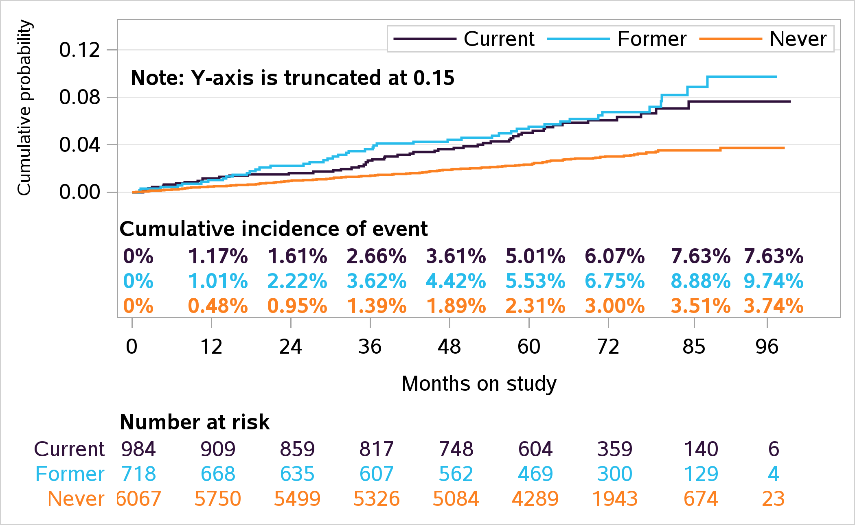
Cumulative Incidence of MACE with Abacavir
Notes:
Individuals with a history of ABC and use of ABC at randomization have higher incidence of MACE events compared to those who do not. Looking at the 3-level exposure, those with former/current have higher incidence of events compared to those who have never had any exposure to ABC.

Slide 8
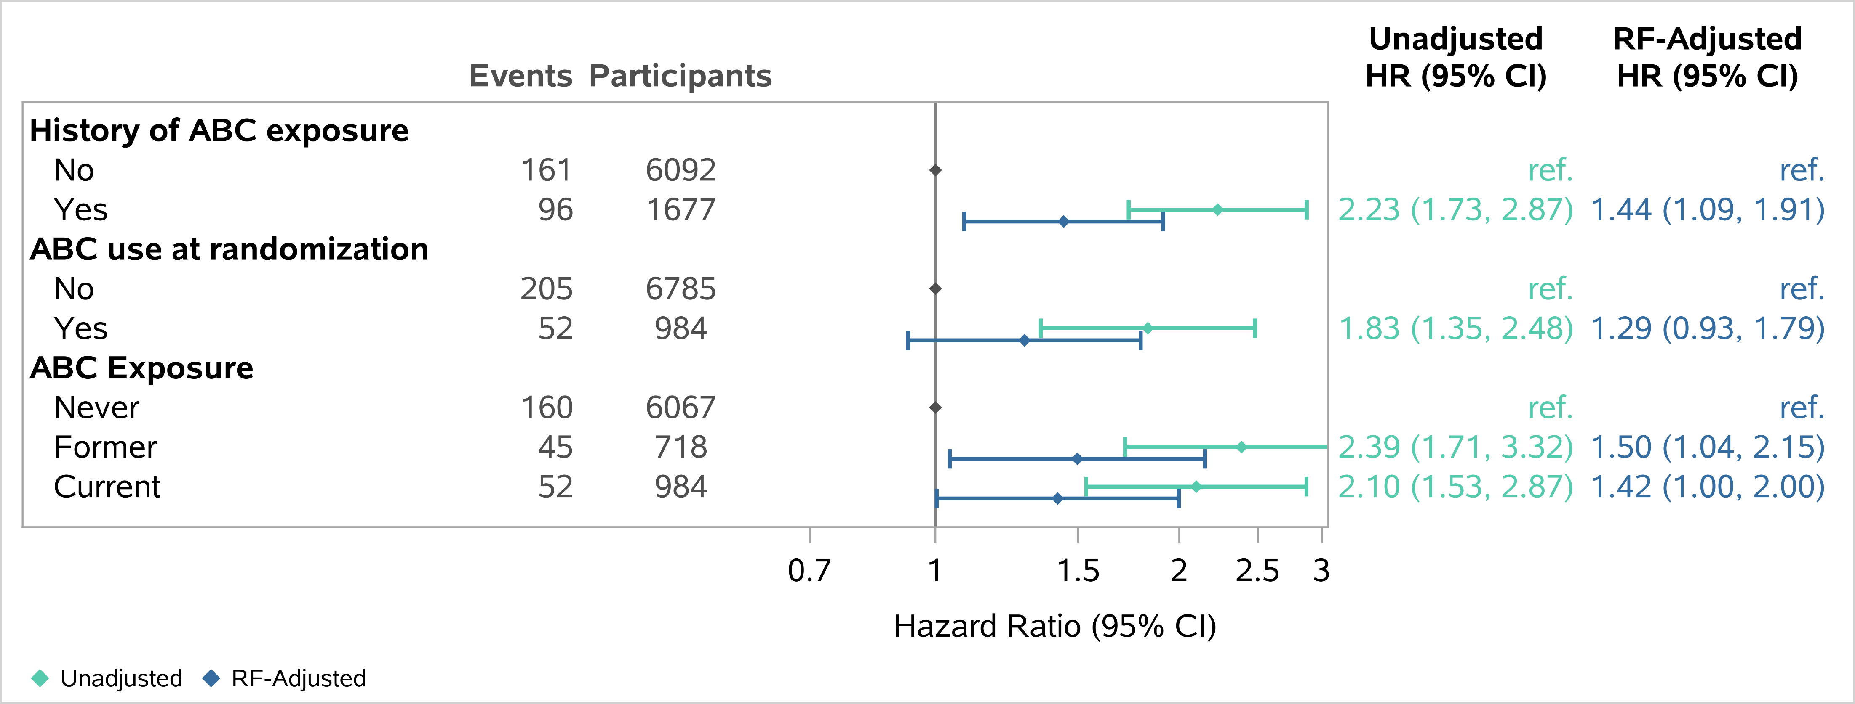
Abacavir exposure and MACE
All models are stratified by randomized study treatment group.
Adjusted model components included: age, natal sex, race, global burden of disease region, family history of CVD, smoking, hypertension, BMI, substance use, nadir CD4, HIV viral load, entry baseline ART regimen class, creatinine clearance, fasting glucose and lipids.
RF= Risk factor

Slide 9
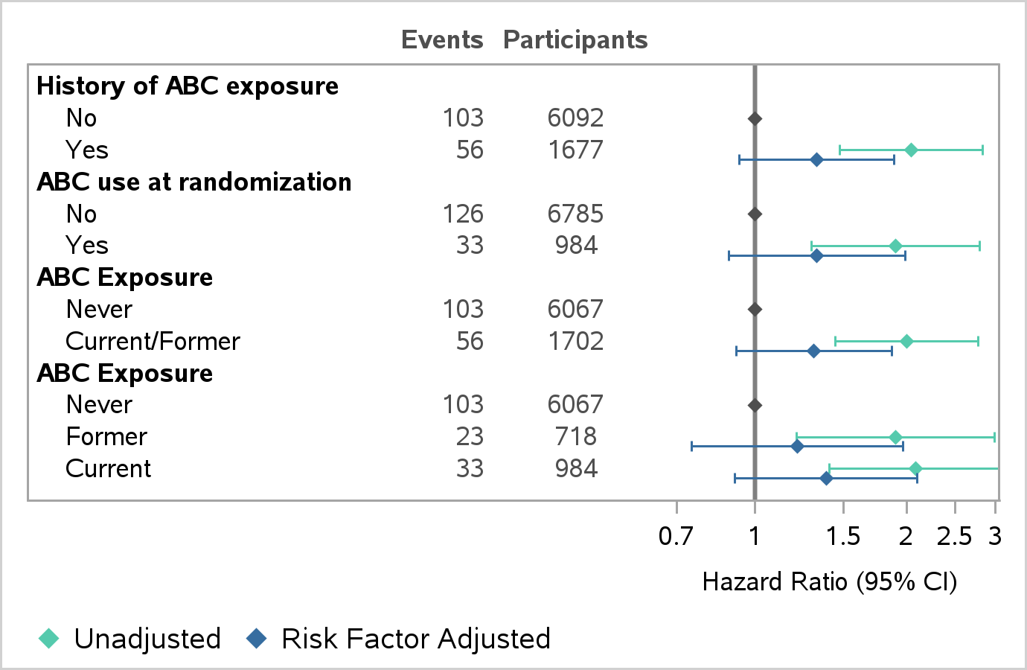
†Hard Mace Events by Abacavir Exposure
Abacavir Exposure | Frequency N (%) | MACE (N) | Hard MACE (N) | MI (N) | Stroke (N)
History of ABC exposure
No | 6092 (78%) | 161 | 103 | 44 | 43
Yes | 1677 (22%) | 96 | 56 | 30 | 20
ABC use at randomization
No | 6785 (87%) | 205 | 126 | 55 | 51
Yes | 984 (13%) | 52 | 33 | 19 | 12
ABC Exposure
Never | 6067 (78%) | 160 | 103 | 44 | 43
Former | 718 (9%) | 45 | 23 | 11 | 8
Current | 984 (13%) | 52 | 33 | 19 | 12
Hard MACE by ABC Exposure
†Hard Mace = Cardiovascular death, myocardial infarction and stroke

Slide 10
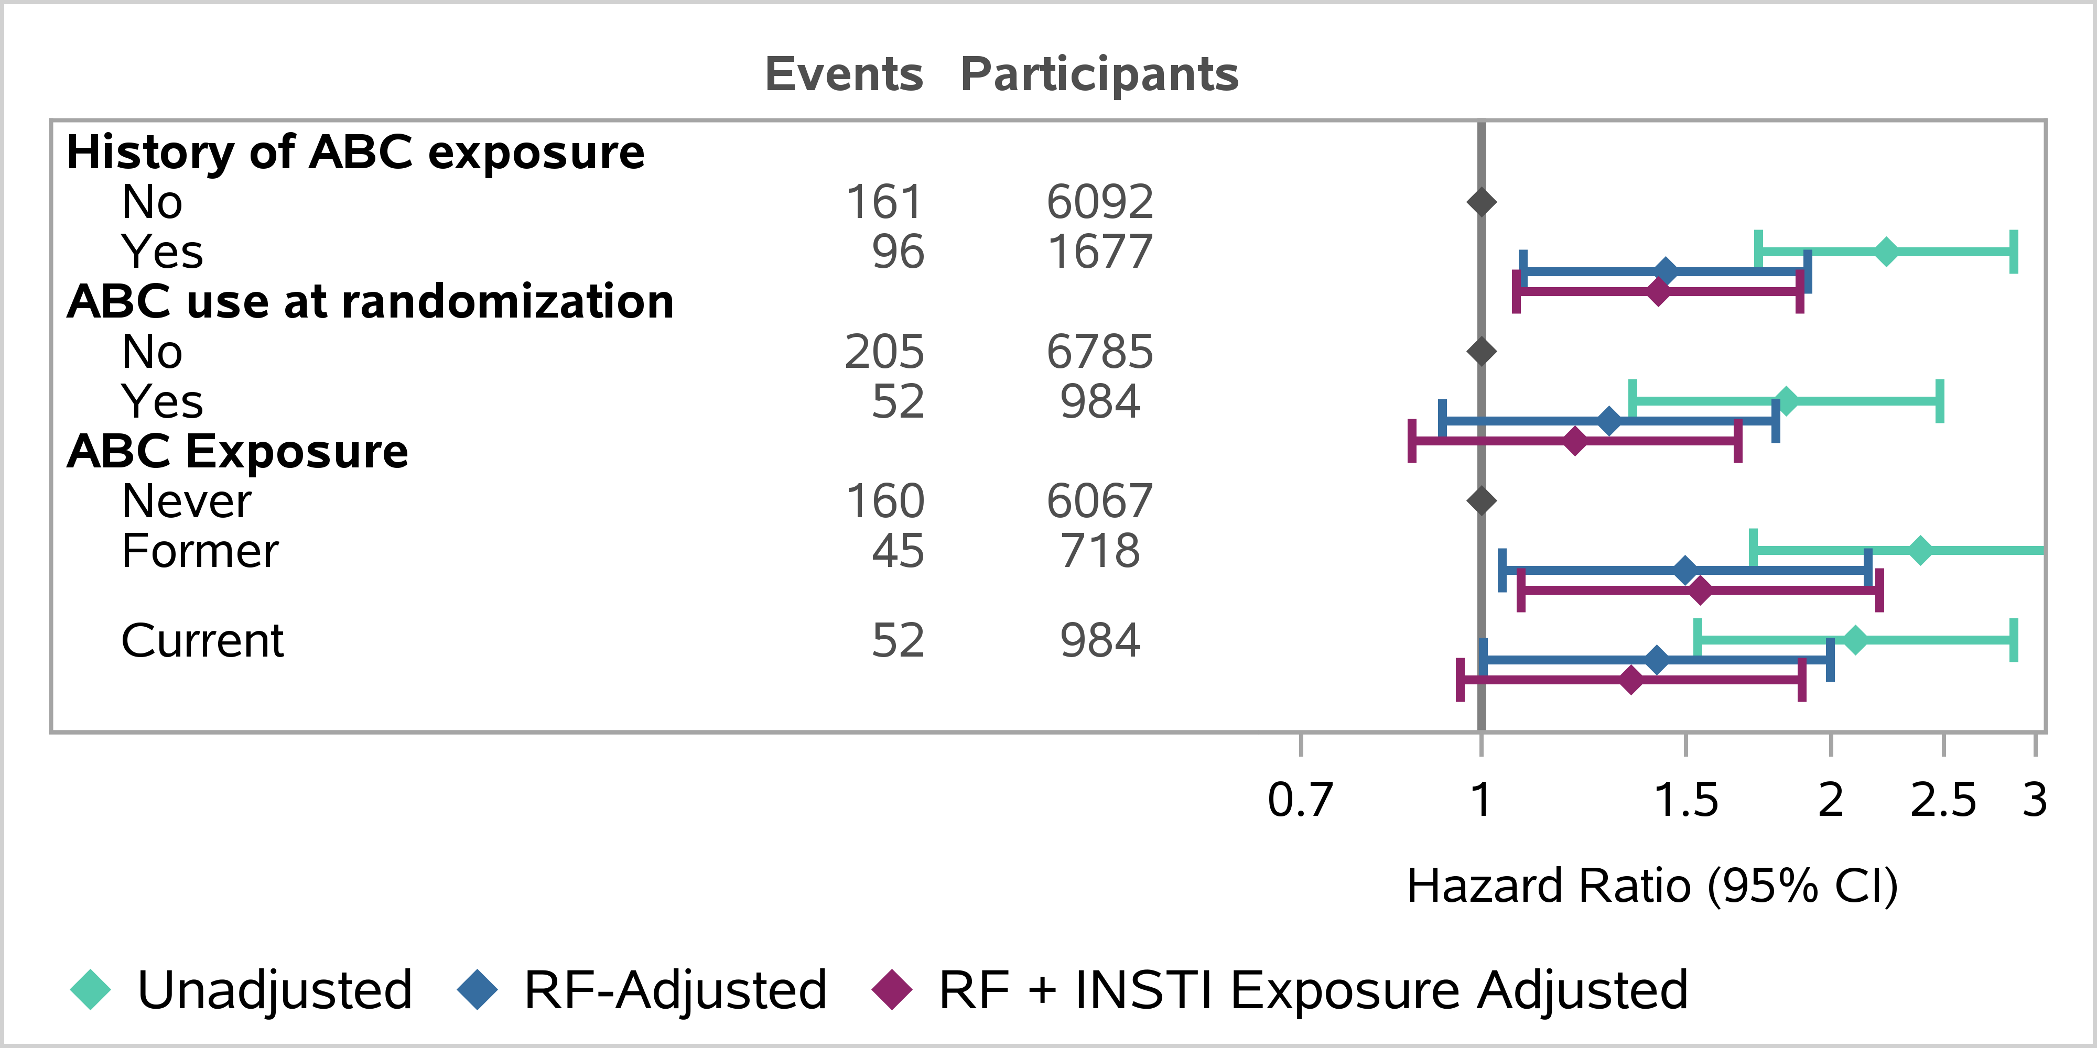
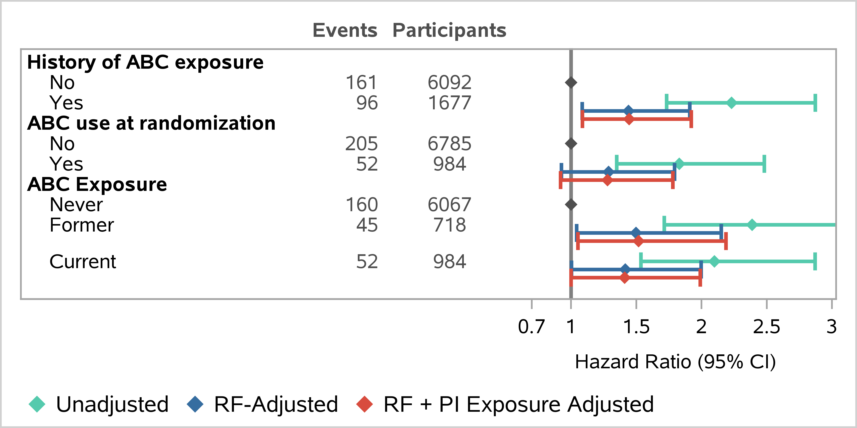
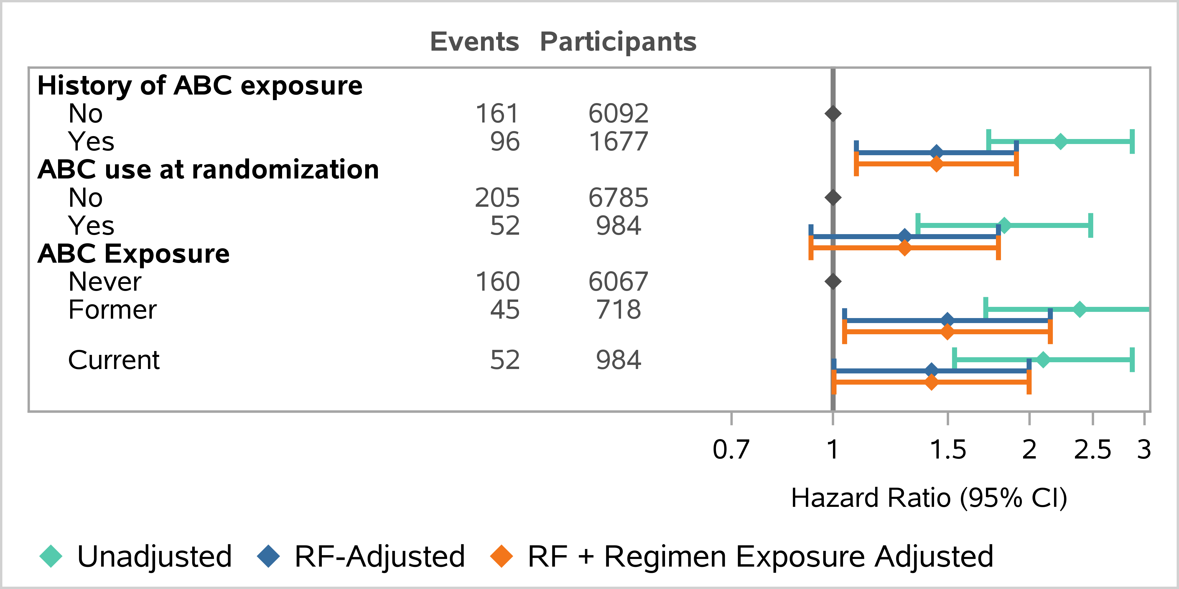
No change of ABC effects by INSTIs, NNRTIs or PIs
ABC effect on MACE adjusted by INSTI Exposure
ABC effect on MACE adjusted by NNRTI Exposure
ABC effect on MACE adjusted by PI Exposure
ABC effect on MACE adjusted by OTHER† regimen exposure
† Other regimens included combinations of antiretroviral agents (e.g., dolutegravir + rilpivirine) that bridged more than one category.

Slide 11
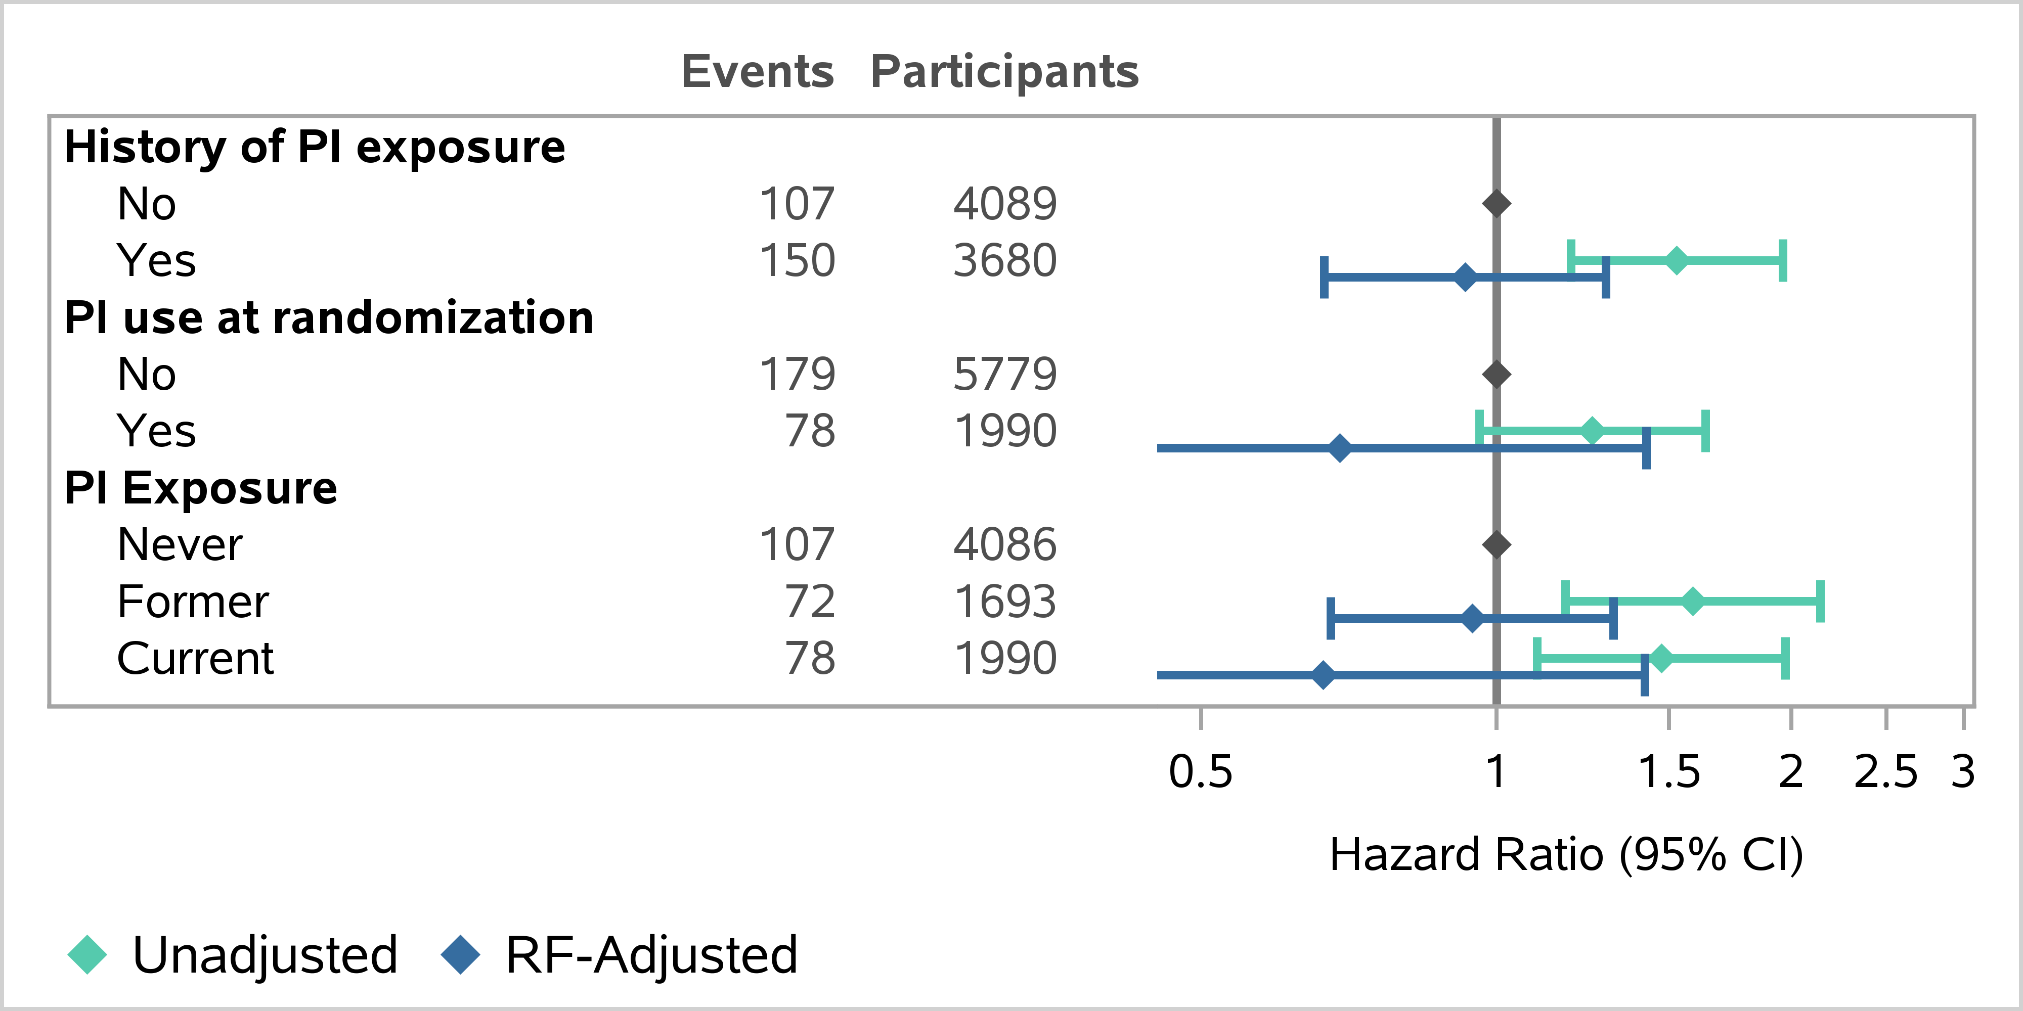
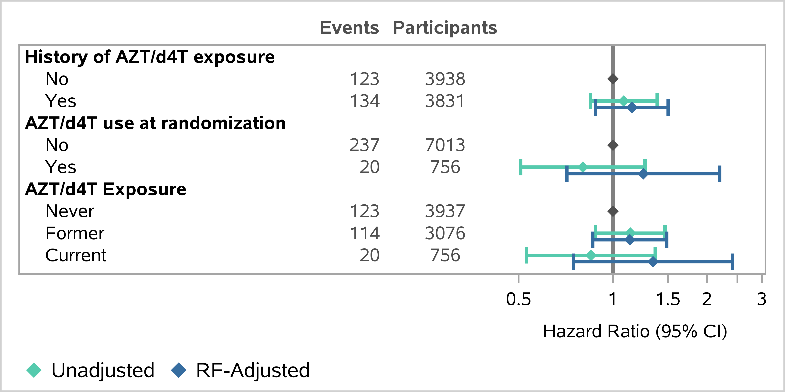
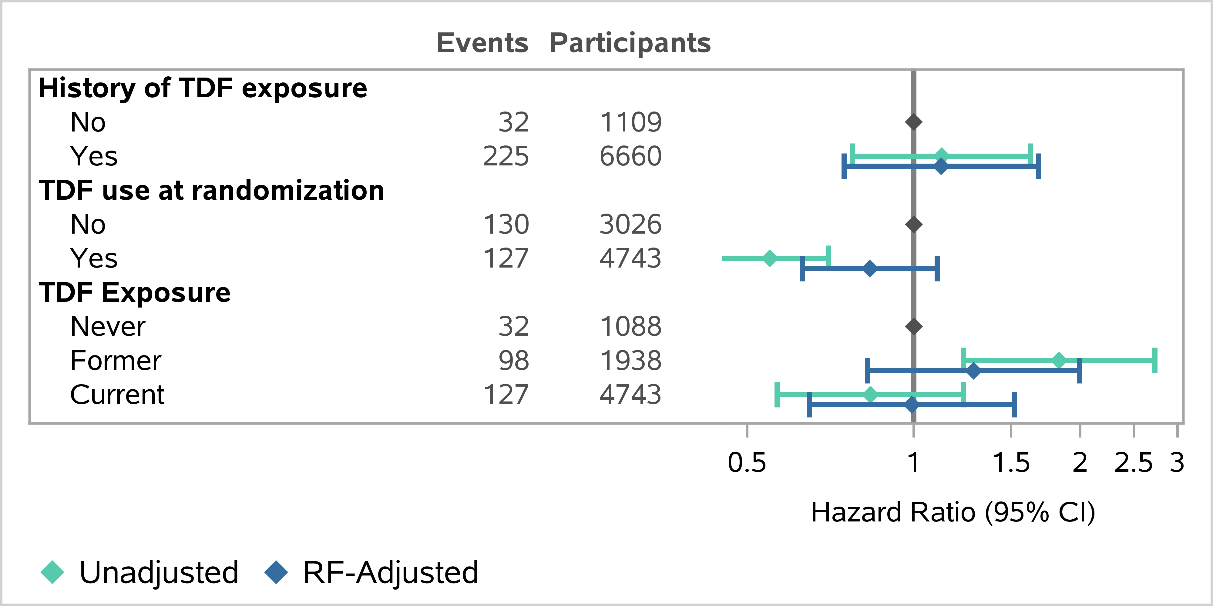
No association of other select agents with MACE
Prior or current PI exposure and risk of MACE
Prior or current Thymidine analog exposure and risk of MACE
Prior or current Tenofovir Disoproxil Fumarate exposure and risk of MACE

Slide 12
Summary and Conclusions
Current and former use of abacavir was associated with a higher incidence of subsequent major adverse cardiovascular events in the REPRIEVE trial (~42%-50% higher risk).
Global study population enrolled without prior known cardiovascular disease.
Low-to-moderate risk population (ASCVD median score – 4.5%)
Independently adjudicated cardiovascular endpoints.
Current and former use of Tenofovir, Protease Inhibitors and Thymidine analogs were not associated with subsequent MACE.
Future REPRIEVE analyses planned:
Time updated analyses of ART use evaluated for their impact on MACE.

Slide 13
Acknowledgements
Study Participants
Site Investigators
Site Staff
REPRIEVE Team Coauthors
Carlos D. Malvestutto
Maya G. Watanabe
Emma Davies Smith
Heather J. Ribaudo
Sara McCallum
Kathleen V. Fitch
Judith S. Currier
Marissa Diggs
Judith A. Aberg
Michael T. Lu
Javier Valencia
Cristina Gómez-Ayerbe
Indira Brar
Jose Valdez Madruga
Gerald S. Bloomfield
Pamela S. Douglas
Steven K. Grinspoon
Markella V. Zanni
THANK YOU!

