Slide 1
Antibody signatures associated with HIV transmission during breastfeeding
Nadege Nziza, PhD Ragon Institute of MGH, MIT and Harvard
HIV in children: What are the challenges?
Juelg lab

Slide 2
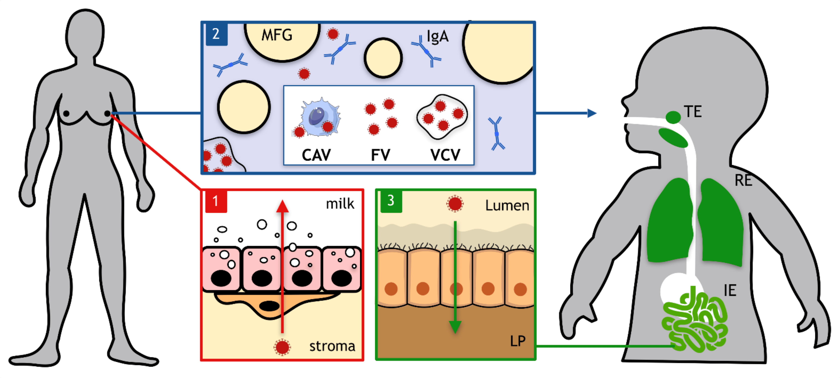
Breastfeeding and HIV transmission
> 150,000 new cases of HIV-1 transmission through MTCT each year
Up to 15% of mothers living with HIV (no ART) transmit HIV during breastfeeding
Difference between non-transmitting and transmitting mothers?
Impact of antibody-mediated immunity?
(Desgraupes et al. 2021 Viruses)

Slide 3
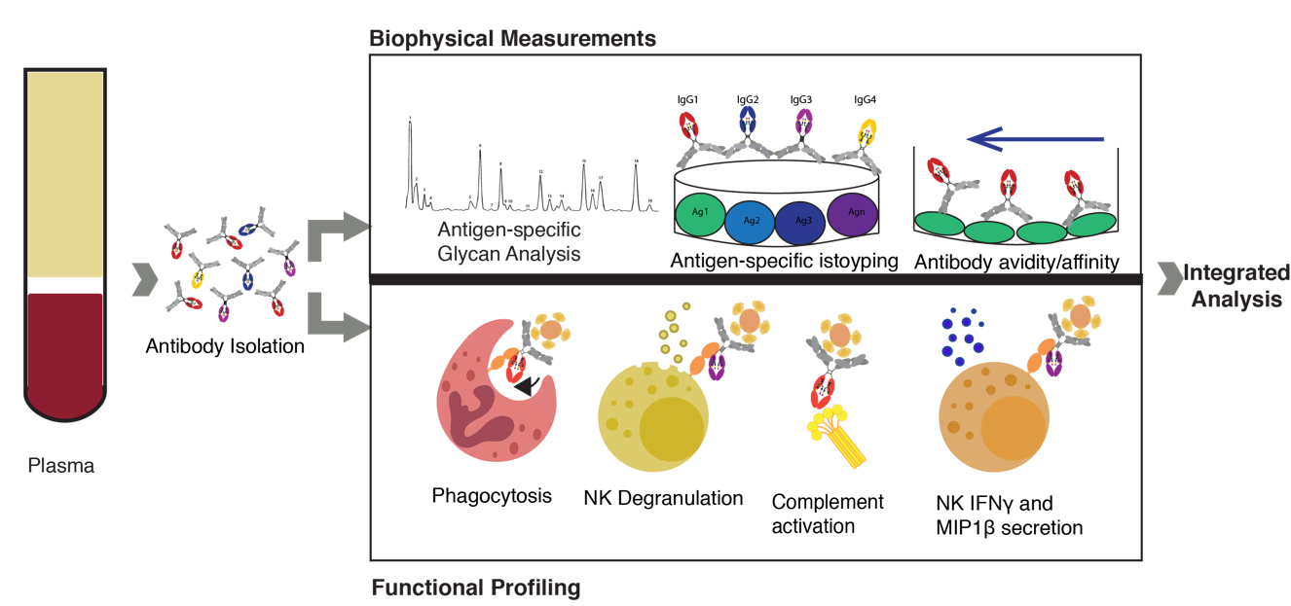
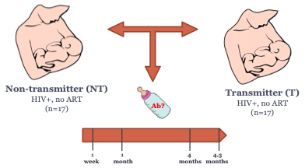
Breastfeeding and HIV transmission
Antigen-specific isotyping
Fc receptor binding
Transmission occurred around 4 months
Similar viral load + CD4

Slide 4
1. Evolution of antibody response over time in NT and T
4 months
4.5 months
NT
T
NT
T
NT
T
Higher antibody functionality is observed in the milk of T mothers.
IgA/FcaR response in NT mothers.

Slide 5
1. Evolution of antibody response over time in NT and T
IgG1
FcgR2A
Antibody response in NT tends to progressively decreases, while antibody levels in T remains high.
Higher p24 response in NT group.

Slide 6
1. Evolution of antibody response over time in NT and T
IgA1
FcaR
➔ IgA response associated with p24 is higher in NT mothers.

Slide 7
2. Correlation with milk HIV viral load
1 month
4 months
4.5 months
Non-Transmitters
P24-specific antibody response associated with lower viral loads in NT mothers.
Transmitters

Slide 8
3. Impact of continuous breastfeeding
Higher antibody response in the “Stopped” group
Low number of samples

Slide 9
Conclusions
Transmitters
Non-Transmitters
Stronger antibody functionality
Higher antibody response in the “Stopped” group
Higher IgA response
Negative correlation between VL and p24-antibodies

Slide 10




Thank you
Wonyeong Jung
Jeff Hsiao
Tina Chen
Caroline Atyeo
Ryan P. McNamara
Galit Alter
Boris Juelg
Fan li
Louise Kuhn
Nicole Tobin
Grace Aldrovandi

Slide 11
Maternal transfer of immunity
Transfer through the placenta
Transfer through breastmilk
Milk from healthy mothers
(Atyeo et al., 2021. Cell )

Slide 12
Breastfeeding and HIV transmission
>150,000 infants newly infected with HIV-1 each year through MTCT
10% of HIV-infected mothers transmit HIV during breastfeeding
Difference between non-transmitting and transmitting mothers?
Impact of antibody-mediated immunity?
(Cavarelli et al., 2011. J Intern Med)

Slide 13
Cytokine release assay
Non-transmitters
Transmitters
IgG has a major impact on the inflammatory phenotype observed in the breastmilk of transmitting mothers.
13

Slide 14
Glycosylation profile
(Jennewein et al., 2019. Cell )
Fist analysis of IgG glycosylation profile in the milk.
HIV transmission associated to hypergalactosylated antibodies.
14

