Slide 1

Comparative analysis of the HIV reservoir localisation and cellular function in paediatric and adult tonsillar tissues
Dr. Faiaz Shaik Abdool, PhD (Africa Health Research Institute – Durban, SA)
HIV in children: What are the Challenges?

Slide 2
Summary
What is your main question?
Is there a difference in HIV location in tonsil tissue in children and adults living with HIV?
What did you find?
Change in T-cell memory subsets with age
Higher frequency of TFH in children
HIV p24-antigen detection in tonsil tissue
Higher proportion of intact HIV in tissue than blood
Why is it important?
Study is important to identify the viral reservoir that seeds rebounding when ART is discontinued or failing to inform strategies that target treatment and eradication of HIV within in tissues in CHILDREN

Slide 3
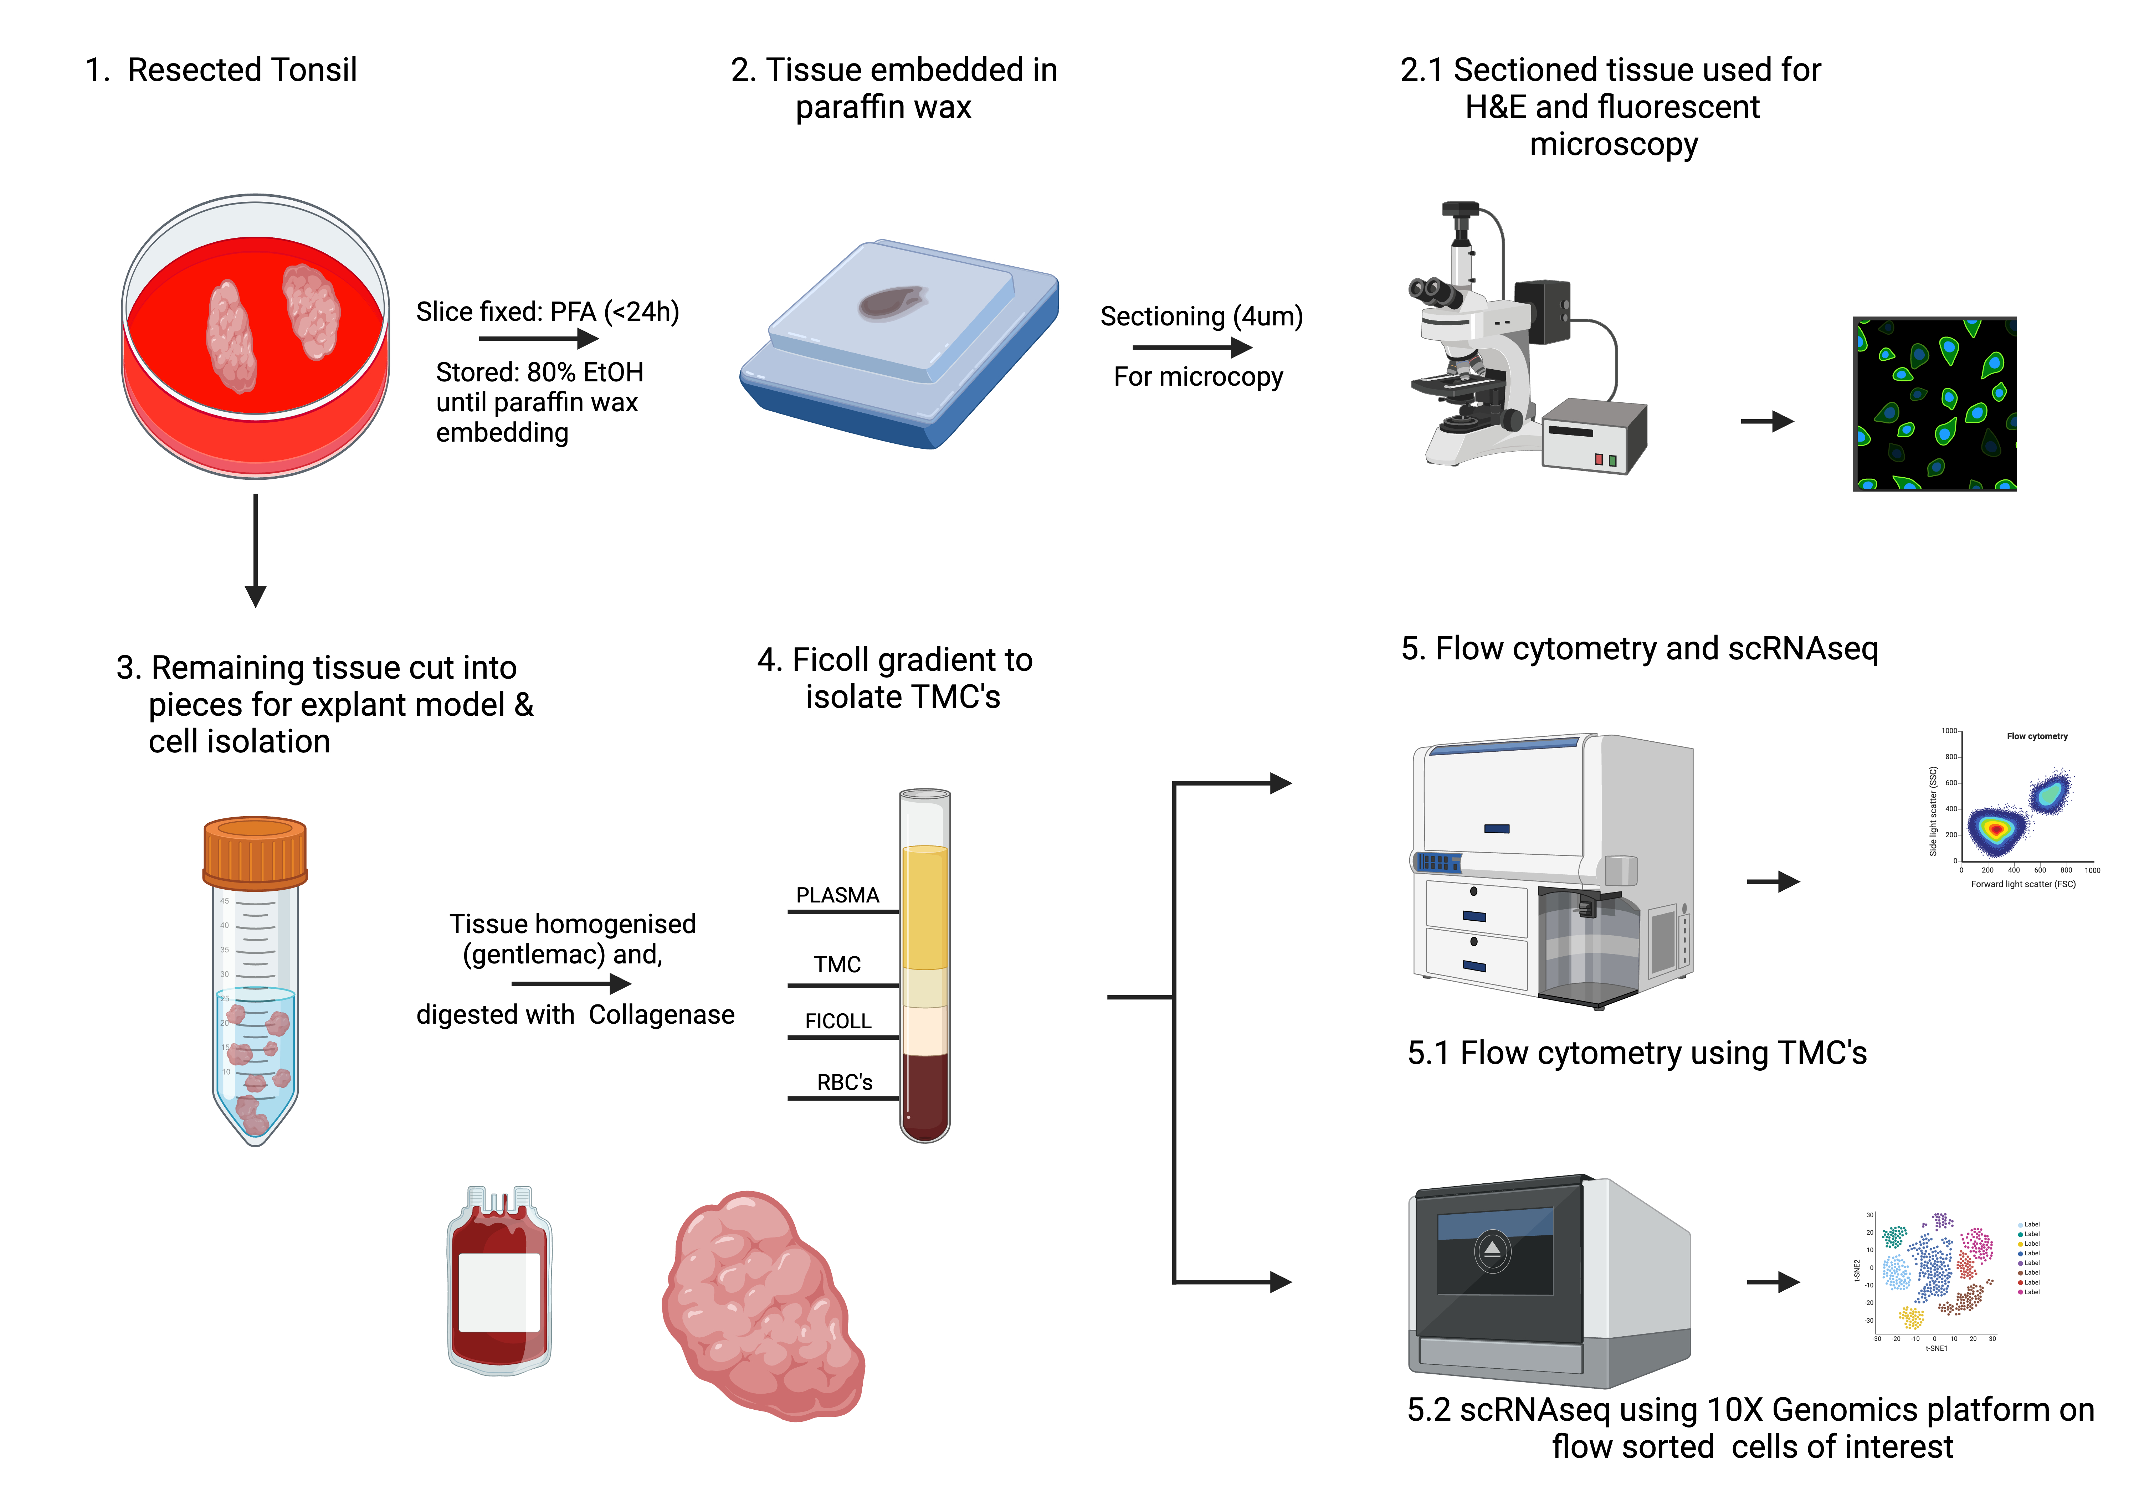
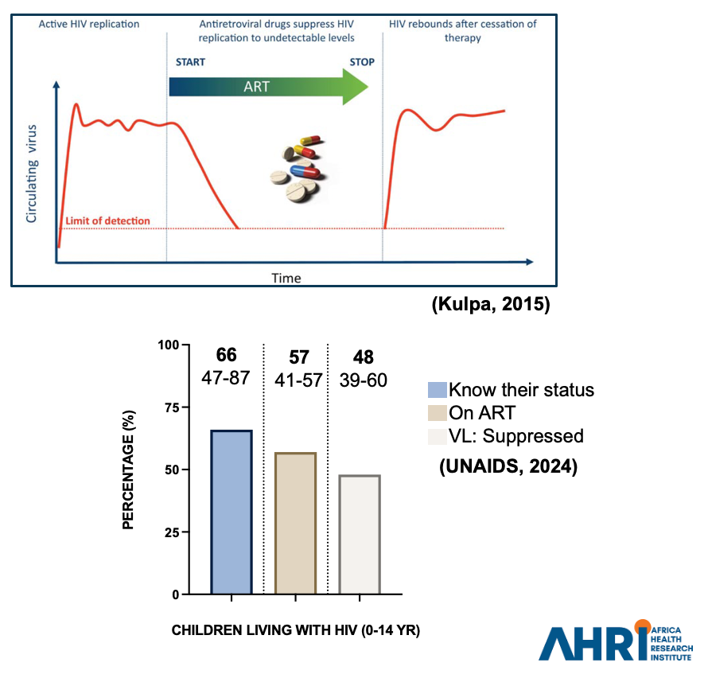
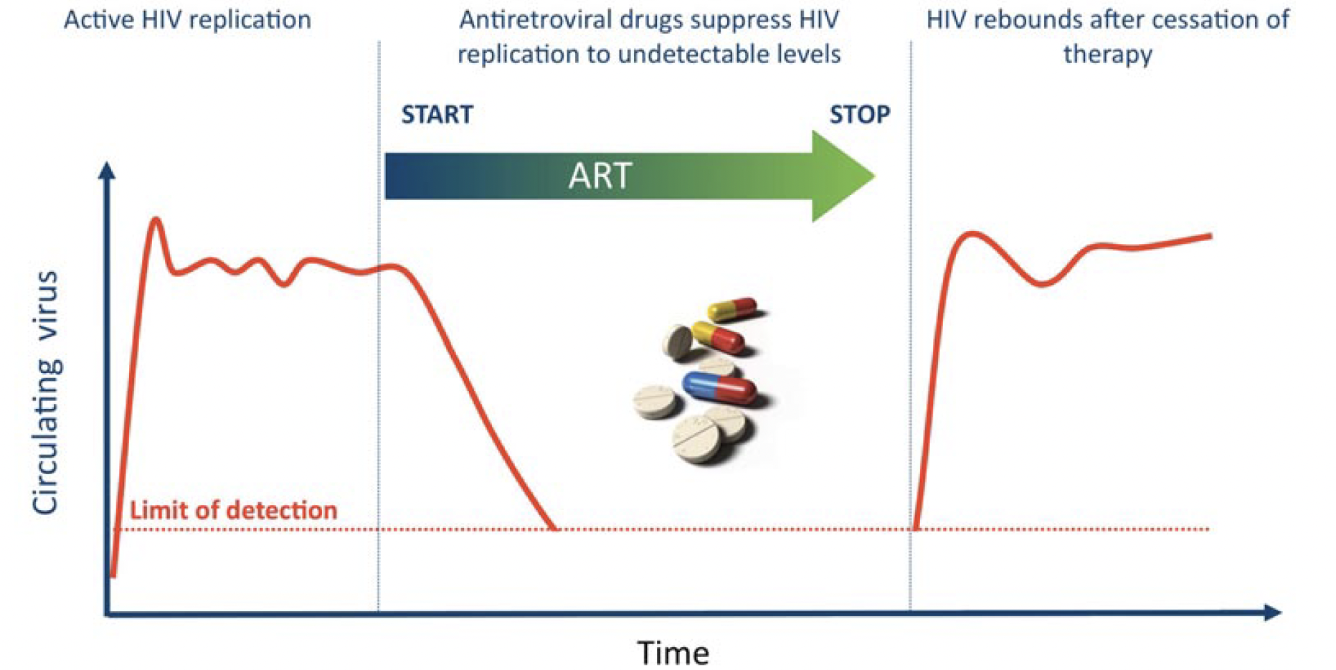
Introduction
x
ART Viral Suppression Cure
Viral Rebound : Anatomical, Cellular, Molecular
BUT : Most studies focus on blood
    Tissue Reservoirs not well characterised
    Lack of reservoir studies in paediatrics
(Kulpa, 2015)
Children represented 12% of global AIDS-related mortality
Challenge with life-long adherence in paediatrics
66
47-87
57
41-57
48
39-60
Know their status
On ART
VL: Suppressed
(UNAIDS, 2024)

Slide 4
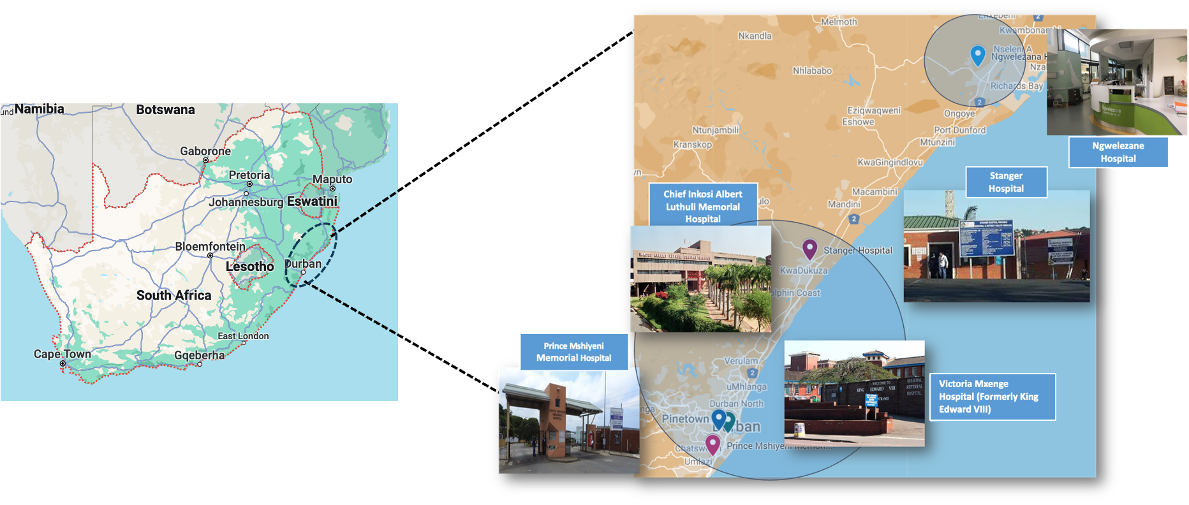
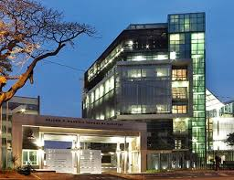
Tonsil cohort at AHRI in KwaZulu-Natal, South Africa
Male
Female
No. of Participants
Age groups (years)
AHRI, DURBAN, SA
<18 Yrs
18⁺ Yrs
AHRI
No. of Participants
SA cohort : HIV-1 Subclade C is prevalent

Slide 5
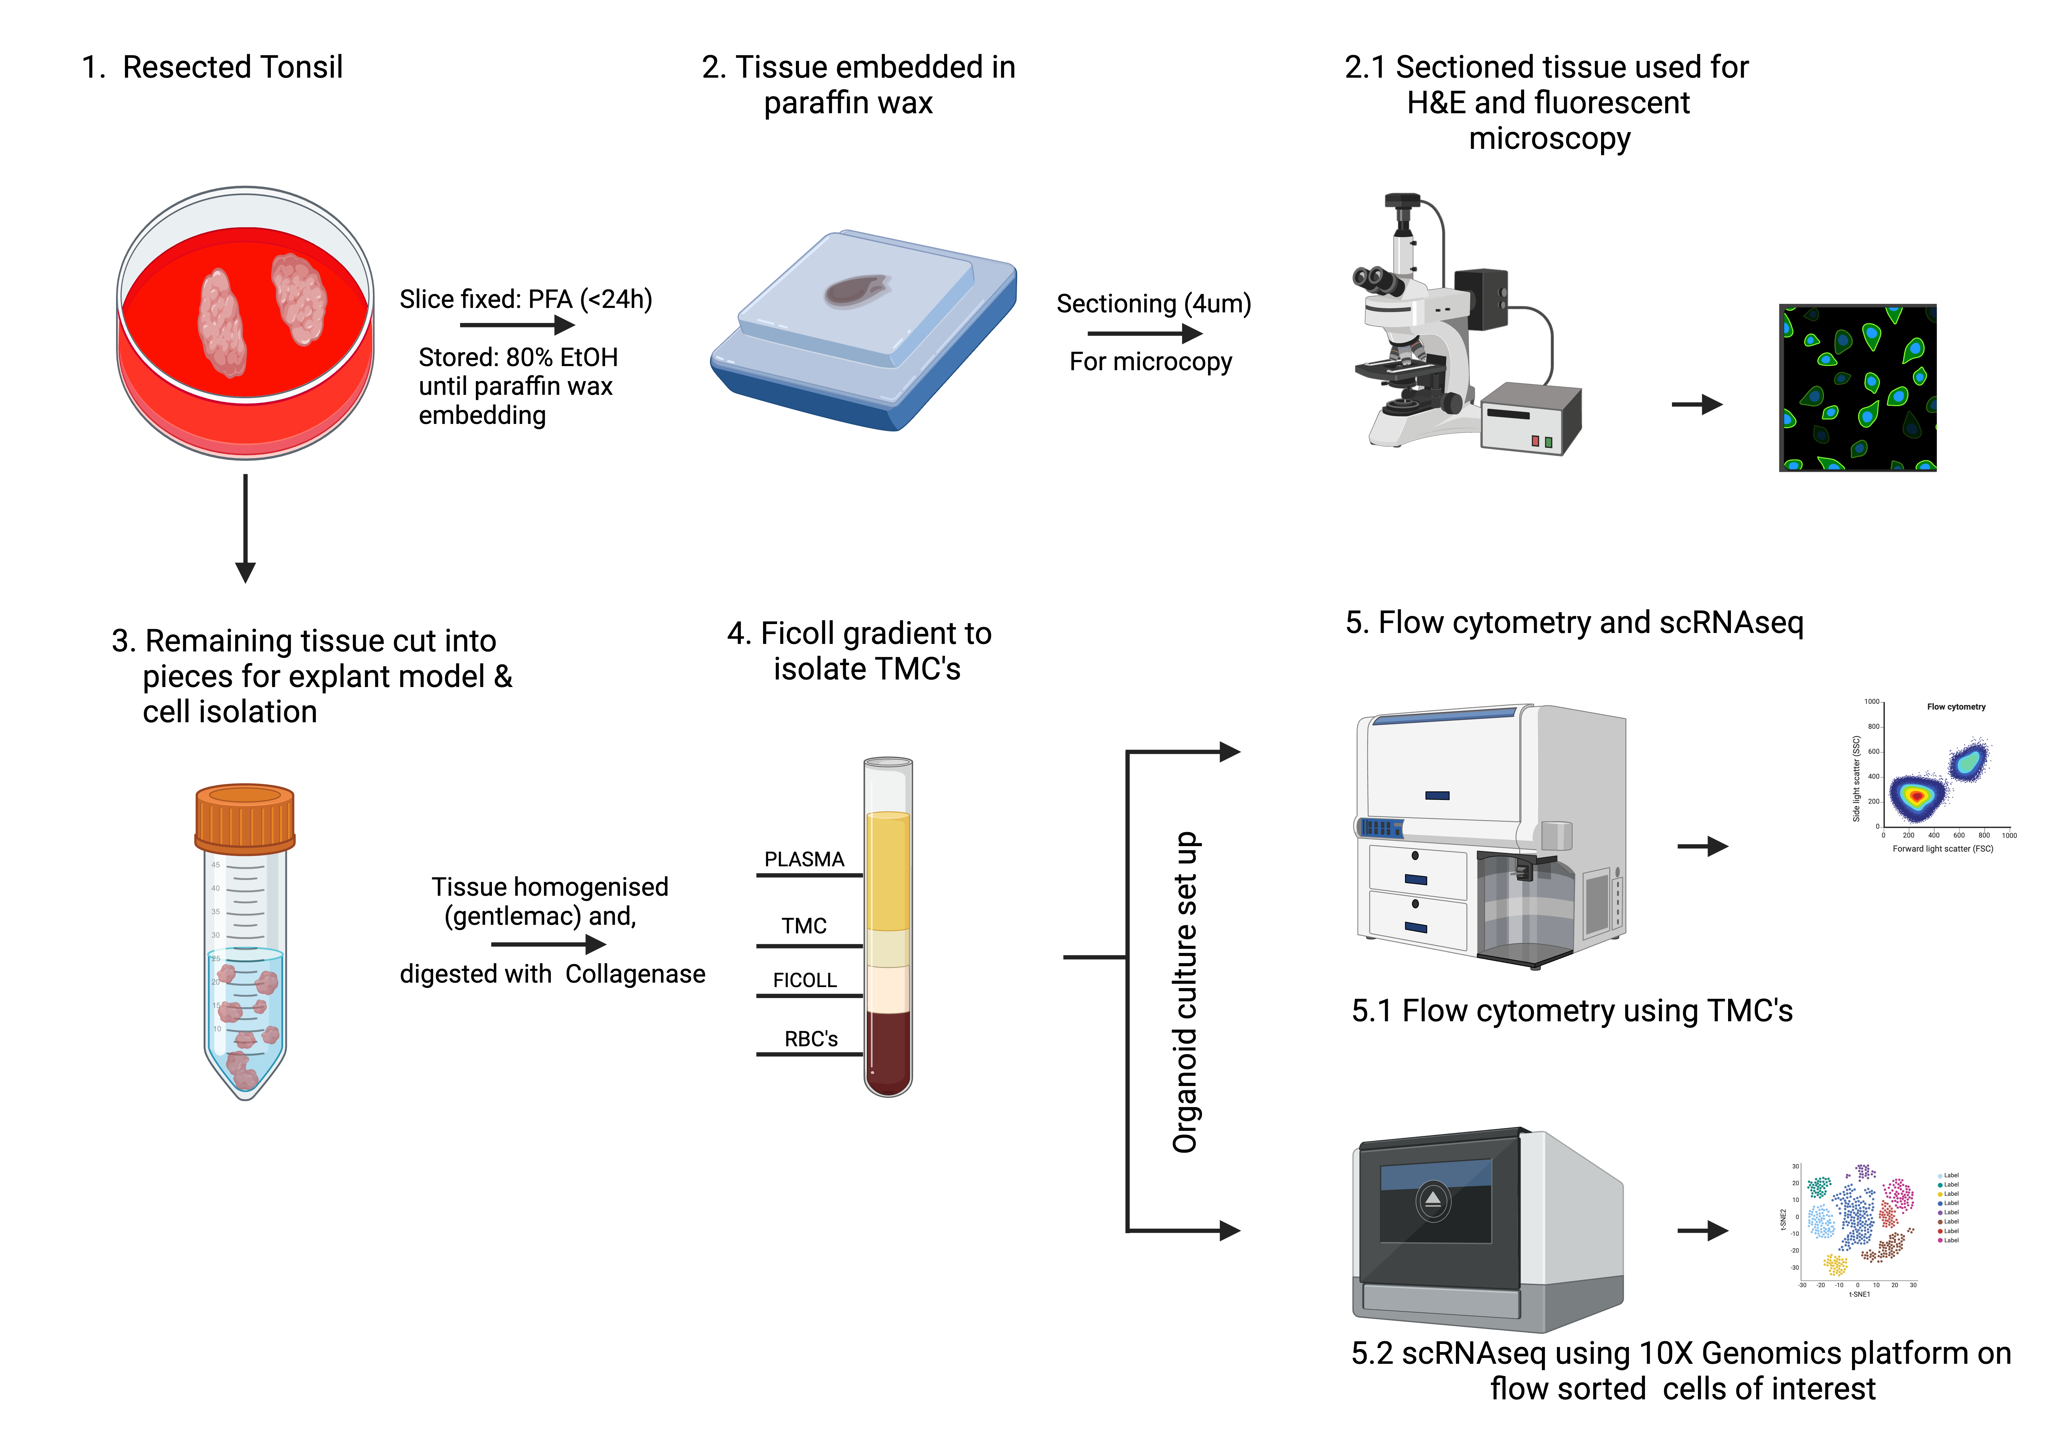
STUDY DESIGN

Slide 6
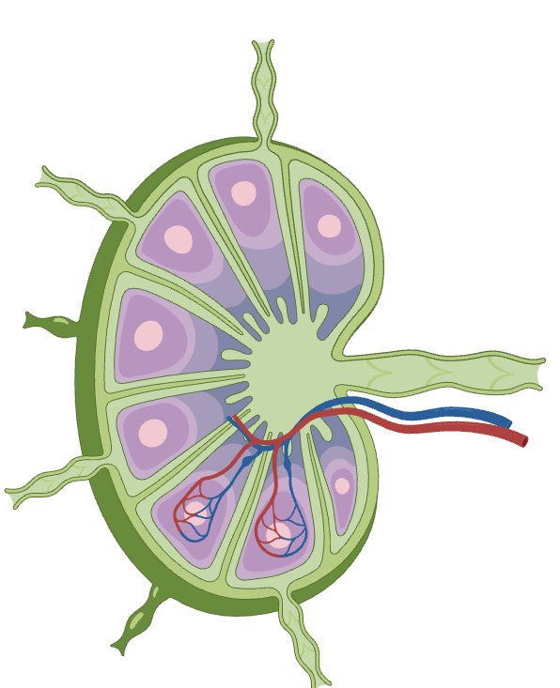
FACS gating strategy for T-cell differentiation in Tonsil from PLWOH
TONSIL
Previous Studies:
CM & EM
TFH
Blood
LYMPH NODE
TFH
DIFFERENTIATION SUBSETS

Slide 7
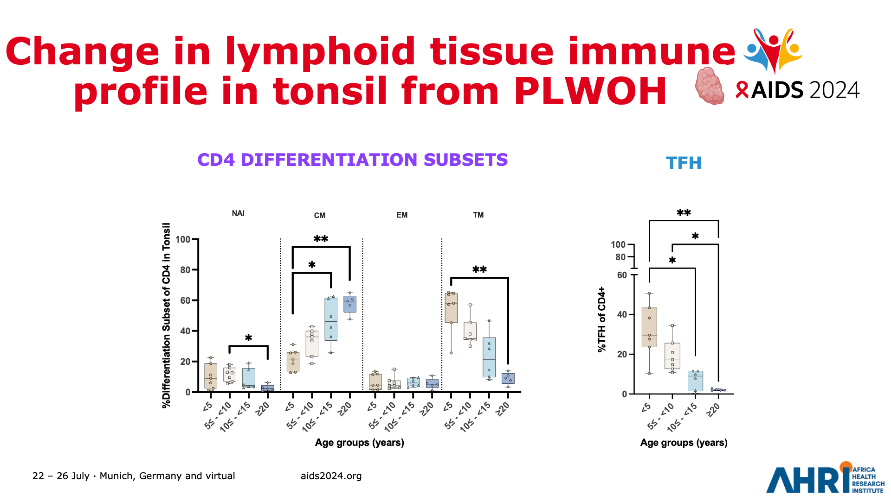
Change in lymphoid tissue immune profile in tonsil from PLWOH
CD4 DIFFERENTIATION SUBSETS

Slide 8
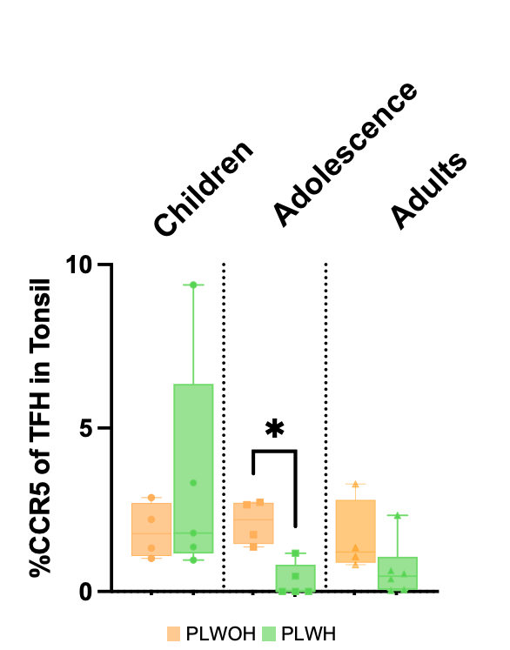
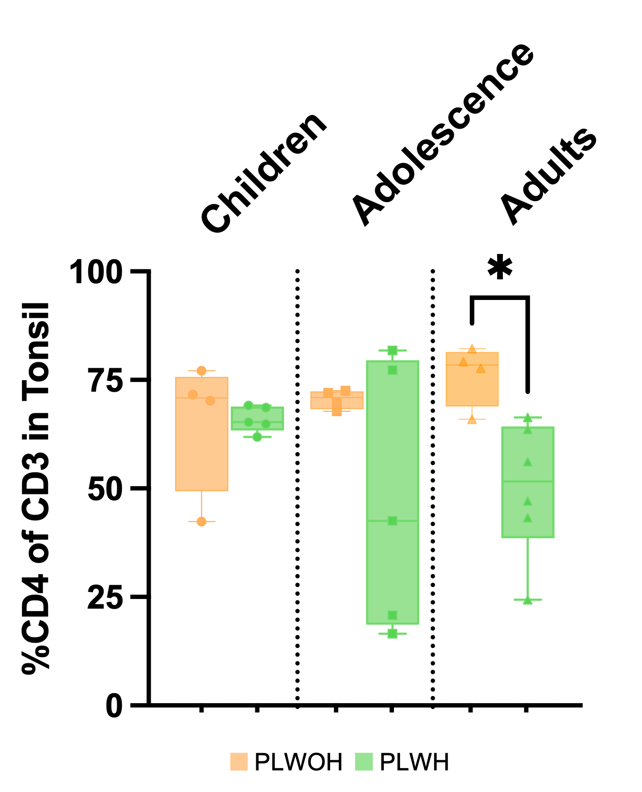
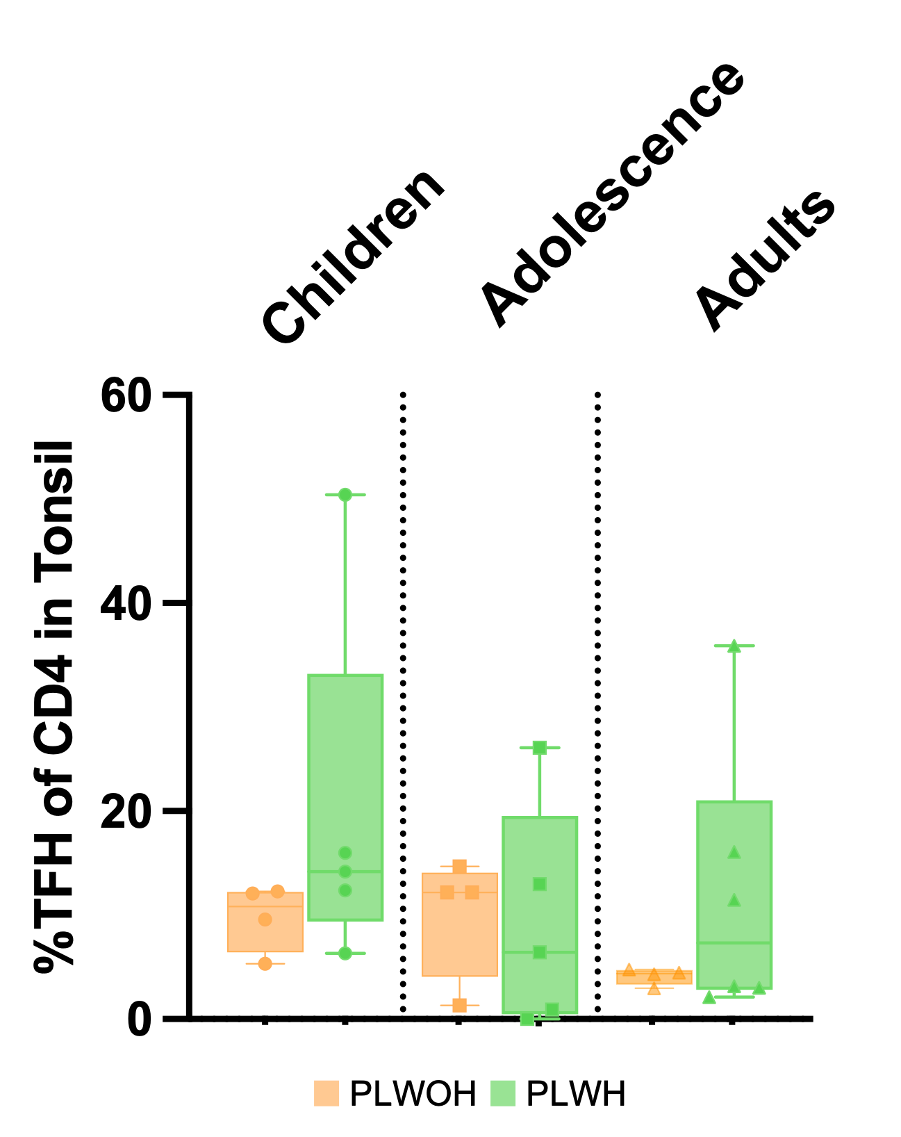
T-Cell Comparison between PLWOH and PLWH in Tonsil

Slide 9
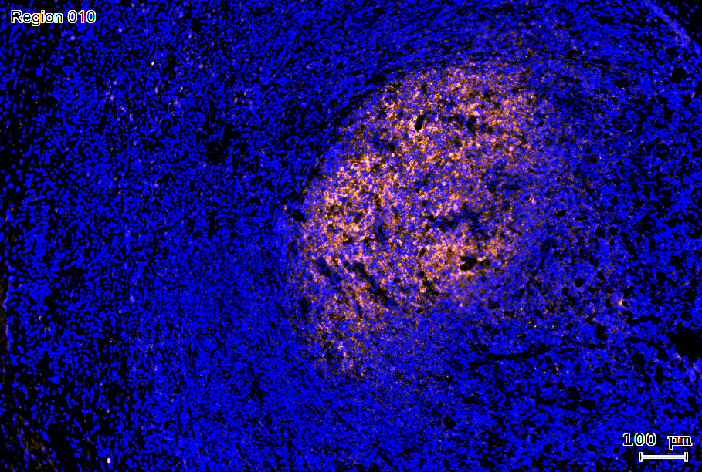
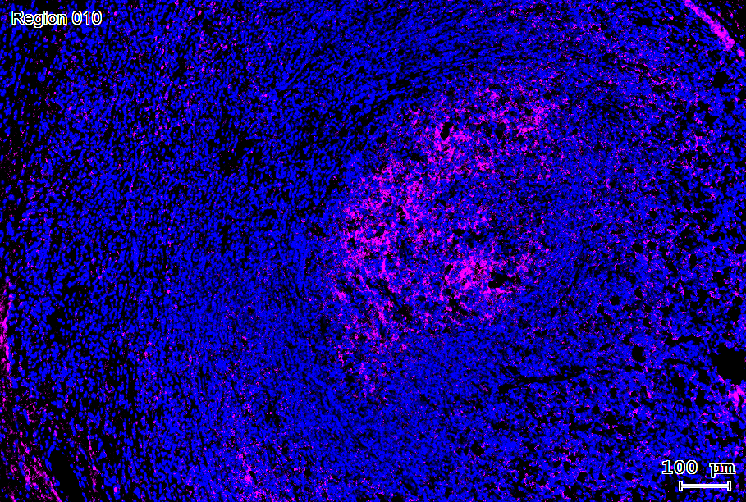
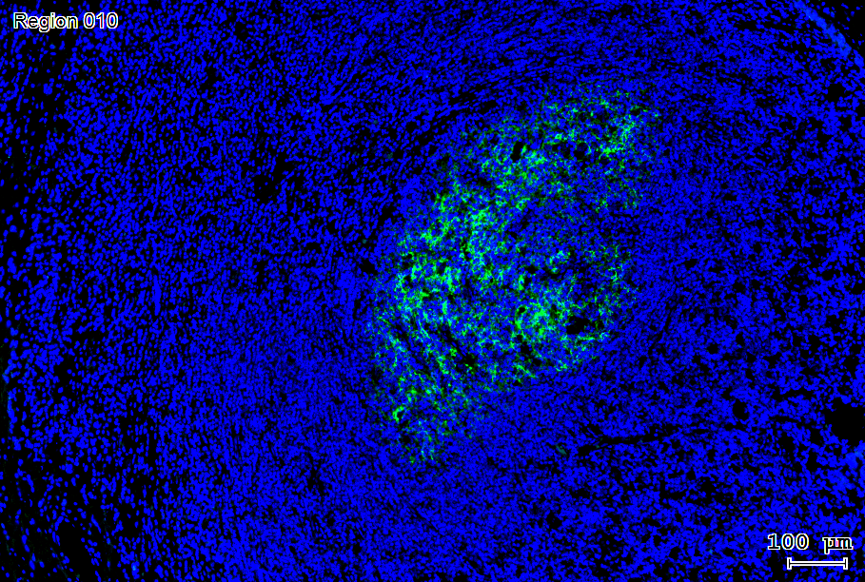
HIV-P24 localisation in Tonsil from PWVH
Adult: 34 YR Old
VL: 170 000 cps/ml
ART: ca. 6 months
CXCR5 CD4
HIV p24 MERGED

Slide 10
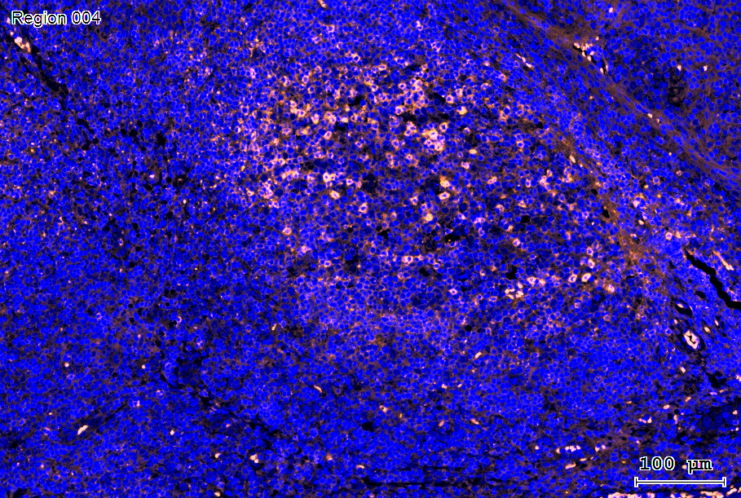
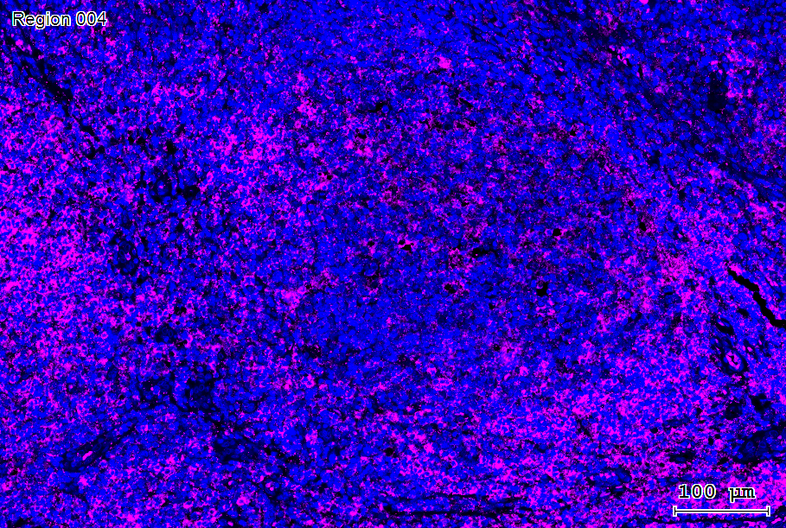
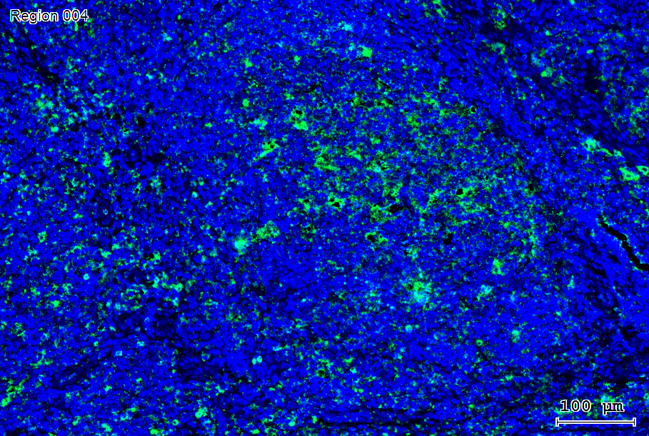
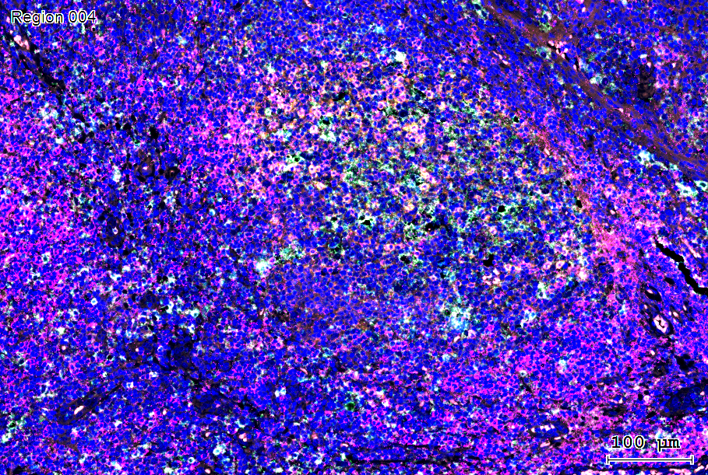
HIV-P24 localisation in Tonsil from PWVH
Adolescent: 12 YR
VL: 17 000 cps/ml
ART: not on ART
CXCR5 CD4
HIV p24 MERGED

Slide 11
HIV-P24 localisation in Tonsil from PWSH
Paediatric: 1 yr 8mo
VL: <30 cps/ml
ART: 1 wk after Birth
CXCR5 CD4
HIV p24 MERGED

Slide 12
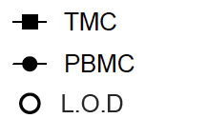

Pre-Liminary data:
HIV Reservoir in TMC vs PBMC
VS
Blood
Collaboration with Mathias Lichterfeld,
Ragon Inst, US
Age (years) 23 34 31
Viral Load (cps/ml) 110 000 <20 <20
Time on ART 3 Yrs 3 Yrs 3 Yrs

Slide 13
CONCLUSION:
Difference in immune profiles with age
Higher TFH frequency in children, CLWH = TFH increased in CCR5
HIV-24 persistence in tissue despite viral suppression in blood
TFH in children : higher susceptibility to HIV

Slide 14




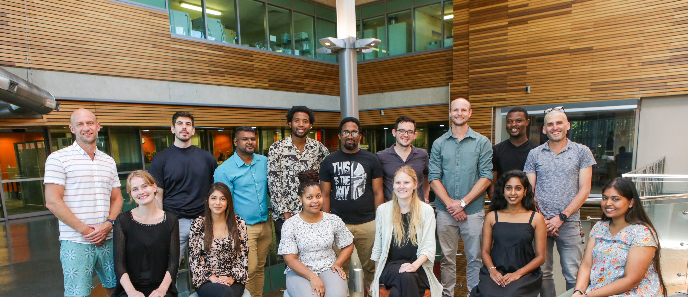


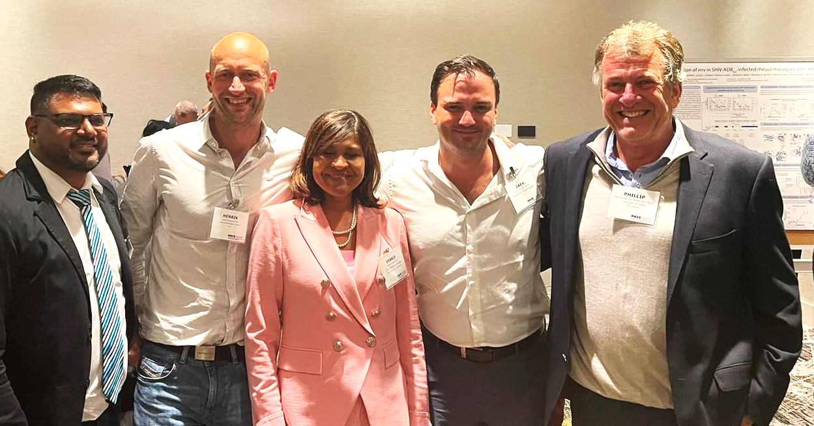
ACKNOWLEDGMENTS
Kloverpris lab, AHRI
Henrik Kløverpris
Miguel Marin
Kasmira Gopee
Snenhlanhla Mfusi
Sabrina Isaac
ENT clinics, KZN, South Africa
Warren Kuhn (Albert Luthuli)
Rishan Bipath (King Edward)
Gavin Charlton (Ngwelezane)
Akhona Yakobi (Prince Mshiyeni)
Kemraj Nepaul (Stanger)
Porterfield lab,USF, US
Zachary Porterfield
Clinical Core, AHRI
Farina Karim
Futhi Mthabela
Lindiwe Madziva
Kevyna Chetty
Leslie lab, AHRI
Al Leslie
Leslie Lab Members
Lichterfeld lab,Ragon Inst MGH,US
Mathias Lichterfeld
PAVE Martin Delaney Collaboratory
Deborah Persaud
Ann Chahroudi
Philip Goulder
AHRI, DURBAN, SA- FEBRUARY 2024
PAVE SABM, ATLANTA,GA- SEPTEMBER 2023

Slide 15

“There can be no greater gift than that of giving one’s time and energy to help others without anything in return.”
Nelson Rolihlahla Mandela
THANK YOU

