Slide 1

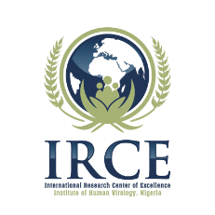
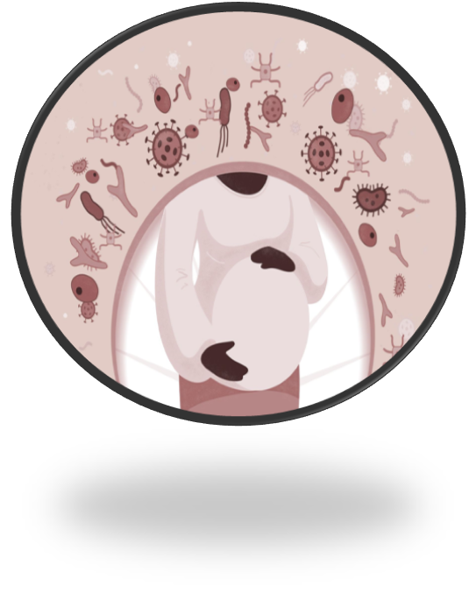
Altered Immune Response to Tetanus Pediatric Vaccines among HIV exposed uninfected infants
AIDS2024: 10243
S. Osawe , C. CO Chukwu , J.A Okopi , A. Abimiku
Institute of Human Virology Nigeria, International Research Center of Excellence, Abuja, Nigeria.

Slide 2
Background
Global data suggests 7 in every 100 pregnant women are likely to be living with HIV [1]. In Nigeria, 41.5% reporting knowing their HIV status [2]
Overall Prevention of Mother to Child Transmission (PMTCT) success rate in Nigeria is 91.8% [3]. While the vertical transmission of HIV has reduced through PMTCT, infants are still exposed to HIV in utero and during delivery.
HIV exposed uninfected (HEU) infants have been documented to be at risk of higher morbidity and mortality rates [4] as well as have stunted growth [5]
HIV exposure may also alter immune responses to pediatric vaccines and interfere with immunization. [6]
Notes:
1. Ozim, C. O., Mahendran, R., Amalan, M., & Puthussery, S. (2023). Prevalence of human immunodeficiency virus (HIV) among pregnant women in Nigeria: a systematic review and meta-analysis. BMJ open, 13(3), e050164. https://doi.org/10.1136/bmjopen-2021-050164
2. Federal Ministry of Health, Nigeria. Nigeria HIV/AIDS Indicator and Impact Survey (NAIIS) 2018:
Technical Report. Abuja, Nigeria. October 2019.
3. Fasakin, K. A., Omisakin, C. T., Adebara, I. O., Ajetunmobi, W. A., Adeniyi, A. A., Esan, A. J., Bolaji, O. B., Ajayi, O. D., & Afe, A. J. (2018). Assessment of PMTCT Success Rates Based on Antiretroviral Interventions and Feeding Options: A Prospective Cohort Study. International journal of MCH and AIDS, 7(2), 226–234. https://doi.org/10.21106/ijma.91
4. Abu-Raya, B., Kollmann, T. R., Marchant, A., & MacGillivray, D. M. (2016). The Immune System of HIV-Exposed Uninfected Infants. Frontiers in immunology, 7, 383. https://doi.org/10.3389/fimmu.2016.00383
5. Jumare, J., Datong, P., Osawe, S., Okolo, F., Mohammed, S., Inyang, B., Abimiku, A., & INFANT Study Team (2019). Compromised Growth Among HIV-exposed Uninfected Compared With Unexposed Children in Nigeria. The Pediatric infectious disease journal, 38(3), 280–286. https://doi.org/10.1097/INF.0000000000002238
6. Dzanibe, S., Jaspan, H. B., Zulu, M. Z., Kiravu, A., & Gray, C. M. (2019). Impact of maternal HIV exposure, feeding status, and microbiome on infant cellular immunity. Journal of leukocyte biology, 105(2), 281–289. https://doi.org/10.1002/JLB.MR0318-120R

Slide 3
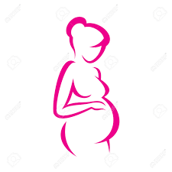
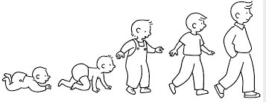
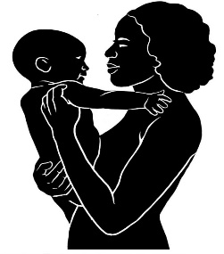

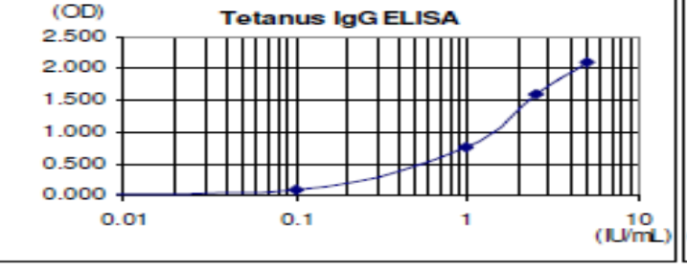
Methodology
N=140
N=144
Time points: Pregnancy
Delivery
Week 15
Women living with HIV
TT Vaccination
HIV Exposed Uninfected infants (HEU)
Birth /Bas
6 weeks
10 weeks
14 weeks
Women living without HIV
Humoral responses
  Anti -TT titres IgG for mothers and their infants
  Protective titres set at >0.1 IU/ml
HIV Unexposed infants (HU)
N=60
N=61
Anti-TT IgG titers

Slide 4
Descriptive and sociodemographic characteristics for all the mother enrolled into the study
Variable | Overall [n (%)] N = 200 | Living w/HIV [n (%)] N = 140 | Living w/o HIV [n (%)] N = 60
Age | 30.6 ± 5.0 | 30.9 ± 4.9 | 30.0 ± 5.0
< 25 years | 24 (12.0) | 12 (8.6) | 12 (20.0)
25-34 years | 130 (65.0) | 92 (65.7) | 38 (63.3)
35 years and above | 46 (23.0) | 36 (25.7) | 10 (16.7)
Education
No Formal Education | 68 (34.0) | 4 (2.9) | -
Elementary/Junior | 55 (27.5) | 56 (40.0) | 12 (20.0)
Senior/High School | 4 (2.0) | 55 (39.3) | 18 (30.0)
Higher Education | 73 (36.5) | 25 (17.9) | 30 (50.0)
Occupation
Employed | 40 (20.0) | 24 (17.1) | 16 (26.7)
Self employed | 107 (53.5) | 78 (55.7) | 29 (48.3)
Unemployed | 53 (26.5) | 38 (27.1) | 15 (25.0)
Marital Status
Married | 195 (97.5) | 135 (96.4) | 60 (100.0)
Single/Previously married | 5 (2.5) | 5 (3.6) | -

Slide 5
Baseline characteristics of all infants enrolled into the study
Variable | Overall [n (%)] N = 205 | Exposed Group [n (%)] N = 144 | Unexposed group [n (%)] N = 61
Gender
Female | 106 (51.7) | 75 (52.1) | 31 (50.8)
Male | 99 (48.3) | 69 (47.9) | 30 (49.2)
Baseline Weight | 3031.7 (408.2) | 2946.5 (369.1) | 3232.8 (428.1)
Low | 7 (3.4) | 6 (4.2) | 1 (1.6)
Normal | 193 (94.2) | 137 (95.1) | 56 (91.8)
High | 5 (2.4) | 1 (0.7) | 4 (6.6)
Weight/Height/Circumference
Week 4 Weight | 3821.9 (639.6) | 3709.4 (564.1) | 4082.1 (727.5)
Week 4 Height | 51.7 (2.9) | 51.3 (2.8) | 52.5 (3.0)
Week 4 Circumference | 37.0 (1.4) | 36.8 (1.3) | 37.4 (1.4)
Week 15 Weight | 6019.8 (911.4) | 5855.4 (831.0) | 6414.2 (979.9)
Week 15 Height | 59.5 (3.3) | 59.2 (3.1) | 60.2 (3.7)
Week 15 Circumference | 40.8 (1.8) | 40.5 (1.8) | 41.3 (1.8)

Slide 6
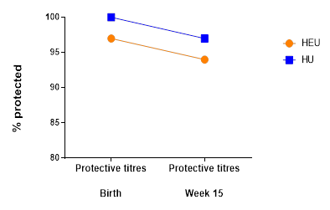
KEY FINDINGS- I
Anti-TT IgG titres in mtothers. While the average anti-IgG TT titres in women living with HIV were lower this difference was not significant
*Mann Whitney U test
Protective anti-TT IgG titres. The proportion of infants with protective humoral antibody levels at
Birth: 97% of HEU and 100% HU
Week 15: 94% HEU and 97% HU

Slide 7
KEY FINDINGS- II
Anti-TT IgG titres between HEU and HU infants
HEU had significant lower anti-TT titres at Birth (p=0.02) and at Week 15 (p=0.01)
*Mann Whitney U test.

Slide 8
IMPLICATIONS
Our data shows weaker immune responses in HEU to Tetanus vaccine.
HIV exposure may alter how well HEU infants and children respond to vaccinations.
Our data highlighting that HEU infants present with altered immune responses.
New strategies that focus on new approaches can improving vaccination responses in HEU infants (ex. additional booster shots for vaccine preventable diseases).

Slide 9




Thank you for your attention
Acknowledgements:
Sponsors

