Slide 1
Maternal HIV status alters the breastmilk virome of mothers living with HIV and the gut virome of related infants through early life
Bryan Brown
University of Washington
Seattle Children’s Research Institute
HIV in children: What are the challenges?

Slide 2
Summary
What is your main question?
How does maternal HIV status affect the development of the microbiome in infants exposed to HIV that remain uninfected?
What did you find?
We find that maternal HIV status significantly alters the composition of the breastmilk virome and alters the composition of the gut virome of related infants, relative to uninfected/unexposed controls.
Why is it important?
These results identify shifts in infant gut viral communities associated with HIV exposure and alterations in bacteriophage abundance that may influence bacterial communities.

Slide 3


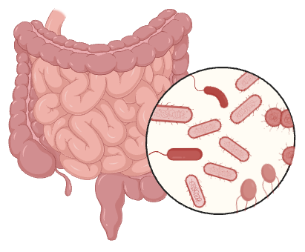
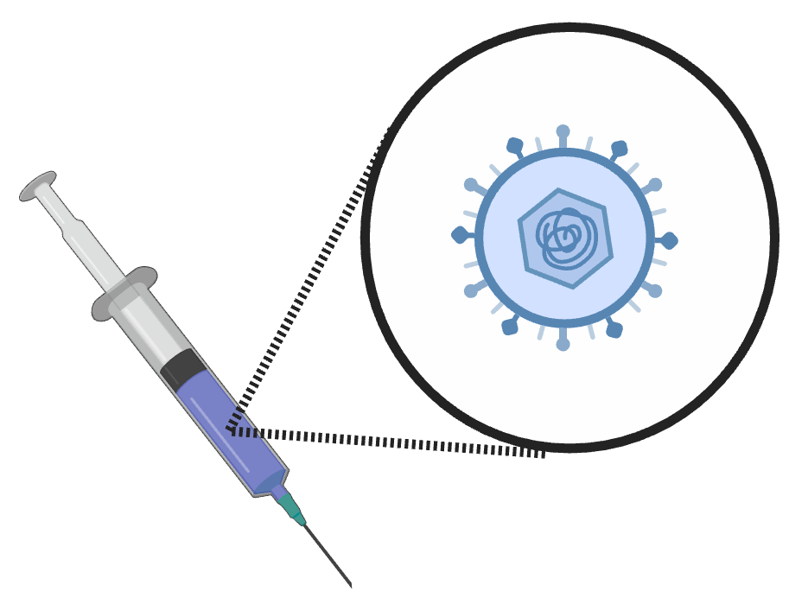
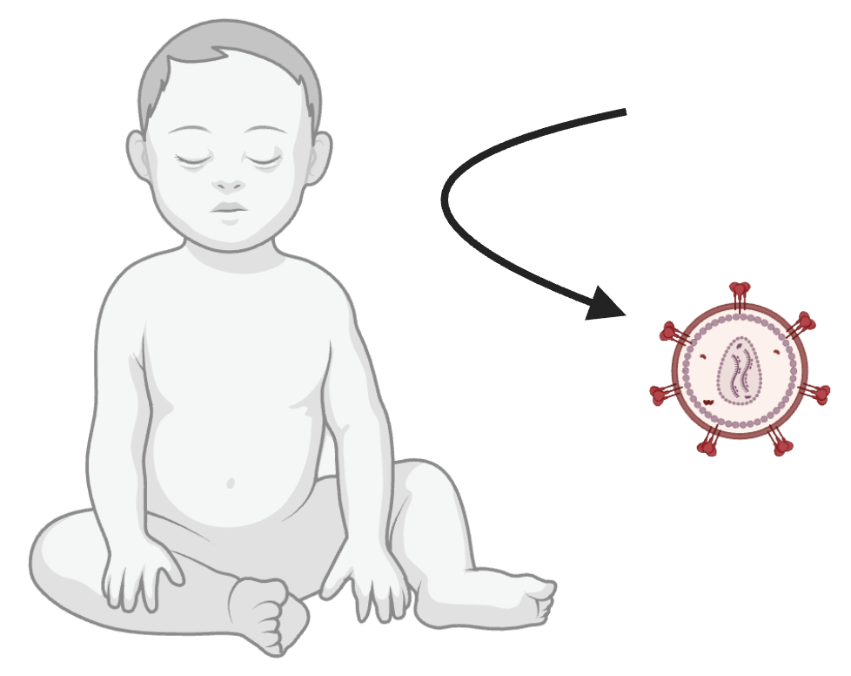
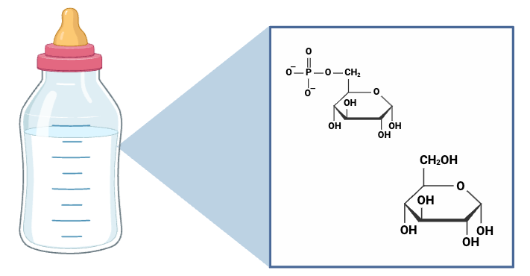
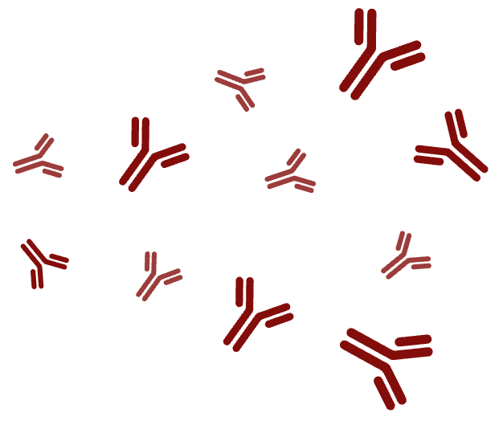
Infants exposed to HIV that remain uninfected(HEU) display altered immunity and microbiota relative to infants that are unexposed (HU)
Kuhn et al. 2006, Embree et al. 2001, Nielsen et al. 2001, Cumberland et al. 2007, Jackson et al. 2022, Monaco et al. 2016, Bender et al. 2016, Nyangahu et al. 2024

Slide 4
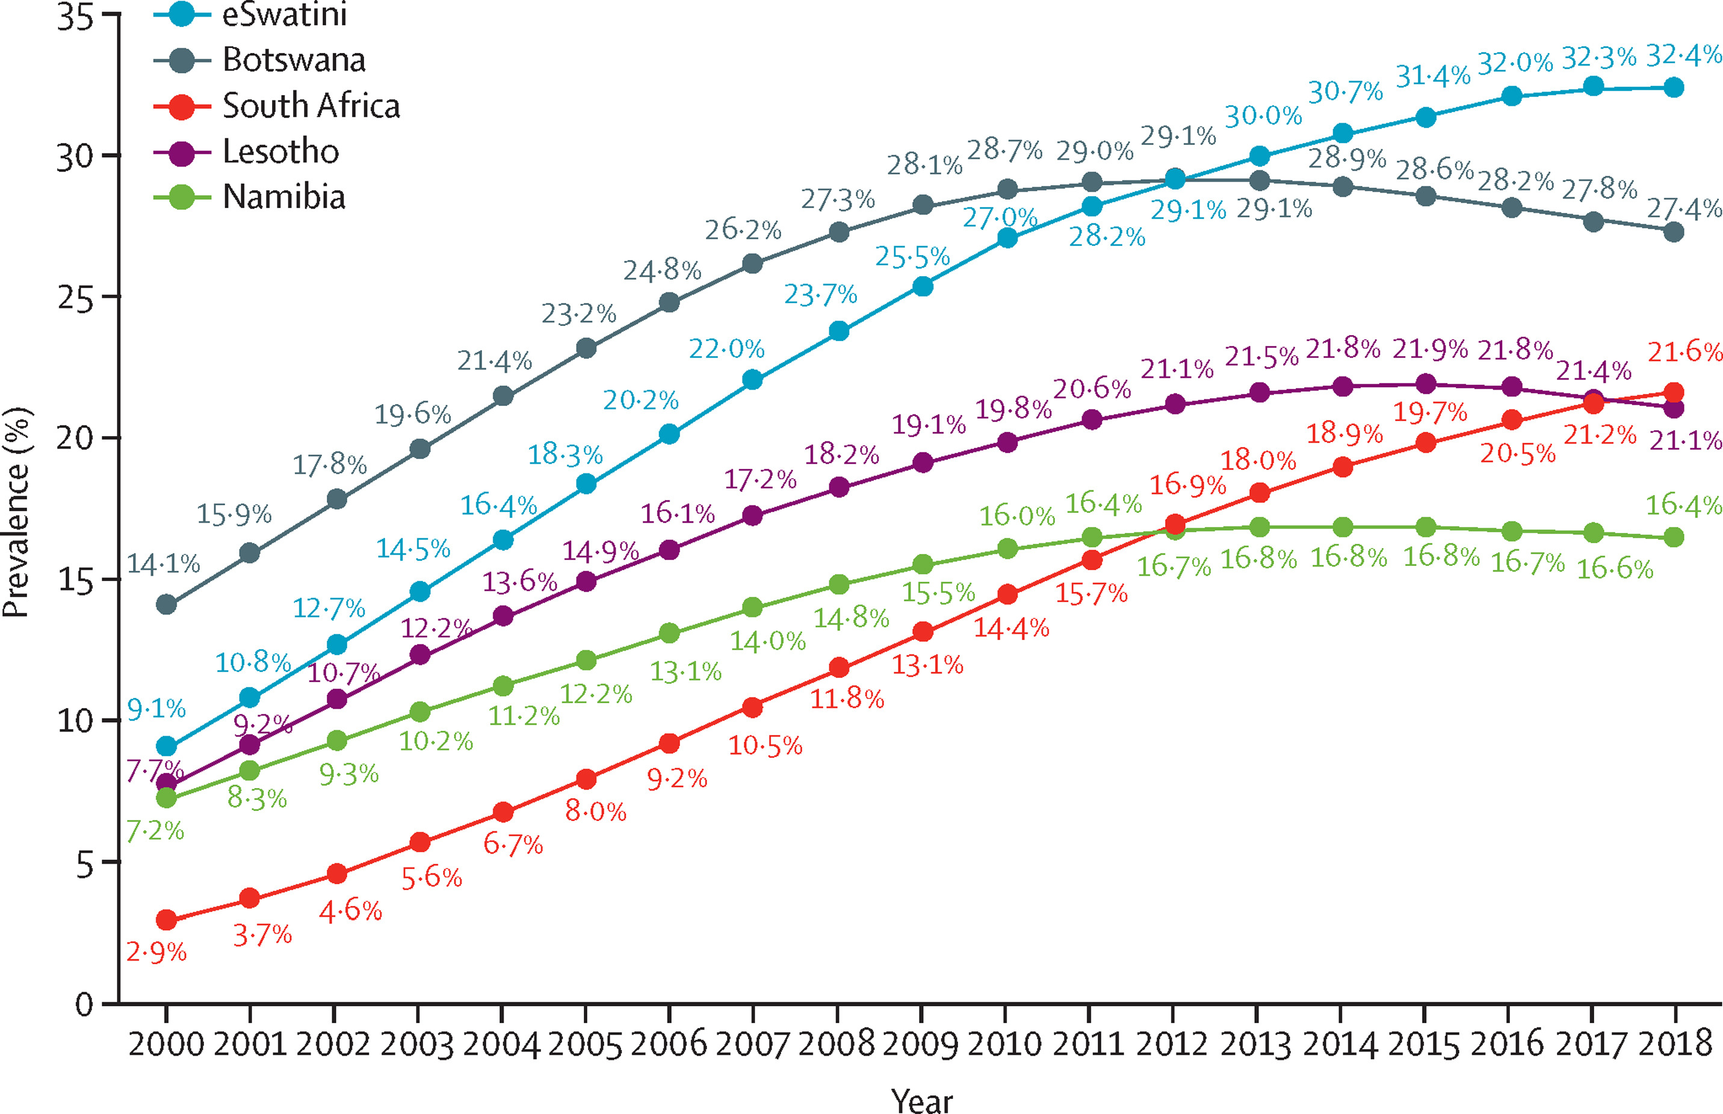
Numbers of children exposed to HIV that remain uninfected (HEU) continue to increase
>90% of HEU live in sub-Saharan Africa
Rates > 20% of all births in several countries
UNAIDS 2022 estimate: 16,000,000 HEU globally

Slide 5



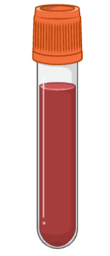

The InFANT substudy- microbial determinants of altered immunity
Hypothesis: the enteric virome is one factor influencing the morbidity of infants that are exposed to HIV but remain uninfected either by directly altering immunity, or by altering the composition of enteric bacterial communities.
~40 HEU/HU + mothers through 36 weeks
All infants were full term, vaginally delivered, and breast fed
All mothers living with HIV were receiving ART
All HEU infants receive ART for up to 6 weeks and had a negative HIV PCR at week 10
Stool/breast milk for microbiome studies
Blood (vaccine immunogenicity, PBMC, HIV DNA PCR)

Slide 6
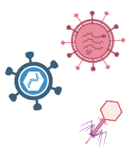
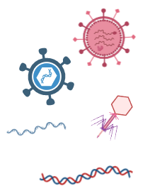

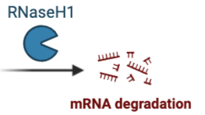
Methods
Collect
Filter out non-viral particles
Digest free DNA
Extract capsid-protected DNA+RNA

Slide 7
Infant gut viromes share similarities with maternal gut communities and, to a lesser extent, breast milk in early life

Slide 8
Viral communities in maternal breast milk are dominated by double stranded DNA viruses and bacteriophages
Relative Abundance
Predicted host
Genome type
unknown
unknown

Slide 9
Viral communities in breast milk from mothers living with HIV are altered and display higher abundance of temperate Bifidobacteria phage
Increased in MNLHIV
*predicted
Bifidobacterium longum
P=0.003

Slide 10
The gut viromes of infants are similarly dominated by double stranded DNA viruses and bacteriophages
Predicted host
Genome type
Relative Abundance
unknown
unknown

Slide 11
The gut viromes of infants exposed to HIV display increased abundance of diverse viral families, including key predicted lytic bacteriophages
Increased in HEU
*predicted
Increased in HEU
Increased in HU
P = 0.004

Slide 12

Summary
Infants exposed to HIV host an altered community of viruses and greater relative abundance of several taxa from diverse viral families in their GI tract in early life.
Infants exposed to HIV also host an elevated relative abundance of several virulent bacteriophages predicted to infect distinct host species, including Bifidobacteria
Breast milk from mothers living with HIV displays an altered composition and reduced relative abundance of temperate Bifiidobacteria phages.

Slide 13


Acknowledgements
Jaspan Group, Seattle Children’s
Donald Nyangahu
Melanie Gasper
Smritee Dabee
Colin Feng
Bryan Yi
Brandon Maust
Audrey Byrne
Allison James
Dana Kamenz
Sera Lee
Jaspan Group, University of Cape Town
Enock Havyarimana
Shameem Jaumdally
Anna-Ursula Happel
Christina Balle
Saori Iwase
Janine Huevel
Adijat Jimoh
Arvind Varsani, Arizona State University
Sam Minot, Fred Hutchinson Cancer Center
Lori Holtz, Washington University in St. Louis
All InFANT Study participants and coordinators
Funding:
R01HD102239 (Jaspan)
F32HD102290 (Brown)
K99HD106861 (Brown)

