Slide 1


IAS 2024
HIV vaccines:
where are we now and what does the future look like?
Devin Sok, PhD
July 25, 2024
Notes:
Thank you Peter and thank you to the conference organizers for inviting me to speak today
This morning, I’ll provide everyone an update on where we are in the HIV vaccine field: where are we now and what does the future look like

Slide 2

Refocus on the finish line
END AIDS
2
Notes:
In putting this together, I was trying to think of what the central message was that I wanted to convey through this presentation
And really the goal isn’t just to demonstrate that it’s possible to develop an HIV vaccine, but it’s to think about how a vaccine can contribute to the end of AIDS.
Or more precisely, to use the UNAIDS definition, it’s to eliminate HIV as a public health threat

Slide 3

The relay race to end AIDS
Despite the different paces of the development programs, we will need all these biomedical interventions in synergy with non-biomedical interventions to end AIDS
Treatment as prevention
HIV vaccine
Long-acting PrEP
Daily oral PrEP
END OF AIDS
3
Notes:
In this context, in the spirit of the Olympic Games starting tomorrow, we can picture the end of AIDS as a relay race.
There are multiple active programs at different stages of the race, passing the baton until we reach this final goal.
Importantly, each of these programs must work in concert with non-biomedical interventions in order to be effective.
The development of an HIV vaccine is likely going to finish out the race in large part because of the difficulty in developing a vaccine

Slide 4
These conventional vaccine approaches have not reliably worked for HIV
1990
1995
2000
2005
2010
2015
2020
2025
No efficacy
AIDSVAX; gp120 protein
Some efficacy
Adapted repeat with clade C
STEP trial
CD8 T cell
HVTN702
gp120 + CD8 T cell
RV144 trial
gp120 + CD8 T cell
Imbokodo
gp140 + CD8 T cell
PrEPVacc
gp120/gp140
+ CD8 T cell
4
Notes:
At this point, you are all probably familiar with the outcomes of the different HIV vaccine efficacy trials to date
None of these trials have not shown reliable protective efficacy. And none of these trials have successfullly generated broadly neutralizing antibodies.
But I do not want to focus today on these trials. Instead, I want to highlight the promising data we have in the field now and why it’s an exciting time for HIV vaccines. A reason for optimism.

Slide 5
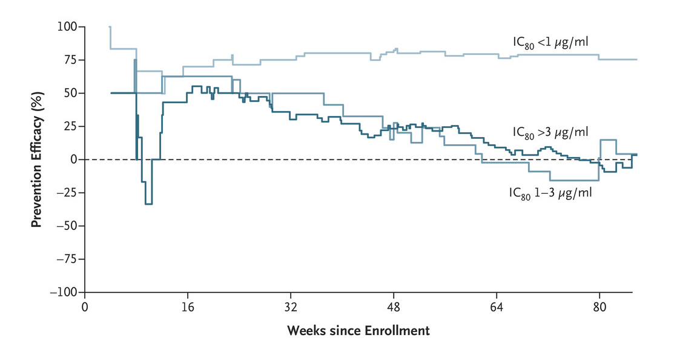
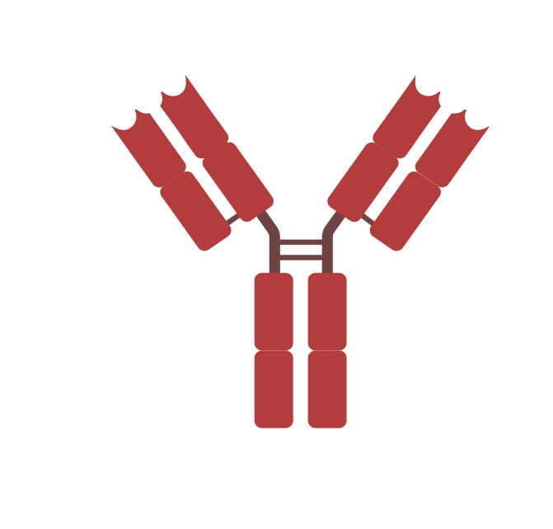
The antibody-mediated protection (AMP) trial showed a signal of protection against HIV infection
VRC01
A broadly neutralizing antibody
Key takeaways
bnAb protects against HIV
Need high amounts
Need durability
Need multiple bnAbs
Corey et al, NEJM, 2021
5
Notes:
First, I want to highlight that there has been a postiive signal in phase IIb clinical trial
The recently completed AMP trial showed 75% protective efficacy for individuals who received the broadly neutralizing antibody VRC01 and were exposed to viruses that were sensitive to that neutralizing antibody. Sensitive means the Ab is able to neutralize (or prevent the virus from infecting target cells) at low concentrations.
The key takeways from this trial that are relevant to the development of an HIV vaccine include: 1) bnABs can protect against HIV, 2) we will need relatively high amounts of bnAbs to be elicited by vaccination, 3) we need those bnAbs to present for a long time to ensure durable protection,4) we need multiple bnAbs targeting different epitopes to increase neutralization coverage
In contrast to previous HIV vaccine trials, we now have a signal to work towards that we know will be protective.

Slide 6
How do we elicit
HIV bnAbs by vaccination?
Germline-targeting
concept
Notes:
So how do we elicit bnAbs by vaccincation? This is where we pause to review the germline targeting concept

Slide 7
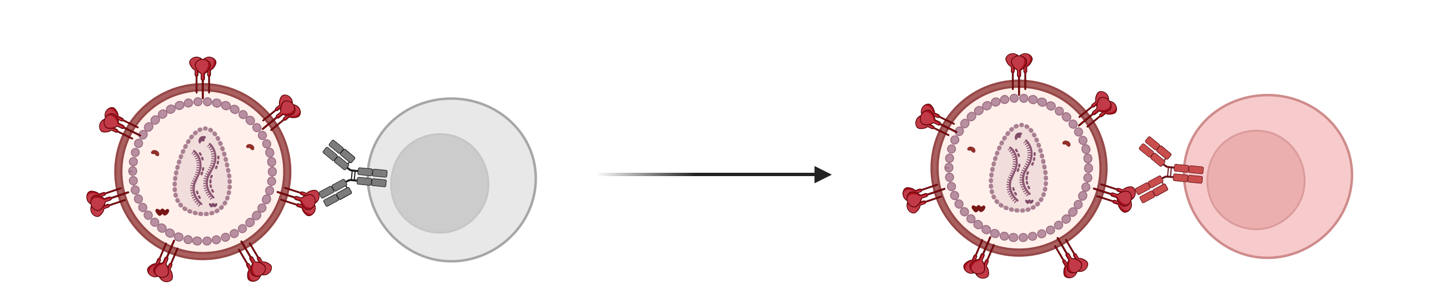
B cells recognize foreign pathogens and develop antibodies in process called affinity maturation
Germline
Mature
Affinity
maturation
VRC01
Low affinity binding to invading pathogen
High affinity binding to invading pathogen
7
Notes:
Before diving into germline targeting, I first want to explain what germline means
Whenever you are infected by a pathogen, HIV or otherwise, the B cells in your body that are responsible for producing antibody first encounters the pathogen and that initial interaction is weak
These B cells first encountering the pathogen are called naive B cells and express germline antibodies on their surface - that’s how it interacts with the proteins from the virus.
Then through this process called affinity maturation, the B cell then mutates so it can bind really tightly to the pathogen to prevent it from infecting the target cell. This is called a memory B cell and expresses a mature antibody.
The memory B cell then becomes what’s called a plasma cell which is an antibody making factory – that’s how you get detectable antibody in blood
VRC01 follows this same process – it’s considered a mature antibody and it started as germline VRC01

Slide 8


Strain-specific neutralizing antibodies
Broadly neutralizing antibodies
The germline challenge: selecting for something specific and rare
Talent scout
Years of training
Not everyone can be a Simone Biles, there are only a select few who can reach that potential. Can we come up with strategies to selectively find a Simone Biles instead of a Devin Sok?
8
Notes:
To conceptually explain germline targeting, I again would like to again draw inspiration from the Olympics and make an analogy
In this analogy, we can think about a pool of toddlers who have the potential to become someone an extraordinary althlete like simone biles
When I grow up, I would love to be simone biles, but that’s probably not in the cards for me
The question then - are there unique features that could help identify which toddler would be more likely to become an extraordinary athlete
If that is the case, then can we develop a strong talent scouting program to find those toddlers who have the potential to be simone biles and not devin sok - that is germline targeting
Once we can scout for the right talent, we will then need to train that toddler to become an extraordinary athlete
Simone biles did not become simone biles overnight
She needed training from a young age to fully reach her potential

Slide 9
Strain-specific neutralizing antibodies
Broadly neutralizing antibodies
The germline challenge: selecting for something specific and rare
Years of training
=
=
Germline antibodies
= Toddler
Germline-targeting immunogen
= talent scout
Boosting immunogens
= training program
Broadly neutralizing antibody
= Simone Biles
9
Notes:
Anchoring this analogy back to vaccines
In this case, the toddlers represent germline antibodies
Germline targeting immunogens are the talent scouts trying to find toddlers with the potential to become extraordinary athletes like simone biles
Boosting immunogens are the training programs and coaches to train the toddlers
And the end goal is to become the greatest of all time, a broadly neutralizing antibody

Slide 10

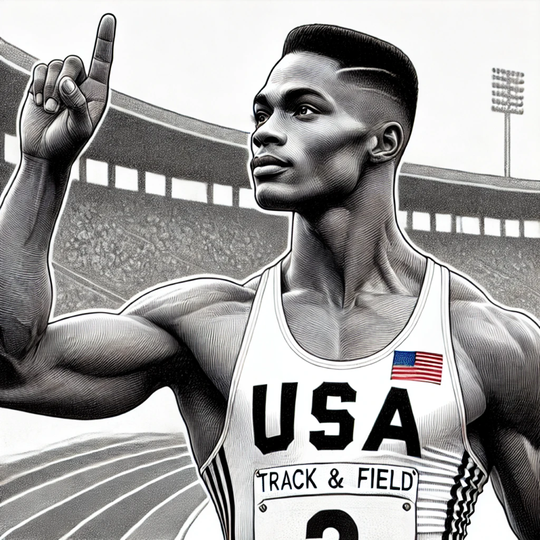
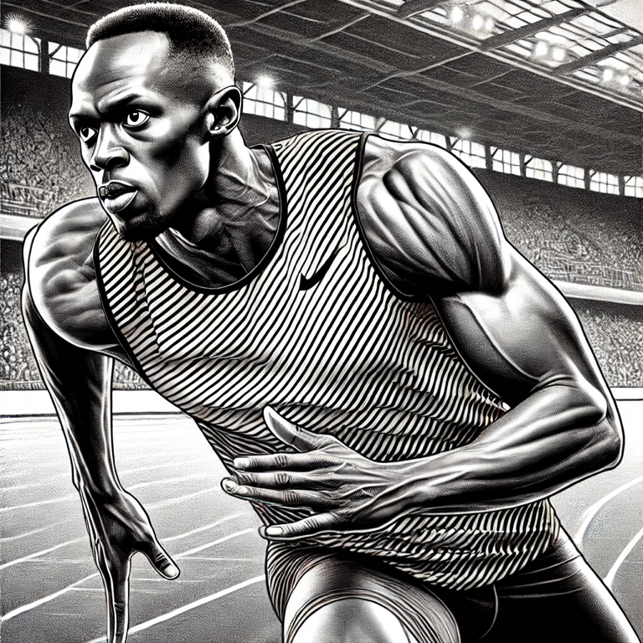
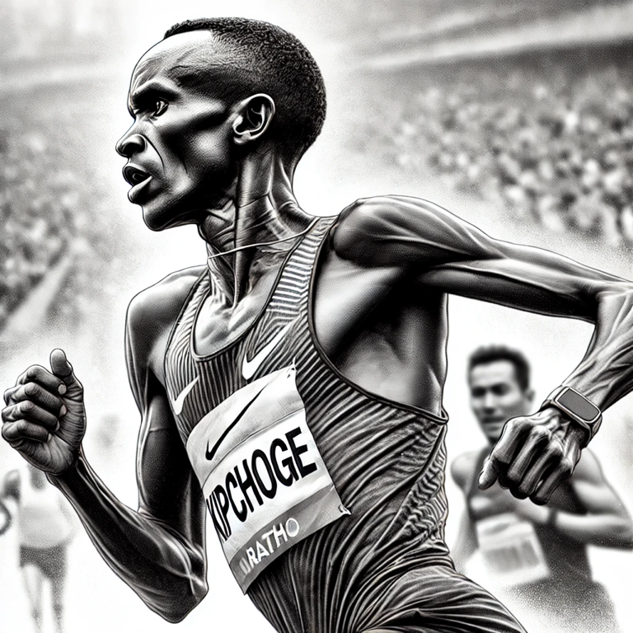
We will need to elicit an elite team of bnAbs for an efficacious vaccine
V2 apex
V3 glycan
CD4bs
Fusion peptide
MPER
Getting a Simone Biles is difficult, but we would also need a Tommie Smith, a Usain Bolt, a Serena Williams, and a Eluid Kipchoge to target up to 4 conserved epitopes on the HIV envelope trimer
10
Notes:
We also can’t stop at Simone Biles.
We similar need to identify and cultivate bnAbs against multiple epitopes on HIV.
We anticpate needing up to 4 different bnAbs elicited by vaccination for an efficacious vaccine.
Having any one of these elite athletes is already a major accomplishment, but we need a whole team – that hopefully highlights the magnitude of the challenge ahead of us

Slide 11
Where are we now
Can germline targeting work in people?
Notes:
Although difficult, we think we have the tools to do it. In this section I’ll descibe ongoing efforts to advance germline-targeting vaccines and why there is so much excitement in the HIV vaccine field right now

Slide 12
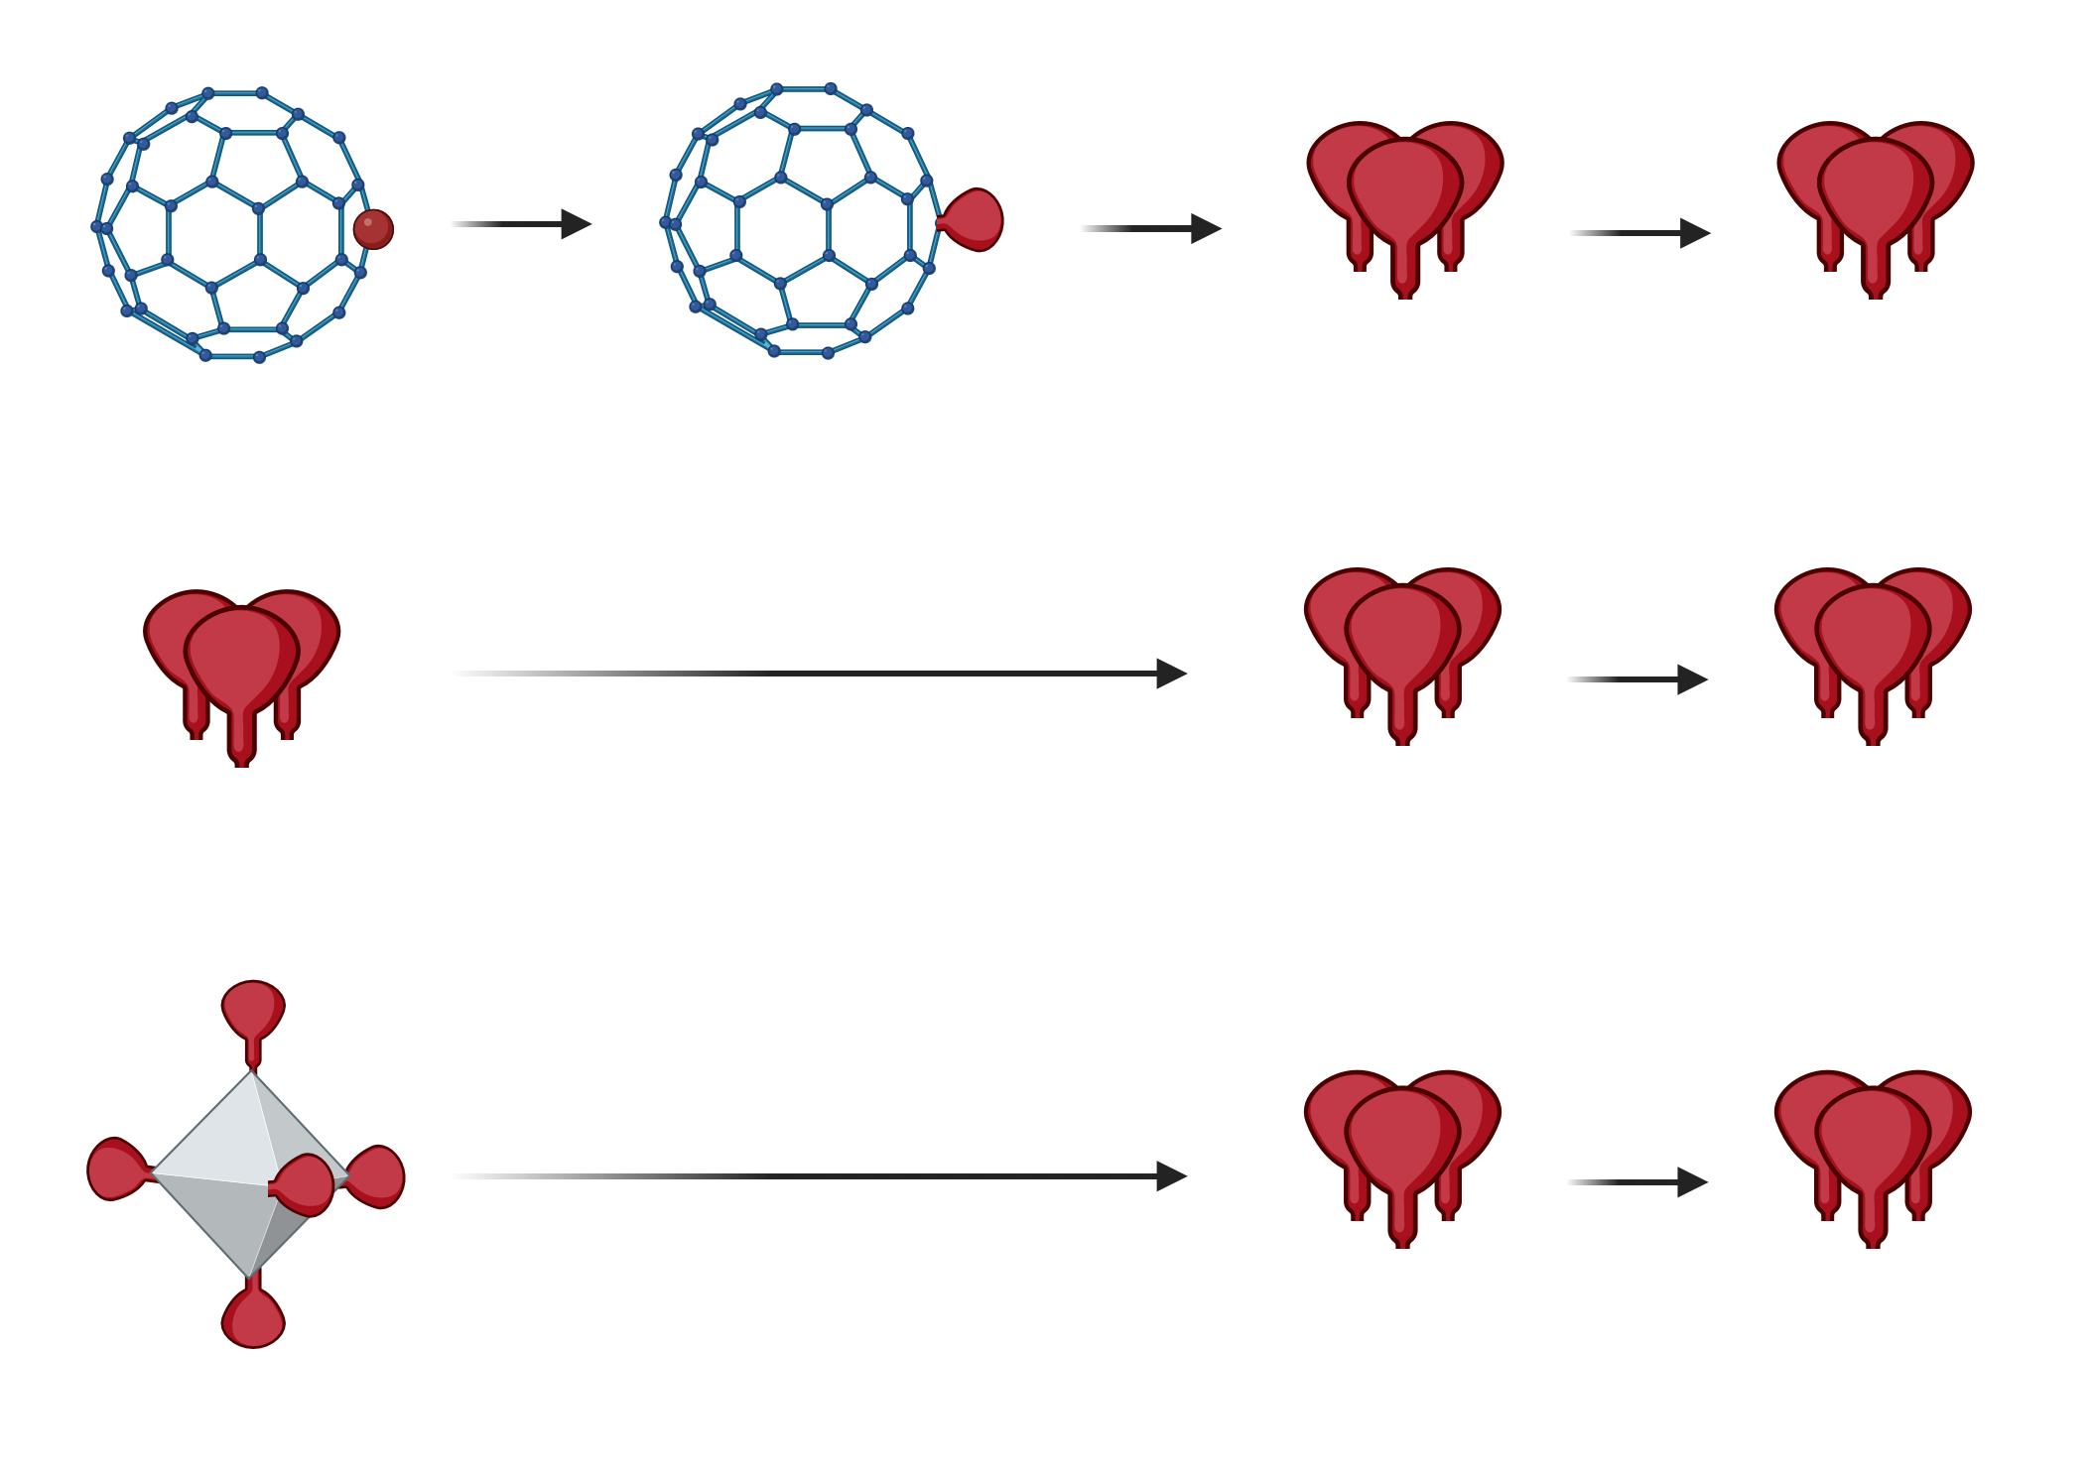
Germline-targeting: talent scouting and training programs
Immunogen candidates
Priming approaches
Promising athlete
Immunogen scout
Athlete training
Immunogen trainers
Olympic ready
Final coach
eOD-GT8
60mer
Fragment on a nanoparticle
BG505 GT1.1 SOSIP
Trimer
Larger fragment on a nanoparticle
426c core 7mer
Increasing resemblance to HIV
12
Notes:
This slide summarizes three approaches all falling under the germline-targeting concept.
We have three different germline targeting immunogens, but the framework is the same – find the potential talent with a germline targeting immunogen, train with the boosting immunogens, finish the regimen to get them olympic ready.
Each of these germline-targeting immunogens represent different talent scouting programs
I’ll first start with eOD-GT8

Slide 13
Germline-targeting: talent scouting and training programs
Immunogen candidates
Priming approaches
Promising athlete
Immunogen scout
Athlete training
Immunogen trainers
Olympic ready
Final coach
eOD-GT8
60mer
Fragment on a nanoparticle
BG505 GT1.1 SOSIP
Trimer
Larger fragment on a nanoparticle
426c core 7mer
Increasing resemblance to HIV
13

Slide 14


From concept to clinic
2010
VRC01
discovery
2013
VRC01
class
2013
eOD-GT6
immunogen
July 2015
Volume 349
Issue 6244
2015
eOD-GT8
immunogen
Priming a broadly neutralizing antibody response to HIV-1 using a germline-targeting immunogen
Joseph G Jardine, Takayuki Ota, Devin Sok, Matthias Pauthner, Daniel W Kulp, Oleksandr Kalyuzhniy, Patrick D Skog, Theresa C Thinnes, Deepika Bhullar, Bryan Briney, Sergey Menis, Meaghan Jones, Mike Kubitz, Skye Spencer, Yumiko Adachi, Dennis R Burton, William R Schief, David Nemazee
2016
Many
preclinical studies
14
Notes:
This slide summaries almost a decade of work, going from concept to clinic.

Slide 15
From concept to clinic
2010
VRC01
discovery
December 2022
Volume 378
Issue 6623
Vaccination induces HIV broadly neutralizing antibody precursors in humans
David J Leggat, Kristen W Cohen, Jordan R Willis, William J Fulp , Allan C deCamp, Oleksandr Kalyuzhniy, Christopher A Cottrell, Sergey Menis, Greg Finak, Lamar Ballweber-Fleming, Abhinaya Srikanth, Jason R Plyler, Torben Schiffner, Alessia Liguori, Farhad Rahaman, Angela Lombardo, Vincent Philiponis, Rachael E Whaley, Aaron Seese, Joshua Brand, Alexis M Ruppel, Wesley Hoyland, Nicole L Yates, LaTonya D Williams, Kelli Greene, Hongmei Gao, Celia R Mahoney, Martin M Corcoran, Alberto Cagigi, Alison Taylor, David M Brown, David R Ambrozak, Troy Sincomb, Xiaozhen Hu, Ryan Tingle, Erik Georgeson, Saman Eskandarzadeh, Nushin Alavi, Danny Lu, Tina-Marie Mullen, Michael Kubitz, Bettina Groschel, Janine Maenza, Orpheus Kolokythas, Nadia Khati, Jeffrey Bethony, Shane Crotty, Mario Roederer, Gunilla B Karlsson Hedestam, Georgia D Tomaras, David Montefiori, David Diemert, Richard A Koup, Dagna S Laufer, M Juliana McElrath, Adrian B McDermott, William R Schief
2013
VRC01
class
2013
eOD-GT6
immunogen
July 2015
Volume 349
Issue 6244
2015
eOD-GT8
immunogen
Priming a broadly neutralizing antibody response to HIV-1 using a germline-targeting immunogen
Joseph G Jardine, Takayuki Ota, Devin Sok, Matthias Pauthner, Daniel W Kulp, Oleksandr Kalyuzhniy, Patrick D Skog, Theresa C Thinnes, Deepika Bhullar, Bryan Briney, Sergey Menis, Meaghan Jones, Mike Kubitz, Skye Spencer, Yumiko Adachi, Dennis R Burton, William R Schief, David Nemazee
2022
IAVI G001: eOD-GT8 60mer (protein) primes VRC01-class responses in all participants
2016
Many
preclinical studies
15
Notes:
This work culminates in the evaluation of eODGT8 in 2022, which showed successful priming of VRC01-class responses in all participants – it’s rare when science works, so this was a huge milestone

Slide 16
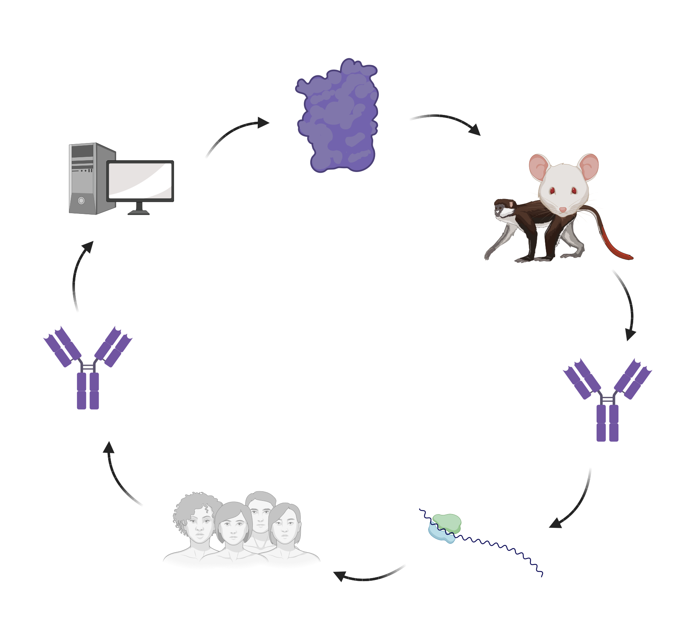
Moving from demonstrating a concept to creating a pipeline
MAKE
EVALUATE
DESIGN
IMPROVE
ACCELERATE TO A VACCINE
ANALYZE
ANALYZE
MAKE
mRNA
EVALUATE
16
Notes:
It’s one thing to try and prove a concept – that requires time and resources. Once that concept is proven, it’s another thing to create a pipeline – we can now move much more rapidly

Slide 17
We can select the right germline B cells, can we start training them?
Study groups
P (16)
P → P → B (16)
P → B (16)
B (8)
Sites: US
Dose: 100 ug each
Study Leads:
Bill Schief, Sarah Andrews, & Dagna Laufer
IAVI G002
Can we prime VRC01-class B cells using mRNA and can we then boost those responses?
Main takeaways
  mRNA responses looks better (higher numbers of VRC01-class, and greater resemblance to VRC01) than protein in G001
  Demonstrated clinical proof of principle for boosting responses
Clinical trial study unpublished
17
Notes:
So we showed in G001 that VRC01-class B cells can be primed, but can they be boosted?
The G002 was a follow on trial to test two things: can delivery by mRNA work as well as protein, and 2) can we start boosting those responses to become bnAbs

Slide 18
We can select the right germline B cells in African populations?
Study groups
P (10, Rwanda)
P (8, RSA)
Sites: Rwanda/RSA
Dose: 100 ug each
Study Leads:
Eunice Nduati, Daniel Muema, Etienne Karita, Vinodh Edwards, Bill Schief, Devin Sok, Elise Landais, Ansuya Naidoo
IAVI G003
Can we prime VRC01-class B cells in populations in Rwanda and
South Africa
Main takeaways
  VRC01-class responses can be detected in 17/18 participants
  mRNA priming responses are similar to those seen in IAVI G002
Clinical trial study unpublished
18
Notes:
The next trial aims to confirm that this concept will also work similarly in african populations

Slide 19
Germline-targeting: talent scouting and training programs
Immunogen candidates
Priming approaches
Promising athlete
Immunogen scout
Athlete training
Immunogen trainers
Olympic ready
Final coach
eOD-GT8
60mer
Fragment on a nanoparticle
BG505 GT1.1 SOSIP
Trimer
Larger fragment on a nanoparticle
426c core 7mer
Increasing resemblance to HIV
19
Notes:
The first is the eODGT8 immunogen – this was developed by taking a small fragment from HIV Env, introduce mutations to enable binding to germline VRC)1, and then display on a nanoparticle.

Slide 20
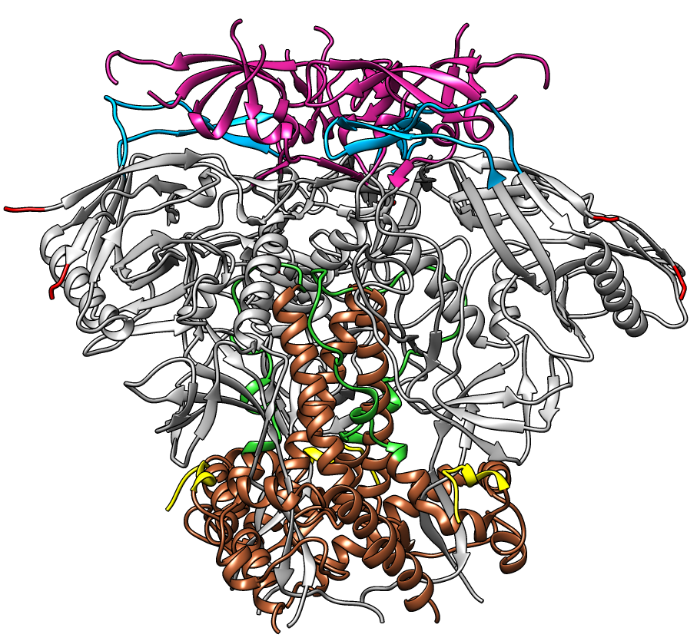

BG505 SOSIP GT1.1 design
September 2017
Volume 214
Issue 9
Design and crystal structure of a native-like HIV-1 envelope trimer that engages multiple broadly neutralizing antibody precursors in vivo
Max Medina-Ramírez, Fernando Garces, Amelia Escolano, Patrick Skog, Steven W de Taeye, Ivan Del Moral-Sanchez, Andrew T McGuire, Anila Yasmeen, Anna-Janina Behrens, Gabriel Ozorowski, Tom L G M van den Kerkhof, Natalia T Freund, Pia Dosenovic, Yuanzi Hua, Alexander D Gitlin, Albert Cupo, Patricia van der Woude, Michael Golabek, Kwinten Sliepen, Tanya Blane, Neeltje Kootstra, Mariëlle J van Breemen, Laura K Pritchard, Robyn L Stanfield, Max Crispin, Andrew B Ward, Leonidas Stamatatos, Per Johan Klasse, John P Moore, David Nemazee, Michel C Nussenzweig, Ian A Wilson, Rogier W Sanders
7-residue deletion
18 single amino acid changes
KO of 5 potential N-linked glycosylation sites
20
Notes:
This paper descibes the design of this immunogen, which includes:

Slide 21
Study groups
P, B, B (20)
Placebo (4)
P, B, B (20)
Placebo (4)
Adjuvant
AS01B
Sites: US, NL
Dose: 30, 300 ug
Study Leads:
Marina Caskey, David Diemert, Godelieve de Bree, Rogier Sanders, John Moore
IAVI C101
Can we prime VRC01-class B cells using a recombinant trimer
Main takeaways
  Serum antibodies targeting the right epitope detected in 72% of high dose recipients
  Monoclonal antibodies from B cells of select participants can neutralize HIV
Clinical trial study unpublished
Tom Caniels
Developments in Eliciting Broadly Neutralizing Antibody Vaccination
IAS, Friday, July 26
21

Slide 22
Same germline-targeting concept, different approach
Immunogen candidates
Priming approaches
Promising athlete
Immunogen scout
Athlete training
Immunogen trainers
Olympic ready
Final coach
eOD-GT8
60mer
Fragment on a nanoparticle
BG505 GT1.1 SOSIP
Trimer
Larger fragment on a nanoparticle
426c core 7mer
Increasing resemblance to HIV
22
Notes:
The first is the eODGT8 immunogen – this was developed by taking a small fragment from HIV Env, introduce mutations to enable binding to germline VRC)1, and then display on a nanoparticle.

Slide 23


426c core 7mer – immunogen deriving from a clade C virus
April 2013
Volume 210
Issue 4
February 2016
Volume 7
Issue 10618
December 2019
Volume 29
Issue 10
Overcoming Steric Restrictions of VRC01 HIV-1 Neutralizing Antibodies through Immunization
K Rachael Parks, Anna J MacCamy, Josephine Trichka, Matthew Gray, Connor Weidle, Andrew J Borst, Arineh Khechaduri, Brittany Takushi, Parul Agrawal, Javier Guenaga, Richard T Wyatt, Rhea Coler, Michael Seaman, Celia LaBranche, David C Montefiori, David Veesler, Marie Pancera, Andrew McGuire, Leonidas Stamatatos
Specifically modified Env immunogens activate B-cell precursors of broadly neutralizing HIV-1 antibodies in transgenic mice
Andrew T McGuire, Matthew D Gray, Pia Dosenovic, Alexander D Gitlin, Natalia T Freund, John Petersen, Colin Correnti, William Johnsen, Robert Kegel, Andrew B Stuart, Jolene Glenn, Michael S Seaman, William R Schief, Roland K Strong, Michel C Nussenzweig, Leonidas Stamatatos
Engineering HIV envelope protein to activate germline B cell receptors of broadly neutralizing anti-CD4 binding site antibodies
Andrew T McGuire, Sam Hoot, Anita M Dreyer, Adriana Lippy, Andrew Stuart, Kristen W Cohen, Joseph Jardine, Sergey Menis, Johannes F Scheid, Anthony P West, William R Schief, Leonidas Stamatatos
23

Slide 24
Same amount of vaccine, delivered different ways, leads to different responses
Extended priming or
fractional dose escalation
Bolus shot
One shot, one time
Multiple shots over 1 week
Lee et al, Nature, 2022; Cirelli et al, Cell, 2019; Tam et al, PNAS, 2016
24

Slide 25
Study groups
Bolus (24)
Fractional dose (24)
Adjuvant
3M-052 (+Alum)
Sites: US
Dose: 30, 100, 300 ug
Study Leads: Leo Stamatatos, Julie McElrath, Hyman Scott, Will Hahn, Peggy Yacovone, Larry Corey
HVTN301
Can we prime VRC01-class B cells using a core nanoparticle
Main takeaways
  Fractional dose escalation better responses than bolus
  Detectable neutralization against 426c virus in all participants
  75-90% responses directed to target epitope (CD4bs) after prime
Clinical trial study unpublished
25

Slide 26
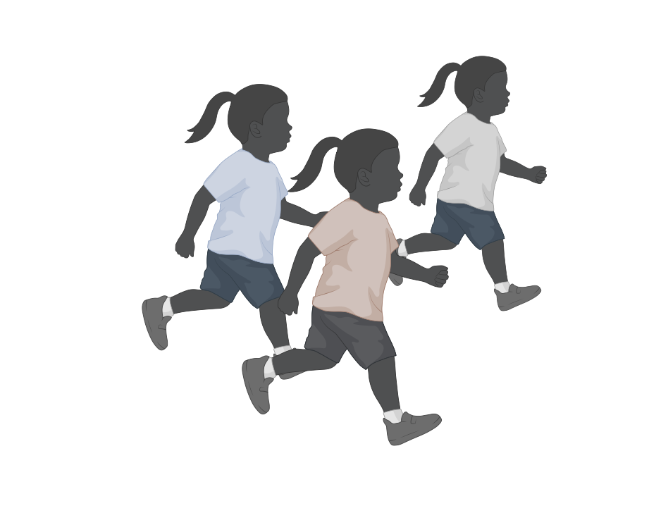
Strain-specific neutralizing antibodies
Broadly neutralizing antibodies
Zooming back out: what do these different approaches mean?
IAVI G001/2/3
Many consistent baby Simones?
What’s the best approach to train to become a Simone Biles?
IAVI C101/HVTN301
A few Simone toddlers?
26
Notes:
You can think of these results as:
we don’t know which one will get us to the finish line, it could be that both are successful at getting us there, but that is the benefit of having a portfolio approach for the development of a vaccine
What’s next – subsequent boosting steps will follow to see which will lead to a simone biles

Slide 27
But what about the other epitope targets?
V2 apex
V3 glycan
CD4bs
Fusion peptide
MPER
We’ve made progress towards one elite athlete, have we made progress with the others?
27
Notes:
we are not waiting for one to be elicited, we are working on these other epitopes in parallel to bring together this team of elite athletes

Slide 28
Study groups
Vaccine (20)
Placebo (4)
Adjuvant
Alum
Sites: US
Dose: 0.5 mcg, 2000 mcg
Study Leads:
Wilton Williams, S. Munir Alam, Bart Haynes, Lindsey Baden
HVTN133
Can we prime and boost bnAbs to MPER
Main takeaways
  Monoclonal antibodies from B cells show neutralization of HIV (15% cross-clade breadth)
  Evidence of bnAb lineage after two immunizations
William WB, et al. Cell, 2024
28

Slide 29
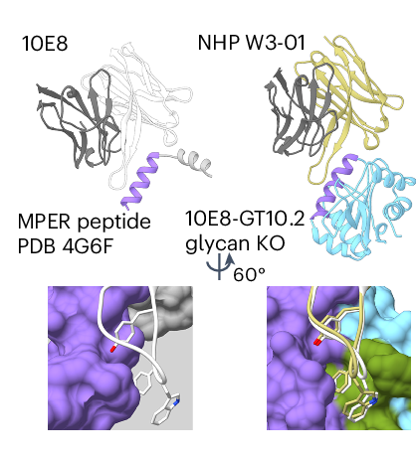

What about the other epitope targets – MPER (preclinical)
June 2024
Volume 25
Issue 6
Vaccination induces broadly neutralizing antibody precursors to HIV gp41
Torben Schiffner, Ivy Phung, Rashmi Ray, Adriana Irimia, Ming Tian, Olivia Swanson, Jeong Hyun Lee, Chang-Chun D Lee, Ester Marina-Zárate, So Yeon Cho, Jiachen Huang, Gabriel Ozorowski, Patrick D Skog, Andreia M Serra, Kimmo Rantalainen, Joel D Allen, Sabyasachi Baboo, Oscar L Rodriguez, Sunny Himansu, Jianfu Zhou, Jonathan Hurtado, Claudia T Flynn, Katherine McKenney, Colin Havenar-Daughton, Swati Saha, Kaitlyn Shields, Steven Schultze, Melissa L Smith, Chi-Hui Liang, Laura Toy, Simone Pecetta, Ying-Cing Lin, Jordan R Willis, Fabian Sesterhenn, Daniel W Kulp, Xiaozhen Hu, Christopher A Cottrell, Xiaoya Zhou, Jennifer Ruiz, Xuesong Wang, Usha Nair, Kathrin H Kirsch, Hwei-Ling Cheng, Jillian Davis, Oleksandr Kalyuzhniy, Alessia Liguori, Jolene K Diedrich, Julia T Ngo, Vanessa Lewis, Nicole Phelps, Ryan D Tingle, Skye Spencer, Erik Georgeson, Yumiko Adachi, Michael Kubitz, Saman Eskandarzadeh, Marc A Elsliger, Rama R Amara, Elise Landais, Bryan Briney, Dennis R Burton, Diane G Carnathan, Guido Silvestri, Corey T Watson, John R Yates 3rd, James C Paulson, Max Crispin, Gevorg Grigoryan, Andrew B Ward, Devin Sok, Frederick W Alt, Ian A Wilson, Facundo D Batista, Shane Crotty, William R Schief
10E8-GT10/12
Immunogen
29
Notes:
Just published last month!

Slide 30
What about the other epitope targets – V3-glycan (preclinical)
May 2024
Volume 384
Issue 6697
germline
immunization results
Vaccine priming of rare HIV broadly neutralizing antibody precursors in nonhuman primates
Jon M Steichen, Ivy Phung, Eugenia Salcedo, Gabriel Ozorowski, Jordan R Willis, Sabyasachi Baboo, Alessia Liguori, Christopher A Cottrell, Jonathan L Torres, Patrick J Madden, Krystal M Ma, Henry J Sutton, Jeong Hyun Lee, Oleksandr Kalyuzhniy, Joel D Allen, Oscar L Rodriguez, Yumiko Adachi, Tina-Marie Mullen, Erik Georgeson, Michael Kubitz, Alison Burns, Shawn Barman, Rohini Mopuri, Amanda Metz, Tasha K Altheide, Jolene K Diedrich, Swati Saha, Kaitlyn Shields, Steven E Schultze, Melissa L Smith, Torben Schiffner, Dennis R Burton, Corey T Watson, Steven E Bosinger, Max Crispin, John R Yates 3rd, James C Paulson, Andrew B Ward, Devin Sok, Shane Crotty, William R Schief
N332-GT5
Immunogen
30
Notes:
Just published two months ago!

Slide 31
Other active or planned trials in the pipeline
Trial
Type of vaccine
GrAd
T cell vaccine; gorilla adenovector
HVTN 302
Membrane-bound trimer, mRNA vaccine
HVTN 303
Fusion peptide immunogen, protein prime/boost
IAVI C112
Trimer immunizations in PLWH
HVTN 142
CMV-vaccine to elicit T cell responses
+ many others …

Slide 32
Where is the HIV vaccine field now
New HIV vaccine concepts are now being tested in human trials
The trial pipeline is robust with many promising immunogens
We are on the pathway to elicit broadly neutralizing antibodies by vaccination
32
Notes:
We now have the game plan
we’ve identified the promisng athlethes and we are now working on training the team

Slide 33
What does the future look like?
Innovations will drive us to an
HIV vaccine

Slide 34
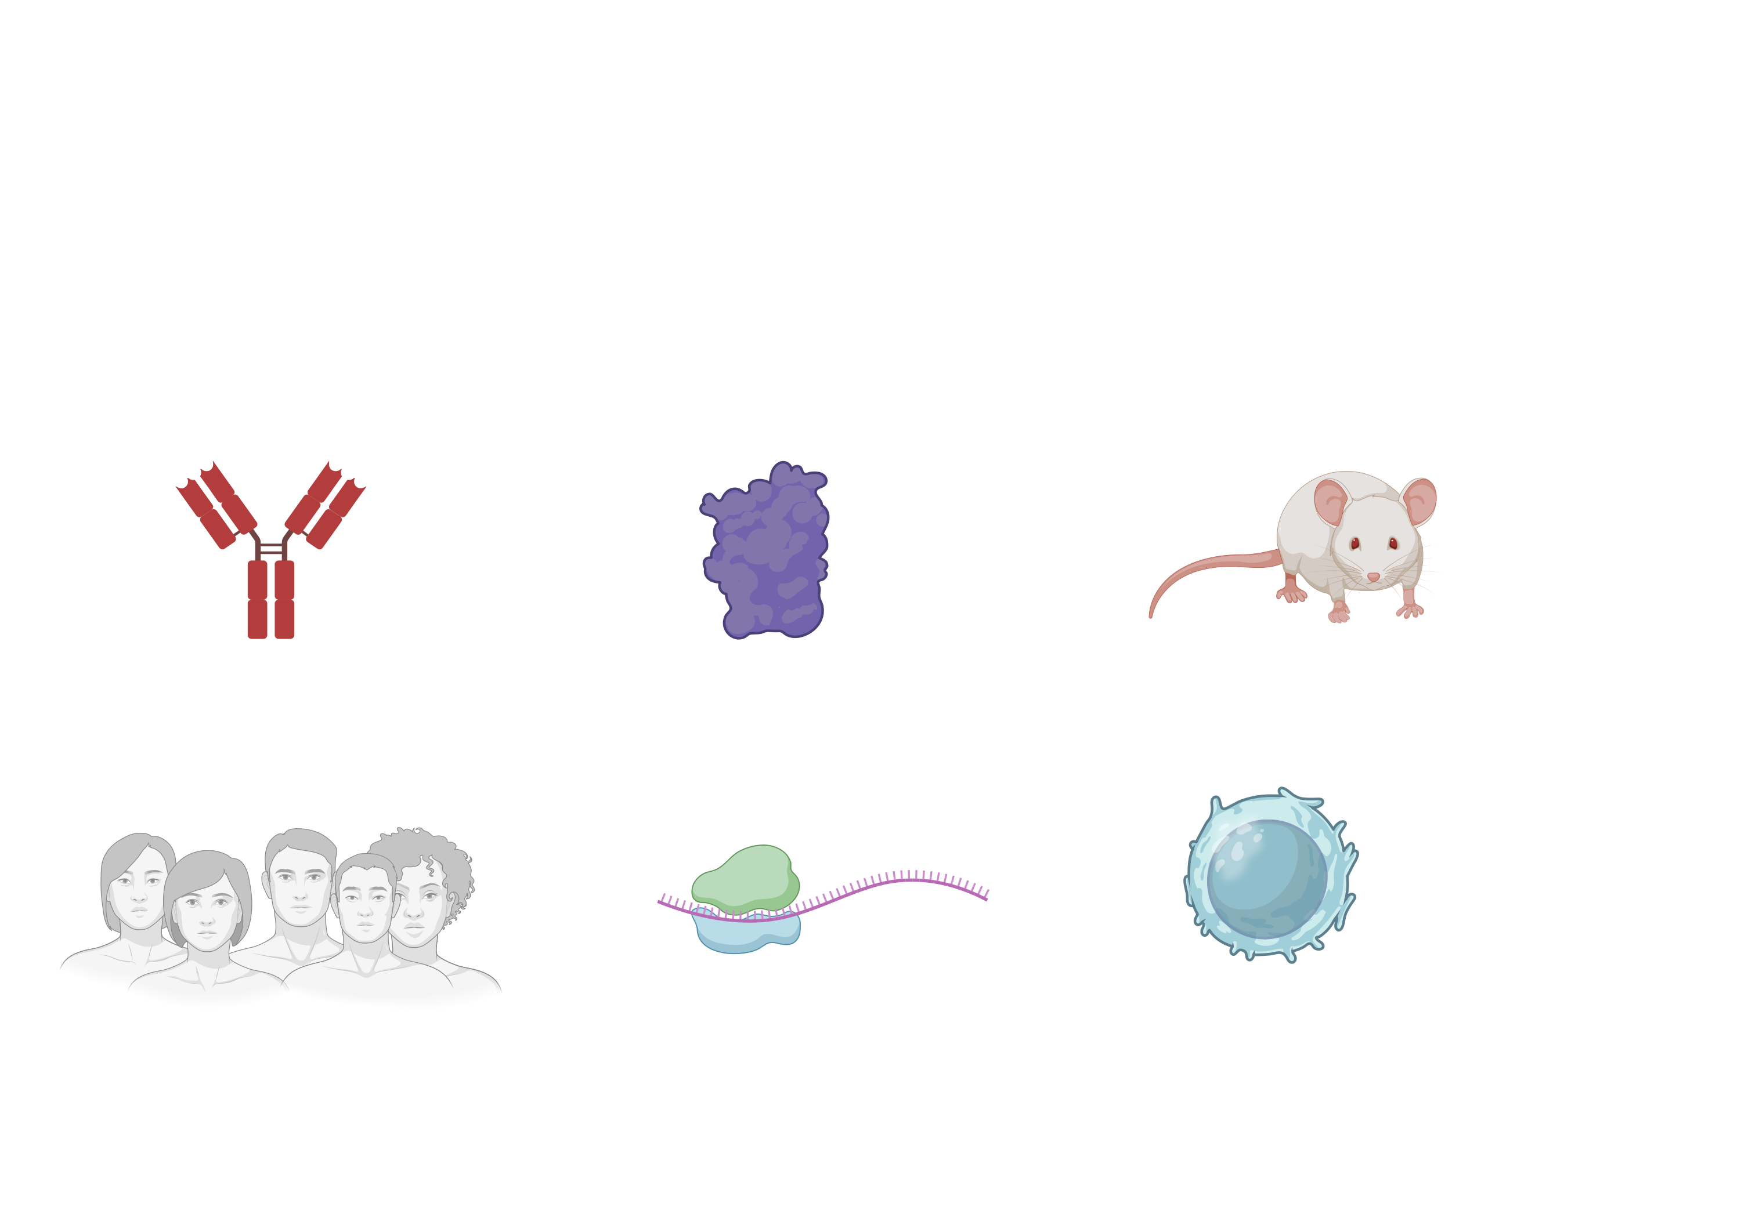
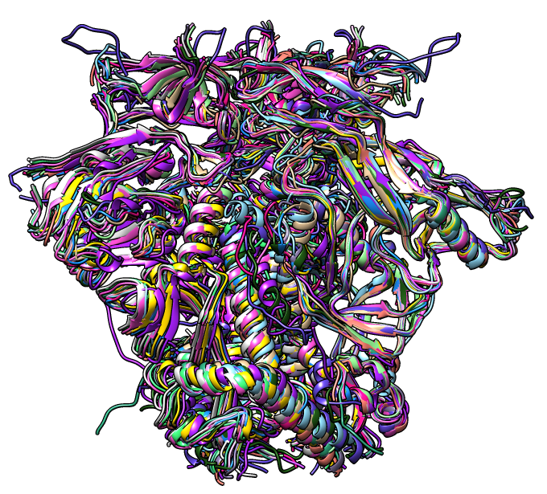
Innovation as the engine for acceleration to a vaccine
bnAb discovery
mRNA platform
PLWH cohorts
Protein design
Structural revolution
Immunology
34

Slide 35
How innovation will pick up the pace towards the finish line
Faster trials to evaluate immunogens
Partner closely with community and advocates
Re-enroll participants to test different boosting strategies
Perform trials where they can be approved and executed quickly
Do trials concurrently and analyze the results quickly
Many promising immunogens need to be tested safety and rapidly in people
35
Notes:
We know where we’re going, we need to do a lot, a lot faster to get to that destination
We need multiple trials concurrently to get all the data we need to move quickly, compress the work, be efficient
We now have athletes,

Slide 36
How innovation will pick up the pace towards the finish line
New tools for immunogen design
Resources and training for emerging scientists in these new tools
Invest in computational access
Solve protein and antibody production bottlenecks
AI/ML-guided immunogen design can support new ideas and concepts
36

Slide 37
How innovation will pick up the pace towards the finish line
T cell vaccine development
Incorporate AI/ML to guide vaccine development
Invest in new platforms and approaches for T cell vaccine development
Integrate T and B cell vaccine trials
We’ll likely need both B and T cell responses as part of an efficacious vaccine
37

Slide 38
How innovation will pick up the pace towards the finish line
Do not forget affordability and access
Invest in affordable and scalable vaccine platforms
Maximize the duration of protection
Minimize the number of vaccinations
Preserve and fortify access and support to the most vulnerable populations around the globe
Shorten the timeline as much as possible between proof-of-concept and product development
38
Notes:
Vaccines don’t end epidemics, vaccinations do
The gold medal -

Slide 39
Reflections
Getting to
the finish line

Slide 40
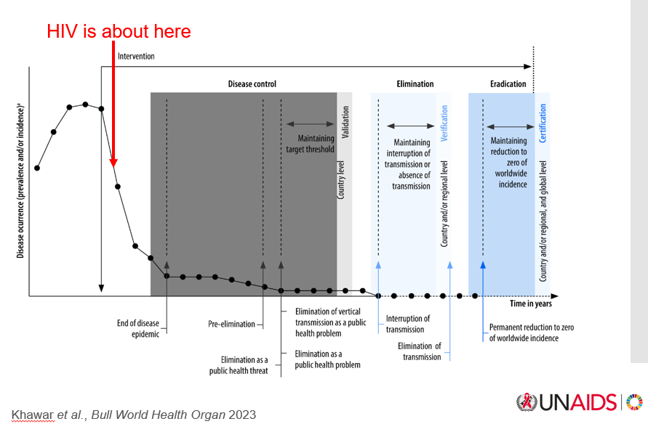
We need all the affordable and accessible tools to control the epidemic, but we cannot just stop there
40
Notes:
Recognize that the HIV epidemic is a fire that can get out of control at any time
To eliminate HIV as a public health threat; reduce the embers to the point so we don’t have a fire
Long actings will hopefully get us closer to this point, but I believe a vaccine will be essential for supporting epidemic control and eventually eliminating hiv as a public health threat
Vaccines don’t end epidemics, vaccinations do – we need to work closely with community and other stakeholders on the science of implementation;
Following this conference’s theme of putting people first

Slide 41
HIV vaccine synergistic w/ other prevention tools
Extended duration of protection (optimally >5 years) delivered before sexual debut
A vaccine could spare long-acting ARTs for treatment
Reduced contact points with health care system
Availability of different prevention tools is important
41

Slide 42
Acknowledgements
HIV community
IAVI
Fred Hutch
DALL-E and Olympic Athletes
Bill Schief
Vincent Muturi-Kioi
Hester Kuipers
Karie Youngdahl
Mark Feinberg
G002 team
G003 team
Leo Stamatatos
Shelly Karuna
Biorender
Clinical trial participants
KWTRP
Clinical site leads
Eunice Nduati
Scripps/CHAVD
Pervin Anklesaria
Carlos Diazgranados
Thandi Onami
AMC
IAS
Rogier Sanders
Sharon Lewin
IAS2024 organizers
Scripps/CHAVD
Dennis Burton
Andrew Ward
Duke/CHAVD
USAID
Wilton Williams
Matt Barnhart
Margaret McCluskey
GHIC
Olayinka Fagbayi
Labeeb Abboud
Imperial College
VRC
Robin Shattock
Nicole Doria-Rose
42

