Slide 1
PrEP implementation in low- and middle-income countries:
Challenges and opportunities
Elizabeth Irungu, Jhpiego
Notes:
Thank you for that lovely introduction and I would like to take this opportunity to thank the conference organizers for inviting me to share on PrEP implementation in low- and middle-income countries.
[CLICK]

Slide 2
Breaking the cycle:
From squandering to seizing opportunities for impactful HIV prevention
Notes:
I have decided to revise the title and call it Breaking the cycle: From squandering to seizing opportunities for impactful HIV prevention.
[CLICK]

Slide 3
Outline
Where we are – and gaps in progress
Explanations (excuses) for slow progress
What we must do now
  Introduce choice
  Simplify delivery
  Address missed opportunities
  Donors, step up
Closing thoughts
Notes:
Here is an outline of my talk this morning. We will review progress in PrEP uptake, explanations for slow progress and some of what we must do now to improve PrEP implementation. And then finish with some closing thoughts
[CLICK]

Slide 4
History of ARV-based HIV prevention
PrEP product | Efficacy results | Years after efficacy results
Oral PrEP | 2010
PrEP ring | 2016
CAB PrEP | 2020
1
2
3
4
5
6
2 years
3 years
4 years
1 year
1 year
½ yr
Time to approval by regulatory body
Approvals are getting a little faster with each new product
Time to WHO recommendation
Notes:
So some history, the first efficacy results for oral PrEP read out in 2010. It was two years before FDA approved oral PrEP and another three years before WHO issued recommendations.
WHO issued recommendations for PrEP ring 1 year after EMA gave positive opinion. For CAB -LA, FDA approval came one year after the study results and WHO recommendation came shortly after.
We are getting a little faster with regulatory approvals and time to receiving WHO recommendations for newer products.
[CLICK]

Slide 5
History of ARV-based HIV prevention
PrEP product | Efficacy results | Years after efficacy results
Oral PrEP | 2010
PrEP ring | 2016
CAB PrEP | 2020
Lenacapavir | 2024 | ?
1
2
3
4
5
6
2 years
3 years
4 years
1 year
1 year
½ yr
Time to approval by regulatory body
Time to WHO recommendation
Notes:
Yesterday we listened to efficacy results for Lenacapavir and we are looking closely and waiting eagerly for approval by regulatory bodies and recommendation by WHO.
[CLICK]

Slide 6
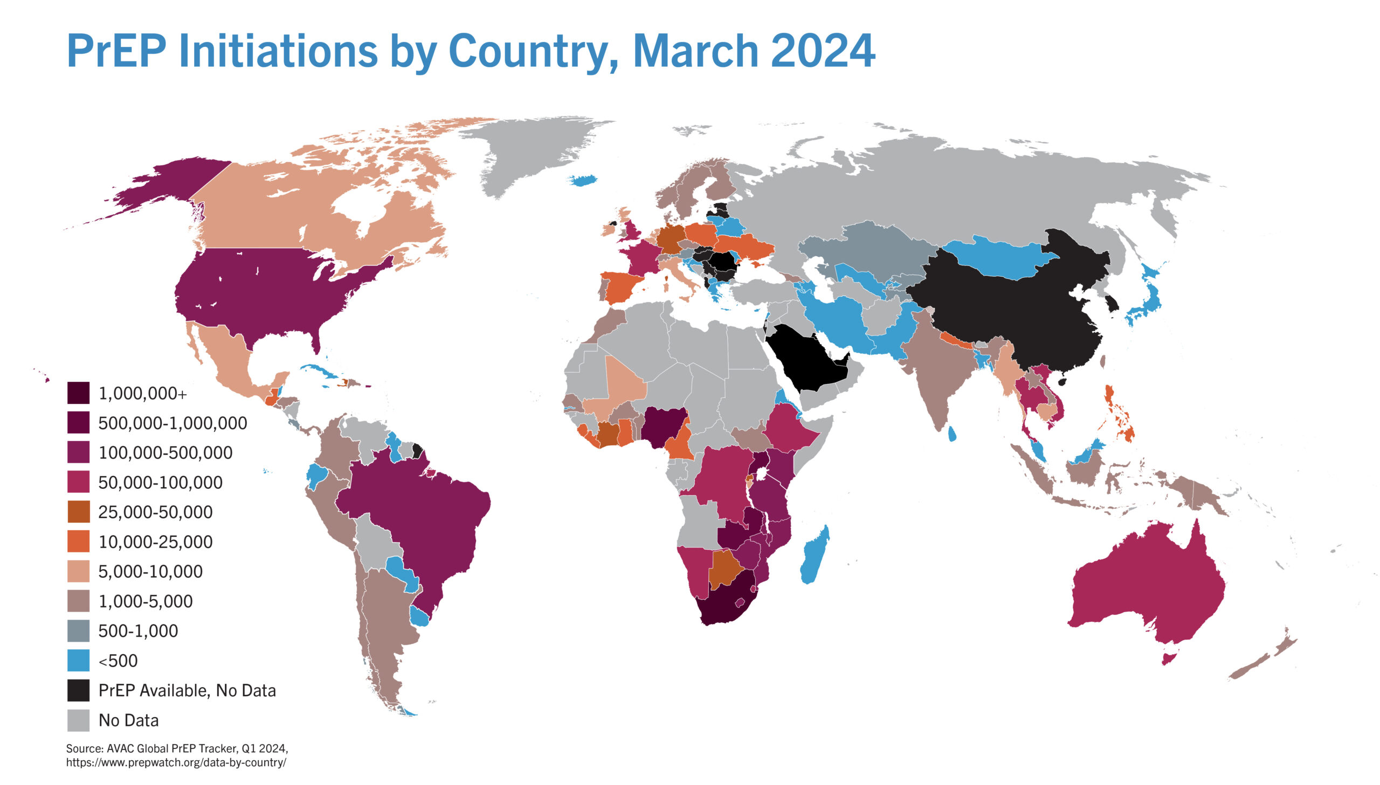
Global PrEP uptake
It has taken 12 years to reach 6.7 million PrEP initiations
Almost all oral PrEP
  DVR – 2,000
  CAB PrEP – 12,000
UNAIDS goal is to reach 10 million PrEP users by 2025
Source: AVAC Global PrEP Tracker
Notes:
Global PrEP Uptake ..As at the end of Q1 this year, there has been a cumulative 6.7 m new PrEP initiations globally.
Of the 6.7m, 3m have initiated in the last year.
Almost all initiations are oral PrEP initiations, we have very few on PrEP ring. Almost all of the 12,000 CAB-LA initiations are in the US.
The UNAIDS target is 10M initiations by 2025 – doesn’t look like we are on track to reach this target.
[CLICK]:

Slide 7
Is 6.7 million PrEP initiations impressive?
17 million
new HIV infections since 2012
Notes:
Is 6.7m initiations impressive? Should we be impressed with ourselves? Between 2012 when oral PrEP was approved by the FDA to date there has been an estimated 17m new HIV infections. 17m, yet we have a potent HIV prevention intervention that could have averted these infections if it was scaled up, effectively.
To curb new HIV infections, we need upwards of 10m people on PrEP, perhaps even 100 million. 6.7m is dismal;
We. Should. Be. Embarrassed.
[CLICK]

Slide 8
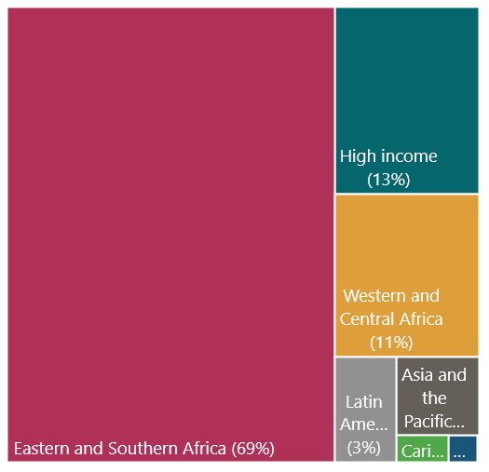

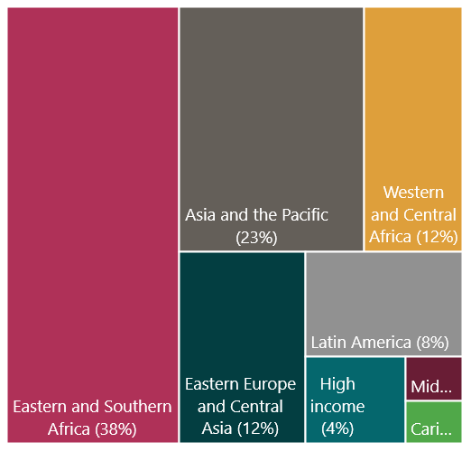
Gaps by region
Cumulative PrEP initiations through Q1 2024
(n = 6.7m)
New HIV infections, 2022 (n = 1.3m)
Source: UNAIDS 2023 report
Source: PrEPWatch.org
Notes:
Slide 8: I’d like to share these charts with you. The chart on the left shows new HIV infections in 2022, by region. These data here are from the UNAIDS 2023 report. The chart on the right shows cumulative number of PrEP initiations, through Q1 of 2024.
[CLICK]
Here, you see that east and southern Africa and western and central Africa in red boxes contribute to the vast majority of new infections and also has the highest number of PrEP initiations. So PrEP is going to where it is needed most – even though it is not sufficient since the new infections are still so high
[CLICK]

Slide 9
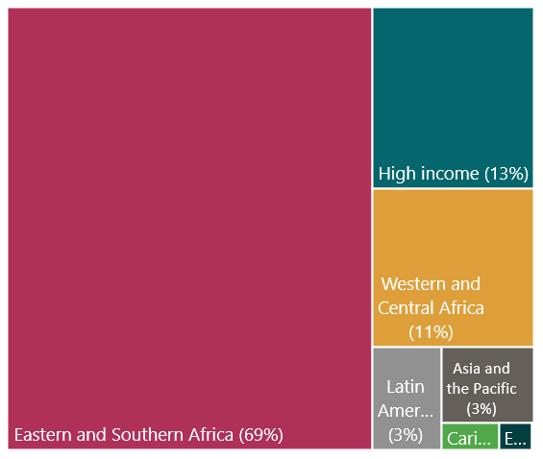

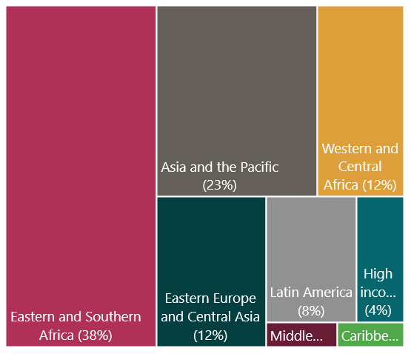

Gaps by region
New HIV infections, 2022 (n = 1.3m)
Cumulative PrEP initiations through Q1 2024 (n = 6.7m)
Source: UNAIDS 2023 report
Notes:
But here are some gaps. Regions such as Asia and the Pacific and Eastern Europe and Central Asia combined contribute to about 35% of new HIV infections and yet PrEP initiations in these regions are so low – at less than 5% of all initiations. We cannot say we are doing well until we are doing well everywhere.

Slide 10
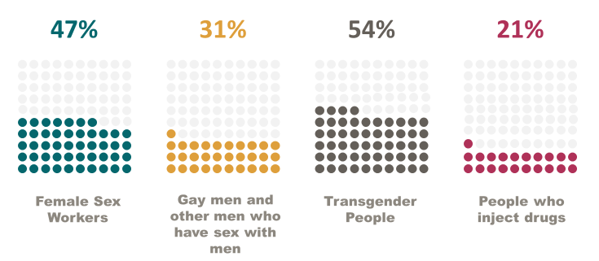

Failure to reach key populations with prevention
Coverage of HIV prevention programs is low among key populations
Source:
UNAIDS 2023 report
Source:
UNAIDS 2023 report
Coverage of HIV prevention interventions among key populations, select countries with available data, Asia and the Pacific, 2018–2022
Notes:
Key populations have huge gaps in prevention coverage.
This chart depicts data from select countries with available data in Asia and the Pacific – and this is HIV prevention coverage.
PrEP coverage specifically among key populations is very low, typically under 5% - will not complete a row of dots. We are not following the epidemic – key populations need PrEP and we are not getting it to them
[CLICK]

Slide 11
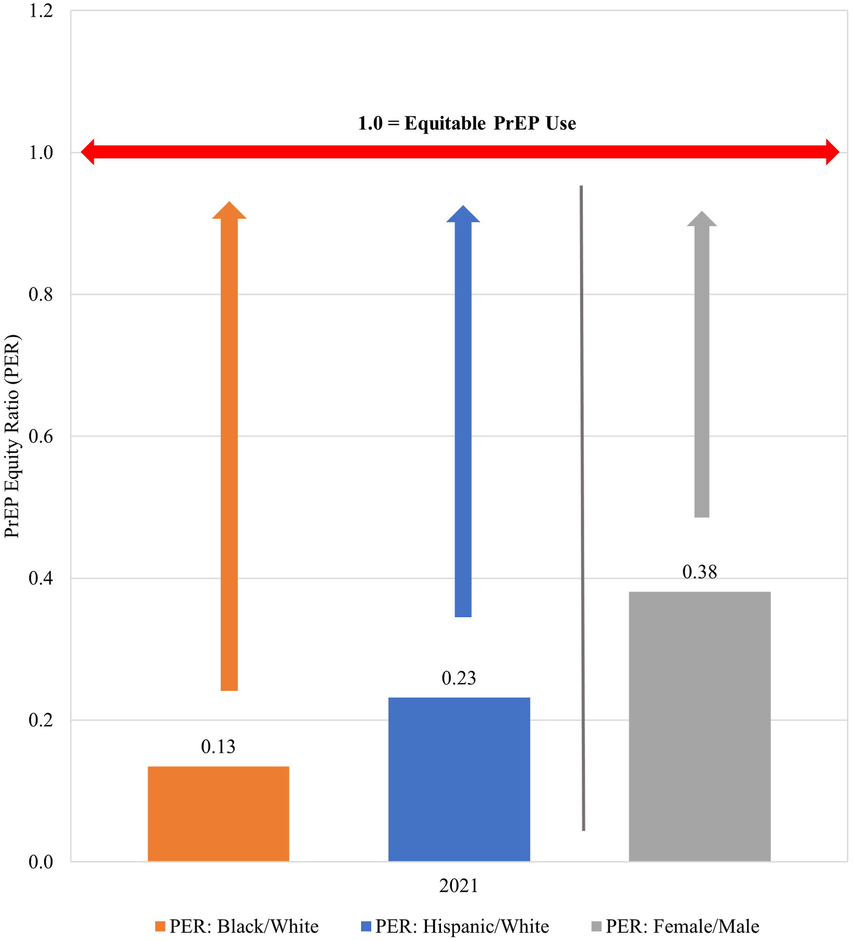
High-income countries fail to match PrEP use to PrEP need
PrEP fails to reach the people who need it most
Black and Hispanic populations in the United States:
  Experience disproportionate shares of HIV infections
  Have lower PrEP provision relative to population need
High-income countries must address PrEP inequities among Black and Hispanic men and women
Source:
UNAIDS 2023 report
Ref: Sullivan et al. Lancet 2024
Notes:
And its not just LMICs with gaps. PrEP fails to reach the people who need it most even in HIC.
HIV incidence in the US is highest among Black and Hispanic populations but PrEP use among these populations is lowest.
A recent analysis of pharmacy data done by Patrick Sullivan demonstrates PrEP inequities.
In this figure, the length of the arrows represents the extent of the inequities compared to equitable use – see how long the arrows are for black and Hispanic populations and also for women.
Addressing these inequities among specific populations in HICs is paramount.
[CLICK]

Slide 12



Explanations (excuses) for slow progress
Product
Users and potential users
Providers and health systems
  Frequent dosing
  Side effects
  Not easy to conceal
  Not enough options
  Do not perceive benefit
  Experience stigma and judgment
  Competing life priorities
  Not aware
  Overburdened
  Difficulty discussing sexual health
  Complex health systems
Source:
UNAIDS 2023 report
Net consequence is low uptake and/or early discontinuation without restarting
Ref: Celum et al. JIAS 2023
Notes:
So what are the excuses we make for slow progress and gaps in implementation?
There are problems with daily dosing and side effects for oral PrEP, not easy to conceal oral PrEP, the bottle rattles and so users are likely to experience stigma and judgement when discovered to be using;
We also say that people who would benefit most from prevention do not perceive its benefit or are not aware or have competing life priorities that they have to attend to. We understand that providers are few and overworked and find it challenging to include conversations about sexual health and HIV prevention during their consultations.
And that the health systems are really very complex to navigate for people who are not unwell and yet want to protect themselves from HIV.
[CLICK]
The net consequence of all these is we have low uptake of PrEP and early discontinuations for those who start. And this makes PrEP programs look like they are failing or not doing well – but how much have we invested to get PrEP programs to succeed?
[CLICK]

Slide 13
What must we do now to address gaps?
Notes:
What should we be doing to address these gaps?
[CLICK]

Slide 14
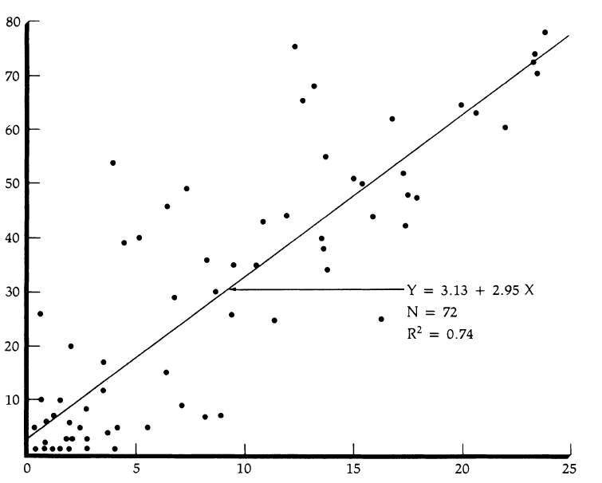
Choice improves coverage
Contraception
HIV prevention
SEARCH study: Introduction of CAB-LA increased coverage from 28% to 70%
Psychology of choice
  Enhances motivation and engagement → increased persistence on chosen method
  Each additional method increases coverage → expands the clientele
Contraceptive prevalence rate
Index of contraceptive availability
  Increased persistence, increase in contraceptive prevalence for each additional method
Ref: Kamya et al. CROI 2024 & Jain et al. Stud Fam Plan 1989
Notes:
One, let us introduce PrEP choice.
We know that availability of choice puts the user in control. Making active choices from available options helps people have greater ownership and satisfaction over a decision, and makes them more likely to follow through.
A WHO systematic review reported increased persistence and an increase in contraception prevalence rate with each additional contraceptive method. We are beginning to see a similar story in HIV prevention.
At the SEARCH trial results presented at CROI earlier this year, we were informed of an increase in HIV prevention coverage from 28 to 70%, when CAB was introduced into the existing mix of oral PrEP and PEP.
[CLICK]

Slide 15
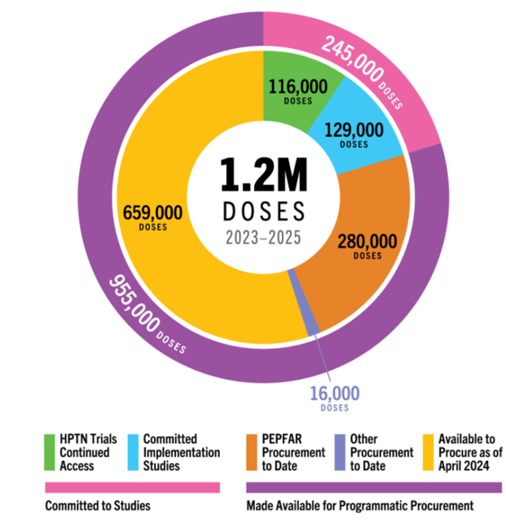
PrEP choice is becoming a reality – but very slowly
Non-commercial CAB supply in low and middle income countries, 2023-2025
Countries poised to receive CAB-LA and PrEP ring through PEPFAR and Global Fund
  Zambia, Zimbabwe, Malawi, Ukraine, Vietnam, Philippines, Eswatini, Lesotho, Thailand, Mozambique, Namibia, Nigeria, Rwanda, South Africa
Source: AVAC.org
Notes:
PrEP choice is becoming a reality – but it is happening really slowly.
While I am careful not to pitch a method against another, from my point of view when we give oral PrEP or PrEP ring prescriptions we do not have certainty about use in the way we do when we administer an injection. With an injection we know for sure that an individual is protected for 2 months or 6 months depending on product.
If we truly want to be serious, we have to take this opportunity to get millions of injection doses so that millions of people can get effective prevention.
There are a couple of countries poised to receive CAB in national PrEP programs this year and next, but they are few. As you can see in this infographic, there are about 1.2 million doses available for LMICs in 2023-2025. These would benefit only about 200,000 people; a really small number
I have learnt that even the few doses available have not all been purchased. What incentive will manufacturers have to produce more doses, if the little that is available has not been purchased? The price will never go down if there is no mass production, and mass production cannot happen if there are no orders and purchases.
This is one cycle we must break out of. I would ask donors to take the risk and purchase existing CAB doses; and governments, take the risk and generate demand for CAB, this is how we will bring the price down and increase access.
[CLICK]

Slide 16


Implementation studies offering PrEP choice
Notes:
There are a number of implementation studies that are providing PrEP choice. Many of the participating countries are in Africa and south America. I’d say, these are enough – we do not need more! Let us now move to program implementation
[CLICK]

Slide 17
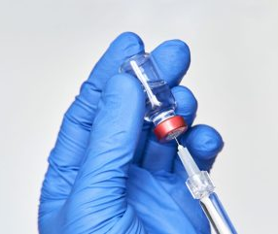
Let’s set a new standard with Lenacapavir
Expedite submission to and review by regulatory agencies
Donors begin to have pricing negotiations and volume guarantees
WHO to issue recommendations and develop guidelines swiftly
Countries develop introduction plans
  a few large, coordinated non-research pilots that serve many countries
  understand how to create demand for prevention
Photo source: Clinical Trials Arena
Notes:
We now have Len results out. Let us seize this opportunity to set a new standard and make it available to all who need it fast.
Gilead expedite submissions to regulatory bodies, who should then be swift to review
Donors should start having pricing negotiations now and volume guarantee discussions now to ensure a sustainable supply before generics come into market
WHO should set up systems now to ensure recommendations are released as soon as possible
Countries should be thinking about introduction plans. Each country does not have to do its own introduction study. We should instead have a few coordinated non-research pilots, with thousands of PrEP users across many countries that will provide relevant information for Len introduction and for other new products.
[CLICK]

Slide 18
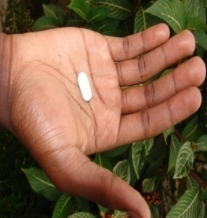

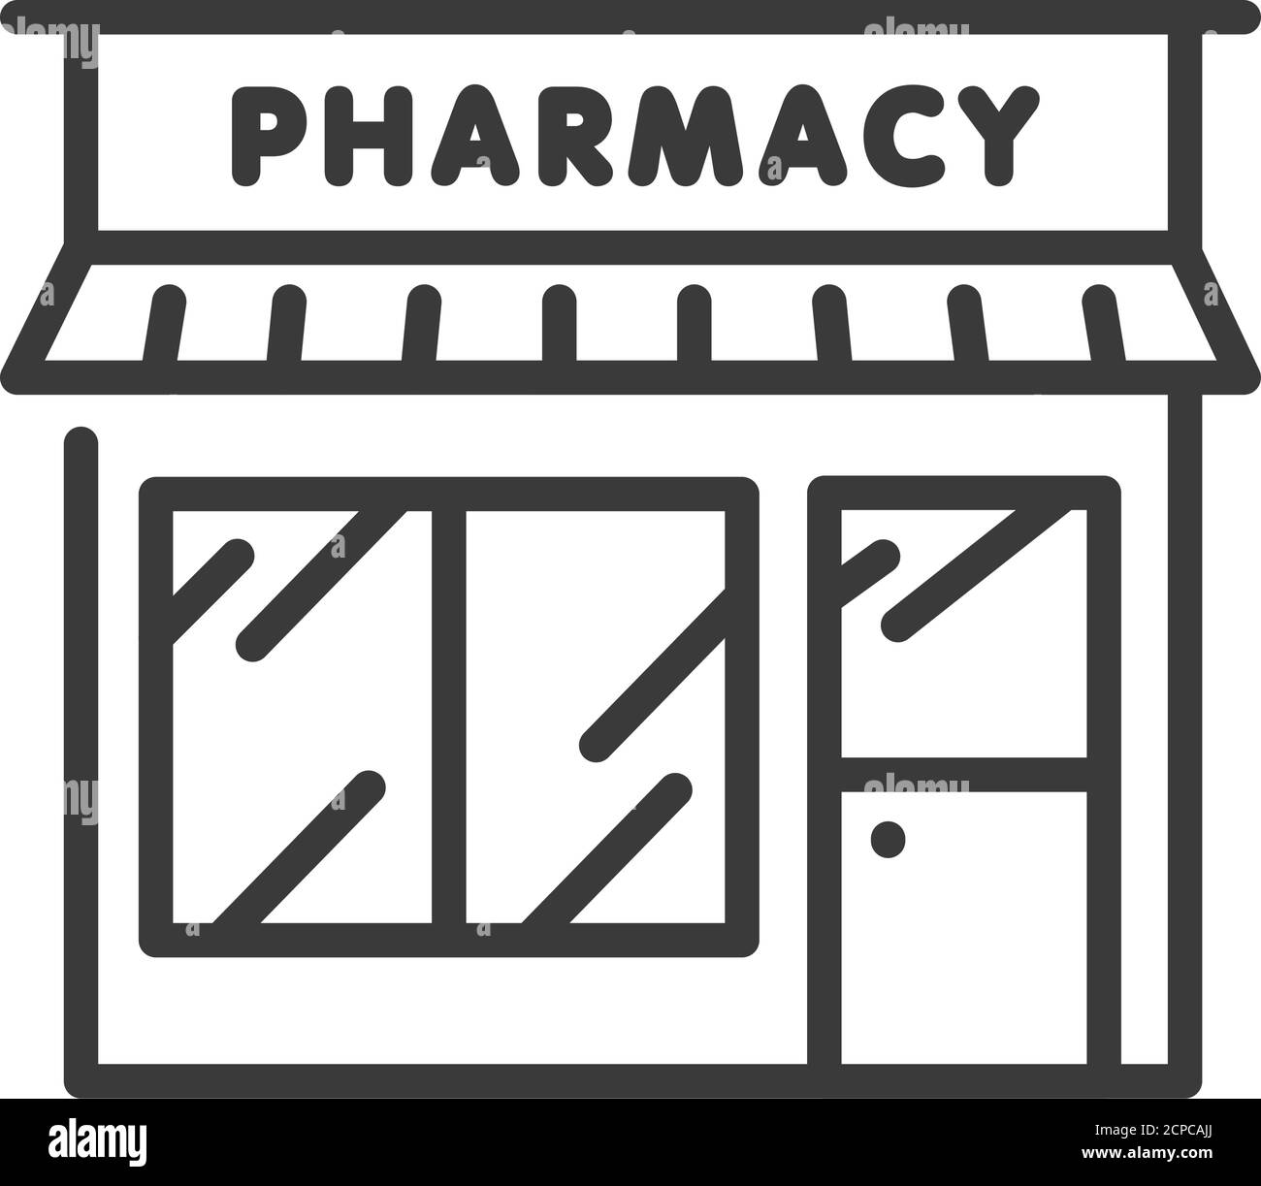



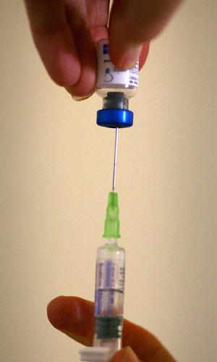


Simplify PrEP delivery: Decentralize, de-medicalize, innovate
Public & Private clinics
Pharmacy delivered
Peer-led Services
Digital PrEP/Tele PrEP
Integrated with other services
Mobile PrEP
PrEP users want more HIV prevention options, delivered in accessible, acceptable approaches
Notes:
Besides having several options that users can pick from, PrEP services need to simplified. WHO has called for decentralization, de-medicalization and innovation as we offer PrEP.
This simplified innovative delivery has taken many forms including delivery in public, private spaces, community, by peers and taking advantage of technology to facilitate efficient service provision.
[CLICK]

Slide 19


Reaching transgender women in Vietnam
One-stop-shop clinic model that has integrated HIV, STI, viral hepatitis, gender affirming, mental health, and primary health care services
Notes:
In Vietnam for example, PATH runs a PrEP program that serves transgender women. They have a one-stop shop delivery approach that offers STI, mental health and primary health care services.
When they introduced gender affirming services to their programs, there was an increase in number of individuals coming to get PrEP and as you can see here, m3 refills have been consistently high among transgender women receiving services at these sites over the last couple of years
[CLICK]

Slide 20

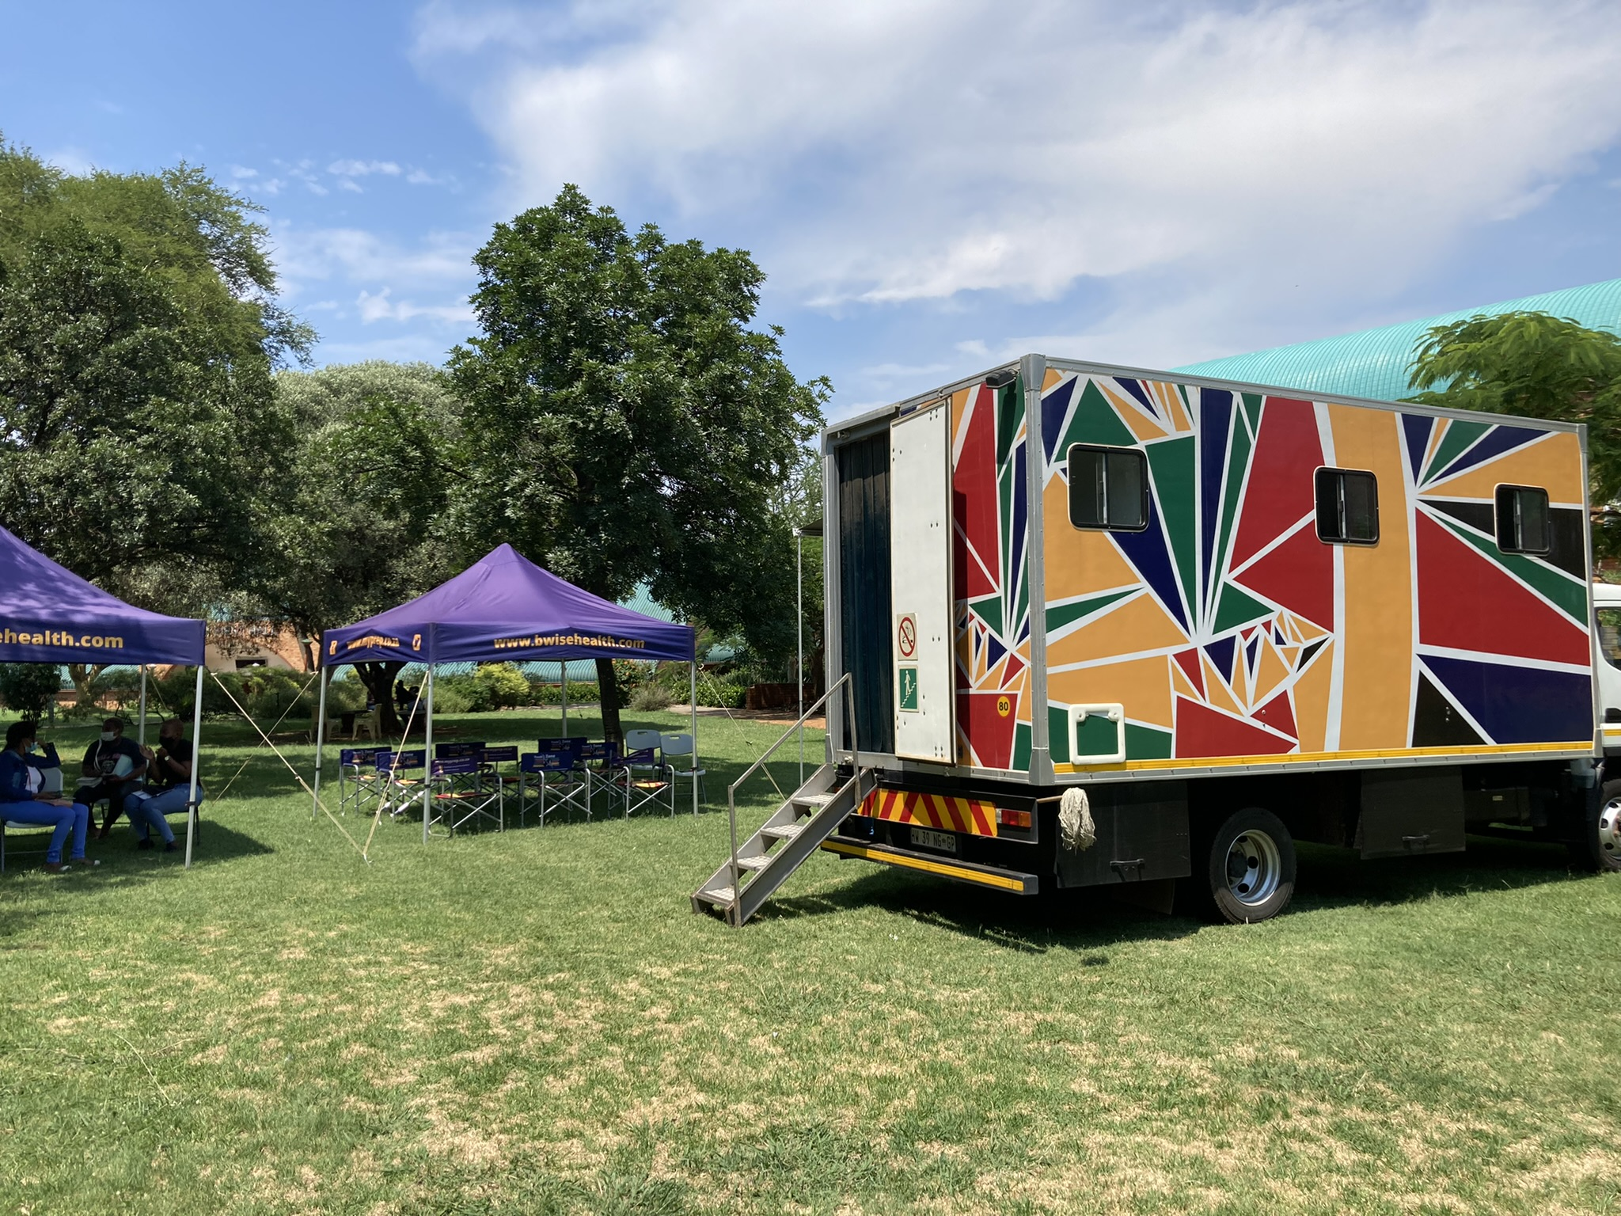



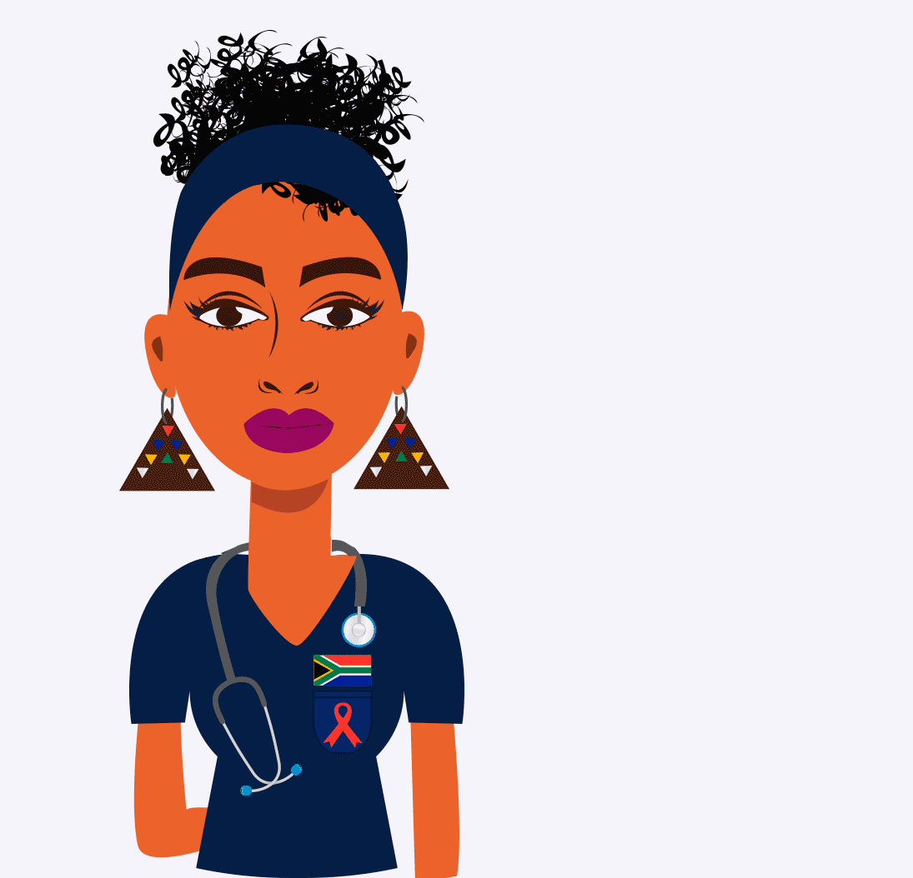






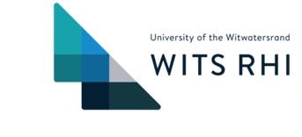
Reducing user burden among adolescent girls and young women in South Africa
CBO
Easy to deliver messages
Community services in mobile clinics, chief homesteads, pharmacies
Self-care packages: sanitary pads, antiperspirant, HIV self-test kits
Dedicated youth navigators
Notes:
In South Africa, the team at Wits RHI has implemented numerous activities to reduce burden among AGYW as they get PrEP services.
PrEP information is delivered through various channels, and services have been brought to the community - at mobile clinics, chief homesteads and community pharmacies.
And it is not just PrEP, but they provide self care packages that resonate with and are important to the young women.
[CLICK]

Slide 21
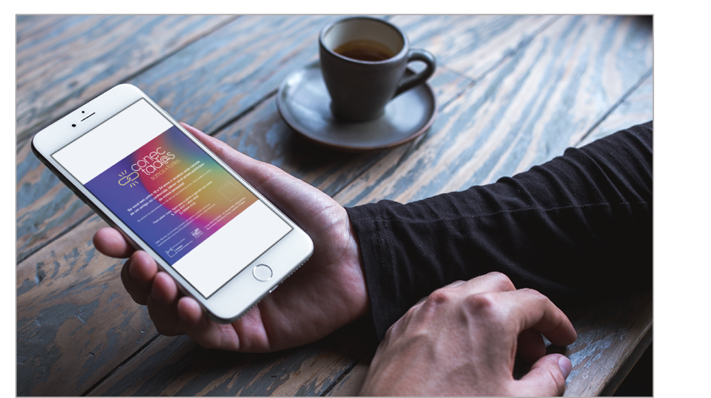

Using technology to engage young and vulnerable men who have sex with men in Brazil
Engaging the most vulnerable men who have sex with men is a challenge
Web-based approaches have worked to reach MSM and keep them engaged
Great follow-up refill rates observed in some projects
94%
89%
81%
80%
83%
Week 4
Week 12
Week 24
Week 36
Week 48
Ref: Torres et al. JMIR 2022
Notes:
In Brazil, use of technology helps to reach young and vulnerable MSM who are lagging behind in PrEP access.
Projects have taken advantage of social media and geosocial networking apps to reach this population and keep them engaged. One project reported great refill rates over a year of follow up for young and vulnerable MSM who had been engaged through technology.
[CLICK]

Slide 22

Innovate service delivery
Make PrEP easy and fun to try and hard to avoid
Anticipate irregular use early and support clients to try again (and again)
Celebrate every new decision to try PrEP and facilitate restarting
NextGen Squad, MOSAIC
Notes:
So making PrEP easy and fun by innovating access points, innovating how to engage with populations that would benefit and by meeting their other needs – which may often be greater than their needs for HIV prevention - may be the way to succeed at PrEP implementation.
We need to employ approaches that are welcoming, that will allow clients to keep coming back, again and again to do prevention again even if they do not succeed at their first attempt.
[CLICK]

Slide 23
We need to address missed opportunities
Notes:
We have missed opportunities that we should address.
[CLICK]

Slide 24

Missed opportunities with pregnant and breastfeeding people
20%
Pregnant and breastfeeding people at increased likelihood of acquiring HIV
Opt-out PrEP for this population in high-incidence areas
  Will prevent HIV in two people at once!
Past trials for new methods have excluded pregnant and breastfeeding populations
Proportion of vertical HIV infections due to new maternal infections among pregnant or breastfeeding people in 2022
Source: UNAIDS 2023 report
Notes:
Pregnancy and breastfeeding constitute periods of increased likelihood of acquiring HIV. And incident maternal HIV infections result in increased probabilities of transmission to their unborn or lactating babies.
In 2022, one in 5 vertical HIV infections were due to new maternal infections during pregnancy or breastfeeding. We cannot succeed at eliminating maternal to child infections if we do not intensify PrEP delivery in this population.
Shouldn’t we have PrEP as an opt out approach, among PBFP especially in high incidence areas? By doing so, PrEP will be preventing HIV in two people at once – that seems quite cost effective to me. How have we ignored this?
The other thing is that PBF are often the last population to get the go-ahead to use new prevention methods because they are excluded from clinical trials!
The research fraternity should now find ways for safe and ethical inclusion of these populations in trials for new products. We have seen movement in this direction from the PURPOSE trials, that included them and we applaud them.
Including PBFP in clinical trials should now be the norm rather than the exception.
[CLICK]

Slide 25



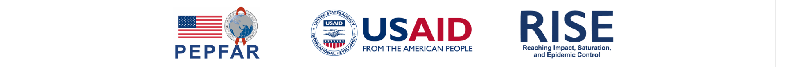
Protecting partners of index clients
HIV-negative partners of index clients screened for PrEP
30,743
HIV-negative partners of people recently testing positive for HIV are often ignored
In Nigeria, of those testing negative during index testing, a third were assessed for PrEP
Of these, 22% were eligible and initiated on PrEP; 60% of those eligible were men
Of 30,743 screened for PrEP, 6,752 were eligible
22%
Of 6,752 eligible for PrEP, 6,274 initiated
93%
Notes:
What do we do with partners of index clients who test negative? We have a missed opportunity for prevention here.
Programs focus on finding partners who test positive for HIV, but we are not paying attention to those who test negative, and yet they are a population that would benefit from PrEP. Their partners have only recently been identified positive and likely not yet virally suppressed.
A project supported by RISE in Nigeria, has been assessing partners of index clients who test negative for PrEP. Over the last 3 years of those screened for PrEP, more than 20% were found eligible and almost all of these initiated PrEP.
[CLICK]

Slide 26


Possibilities of post-exposure prophylaxis (PEP)
An effective but under-utilized intervention
  Positioned as what to use when you have ‘failed’
Engagement to remedy a recognized high-risk event is different and urgent
There is high demand for PEP
Isn’t it time for meaningful PEP programming?
In Kenya, studies designed to provide PrEP through online and brick and mortar pharmacies found that
PEP uptake was 7 and 2 times that of PrEP, respectively
Ongwen et al. #E2102
Kiptinness et al. #515
AIDS 2024
Notes:
This is a PrEP talk, but I would like to say something about Post exposure prophylaxis, an effective but an under-utilized intervention. HIV prevention programs have positioned PEP as the product to use when you have failed – when you have not been the perfect individual who plans for sex and therefore used PrEP in advance.
PEP access is difficult – it is highly medicalized and reserved for high‐risk occupational exposures and GBV.
Engagement in HIV prevention to remedy a recognized high-risk event that has already occurred is different from engagement to protect an anticipated event in the future.
Colleagues in Kenya and the US have been conducting studies to evaluate feasibility of providing PrEP in pharmacies. They have found that for every person initiating PrEP in the online pharmacy platform, 7 initiated PEP. In the brick and mortar pharmacies, there were 2 people initiating PEP for every PrEP initiation.
These findings were not expected going into these studies. All demand generation work was geared to promote PrEP. This work has been presented at this conference by Patricia and Tabitha on behalf of the team.
It is unacceptable that there is an absence of meaningful PEP programming in the face of high client demand and existing pharmacy distribution channels, that are proving to be a preferred channel of delivery. Shouldn’t we now have concerted efforts to make PEP more accessible? Shouldn’t we now have dedicated funding for PEP programming?
[CLICK]

Slide 27
PrEP is not ART lite!
Potential Novel PrEP Indicators
Current PrEP indicators are
Burdensome to obtain
Challenging to interpret
Need indicators that facilitate program planning and enable estimation of PrEP coverage and impact
Volume of PrEP prescribed
Indicator | Definition
Volume of PrEP prescribed | Total volume of PrEP product prescribed (or dispensed)
 | Included in new WHO guidelines as a core indicator for PrEP
Person-Years of PrEP | Total years of PrEP product prescribed or dispensed based on the duration of HIV prevention provided by each unit of product
 | Included in new WHO guidance as one use of Volume indicator above
PrEP Visits (Optional) | Total number of client visits during which PrEP is prescribed and/or dispensed
 | Supplemental indicator to provide essential disaggregations if missing from volume data
Williamson et al, #E618, AIDS 2024
Notes:
PrEP programs have been obtaining uptake, continuation and current use indicators.
To collect this data, facilities have registers, often paper, with columns upon columns of data for each client that health providers have to complete and then summarize into aggregated reports. Most countries have additional reporting requirements that add to provider burden.
Some of the indicators are challenging to interpret. For instance, effective use does not always mean continuous use, and people may cycle on and off of PrEP effectively, but our indicators do not pick this.
We need a new approach to PrEP M&E that isn’t just an adaptation of tools used for treatment. We need indicators that are less burdensome and more informative. WHO has proposed new indicators that enable us better understand the scale and impact of PrEP programs. An example is the volume of PrEP prescribed.
Katharine Kripke and Jessica from Avenir and as part of the MOSAIC consortium have examined the feasibility of collecting this indicator and using it to estimate PrEP coverage and impact. This work has been presented at this conference, and I would encourage you to look at it.
[CLICK]

Slide 28
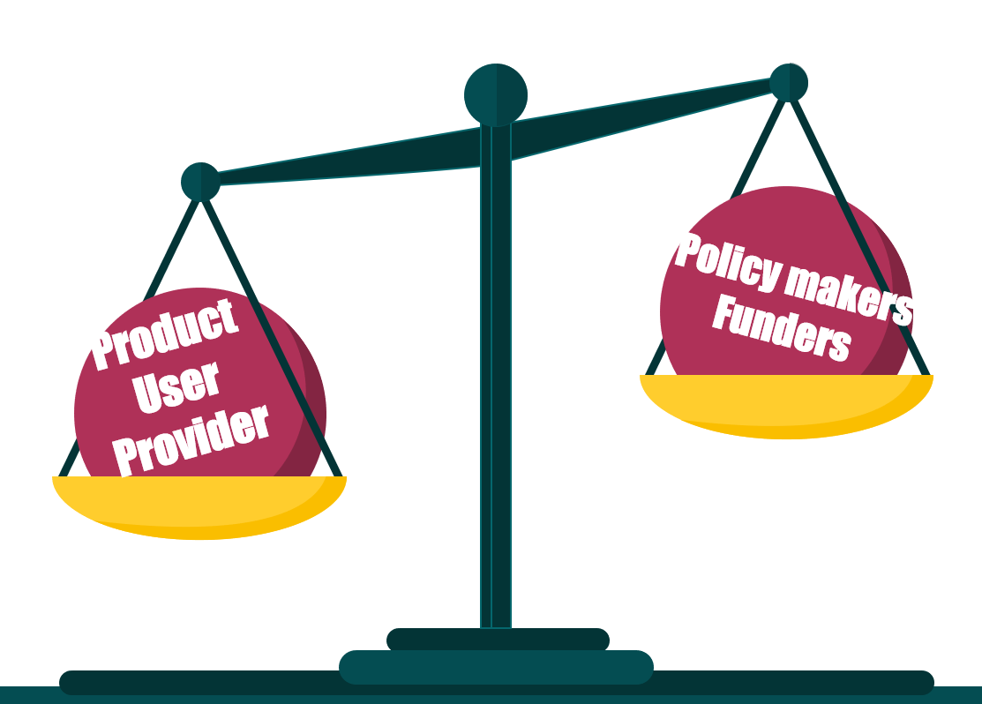
Donors and governments, step up!
Investments have been “poor”
Are donors exploiting challenges to stall investments?
Commit to increase investments in HIV prevention
  To normalize PrEP
  To scale up innovative delivery models
  To introduce new products
Notes:
Donor investments for PrEP programming have been low and difficult to quantify; and any increases have been slow. PrEP funding “ is usually on the margins” of other programs.
We remain in a state of imbalance. On one hand, we have PrEP users and providers trying to make PrEP work, despite challenges with products and service provision that make it difficult for users to start and stay on PrEP. On the other hand, are donors who are looking at the small, slow numbers and using this to justify reduced or stalled investments in PrEP.
This is a cycle we must break out of. And the donor community should get us out of this cycle. Resources are necessary to scale up innovative preferred service delivery models. Resources are needed to get people to try PrEP over and over – and thus normalize PrEP. We cannot just sit and wait for new products and plan to scale those up. People need prevention now.
To you donor community and governments - wholeheartedly commit to bringing HIV infection to an end, by seriously investing in prevention. We know you can commit and when you do the impact is great. So, we, are counting on you to step up!
[CLICK]

Slide 29
Summary
HIV prevention is not a luxury | Accelerated, smarter implementation of client-centered delivery models | Streamline introduction of new PrEP products and remove obstacles
There is a high cost to inaction Primary prevention of HIV is needed to end the epidemic PEP needs to be one of the choices | Scale up what we have learned – both new and old Address inequities Address missed opportunities | Researchers Drug manufacturers Donors Policymakers and regulators Communities
Notes:
So in summary:
Not doing HIV prevention well is a luxury we cannot afford. Our current PrEP program efforts are certainly not sufficient as new HIV infections have stagnated. Each new infection means care and treatment for that individual for life – and this is not inexpensive. It has been repeated many times, and it remains true that we cannot treat ourselves out of this epidemic and primary prevention, including PrEP and PEP are needed.
Second, we have examples of client centered delivery models that are preferred and well received by PrEP users. However, many of these are done on a small scale. For impactful HIV prevention, we need accelerated scale up of these proven models. And while doing so address inequities in delivery and address missed opportunities.
We must streamline introduction of new products and remove obstacles to scale.
Let us conduct few, large adaptive introduction studies that facilitate fast and broad adoption of innovation and include adolescents, the pregnant and breastfeeding populations.
Manufacturers: prepare for product introduction while studies are ongoing
Donors: have pricing and volume discussions early
Regulators and policy makers: do expedited reviews of new products. Two years is too long to be waiting for regulatory approval of effective HIV prevention products, as has been the case in Kenya, my country.
Communities should continue to make realistic demands, and hold all of us to account as we come together for a common purpose of streamlining new product introduction.
So, we all have a role to play and a choice to make. We have been thinking small and have gone slow over the past 12 years. Today, at this conference let us decide to do things differently; so we are not here 12 years later, talking about the challenges and burden of HIV disease; but rather celebrating the great strides we have made in HIV prevention. Let us seize this opportunity, to break the cycles that are holding us back and make the choice to go bigger and go faster.
[CLICK]

Slide 30


Acknowledgments
Beatriz Grinsztejn
Elizabeth Bukusi
Jared Baeten
Jason Reed
Jessica Williamson
Katharine Kripke
Kelly Curran
Kimberly Green
Kristine Torjesen
Manya Dotson
Mitchell Warren
Nelly Mugo
Rose Wilcher
Saiqa Mullick
Notes:
I would like to thank all these individuals who worked with me to develop this talk. And also acknowledge these organizations and projects that I have worked for that allow me to do HIV prevention work and learn so much in the process.
Thank you

