Slide 1
Collaborative Initiative for Paediatric HIV Research and Education (CIPHER) Award Ceremony
Birgit Poniatowski, IAS – the International AIDS Society

Slide 2

CIPHER Grant Programme
Objectives
Award research grants to early-stage investigators in countries with limited resources for HIV research
To address research gaps in paediatric and adolescent HIV
Up to USD 140,000 for two years
Applications can be submitted in English or French

Slide 3

2024 CIPHER Grantee
Minh Nguyen
Hanoi Medical University, Vietnam
Moving towards a status-neutral approach to improve HIV testing, prevention and care for adolescent and young men who have sex with men in Vietnam: adaptation of an evidence-based mobile health intervention

Slide 4
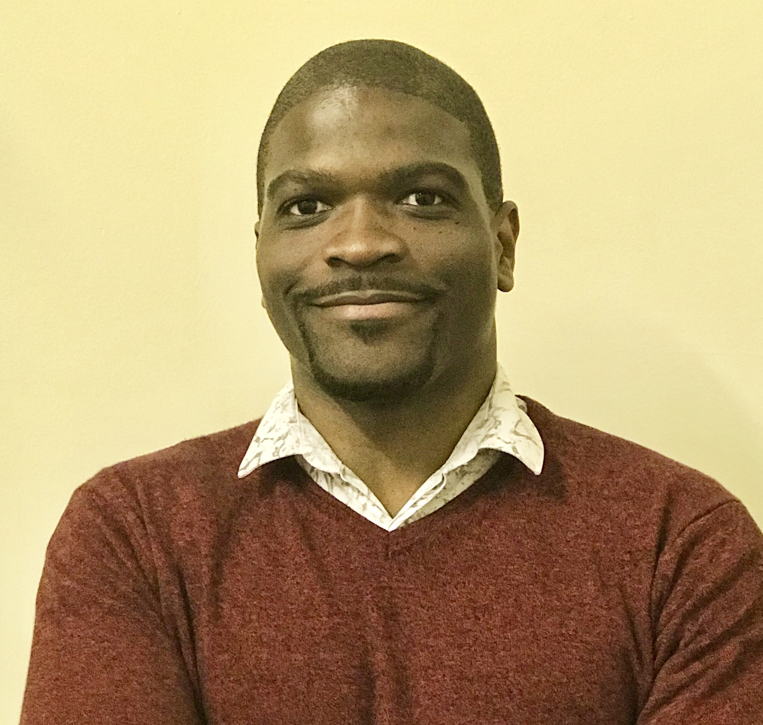
2024 CIPHER Grantee
Clifford G Banda
Malawi-Liverpool-Wellcome Programme, Kamuzu University of Health Science, Malawi
Breastmilk transfer of cabotegravir and its association with infant growth, development and safety following intramuscular administration of long-acting cabotegravir for HIV pre-exposure prophylaxis in lactating mothers: an observational pharmacokinetic cohort study

Slide 5
2nd International Paediatric HIV Symposium in Africa (IPHASA 2023) Grant Programme
Theme: What can we do differently: Closing the gaps in paediatric HIV prevention, care, testing and treatment
Organizers: Ministry of Health of Uganda in collaboration with CIPHER of the IAS

Slide 6
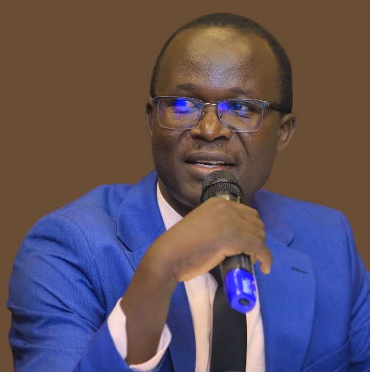

Implementation Science Research Grant recipients
Ouma Simple
The AIDS Support Organization (TASO)
Uganda
Ihuoma Aaron Wali
Rivers State University Teaching Hospital
Nigeria

Slide 7

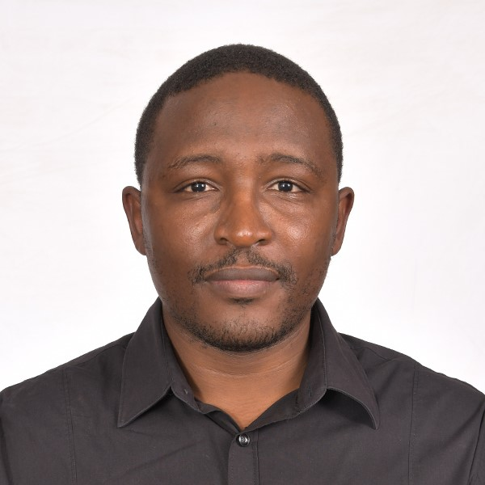
Peer Learning Visit Grant recipients
Valentina Trivella
Right to Care NPC
South Africa
Cyrus Mugo
Kenyatta National Hospital
Kenya

Slide 8

Launch of the 2024/2025 CIPHER Grant Programme
Are you an early-stage investigator working on paediatric and adolescent HIV?
Applications open 2 September 2024

