Slide 1
ICASA side-event Key takeaways
Missing in actions: HIV & TB care during emergencies and humanitarian crisis
Stéphanie Dreze, HIV/TB advocacy coordinator, MSF
Resilience in a time of polycrises: How HIV programs are adapting to climate, humanitarian, political, and social crises

Slide 2
ICASA side-event
Panelists
WHO, Dr. Meg Doherty. Director of the Department Global HIV, Hepatitis and Sexually Transmitted Infections Programs.
PEPFAR, Dr. Mike Reid. Chief Science Officer.
Zimbabwean National Network of People living with HIV (ZNNP+), Tatenda Makoni. Executive Director
Global Fund, Dr. Amir Shroufi. Senior Disease Advisor.
UNAIDS, Dr. Fodé Simaga. Director of Science, Services and Systems for All.
MSF, Dr. Antonio Flores, Senior HIV/TB advisor. Dr. Tom Ellman, Director Southern Africa Medical Unit. Stephanie Dreze, HIV/TB Advocacy Coordinator.

Slide 3
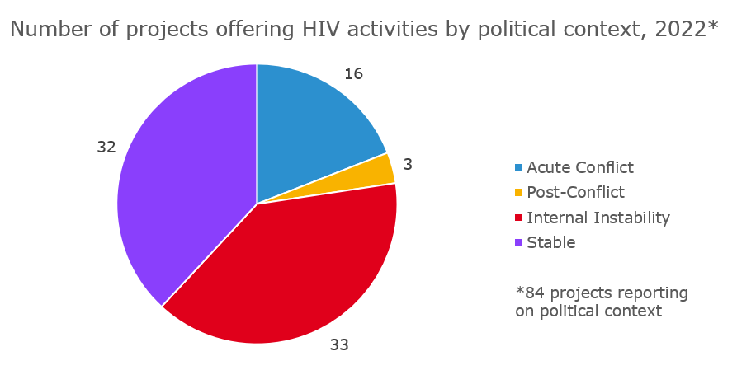
MSF HIV activities in unstable settings, 2022
Plus projects addressing the needs of:
Key populations and criminalized populations
Natural disasters humanitarian settings

Slide 4

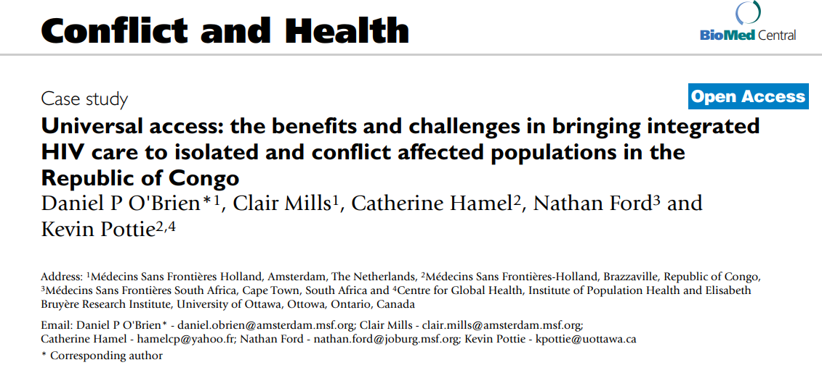
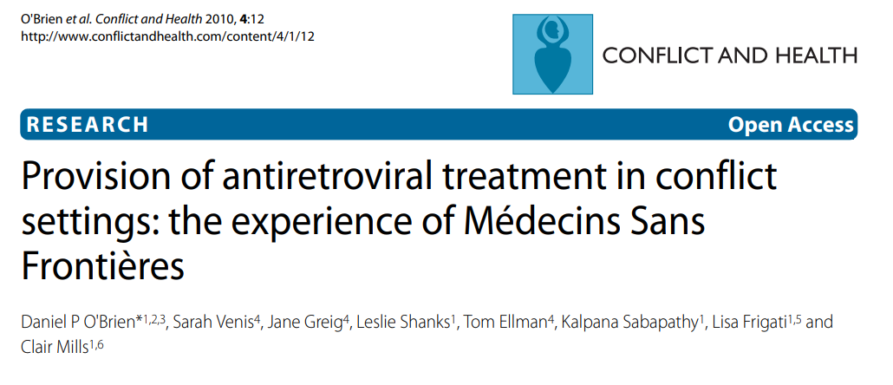
MSF and HIV in conflict and humanitarian settings

Slide 5
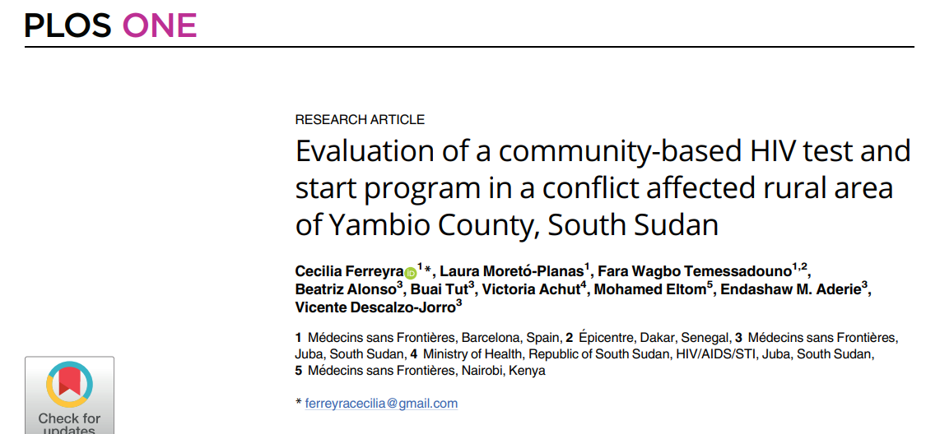
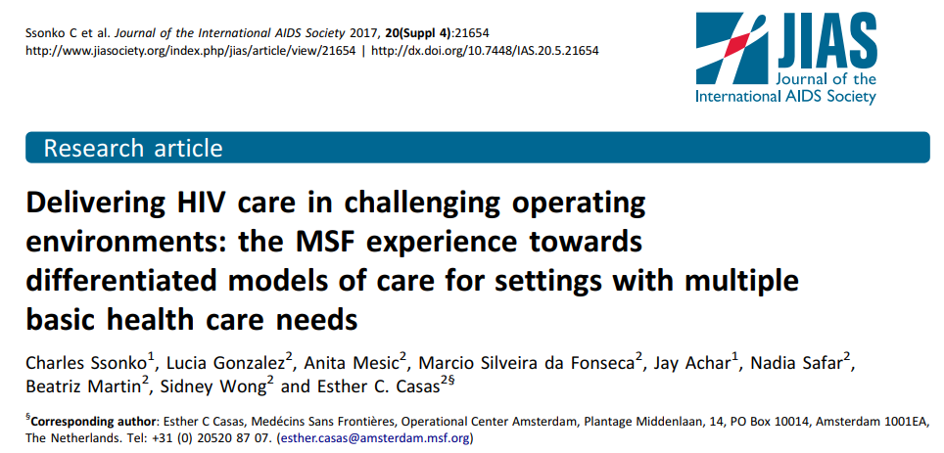
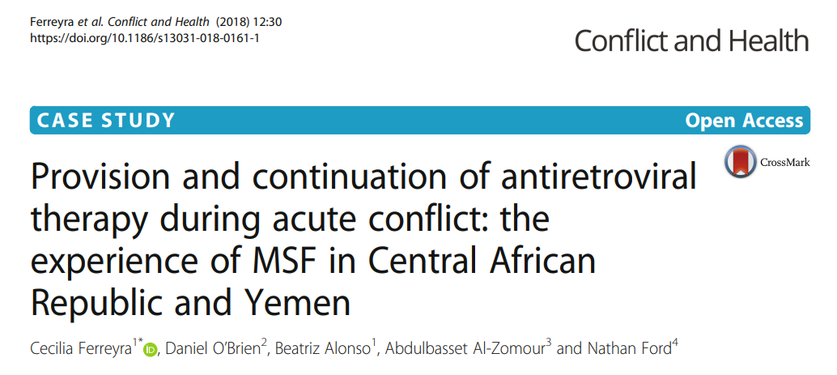

Slide 6
MSF, HIV and humanitarian settings – more recently
Cyclone Idai
Beira Mozambique and Mutare, Zimbabwe
2019
Conflict
Cabo Delgado, Mozambique, 2022 to date
Violence
Abyei Special Administrative Area, 2022
Facility closures
Treatment interruption
AHD-related deaths in cholera centres
Food insecurity and survival sex
Population displacement
Destroyed facilities
Partners withdrew
Mass displacement: Agok → Abye + Twic
Non-existent local HIV/TB services
Referrals > 1 hour
Overlap of violence and rainy season

Slide 7

Summary of key discussion points: Commodities
Ensure continuation of Multi-Month Dispensing
Ensure access to laboratory point-of care
Decentralized distribution points (e.g. ICCM sites)
Agile pre- or re-positioning of commodities,
adaptation of supply chain according to the needs
Buffer stocks at the level of the people
Package of care that includes ARVs, tests,
management of key Opportunistic Infections and prevention

Slide 8
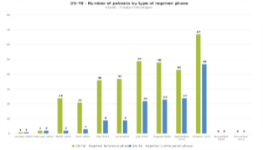
Summary of key discussion points: Data
= Documentation and Visibility
Key indicators: definition and inclusion in national systems
Inclusion of key AHD indicators
Ensure/support data collection
How much missingness is acceptable?

Slide 9

Summary of key discussion points: Policies
International (e.g. GF) and national guidelines (e.g. Mozambique): Political commitment and allocation of resources
Assessment tools
Defined HIV package in case of emergency, importance of incremental approach
Integration (gender-based violence, mental health, sexual and reproductive health)

Slide 10
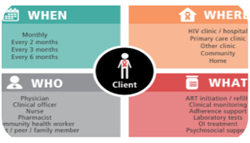
Summary of key discussion points: Community/Self-management
DSD for people with AHD?
Community-led services and briefing of people in case of unforeseen events
Mapping of existing services
Liaison with civil society organizations and communities

Slide 11


Principles
Adaptability, creativity, pragmatism, and mitigation measures (//DSD failure)
HIV fatigue (including decreasing funding resources and sustainability narrative) (//East DRC)
Blanket approach will not work (one size doesn’t fit all)
Existing tools not broadly implemented
We have more tools today than what we had 20 years ago (DSD, person centered, community engagement, etc.).

Slide 12
Thank you!

