Slide 1
Successes, gaps, and way forward
Hally Mahler, FHI 360
Resilience in a time of polycrises: How HIV programs are adapting to climate, humanitarian, political, and social crises

Slide 2
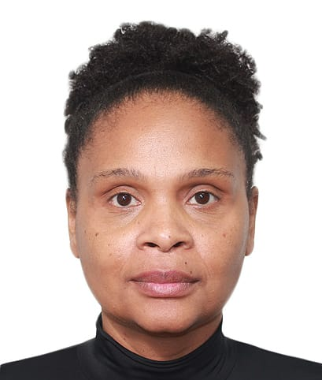
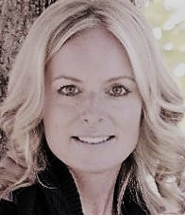
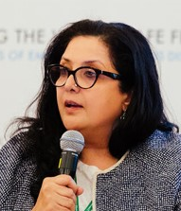
Speakers
Daryna (Dasha) Shevchuk Senior Technical Advisor, FHI 360 Ukraine
Aleny Couto Director, National STI and HIV/AIDS Program, Mozambique Ministry of Health
Frank Mugisha Executive Director, Sexual Minorities Uganda
Shawn Wesner PEPFAR Chair for Ethiopia and South Sudan, Global Health Security and Diplomacy
Mandeep Dhaliwal Director, HIV and Health Group, United Nations Development Programme

