Slide 1
Differentiated strategies to support sustained engagement and re-engagement in HIV services in eastern and southern Africa
Robinah Babirye, HER Initiative, Uganda & Lynne Wilkinson, IAS, South Africa

Slide 2


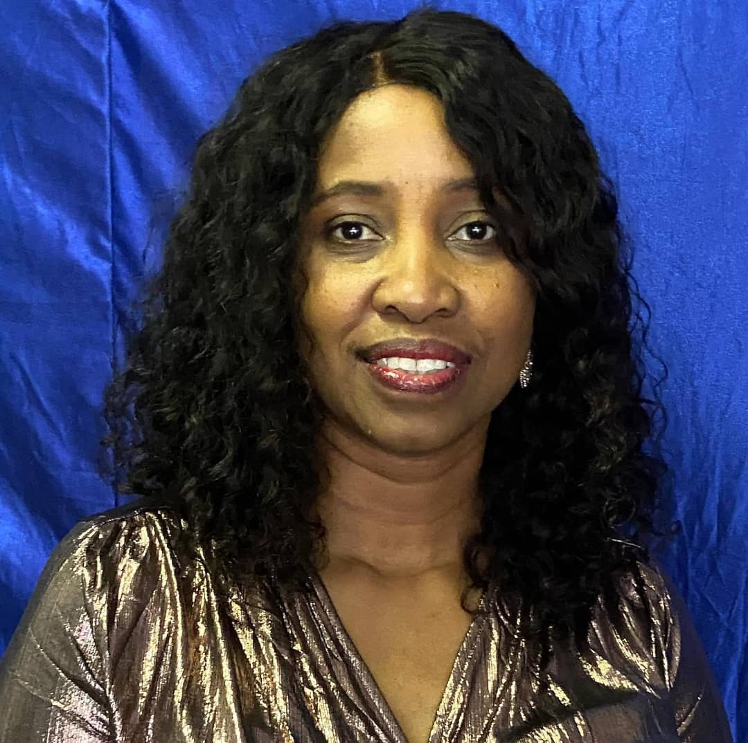

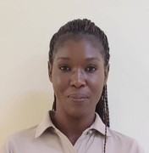

Differentiated strategies to support sustained engagement and re-engagement in HIV services in eastern and southern Africa
Co-chairs | Presenters
Robinah Babirye HER Initiative Uganda | Clarice Pinto World Health Organization Switzerland | Tsitsi Apollo Ministry of Health and Child Care Zimbabwe
Lynne Wilkinson IAS South Africa | Khumbo Nyirenda Partners in Hope Malawi | Musa Manganye National Department of Health South Africa
Notes:
2

Slide 3
Overview
Launch of a policy brief on re-engagement, Clarice Pinto, World Health Organization, Switzerland
Early learnings from implementation of revised re-engagement guidelines in Zimbabwe, Tsitsi Apollo, AIDS and TB Program, Ministry of Health and Child Care, Zimbabwe
Understanding treatment interruptions and the importance of flexibility to support quality re-engagement: the Malawi experience, Khumbo Nyirenda, Partners in Hope, Malawi
Differentiation at re-engagement: Considerations in building South Africa’s re-engagement algorithm, Musa Manganye, National Department of Health, South Africa

Slide 4
Engage!
#AIDS 2024

