Slide 1

Launch of the WHO policy brief on supporting re-engagement in HIV treatment services
Clarice Pinto, World Health Organization, Switzerland
Differentiated strategies to support sustained engagement and re-engagement in HIV services in eastern and southern Africa
Notes:
Questions to the audience:
- "Please stand up or raise your hand if you have ever forgotten to take any type of medication."
- Pause for a moment to let people respond and observe the room.
- "Keep standing or raise your hand if you remember exactly what you ate for dinner last Friday."
- Pause and observe.
- "Please stand up or raise your hand if you have ever missed a clinical appointment and forgot to inform the clinic."
- Pause and observe.
- "Stand up or raise your hand if you have ever felt ashamed to share personal information with a healthcare worker."
- Pause and observe.
- "Finally, please stand up or raise your hand if you have ever felt unwelcomed in a clinical environment."
- Pause and observe.
- These experiences are quite common. Now, imagine dealing with these challenges while managing a chronic condition like HIV. This exercise highlights how difficult it can be to face barriers to continuous care and emphasizes the importance of supportive healthcare environments.
- By understanding these shared experiences, we can better empathize with and support those living with HIV to stay engaged in their care. Let's work together to create a more welcoming and supportive healthcare system for everyone

Slide 2
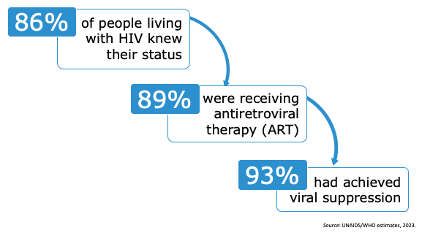
95%-95%-95% targets progress
Notes:
This testing and treatment cascade makes it clear that once people are engaged on treatment, they reach viral suppression and can live better quality of life
But we need to make this final stretch to reaching the last two targets, and supporting engagement and re-engagement will help us doing that

Slide 3
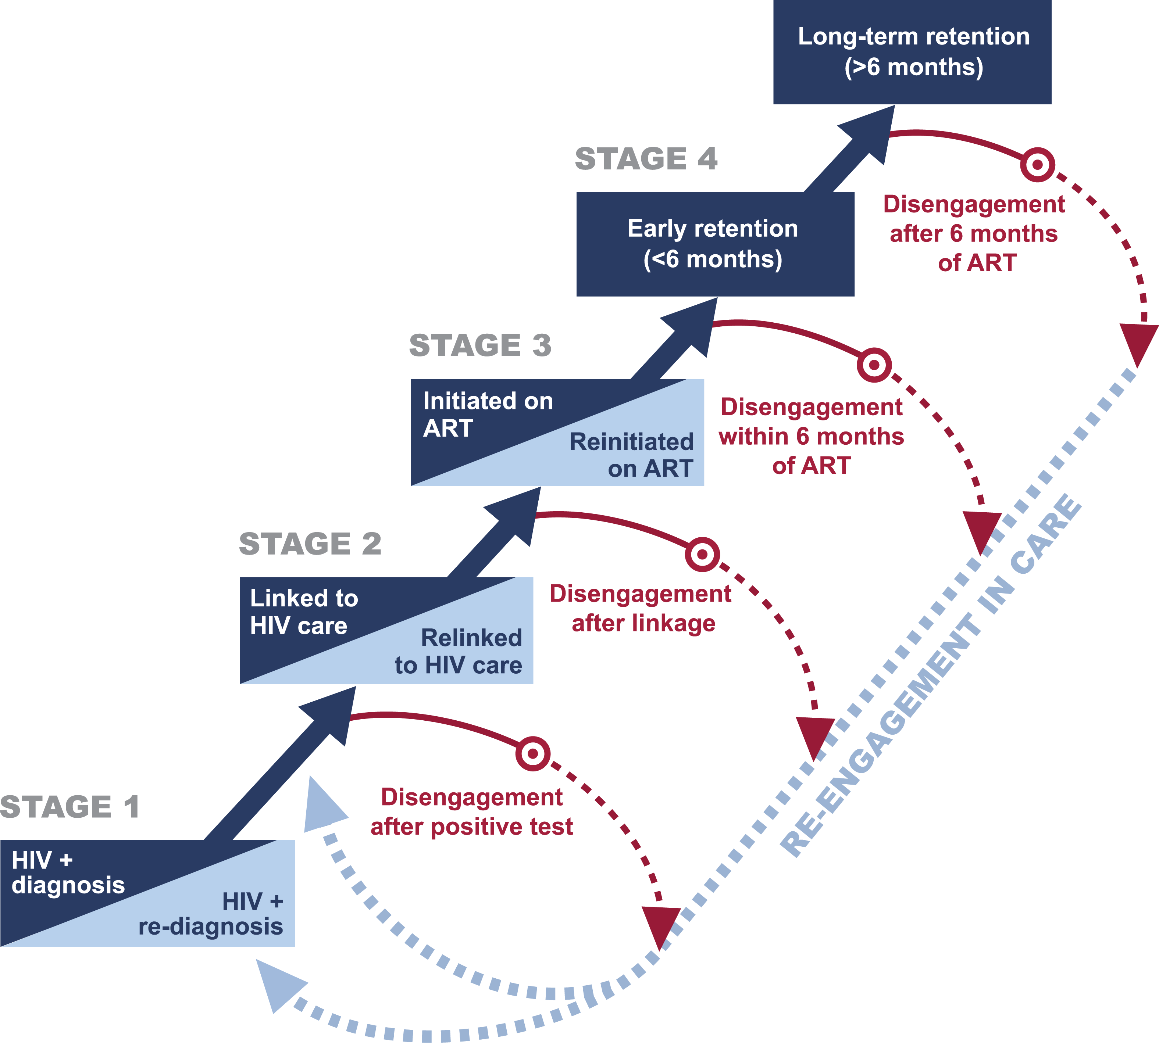

People who have been diagnosed with HIV may disengage from care after starting antiretroviral therapy (ART) and may do so more than once
Figure Source: The revolving door of HIV care: Revising the service delivery cascade to achieve the UNAIDS 95-95-95 goals Ehrenkranz P, Rosen S, Boulle A, Eaton JW, Ford N, et al. (2021) The revolving door of HIV care: Revising the service delivery cascade to achieve the UNAIDS 95-95-95 goals. PLOS Medicine 18(5): e1003651. https://doi.org/10.1371/journal.pmed.1003651
Notes:
We focus on clients who are already on ART and disengage from HIV treatment services

Slide 4
What is re-engagement in HIV treatment services?
Re-engagement in HIV treatment services refers to individuals returning to HIV services after a period of interruption.
This occurs when a person misses scheduled visits or appointments and does not receive treatment for a certain period.
Notes:
For the purpose of this discussion we focus on clients who are already on ART and disengage from HIV treatment services
So when we talk about re-engagement, we refer to individuals returning to HIV services after a period of interruption

Slide 5
The challenges and consequences of disengagement
Health impact:
  progression to advanced HIV disease,
  increased mortality,
  increased risk of developing antiretroviral drug resistance, and
  higher risk of onward transmission.
Public health impact:
  Morbidity, mortality, and HIV transmission resulting from people disengaged from care.
50%
20%
Notes:
As countries strive towards the UNAIDS 95-95-95 targets, it's imperative to support re-engagement in HIV services, as disengagement from care can result in advanced HIV disease along with opportunistic infections, increased risk of mortality, higher rates of viral non-suppression and can drive development of drug resistance.
A recent systematic review on prior exposure to ARVs among adult patients presenting for HIV treatment initiation or reinitiation in sub-Saharan Africa found that 20%–50% of people who present for ART had already been exposed to ART

Slide 6
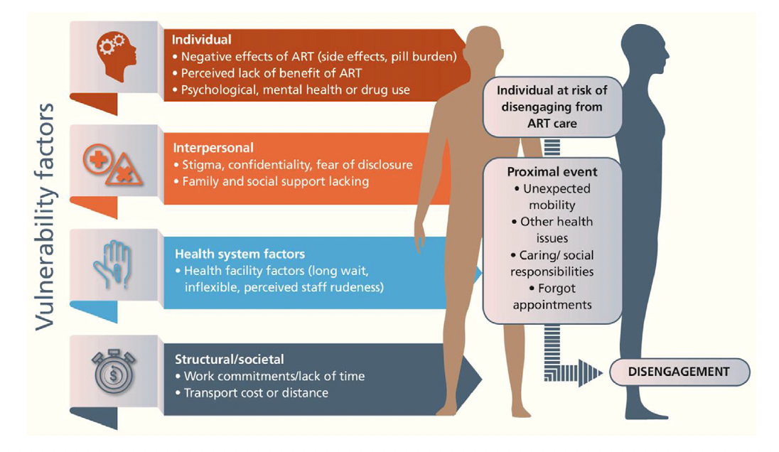
Reasons for disengagement
Burke R. et al (2024) systematic review identified main reasons for disengagement:​
Unplanned mobility​ (incl. migration/displacement),
Lack of perceived benefits of antiretroviral therapy (ART),
Structural/societal factors (such as transport costs or distance).
Notes:
A recent systematic review examining reasons for disengagement during the “treat all” era showed that the reasons for disengagement are multifaceted, encompassing individual, interpersonal, health system and structural factors. Lack of transportation, unplanned mobility, stigma, mental health problems and a lack of perceived benefits from ART, among other issues, often hinder sustained engagement in treatment and care

Slide 7

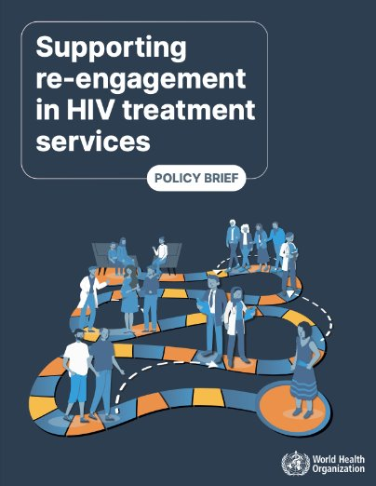
WHO’s new "Supporting re-engagement to HIV treatment: policy brief"
Overview of challenges and reasons for disengagement and re-engagement
Highlights key WHO guidance on continuous engagement, tracing and re-engagement
Key differentiated re-engagement guiding principles
Differentiated pathways to support re-engagement in HIV treatment and care
Assist countries and communities adopt and adapt tracing and re-engagement recommendation
Notes:
We basically zoom into the 2021 WHO recommendation on tracing and re-engagement aiming to assist countries and communities in adopting this guidance
We build recent evidence of the burden of disengagement and present the most common reasons for disengagent which include individual and health system barriers, among others
We are not bringing new recommendations but we unpacked the tracing and re-engament recommendation and connect to other recommendations that create a clear picture of how to tackle the issue
It proposes a clear picture of the tracing process, and presents guiding principles to sustain re-engagement and key factors that should be considered when designing differentiated pathways at re-engagement

Slide 8
WHO recommendations to support continuous engagement and re-engagement
Good practice statements
Health systems should invest in people-centred practices​ (2016 guidance)
Non-judgmental, tailored approaches to assessing adherence (2021 guidance)
Engagement recommendations
Adherence support interventions should be provided to people on ART (2016 guidance)
Re-engagement recommendations
To support those who are disengaged to re-engage in HIV care (2021 guidance)
To improve re-engagement and retention in care (2023 guidance)
People established on ART should be offered refills of ART lasting 3–6 months, preferably six months if feasible (2021 guidance)
Programmes should provide community support for people living with HIV to improve retention in HIV care (2016 guidance)
Programmes should implement interventions to trace people who have disengaged from care and provide support for re-engagement
Use of person-centred patient data is recommended to continuously assess interruption of HIV treatment to improve re-engagement and retention in care
The offer of same-day ART initiation should include approaches to improve uptake, treatment adherence and retention such as tailored patient education, counselling and support. (2021 guidance)
People established on ART should be offered clinical visits every 3–6 months, preferably every six months if feasible (2021 guidance)
Notes:
We know that people disengage and re-engage at various points of the continuum
And there are a number of HIV service delivery recommendations that can support continuous engagement and re-engagement.
In this brief we highlight some of them, such as:
investing in people-centered practices, adherence support, reduced frequency of clinical visits and ART refills, community support, as well as the use person-centered data.

Slide 9

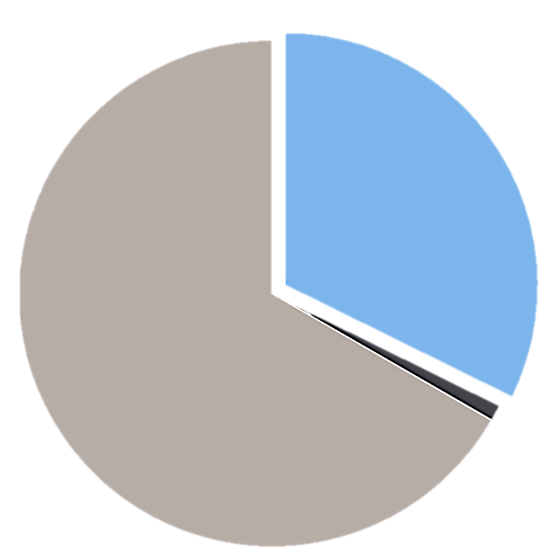
WHO recommendations on tracing and re-engagement: Policy adoption
Interventions to trace people who have disengaged from care and support reengagement implemented,
Global, Most recent data
Percentage of reporting countries
(Total of 195 countries)
32% (63)
©WHO – Ethnovision – Billy Miaron
67% (130)
67% of reporting countries have not implemented interventions to trace and support reengagement of people who have disengaged from HIV care.
Only 32% have implemented these interventions, indicating a substantial gap in global HIV care efforts.
1% (2)
Source: WHO Policy Data 2022
Notes:
Majority of countries reported not having adopted interventions to trace and support reengagement of people who have disengaged from HIV care

Slide 10

Tracing approaches
Remember:
- Not every disengaged client requires tracing.
- Some traced clients may not be located or may not return to care.
Develop a process to obtain informed consent from clients for tracing activities.
Establish criteria (e.g. recent treatment initiation, abnormal lab results, overdue consultations or ART pick-ups, most vulnerable groups)
Ensure tracing methods (e.g. remote or in-person) are respectful, consensual, and tailored to the individual needs and preferences of each client.
Monitoring tracing outcomes can help improve health systems.
Trained and supervised Tracing Team: Lay workers, peer supporters, community health workers, and outreach teams.
Identify and address reasons for disengagement
Provide non-judgmental, supportive, and clear information and counselling services
Enhanced monitoring systems can support identifying disengagement and re-engagement dynamics that triggers tracing efforts
Notes:
Designing the tracing process involves of considerations such as enhancing monitoring systems, setting criteria for tracing, ensuring respectful and consensual tracing approaches, train outreach teams to not only assess the reasons for disengagement but ensure clients receive guidance on how to re-engage, and ensure that monitoring outcomes and collected and reported.

Slide 11
Guiding principles for differentiated re-engagement
Supporting adherence challenges
Ensuring a welcoming, non-stigmatizing environment
Providing advanced HIV disease identification and rapid screening for opportunistic infections
Ensuring equitable access to care
Engaging communities
Providing immediate treatment and care
Images source: ©WHO
Notes:
We compiled a set of guiding principles that can contribute improving the quality of services and therefore to maintaining engagement and sustaining re-engagement.
They include:
Creating a supportive, non-judgmental and non-stigmatizing environment.
Ensuring that everyone receive the care that they have the right to receive
Engaging communities no only on providing services, but also on designing, planning and monitoring it

Slide 12
What to consider when defining DSD pathways to support re-engagement
Specific population considerations
Clinical assessment and rapid ART re-initiation
Addressing treatment interruption
Provide immediate treatment and care, including advance HIV disease identification and rapid screening for opportunistic infections
Support adherence challenges to sustain re-engagement
Consider impact of interruption on an individual’s clinical well-being needs to develop the appropriate pathway
Consider each population unique challenges to sustained engagement in HIV treatment services
Psychosocial assessment and adherence support needs
Images source: ©WHO
Notes:
And ensure that they receive high quality clinical and support services that are also part of the key factors we would like countries to when defining differentiated re-engagement support pathways
Which includes:
Clinical Assessment and Rapid ART Reinitiation
support clients overcome barriers, by providing psychosocial and Adherence support
Tailoring pathways according to individual clinical needs, and not as a punitive measure
Address the unique challenges of different population groups according to their needs.

Slide 13
Key takeaways
Improve HIV service quality by addressing health system barriers
Adopt and adapt WHO differentiated person-centered engagement and re-engagement recommendations
Strengthen monitoring systems to track client engagement and re-engagement and evidence on specific contexts and population groups, are needed to boost re-engagement efforts.
Promote community-led service delivery to align with preferences and enhance engagement.
Engage communities to tailor re-engagement strategies to clients' needs
Ensure a non-punitive, non-judgmental, welcoming environment for equitable service access
Notes:
In summary, we need to continue to strengthen healthsystems by identifying and addressing barriers.
Strengthen monitoring systems, promoting community engagement and community-led services, and ensuring non-punititive and non-judgmental environments are crucial for boosting re-engagement efforts.
Continue to adopt and adapt WHO's differentiated engagement and re-engament recommendations.

Slide 14


WHO NEW TECHNICAL PRODUCTS

Slide 15
Acknowledgements
WHO staff members from the Department of Global HIV, Hepatitis and Sexually Transmitted Infections Programmes contributed to developing these guidelines:
Meg Doherty
Nathan Ford
Ajay Rangaraj
Antons Mozalevskis
Ivy Kasirye
Morkor Newman Owiredu
Nandita Sanjay Sugandhi
Wole Ameyan,
Hiwot Teferra Haile-Selassie,
Francoise Renaud,
Shona Dalal,
Busisiwe Msimanga,
Carlota Baptista Da Silva,
Cheryl Case Johnson,
Doroux Aristide Charles Billy (Regional Office for Africa),
Muhammad Shahid Jamil (WHO Regional Office for the Eastern Mediterranean), and
Omar Sued (Pan American Health Organization)
The following individuals contributed to developing this policy brief:
Anna Grimsrud (Cape Town, South Africa)
Brenda E Crabtree-Ramírez (Departamento de Infectología, Instituto Nacional de Ciencias Médicas y Nutrición Salvador Zubirán, México City, México)
Charles Holmes (Georgetown Center for Innovation in Global Health, Washington D.C, United States)
Florence Riako Anam (The Global Network of People Living with HIV, Kisumu, Kenya)
Kenneth Mwehonge (Coalition for Health Promotion and Social Development, Kampala city, Uganda)
Khumbo Phiri (Partners in Hope, Lilongwe, Malawi)
Lynne Wilkinson (International AIDS Society, Johannesburg, South Africa)
Nittaya Phanuphak (Institute of HIV Research and Innovation, Bangkok, Thailand), and
Raphael Adu-Gyamfi (National AIDS/STI Control Programme, Accra, Ghana)

Slide 16

Thank you!
Images source: ©WHO

