Slide 1
Early learnings from implementation of revised re-engagement guidelines in Zimbabwe
Tsitsi Apollo, Ministry of Health and Child Care, Zimbabwe
Differentiated strategies to support sustained engagement and re-engagement in HIV services in eastern and southern Africa

Slide 2
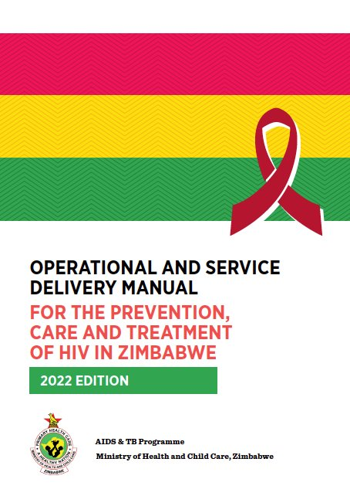
Zimbabwe’s updated Operational and Service Delivery Manual
The Ministry of Health and Child Care (MOHCC) updated its HIV Prevention, Testing and Treatment guidelines in 2022 in line with updated WHO guidelines – the “what to do”, ​
To accompany this, the Operational and Service Delivery Manual was updated - “how to do it” to increase retention at all steps of the cascade​
  For doctors, clinical officers, nurses, counselors, pharmacists, health information officers, health promotion officers, community health workers and community-based organizations (CBOs)​

Slide 3
What’s in the OSDM on HIV care and treatment
1
Re-engagement in care
2
Differentiated ART initiation
3
Integration of other medical needs into DSD models for RoCs established on treatment SRH/HIV, DM and HPTN and mental health integration ​
4
Differentiated service delivery for advanced HIV​

Slide 4
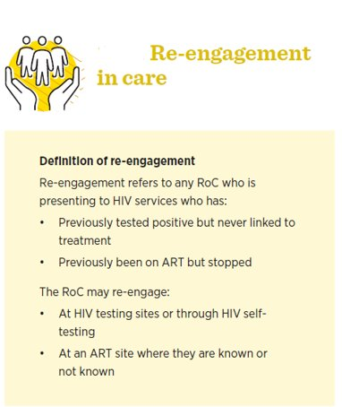
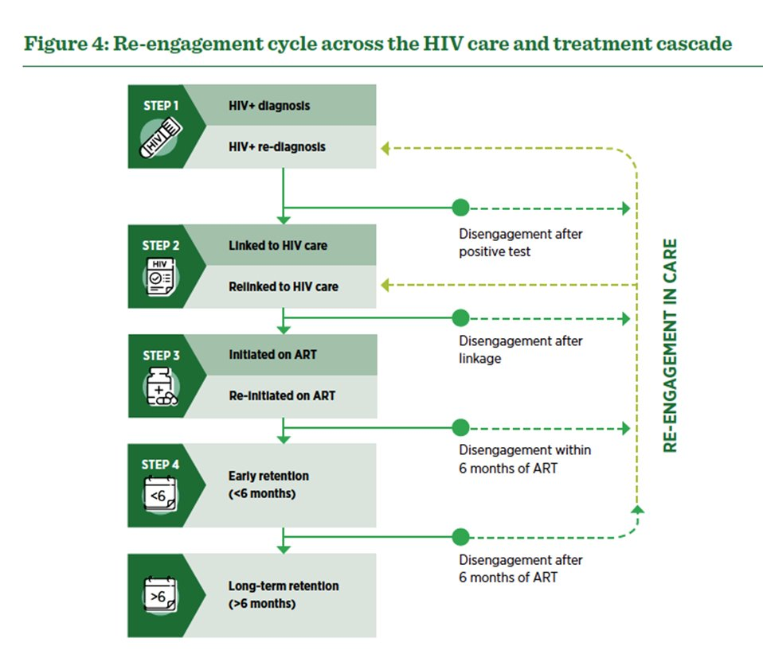


Slide 5
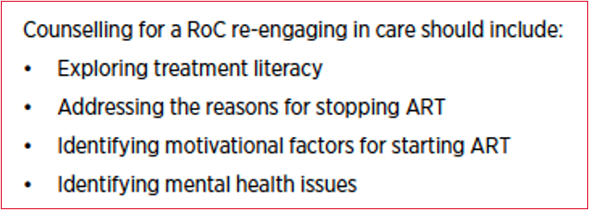
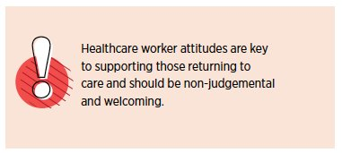
Re-engagement in care
“Re-engagement services should ensure that RoCs who re-engage are received with dignity, are assisted and clinically managed and receive quality psychosocial services from healthcare workers. RoCs re-engaging in care are often those struggling the most with adherence and should not be penalized by being asked to attend more frequently unless there is a clinical indication.”

Slide 6
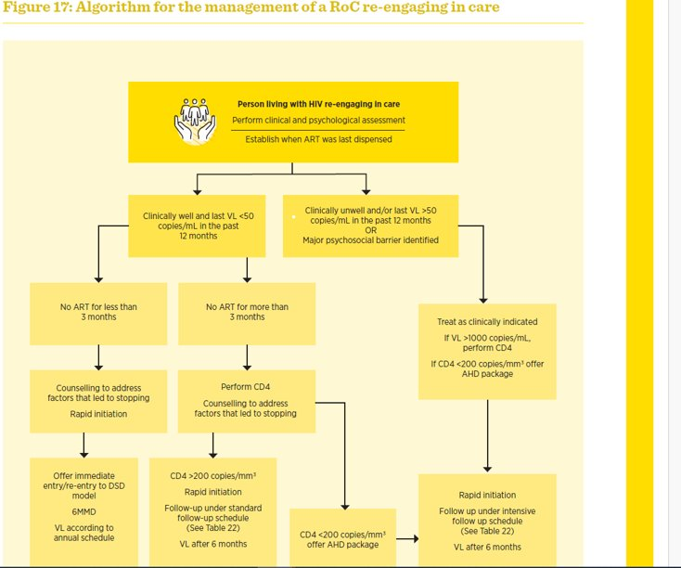

Slide 7
Implementation experience from 70 facilities (1)
Data on re-engagement (returning after 3+ months) from 70 public sector facilities from five provinces introducing new guidelines
N=1,484 re-engaged between Oct 2022-Sept 2023
23% (n=345) received CD4 testing, 41% (n=142) had a CD4 cell count <200 cells/mL
14% (n=202) tested for TB-LAM, 12% (n=25) CrAG positive
Dhiwayo R el al, “Prioritizing advanced HIV disease screening for treatment interruption in PLHIV: early lessons from implementation of new guidelines in Zimbabwe”, abstract 41000

Slide 8
Implementation experience from 70 facilities (2)
Health-care workers reported that guidelines specifying which laboratory test to prioritize for people living with HIV returning to care was helpful
Client flow and staff shortages were challenges to implementation.
Need to ensure that recipients of care get AHD screening on point of re-engagement
Dhiwayo R el al, “Prioritizing advanced HIV disease screening for treatment interruption in PLHIV: early lessons from implementation of new guidelines in Zimbabwe”, abstract 41000

Slide 9
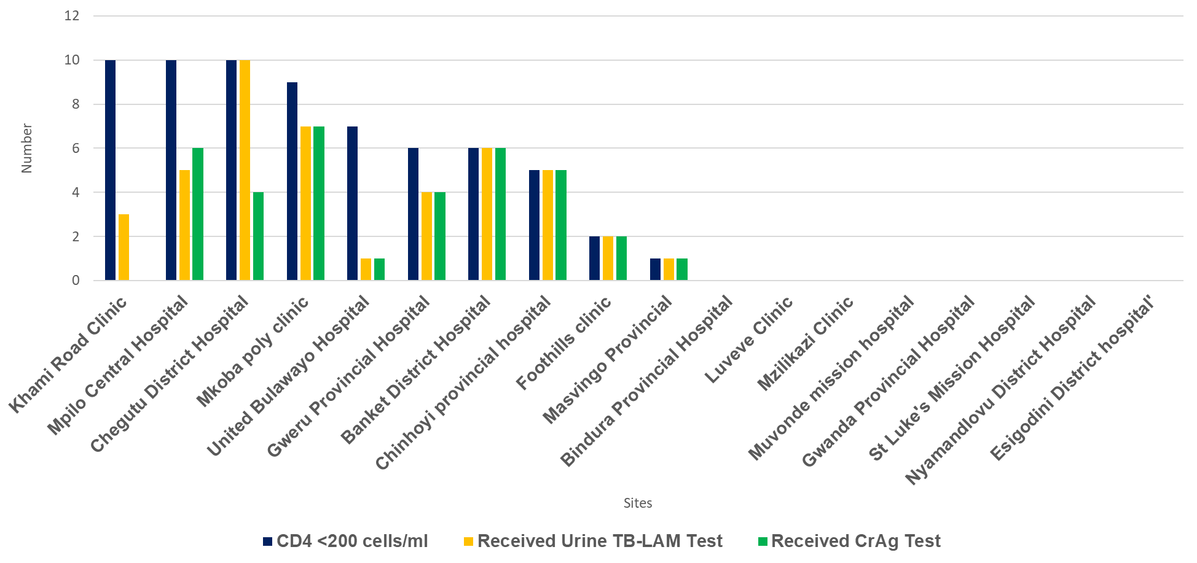
Implementation experiences from 18 Facilities (3): Documented Urine TB-LAM and CrAg Tests among Patients Returning to Care with CD4 <200 cells/ml, 2023
56% (10/18) of facilities had documented patients eligible for TB LAM and CrAg Tests
Eight HFs did not routinely offer a CD4 test or did not have patients with a CD4 test count below 200 copies/ml
5/10 and 4/10 of facilities conducted Urine TB-LAM and CrAg Tests respectively for all eligible patients.
Urine TB-LAM coverage among eligible patients was 67% ranging from 14%-100%.
CrAg Testing coverage among eligible patients was 55% ranging from 0%-100%.
MOHCC, HIV Quality of Care Assessment June 2024

Slide 10
Implementation experience from 18 HFs facilities (4)
Facilities with training in re-engagement guidelines confidently screened returning patients for Advanced HIV Disease (AHD).
Newly initiating ART patients were more consistently offered CD4 tests compared to patients returning care
Implementation was hindered by shortages of commodities such as Point-of-Care (POC) CD4 test kits and underutilization of conventional testing platforms.
Some disengaged patients live in diaspora, sending others “Malaicha” to collect ARVs, missing out on AHD screening and management.

Slide 11
Lessons Learnt:
1
2
Addressing Socio-economic determinants- Socio-economic barriers hinder care. Strategies like DREAMS reduce poverty and improve education
3
Innovative Approaches- Technology bridges care gaps. Mobile apps, telemedicine and messaging enhance engagement and adherence
4
Strengthening Health Systems- Health system investment is crucial. Improves infrastructure, supply chain chains, and healthcare financing for better care access​
Community Engagement and Support- Involving PLHIV and communities boosts program effectiveness
Notes:
1. Community Engagement and Support
Engaging People Living with HIV (PLHIV) and their communities in all aspects of HIV programs—design, implementation, and monitoring—has proven highly effective. Active involvement of community leaders, peer educators, and support groups has been instrumental in reducing stigma, enhancing access to care, and ensuring that interventions are both relevant and widely accepted.
2. Addressing Socioeconomic Determinants
Addressing the socioeconomic barriers that impede engagement in care is vital. Strategies such as those employed in the DREAMS project, which aim to reduce poverty, improve educational opportunities, and provide financial support for healthcare expenses, are crucial. Tackling these determinants helps create an environment where individuals are more likely to seek and remain in care.
3. Innovative Approaches
Utilizing technology to bridge gaps in care delivery is essential. Mobile health applications, telemedicine, and text messaging have proven effective in overcoming geographical barriers. These innovations enhance patient engagement by providing appointment reminders, supporting medication adherence, and facilitating access to critical health information.
4. Strengthening Health Systems
Investing in the strengthening of health systems is fundamental to improving HIV care and treatment. This includes developing infrastructure, optimizing supply chain management, and securing healthcare financing. Such efforts ensure the continuous availability of essential medications, laboratory services, and trained healthcare providers, which are crucial for maintaining high levels of care engagement.

Slide 12
Next steps
Ensuring the consistent availability of essential commodities, such as CD4 test kits and other critical supplies through better forecasting, procurement, and distribution practices.
Continuous professional development and mentorship programs, particularly for new staff, are essential to maintain high standards of care.
Support people living with HIV to update the treatment literacy manual to incorporate re-engagement guidelines.
Collaborate across borders to enhance the care for people living with HIV who are part of the diaspora.

Slide 13
Acknowledgements
MOHCC – programme managers, health care workers
National AIDS Council
PEPFAR
Global Fund
UN Agencies
Technical Partners
Civil Society Organizations
Recipients of Care
IAS

