Slide 1
Understanding treatment interruptions and the importance of flexibility to support quality re-engagement: the Malawi experience
Khumbo Nyirenda, Partners in Hope, Malawi
Differentiated strategies to support sustained engagement and re-engagement in HIV services in eastern and southern Africa

Slide 2
Why do people disengage?
Health System
Intra- and inter-personal
Clinical
Health system challenges
  Appointment frequency
  Inflexible appointment schedules
    Mobility, competing demands, time and cost
  Negative experiences with providers
Intra- and inter-personal drivers
  Internal and external stigma
  Treatment fatigue
  Poor HIV-related knowledge /
  ability to navigate health system
Clinical reasons
  Illness

Slide 3
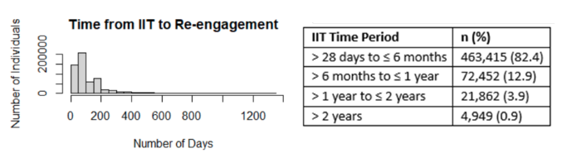
“Time matters”: Time to re-engagement in Malawi
Objective: Understand frequency and duration of interruptions in treatment (IIT) in Malawi (>28 days late for ART visit)
Design:
Review of national data from Jan 2020-Sept 2023
  N=1,145215 ART clients reviewed
Findings
60% of ART clients experienced IIT
  81% re-engagement in care
  Majority returned within 100 days
  82% re-engaged in care within 6 months
Among those with ITT
Norwood K et al, “Time matters: levering longitudinal, person-centered data to understand interruptions and re-engagement in HIV treatment in Malawi from January 2020 to September 2023”, AIDS 2024. Abstract 1265

Slide 4
Outcomes among men successfully traced
Objective
Understand outcomes for men documented as disengaged (>28days late for an ART visit)
Design:
Medical chart reviews at 20 health facilities to identify men who disengaged from care between August 2020-November 2021
N=1,303
Findings
32% of men categorized as disengaged who were traced
were alive and on ART
Among these:
53% silent transfer
46% active at study facility
but poor documentation
Dovel K et al. IDEaL: a study protocol for an individually randomised control trial. BMJ open. 2023 Jul 1;13(7):e070896.
Choko AT et al. ENGAGE: A study protocol for a randomized control trial. PLoS One. 2023 Feb 24;18(2):e0281472.

Slide 5
Why do clients re-engage?
Re-engagement facilitators
Fear of illness
Social network support encouraging reengagement
Active follow-up by health workers
Positive facility experiences
Concern for family (i.e., livelihoods)
Objective: To understand why individuals miss appointments and how they re-engage in HIV care
Design:
Qualitative interviews with 44 participants in Malawi
  21 men; 23 women
Eligible participants:
≥15 years of age & not ART naïve
14-60 days late for ART appointment <12m after initiation
Returned to care
Non-pregnant/non-breastfeeding
Analysis
Conducted in Chichewa, transcribed & translated in English, coded in Atlas.ti, analyzed using framework analysis
Chamberlin et al. How HIV clients find their way back to the ART clinic: A qualitative study of disengagement and re-engagement with HIV care in Malawi. AIDS and Behavior. 2022 Mar;26(3):674-85.
Coursey K et al. Understanding the unique barriers and facilitators that affect Men’s initiation and retention in HIV care in Malawi. AIDS and Behavior. 2023 Jun;27(6):1766-75.

Slide 6
Why re-engagement is delayed?
Barriers to timely re-engagement
Unexpected obstacles + repeated efforts required to return to care
Repeated returns increased client transport and opportunity costs
Negative attitudes of staff experienced but did not delay return
Turned away: not correct day or provider not available
Objective: To understand why individuals miss appointments and how they re-engage in HIV care
Design:
Qualitative interviews with 44 participants in Malawi
  21 men; 23 women
Eligible participants:
≥15 years of age & not ART naïve
14-60 days late for ART appointment <12m after initiation
Returned to care
Non-pregnant/non-breastfeeding
Analysis
Conducted in Chichewa, transcribed & translated in English, coded in Atlas.ti, analyzed using framework analysis
Chamberlin et al. How HIV clients find their way back to the ART clinic: A qualitative study of disengagement and re-engagement with HIV care in Malawi. AIDS and Behavior. 2022 Mar;26(3):674-85.
Coursey K et al. Understanding the unique barriers and facilitators that affect Men’s initiation and retention in HIV care in Malawi. AIDS and Behavior. 2023 Jun;27(6):1766-75.

Slide 7
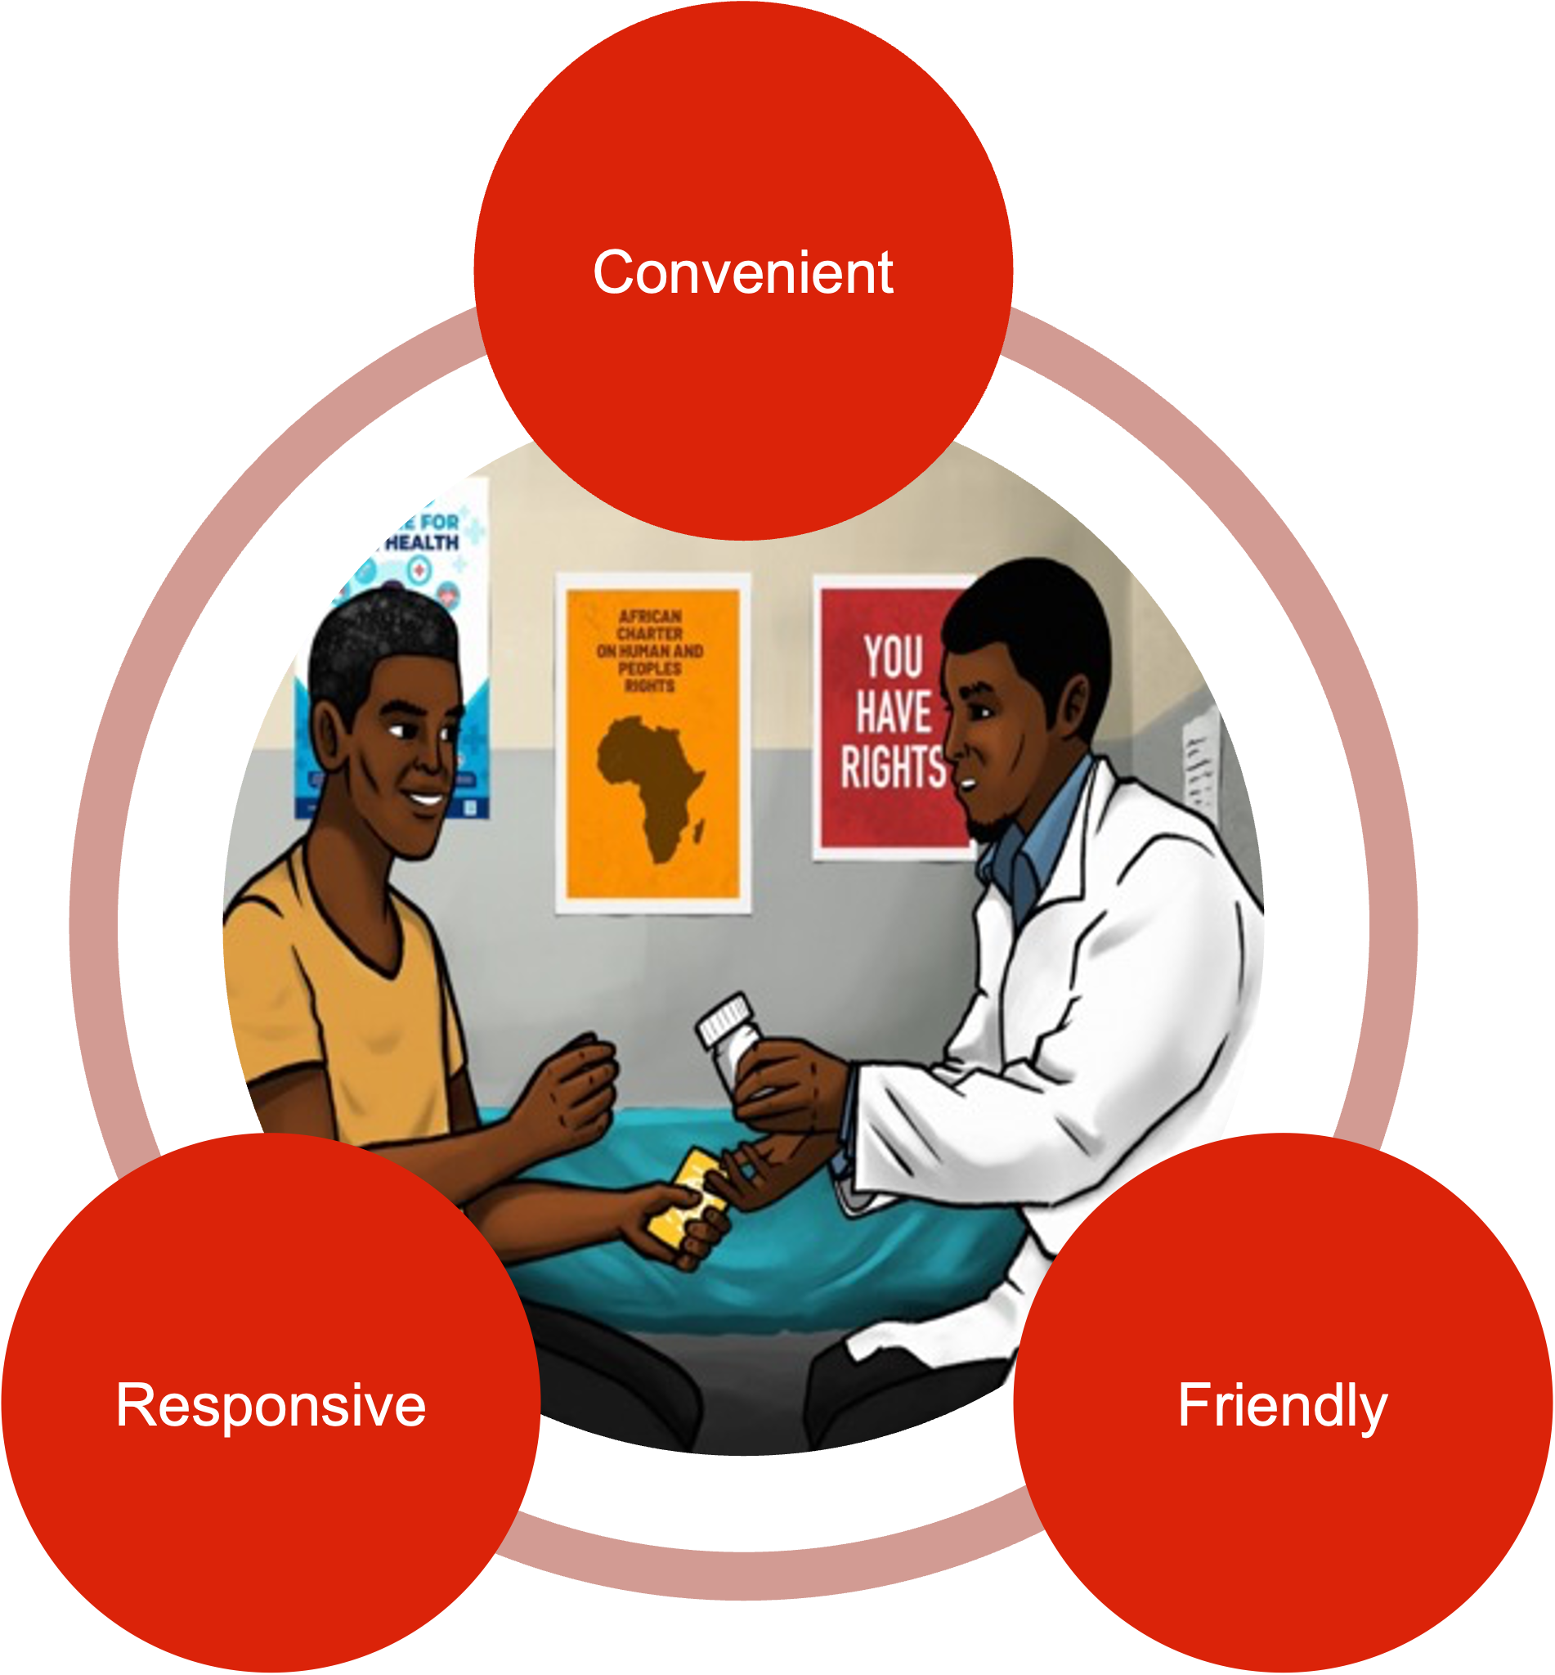
The experience at return and how it impacts retention going forward…
IDEaL and ENGAGE trials
Objective Test person centered care strategies to engage and sustain men in ART care
Design
2 unblinded individually randomized control trials
  IDEaL: 12 health facilities
  ENGAGE: 11 health facilities
Target Population
Men (>15 years) living with HIV
Not on treatment (ART naïve or >28 days late)
Living within facility catchment area
Outcomes
ART (re-)initiation at 3-months and 6-month retention
Qualitative work
Male clients – in depth interviews at midline and endline
Healthcare workers – focus group discussions at midline and endline
Combined 1,303 men enrolled from 24 health facilities
Person Centered Care
Dovel K et al. IDEaL: a study protocol for an individually randomised control trial. BMJ open. 2023 Jul 1;13(7):e070896.
Choko AT et al. ENGAGE: A study protocol for a randomized control trial. PLoS One. 2023 Feb 24;18(2):e0281472.

Slide 8

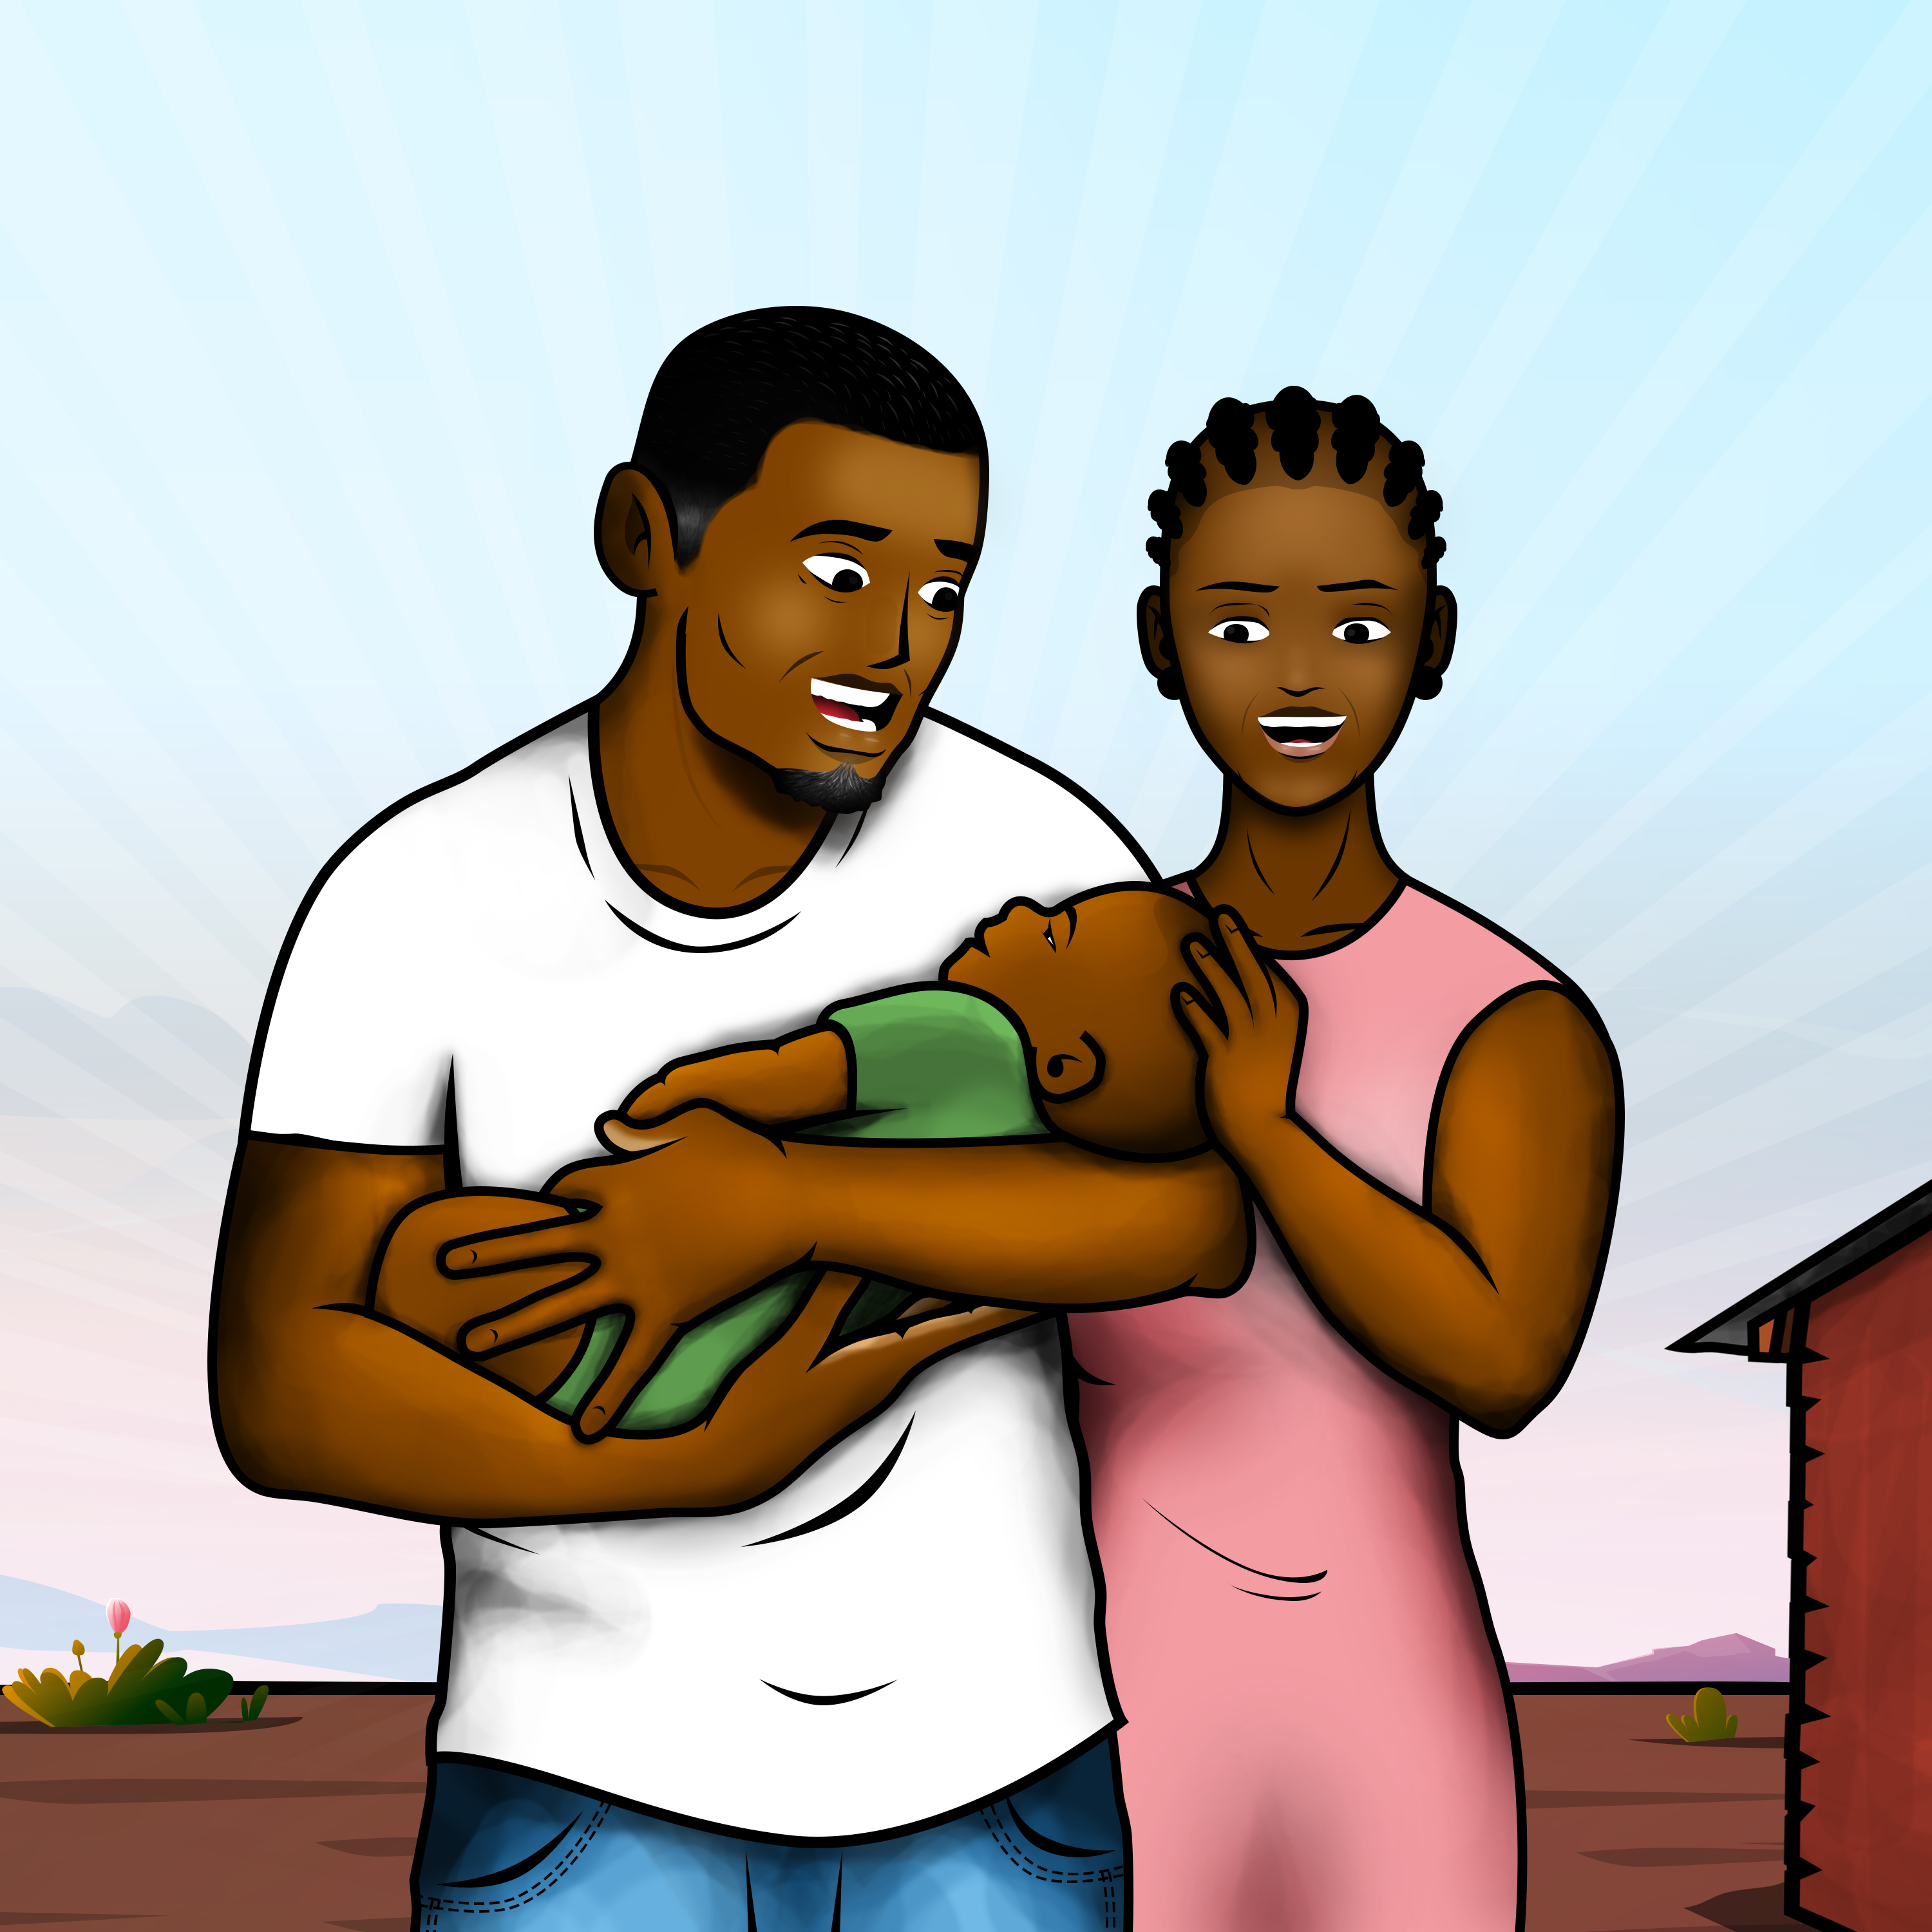
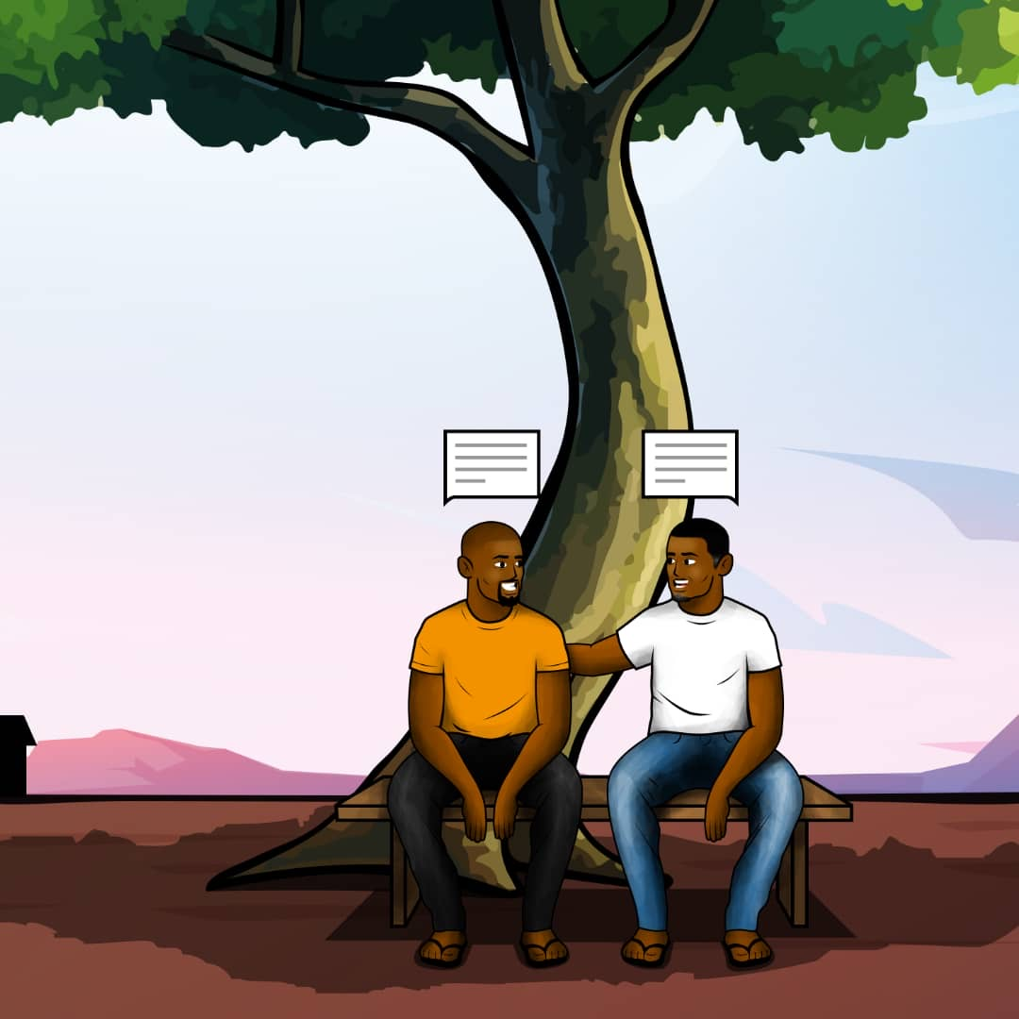
Interventions from IDEaL and ENGAGE
MALE-SPECIFIC COUNSELING
(Low Intensity)
CHOICE OF HOME ART
(High Intensity)
STEPPED INTERVENTIONS
(Varying Intensity)
Objective:
Provide kind, meaningful
interactions with healthcare
workers
Provide flexible ART services
Men’s counseling
Facility navigation
Lay Cadre
Men’s counseling
Home ART initiation
Facility navigation
Nurse
Men’s counseling →
Ongoing mentorship →
Home ART initiation →
Facility navigation
Combination
Dovel K et al. IDEaL: a study protocol for an individually randomised control trial. BMJ open. 2023 Jul 1;13(7):e070896.
Choko AT et al. ENGAGE: A study protocol for a randomized control trial. PLoS One. 2023 Feb 24;18(2):e0281472.

Slide 9


Lessons learned: Kind interactions and compelling, bi-directional counseling matter most
More important
Compelling, relevant messaging
Less important
Positive healthcare worker interactions
Outside-facility dispensing
Positive interactions
with HCWs
Kind and reciprocal
Private
Uninterrupted discussions
(less frequently mentioned)
Community
ART dispensing
Compelling messaging
Explore how ART contributes to life goals
Develop tailored solutions
*Findings from 92 in-depth interviews with men (mid and endline) and 20 HCWs in the trial

Slide 10
Examples of positive interactions and motivating messaging
  Positive interactions
  Kind and reciprocal interactions
    He opened up to me as a fellow man and there was nothing to hide. So I also opened up to him.
    – 32yrs, southern region
    Private
    They (HCWs) keep our secrets. I trust them because we chat in secluded, private areas.
    – 24yrs, central region
    Uninterrupted and focused conversations
  [Past HCWs] spent little time with us. But these HCWs ask what challenges I’m facing now, what I faced in the past. – 24yrs, southern region
Motivating messaging
Explore how ARV contributes to life goals
Now I understand: when I take my ARVs, I can be strong, healthy and able to work. When I work, I make money. When I make money, I take care of my family. – 35yrs, southern region
Tailored solutions
My client always travels to Mozambique, but for a very good reason: to make sure that there is food on his table. This means I need to support him, despite his travels, to make ARVs a priority. –Lay Cadre, 37yrs, southern region

Slide 11
Evidence to practice: HCW Job Aid
START HERE
Has there been a negative facility experience?
Be Kind
Greet in a friendly way
Is this the first interaction?
Understand
Ask about the story
Apologize
for previous experiences
Is this a follow-up visit?
Tailor
counseling to fit experiences
Are there remaining barriers?
Support tailored action plan
Desire more support?
Ongoing relationship

Slide 12
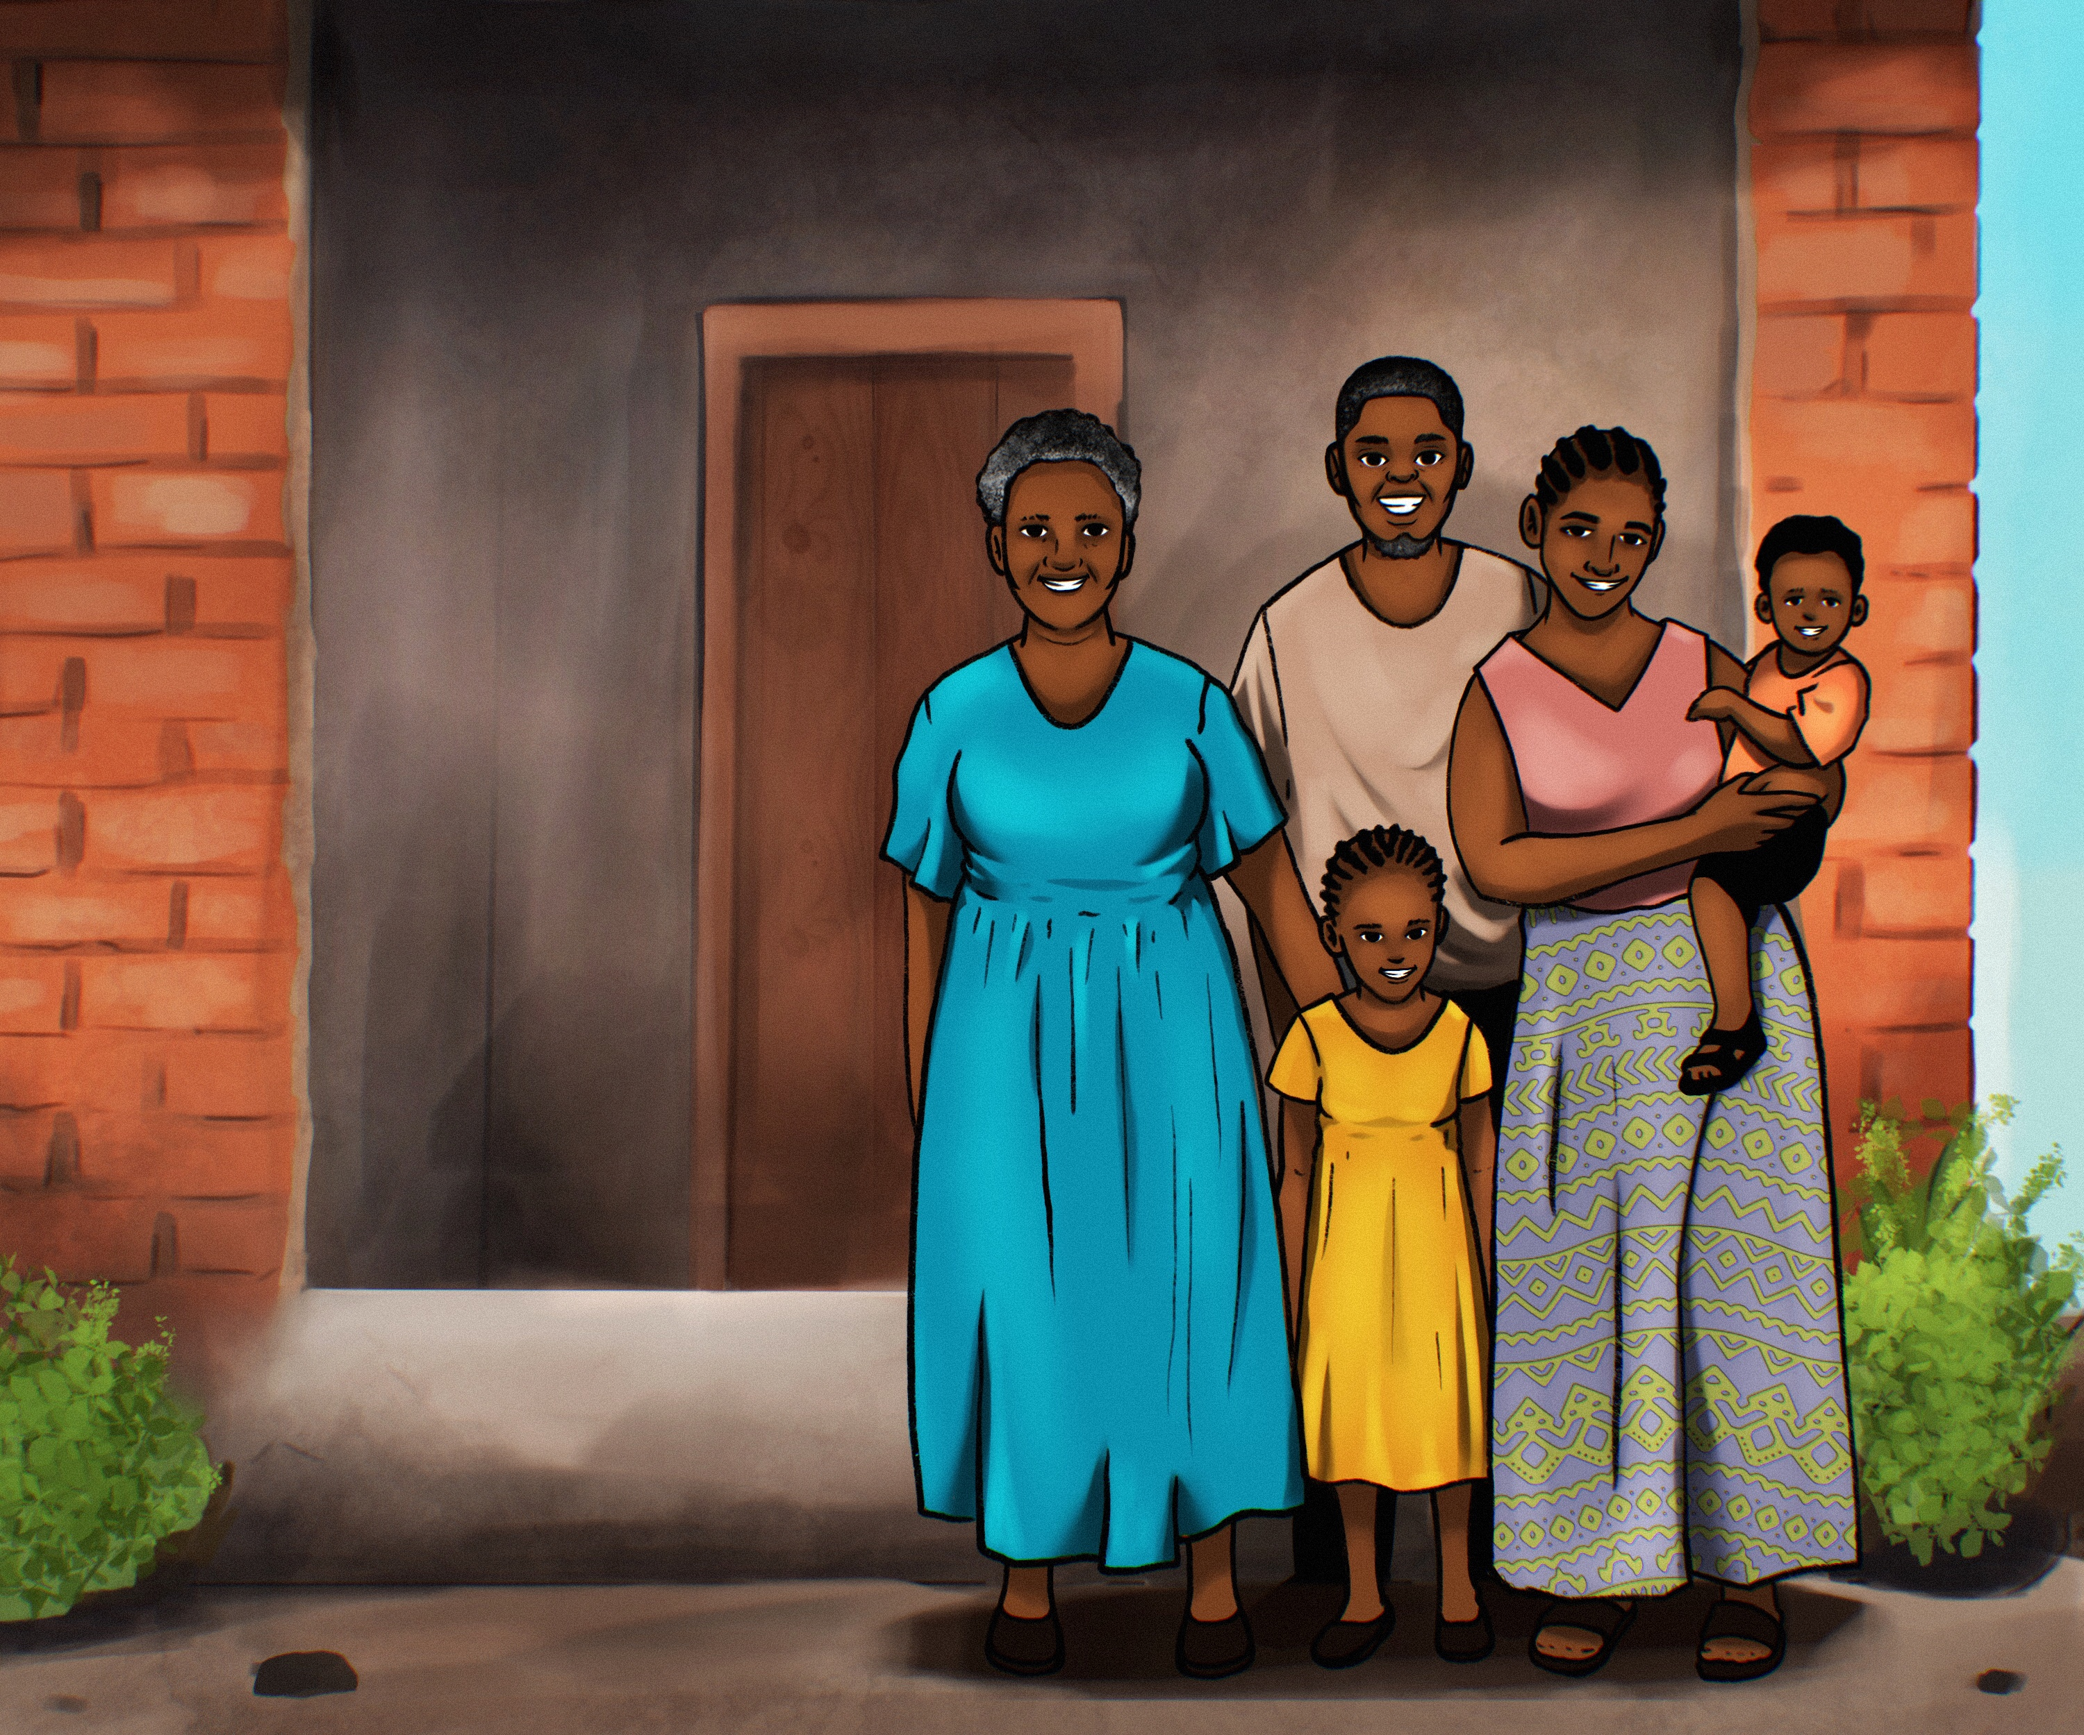
Next Steps: INTEGRATE
Objective
Pilot core PCC curriculum at 8 facilities as part of routine care, to promote and expedite scale up
Easy to scale “add-on intervention package”
Core Curriculum
Tips for 2 min interactions
10-15 min counseling
30 min advanced counselling
Implementation
Brief training (assessing intensity of training needed
HCW job aids and curriculum materials
Mentoring and monitoring and evaluation plans (lightest touch to still achieve quality)

Slide 13
To support re-engagement going forward
Facilitate positive HCW-client interactions
Implement prioritized tracing programmes
Ensure flexible refills when clients are late
Provide accelerated access to DSD for those re-engaging and eligible
Provide differentiated counselling and support, depending on need and client preference
Support screening for common co-morbidities, including around mental health
Do not require repeated visits to restart ART

Slide 14
Acknowledgements
Funders
Bill and Melinda Gates Foundation
(INV-001423)
NIH (R01MH122308)
U.S. Agency for International Development (USAID) and the President’s Emergency Plan for AIDS Relief (PEPFAR) (AID-OAA-A-15–00070)
University of California Los Angeles (UCLA) CFAR (AI028697)
Special thanks to
PIH facility staff
Client and HCW participants

