Slide 1
Differentiation at re-engagement: Considerations in building South Africa’s re-engagement algorithm
Musa Manganye, National Department of Health, South Africa
Differentiated strategies to support sustained engagement and re-engagement in HIV services in eastern and southern Africa

Slide 2
South Africa’s cascade is 95-80-93
Cascade figures vary by population
Adult females: 96-84-94
Adult males: 95-73-94
Children (<15): 82-66-69
To achieve 95-95-95 targets, South Africa must increase the number of total clients on ART by 1,139,059:
  Increase adult females on ART by 498,995
  Increase adult males on ART by 565,177
  Increase children (<15) on ART by 74,887
95%
80%
93%

Slide 3
Two largest challenges: Sub-optimal 12-month retention and viral suppression
80% of cohort has a viral load done. Of those:
  907,658 have a VL 50-1000 copies/mL
  321,462 have a VL >1000 copies/mL
2023 Guideline update focused on 2nd and 3rd 90s – keeping people on treatment (especially in the first 12 months) and virally suppressed

Slide 4

Revised ART & differentiated models of care (DMOC) guidelines central approach
Aim 1: Implement optimized ART regimens
Clinical updates
Aim 2: Create an enabling environment to support engagement in care and adherence
Person-centred service delivery updates
Updated clinical and service delivery guidance at the same time
Coordinated national technical working group
Reviewed previous re-engagement algorithm
DMOC and ART Clinical Guidelines assume full integrated approach in South Africa
The first time clinical and service delivery guidelines were revised together to ensure coordinated approach to of both components of HIV care
Notes:
This ART guideline recognises that critical to improving retention and viral suppression is an integrated approach recognising that clinical management includes patient centred service delivery.
The ART guidelines have considered the clinical components and the service delivery components together throughout the guideline, towards improving the 2nd and 3rd 95 targets.
The service delivery components in the ART guidelines are supported by the procedures set out in the Differentiated Models of Care SOPs.
The clinical updates is the “WHAT” and the service delivery DMOC SOPs is the “HOW”.

Slide 5

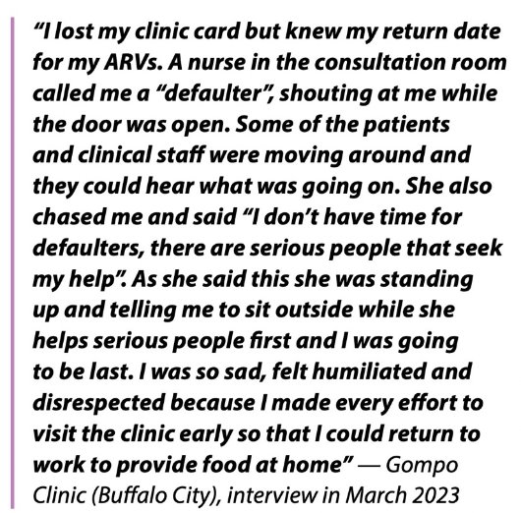
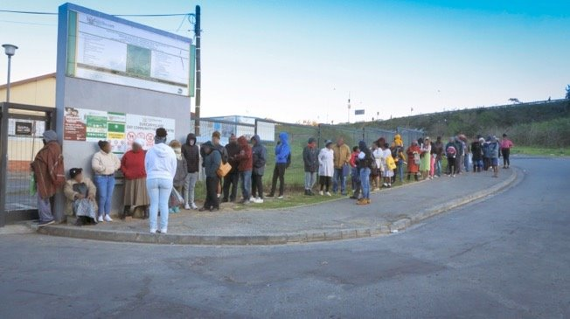
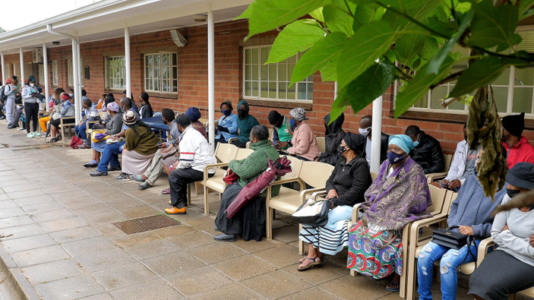
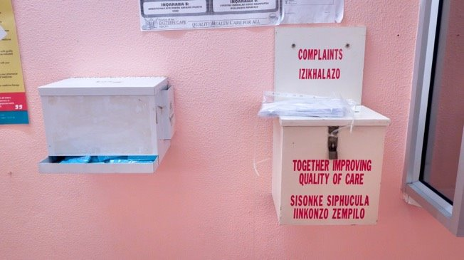
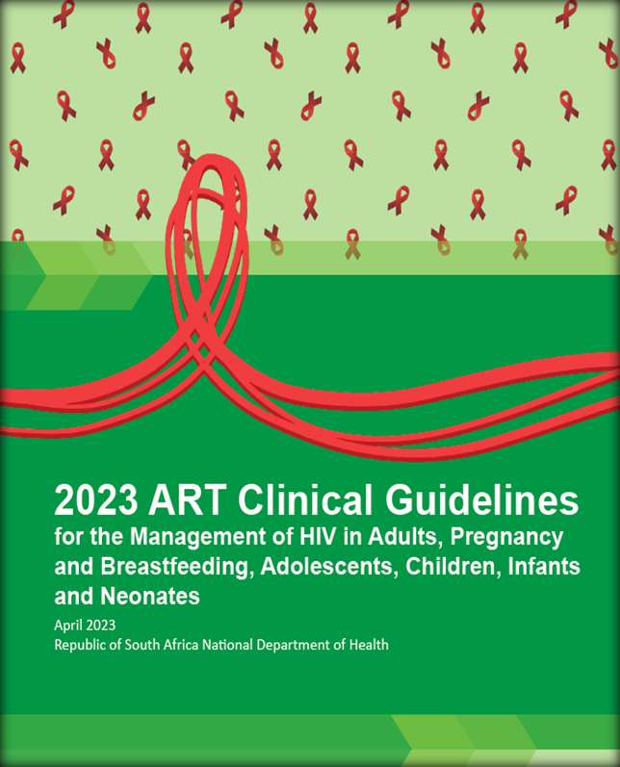

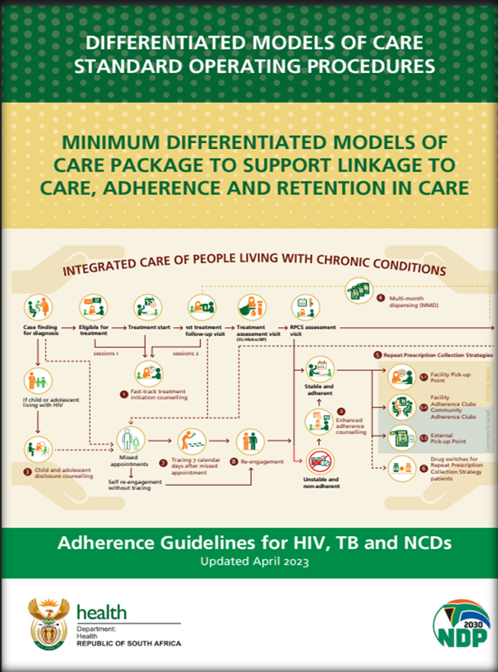
Updated the re-engagement algorithm based on SA data
The situation
The response

Slide 6
Why an increased focus on re-engagement?
There are more clients returning to treatment than initiating treatment for the first time
(data from Johannesburg)
Notes:
Why is there an increased focus on re-engagement in these ART guidelines?
As the HIV epidemic in SA matures, we see more returning clients (clients who are not treatment naïve) than treatment naïve clients.
Here this is clearly represented from recent data from Johannesburg’s health facilities. It is therefore essential that clinicians are capacitated to appropriately manage clients re-engaging in care to ensure the best possible retention and clinical outcomes.

Slide 7

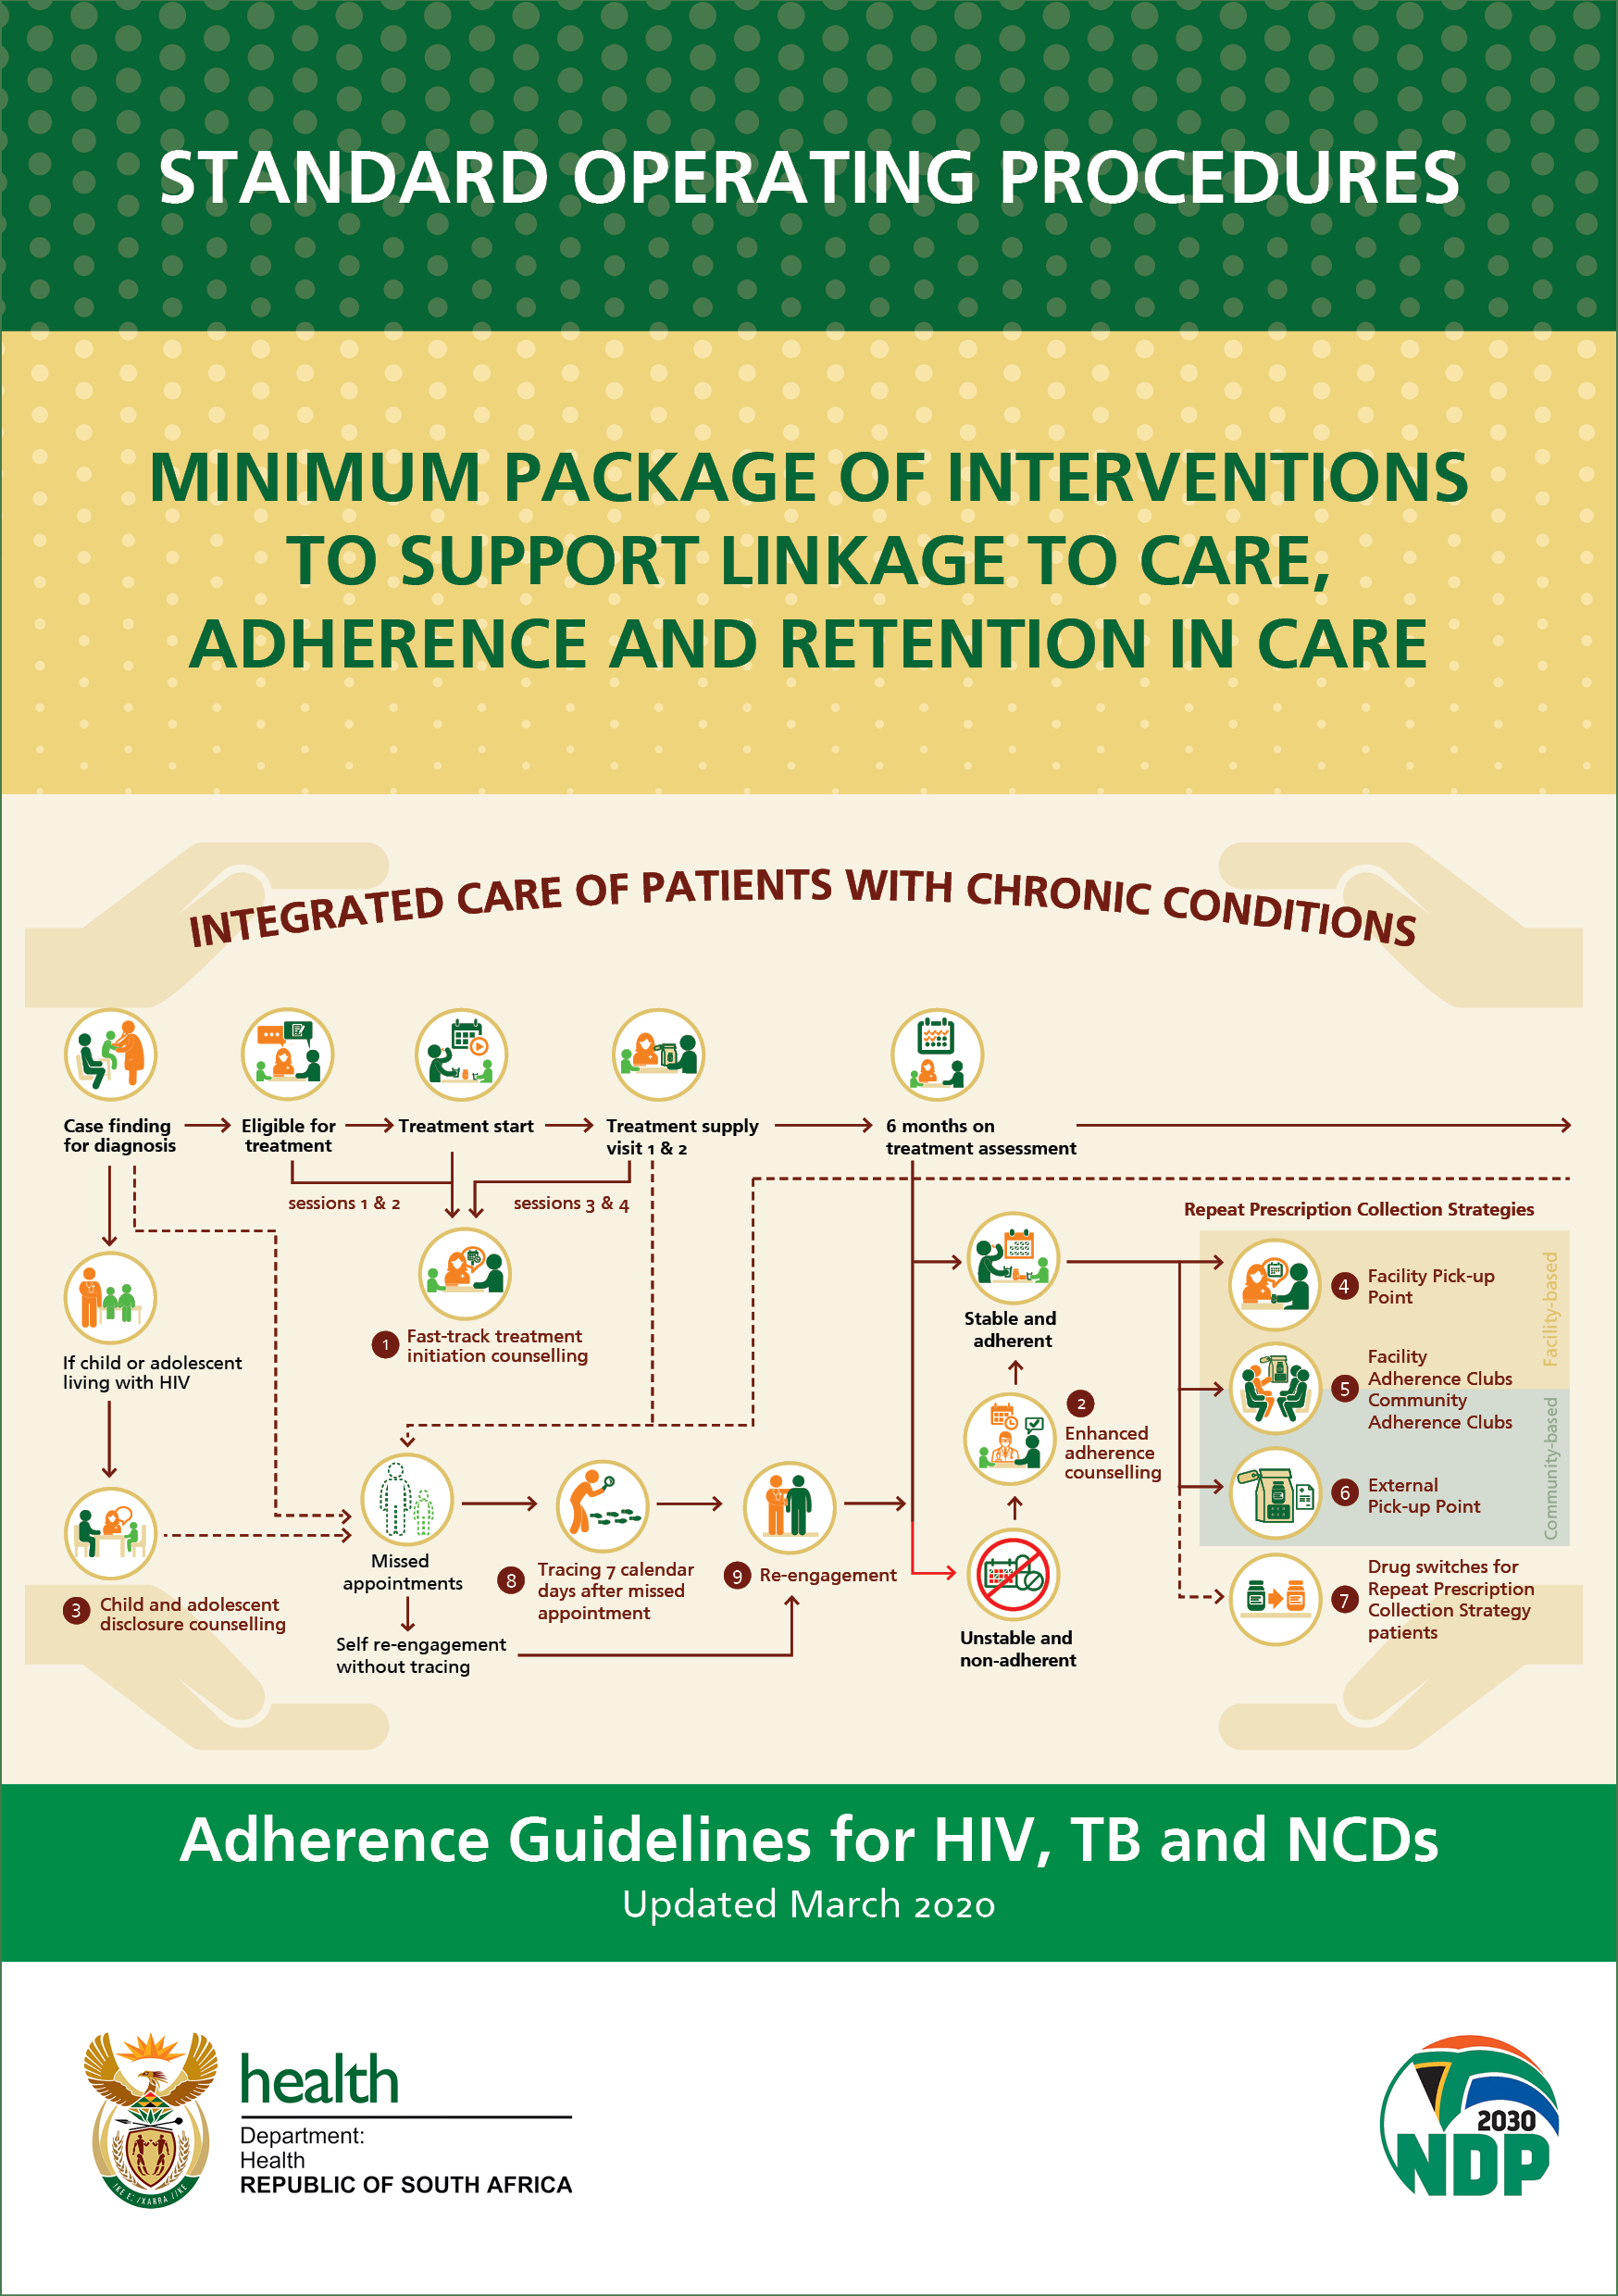



Lessons from previous re-engagement algorithm implementation
2020 AGL SOP 9 started differentiation approach at re-engagement: limited implementation to date
60% of returning patients ≤14 days late
Of those >14 days late:
  25% returned 14-28 days after their missed appointment
  47.4% self-reported not interrupting ART but sufficient buffer stock/sourcing ART elsewhere
For those with a pre-disengagement viral load result 72% were virally suppressed.
High proportion of returning patients ≤28 days late (1 ART supply)
High proportion may not have interrupted ART at all
Notes:
Usefully, the previous service delivery focused was implemented in 9 Johannesburg public sector facilities which provided useful and important information for this ART guideline’s re-engagement algorithm development.
Lesson 1: A high proportion of returning patients are <28 days late which is equivalent to one month’s supply.
Lesson 2: Many of these people may not have interrupted treatment at all having sourced ART elsewhere and the majority were adherent to ART before their missed appointment.

Slide 8
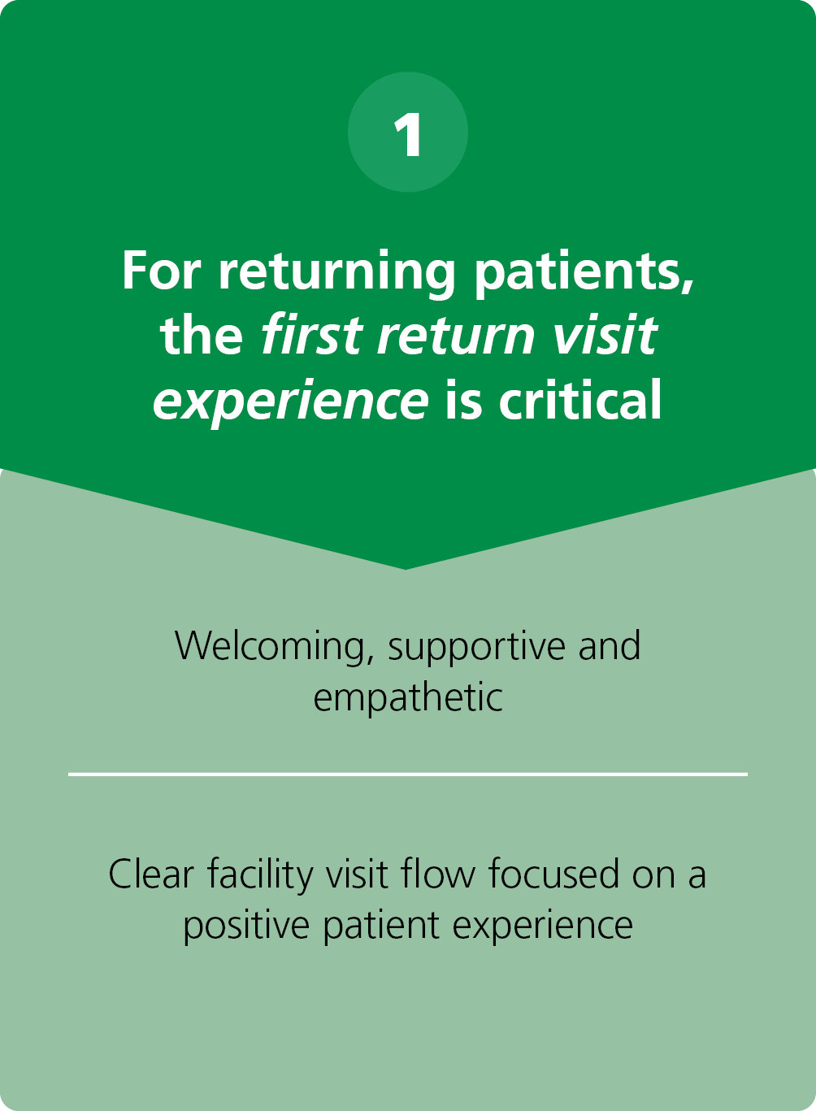
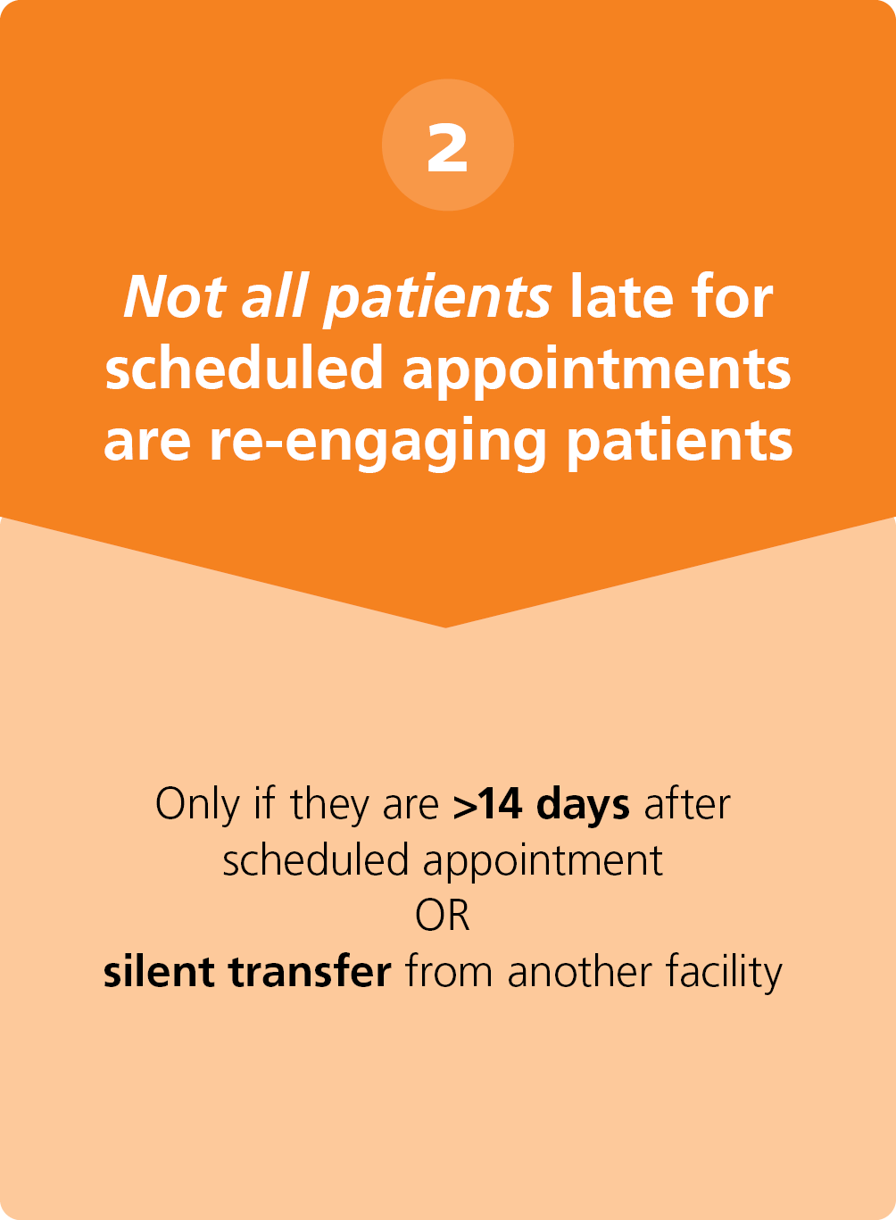
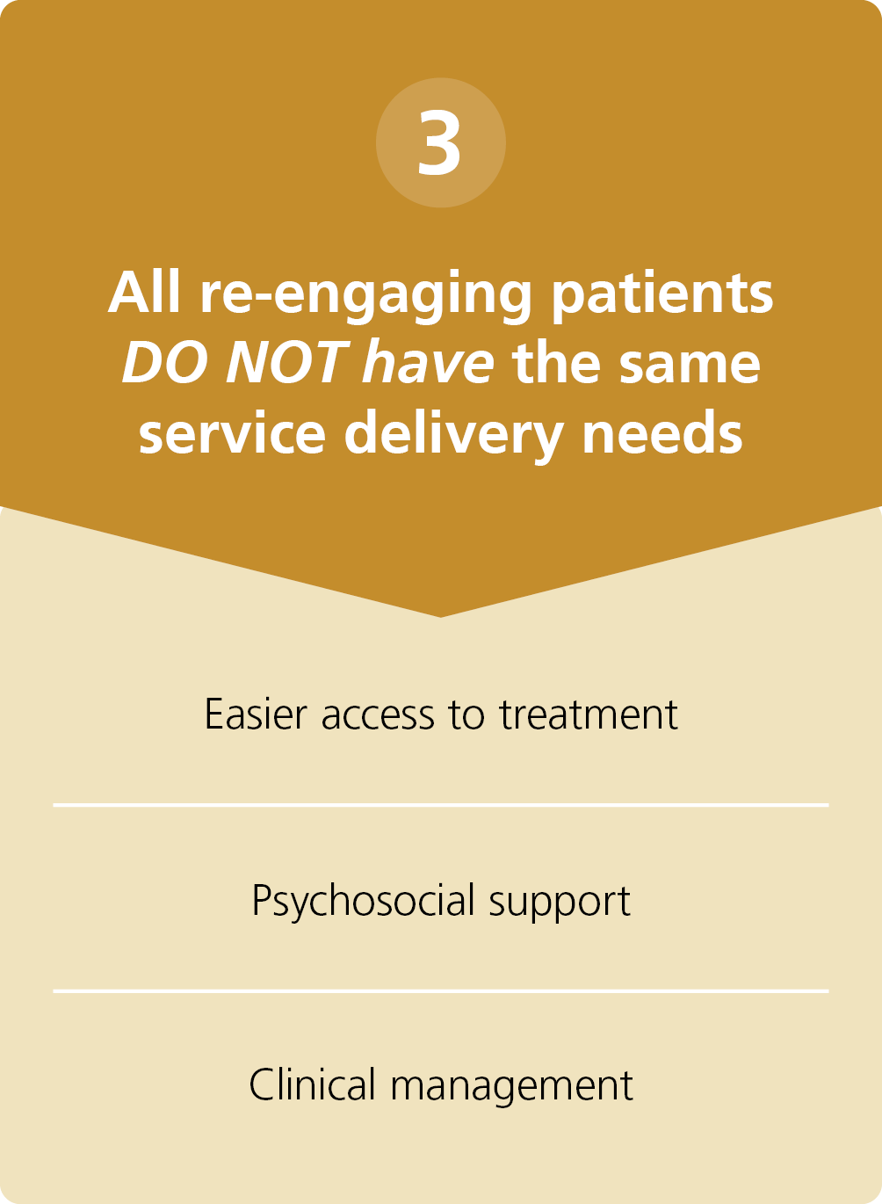


Considerations for managing re-engaging clients
Defined period
Differentiation is critical – move away from a one size all approach for returning patients

Slide 9
Considerations for differentiation
Clinical Factors
Duration since missed appointment
1. Clinical assessment
2. When to perform a CD4
4. Regimen
3. When to perform a viral load
1. Who to return immediately to Repeat Prescription collection strategies (RPCs = DSD)
2. Who to return to
facility-based follow-up and appropriate refill length
Notes:
2 sets of factors need to be considered in determining how to differentiate management for returning clients.
Clinical factors and
The length of time since the missed appointment
These are the 4 important clinical factors to consider
Who needs a clinical assessment
Who needs another CD4, considering that CD4 declines rapidly when stopping ART, approximately 200-250 cells/mm³ by 12 weeks
Who needs another VL and the timing thereof; and
The optimal regimen for a returning client – is the client already on TLD? Or needs to be switched.
The time since missed appointment gives us an idea of the expected length of interruption
Who can stay in their model of care and who needs more frequent follow-up and at what frequency?

Slide 10
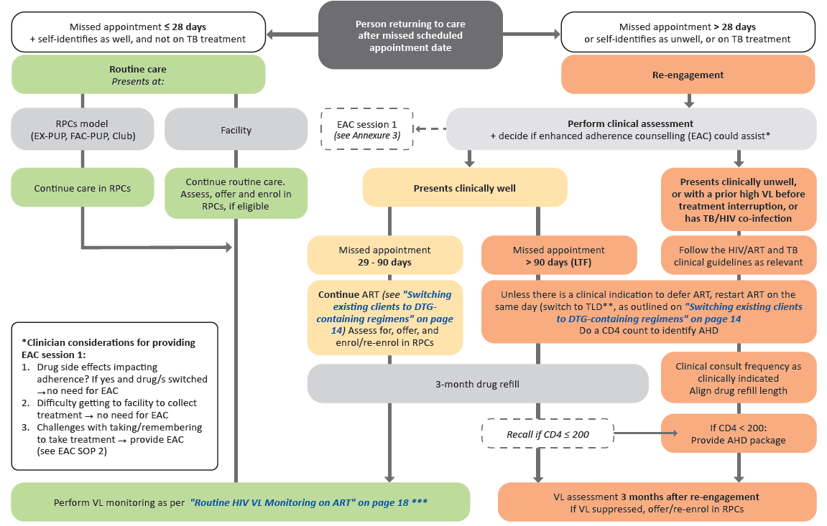

Updated clinical + service delivery algorithm
Notes:
I will now turn to taking your through the newly introduced re-engagement algorithm in the ART guidelines that differentiates management on return after missing a schedule appointment.

Slide 11
1. Clarifies returning clients are NOT ALL re-engaging clients
If client not complaining of illness and less than 28 days late for appointment
  Continue in routine care
If client complaining of illness or on TB treatment or more than 28 days late for appointment – needs to be seen by a clinician
  Manage as a re-engaging client
WHY?
Support appointment flexibility rather than disengagement in era of DTG
Reduce unnecessary burden/administration complexity on clients and health system
Notes:
First the algorithm differentiates between
1. Clients returning within 28 days and not complaining of illness and not on TB treatment. These clients stay in routine care and are not regarded as re-engaging in care.
2. Clients returning after 28 days or complaining of illness or on TB treatment. These clients are regarded as re-engaging in care.
Lets remember why this approach?
It supports appointment flexibility rather than disengagement in era of DTG
It reduces unnecessary burden/administration complexity on clients and the health system

Slide 12
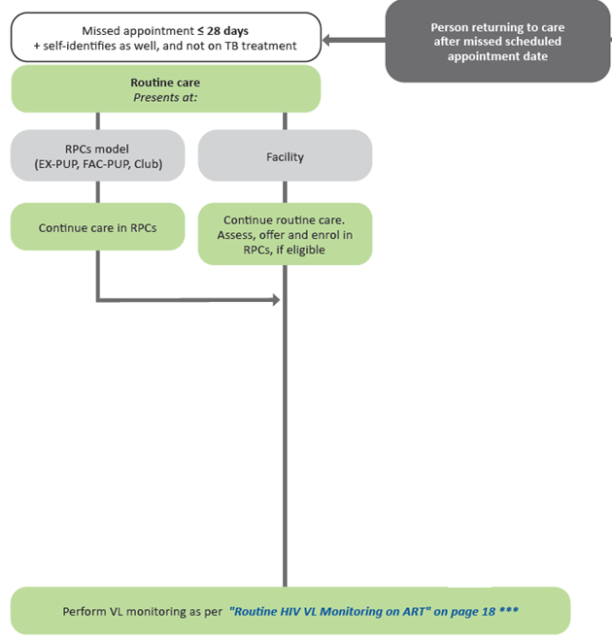
2. Returning to routine care includes staying in your RPCs
If in RPCs – stay in RPCs
If not in RPCs – prioritize assessment for RPCs or rescript for RPCs
  Late for this appointment or previous appointments does not disqualify client BUT rather red flags for RPCs enrolment to reduce risk of disengagement
Consideration to note: supply chain complexities meant pre-packed ART could not remain at pick-up points for longer than 28 days
When do you do CD4 and VL?
No repeat CD4
Repeat VL as per annual schedule
  For RPCs client - next scheduled RPCs clinical review with VL
If VL overdue at return perform after back on ART for 3 months
Notes:
Lets now focus on the left side of the algorithm – those who return to routine care. This means you can stay in your model of care.
If in repeat prescription collection strategies, the client stays in their external pick-up point or facility pick-up point or adherence club.
If the client is not in a repeat prescription collection strategy, it is important to prioritize assessment for one of these strategies.
An important consideration for South Africa in deciding on 28 days and not longer were the supply chain concerns - where pre-packed ART could not remain at pick-up points for longer than 28 days
There is no need to repeat CD4 and the VL can be taken as per the annual schedule.
Where a client is overdue for their VL, this should be performed at their next clinical review date but the client must have been on ART again for at least 3 months
his will take a massive burden off the client and the health system.

Slide 13
3. Re-engaging clients management depends on clinical stability
If return and self-identify as unwell, more than 28 days late or on TB treatment require a clinical assessment
  Check clinical presentation – decide if well or not?
  Check last VL result
  Check regimen – on TLD?
  Assess if enhanced adherence counselling (EAC) useful. If yes, clinician to provide.
Differentiate again
  Unwell OR previous elevated VL OR on TB treatment
  Well
WHY differentiate care?
Most clients who disengaged need less intensive not more intensive follow-up to reduce risk of interrupting treatment again.
HOWEVER minority do need more intensive clinical management
Notes:
Now to the right side of the algorithm –
For clients returning and complaining of being unwell, more than 28 days late or on TB treatment, these clients require a re-engagement clinical assessment
It is important to:
Check their clinical presentation – decide if the client is well or not?
Check their previous VL result
Check their regimen – is the client on TLD?
Assess if enhanced adherence counselling (EAC) will be useful and appropriate for this client. If yes, the clinician should provide this counselling unless a trained counsellor is available.
Now it is necessary to differentiate again between
Those clients who are unwell or have a previous elevated VL or are on TB treatment and
Those clients who are well

Slide 14
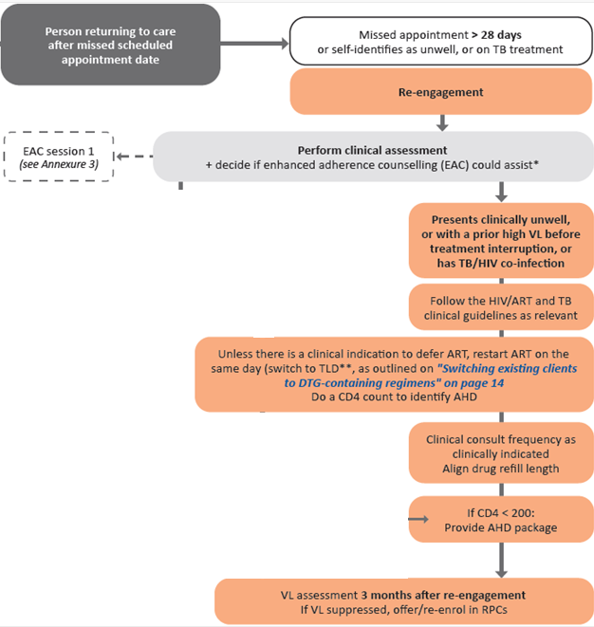
4. Client unwell, previous elevated VL or on TB treatment
Follow ART and TB guidelines for management of OIs
Restart ART same day* – switch if not on TLD
Take CD4 count – may now have AHD
Review CD4 count, if <200 - provide AHD screening and treatment package
VL assessment after 3 months
Do not have to see client each month until follow- up VL – clinician to decide:
      necessary clinical review frequency
      align ART refills
Notes:
For clients unwell or with a previous elevated VL or on TB treatment:
Follow the ART and TB guidelines for management of opportunistic infections
Restart ART on the same day* – switch if not on TLD
Take a CD4 count – as the client may now have advanced HIV disease
Review the CD4 count result, if less than 200 - provide the AHD screening and treatment package
Take their follow-up VL after 3 months on ART
The clinician does not have to see client each month until their follow- up VL. The clinician can decide the necessary clinical review frequency and align their ART refills. It is possible to provide 2 or 3 months of ART in between necessary clinical visits

Slide 15
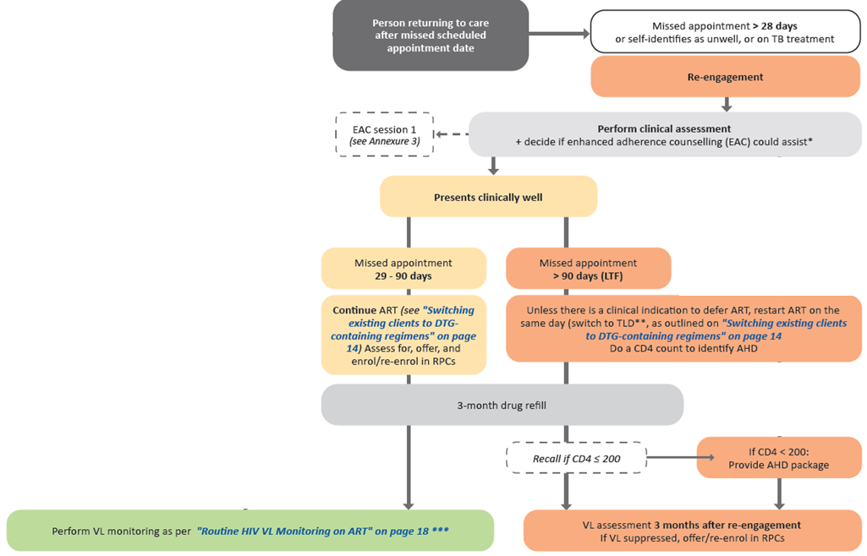
5. Client well BUT >28 days late
29-90 days late:
No CD4, no additional VL
Continue ART (switch if not on TLD)
Assess for and offer RPCs or facility to provide 3 months of ART
2. More 90 days late (unconfirmed LTF)
CD4 (recall if CD4<200 for AHD package)
VL in 3 months time
Facility to provide 3-months supply until VL date
Note ONLY differences between ≤28 days (routine care) and >28 days (re-engagement):
Must get clinical assessment and possibly EAC
Cannot collect ART in RPCs as prepacks will have been returned. Can be immediately rescripted for RPCs
Notes:
For clients who are well but more than 28 days late – clinicians again differentiate between
Those who 29-90 days late: These clients
Do not require a CD4 or an additional VL
They can continue on ART but remember to switch if not on TLD
And asssess for and offer repeat prescription collection strategies or at a minimum provide 3 months of ART
For clients more than 90 days late (also known as unconfirmed lost to follow up): These clients
Do require a CD4. Remember to recall them if their CD4 is less than 200 for provision of the AHD package.
They do require a follow-up VL in 3 months time and
The facility should provide 3-months ART supply until VL follow-up date

Slide 16



Implementation to date and next steps
Training –Clinicians, Non-Clinicians Trained on revised DSD SOPs Including SOP number 8 on Re-Engagement in all nine provinces.
Monitoring of implementation - DSD Performance reviews conducted in all nine provinces (Data Abstractions) and routine implementation of SOP 8 and reporting
Evaluation
  DSD Performance reviews results reported back at disseminations workshops.
  Research agenda to address the challenges on re-engagement (NDOH collaborating with HE2RO)

Slide 17


Acknowledgements
National Department of Health
Provincial Department of Health
Operation Phuthuma
IAS
District Support Partners
ICAP- CQUIN
Global Fund
PEPFAR
CDC
USAID
Learning Sites / Health Facilities

