Slide 1


This WHO policy brief highlights person-centred interventions that address the reasons for disengagement, the importance of providing support at re-engagement tailored to individual needs and country examples of tracing and re-engagement interventions.

Slide 2



Slide 3

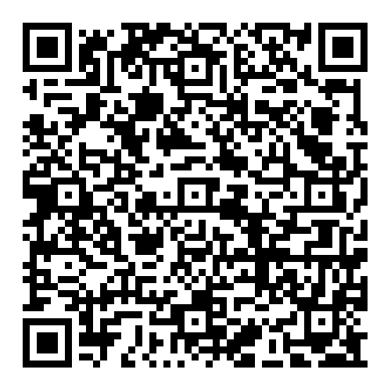
Sign up for the DSD newsletter
The quarterly DSD newsletter promotes knowledge sharing among stakeholders working on DSD and provides updates on related activities.
https://www.differentiatedservicedelivery.org/differentiated-service-delivery-newsletters/

Slide 4


Visit the DSD website
The compendium website contains tools and evidence endorsed for use by national HIV programmes and country implementing partners supported by the agencies engaged in its development.
https://differentiatedservicedelivery.org/

Slide 5
Questions?
Email us dsd@iasociety.org

Slide 6
Thank you!

