Slide 1
Person-centred and integrated healthcare and harm reduction services for people living with and affected by HIV, hepatitis C and tuberculosis in eastern Europe and central Asia

Slide 2
Translation is available for this session
Scan the QR code located at the entrance and around the session room
Select your preferred language, and
Click “Join”
Use own headphones or read captions

Slide 3
Organizers
Notes:
IAS - the International AIDS Society, European Network of People Who Use Drugs, Ukrainian Institute on Public Health Policy

Slide 4
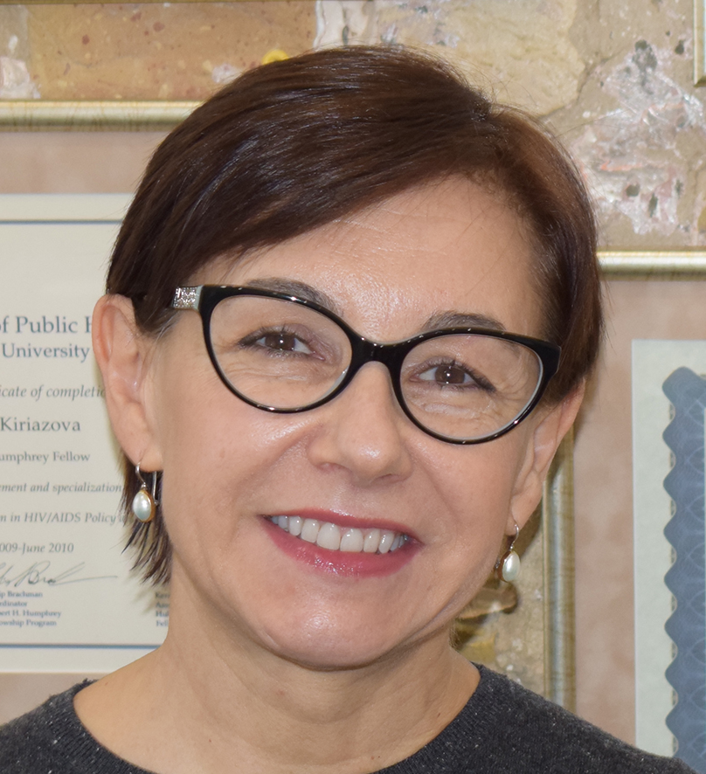
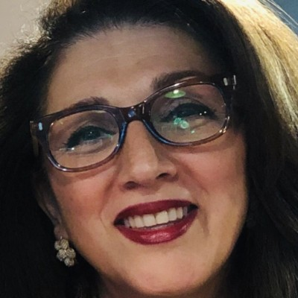
Moderators
Fariba Soltani
UNODC, Austria
Tetiana Kiriazova
UIPHP, Ukraine

Slide 5
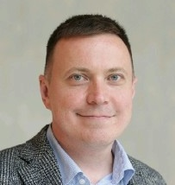
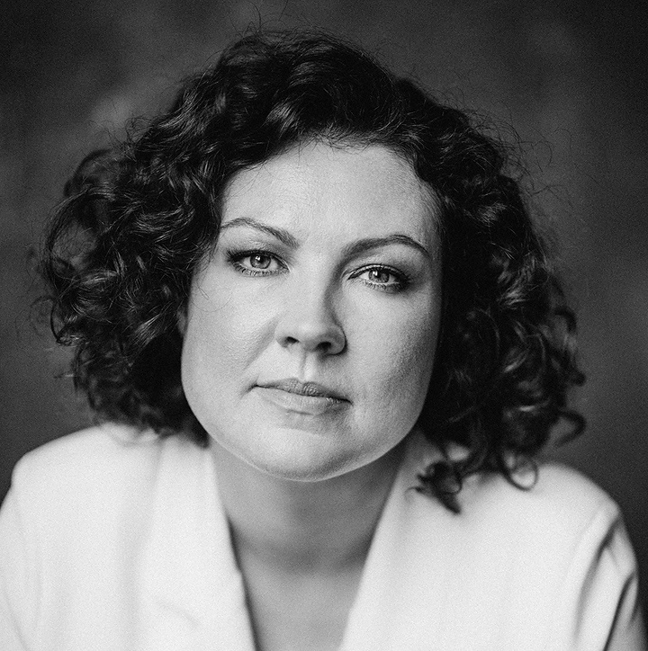
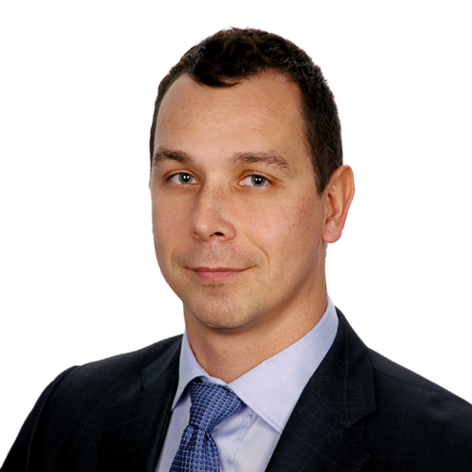
Speakers (part one)
Alexei Lakhov
European Network of People Who Use Drugs,
Germany
Natalia Sidorenko
ANO Center for Promoting Partnerships in the Healthcare Sphere “Zdorovye.ru”, Kazakhstan
Anna Koshikova
Eurasian Movement for the Right to Health in Prisons,
Ukraine
Milosz Parczewski
Pomeranian Medical University,
Poland

