Slide 1
HIV, Sustainability and GHS
Michael Ruffner
July 22, 2024

Slide 2
Working Together: GHS and PEPFAR
Foreign Ministry Channel for Global Health Security
Infectious Disease Response in PEPFAR Supported Countries
Intensive Support Partner GHS Capacity Metrics Reporting
Notes:
One of the greatest contributions the Bureau provides PEPFAR is raising the level of diplomatic engagement. The FMC was launched in March of this year. PEPFAR staff and leadership were able to attend the launch this year and engage with ministries of foreign affairs on health security issues.
These disease outbreaks threaten the service delivery of PEPFAR programs, resulting in the loss of HIV/AIDS progress. In addition to the threat to HIV/AIDS gains, a lack of or delayed support from PEPFAR programs is a diplomatic risk, damaging relationships built with the local government and communities. We are streamlining the process and increasing the communication for how PEPFAR country teams can support the infectious disease outbreak response office (IDOR) during outbreak response. The PEPFAR Chair and PPM have been working hand-in-hand with IDOR this year to support their engagement in the DRC Clade I mPox response as appropriate.
The United States has established 50 formal Global Health Security (GHS) partnerships with countries and one regional group to strengthen capacity. To support Goal 3 of the GHSS and increase linkages between health security and complementary programs, PEPFAR is institutionalizing the expectation the country teams engage in ISP work planning and GHS capacity reporting on a biannual basis.

Slide 3
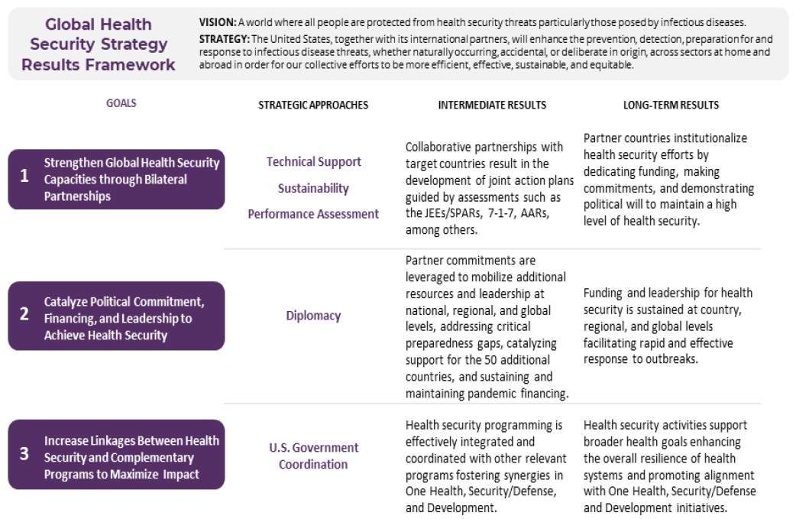
Global Health Security Strategy Overview

Slide 4
PEPFAR Invests in 13 of 16 JEE Capacities
JEE Goal | JEE Capacity | Direct Support | Indirect Support
Prevention | P.1 National Legislation, Policy and Financing | P
 | P.2 IHR Coordination, Communication and Advocacy | P
 | P.3 Antimicrobial Resistance (AMR)* | P
 | P.4 Zoonotic Disease
 | P.5 Food Safety | P | P
 | P.6 Biosafety & Biosecurity* | P | P
 | P.7 Immunization* |  | P
Detection | D.1 National Laboratory Systems | P | P
 | D.2 Real Time Surveillance Systems | P
 | D.3 Reporting | P
 | D.4 Workforce Development | P | P
Response | R.1 Preparedness
 | R.2 Emergency Response Operations* | P
 | R.3 Linking Public Health & Security Authorities
 | R.4 Medical Countermeasures & Personnel Deployment | P
 | R.5 Risk Communication* |  | P

Slide 5
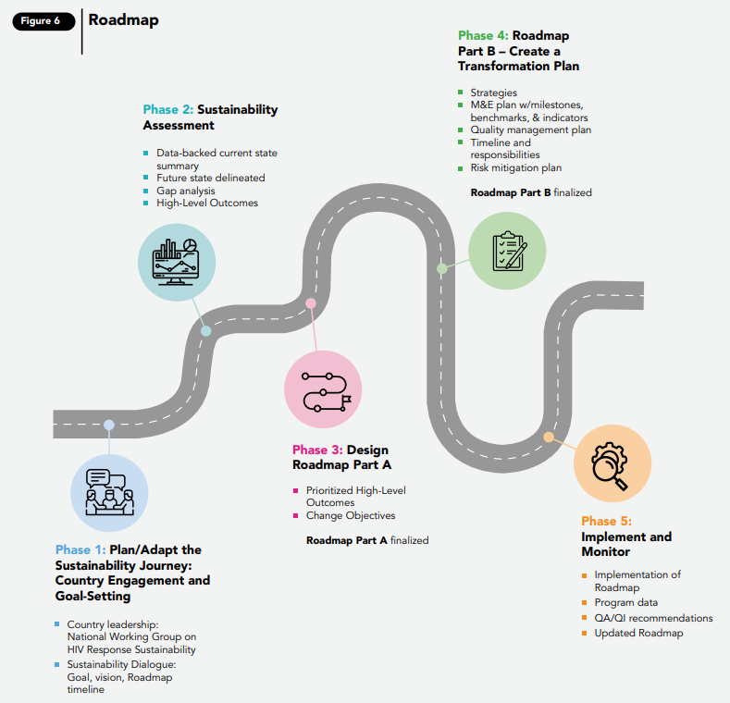
Overview of Roadmap Phases and Key Deliverables for 2024
Roadmap Phases
Part A
Phase 1: Country Engagement and Goal Setting (Jan-Mar)
Country leadership; National Working Group on HIV Response Sustainability Roadmap
Sustainability Dialogue: Goal, Vision, Roadmap timeline
Phase 2: Sustainability Assessment (Apr-Jun)
Data-backed Current State Summary
Future State Delineated
Gap Analysis
High-Level Outcomes
Phase 3: Roadmap Part A, Design, HLO and Change Objectives (Jul-Dec)
Prioritized High-level Outcomes
Change Objectives
Roadmap Part A Template populated

Slide 6
Overview of Roadmap Phases and Key Deliverables for 2025
Roadmap Phases
Part B
Phase 4: Roadmap Part B - Create a Transformation Plan (Jan-May, 2025)
Strategies
M&E plan w/milestones, benchmarks, & indicators
Quality management plan
Timeline and responsibilities
Risk mitigation plan
Phase 5: Implement and Monitor (Jun 2025 – onward)
Implementation of Roadmap
Program data
QA/QI recommendations
Updated Roadmap

Slide 7
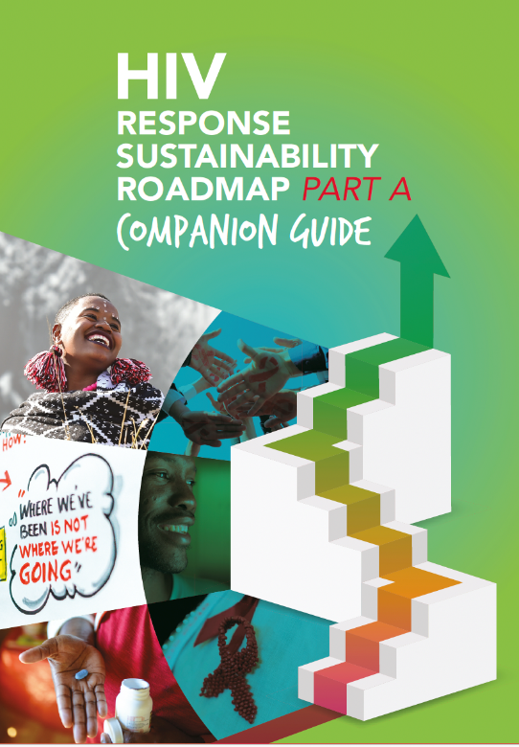
Country Roadmaps will guide PEPFAR Investment Decisions to realize Future Sustained State Vision
Future Sustained State
Country
Sustained VL Suppression
Prevent, detect, and respond rapidly to new HIV infections
Reduce and ultimately eliminate inequities that drive the HIV epidemic (e.g., AGYW, Children, Key Pops)
Country-specific future imperatives (e.g., leveraging public health platforms being used for HIV to address future disease threats)
COP25/COP27/COP29
Investment Decisions

Slide 8
Sequencing Sustainability Efforts
Every Country will (and should) have a unique approach and sequencing to sustainability.
However, we recommend that countries consider sequencing efforts to maximize early impact and address critical underlying policies:
Increasing Functional Capacity (Systems)
Increasing Financial Responsibility
Commodity and site-level HRH Transition
CSO/ NGO/ FBO Revenue Diversification
Policies enabling sustainability (esp. social contracting, NHIF, procurement, HRH, stigma & discrimination)

